Slide 1
Isaiah 40:1-31

Slide 2
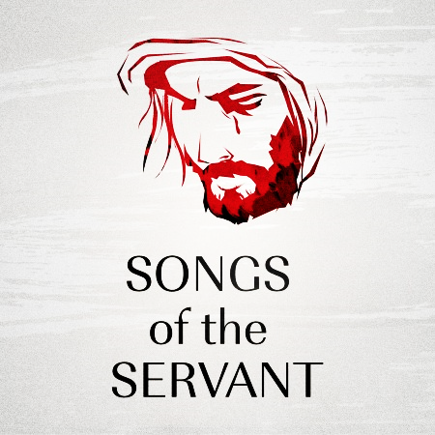
The Servant Songs of Isaiah

Slide 3
Prayer

Slide 4
Isaiah 42:1-4 // 355 – Jesus, Meek and Gentle

Slide 5
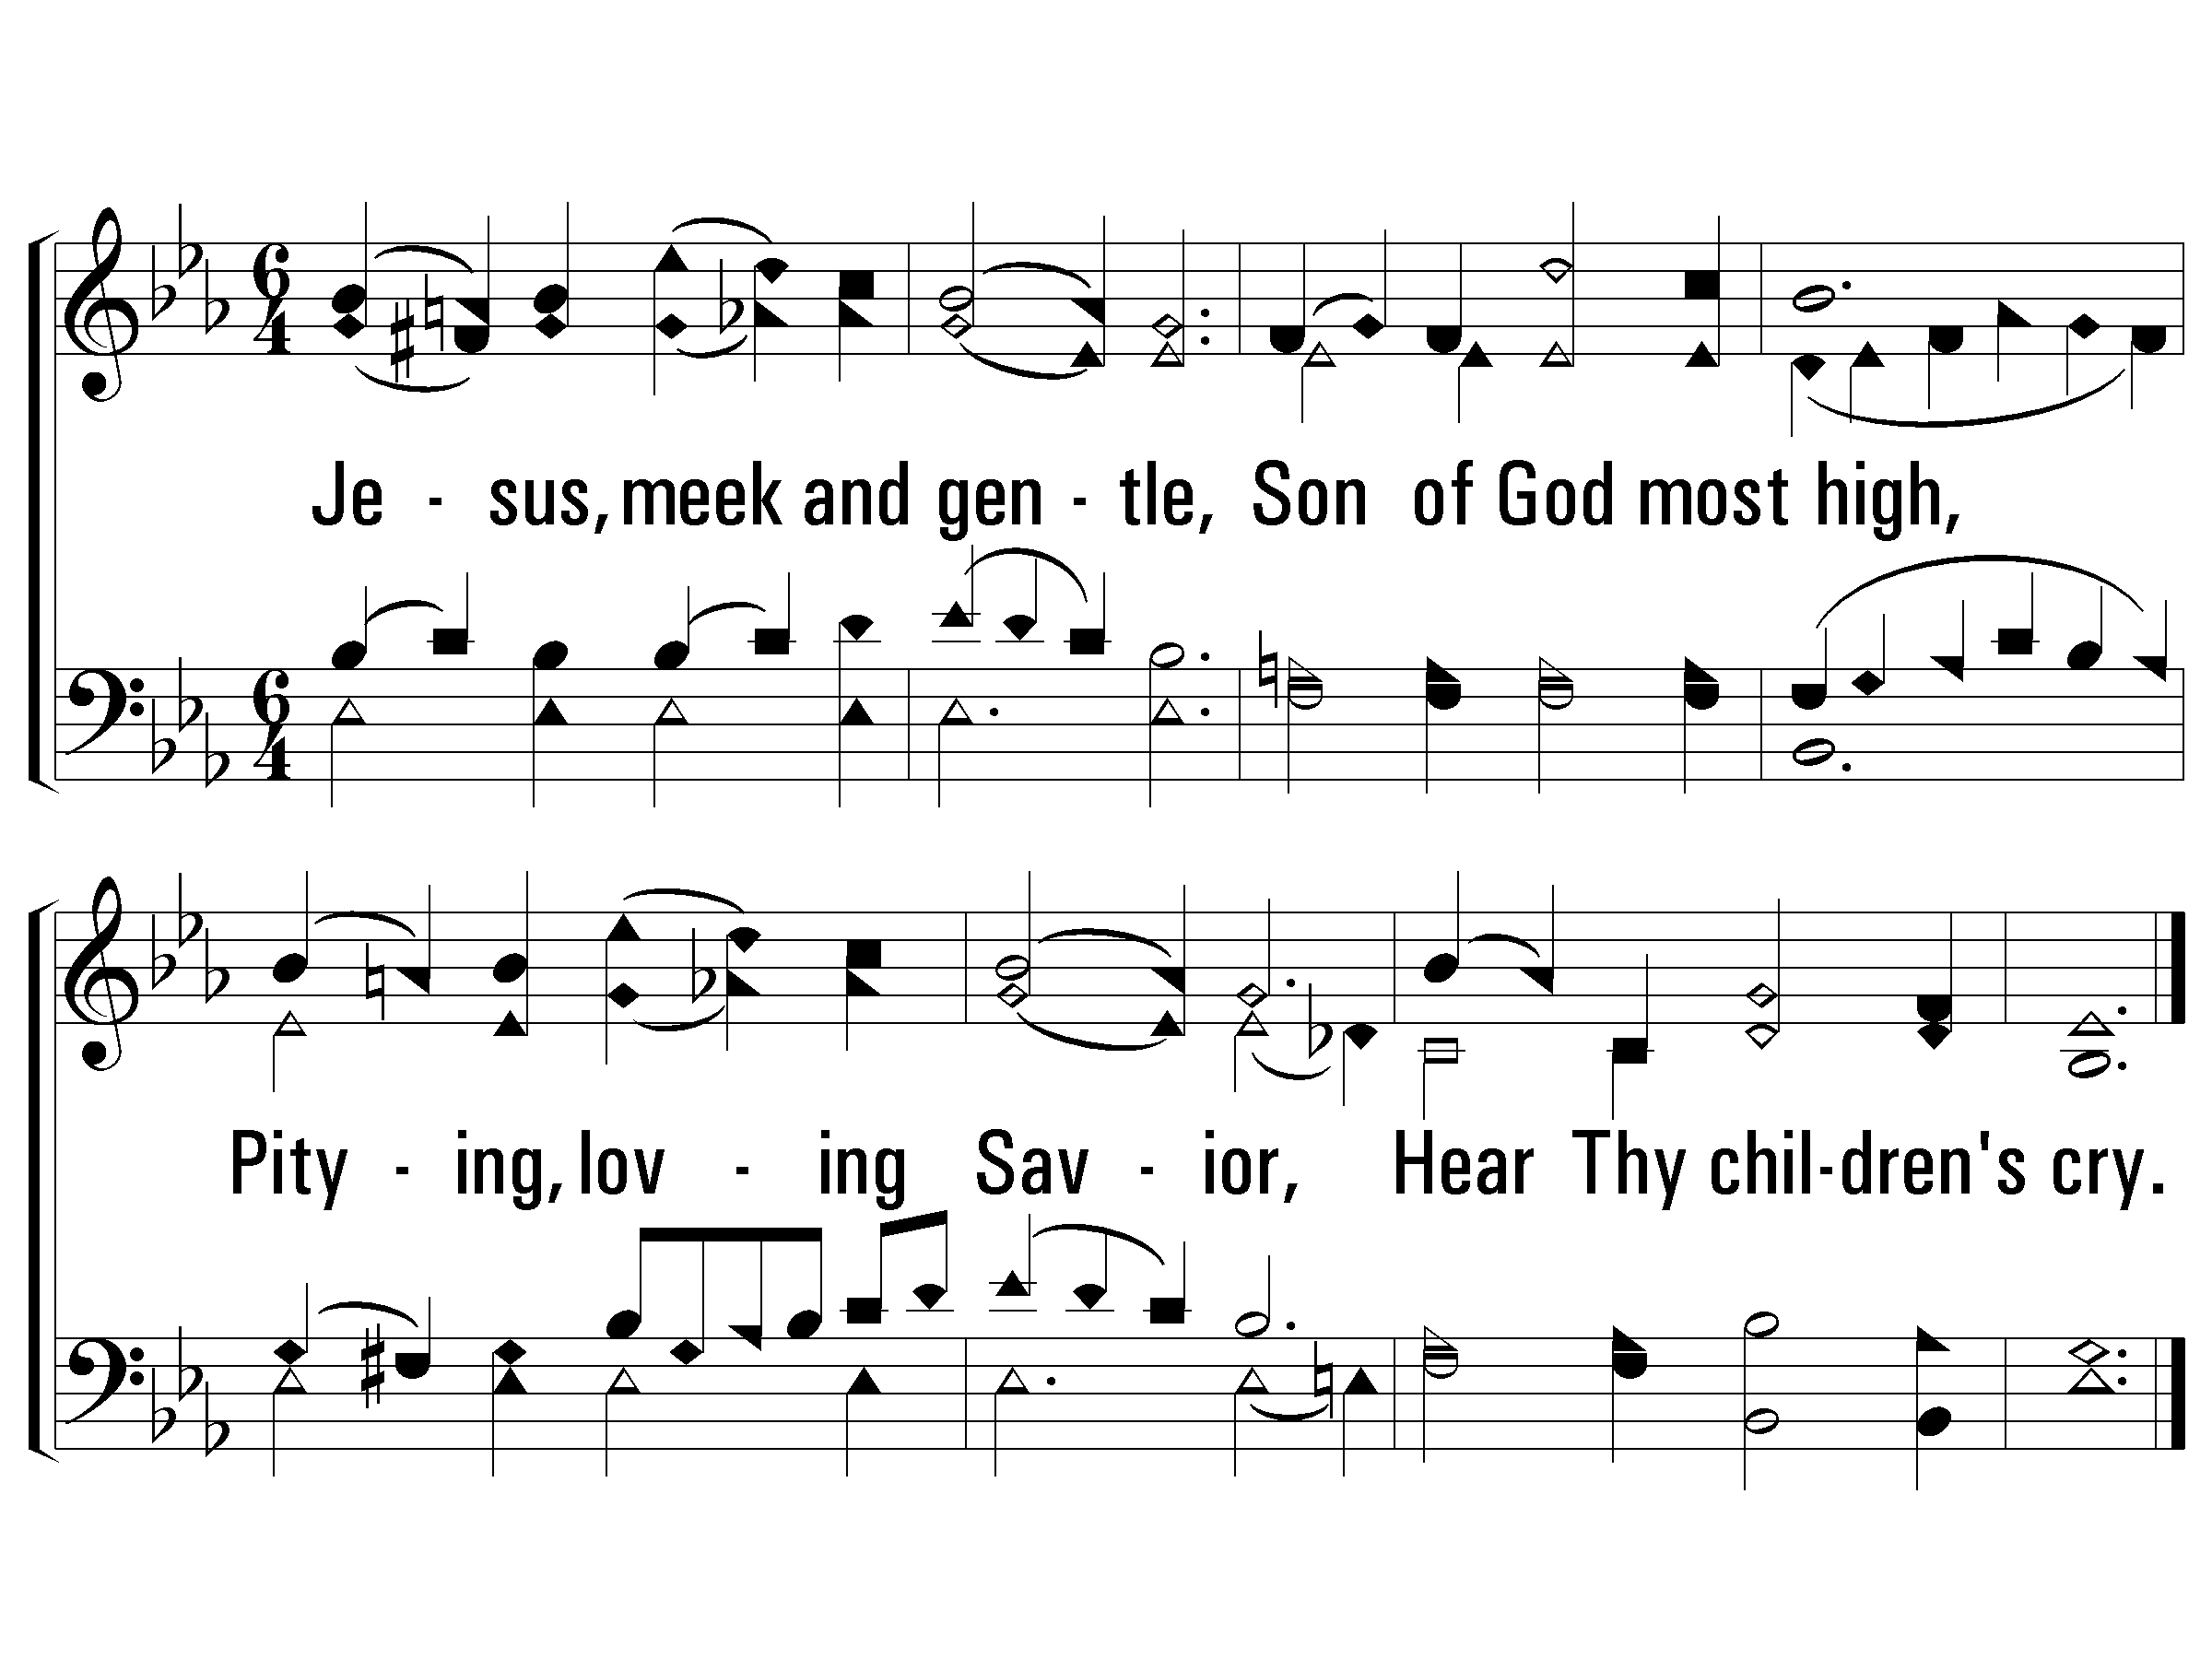
1 - Jesus, Meek and Gentle
355
1.
Jesus, meek and gentle,
Son of God most high,
Pitying, loving Savior,
Hear Thy children's cry.
Words: George R. Prynne
Music: Clarence Hudson
© 2008 The Paperless Hymnal®

Slide 6
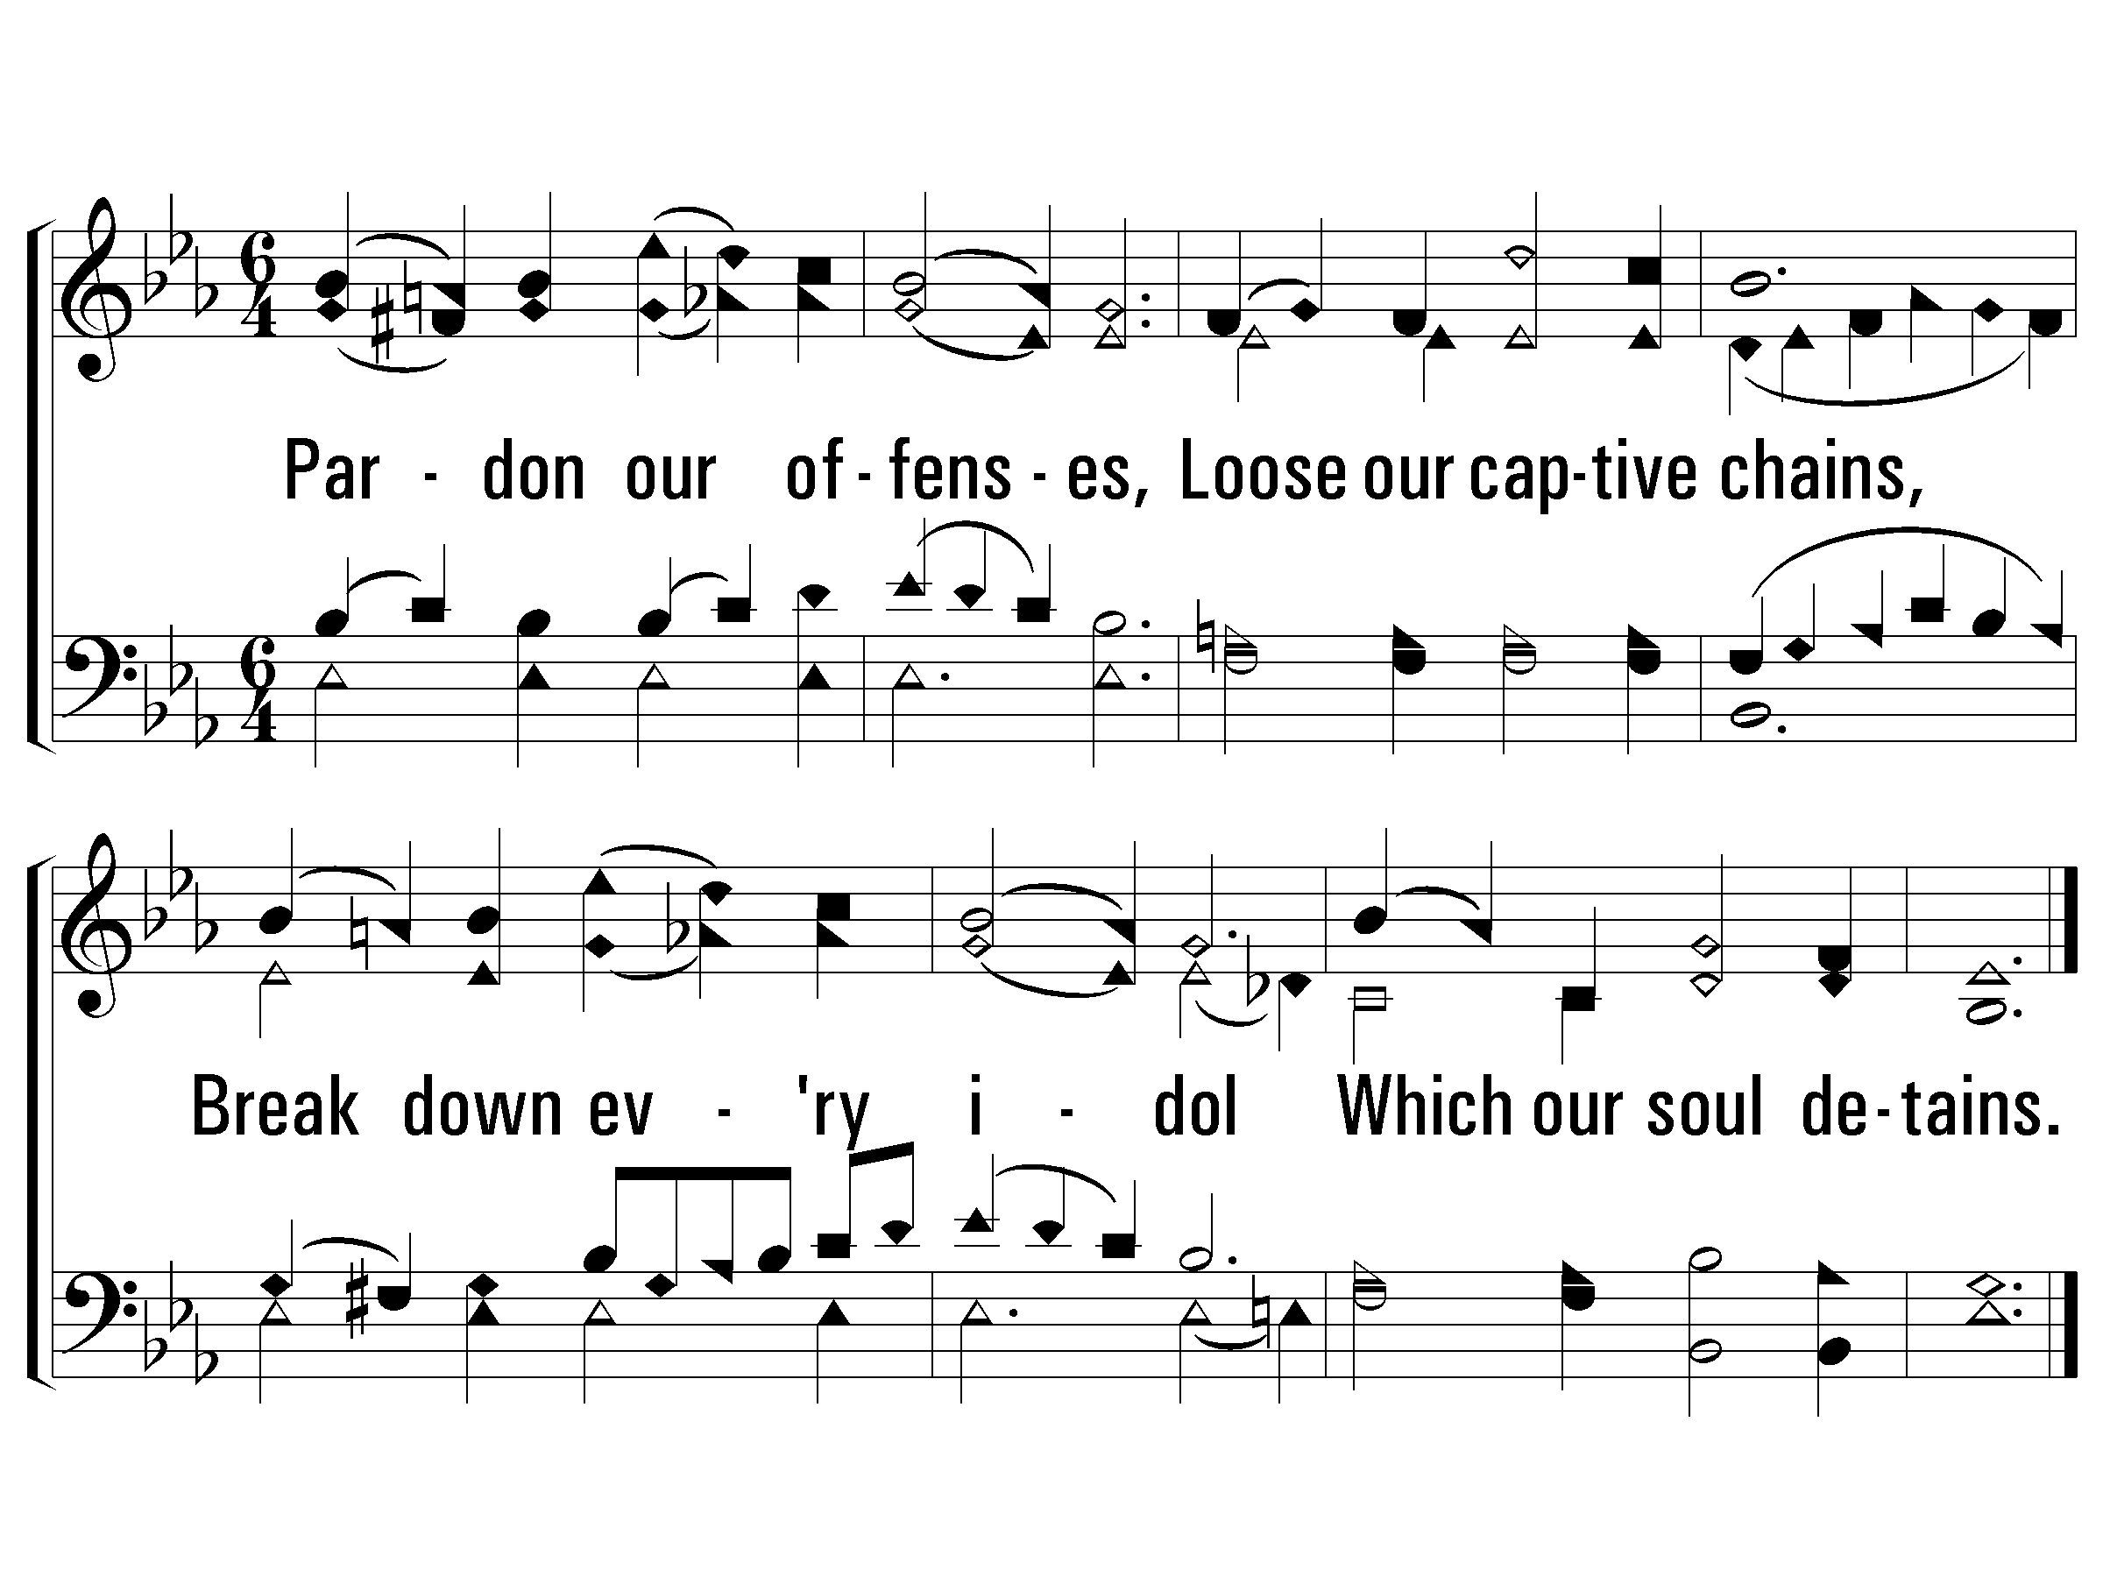
2 - Jesus, Meek and Gentle
355
2.
Pardon our offenses,
Loose our captive chains,
Break down every idol
Which our soul detains.
Words: George R. Prynne
Music: Clarence Hudson
© 2008 The Paperless Hymnal®

Slide 7
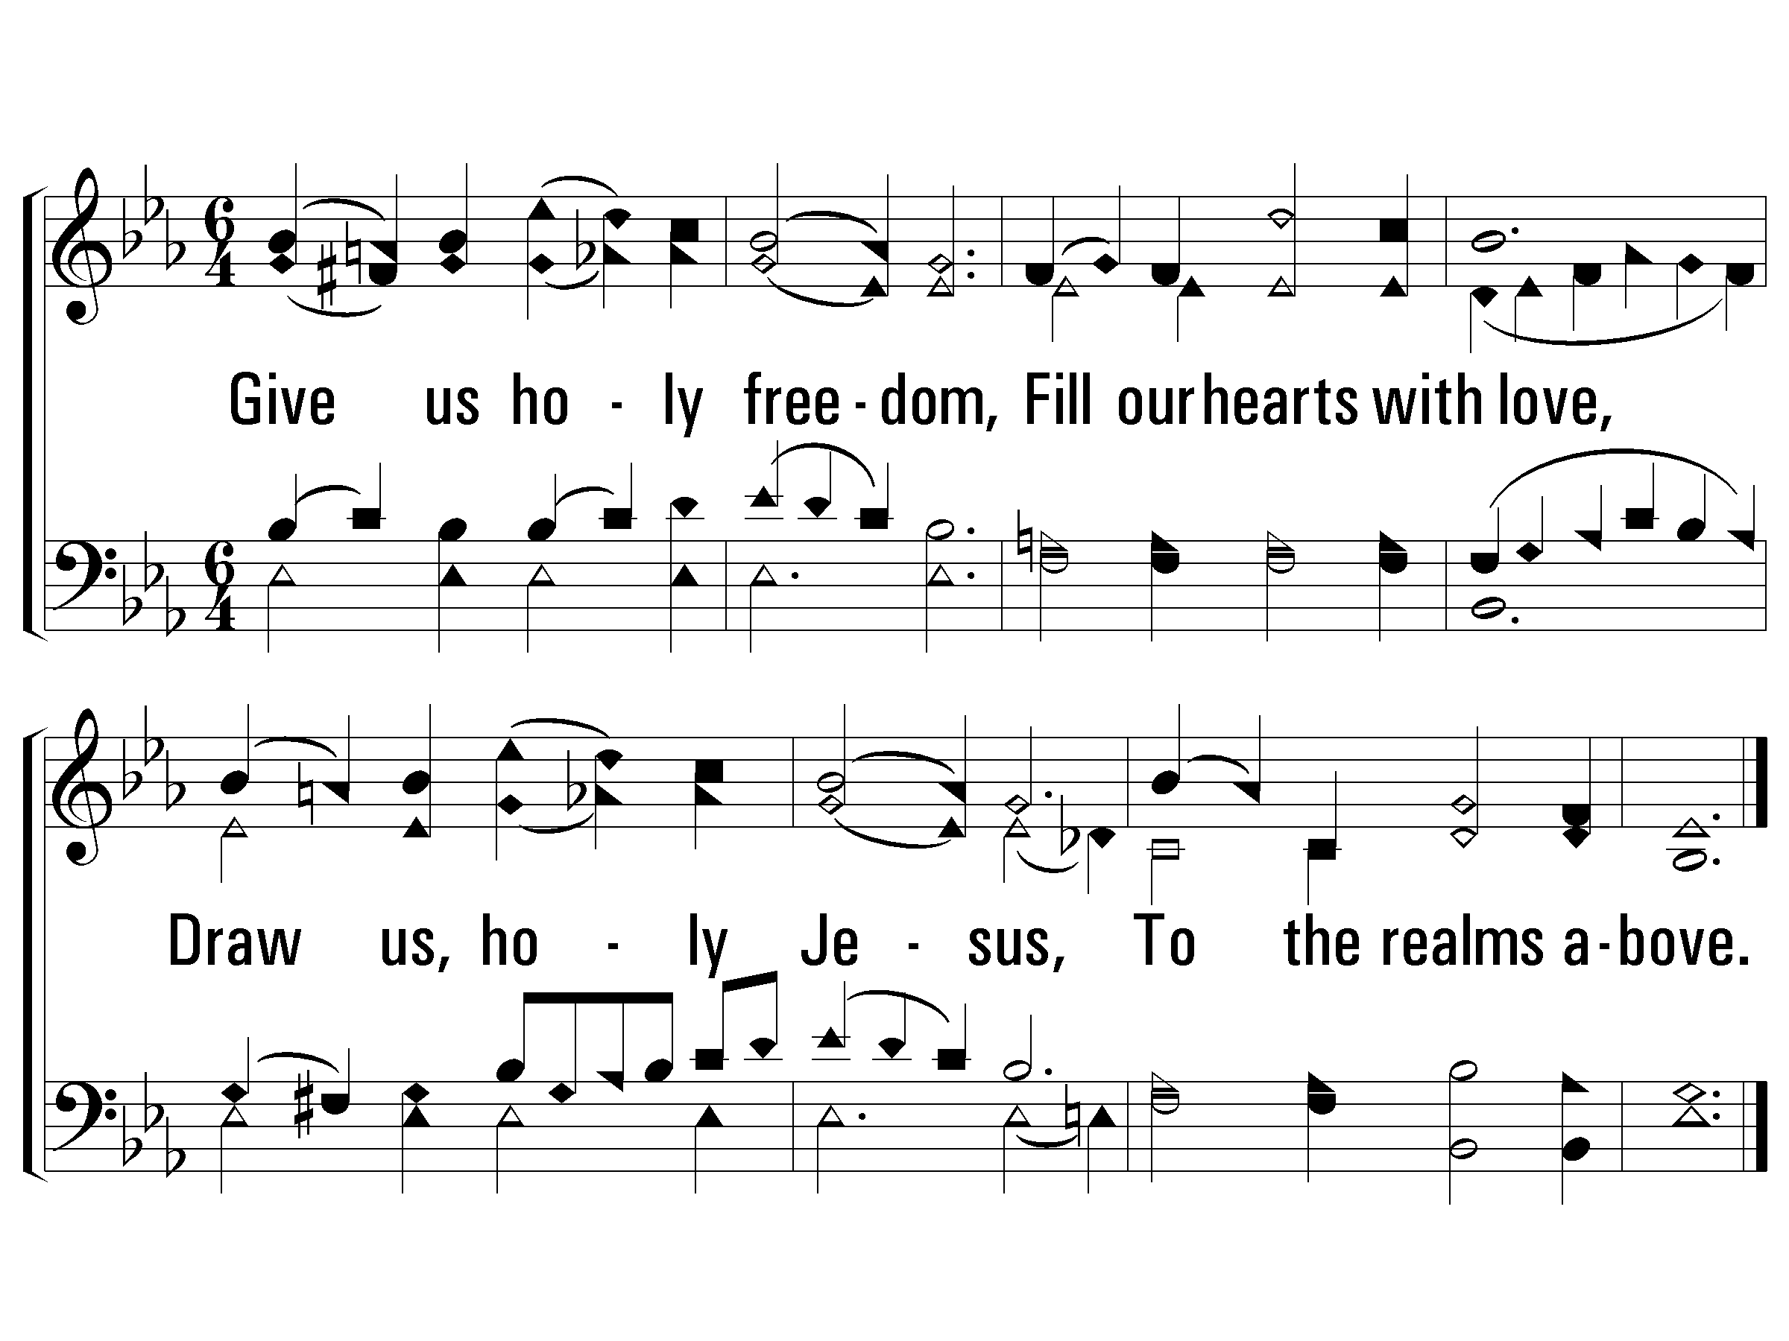
3 - Jesus, Meek and Gentle
355
3.
Give us holy freedom,
Fill our hearts with love,
Draw us, holy Jesus,
To the realms above.
Words: George R. Prynne
Music: Clarence Hudson
© 2008 The Paperless Hymnal®

Slide 8
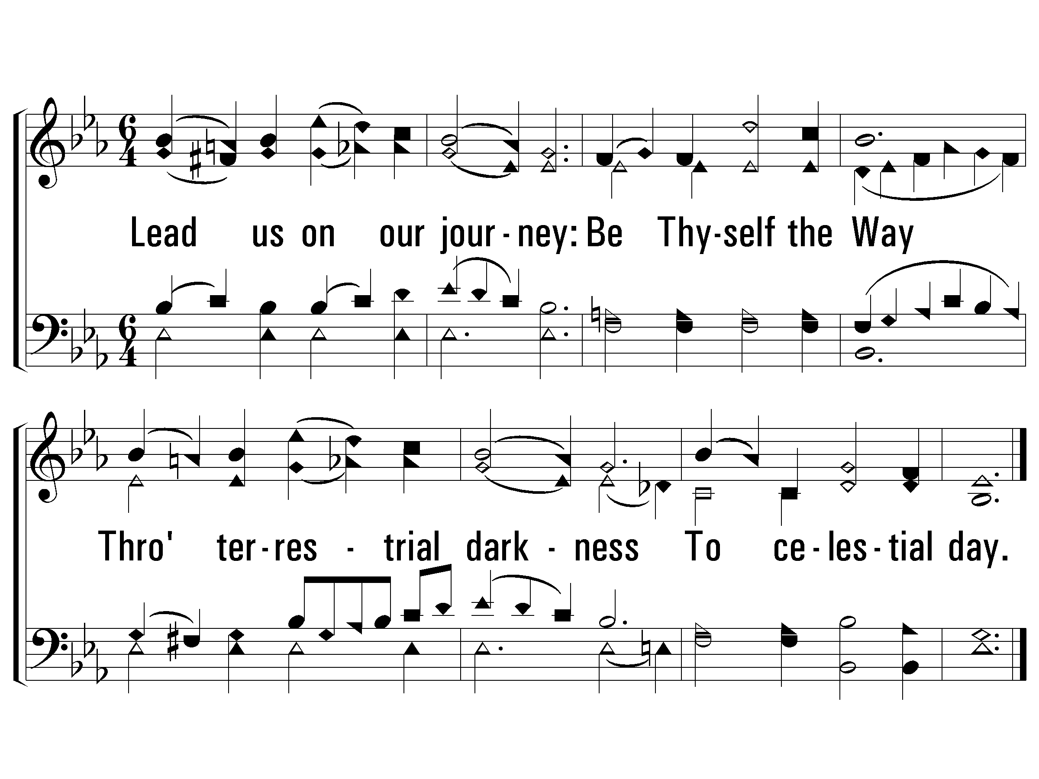
4 - Jesus, Meek and Gentle
355
4.
Lead us on our journey:
Be Thyself the Way
Through terrestrial darkness
To celestial day.
END
Words: George R. Prynne
Music: Clarence Hudson
© 2008 The Paperless Hymnal®

Slide 9
Isaiah 49:1-6 // 108 – Come, Long Expected Jesus

Slide 10
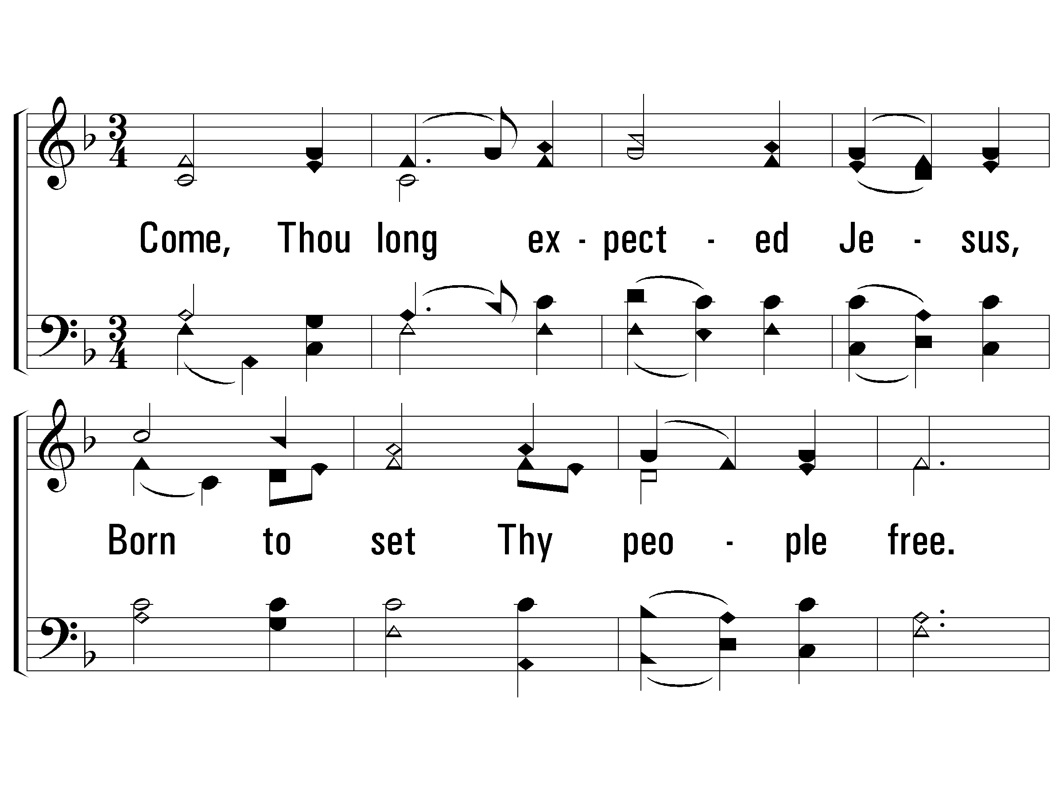
1 - Come, Thou Long Expected Jesus
108
1.
Come, Thou long expected Jesus,
Born to set Thy people free.
From our fears and sins release us;
Let us find our rest in Thee.
Israel's Strength and Consolation,
Hope of all the earth Thou art;
Dear Desire of every nation,
Joy of every longing heart!
Words: Charles Wesley
Music: Rowland H. Prichard, Arr: Ralph Vaughn Williams
© 2001 The Paperless Hymnal™

Slide 11
1 - Come, Thou Long Expected Jesus
108
© 2001 The Paperless Hymnal™

Slide 12
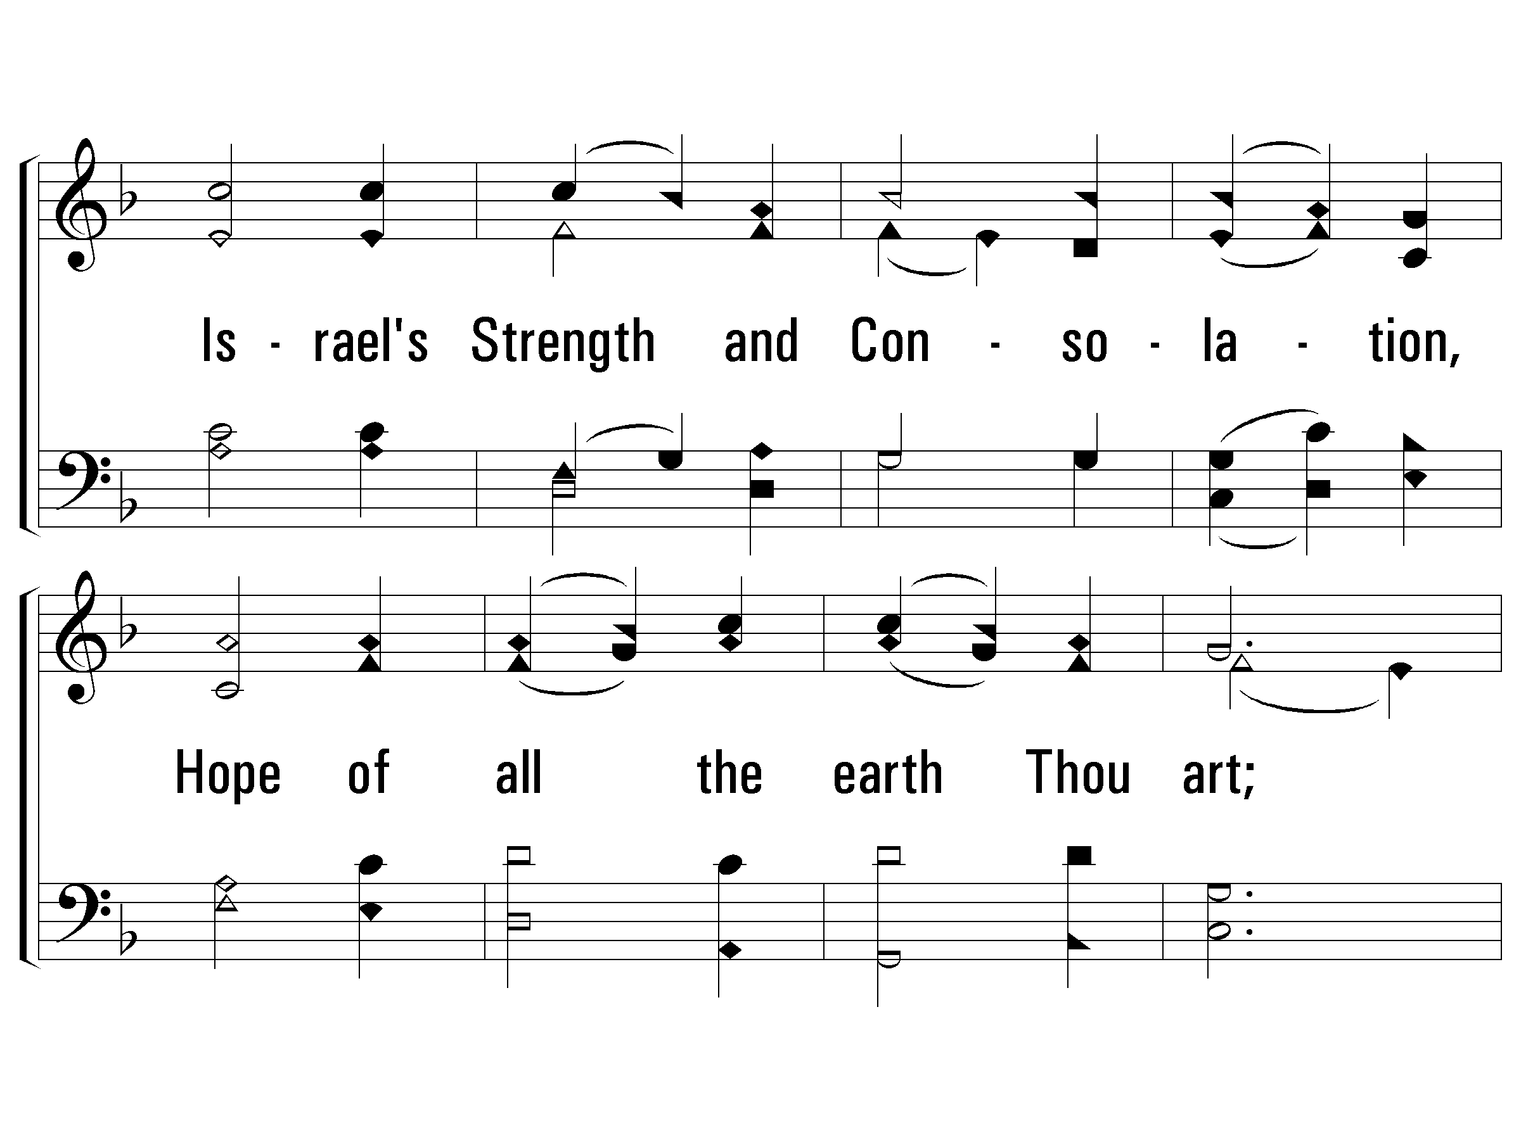
1 - Come, Thou Long Expected Jesus
108
© 2001 The Paperless Hymnal™

Slide 13
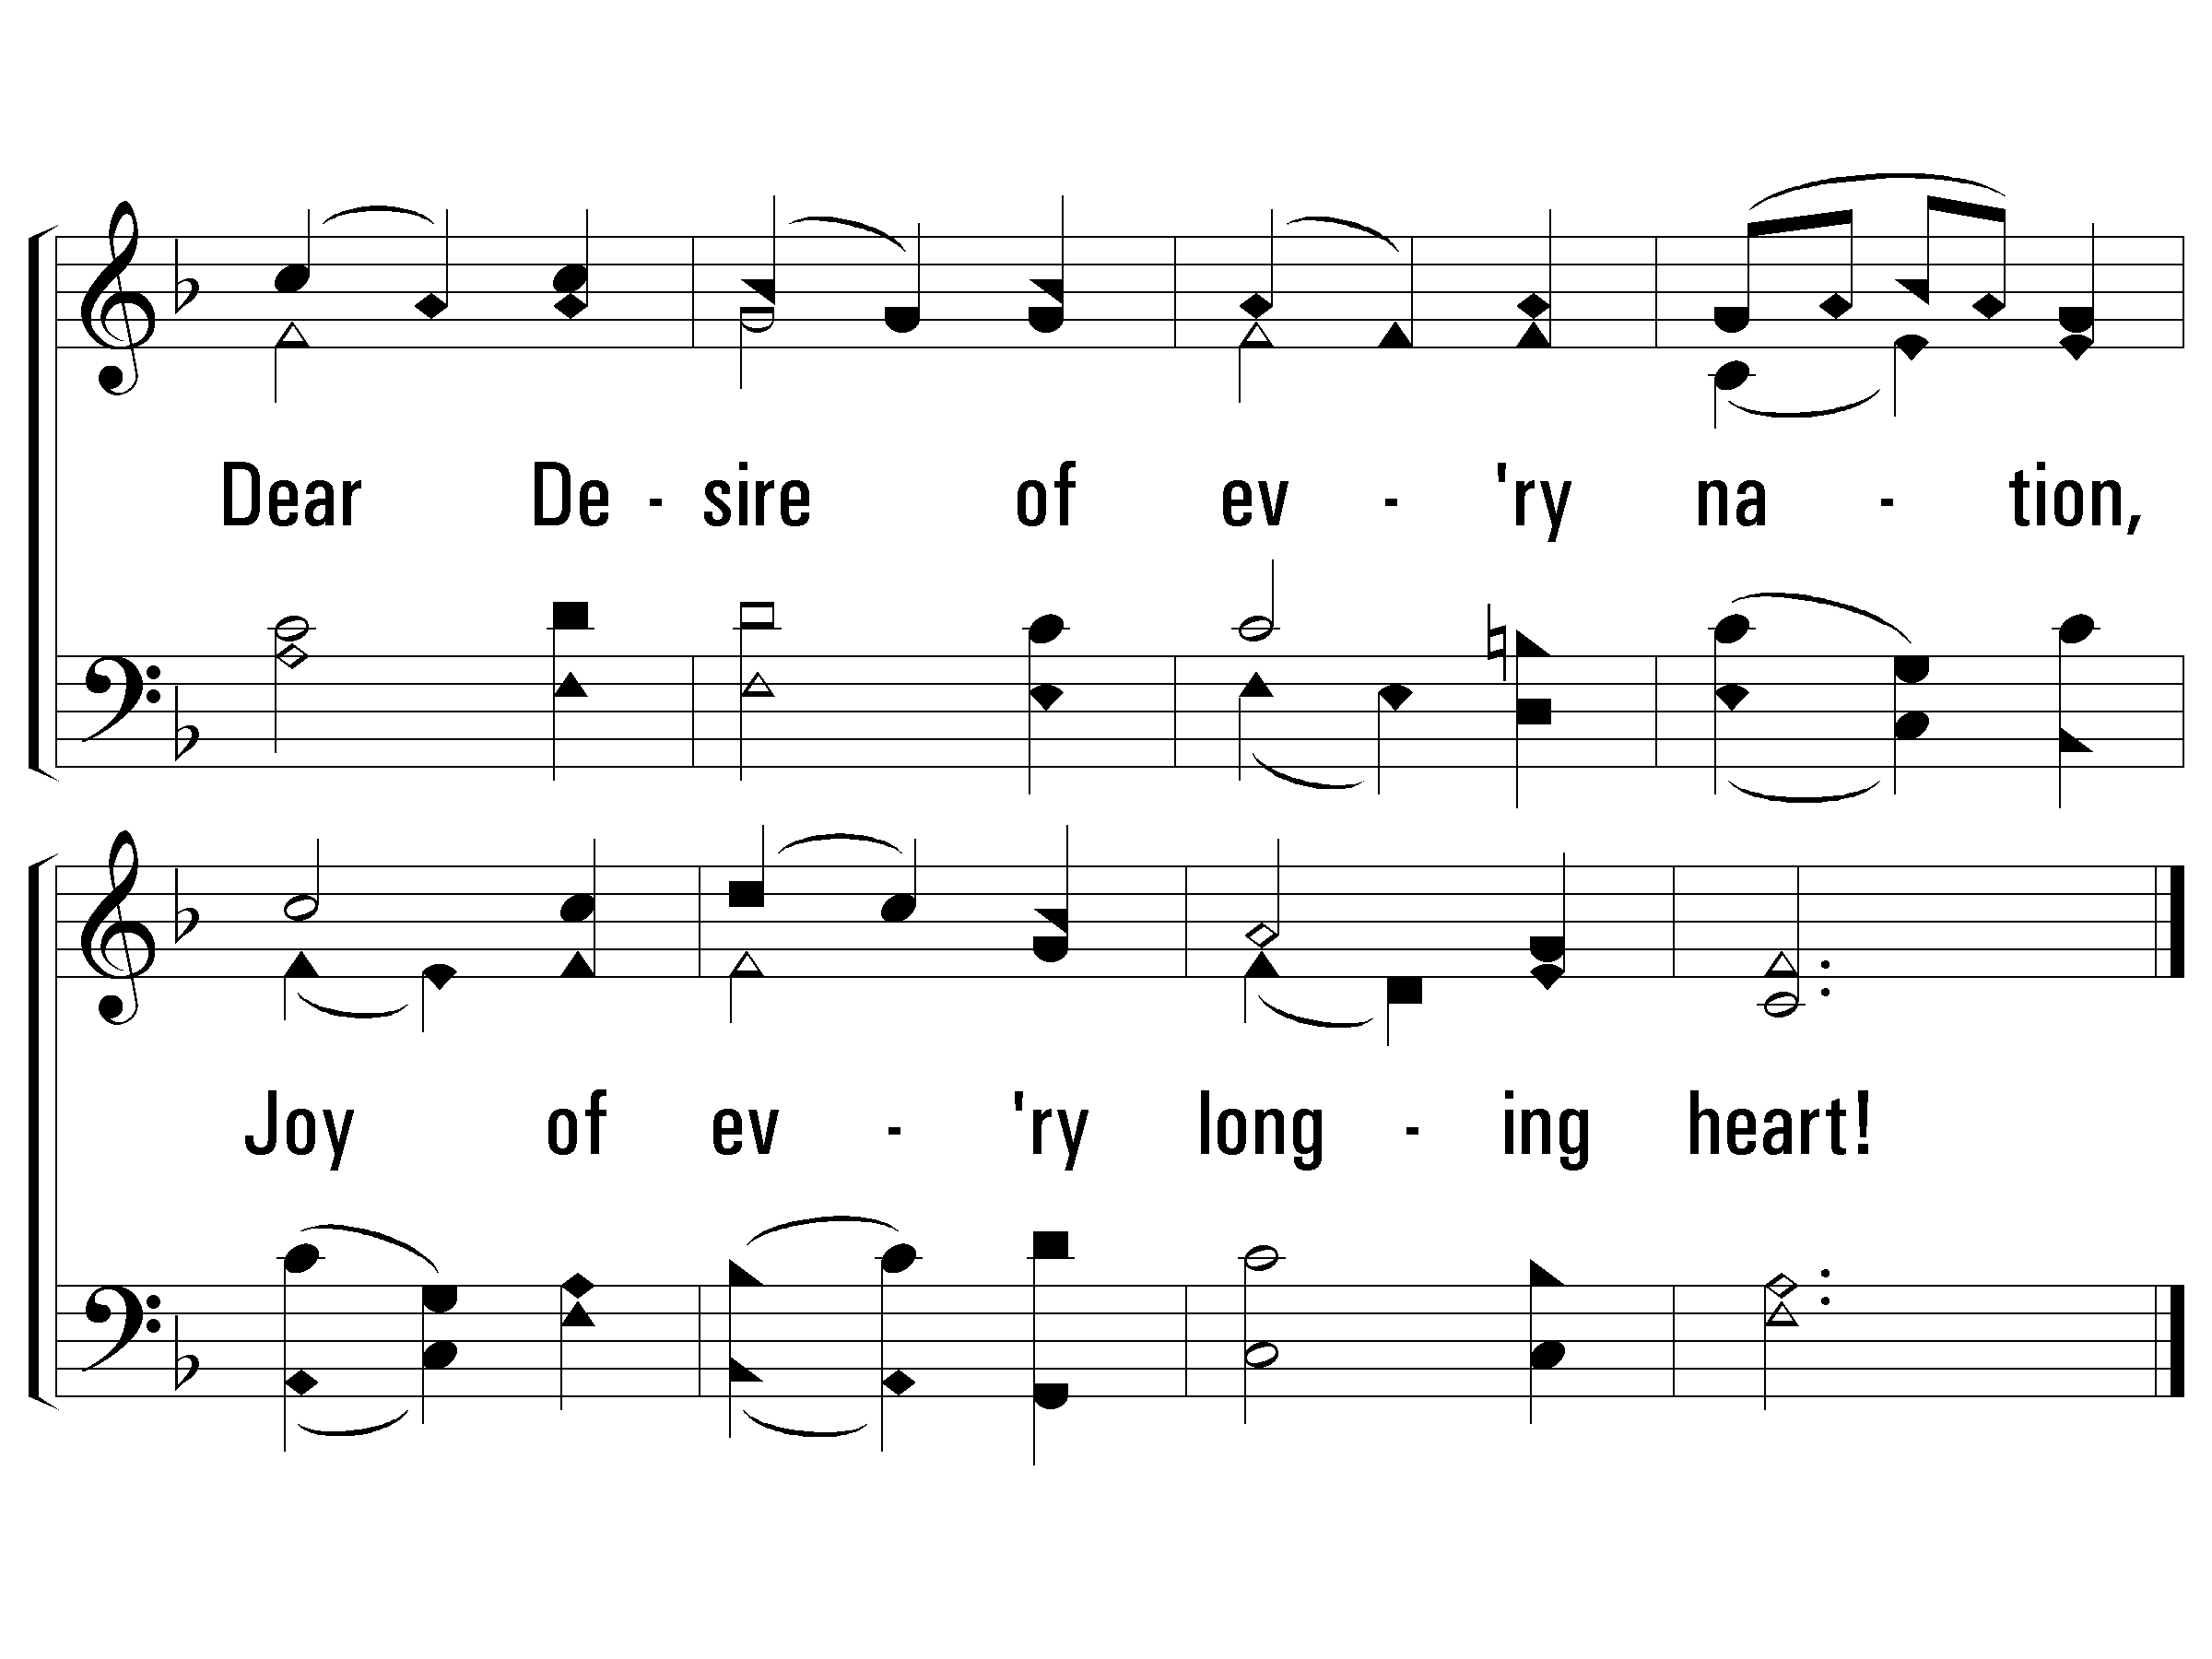
1 - Come, Thou Long Expected Jesus
108
© 2001 The Paperless Hymnal™

Slide 14
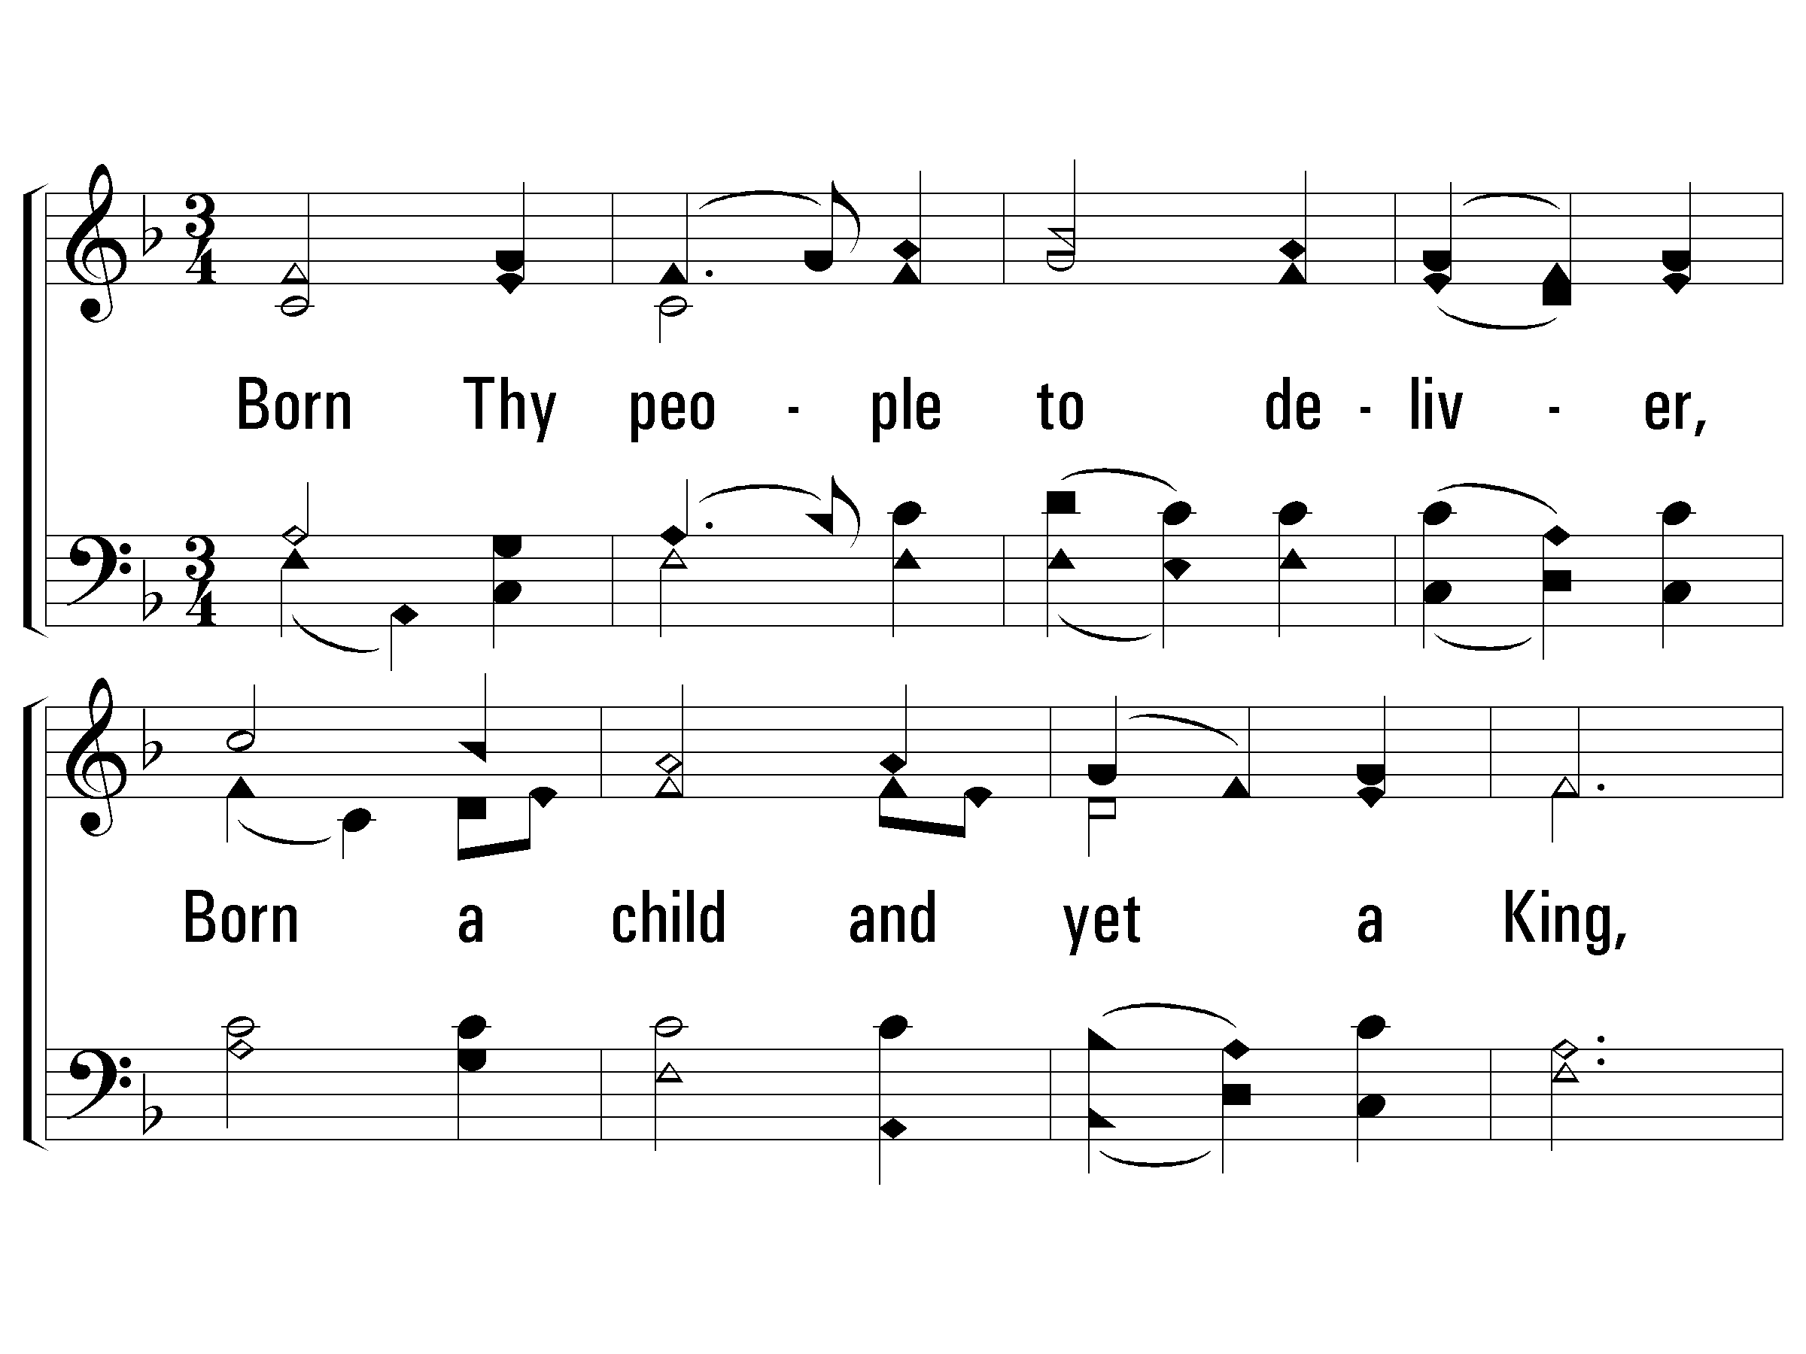
2 - Come, Thou Long Expected Jesus
108
2.
Born Thy people to deliver,
Born a child and yet a King,
Born to reign in us forever,
Now Thy gracious kingdom bring.
By Thine own eternal Spirit
Rule in all our hearts alone;
By Thine all sufficient merit,
Raise us to Thy glorious throne.
Words: Charles Wesley
Music: Rowland H. Prichard, Arr: Ralph Vaughn Williams
© 2001 The Paperless Hymnal™

Slide 15
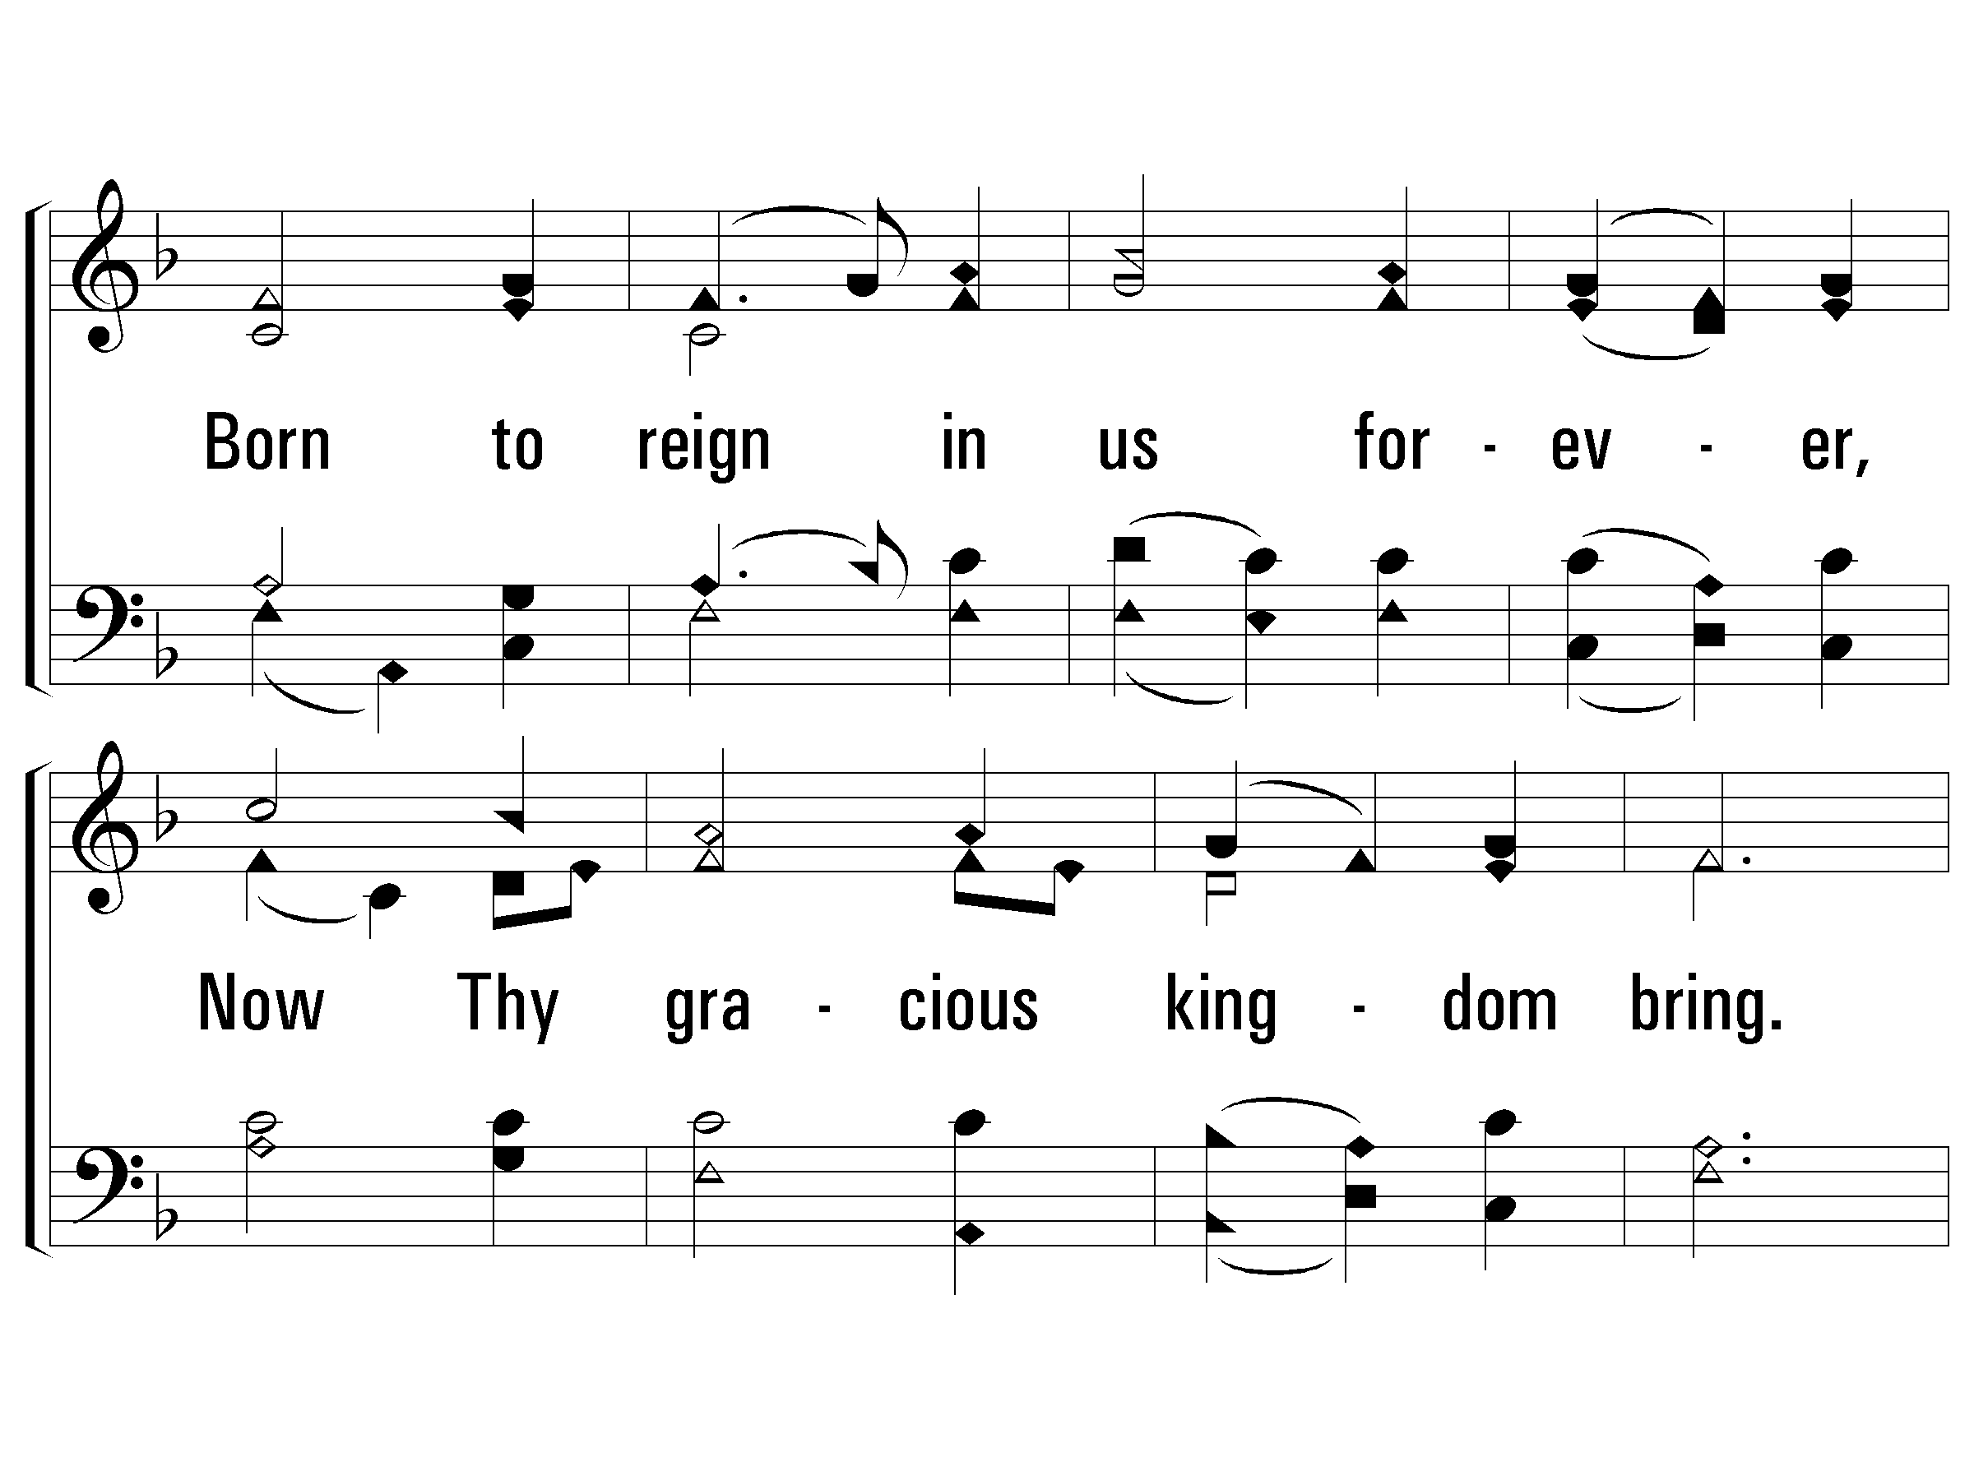
2 - Come, Thou Long Expected Jesus
108
© 2001 The Paperless Hymnal™

Slide 16
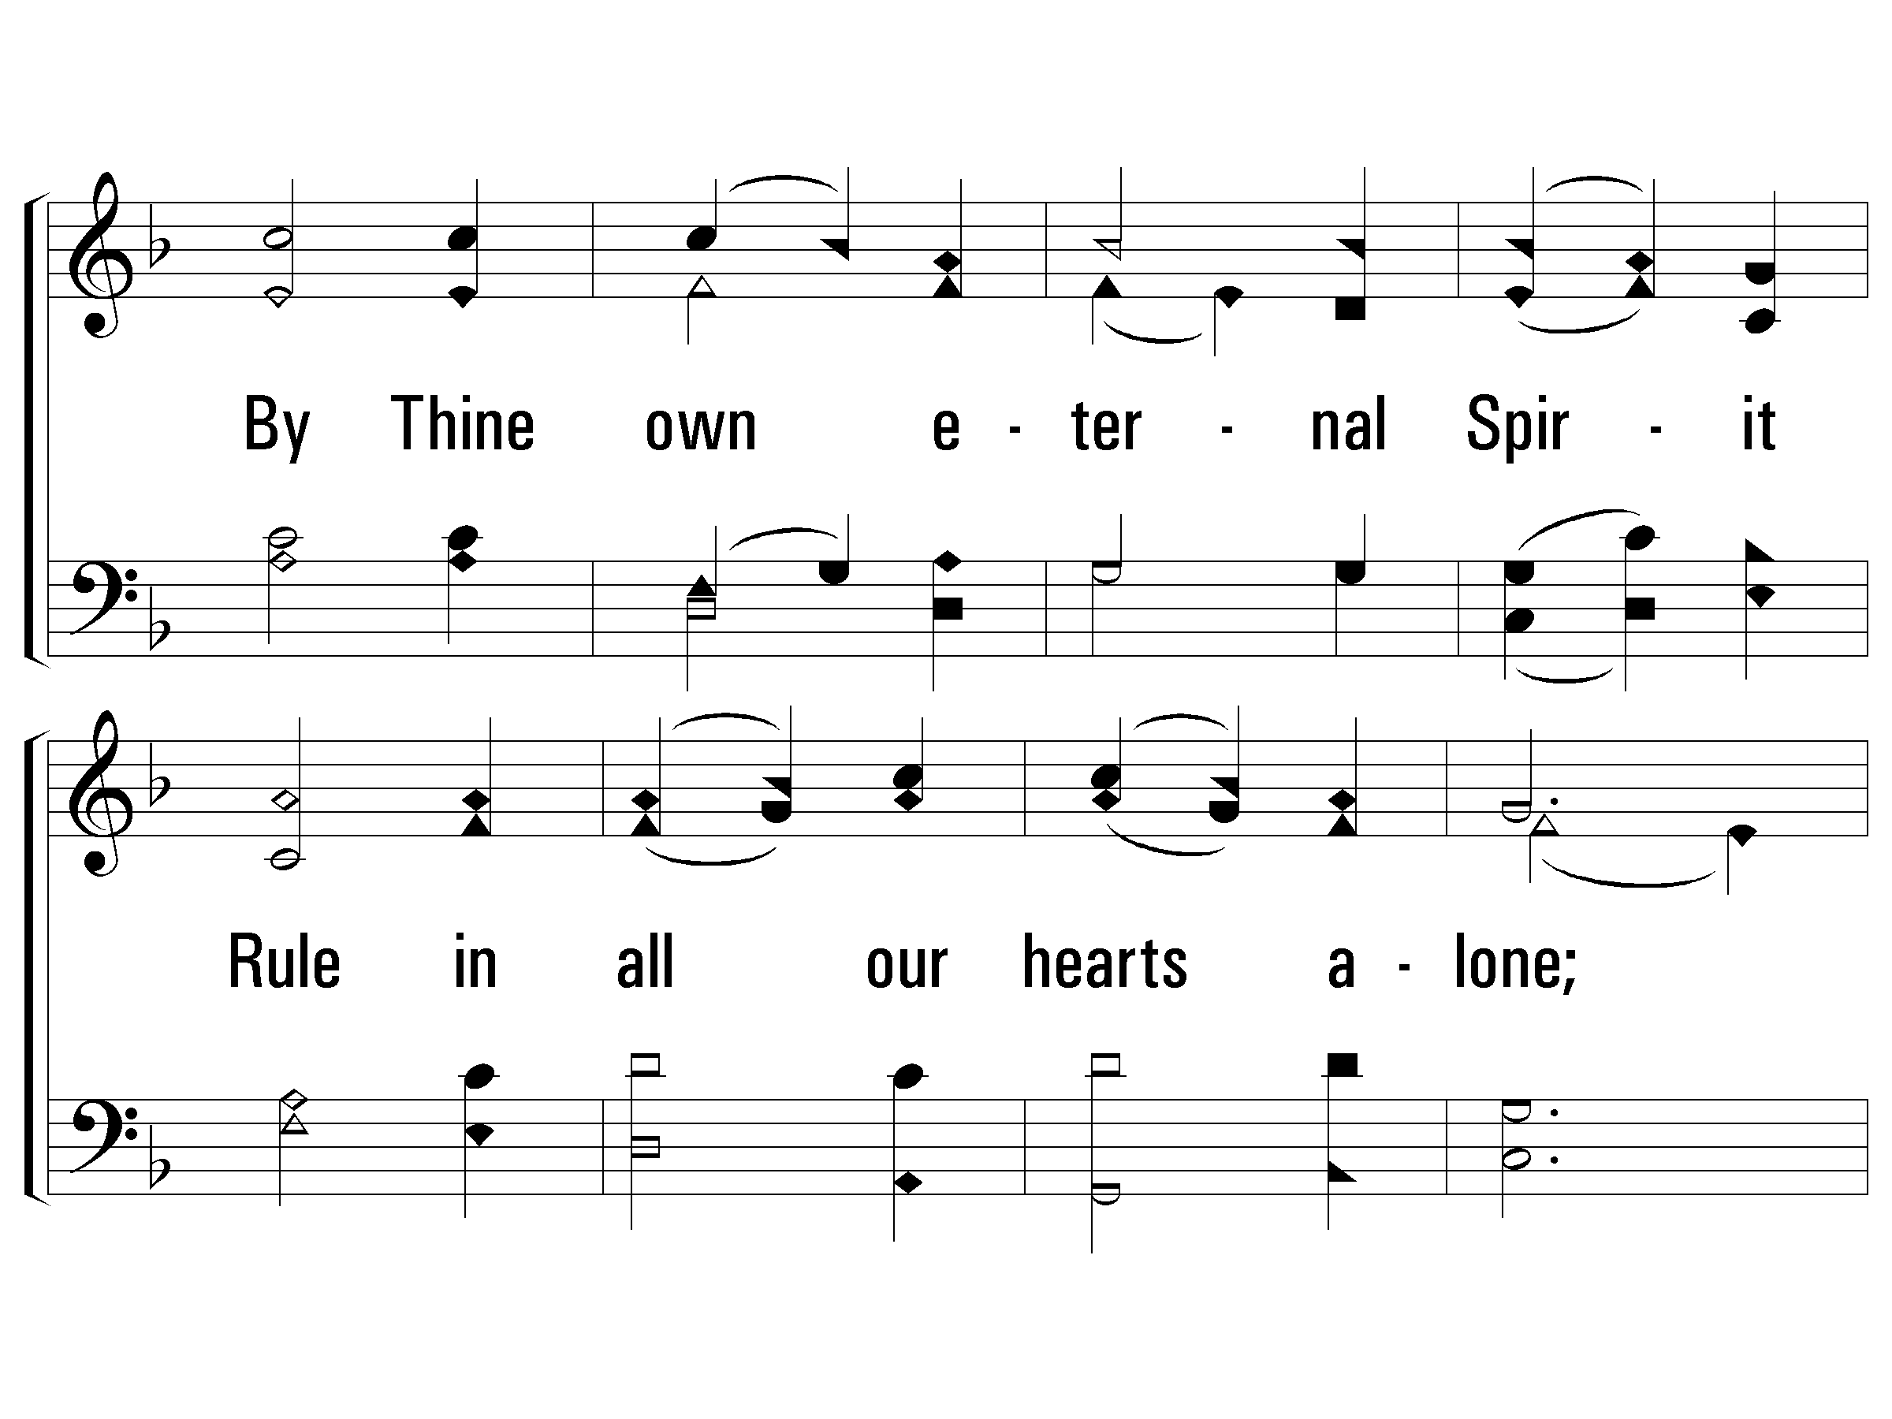
2 - Come, Thou Long Expected Jesus
108
© 2001 The Paperless Hymnal™

Slide 17
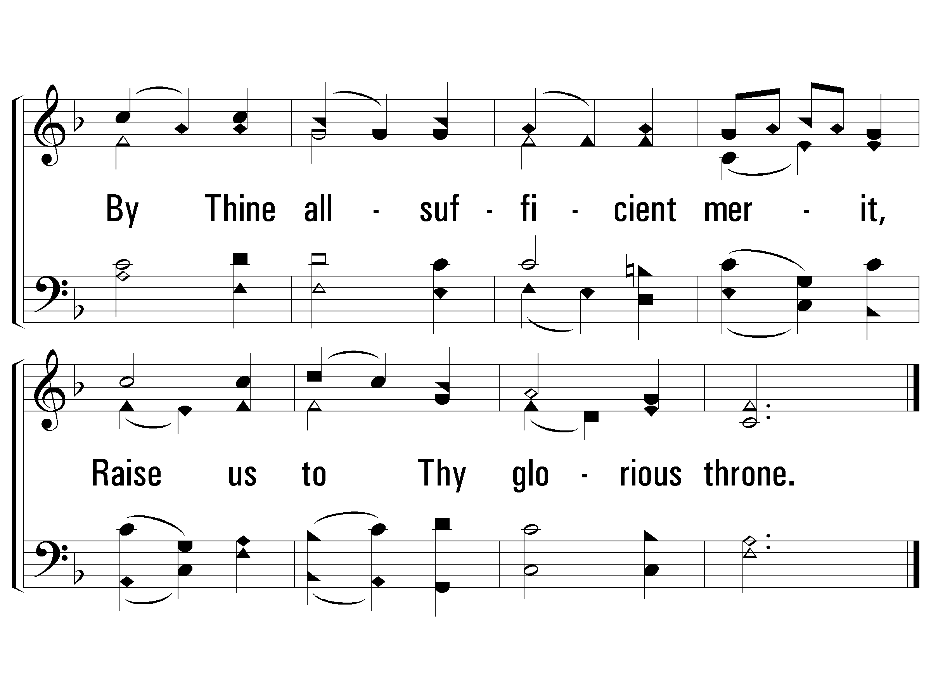
2 - Come, Thou Long Expected Jesus
108
END
© 2001 The Paperless Hymnal™

Slide 18
Isaiah 50:4-11 // 452 – Night, with Ebon Pinion

Slide 19
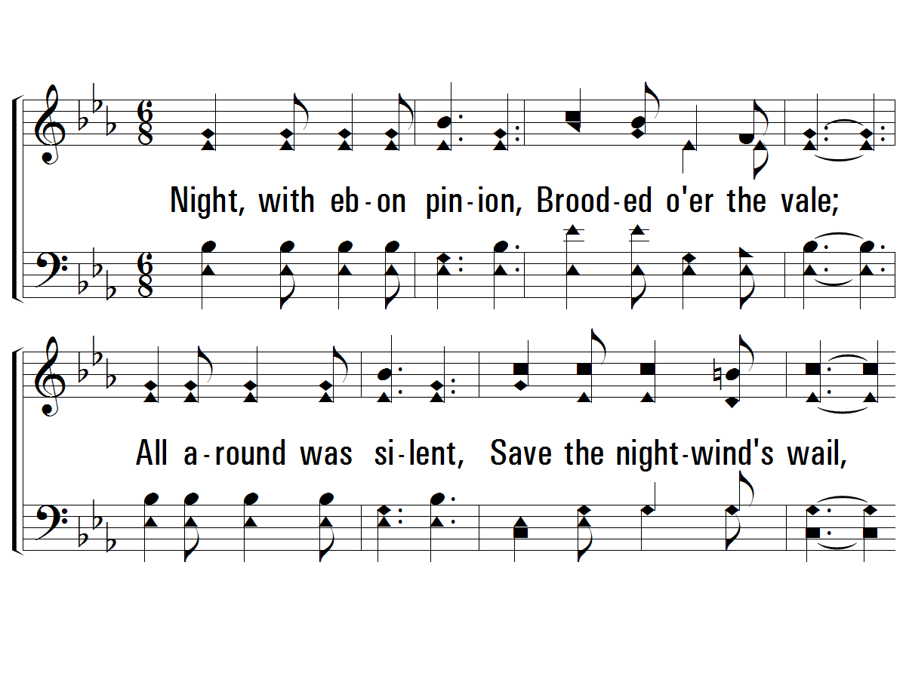
1 - Night, with Ebon Pinion
452
1.
Night, with ebon pinion,
Brooded over the vale;
All around was silent,
Save the night-wind's wail,
When Christ, the Man of Sorrows,
In tears and sweat and blood,
Prostrate in the garden,
Raised His voice to God.
Words: Love H. Jameson
Music: Joseph P. Powell
© 2007 The Paperless Hymnal®

Slide 20
1 - Night, with Ebon Pinion
452
© 2007 The Paperless Hymnal®

Slide 21
2 - Night, with Ebon Pinion
452
2.
Smitten for offenses
Which were not His own,
He, for our transgressions,
Had to weep alone;
No friend with words to comfort,
Nor hand to help was there,
When the Meek and Lowly
Humbly bowed in prayer.
Words: Love H. Jameson
Music: Joseph P. Powell
© 2007 The Paperless Hymnal®

Slide 22
2 - Night, with Ebon Pinion
452
© 2007 The Paperless Hymnal®

Slide 23
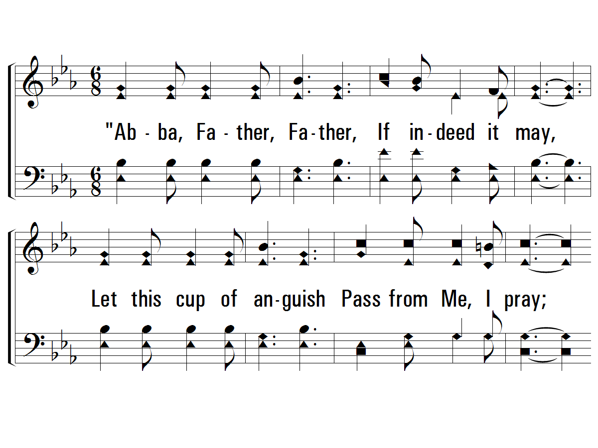
3 - Night, with Ebon Pinion
452
3.
"Abba, Father, Father,
If indeed it may,
Let this cup of anguish
Pass from Me, I pray;
Yet, if it must be suffered,
By Me, Thine only Son,
Abba, Father, Father,
Let Thy will be done."
Words: Love H. Jameson
Music: Joseph P. Powell
© 2007 The Paperless Hymnal®

Slide 24
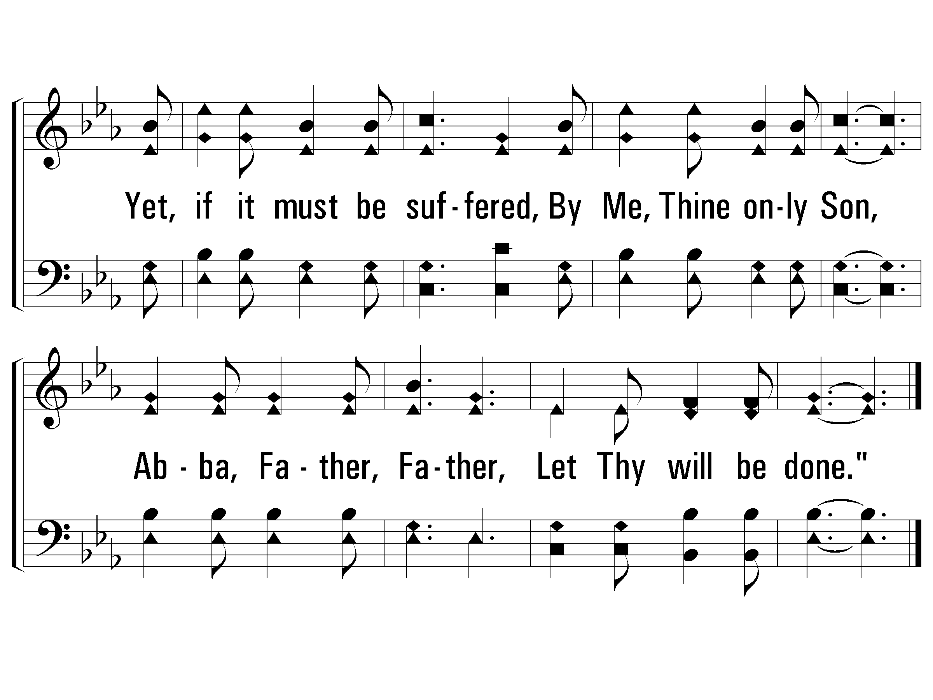
3 - Night, with Ebon Pinion
452
END
© 2007 The Paperless Hymnal®

Slide 25
Isaiah 52:13-53:12 // 484 – O Sacred Head Now Wounded / 203 – Hallelujah, What a Savior

Slide 26
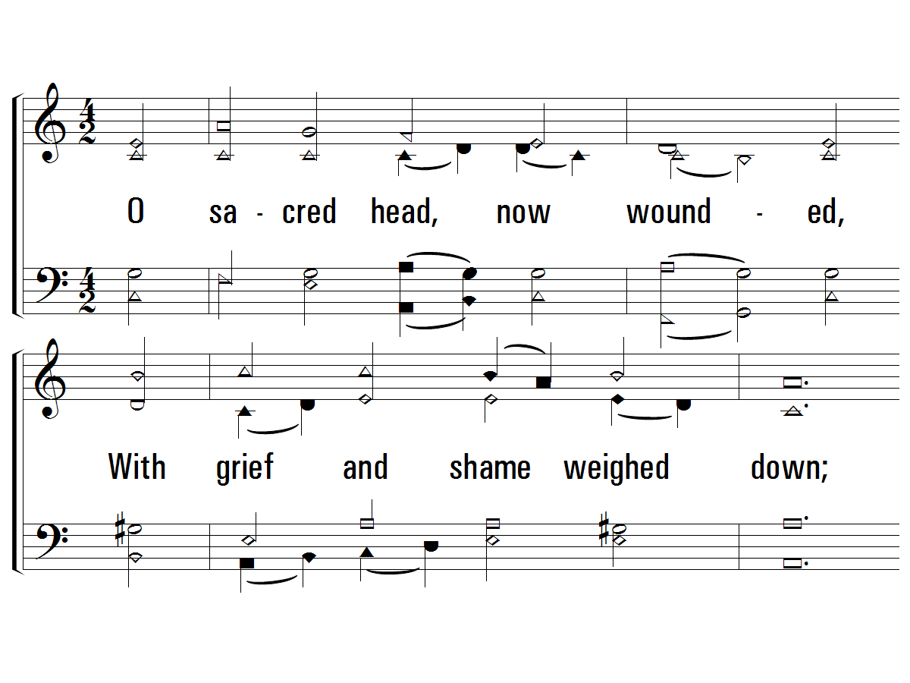
1 - O Sacred Head
484
1.
O sacred head, now wounded,
With grief and shame weighed down;
Now scornfully surrounded
With thorns, Thine only crown;
How art Thou pale with anguish,
With sore abuse and scorn;
How does that visage languish,
Which once was bright as morn!
Words by: Bernard of Clairvaux / Tr., German, Paul Gerhardt / Tr., English: James W. Alexander
Music by: Hans Hassler / Arr.: Johann S. Bach
© 2001 The Paperless Hymnal™

Slide 27
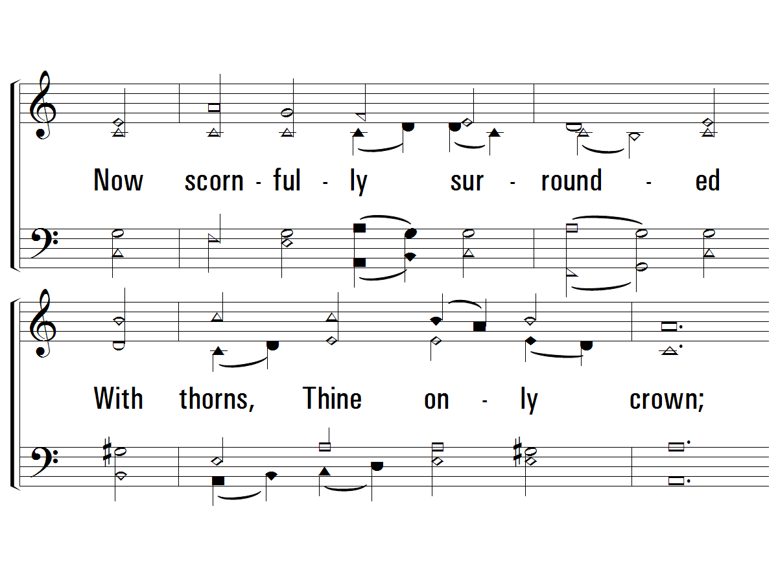
1 - O Sacred Head
484
© 2001 The Paperless Hymnal™

Slide 28
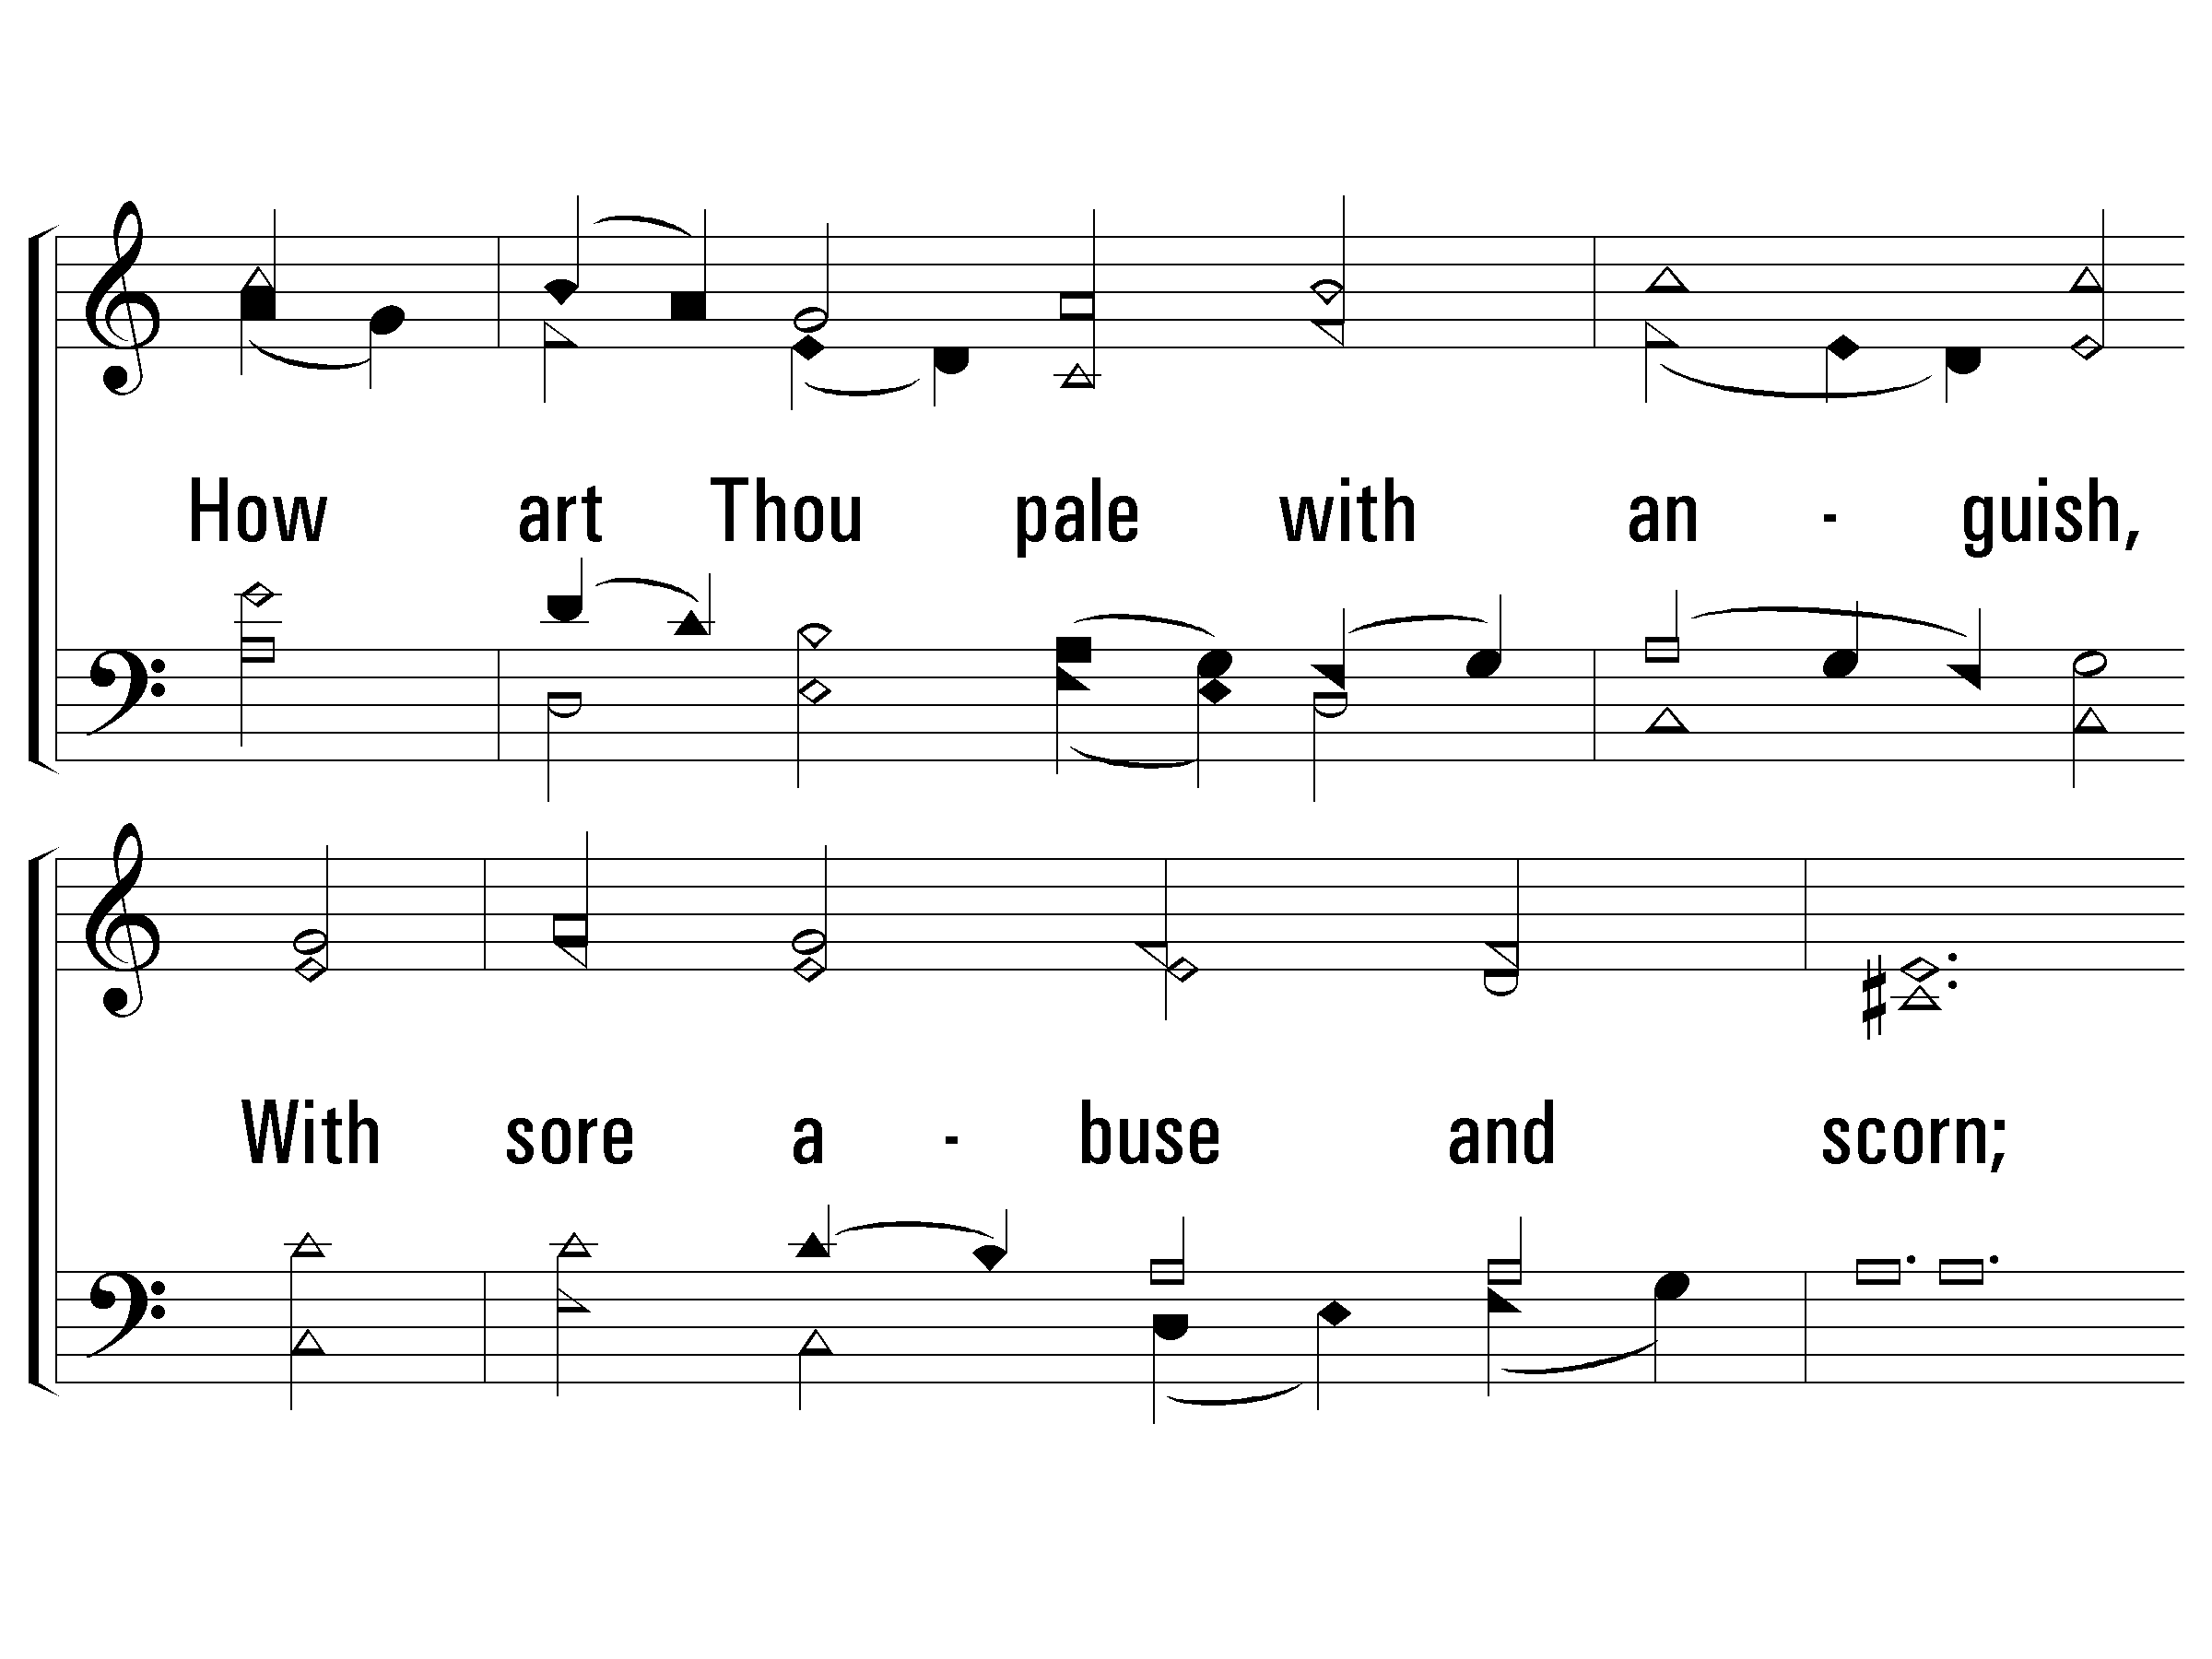
1 - O Sacred Head
484
© 2001 The Paperless Hymnal™

Slide 29
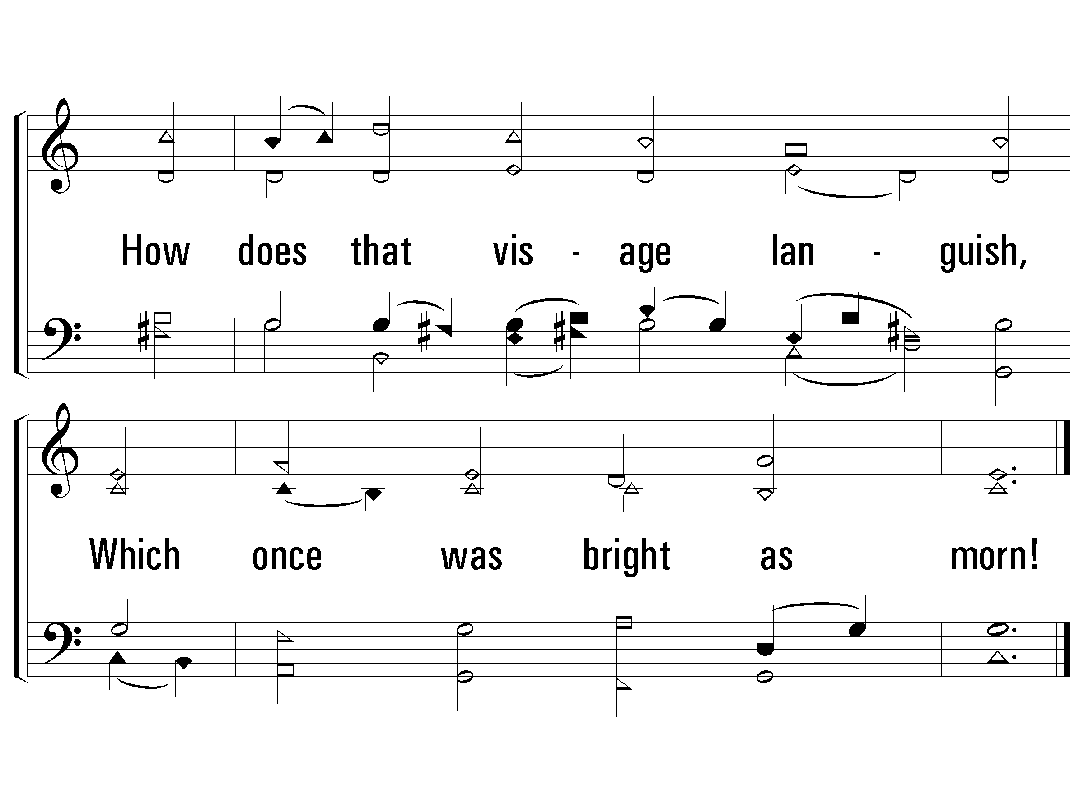
1 - O Sacred Head
484
© 2001 The Paperless Hymnal™

Slide 30
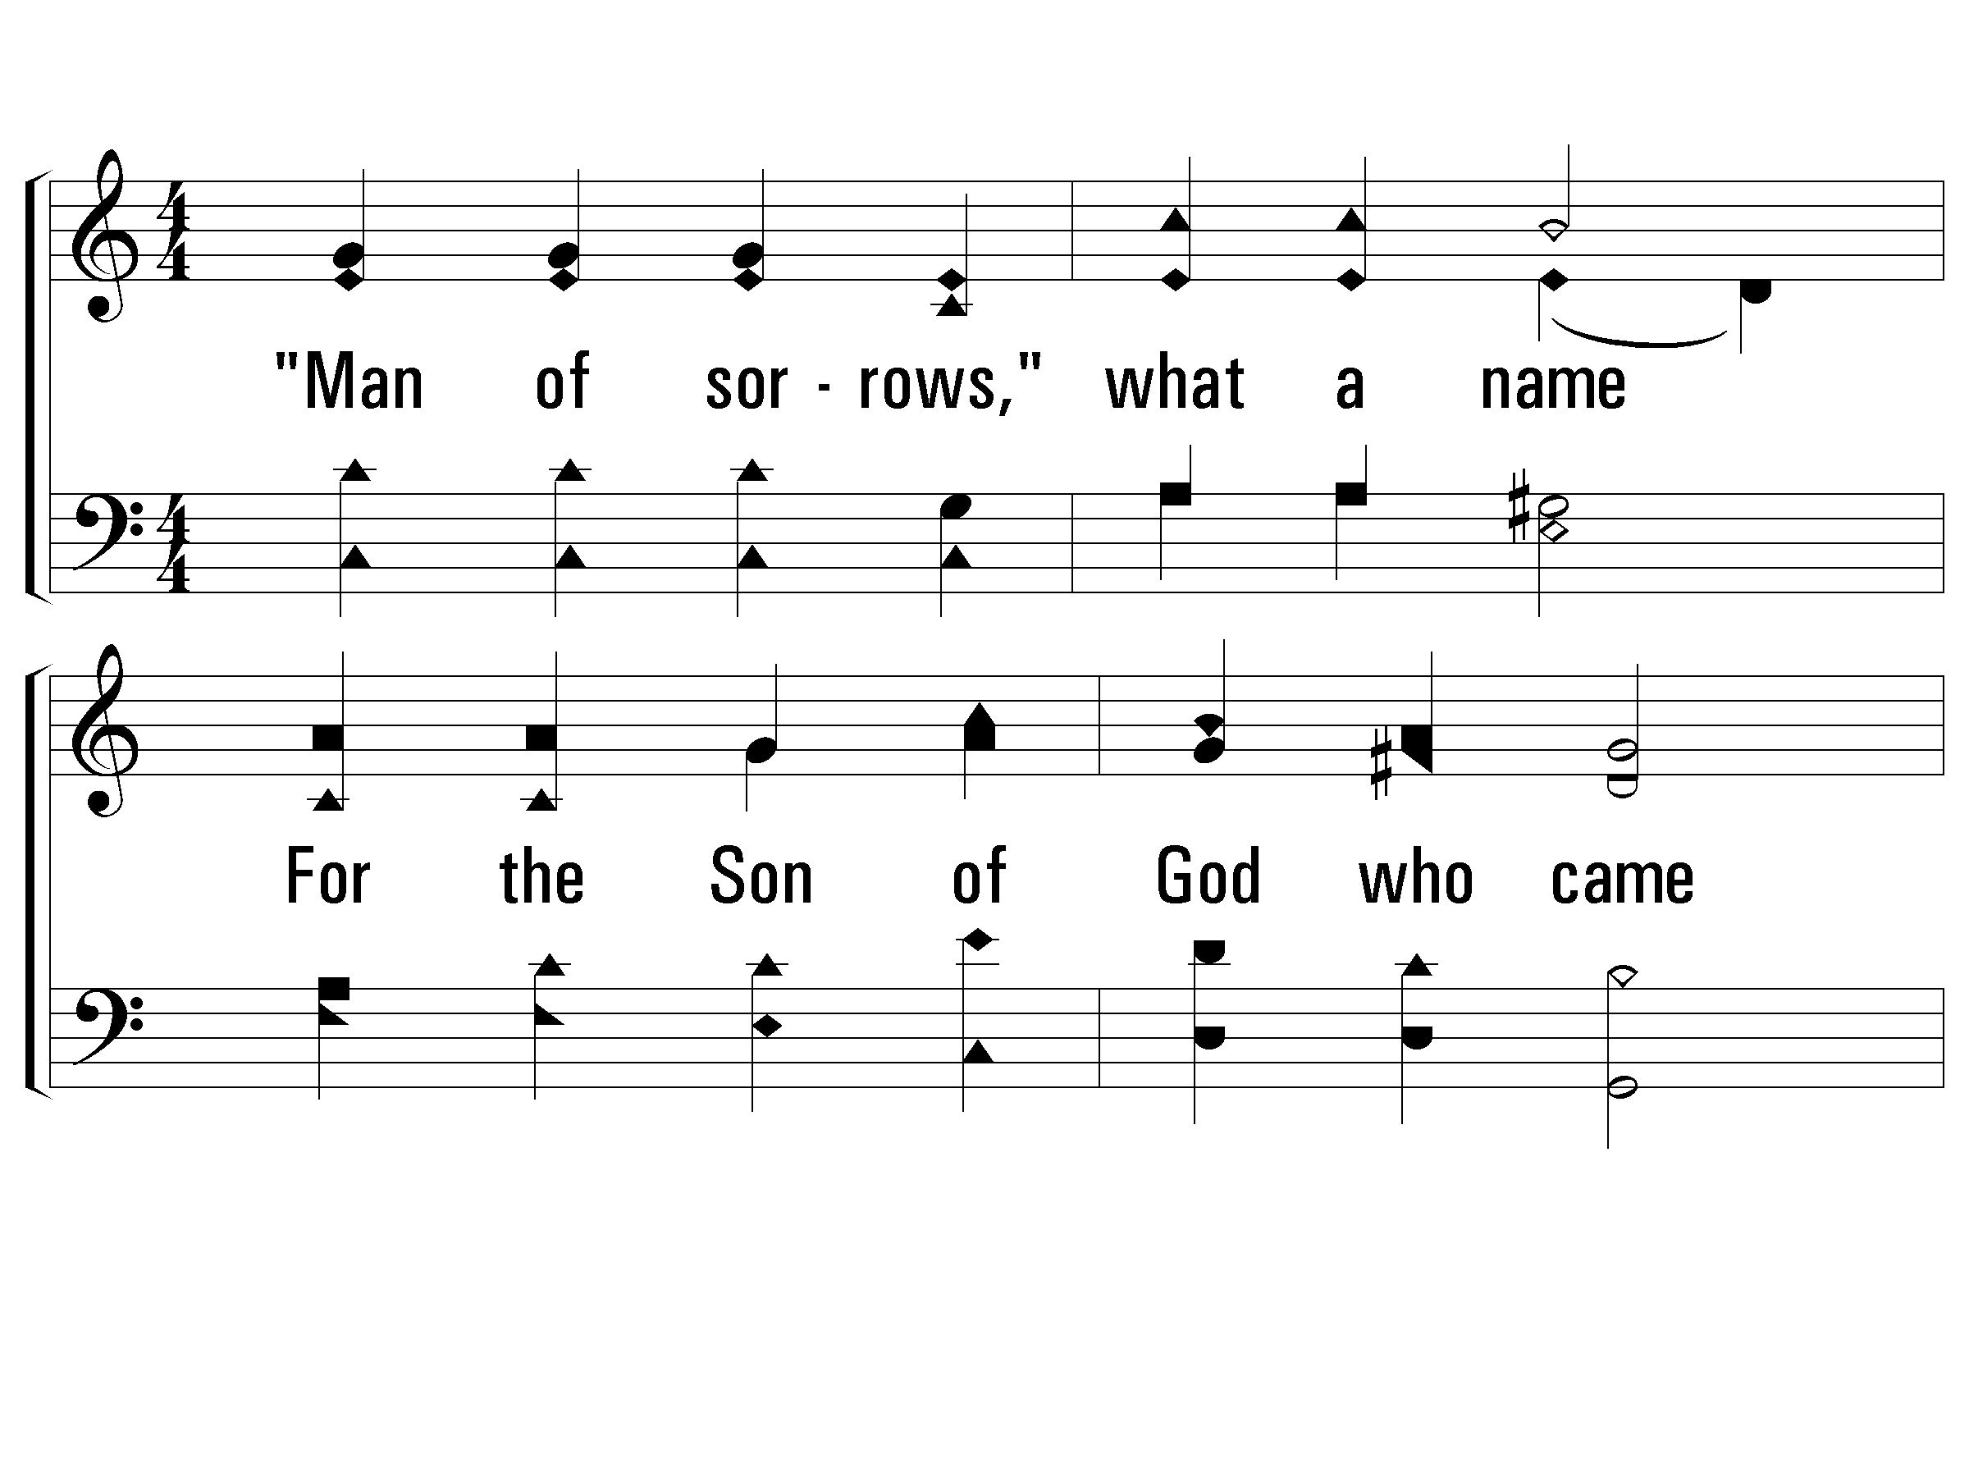
1 - Hallelujah! What a Savior
203
1.
"Man of sorrows," what a name
For the Son of God who came
Ruined sinners to reclaim!
Hallelujah! What a Savior!
Words & Music: Philip P. Bliss
© 2001 The Paperless Hymnal™

Slide 31
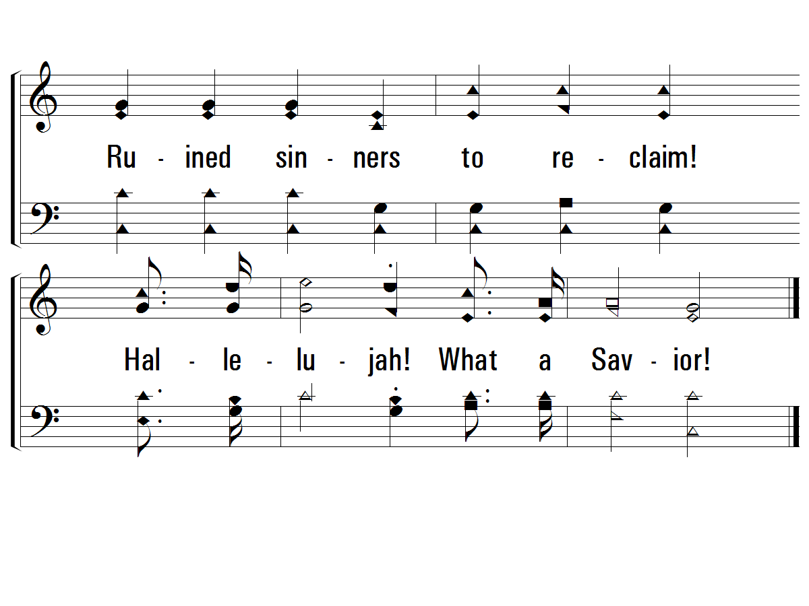
1 - Hallelujah! What a Savior
203
© 2001 The Paperless Hymnal™

Slide 32
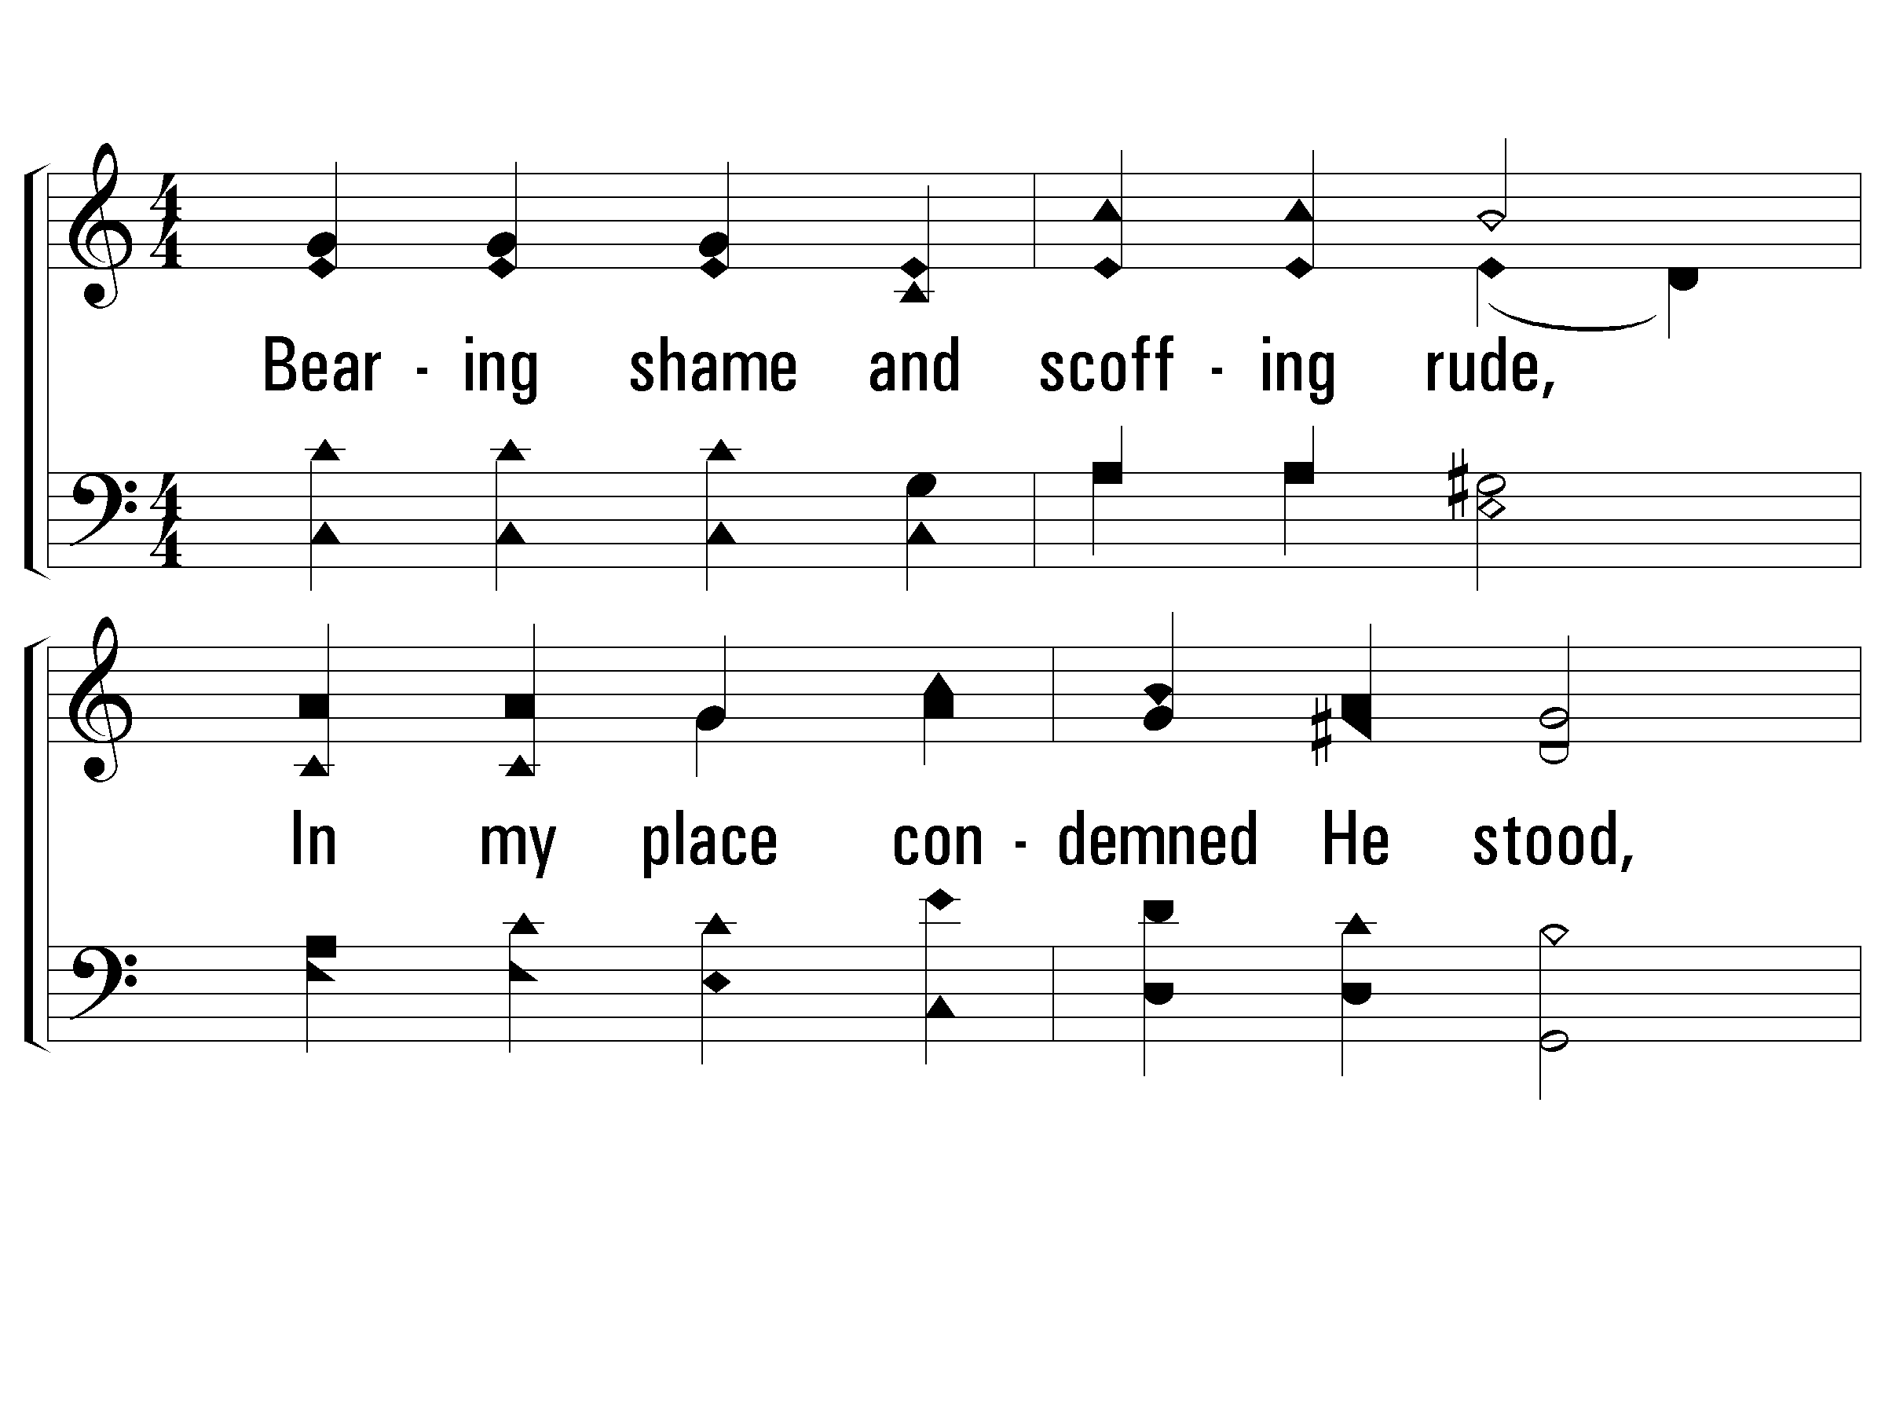
2 - Hallelujah! What a Savior
203
2.
Bearing shame and scoffing rude,
In my place condemned He stood,
Sealed my pardon with His blood;
Hallelujah! What a Savior!
Words & Music: Philip P. Bliss
© 2001 The Paperless Hymnal™

Slide 33
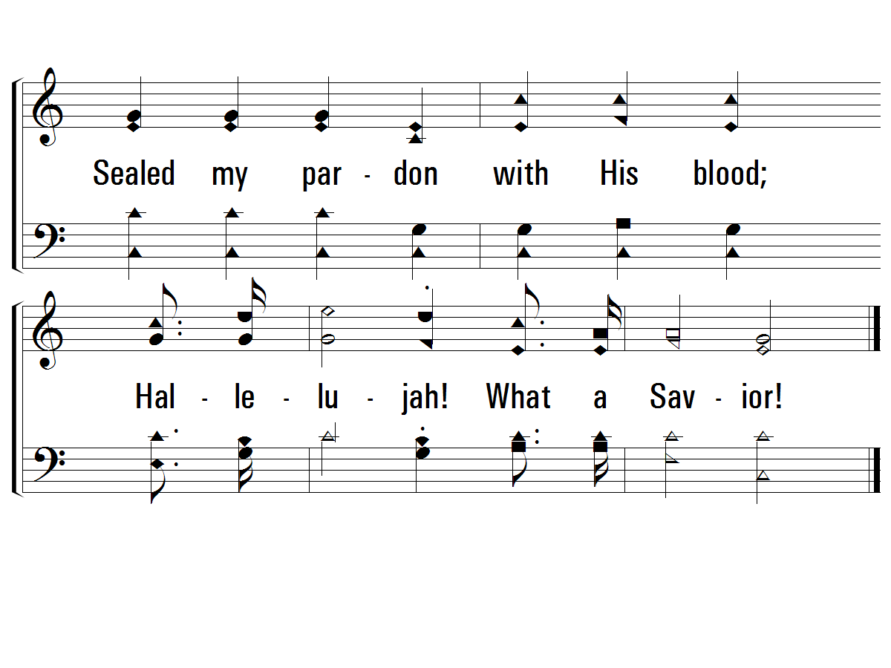
2 - Hallelujah! What a Savior
203
© 2001 The Paperless Hymnal™

Slide 34
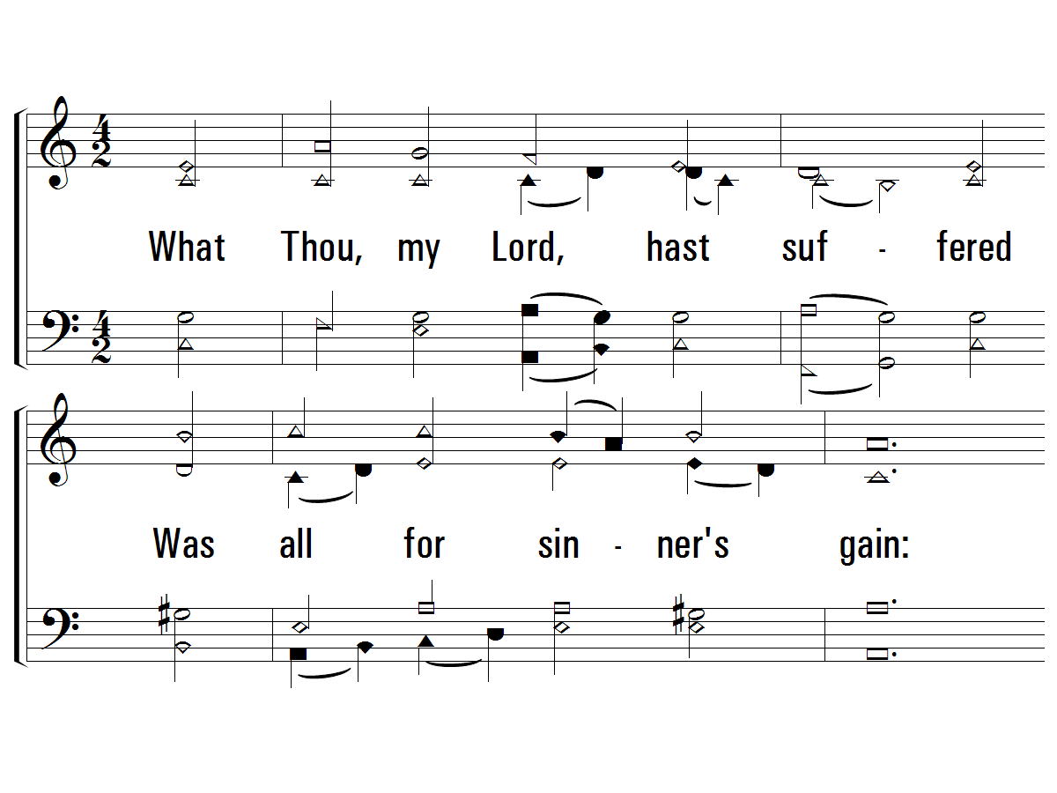
2 - O Sacred Head
484
2.
What Thou, my Lord, hast suffered
Was all for sinner’s gain:
Mine, mine was the transgression,
But Thine the deadly pain;
Lo, here I fall, my Savior!
‘Tis I deserve Thy place;
Look on me with Thy favor,
Vouchsafe to me Thy grace
Words by: Bernard of Clairvaux / Tr., German, Paul Gerhardt / Tr., English: James W. Alexander
Music by: Hans Hassler / Arr.: Johann S. Bach
© 2001 The Paperless Hymnal™

Slide 35
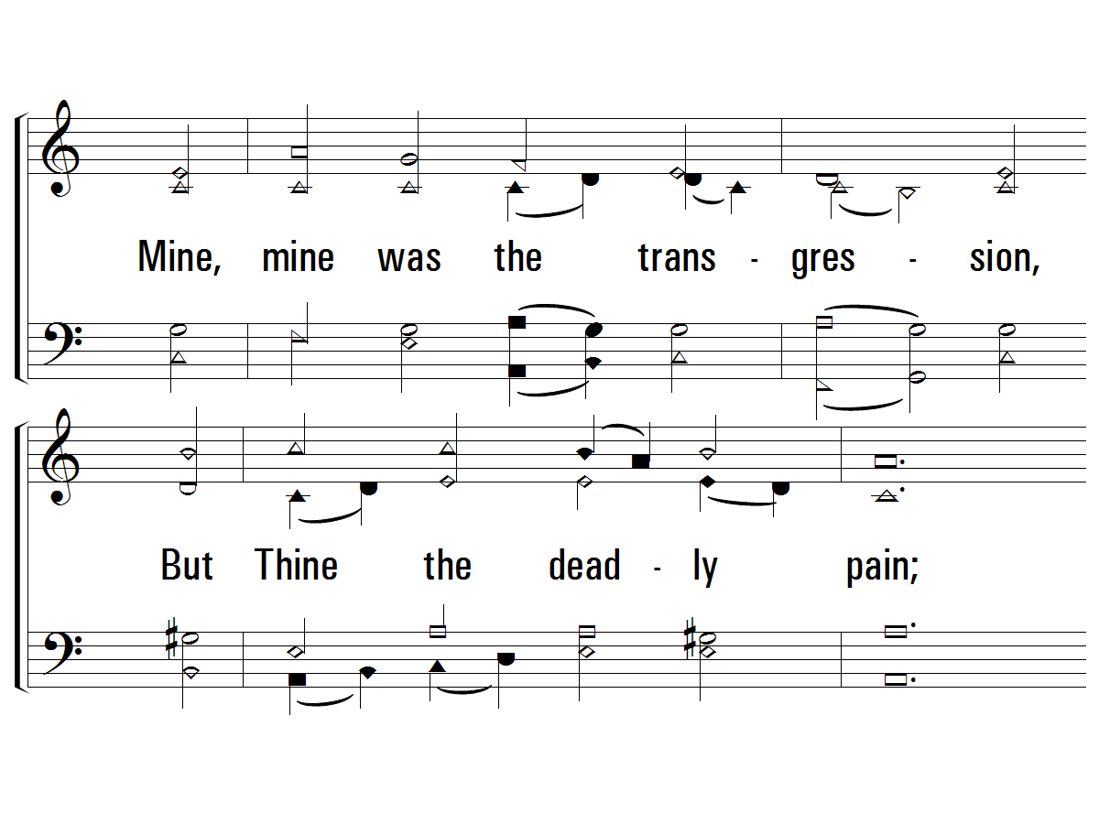
2 - O Sacred Head
484
© 2001 The Paperless Hymnal™

Slide 36
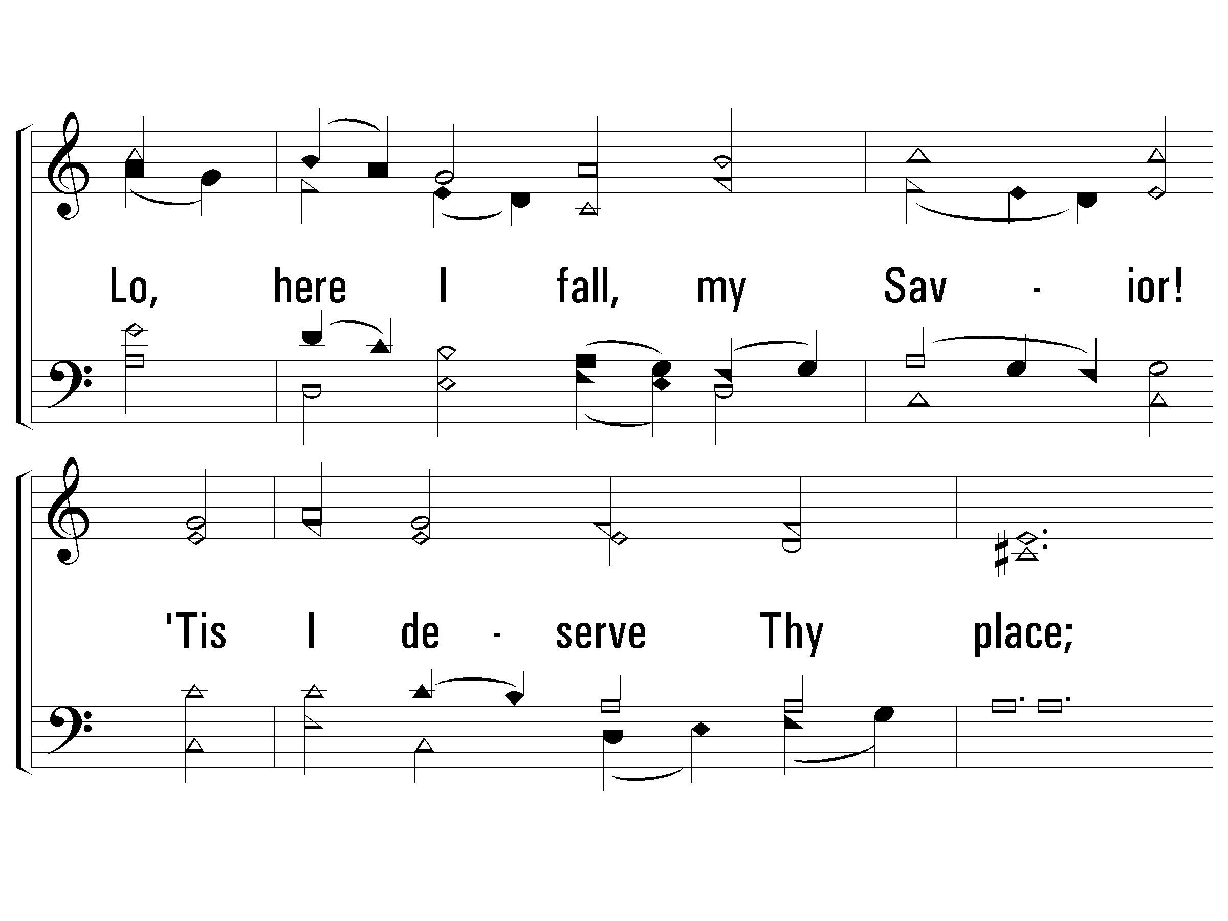
2 - O Sacred Head
484
© 2001 The Paperless Hymnal™

Slide 37
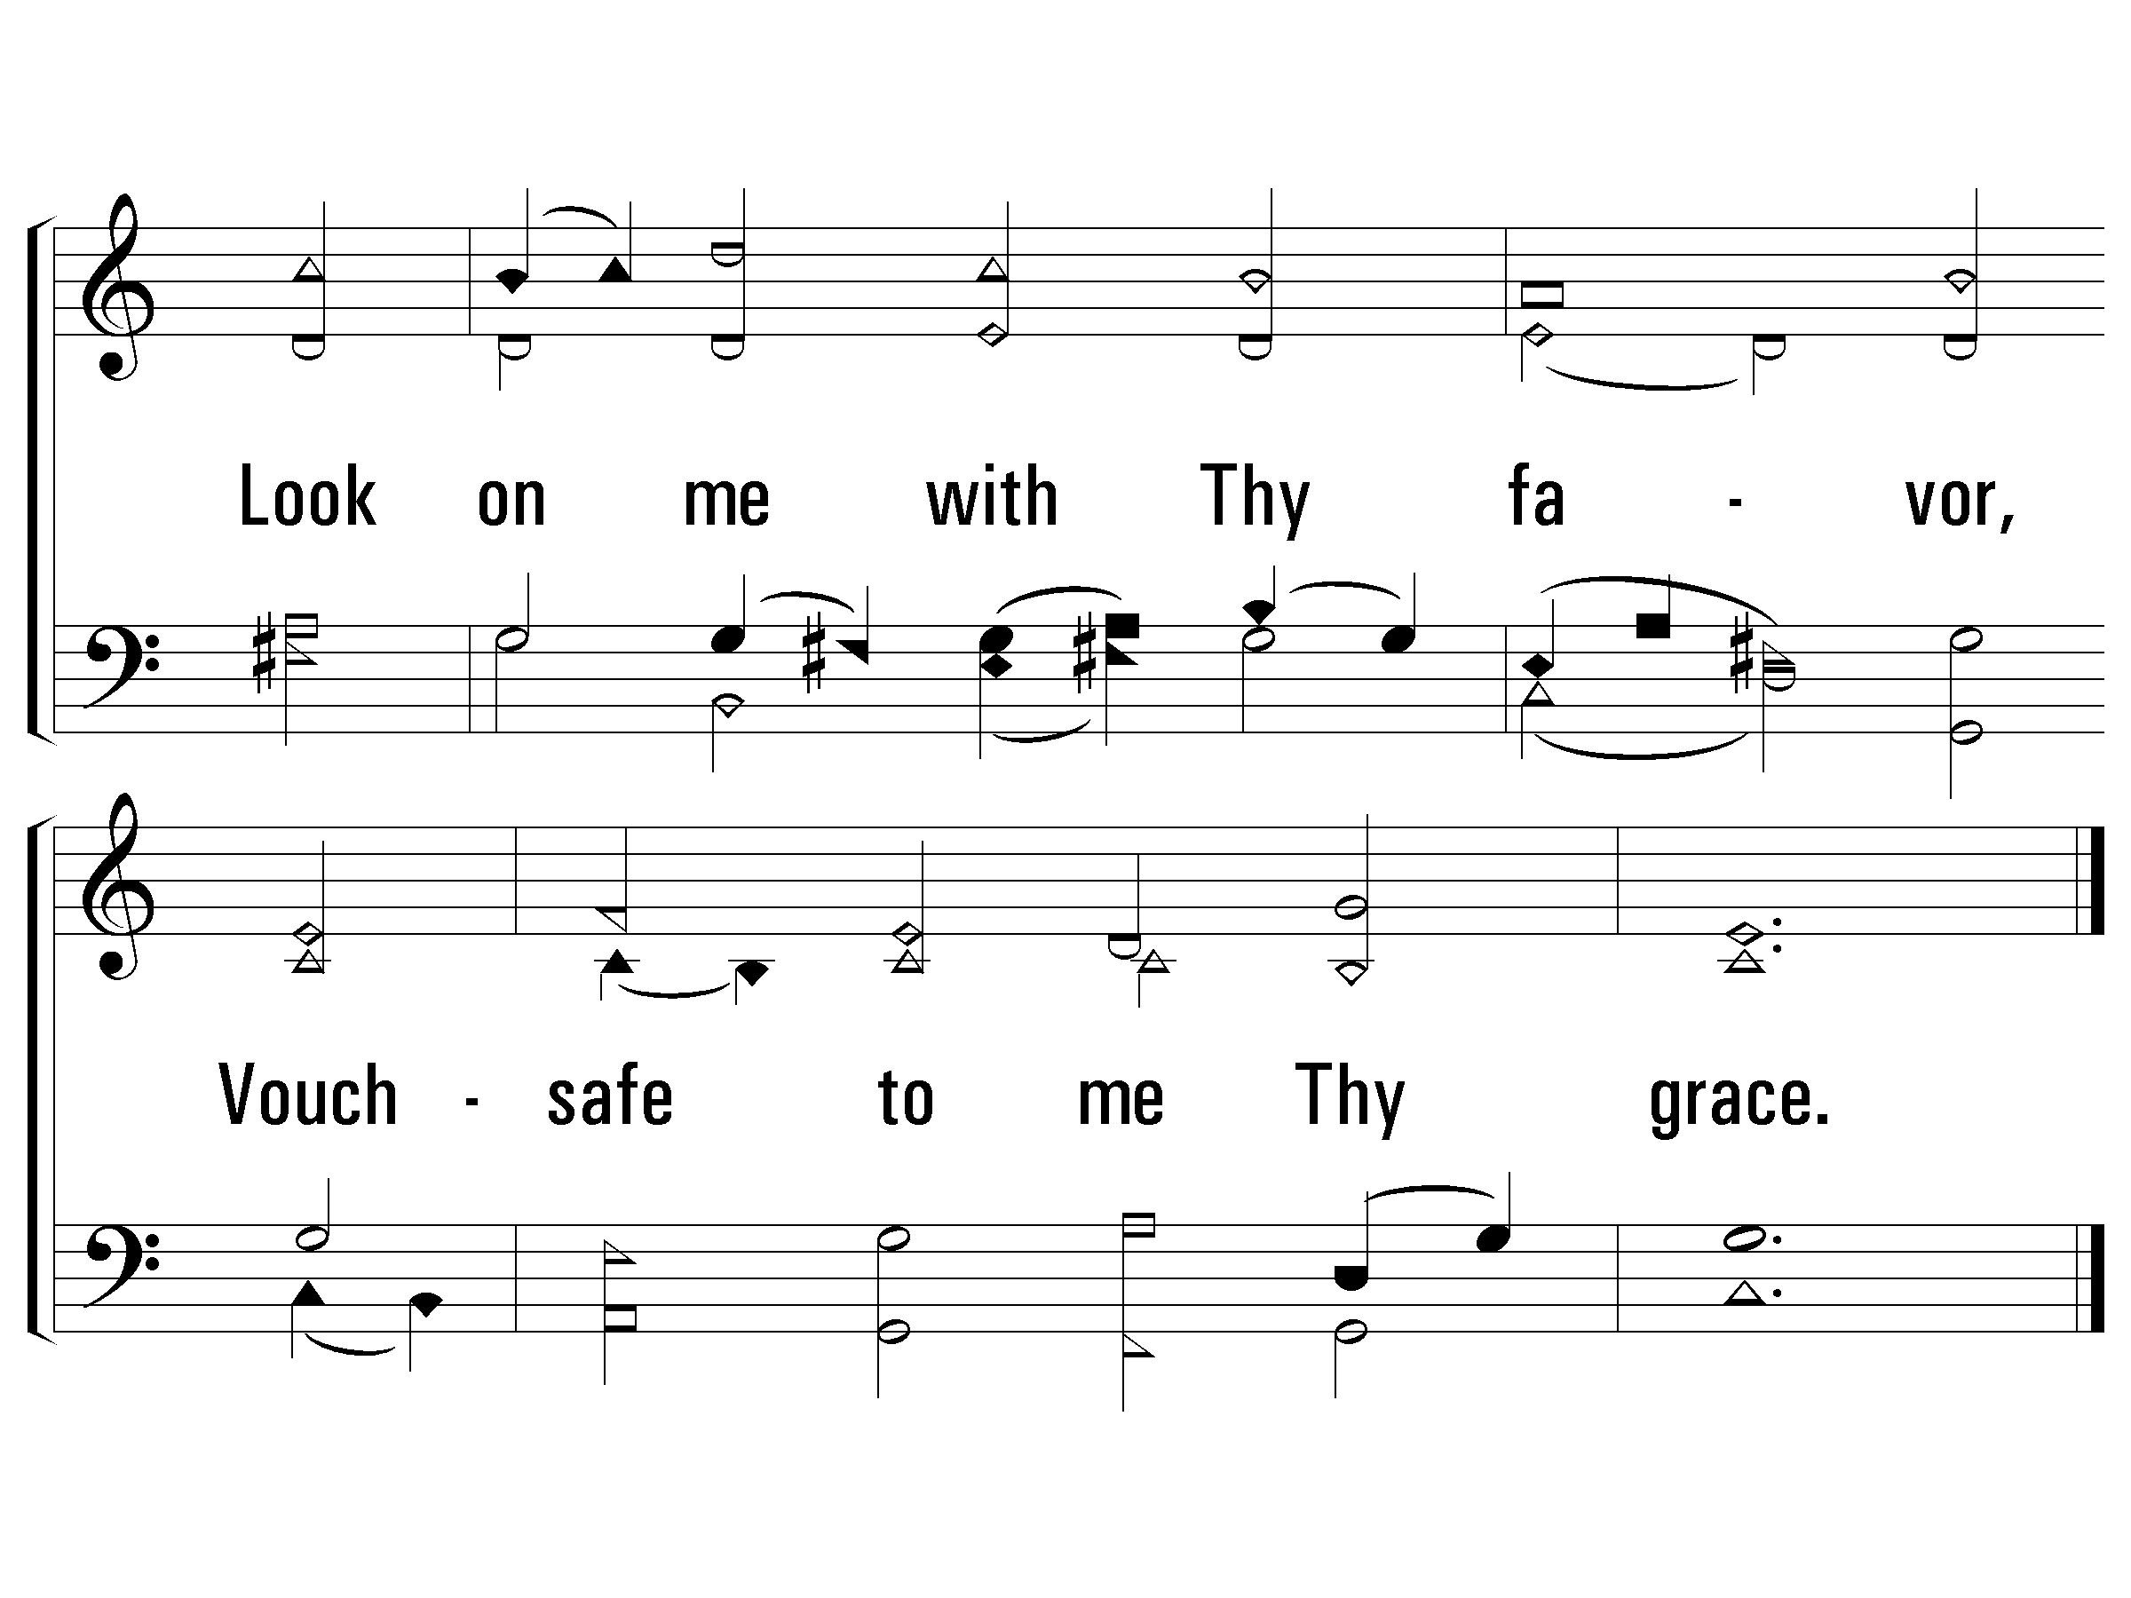
2 - O Sacred Head
484
© 2001 The Paperless Hymnal™

Slide 38
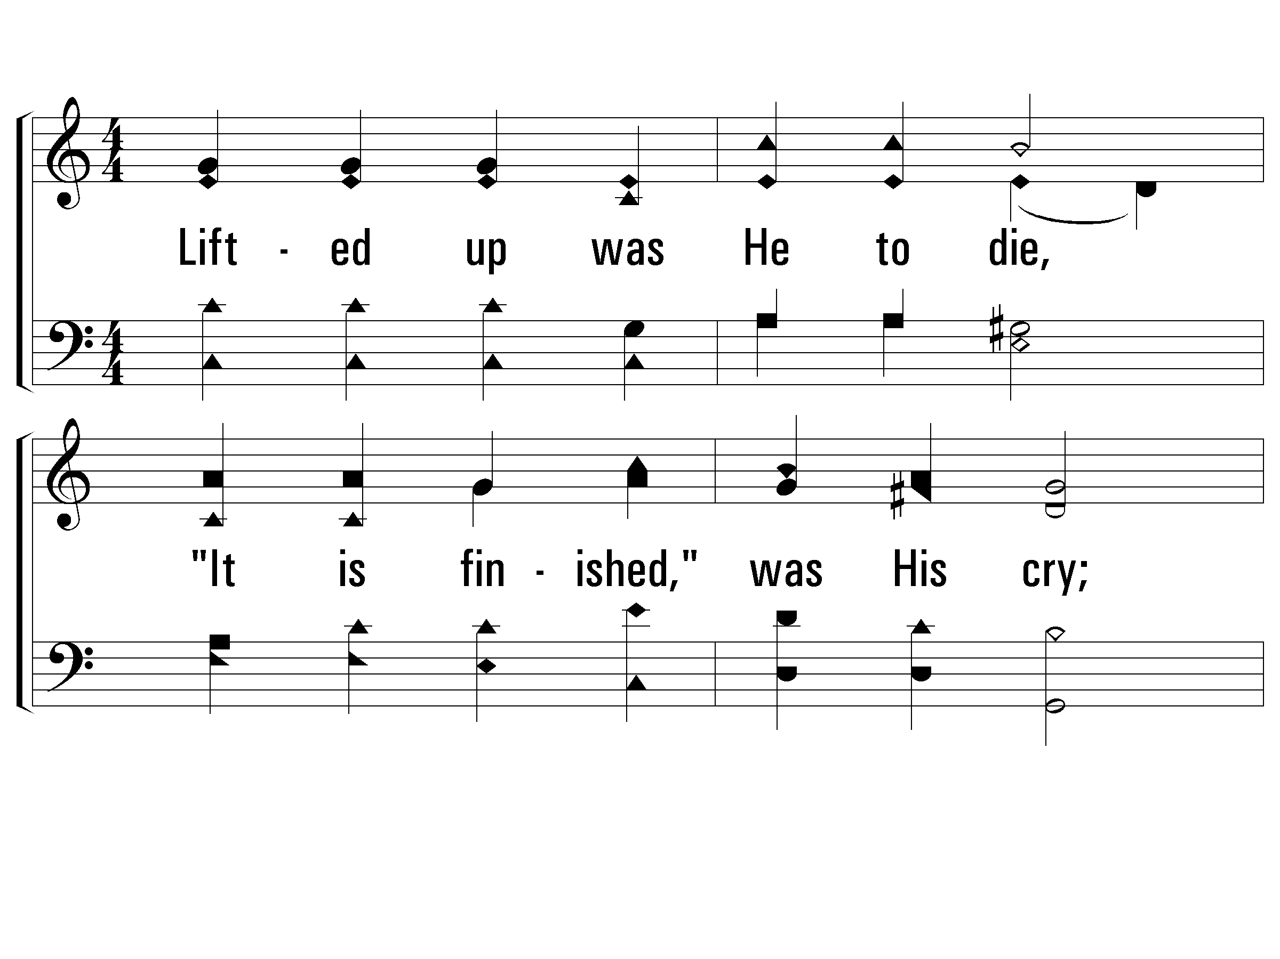
4 - Hallelujah! What a Savior
203
4.
Lifted up was He to die,
"It is finished," was His cry;
Now in heaven exalted high,
Hallelujah! What a Savior!
Words & Music: Philip P. Bliss
© 2001 The Paperless Hymnal™

Slide 39
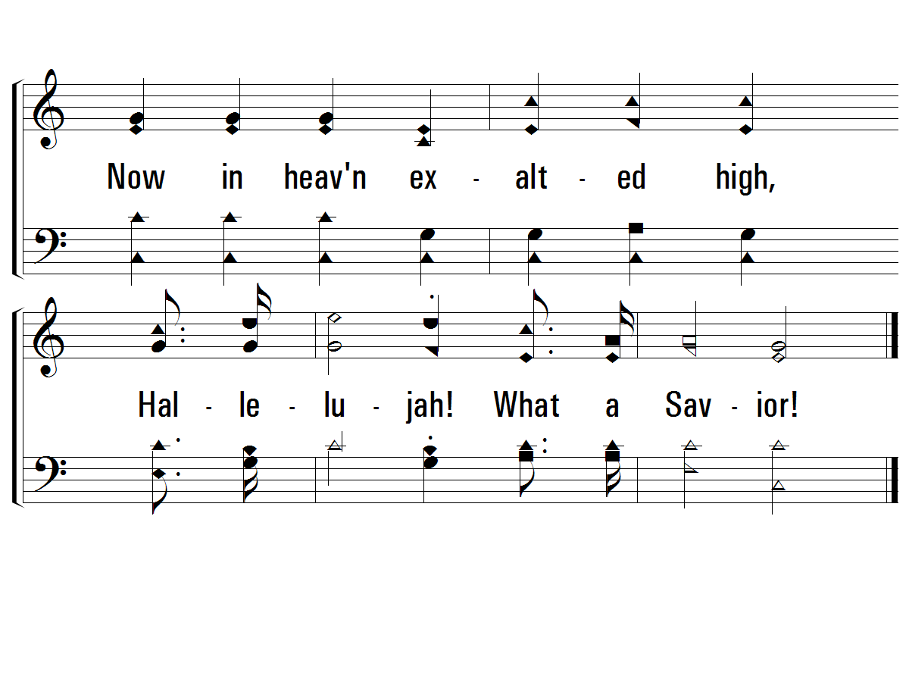
4 - Hallelujah! What a Savior
203
© 2001 The Paperless Hymnal™

Slide 40
5 - Hallelujah! What a Savior
203
5.
When He comes, our glorious King,
All His ransomed home to bring,
Then anew this song we'll sing,
Hallelujah! What a Savior!
Words & Music: Philip P. Bliss
© 2001 The Paperless Hymnal™

Slide 41
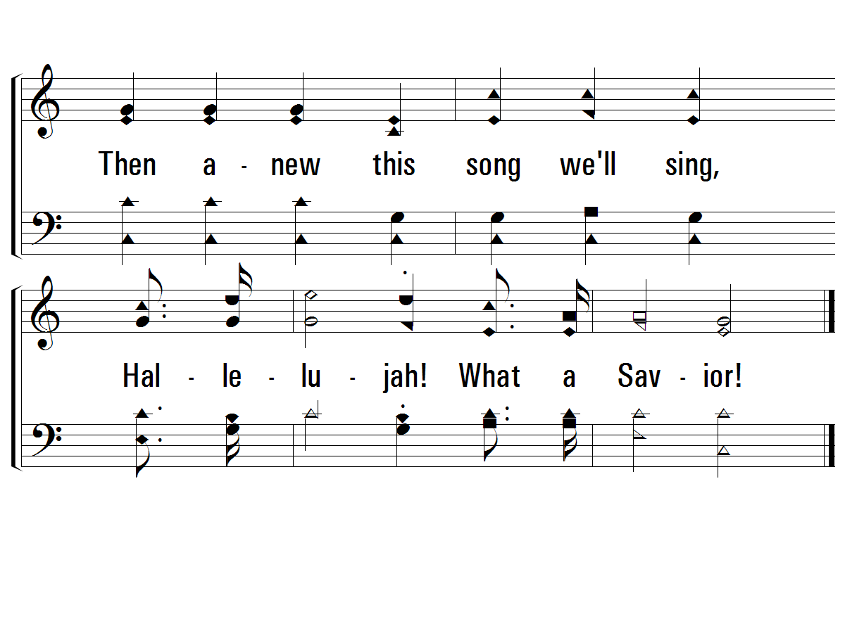
5 - Hallelujah! What a Savior
203
END
© 2001 The Paperless Hymnal™

Slide 42
Invitation // 33S – Servant Song

Slide 43
“Have this mind among yourselves, which is yours in Christ Jesus, who, though he was in the form of God, did not count equality with God a thing to be grasped, but emptied himself, by taking the form of a servant, being born in the likeness of men. And being found in human form, he humbled himself by becoming obedient to the point of death, even death on a cross.” (PHILIPPIANS 2:5-8, ESV)
“For He made Him who knew no sin to be sin for us, that we might become the righteousness of God in Him.” (2 CORINTHIANS 5:21, NKJV)
“For Christ also suffered once for sins, the just for the unjust, that He might bring us to God …” (1 PETER 3:18, NKJV)
“For to this you were called, because Christ also suffered for us, leaving us an example, that you should follow in His steps, ‘WHO COMMITTED NO SIN, NOR WAS DECEIT FOUND IN HIS MOUTH’; who, when He was reviled, did not revile in return; when He suffered, He did not threaten, but committed Himself to Him who judges righteously; who Himself bore our sins in His own body on the tree, that we, having died to sins, might live for righteousness – by whose stripes you were healed.” (1 PETER 2:21-24, NKJV)

Slide 44
“Or do you not know as many of us as were baptized into Christ Jesus were baptized into His death? Therefore we were buried with Him through baptism into death, that just as Christ was raised from the dead by the glory of the Father, even so we also should walk in newness of life.
For if we have been united together in the likeness of His death, certainly we also shall be in the likeness of His resurrection, knowing this, that our old man was crucified with Him, that the body of sin might be done away with, that we should no longer be slaves of sin. For he who has died has been freed from sin. Now if we died with Christ, we believe that we shall also live with Him, knowing that Christ, having been raised from the dead, dies no more. Death no longer has dominion over Him. For the death that He died, He died to sin once for all; but the life that He lives, He lives to God. Likewise you also, reckon yourselves to be dead indeed to sin, but alive to God in Christ Jesus our Lord.”
(ROMANS 6:3-11, NKJV)

Slide 45
“… And he said to them, ‘If anyone would be first, he must be last of all and servant of all.’” (MARK 9:35, NKJV)
“… But whoever would be great among you must be your servant, and whoever would be first among you must be slave of all. For even the Son of Man came not to be served but to serve, and to give his life as a ransom for many.” (MARK 10:43-45, NKJV)
“But he who is greatest among you shall be your servant. And whoever exalts himself will be humbled, and he who humbles himself will be exalted.” (MATTHEW 23:11-12, NKJV)
“For you, brethren, have been called to liberty; only do not use liberty as an opportunity for the flesh, but through love serve one another.” (GALATIANS 5:13, NKJV)
“Let this mind be in you which was also in Christ Jesus … taking the form of a bondservant…” (PHILLIPIANS 2:5,7, NKJV)
“I have been crucified with Christ; it is no longer I who live, but Christ lives in me; and the life which I now live in the flesh I live by faith in the Son of God, who loved me and gave Himself for me.” (GALATIANS 2:20, NKJV)

Slide 46
Invitation // 33S – Servant Song

Slide 47
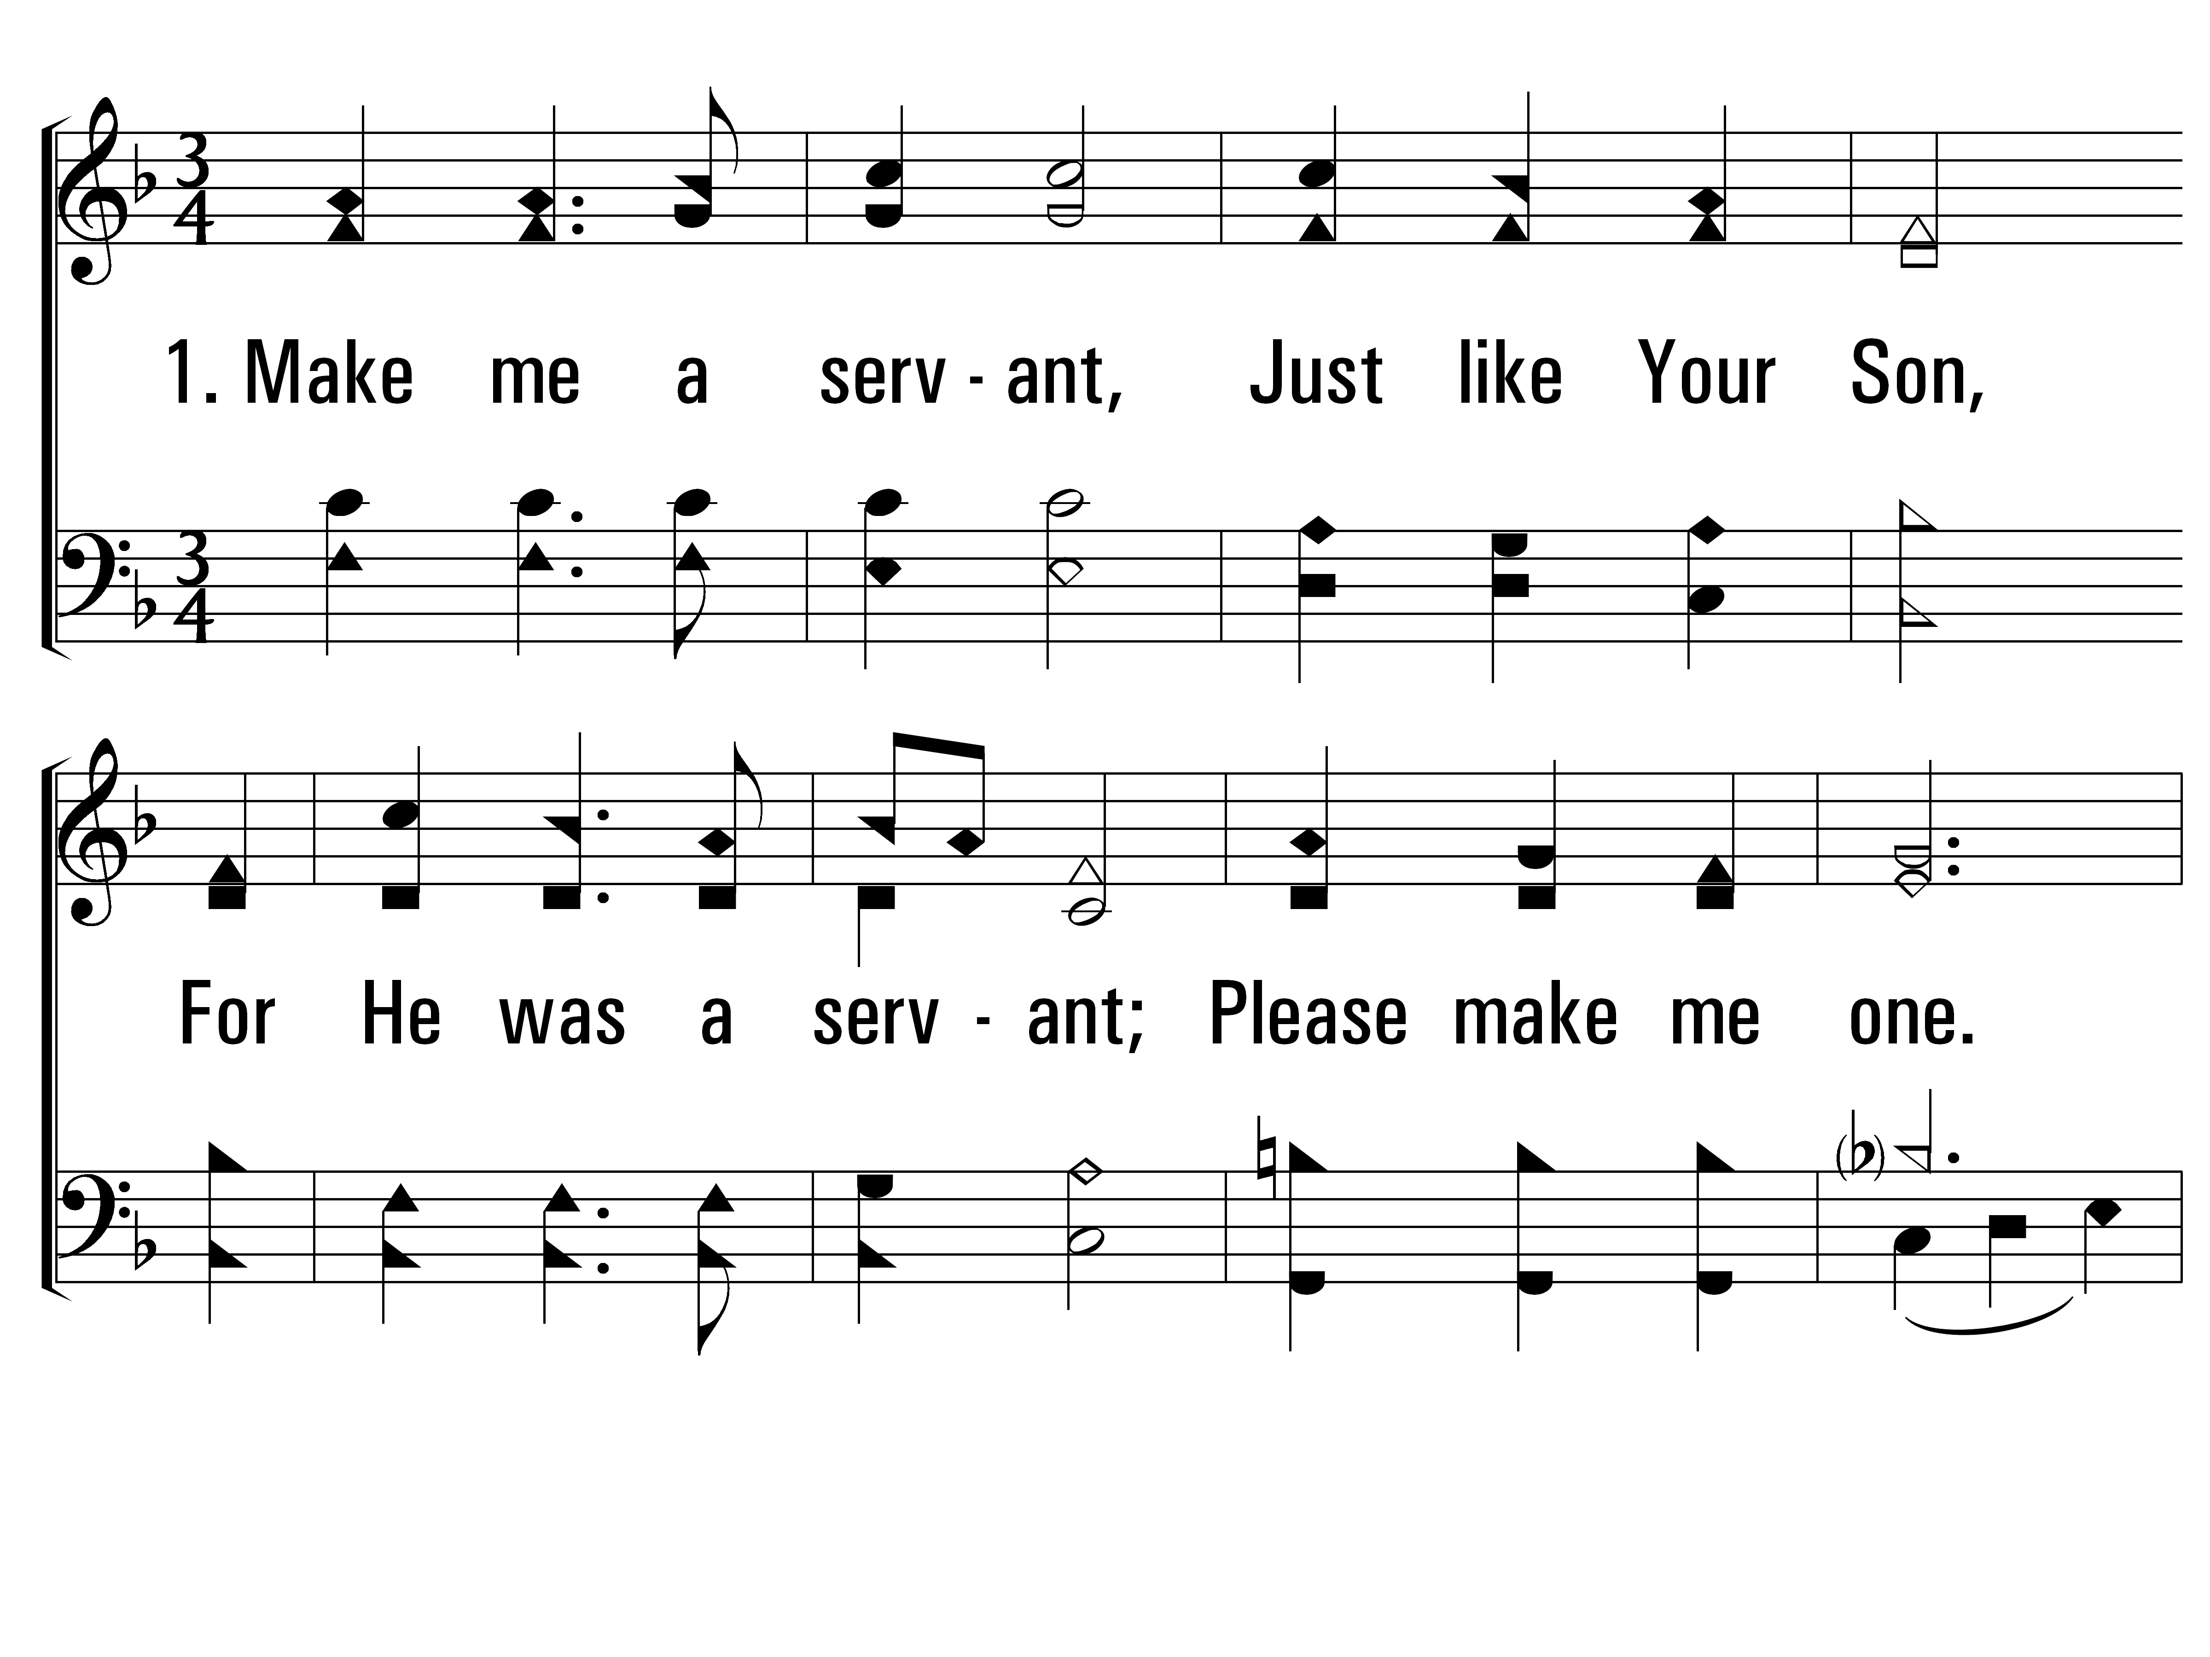
ServantSong_st1_a
Hymn: Jimmy Owens (1978); Carol Owens (1978); arr. Tim Jennings (2000); st. 2-3 M. W. Bassford (2000)
Tune: MAKE ME LIKE YOU • Jimmy Owens (1978); Carol Owens (1978); arr. Richard L. Morrison (2000)
© 1978 Communiqué Music, Inc.; st. 2-3 © 2000 Tim Jennings
Vs 1
© 2014 Sumphonia Productions, LLC

Slide 48
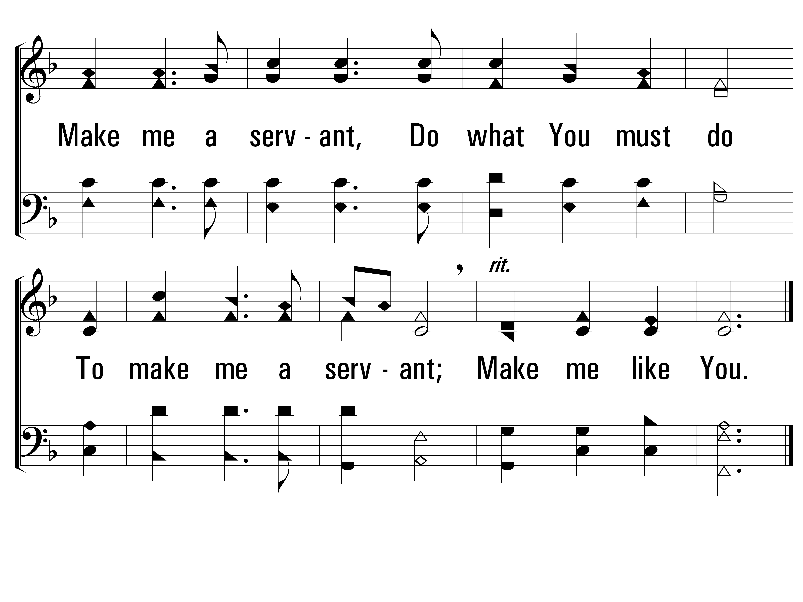
ServantSong_st1_b
Vs 1
© 2014 Sumphonia Productions, LLC

Slide 49
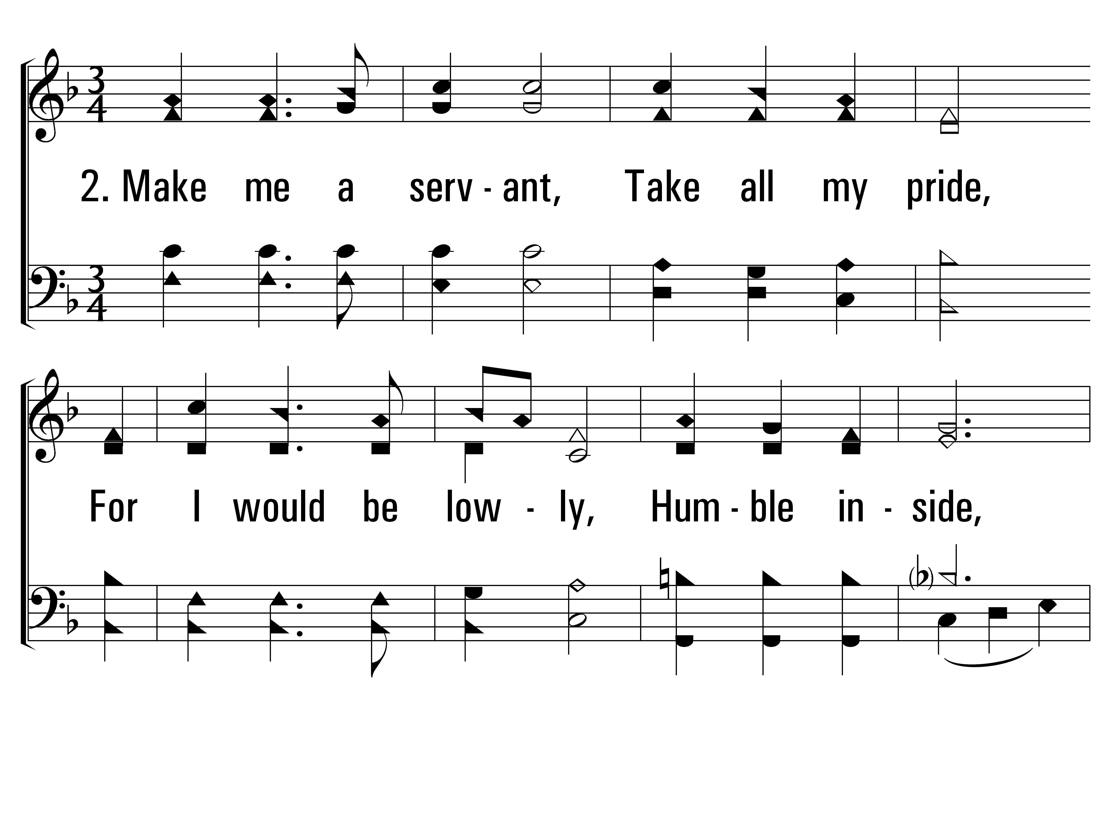
ServantSong_st2_a
Vs 2
© 2014 Sumphonia Productions, LLC

Slide 50
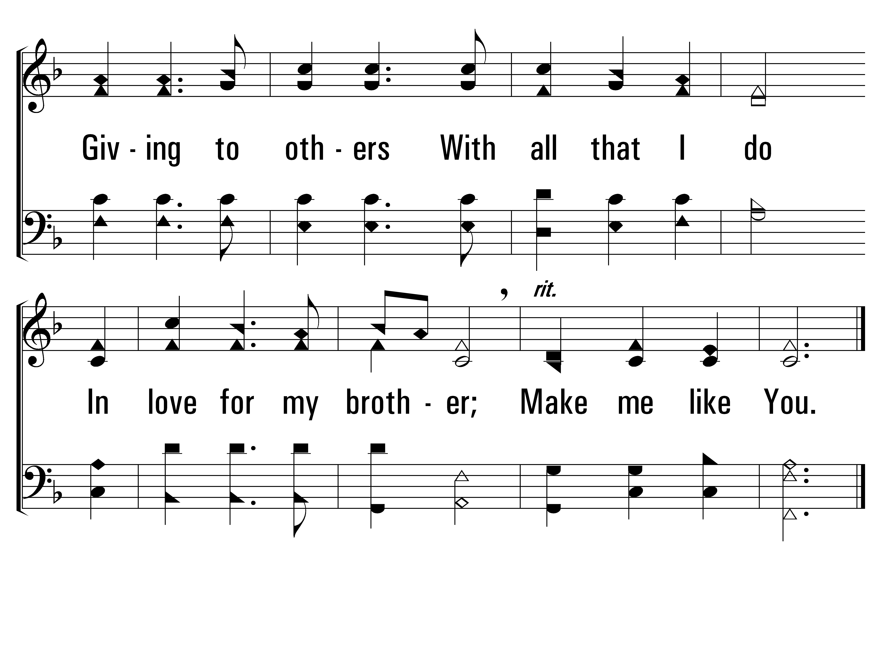
ServantSong_st2_b
Vs 2
© 2014 Sumphonia Productions, LLC

Slide 51
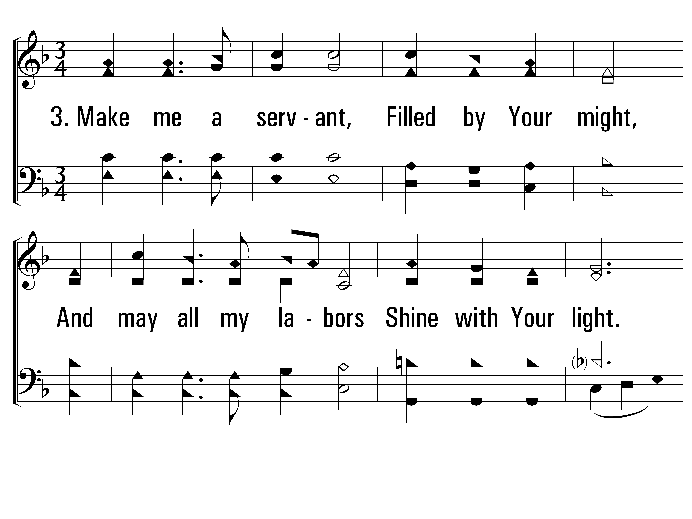
ServantSong_st3_a
Vs 3
© 2014 Sumphonia Productions, LLC

Slide 52
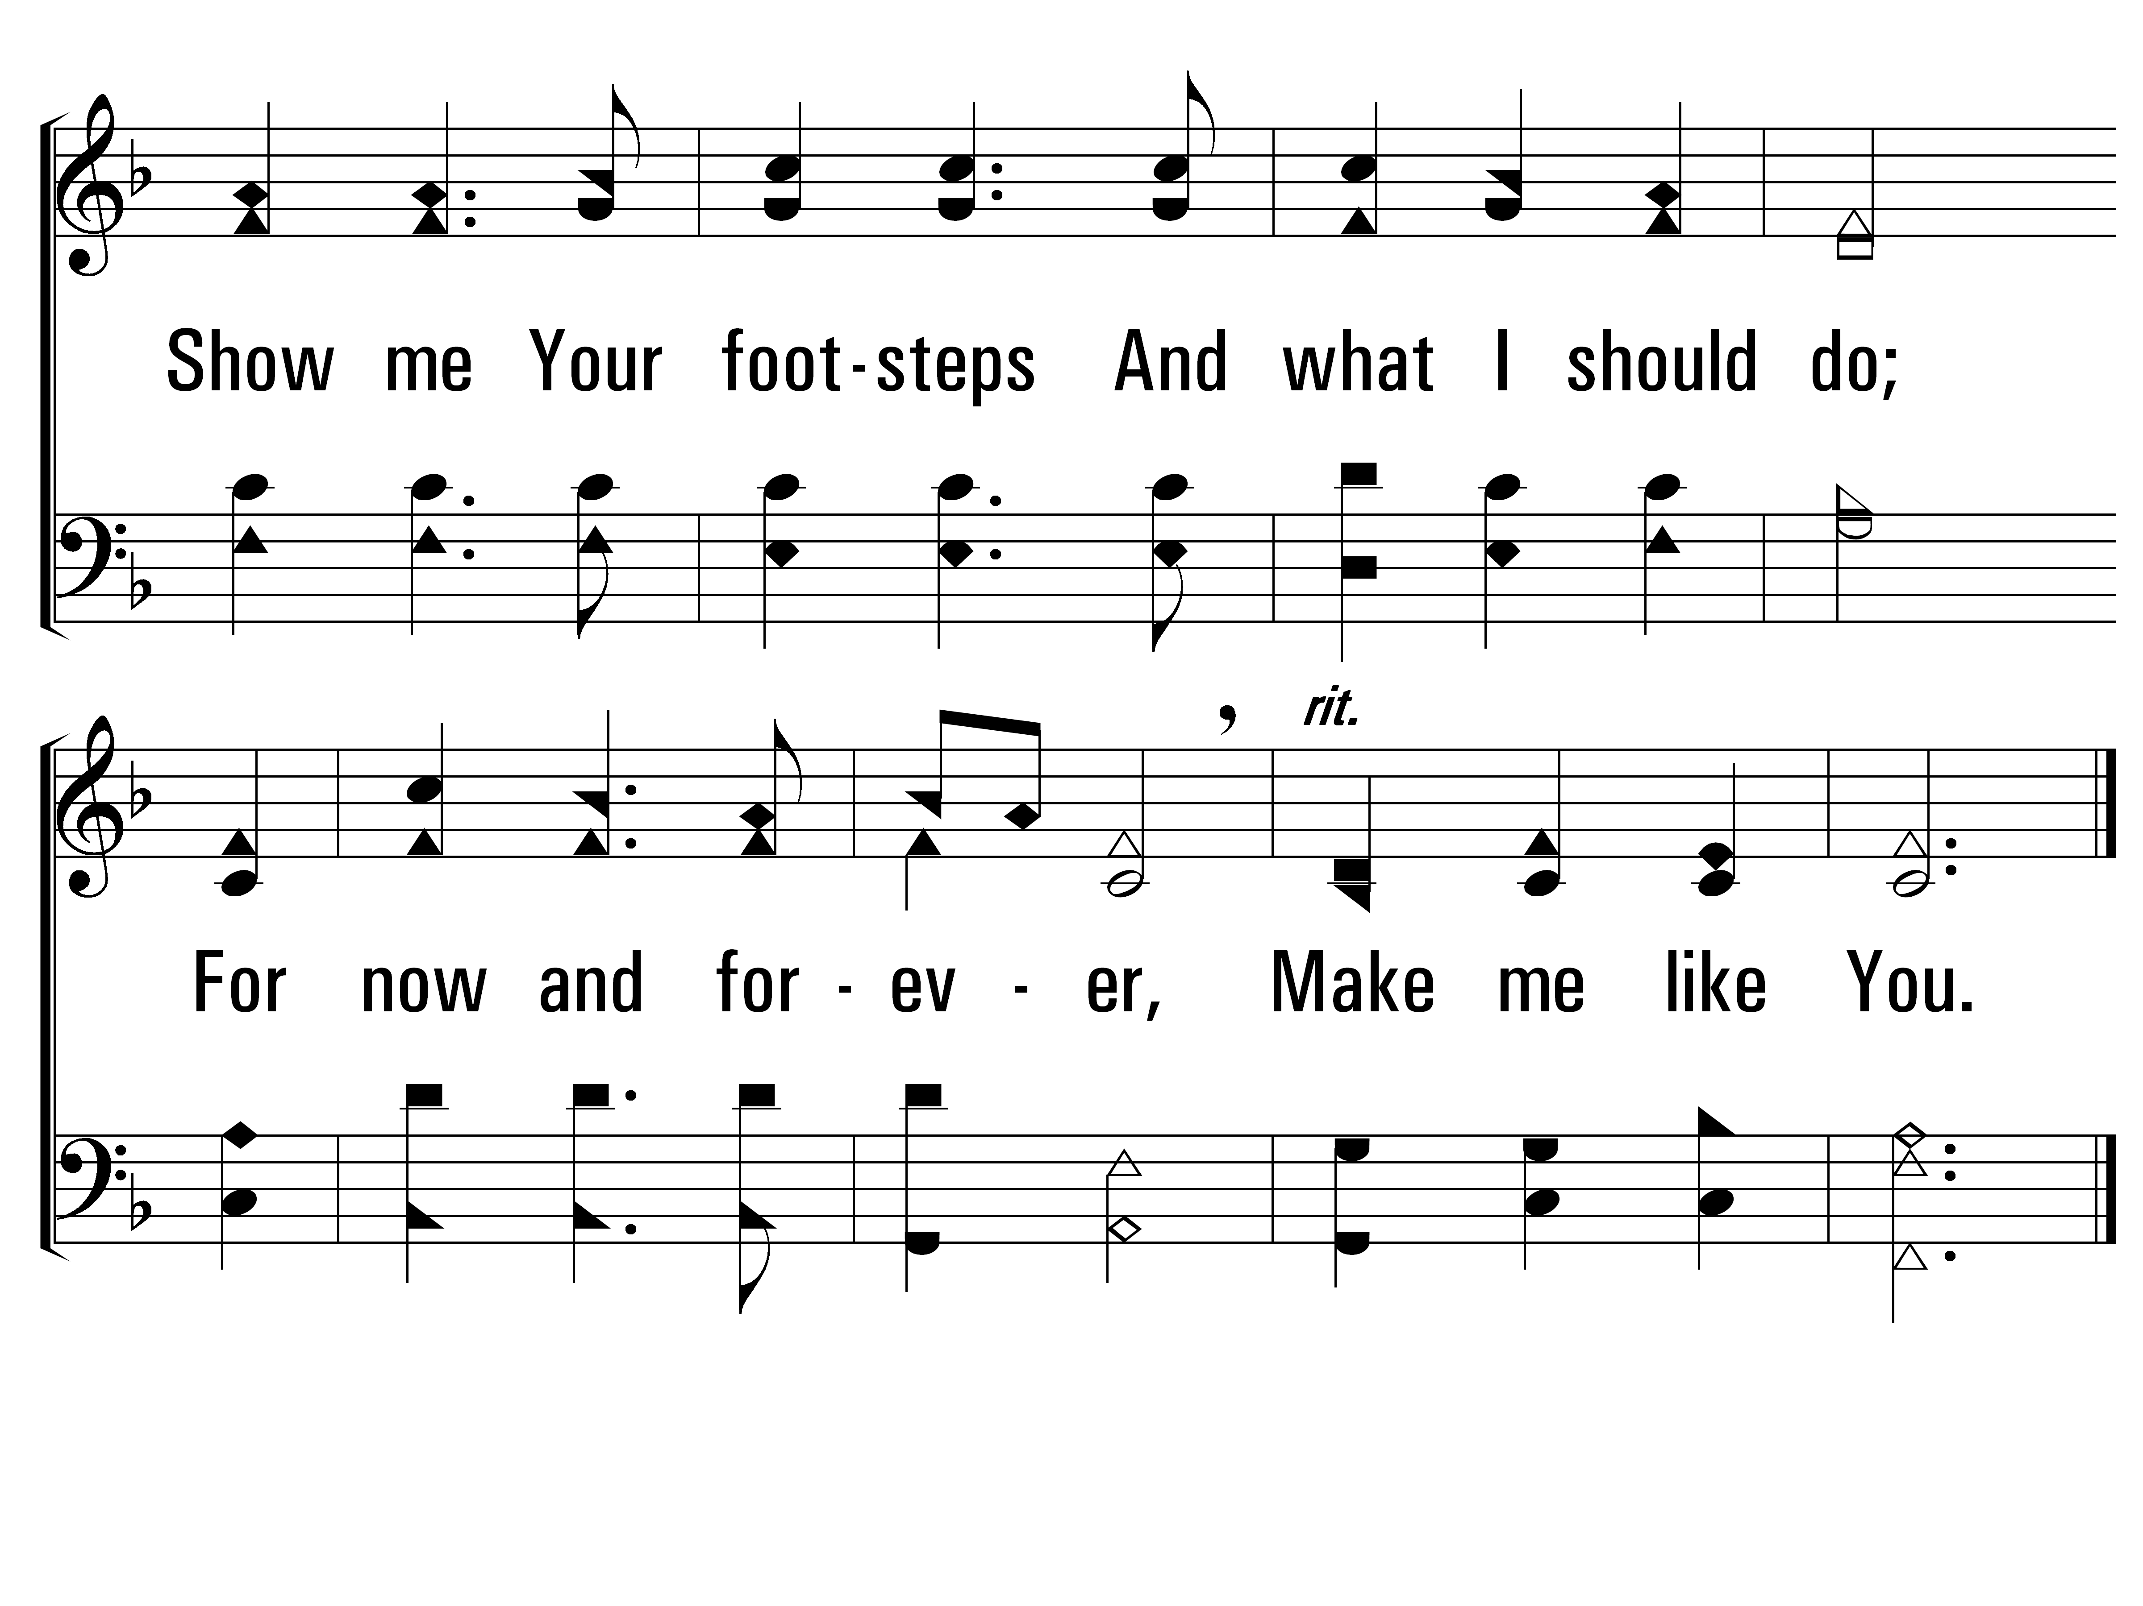
ServantSong_st3_b
END
Vs 3
© 2014 Sumphonia Productions, LLC

