Slide 1
CHILD TRAINING

Slide 2
Proverbs 22.6 ESV
“Train up a child in the way he should go,
Even when he is old, he will not depart from it”

Slide 3
Prov. 29:15 NET
A rod and reproof impart wisdom, but a child who is unrestrained brings shame to his mother.

Slide 4
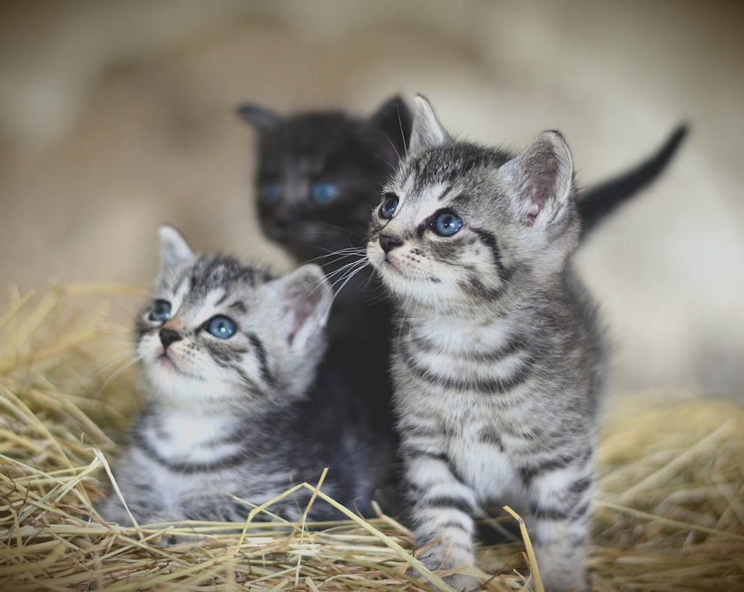
CHILD TRAINING & TIME
Cats are considered adults at one year old… At about four weeks, the mother will start to wean her kittens, and by the end of the fifth week of their lives, they are expected to eat solid food and be starting to find it on their own. (feral) catwiki.com/faqs/when-do-feral-cats-leave-their-kittens/
It takes the babies about 2 weeks to leave the nest …and then they usually stay with their parents for two or three weeks after that. Journey North American Robin
Dt. 6.7
Eph.6.4
Prov. 22.6

Slide 5
CHILD TRAINING & TIME
Cats are considered adults at one year old… At about four weeks, the mother will start to wean her kittens, and by the end of the fifth week of their lives, they are expected to eat solid food and be starting to find it on their own. (feral) catwiki.com/faqs/when-do-feral-cats-leave-their-kittens/
It takes the babies about 2 weeks to leave the nest …and then they usually stay with their parents for two or three weeks after that. Journey North American Robin
Dt. 6.7
Eph.6.4
Prov. 22.6

Slide 6
early child training

Slide 7
LESSON # 1: basic vocabulary:
No
No

Slide 8
EARLY TRAINING & “NO”
The importance of “no” [cf. Gen.2]
respect & compliance for the prohibitory “no”
if you don’t mean it, don’t say it, and if you do mean it, enforce it - Mt.5.37

Slide 9
VOCABULARY TEST:
What does “no” mean to my child?
Tantrum
time
No
The defense attorney may now cross examine
No
No
Don’t do it while Mom or Dad are watching
No
No

Slide 10
RESPECT
FOR AUTHORITY
I WON’T ALWAYS GET MY WAY
BEHAVIOR IS MORE IMPORANT THAN DESIRE
SELF DENIAL
/ SELF CONTROL
No
No

Slide 11
EARLY TRAINING & “NO”
important foundation: learning to submit to an earthly father prepares the child for submission to a far more important Father.

Slide 12
EARLY TRAINING & “NO”
respect & compliance for prohibitory “no”
zero tolerance for defiant & rebellious “no”

Slide 13
avoiding upside down homes

Slide 14
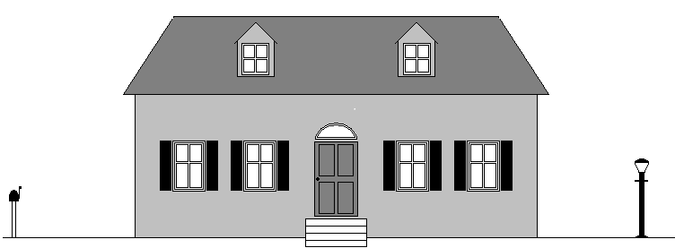
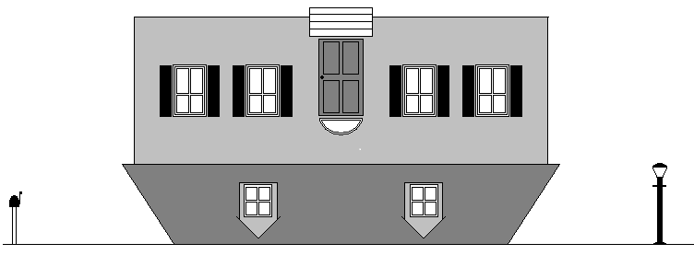

Slide 15
The child needs to understand:
CHILD
PARENTS
GOD
GOD
father
mother
child

Slide 16
a child untrained . . . (breakfast brat)
Prov. 29:15
The rod and reproof give wisdom,
but a child left to himself brings
shame to his mother.

Slide 17
Prov. 29:15 ESV
The rod and reproof give wisdom,
but a child left to himself brings
shame to his mother.

Slide 18
some common mistakes to avoid
parenting pitfalls

Slide 19
1. failing to discipline...
He who spares his rod hates his son, but he who loves him disciplines him diligently Prov.13.24
Discipline your son while there is hope, and do not desire his death Prov. 19.18
Foolishness is bound up in the heart of a child; the rod of discipline will drive it far from him Prov. 22.15

Slide 20
1. failing to discipline...
Do not hold back discipline from the child, Although you strike him with the rod, he will not die Prov. 23.13
The rod and reproof bring wisdom, but a child who gets his own way brings shame to his mother Prov. 29.15
Correct your son, and he will give you comfort; he will also delight your soul Prov. 29.17
(illustration / 4 yr. old)

Slide 21
2. Rewarding misbehavior
Why do children throw tantrums?
the difference between a boy and a pig
“The rod and reproof bring wisdom, but a child who gets his own way brings shame to his mother” Prov. 29.15

Slide 22
3. Expecting misbehavior
Not talking about wanting misbehavior, hoping for, or preferring misbehavior…
but expecting misbehavior
“Oh, we can’t take him to the restaurant”
“There’s no way Jr’s going to sit still for an hour”
“Well after that sugar, he’s going to be impossible”
“Oh, I’ll never get him to eat that”
“Sorry, my son’s not much of a sharer”
“Foolishness is bound up in the heart of a child; the rod of discipline will drive it far from him” Pr.22.15

Slide 23
If you expect tantrums, you will get them. If you expect dishonesty, you will get it. If you expect bad attitudes, you will get it. but if you really EXPECT the opposite, and require and TRAIN for the opposite, you will GET the opposite.
as a general rule: you get what you expect

Slide 24
4. failing to be consistent...
“he who loves him disciplines him diligently” Pr.13.24
“No Parking” illustration (next slide)

Slide 25
Imagine treating “No Parking” violations like this?
10 minutes:
Please do not park here
20 minutes:
We asked you not to park here
30minutes:
I really mean it, do not park here
40 minutes:
Don’t make me tell you again
50 minutes:
I’m going to start counting to 10
60 minutes:
OK, now you’re in trouble !
$ TICKET
What would those no parking areas be filled with?

Slide 26
5. Thinking “I don’t have time…”
Like saying “I don’t have time to get rid of lice”
“All discipline for the moment seems not joyful, but sorrowful, yet … afterwards it yields the peaceful fruit…” Heb.12.11

Slide 27
6. failing to control self...
proper motivation: Prov.13.24 “he who loves him disciplines him diligently”
discipline vs. abuse
discipline vs. YELLING!!
“expert” advice [?]
Why won’t he obey??? [
“What’s wrong with you?” “I don’t know why you won’t do right!”
the vase test (see next slide)

Slide 28
THE VASE TEST set up: a.) Jr. bounces a ball off the wall b.) Mom says: “Jr., don’t throw that ball in the house” c.) Jr. looks at mom, heard her; throws the ball again anyway.
scenario A:
nothing broken
scenario B:
antique vase is shattered
Reaction:
No big deal.
Mom says,
“Jr., I asked you not to do that.”
Reaction:
Seeing her son’s willful defiance & disobedience, Mom takes this very serious and he is punished.
WHY?
Reaction:
No big deal. Mom says, “Jr., I asked you not to do that” ?
Reaction:
Jr’s in BIG trouble!! NOW he’s going to get it! This is VERY serious.
WHY?

Slide 29
7. Training them to disrespect instructions given calmly
The parents’ choice:
they never obey
they obey after you scream
Or only after saying it over & over & over
Or the 1st time, and to calm instructions (w/o yelling, nagging, badgering, etc.)

Slide 30
8. fathers “discouraging,” “provoking to wrath”
“Fathers, provoke not your children, that they be not discouraged” -Col. 3.21
“fathers, provoke not your children to wrath: but nurture them in the chastening and admonition of the Lord” -Eph.6.4
criticism … or nothing
expecting talents beyond their capacity
fluctuating boundaries based on your mood

Slide 31
9. failing to parent with joy
rejoice in the wife of your youth. Prov. 5.18
The father of the righteous will greatly rejoice; And he ...will have joy of him. Let your father and your mother be glad, And let her rejoice who gave birth to you. Prov. 23.24-25
A joyful heart makes a cheerful face, But when the heart is sad, the spirit is broken... a cheerful heart has a continual feast… Better is a dish of vegetables where love is Than a fattened ox served with hatred. Prov. 15.13-17nasb
the law of kindness is on her tongue. Prov.31.26
A joyful heart is good medicine, but a crushed spirit dries up the bones. Prov. 17.22esv
Ga.5.22 Love, Joy, Peace…

Slide 32
10. failing to use rod AND reproof
Just rod? [learns… what?]
Just reproof? [kid at walmart]
value in “the lecture”
conscience
anticipation
“The rod and reproof bring wisdom, but a child who gets his own way brings shame to his mother” Prov. 29.15

Slide 33
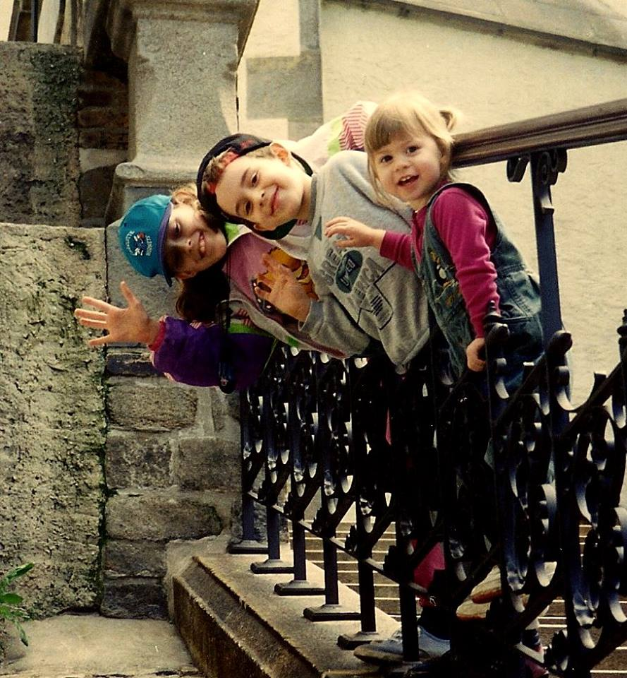
11. Settling for situation control instead of training the child.
twinkie brat - Michael & Debbie Pearl / To Train up a Child
BRIANNE & THE CAR SEAT ILLUSTRATION
A mom’s comment on this point: “live altering experience” in 2 or 3 days: improved behavior / happier child
MERE CONTROL vs. TRAINING (& what results?) “They’re not going to do that under my roof” is not enough. Train them. Teach them self-control so they will behave themselves under any roof.
“TRAIN up a child in the way he should go, even when he is old he will not depart from it” Pr.22.6 (not just “control”)
TRAIN THEIR HEARTS
a little boy, made to sit down, had this to say: “I’m still standing up on the inside!” … then job’s not done!

Slide 34
12. Mistaking “taking them to church” for “bringing them up in the nurture and admonition of the Lord”
Eph. 6.4
Deut. 6.7
“You shall teach them diligently to your sons and shall talk of them when you sit in your house and when you walk by the way and when you lie down and when you rise up”

Slide 35
14. assuming cultural norms : “terrible 2’s” > “rebellious teens”
culturally common: >rebellious teens
also common: >ungodly adults
Josiah 2 Chron. 34.1-3
Timothy Acts 16:1-3 / cf. 1Tim.4.12
Note: wise parenting & the consideration of “trajectory” [cf: Jonadab in Jer.35 / Lot in Gn.13]
Expect Train Guide Eccl.12.1

Slide 36
16. Failing to train humility
Proverbs 6 (first abomination)
being aware of a culture that celebrates youth and lacks respect for its elders
The fool test (prov.)

Slide 37
17. Focusing on home income ($) over home outcome (the children)
“Better is a little with the fear of the Lord than great treasure and turmoil with it. Better is a dish of vegetables where love is than a fattened ox served with hatred” Prv. 15.17
the home, not the house / the family, not the stuff
Do our homes reflect scriptural priorities? Or cultural priorities? older women: “train the young women to love their husbands, to love their children, to be sober minded, chaste, workers at home, kind, being in subjection to their own husbands” Titus 2:3-5

Slide 38
1Tim. 6:6-10

