Slide 2
“Is it right to pay the imperial tax
to Caesar or not?”
“Judas, the Galilean, appeared in the days of the census and led a band of people in revolt. He too was killed, and all his followers were scattered.’” Acts 5:37
BETWEEN LEFT & RIGHT
“Give back to Caesar what is Caesar’s, and to God what is God’s.”

Slide 4
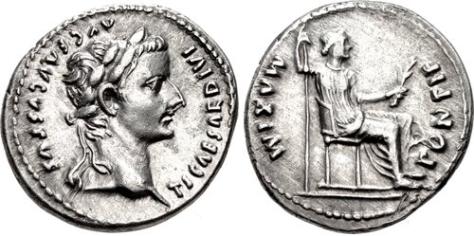
ESSENTIAL TRUTH
Bearing the Image of God
“Jesus said to him, ‘“You shall love the Lord your God with all your heart, with all your soul, and with all your mind.” This is the first and great commandment.’” Matthew 22:37, 38
“So God created man in His own image; in the image of God He created him...” Genesis 1:27
“For you were bought at a price; therefore glorify God in your body and in your spirit, which are God’s.” 1 Corinthians 6:20
Caesar Augustus, Son of the Divine

Slide 5
CRITICAL COMPARISON
If the gospel of Jesus isn’t at the center of your heart, then your heart isn’t centered on Jesus.
The King & His Kingdom
“And in the days of these kings the God of heaven will set up a kingdom which shall never be destroyed; and the kingdom shall not be left to other people; it shall break in pieces and consume all these kingdoms, and it shall stand forever.” Daniel 2:44
“The kingdom of God will always supersede the politics of man.”
“Which kingdom is more valuable?
The kingdom that owns the coins or the Kingdom that owns the world?”
“But seek first the kingdom of God and His righteousness...” Matthew 6:33
“But seek first the kingdom of God and His righteousness...” Matthew 6:33

Slide 6
FINAL THOUGHT
When elections are over, God will still be in control.
There are Christians of all political persuasions.
Prayer for whoever is elected is not optional.
Let’s Remember…
Patriotism is not spirituality.
Be careful trying to register Jesus for your political party.
“For God is the King of all the earth, sing to him a psalm of praise. God reigns over the nations; God is seated on his holy throne. The nobles of the nations assemble as the people of the God of Abraham. For the kings of the earth belong to God; he is greatly exalted.” Psalm 47:7-9
“Therefore I exhort first of all that supplications, prayers, intercessions, and giving of thanks be made for all men, for kings and all who are in authority, that we may lead a quiet and peaceable life in all godliness and reverence. For this is good and acceptable in the sight of God our Savior.” 1 Timothy 2:1-3
“If then you were raised with Christ, seek those things which are above, where Christ is, sitting at the right hand of God. Set your mind on things above, not on things on the earth.” Colossians 3:1, 2
“For you are all sons of God through faith in Christ Jesus. For as many of you as were baptized into Christ have put on Christ. There is neither Jew nor Greek, there is neither slave nor free, there is neither male nor female; for you are all one in Christ Jesus.” Galatians 3:26-28

Slide 7
“After these things I looked, and behold, a great multitude which no one could number, of all nations, tribes, peoples, and tongues, standing before the throne and before the Lamb, clothed with white robes, with palm branches in their hands, and crying out with a loud voice, saying, ‘Salvation belongs to our God who sits on the throne, and to the Lamb!’… These are the ones who come out of the great tribulation, and washed their robes and made them white in the blood of the Lamb.” Revelation 7:9, 10, & 14

Slide 8
BETWEEN LEFT & RIGHT

