Slide 4
DANGER

Slide 5
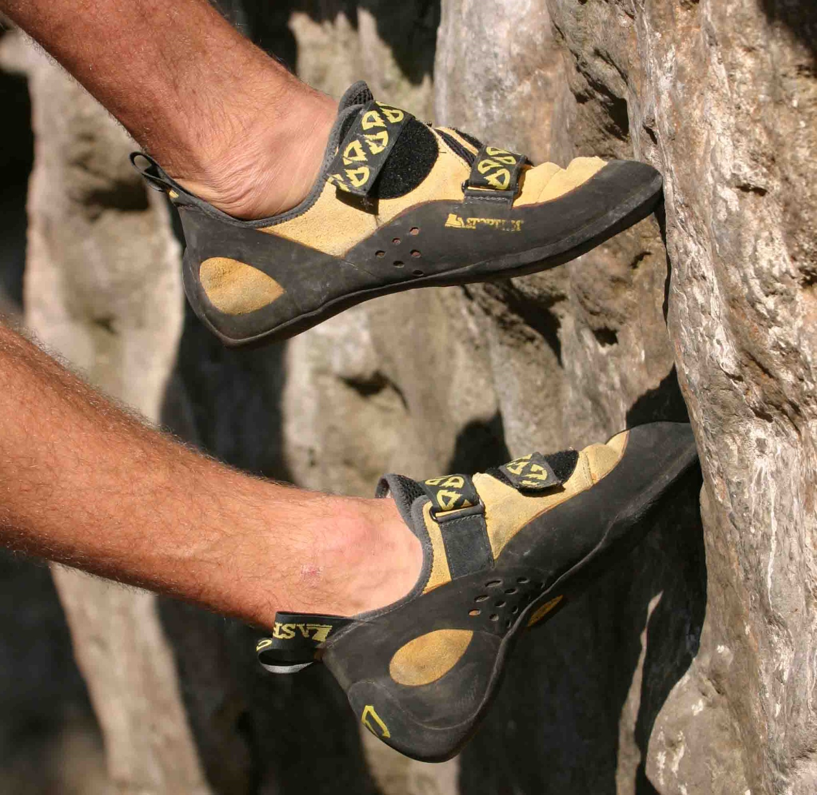

Slide 6
DANGER
SEASON
MANAGE
Count The Cost
Lower The Volume
Love The Enemy

