Slide 2
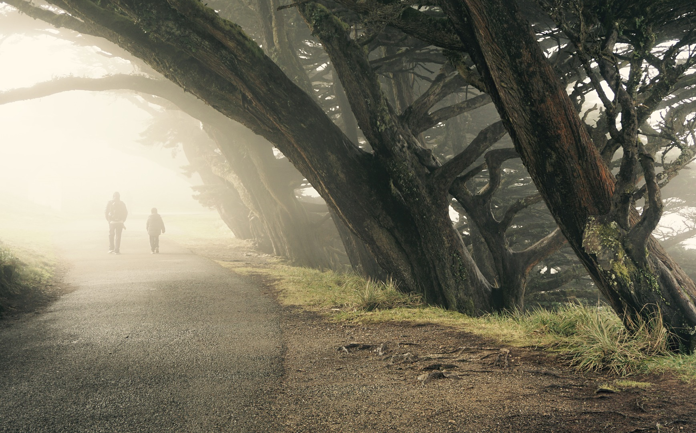

Slide 3
You are not alone.
It’s not your fault.
Never give up.
Continue.

