Slide 3
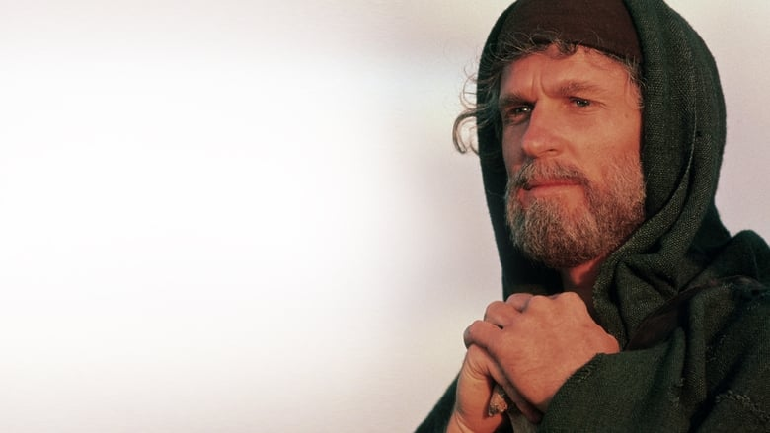

Slide 4
“Two nations are in your womb, and two peoples from within you shall be divided; the one shall be stronger than the other, the older shall serve the younger.” Genesis 25:23

Slide 5
Jacob – “cheater, deceiver”
He “trades” the birthright from Esau
He steals the blessing from Esau
Runs away from his family
He sees heaven’s blessings at Bethel
He is deceived at his own marriage
He seeks a deal to marry Rachel/Leah
He is cheated by his father-in-law
He runs away from his in-laws
9. He fears retribution from Esau

Slide 6
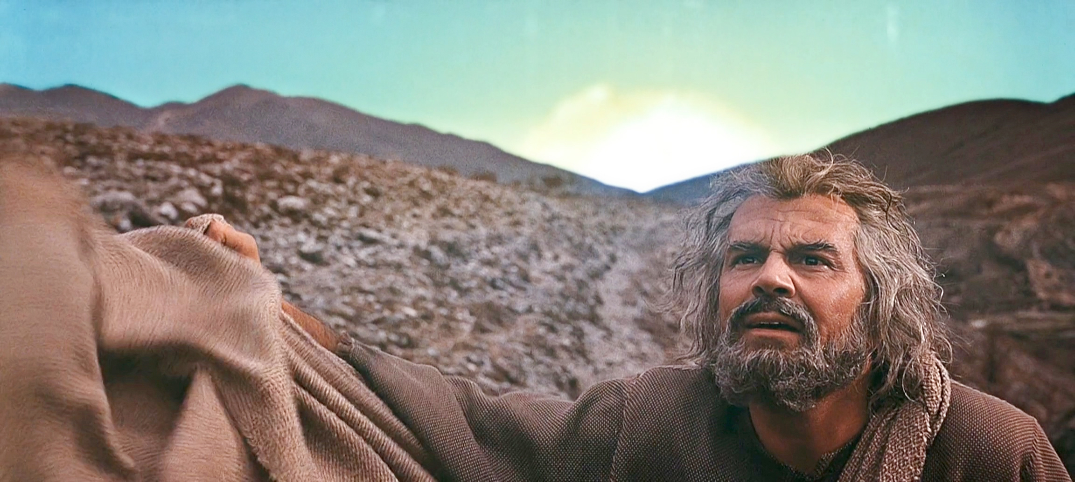
Jacob wrestles with the Lord – Genesis 32

Slide 7
Israel means “wrestles with God” or “God wrestles for”

Slide 8
Israel means “wrestles with God” or “God wrestles for”
He loses the contest
He begs for a blessing
He accepts a name change
He prevails?

Slide 9
Take Home
Be content with God’s plan
Children imitate their parents

Slide 10
10. He literally wrestles with God
11. He “reconciles” with Esau
12. His sons slaughter the Hivites
13. His wife, Rachel, dies in childbirth
14. He removes all idols from the camp
15. His sons betray him (Joseph’s “death”)
16. He moves his family to Egypt
17. He passes the blessings to Ephraim
18. He dies seeking a homeland

Slide 11
Take Home
Be content with God’s plan
Children imitate their parents
God’s grace is unfathomable
God wrestles for us

Slide 12
“By faith Jacob, when he was dying, blessed each of Joseph’s sons, and worshiped as he leaned on the top of his staff”
Hebrews 11:21

