Slide 2


Slide 3
“I have found in David the son of Jesse a man after my heart, who will do all my will.”
(Acts 13:22, ESV)

Slide 4
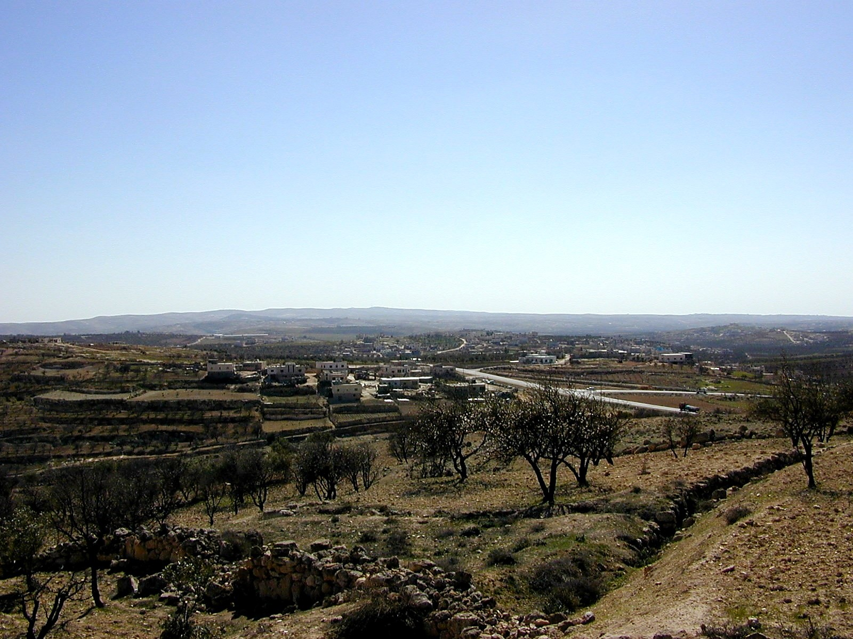
Bibleplaces.com

Slide 5

A Heart That Accepts Instruction
1 Samuel 25
Consistency is often an issue
God’s will is what matters
Be humble enough to accept
instruction from anyone
God’s blessings come to those
who accept His instruction

