Slide 1
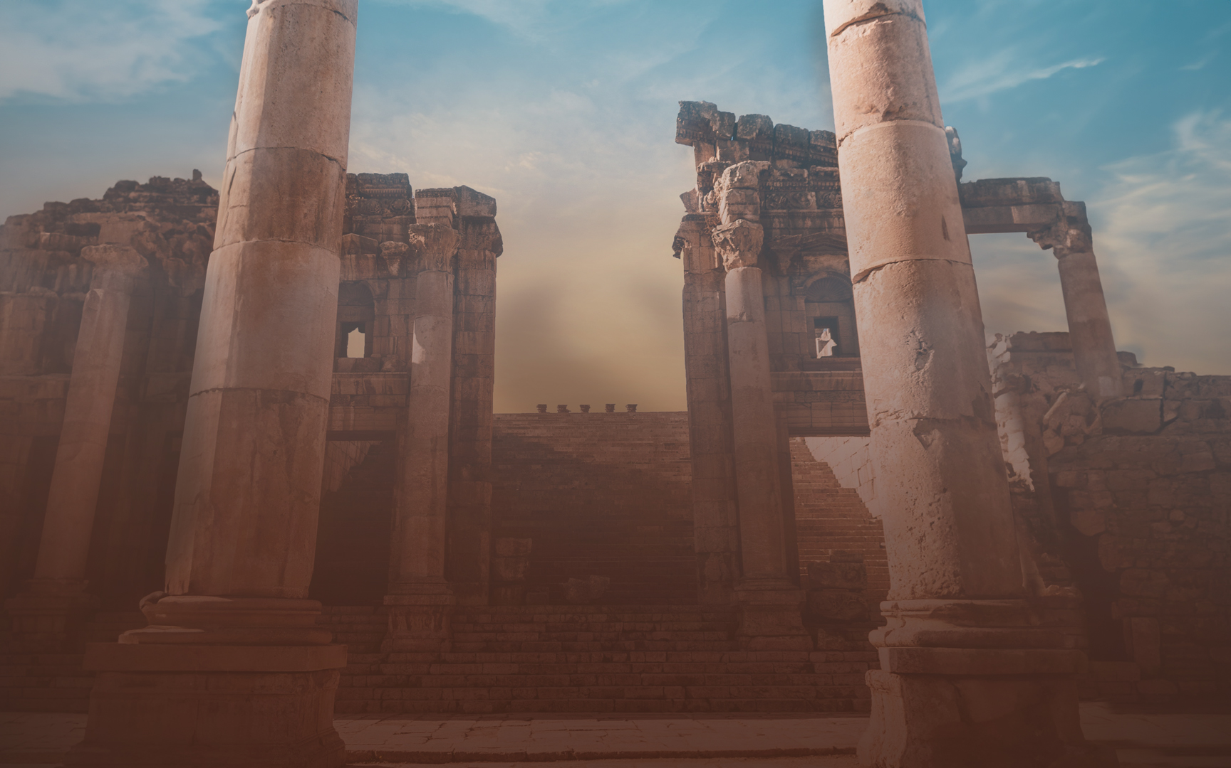
Notes:
Tonight we are continuing with our theme lessons….

Slide 2
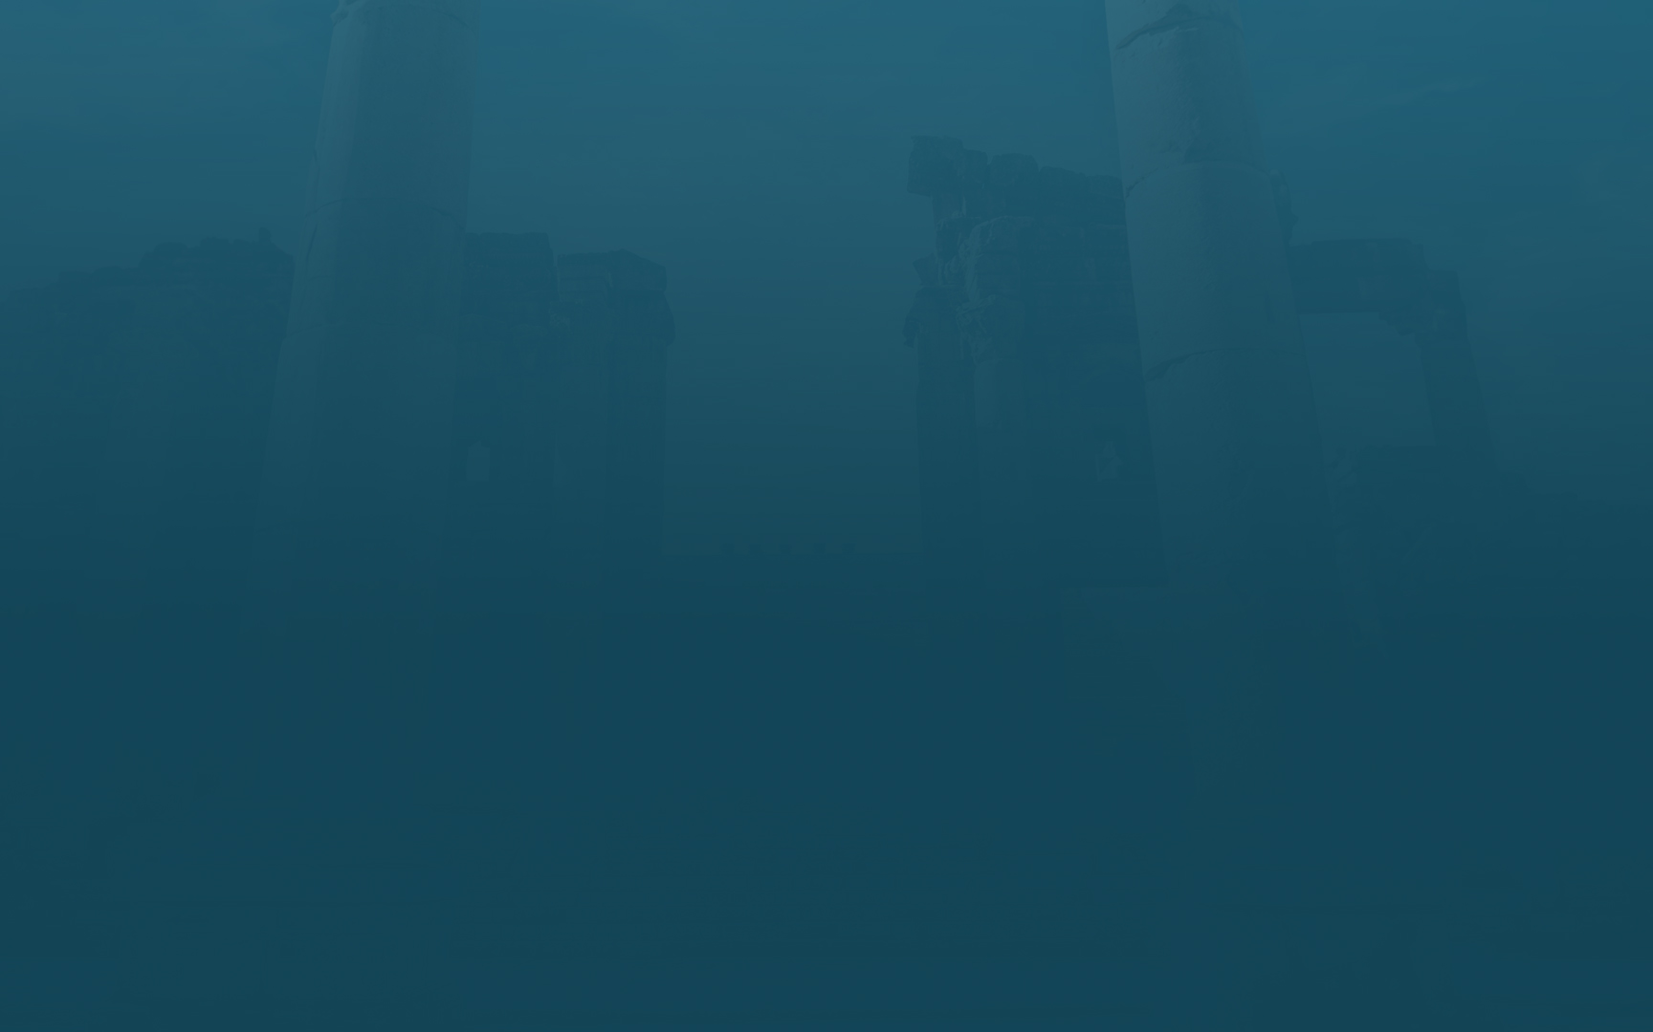
Lesson Titles | Sundays at 6 PM
Intro: Fixing Our Eyes on Jesus | September 17, 2023
Focusing Our Eyes on Jesus:
The Author and Perfector of Faith | October 15, 2023
The Joy Set Before Him | November 19, 2023
Enduring the Cross, Despising the Shame | December 17, 2023
Sitting at the Right Hand of God’s Throne | January 21, 2024
The Same Yesterday, Today, and Tomorrow | February 18, 2024
Living Like Jesus:
Laying Aside Every Weight and Sin | March 17, 2024
Sharing in His Holiness | April 21, 2024.
Seeking the City to Come | May 19, 2024
Loving Sacrificially | June 16, 2024
Rejecting Strange Teaching | July 21, 2024
Conclusion: Jesus Working in Us | August 18, 2024
Notes:
Russ started this series.
Bill did lesson 2…

Slide 3
CONSIDER
The Race We Run
CONSIDER
CONSIDER
The Cloud of Witnesses
Jesus, Our Forerunner
“Therefore, since we have so great a cloud of witnesses surrounding us, let us also lay aside every encumbrance and the sin which so easily entangles us, and let us run with endurance the race that is set before us fixing our eyes on Jesus” Hebrews 12:1-2a
Notes:
The Heroes of Faith in ch. 11 had some big things they had to let go of…
Abraham left his home.
Moses left the treasures of Pharaoh's household.
Jesus left the JOY of Heaven (Philippians 2)
Jesus traveled around without a consistent place to lay his head.
Our Race will require the same…
So when we look at this race more closely we see that there are some extremely helpful details…
Consider The Cloud of Witnesses. Their Faith. Their Commitment. Their Endurance. Their Focus.
Consider Ourselves. Am I Running? What’s Holding Me Back? What’s My Focus?
Consider Christ. His Race. His Endurance. His Reward. His Example.
“We are also urged us to “rid ourselves of every obstacle and the sin which so easily entangles us” (Heb. 12:1). If we’re going to be sustained throughout the race, we must honestly examine our life for anything that might prevent us from knowing the Lord and following Him. It could be habitual sin, an idol, worldly distractions, or false teaching that we’ve accepted as true.”

Slide 4
“EVERY”
WEIGHT/ENCUMBRANCE
SIN THAT “CLINGS”
LAY ASIDE: WHY & HOW
Notes:
Lay Aside – This is one of those things that sometimes feels easier said than done. Some habits are hard to break. Some battles are hard to win. It takes time. But notice the language – lay aside describes a choice that we purposefully make.
In the Roman world – a runner preparing for a race – would lay aside his normal robes, in order to run without getting tangled up. These runners did this willingly.
Willingly Give Up. It doesn’t have to be wrestled from our possession. We purposefully let go, because of the race we want to win.

Slide 5
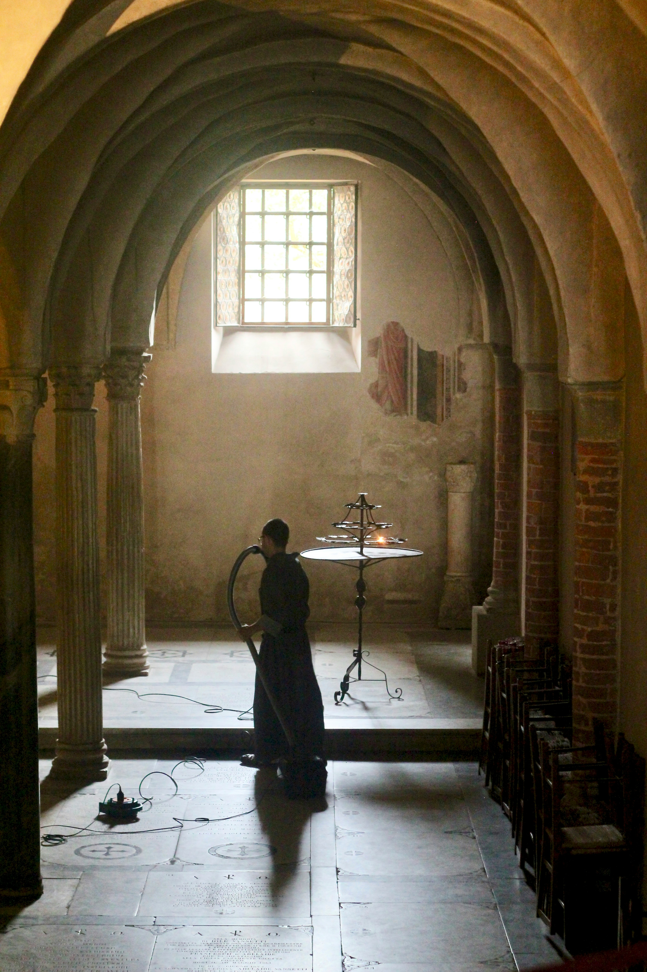
“EVERY”
²⁰ If you have died with Christ to the elementary principles of the world, why, as if you were living in the world, do you submit yourself to decrees, such as, ²¹ “Do not handle, do not taste, do not touch!” ²² (which all refer to things destined to perish with use)—in accordance with the commandments and teachings of men? ²³ These are matters which have, to be sure, the [appearance of wisdom in self-made religion and self-abasement and severe treatment of the body, but are of no value against fleshly indulgence.
Notes:
Everything is under consideration…but simply giving up “everything” in the sense of physical possessions isn’t the solution…

Slide 6
“EVERY”
“with old Jewish acquaintances, the relations formed by trade and merchandise, might be hindrances of this kind for the readers, and in such a case it was right, and is still right, to break entirely away from such relations, and to get rid of the fetters which impose as soon as they threaten to become a snare, even though they themselves be innocent.” (Pulpit Commentary, Pg 372)
What do I need to remove?
What do I need to reduce?
What do I need to replace?
Notes:
To Change….
The HEART (The Will – you want this…)
The HELP (The Team and support… The prayer… The education…)
The HURT (The pain you want to avoid and the pain you prepare to endure… )
The HOPE (The
Remove.
Reduce.
Replace.
Internalize:
I am a runner - I don’t do things that slow me down.
I am a Christian – I don’t participate in that…
Immediately they left their nets…
Lord, we have left everything… ?

Slide 7
WEIGHT/ENCUMBRANCE
Some Things Slow Us Down… “Entangle” 2 Timothy 2:3-4
Some Things Trip Us Up... “Win” 1 Corinthians 9:24
Some Things Cost Us Too Much… “Disqualified”1 Corinthians 9:27 Galatians 5:7
Notes:
The Problem with Extra Weight…
Dishonesty.
Anger.
Fear.
Lust.
> > > Moses had to consider the riches of Egypt as not worthy of being with God and His people.
> > > Paul had to count his entire career as

Slide 8
WEIGHT/ENCUMBRANCE
“Now as Jesus was walking by the Sea of Galilee, He saw two brothers, Simon who was called Peter, and Andrew his brother, casting a net into the sea; for they were fishermen. And He said to them, “Follow Me, and I will make you fishers of men.” Immediately they left their nets and followed Him.” Going on from there He saw two other brothers, James the son of Zebedee, and John his brother, in the boat with Zebedee their father, mending their nets; and He called them. Immediately they left the boat and their father, and followed Him.” Matthew 4:18-22
Notes:
“We are also urged us to “rid ourselves of every obstacle and the sin which so easily entangles us” (Heb. 12:1). If we’re going to be sustained throughout the race, we must honestly examine our life for anything that might prevent us from knowing the Lord and following Him. It could be habitual sin, an idol, worldly distractions, or false teaching that we’ve accepted as true.”

Slide 9
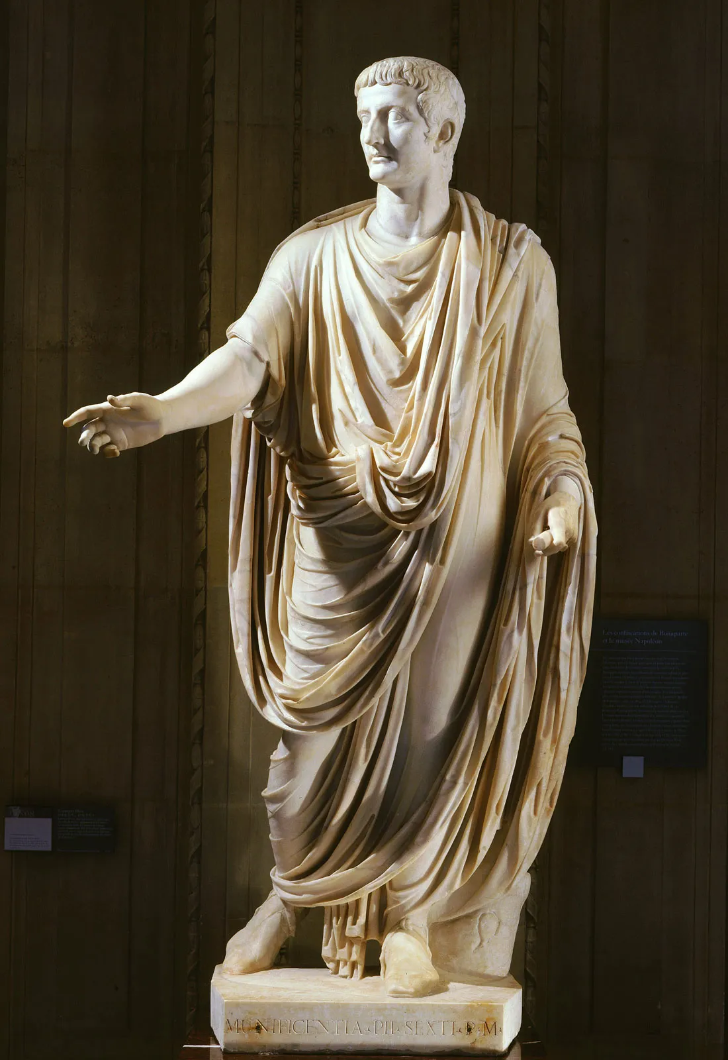
SIN THAT “CLINGS”
“This word, which is found nowhere else either in biblical or classical Greek, has to be interpreted from its:
derivation
the analogy of similar words
and the context.
The usual and most probable view is “that which easily surrounds us.” We may understand the figure of a race to be still kept in view, with regard to the runner not only laying aside encumbrances, but also stripping himself of his clothes, which would cling round him and impede his course.” (Pulpit Commentary, Pg 355)
Notes:
Sin that clings is an incredible term…
These people knew a lot about garments that hang and cling to you. You aren’t going to run a race in a Toga.
The Romans did not run nude like the Greeks – but they did strip down to the bare minimum for running.

Slide 10
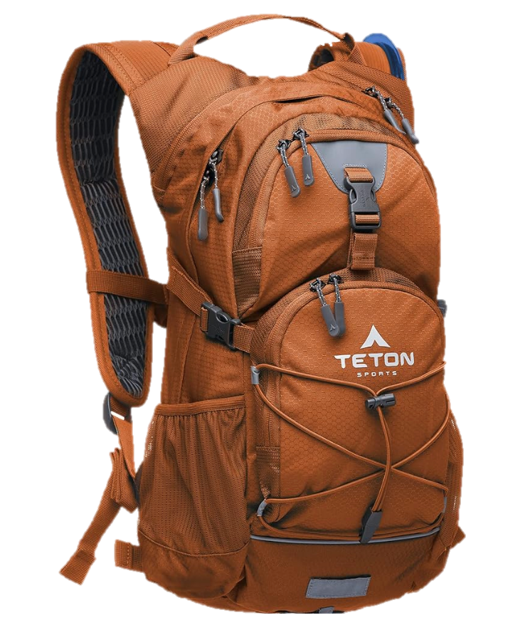
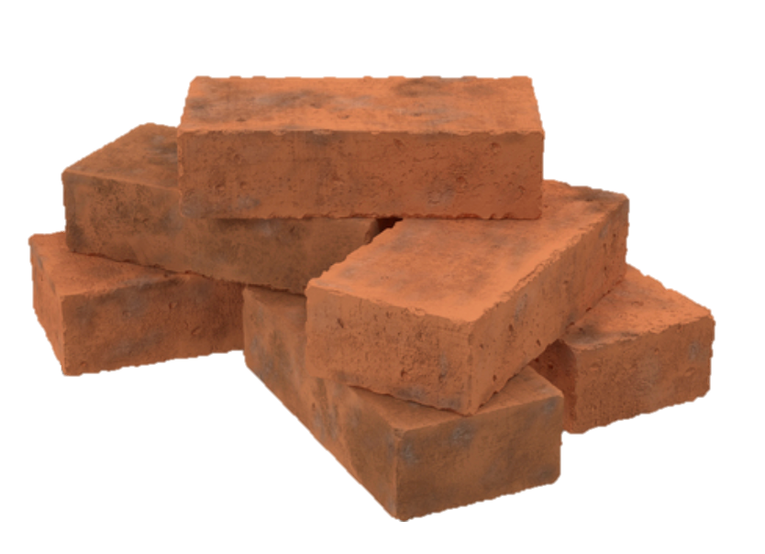
SIN THAT “CLINGS”
THE STORY OF
Leroy’s Backpack
Notes:
I need to tell you a story about my dad, and I want you to know from the beginning that the key to the story is what I don’t remember….
On a Wednesday night – dad got the orange backpack that usually contained our Volleyball Net – out of the basement and put it in the minivan.
After class he lifted it up on the table and took out brick after brick – and talked about the weights and the sins that we carry…
I don’t remember any of the things he listed.
I’m sure that he must have mentioned things like anger or greed or lust.
I’m sure he included the things that weigh down our hearts – like worry, fear, and doubt…
But I don’t remember what he said. So why am I telling you this story – because it wasn’t what he said. It was how he said it.
When dad took each brick out of the backpack – he spoke with such sincere concern for every person in the room.
He didn’t want people to lay these things aside just because they were included in a list of sins… He wanted people to lay these things aside because HE HATED to see them suffering.
He cared so much about every teen – hiding something.
He cared so much about every man – struggling to keep going.
He cared so much about every woman – trying to hold on.
When dad put that orange backpack on the table – it wasn’t to bring in a prop. It was to let people know that as God watches us “running our race” – He CARES. And He is telling us – please – stop holding onto the very things that are exhausting you and causing you to stumble.
Come and HOLD onto the LORD.

Slide 11
SIN THAT “CLINGS”
IN MY RACE…
What’s My Brick?
Notes:
I need to tell you a story about my dad, and I want you to know from the beginning that the key to the story is what I don’t remember….
On a Wednesday night – dad got the orange backpack that usually contained our Volleyball Net – out of the basement and put it in the minivan.
After class he lifted it up on the table and took out brick after brick – and talked about the weights and the sins that we carry…
I don’t remember any of the things he listed.
I’m sure that he must have mentioned things like anger or greed or lust.
I’m sure he included the things that weigh down our hearts – like worry, fear, and doubt…
But I don’t remember what he said. So why am I telling you this story – because it wasn’t what he said. It was how he said it.
When dad took each brick out of the backpack – he spoke with such sincere concern for every person in the room.
He didn’t want people to lay these things aside just because they were included in a list of sins… He wanted people to lay these things aside because HE HATED to see them suffering.
He cared so much about every teen – hiding something.
He cared so much about every man – struggling to keep going.
He cared so much about every woman – trying to hold on.
When dad put that orange backpack on the table – it wasn’t to bring in a prop. It was to let people know that as God watches us “running our race” – He CARES. And He is telling us – please – stop holding onto the very things that are exhausting you and causing you to stumble.
Come and HOLD onto the LORD.

Slide 12
LAY ASIDE
How?
1 Peter 4:1-4
Notes:
To me the biggest question is: How?
We say to ourselves, if it were as easy as unloading a backpack, I’d take these sins and troubles and throw them as far as possible.
Fixing our Eyes on Jesus..
I want the MOST – to be like HIM.
I want the MOST – to go to HEAVEN.
I want the MOST – to help my FAMILY go to heaven.
Philippians 3:9-11
More than anything, Paul wants to receive the righteousness and the resurrection that comes by Faith in Christ.

Slide 13
LAY ASIDE
How?
1 Peter 4:1-4
I Am A Christian: I Live For The Will of God 1 Peter 4:1-2
I Am A Christian: I’ve Wasted Enough Time On This 1 Peter 4:3
I Am A Christian: I Am Running A New Race 1 Peter 4:4
Notes:
In light of all these witnessess, and in light of all that Jesus had done… we run with Passion and Perseverance.
Key: I have to look forward. Not at what I’m letting go of.
I am laying aside distractions…Godly priorities are more important.
I am laying aside anxiety…God cares for me.
I am laying aside secrets… God sees and knows and wants to help.
I am laying aside self-reliance… God’s strength and grace will be my success.
I am laying aside over-commitment…God’s narrow way is my path now.
I am laying aside isolation…God’s family is where I belong.

Slide 14
LAY ASIDE
I Am A Christian. God Will Help Me Break Bad Habits.
Runner’s Heart
Runner’s Help
“create in me a clean heart…” Psalm 51:10
“Encourage one another day after day...” Hebrews 3:13
Runner’s Hurts
Runner’s Hope
“pierced themselves with many griefs…” 1 Timothy 6:10
“This hope we have as an anchor…” Hebrews 6:19
Notes:
To Change….
The HEART (The Will – you want this…)
The HELP (The Team and support… The prayer… The education…)
The HURT (The pain you want to avoid and the pain you prepare to endure… )
The HOPE (The
Remove.
Reduce.
Replace.
Internalize:
I am a runner - I don’t do things that slow me down.
I am a Christian – I don’t participate in that…
Immediately they left their nets…
Lord, we have left everything… ?
Identify It… Info
Confess It.. Info
Repent of It… Replace It… Info

Slide 15
LAY ASIDE
NEVER GIVE UP WHAT YOU WANT THE MOST FOR WHAT YOU WANT IN THE MOMENT.
“And Jesus stopped and said, “Call him here.” So they called the blind man, saying to him, “Take courage, stand up! He is calling for you.” Throwing aside his cloak, he jumped up and came to Jesus.” Mark 10:49-50
Notes:
Fixing our Eyes on Jesus..
I want the MOST – to be like HIM.
I want the MOST – to go to HEAVEN.
I want the MOST – to help my FAMILY go to heaven.
Philippians 3:9-11
More than anything, Paul wants to receive the righteousness and the resurrection that comes by Faith in Christ.

