Slide 1
Our Common Faith
A study of What Binds Us to God and to Each Other

Slide 2
Foundational Beliefs
Who God is (Nature of God)
Our personal accountability to God (Nature of Man)
How we learn of and from God (Revelation and Inspiration)
God’s plan in Christ (Jesus the Christ)
How we are saved (Salvation)
How we work together (The Church)
Promise of resurrection and eternal life (End Things)

Slide 3
Assumptions
What we believe matters, to be acceptable to God (Heb 11:6)
God has revealed all that we need to know in the Bible (II Tim 3:17)
The Bible is inspired and is the final source of truth (II Tim 3:16)
Some doctrines are essential for acceptance by God, and for unity
It is possible to determine truth on essential doctrines (John 7:17)
What we believe will be expressed in our behavior
We may disagree on many unessential things
Some things cannot be known (Is 55:8-9, Deut 29:29)

Slide 4
Class Lesson Schedule
Date | Day | Class | Lesson | Title | Teacher
4/14/24 | Sun | 1 | 1 | Introduction – Nature of God | Russ
4/17/24 | Wed | 2 | 2 | The Nature of God | Sam
4/21/24 | Sun | 3 | 3 | The Nature of Man | Sam
4/24/24 | Wed | 4 | 4 | Revelation and Inspiration | Barry
4/28/24 | Sun | 5 | 4 | Revelation and Inspiration | Barry
5/1/24 | Wed | 6 | 5 | Jesus, the Christ – Identity and Promise | Russ
5/5/24 | Sun | 7 | 5 | Jesus, the Christ – Life and Purpose | Russ
5/8/24 | Wed | 8 | 5 | Jesus, the Christ – Resurrection and Rule | Russ
5/12/24 | Sun | 9 | 6 | Salvation | Russ
5/15/24 | Wed | 10 | 6 | Salvation | Russ
5/19/24 | Sun | 11 | 7 | The Church | Russ
5/22/24 | Wed | 12 | 7 | The Church | Russ
5/26/24 | Sun | 13 | 8 | End Things | Russ

Slide 5
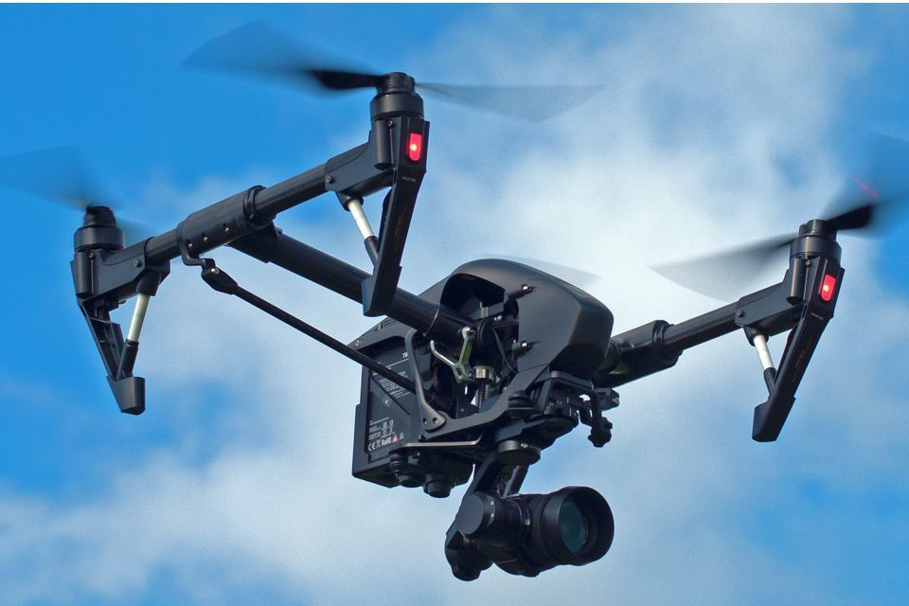
Who would build a drone and release it without some means of communicating with it?

Slide 6
Evidences
Personal Existence & Ability to Reason
Consciousness, logic, memory, sense, emotion, will, choice, action & effects
Existence of the Universe (Apart from me)
Effect of Universe on Me: observation of external order, ability to describe/predict…
Possibility of the Supernatural
Cause & effect requires 1st cause
Desire, hope, emotion, moral consciousness (felt spirituality)
Sequence of Conclusions
Supernatural Origin of the Universe
Temporal (decaying) universe
Evidence of beginnings beyond natural
Intelligent, Personal Origin (of man)
Perceived order & power (e.g. Rom 1:20)
Human will, reason, desire for “right” (e.g. Acts 17:28)
Purpose for Creation
Possibility of Moral Law
Possibility of Supernatural Intervention
Principle of intelligent (purposeful) action
Human character to “seek God” (Ac 17:27)
Inductive Faith
Possibility of Miracles, Divine Revelation…
Logical extension of above “possibilities”
Unity of the message, with diverse authors
Fulfilled prophecies, Success of Message
Quality of accounts; Historical accuracy
The Bible contains information from God
All Information in the Bible is Truth (II Pet 1:20-21)
History, commands, facts are authoritative throughout time (II Tim 3:16,17)
Bible is exclusive Truth: no need to keep looking (II Pet 1:3; Jude 3)
Bible has been preserved by God’s providence (I Pet 1:24,25)
Deductive Faith

Slide 7
Lesson 4 Objectives (at the end of the lesson you should be able to…)
List some ways God has communicated in the past.
Identify the only way God communicates with us now.
Know the difference between revelation and inspiration.
Give reasons to expect God to protect His word.

Slide 8
How Does God Speak To Us?
Hebrews 1:1-4: The Preeminent Son – God’s Greatest Spokesman
God, after He spoke long ago to the fathers in the prophets in many portions and in many ways,
Those who were given charge over His people and/or those in roles of leadership
God did not reveal Himself fully to any one prophet.
Ephesians 3:4-5 - By referring to this, when you read you can understand my insight into the mystery of Christ, ⁵ which in other generations was not made known to the sons of men, as it has now been revealed to His holy apostles and prophets in the Spirit;
God is the primary source of this message! The Creator of all things has communicated with us indicating that he wants a relationship.
It came from God in parts, a piece at a time
direct revelations, dreams, visions, prophets, symbols, angels

Slide 9
“God Has Spoken”
Abraham –
Called out of Ur and God revealed Himself,
He would be the father of a great nation
Moses – God spoke in a greater portion and in different ways
Spoke to him “face to face”
Spoke to Moses on Sinai through an angelic form
Gave laws of the Mosaic system to convey to Israelites
David – God revealed truth to David in diff. ways and portions
Revealed many of the Psalms to the “sweet psalmist of Israel”
First in a long succession of Kings that God granted rulership forever

Slide 10
“God Spoke Long Ago”
Solomon – God spoke to Israel through Solomon in Wisdom literature & Proverbs
Elijah – Sent to the northern kingdom of Israel
While prophesying dressed in animal skin as if he had been devastated by an army
Message of impending judgment on God’s people
Isaiah
Sees a manifestation of the greatness and holiness of God
God reveals the message of future judgment through the names of the sons of Isaiah

Slide 11
“God Spoke Long Ago”
Daniel – Taken into Babylonian Captivity, Court Official
Reveals visions of the future of the nations including the kingdom that God would establish as preeminent
Zechariah – post exile
God spoke to the people through Zechariah
Visions of the temple and Jerusalem and the coming Messiah, His great Kingdom and the Davidic throne restored

Slide 12
God Has Spoken
What are some other ways God has “spoken”?
Creation (Rom 1, Psalm 19)
Dreams (Joseph, Daniel, Ezekiel,…)
Fulfilled prophecy
Angel of the Lord (Moses, Jacob, Abraham,…)
Sinai’s thunder and lightening (Israel)
Elijah and a still small voice
Miracles (Egypt, Red Sea, manna, water, etc)
Urim (I Samuel 28:6)

Slide 13
Prologue - Hebrews 1:1-4 (NASB)
The Preeminent Son – God’s Greatest Spokesman
“Son” emphasizes the status of an exalted one, sharing the nature of the Father.
God, after He spoke long ago to the fathers in the prophets in many portions and in many ways, ² in these last days has spoken to us in His Son,
The days ushered in with Christ's coming and lasting until he appears “a second time” (9:28)
God has delivered His new revelation through one person. One who is much greater than the prophets. His Son!
Do we only need to focus on the words of Jesus (red letters)?

Slide 14
”However, when He, the Spirit of truth, has come, He will guide you into all truth; for He will not speak on His own authority, but whatever He hears He will speak; and He will tell you things to come. (John 16:13)
How Did Jesus Promise to Speak to His Apostles?
The Holy Spirit would speak “whatever He hears” from Jesus (vs 14)
He would guide them into “all truth.”
He would tell them things to come.

Slide 15
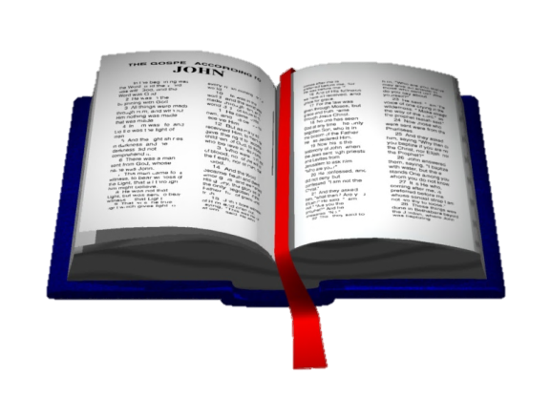
How is Jesus’ Will Transmitted?
Jesus
Truth
But the Helper, the Holy Spirit, whom the Father will send in My name, He will teach you all things, and bring to your remembrance all things that I said to you. (John 14:26)
...When He, the Spirit of truth, has come, He will guide you into all truth; for He will not speak on His own authority, but whatever He hears He will speak. (John 16:13)
Holy Spirit
Apostles
Spoke & Wrote
Disciples

Slide 16
How has God “spoken to us by His son”?
Jesus spoke the words of God—Jn. 12:49
Jesus did not write anything permanent.
He chose apostles to relay His message.
He sent the Holy Spirit to assure that they got it right—John 14:26 ; 16:12-15
The apostles’ message is God’s word to us through His Son— 2 Pe.3:1-2 - This is now, beloved, the second letter I am writing to you in which I am stirring up your sincere mind by way of reminder, ² that you should remember the words spoken beforehand by the holy prophets and the commandment of the Lord and Savior spoken by your apostles. (NASV)

Slide 17
Foundational Concept
The Bible is inspired by God; in it He reveals Himself to us.
The Bible was written, collected, and transmitted by men.
Both are true, neither can be ignored.
God managed and approved of everything written (and collected), and He also guided the transmission through the copying and translations so that the meaning has never been, and will never be lost. His guidance allows for and accommodates personality and language differences among the authors, variations in the copies, without a loss or corruption of Truth, nor does it provide an excuse for man to reject it.

Slide 18
“Prophecy never came by the will of man, but holy men of God spoke as they were moved* by the Holy Spirit.” (2 Peter 1:21)
Prophecy Was of God’s Spirit
*Carried along (ESV)
Prophecy was not the product of man’s will.
The prophets were “carried along by the Holy Spirit.”
Note Hebrews 3:7 - Therefore, just as the Holy Spirit says, “TODAY IF YOU HEAR HIS VOICE, (quotes Psalm 95:7-11)
God used the man as he is and his personality may be reflected, but the revelation is God’s, not the man who is the final instrument through which it was given to others.

Slide 19
Prophecy Was of God’s Spirit
1 Peter 1:9-12
¹⁰ Concerning this salvation, the prophets who prophesied about the grace that was to be yours searched and inquired carefully, ¹¹ inquiring what person or time the Spirit of Christ in them was indicating when he predicted the sufferings of Christ and the subsequent glories. ¹² It was revealed to them that they were serving not themselves but you, in the things that have now been announced to you through those who preached the good news to you by the Holy Spirit sent from heaven, things into which angels long to look.

Slide 20
All Scripture is inspired by God and profitable for teaching, for reproof, for correction, for training in righteousness; so that the man of God may be adequate for every good work” (2 Tim 3:16-17- NAS)
The Source of Scripture
theopneustos – “God-breathed”
All scripture is “breathed by God.” cf Gen. 2:7 - breathed into his nostrils the breath of life; and man became a living being., Ezekiel 37 – God’s breath Spirit) works through the prophet’s word to bring life
Includes OT and NT, much of which had been written and circulated at the time of this writing
All scripture is profitable for teaching, reproof (tests and convicts of sinfulness), correction (what to do in order make right whatever is wrong before God), and instruction in righteousness. (All Sufficient)
With scripture the man of God is “complete, thoroughly equipped for every good work.”
Peter designated Paul’s writing as scripture (See 2 Peter 3:15-16)

Slide 21
Therefore, beloved, since you look for these things, be diligent to be found by Him in peace, spotless and blameless, ¹⁵ and regard the patience of our Lord as salvation; just as also our beloved brother Paul, according to the wisdom given him, wrote to you, ¹⁶ as also in all his letters, speaking in them of these things, in which are some things hard to understand, which the untaught and unstable distort, as they do also the rest of the Scriptures, to their own destruction.
Paul’s writing is “Scripture”
2 Peter 3:15-16

Slide 22
”If anyone thinks himself to be a prophet or spiritual, let him acknowledge that the things which I write to you are the commandments of the Lord.” (1 Corinthians 14:37)
Paul claimed that what he wrote were the commandments of the Lord.
That is almost half the New Testament.
the “prophets” and “spiritual” (those in possession of a spiritual gift) must acknowledge that the regulations for the use of their gift are the commandments from God and not just Paul’s personal opinion.
If this statement of Paul is untrue, then there is no reason to trust the rest of his writings.
Notes:
.

Slide 23
”Now we have received, not the spirit of the world, but the Spirit who is from God, that we might know the things that have been freely given to us by God. ¹³ These things we also speak, not in words which man’s wisdom teaches but which the Holy Spirit teaches, comparing spiritual things with spiritual.” (1 Corinthians 2:12-13)
Paul agreed with Peter that his wisdom was given to him by the Holy Spirit.
He claimed that the “words” he wrote were taught by the Holy Spirit.
“that we might know” = Revelation
“in words…which the Holy Spirit teaches” = Inspiration
This does not mean there is no human element in the words, for God used the men as they were with their human language, human vocabulary, human forms of expressions, and sometimes even the knowledge they had gained by research of personal eyewitness, etc. (Luke 1:1-4; 1 Cor. 15:1-8). But God then used them as they were and guided them to speak the words that accurately expressed His will.

Slide 24
Thessalonian Example
1 Thessalonians 2:13
“For this reason we also constantly thank God that when you received the word of God which you heard from us, you accepted it not as the word of men, but for what it really is, the word of God, which also performs its work in you who believe.”
Notes:
.

Slide 25
”But even if we, or an angel from heaven, preach any other gospel to you than what we have preached to you, let him be accursed. ⁹ As we have said before, so now I say again, if anyone preaches any other gospel to you than what you have received, let him be accursed.” (Galatians 1:8-9)
Any Other is Not Authorized
The teaching of the apostles was truth and anything that contradicted it was false.
If any man teaches anything different, he is accursed.
Even if an angel preaches anything different, he is also accursed.

Slide 26
“Beloved, while I was very diligent to write to you concerning our common salvation, I found it necessary to write to you exhorting you to contend earnestly for the faith which was once for all delivered to the saints.” (Jude 3)
“Once For All”
“to agonize” - the Christian message of the gospel, "the faith“, is under attack from false teachers and they must be diligent and work hard to fight against heresies.
Rom 6:8-10 Now if we died with Christ, we believe that we shall also live with Him, (9) knowing that Christ, having been raised from the dead, dies no more. Death no longer has dominion over Him. (10) For the death that He died, He died to sin once for all; but the life that He lives, He lives to God.
Heb 7:27 who does not need daily, as those high priests, to offer up sacrifices, first for His own sins and then for the people's, for this He did once for all when He offered up Himself.
Heb 9:11-12 But Christ came as High Priest of the good things to come, with the greater and more perfect tabernacle not made with hands, that is, not of this creation. (12) Not with the blood of goats and calves, but with His own blood He entered the Most Holy Place once for all, having obtained eternal redemption.
Heb 10:9-10 then He said, "BEHOLD, I HAVE COME TO DO YOUR WILL, O GOD." He takes away the first that He may establish the second. (10) By that will we have been sanctified through the offering of the body of Jesus Christ once for all.
"The Faith" refers to the entire body of revealed truth. John's epistles, and II Peter are "review," rather than first-time revelation. These words are inspired and authoritative (see II Pet 1:21; 3:15-16), but are primarily reminders/warnings to those who already knew all they needed.

Slide 27
”Beloved, while I was very diligent to write to you concerning our common salvation, I found it necessary to write to you exhorting you to contend earnestly for the faith which was once for all delivered to the saints.” (Jude 3)
“ For I testify to everyone who hears the words of the prophecy of this book: If anyone adds to these things, God will add to him the plagues that are written in this book.” (Rev. 22:18)
When the New Testament was finished, nothing was to be added later—the faith was “once for all delivered.”

Slide 28
”Heaven and earth will pass away, but My words will by no means pass away.” (Matthew 24:35)
Permanence of God’s Word
“All flesh is like grass, And all its glory like the flower of grass. The grass withers, And the flower falls off, ²⁵ But the word of the Lord endures forever.”
And this is the word which was preached to you.
(1 Peter 1:24-25)
How permanent did God intend His word to be?
Do we doubt His ability to preserve it?
What does this indicate about modern questions regarding the dependability of our text?

Slide 29
Summary
God speaks to us today through His Son.
The Son sent the Holy Spirit to His apostles to reveal His will and to inspire the words in which they should deliver.
They would be guided into “all truth.”
The scriptures are the words they wrote.
The scriptures are sufficient for our needs.
Nothing was to be added to the scriptures.
God intended that His word will not pass away.
Therefore it is:
True (respecting its intention and context)
Inerrant (despite transmission imperfections)

Slide 30
And we have the prophetic word more fully confirmed, to which you will do well to pay attention as to a lamp shining in a dark place, until the day dawns and the morning star rises in your hearts. (2 Peter 1:19)
The light of God’s Word illumines those in darkness and gives hope in a dark world, until He comes again.
Pay attention to it! Continue in it! Use it!

