Slide 2
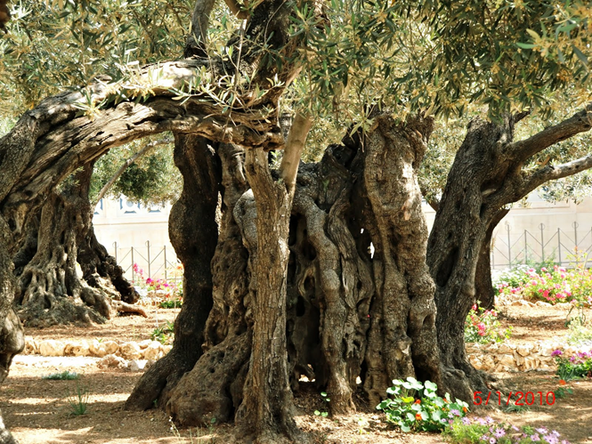
Three Men Left the Garden
After, During and Before Meeting in Gethsemane

Slide 3
Three Men Left the Garden

Slide 4
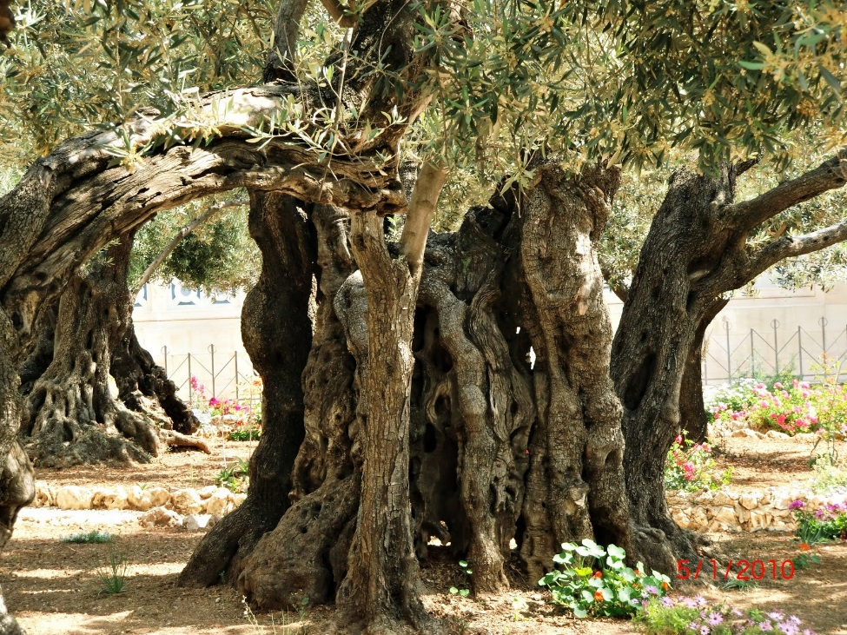
Three Men Left the Garden
Gethsemane: Garden at the Foot of the Mount of Olives

Slide 5
Three Men Left the Garden
Gethsemane: Garden at the Foot of the Mount of Olives
The Actions in the Hours After the Meeting in the Garden Reveal the Character of Each One

Slide 6
Three Men Left the Garden
Gethsemane: Garden at the Foot of the Mount of Olives
The Actions in the Hours After the Meeting in the Garden Reveal the Character of Each One
We Can Follow the Course of Each One, Observing Their Conduct in the Garden and Before Arriving There

Slide 7
Three Men Left the Garden
Gethsemane: Garden at the Foot of the Mount of Olives
The Actions in the Hours After the Meeting in the Garden Reveal the Character of Each One
We Can Follow the Course of Each One, Observing Their Conduct in the Garden and Before Arriving There
We Learn Valuable Lessons

Slide 8
Jesus Christ Left the Garden

Slide 9
John 18:1-11

Slide 10
Jesus Christ Left the Garden

Slide 11
Jesus Christ Left the Garden
On His way out, He met a group of perhaps 600 men or more

Slide 12
Jesus Christ Left the Garden
On His way out, He met a group of perhaps 600 men or more
They sent Judas ahead to identify Him

Slide 13
Jesus Christ Left the Garden
On His way out, He met a group of perhaps 600 men or more
They sent Judas ahead to identify Him
He presented Himself, and the detachment drew back and fell!

Slide 14
Jesus Christ Left the Garden
On His way out, He met a group of perhaps 600 men or more
They sent Judas ahead to identify Him
He presented Himself, and the detachment drew back and fell!
He did not call angels, and did rebuke Peter

Slide 15
Jesus Christ Left the Garden
On His way out, He met a group of perhaps 600 men or more
They sent Judas ahead to identify Him
He presented Himself, and the detachment drew back and fell!
He did not call angels, and did rebuke Peter
He advanced with purpose and determination

Slide 16
Judas Iscariot Left the Garden

Slide 17
Judas Iscariot Left the Garden
When they left the garden, where was Judas? Hidden behind the soldiers?

Slide 18
Judas Iscariot Left the Garden
When they left the garden, where was Judas? Hidden behind the soldiers?
He had already completed his mission with the kiss of a false disciple

Slide 19
Judas Iscariot Left the Garden
When they left the garden, where was Judas? Hidden behind the soldiers?
He had already completed his mission with the kiss of a false disciple
During the night, he had time to reflect

Slide 20
Judas Iscariot Left the Garden
When they left the garden, where was Judas? Hidden behind the soldiers?
He had already completed his mission with the kiss of a false disciple
During the night, he had time to reflect
He felt regret, but did not seek mercy

Slide 21
Matthew 27:3-5

Slide 22
Judas Iscariot Left the Garden
When they left the garden, where was Judas? Hidden behind the soldiers?
He had already completed his mission with the kiss of a false disciple
During the night, he had time to reflect
He felt regret, but did not seek mercy

Slide 23
Judas Iscariot Left the Garden
When they left the garden, where was Judas? Hidden behind the soldiers?
He had already completed his mission with the kiss of a false disciple
During the night, he had time to reflect
He felt regret, but did not seek mercy
He tried to run away, but threw himself into the hands of the Righteous Judge

Slide 24
Hebrews 10:29-31 Hebrews 12:29

Slide 25
Judas Iscariot Left the Garden
When they left the garden, where was Judas? Hidden behind the soldiers?
He had already completed his mission with the kiss of a false disciple
During the night, he had time to reflect
He felt regret, but did not seek mercy
He tried to run away, but threw himself into the hands of the Righteous Judge

Slide 26
Simon Peter Left the Garden

Slide 27
Simon Peter Left the Garden
His first reaction: courageous defense of his Master

Slide 28
Simon Peter Left the Garden
His first reaction: courageous defense of his Master
He followed to know, but tried to stay in the shadows

Slide 29
Simon Peter Left the Garden
His first reaction: courageous defense of his Master
He followed to know, but tried to stay in the shadows
When he could not hide himself, he denied Christ!

Slide 30
Luke 22:60-62

Slide 31
Simon Peter Left the Garden
His first reaction: courageous defense of his Master
He followed to know, but tried to stay in the shadows
When he could not hide himself, he denied Christ!
The difference between Peter and Judas:

Slide 32
Simon Peter Left the Garden
His first reaction: courageous defense of his Master
He followed to know, but tried to stay in the shadows
When he could not hide himself, he denied Christ!
The difference between Peter and Judas:
Not in the seriousness of the sins they committed

Slide 33
Simon Peter Left the Garden
His first reaction: courageous defense of his Master
He followed to know, but tried to stay in the shadows
When he could not hide himself, he denied Christ!
The difference between Peter and Judas:
Not in the seriousness of the sins they committed
But in what each one did with his sin

Slide 34
Before and During

Slide 35
Before and During: Judas

Slide 36
Before and During: Judas
Joined himself to the enemies

Slide 37
Before and During: Judas
Joined himself to the enemies
Entered with the intention to betray

Slide 38
Before and During: Judas
Joined himself to the enemies
Entered with the intention to betray
He pretended to love the Master

Slide 39
Before and During: Peter

Slide 40
Before and During: Peter
Confident, denying his own vulnerability

Slide 41
Matthew 26:31,33

Slide 42
Before and During: Peter
Confident, denying his own vulnerability

Slide 43
Before and During: Peter
Confident, denying his own vulnerability
He did not recognize his own necessity, and so he slept

Slide 44
Before and During: Peter
Confident, denying his own vulnerability
He did not recognize his own necessity, and so he slept
He did not position himself as an enemy to Jesus, but he was negligent in that critical hour

Slide 45
Before and During: Jesus

Slide 46
Before and During: Jesus
He recognized his own fragility

Slide 47
John 12:27-28a

Slide 48
Before and During: Jesus
He recognized his own fragility

Slide 49
Before and During: Jesus
He recognized his own fragility
He did not stray from His purpose

Slide 50
How Do We Enter the Garden of Prayer?

Slide 51
How Do We Enter the Garden of Prayer?
As enemies, pretending to be interested while we flee from the Lord´s presence?

Slide 52
How Do We Enter the Garden of Prayer?
As enemies, pretending to be interested while we flee from the Lord´s presence?
Confident, but negligent and unsteady in the time of trial?

Slide 53
How Do We Enter the Garden of Prayer?
As enemies, pretending to be interested while we flee from the Lord´s presence?
Confident, but negligent and unsteady in the time of trial?
Dependent, but determined to do God´s will at all cost?

