Slide 1
“Things Hoped For”: Our Resurrection
December 28, 2014

Slide 2
1 Peter 3:14-15
“But even if you should suffer for righteousness' sake, you will be blessed. Have no fear of them, nor be troubled, but in your hearts honor Christ the Lord as holy, always being prepared to make a defense to anyone who asks you for a reason for the hope that is in you; yet do it with gentleness and respect,”

Slide 3
Romans 8:29
“For whom He foreknew, He also predestined to be conformed to the image of His Son, that He might be the firstborn among many brethren.”

Slide 4
Philippians 3:20
“For our citizenship is in heaven, from which we also eagerly wait for the Savior, the Lord Jesus Christ, who will transform our lowly body that it may be conformed to His glorious body, according to the working by which He is able to subdue all things to Himself.”

Slide 5
1 Corinthians 15:51-52
“Behold, I tell you a mystery: we shall not all sleep, but we shall all be changed - in a moment, in the twinkling of an eye, at the last trumpet. For the trumpet will sound, and the dead will be raised incorruptible, and we shall be changed.”

Slide 6
#68 - Because He Lives
William and Gloria Gaither

Slide 7
Verse 3
“And then one day I’ll cross that river,
I’ll fight life’s final war with pain;
And then as death gives way to vict’ry,
I’ll see the lights of glory and I’ll know He reigns.”
- William and Gloria Gaither

Slide 8
Because He Lives
we will live.

Slide 9
Because He lives, we will live.
1 Corinthians 15:51-54
⁵¹ Listen, I tell you a mystery: We will not all sleep, but we will all be changed— ⁵² in a flash, in the twinkling of an eye, at the last trumpet. For the trumpet will sound, the dead will be raised imperishable, and we will be changed. ⁵³ For the perishable must clothe itself with the imperishable, and the mortal with immortality. ⁵⁴ When the perishable has been clothed with the imperishable, and the mortal with immortality, then the saying that is written will come true: “Death has been swallowed up in victory.”

Slide 10
Because He lives, we will live.
John 5:28-29
²⁸ Do not be amazed at this, for a time is coming when all who are in their graves will hear his voice ²⁹ and come out—those who have done what is good will rise to live, and those who have done what is evil will rise to be condemned.

Slide 11
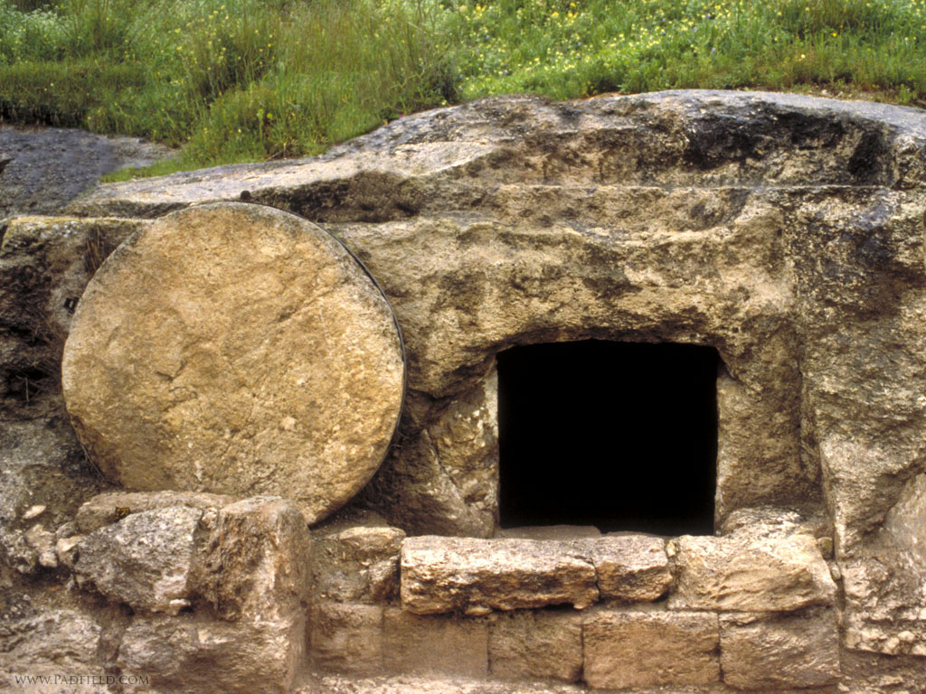
He has power to raise us. He has a plan to raise us.

Slide 12
Because He lives, we will live.
1 Corinthians 6:14
¹⁴ By his power God raised the Lord from the dead, and he will raise us also.

Slide 13
Because He lives, we will live.
1 Corinthians 15:20-23
²⁰ But Christ has indeed been raised from the dead, the firstfruits of those who have fallen asleep. ²¹ For since death came through a man, the resurrection of the dead comes also through a man. ²² For as in Adam all die, so in Christ all will be made alive. ²³ But each in turn: Christ, the firstfruits; then, when he comes, those who belong to him.

Slide 14
Because He lives, we will live.
1 Thessalonians 4:14-18
¹⁴ For we believe that Jesus died and rose again, and so we believe that God will bring with Jesus those who have fallen asleep in him. ¹⁵ According to the Lord’s word, we tell you that we who are still alive, who are left until the coming of the Lord, will certainly not precede those who have fallen asleep. ¹⁶ For the Lord himself will come down from heaven, with a loud command, with the voice of the archangel and with the trumpet call of God, and the dead in Christ will rise first. ¹⁷ After that, we who are still alive and are left will be caught up together with them in the clouds to meet the Lord in the air. And so we will be with the Lord forever. ¹⁸ Therefore encourage one another with these words.

Slide 15
Because He Lives
we know our life is in God’s hands.

Slide 16
Verse 2
“How sweet to hold a newborn baby,
And feel the pride and joy he gives;
But greater still, the calm assurance,
This child can face uncertain days because He lives.”
- William and Gloria Gaither

Slide 17
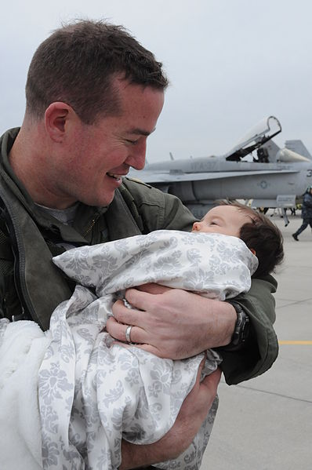
Job 14:1 “Man who is born of woman is of few days and full of trouble.”

Slide 18
Because He lives, we will live. Because He lives, we know our life is in God’s hands.
Acts 2:23-24
²³ This man was handed over to you by God’s deliberate plan and foreknowledge; and you, with the help of wicked men, put him to death by nailing him to the cross. ²⁴ But God raised him from the dead, freeing him from the agony of death, because it was impossible for death to keep its hold on him.

Slide 19
Because He lives, we will live. Because He lives, we know our life is in God’s hands.
2 Corinthians 4:7-11
⁷ But we have this treasure in jars of clay to show that this all-surpassing power is from God and not from us. ⁸ We are hard pressed on every side, but not crushed; perplexed, but not in despair; ⁹ persecuted, but not abandoned; struck down, but not destroyed. ¹⁰ We always carry around in our body the death of Jesus, so that the life of Jesus may also be revealed in our body. ¹¹ For we who are alive are always being given over to death for Jesus’ sake, so that his life may also be revealed in our mortal body.

Slide 20
Because He lives, we will live. Because He lives, we know our life is in God’s hands.
2 Corinthians 4:13-14
¹³ It is written: “I believed; therefore I have spoken.” Since we have that same spirit of faith, we also believe and therefore speak, ¹⁴ because we know that the one who raised the Lord Jesus from the dead will also raise us with Jesus and present us with you to himself.
(see Psalm 116)

Slide 21
Because He Lives
His tomb is empty.

Slide 22
Verse 1
“God sent His Son, they called Him Jesus,
He came to love heal and forgive;
He lived and died to buy my pardon,
An empty grave is there to prove my Savior lives.”
- William and Gloria Gaither

Slide 23
Because He lives, we will live. Because He lives, we know our life is in God’s hands. Because He lives, His tomb is empty.
1 Corinthians 15:14
¹⁴ And if Christ has not been raised, our preaching is useless and so is your faith.

Slide 24
Mark 16:6 But He said to them, ‘Do not be alarmed. You seek Jesus of Nazareth, who was crucified. He is risen! He is not here. See the place where they laid him.

Slide 25
¹⁸ I pray that the eyes of your heart may be enlightened in order that you may know the hope to which he has called you, the riches of his glorious inheritance in his holy people, ¹⁹ and his incomparably great power for us who believe. That power is the same as the mighty strength ²⁰ he exerted when he raised Christ from the dead and seated him at his right hand in the heavenly realms,
Ephesians 1:18-20

