Slide 1

Book of Joshua
Lesson 1
Continuity of the Covenant

Slide 2
Pre-Class Questions
What would you like to gain from studying Joshua?
What three things do you remember about the book of Joshua?
Ever have a discussion with anyone about the book of Joshua?
Notes:
Exodus 23:1-33(ESV)
¹“You shall not spread a false report. You shall not join hands with a wicked man to be a malicious witness.
²You shall not fall in with the many to do evil, nor shall you bear witness in a lawsuit, siding with the many, so as to pervert justice,
³nor shall you be partial to a poor man in his lawsuit.
⁴“If you meet your enemy’s ox or his donkey going astray, you shall bring it back to him.
⁵If you see the donkey of one who hates you lying down under its burden, you shall refrain from leaving him with it; you shall rescue it with him.
⁶“You shall not pervert the justice due to your poor in his lawsuit.
⁷Keep far from a false charge, and do not kill the innocent and righteous, for I will not acquit the wicked.
⁸And you shall take no bribe, for a bribe blinds the clearsighted and subverts the cause of those who are in the right.
⁹“You shall not oppress a sojourner. You know the heart of a sojourner, for you were sojourners in the land of Egypt.
¹⁰“For six years you shall sow your land and gather in its yield,
¹¹but the seventh year you shall let it rest and lie fallow, that the poor of your people may eat; and what they leave the beasts of the field may eat. You shall do likewise with your vineyard, and with your olive orchard.
¹²“Six days you shall do your work, but on the seventh day you shall rest; that your ox and your donkey may have rest, and the son of your servant woman, and the alien, may be refreshed.
¹³“Pay attention to all that I have said to you, and make no mention of the names of other gods, nor let it be heard on your lips.
¹⁴“Three times in the year you shall keep a feast to me.
¹⁵You shall keep the Feast of Unleavened Bread. As I commanded you, you shall eat unleavened bread for seven days at the appointed time in the month of Abib, for in it you came out of Egypt. None shall appear before me empty-handed.
¹⁶You shall keep the Feast of Harvest, of the firstfruits of your labor, of what you sow in the field. You shall keep the Feast of Ingathering at the end of the year, when you gather in from the field the fruit of your labor.
¹⁷Three times in the year shall all your males appear before the Lord God.
¹⁸“You shall not offer the blood of my sacrifice with anything leavened, or let the fat of my feast remain until the morning.
¹⁹“The best of the firstfruits of your ground you shall bring into the house of the Lord your God. “You shall not boil a young goat in its mother’s milk.
²⁰“Behold, I send an angel before you to guard you on the way and to bring you to the place that I have prepared.
²¹Pay careful attention to him and obey his voice; do not rebel against him, for he will not pardon your transgression, for my name is in him.
²²“But if you carefully obey his voice and do all that I say, then I will be an enemy to your enemies and an adversary to your adversaries.
²³“When my angel goes before you and brings you to the Amorites and the Hittites and the Perizzites and the Canaanites, the Hivites and the Jebusites, and I blot them out,
²⁴you shall not bow down to their gods nor serve them, nor do as they do, but you shall utterly overthrow them and break their pillars in pieces.
²⁵You shall serve the Lord your God, and he£ will bless your bread and your water, and I will take sickness away from among you.
²⁶None shall miscarry or be barren in your land; I will fulfill the number of your days.
²⁷I will send my terror before you and will throw into confusion all the people against whom you shall come, and I will make all your enemies turn their backs to you.
²⁸And I will send hornets before you, which shall drive out the Hivites, the Canaanites, and the Hittites from before you.
²⁹I will not drive them out from before you in one year, lest the land become desolate and the wild beasts multiply against you.
³⁰Little by little I will drive them out from before you, until you have increased and possess the land.
³¹And I will set your border from the Red Sea to the Sea of the Philistines, and from the wilderness to the Euphrates, for I will give the inhabitants of the land into your hand, and you shall drive them out before you.
³²You shall make no covenant with them and their gods.
³³They shall not dwell in your land, lest they make you sin against me; for if you serve their gods, it will surely be a snare to you.”

Slide 3
Class Objectives
Learn about God's fulfillment of the land promise.
Learn about Serving the Lord in the days of Joshua
Study the Geography & Archaeology of the Conquest of Canaan
Be ready to give a defense of the Conquest of Canaan

Slide 4
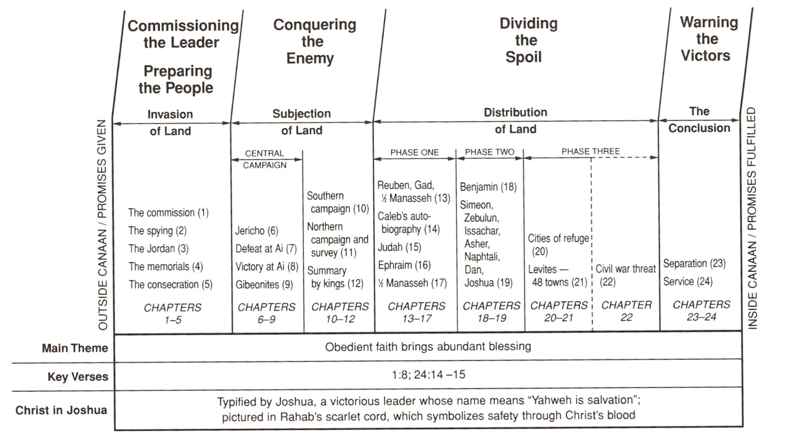
Claiming the land
Conquering the land
Distributing
the land
Living the land
Resting in the land

Slide 5
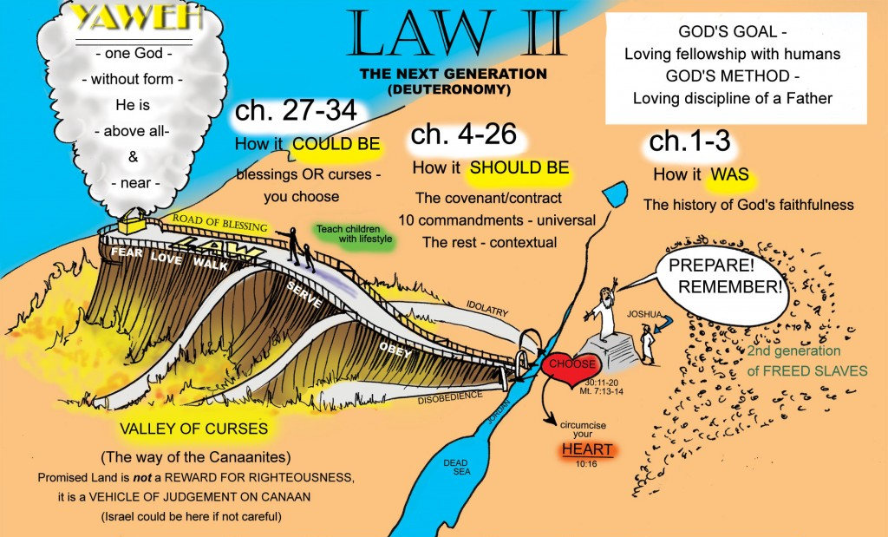
Key Verses
Joshua 1:8(ESV)
⁸This Book of the Law shall not depart from your mouth, but you shall meditate on it day and night, so that you may be careful to do according to all that is written in it.
For then you will make your way prosperous, and then you will have good success.

Slide 6
Key Verses
Joshua 24:14-15(ESV)
¹⁴“Now therefore fear the Lord and serve him in sincerity and in faithfulness. Put away the gods that your fathers served beyond the River and in Egypt, and serve the Lord.
¹⁵And if it is evil in your eyes to serve the Lord, choose this day whom you will serve, whether the gods your fathers served in the region beyond the River, or the gods of the Amorites in whose land you dwell.
But as for me and my house, we will serve the Lord.” .

Slide 7
God's fulfillment of the land promise
Genesis 12:1-3(ESV)
¹Now the Lord said to Abram, “Go from your country and your kindred and your father’s house
to the land that I will show you.
²And I will make of you a great nation,
and I will bless you and make your name great, so that you will be a blessing. ³I will bless those who bless you, and him who dishonors you I will curse, and
in you all the families of the earth shall be blessed.”
Book of
Joshua
Egypt
Jesus

Slide 8
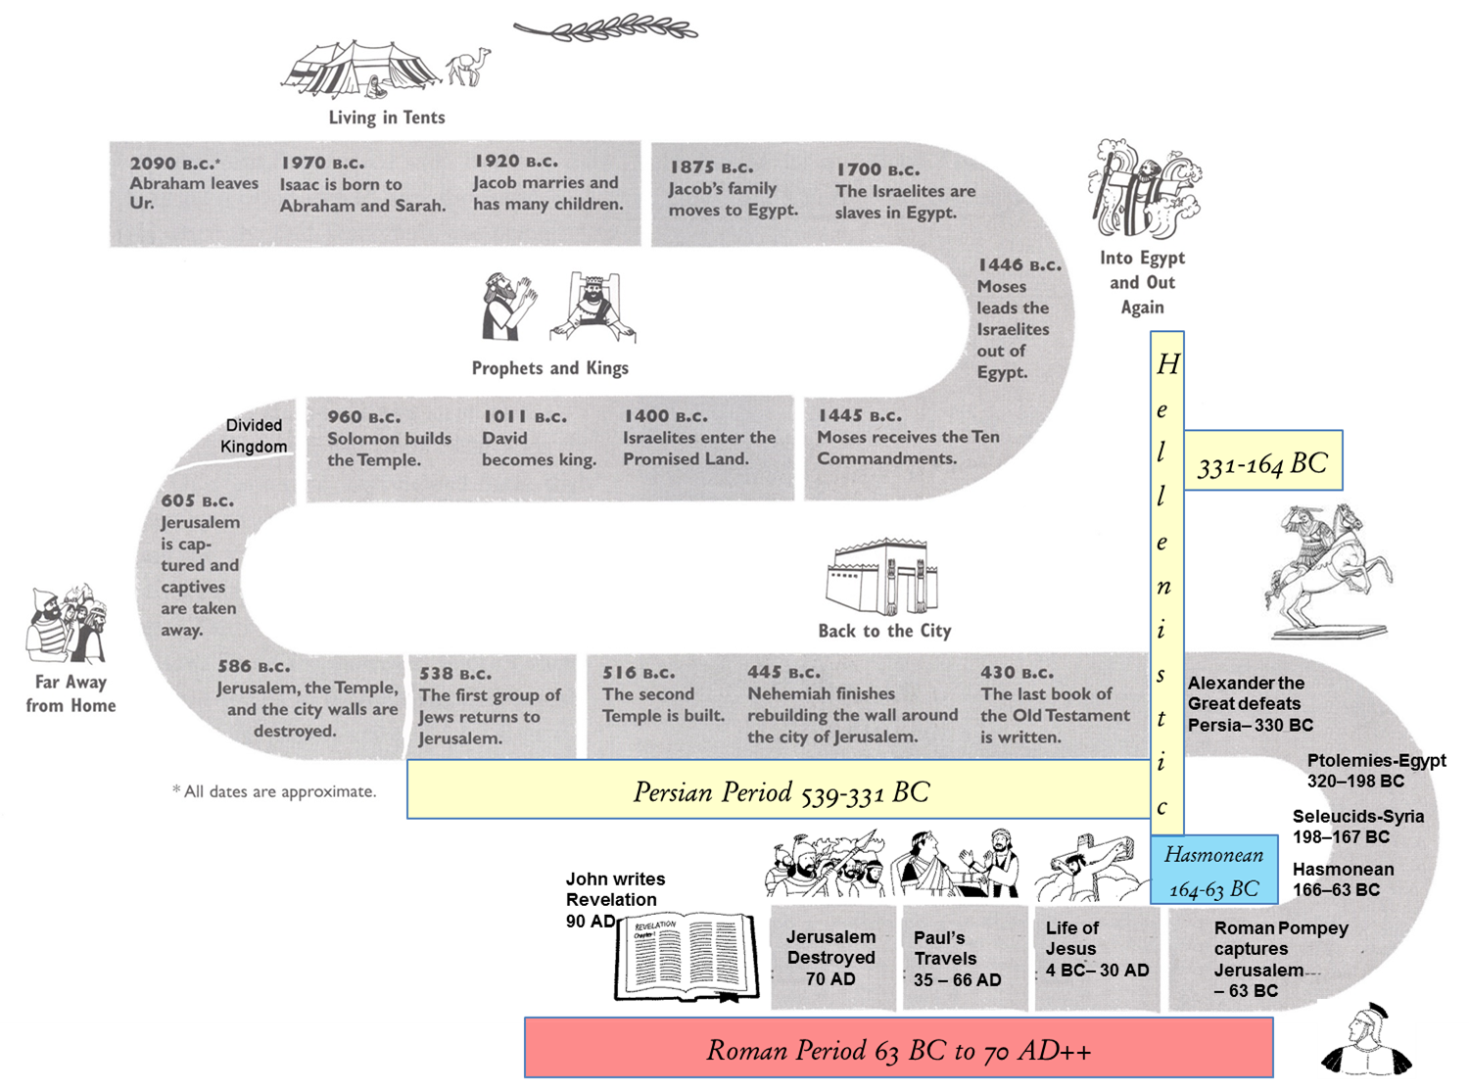
Promised Land
Sojourners in the land
Conquest of the land
Living in the land
Taken from the land
Remnant returns to the land
Christ comes

Slide 9
Worksheets in Back of Folder
Conquest Worksheet
  Learn about God’s fulfillment of Land Promise
  Better Understanding of Conquest
Cities & Kings Defeated
  Fulfillment of land promise
  Allotment of land exercise
  Better Understanding of Conquest
  Nations/people conquered

Slide 10
Conquest of Canaan
# | Chapter & Verse | Description of the Conquest
1 | Genesis 12:5-7 | ⁵...When they came to the land of Canaan, ⁶Abram passed through the land to the place at Shechem, to the oak of Moreh. At that time the Canaanites were in the land. ⁷Then the Lord appeared to Abram and said, “To your offspring I will give this land.” So he built there an altar to the Lord, who had appeared to him.
2 | Genesis 15:7, 3-14, 16 | ⁷And he said to him, “I am the Lord who brought you out from Ur of the Chaldeans to give you this land to possess.” ¹³Then the Lord said to Abram, “Know for certain that your offspring will be sojourners in a land that is not theirs and will be servants there, and they will be afflicted for four hundred years. ¹⁴But I will bring judgment on the nation that they serve, and afterward they shall come out with great possessions. ¹⁶And they shall come back here in the fourth generation, for the iniquity of the Amorites is not yet complete.”

Slide 11
Conquest of Canaan
# | Chapter & Verse | Description of the Conquest
6 | Genesis 50 | ²⁴And Joseph said to his brothers, “I am about to die, but God will visit you and bring you up out of this land to the land that he swore to Abraham, to Isaac, and to Jacob.” ²⁵Then Joseph made the sons of Israel swear, saying, “God will surely visit you, and you shall carry up my bones from here.”
7 | Exodus 3:16-17 | ¹⁶Go and gather the elders of Israel together and say to them, ‘The Lord, the God of your fathers, the God of Abraham, of Isaac, and of Jacob, has appeared to me, saying, “I have observed you and what has been done to you in Egypt, ¹⁷and I promise that I will bring you up out of the affliction of Egypt to the land of the Canaanites, the Hittites, the Amorites, the Perizzites, the Hivites, and the Jebusites, a land flowing with milk and honey.”’

Slide 12
Conquest of Canaan
# | Chapter & Verse | Description of the Conquest
10 | Exodus 23 | ²⁸And I will send hornets before you, which shall drive out the Hivites, the Canaanites, and the Hittites from before you.
11 | Exodus 23 | ²⁹I will not drive them out from before you in one year, lest the land become desolate and the wild beasts multiply against you. ³⁰Little by little I will drive them out from before you, until you have increased and possess the land. ³¹And I will set your border from the Red Sea to the Sea of the Philistines, and from the wilderness to the Euphrates, for I will give the inhabitants of the land into your hand, and you shall drive them out before you.

Slide 13
Conquest of Canaan
# | Chapter & Verse | Description of the Conquest
13 | Exodus 33 After incident with Golden Calf | ¹The Lord said to Moses, “Depart; go up from here, you and the people whom you have brought up out of the land of Egypt, to the land of which I swore to Abraham, Isaac, and Jacob, saying, ‘To your offspring I will give it.’ ²I will send an angel before you, and I will drive out the Canaanites, the Amorites, the Hittites, the Perizzites, the Hivites, and the Jebusites. ³Go up to a land flowing with milk and honey; but I will not go up among you, lest I consume you on the way, for you are a stiff-necked people.” ⁴When the people heard this disastrous word, they mourned, and no one put on his ornaments.
14 | Exodus 34 | ¹¹“Observe what I command you this day. Behold, I will drive out before you the Amorites, the Canaanites, the Hittites, the Perizzites, the Hivites, and the Jebusites. ¹²Take care, lest you make a covenant with the inhabitants of the land to which you go, lest it become a snare in your midst.

Slide 14

Class Objectives
Learn about God's fulfillment of the land promise.
Learn about Serving the Lord in the days of Joshua
Study the Geography & Archaeology of the Conquest of Canaan
Be ready to give a defense of the Conquest of Canaan

Slide 15
Some Comparisons between the Crossing of the Red/Reed Sea with the Crossing of the Jordan River
Exodus | Joshua
God separated the waters (14:21; 15:8) | God separated the waters (3:13, 15–16)
The waters piled up and stood up in a heap (15:8) | The waters stood and rose up in a heap (3:13, 16)
Israel passed through on dry ground (14:22, 29) | Israel passed through on dry ground (3:17; 4:22)
Moses affirmed (14:31) | Joshua affirmed (4:14)
Surrounding nations respond in fear (15:15–16) | Surrounding nations respond in fear (5:1)
Exiting Egypt | Entering Canaan
Enemies Behind Moses | Enemies Ahead of Joshua

Slide 16
Serving the Lord in the days of Joshua
Joshua 24:15 -
¹⁵ And if it is evil in your eyes to serve the Lord, choose this day whom you will serve, whether the gods your fathers served in the region beyond the River, or the gods of the Amorites in whose land you dwell. But as for me and my house, we will serve the Lord.”
As Christians we strive to be serve God, it behooves us to learn more about this man who was an assistant of Moses, the people obeyed and who sought for his family to serve the Lord.

Slide 17
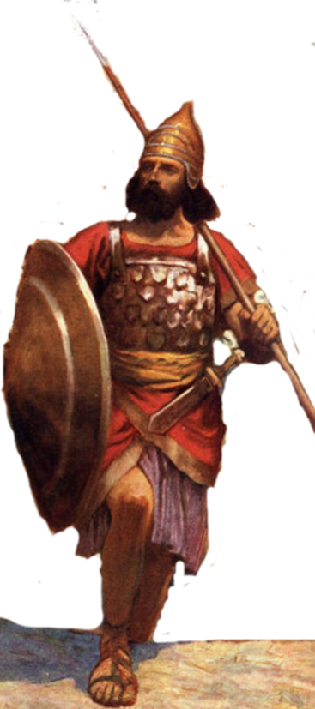
Character of Joshua
Reflected his mentor, Moses Exodus 24:13; 33:11
Loyal – Numbers 11
Courageous – Numbers 14:6-10
Emotional – Joshua 7:6
Intelligence/Wise military man – Joshua 8:3-29
Could be beguiled – Joshua 9:3-27
Prophetic – Joshua 6:26-27
Strong religious leader Judges 2:7
Obedient/Devoted to God Joshua 23-24
Good Example – Joshua 24:14-15
Focused – spied out Canaan Numbers 14
Endurance – Joshua 12
Speaking Ability – Joshua 24
Kept Oath – Joshua 9-10
Spoken Words
Josh 10:25
²⁵And Joshua said to them, “Do not be afraid or dismayed; be strong and courageous. For thus the Lord will do to all your enemies against whom you fight.”
Josh. 21:43–45: “Not one of all the LORD’s good promises failed.”
Josh. 24:14–15: “As for me and my household, we will serve the LORD.”

Slide 18
Class Objectives
Learn about God's fulfillment of the land promise.
Learn about Serving the Lord in the days of Joshua
Study the Geography & Archeology of the Conquest of Canaan
Be ready to give a defense of the Conquest of Canaan

Slide 19
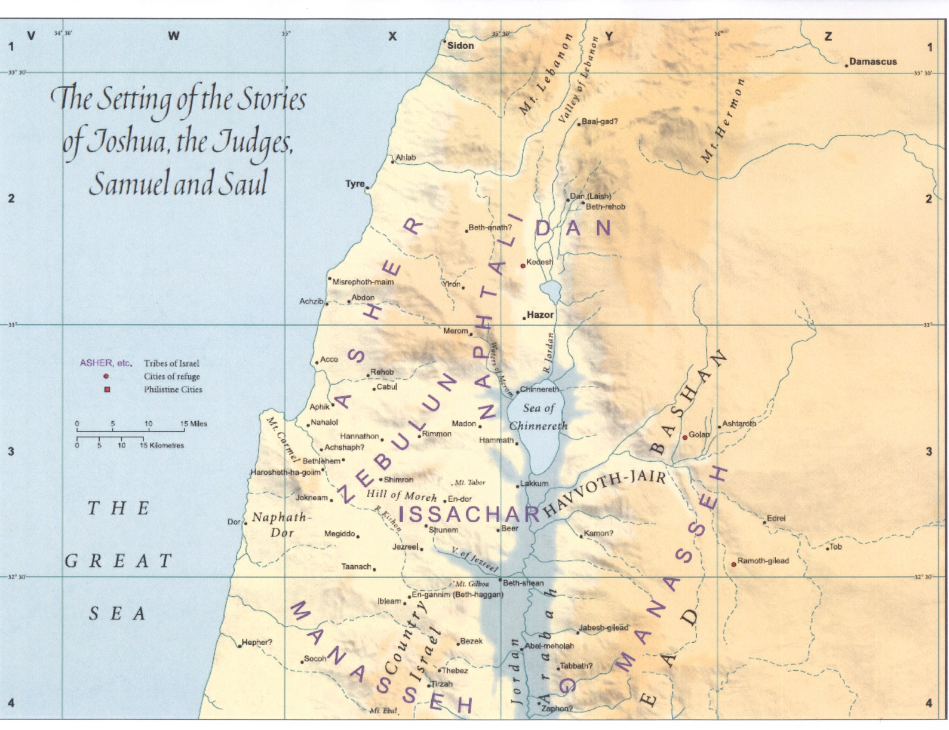
Geography of the Conquest
There is hardly a city referenced in the bible that does not include a city named in the book of Joshua.

Slide 20
It is Possible that there is Supernatural
The Universe had Supernatural Origins
The Universe had a Intelligent, Personal Origin
Reasonable to Believe
There is a Purpose for the Creation
It is Likely There is a Moral Law
Miracles & Revelation are Possible
No Purpose
No Moral Laws
No Miracles
No Revelation

Slide 21
It is Possible that there is Supernatural
The Universe had Supernatural Origins
The Universe had a Intelligent, Personal Origin
Reasonable to Believe
There is a Purpose for the Creation
It is Likely There is a Moral Law
Miracles & Revelation are Possible
No Revealing
Of what is Right
& Wrong
Divine Revelation is Possible
Divine Revelation or Bible would be Accurate
Accurate Account of Jesus’ Life
Account In Old Testament is Accurate
Bible is Inspired
Teachings of Jesus are Truth
Bible a work
Of Man & Is
At Best Myth
At Worst Lies
Bible is
Inaccurate
Bible is
Inaccurate
Based on Bible Testimony Jesus is the Son of God

Slide 22
Ranking the Impossible
Rank | Person | Miracle | Passage | Physical Explanation or Doable by Men
 | Joshua | Crossing Jordan river at flood stage | Josh 3:14-17
 | Joshua | Walls of Jericho when people shouted | Josh 6:15-21
 | Joshua | Sun stands till for about a whole day | Josh 10:12-15
 | Joshua | Conquest of Canaan - 1 man = 1000 of the Canaanites | Josh 23:9-10
3
2
1
4

Slide 23
Archaeology Can Only See Physical Things of the Bible
Modern science is limited due to an inability to measure Spiritual Things
Archaeology
Studies Physical Remains in Context
& Uses Comparative Interpretation
(Archaeologist's View Point)
Archaeology Can
  Confirm
  Give Context
  Contradict
  Measure Physical Things
Cannot Verify Spiritual Truth
Cannot Measure
Spiritual Things

Slide 24
Archaeology of the Conquest
We have to start by going all the way back to the Exodus, which the combination of archaeology and text has led me to argue was historical; it actually happened.
Ninety percent of the arguments against its historicity are not about the event itself
but about the size of the event:
All of Israel! Two million people (as suggested by
Exodus 12:37–38)! Impossible!
One should be able to look at the archaeological evidence in the land and identify Joshua’s Conquest
Richard Elliott Friedman
B I B L I C A L A R C H A E O LO G Y R E V I EW
S E P T E M B E R / O C TO B E R 2 0 1 4

Slide 25
Archaeology of the Conquest
It is certainly true that there are also some harsh
passages toward foreigners in the Bible: Dispossess
the Canaanites, destroy Jericho, etc.
But the evidence in the ground, discussed and debated many times in BAR’s pages, indicates that most of that
(the so-called Conquest of the land) never happened.
One should be able to look at the archaeological evidence in the land and identify Joshua’s Conquest
Richard Elliott Friedman
B I B L I C A L A R C H A E O LO G Y R E V I EW
S E P T E M B E R / O C TO B E R 2 0 1 4

Slide 26
Class Objectives
Learn about God's fulfillment of the land promise.
Learn about Serving the Lord in the days of Joshua
Study the Geography & Archaeology of the Conquest of Canaan
Be ready to give a defense of the Conquest of Canaan

Slide 27
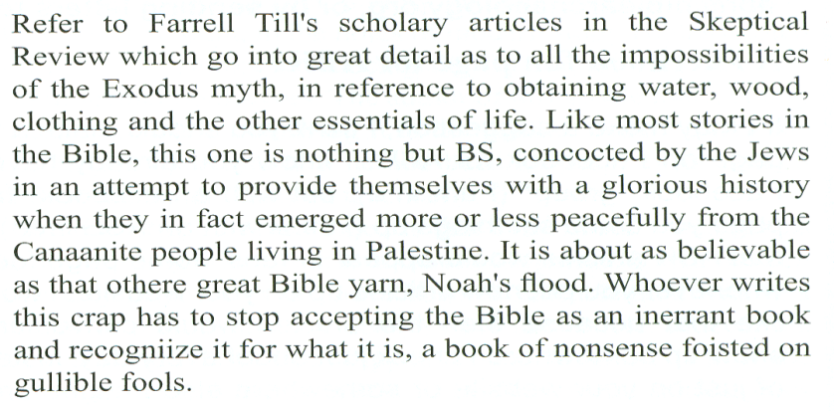
Inerrancy of the Scriptures
The Exodus and the Conquest are two events denied by most Bible Scholars and Archaeologist
The main reason is an inability to accept a supreme being and events outside of the natural world.

Slide 28
Be ready to give a defense of the Conquest of Canaan
1 Peter 3:13-17(ESV)
¹³ Now who is there to harm you if you are zealous for what is good?
¹⁴ But even if you should suffer for righteousness’ sake, you will be
blessed. Have no fear of them, nor be troubled,
¹⁵ but in your hearts regard Christ the Lord as holy, always being prepared to make a defense to anyone who asks you for a reason for the hope that is in you;
¹⁶ yet do it with gentleness and respect, having a good conscience, so that, when you are slandered, those who revile your good behavior in Christ may be put to shame.
¹⁷ For it is better to suffer for doing good, if that should be God’s will, than for doing evil.

Slide 29
Why is it important to understand what we learn in Joshua is part of a continuity of God’s plan started before the Covenant made with Abraham and carried on down to the death of His son on the cross and resurrection so that we may be saved?

Slide 30
Joshua’s Promised Land not the Rest
Hebrews 4:8-11 (ESV)
⁸For if Joshua had given them rest, God would not have spoken of another day later on.
⁹So then, there remains a Sabbath rest for the people of God,
¹⁰for whoever has entered God’s rest has also rested from his works as God did from his.
¹¹Let us therefore strive to enter that rest, so that no one may fall by the same sort of disobedience.

Slide 31
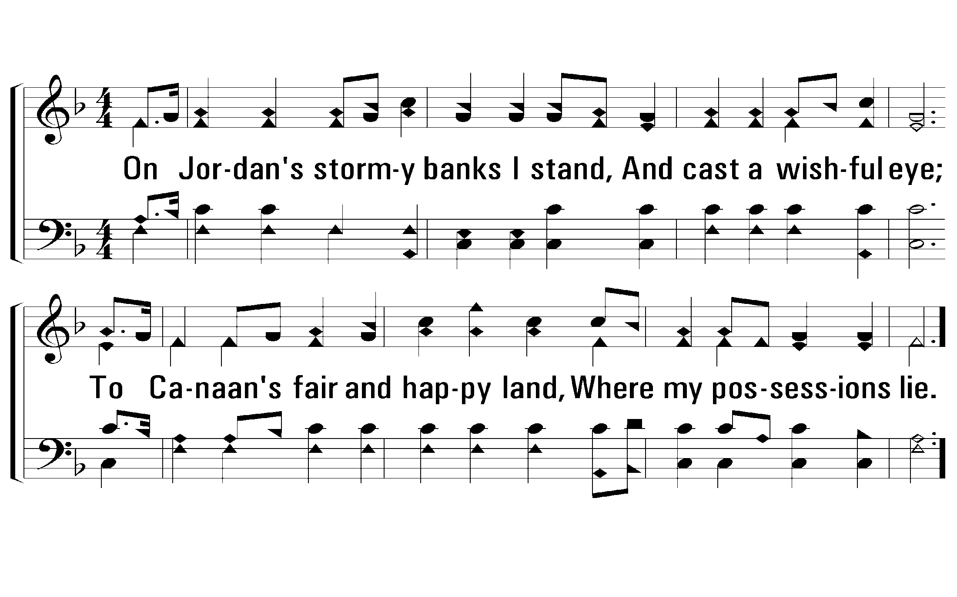
1 – On Jordan’s Stormy Banks
509
1.
On Jordan's stormy banks I stand,
And cast a wishful eye;
To Canaan's fair and happy land,
Where my possessions lie.
Words: Samuel Stennett / Cho.: Rigdon M. McIntosh
Music: Walker’s Southern Harmony / Arr.: Rigdon M. McIntosh
© 2001 The Paperless Hymnal™

Slide 32
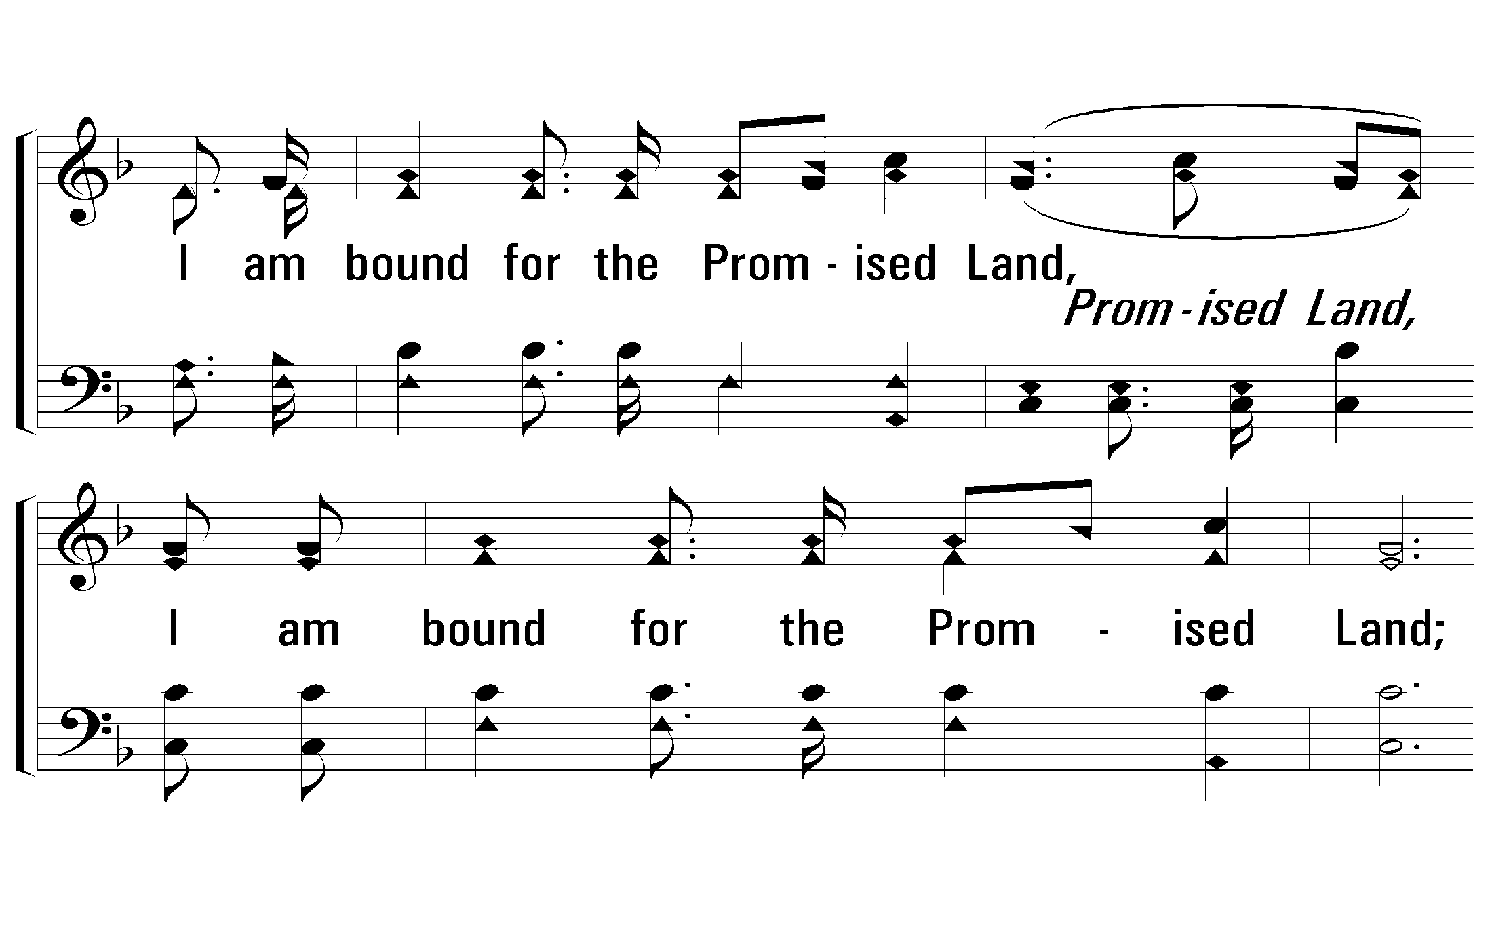
c – On Jordan’s Stormy Banks
509
I am bound for the Promised Land,
I am bound for the Promised Land;
O who will come and go with me?
I am bound for the Promised Land.
© 2001 The Paperless Hymnal™

Slide 33
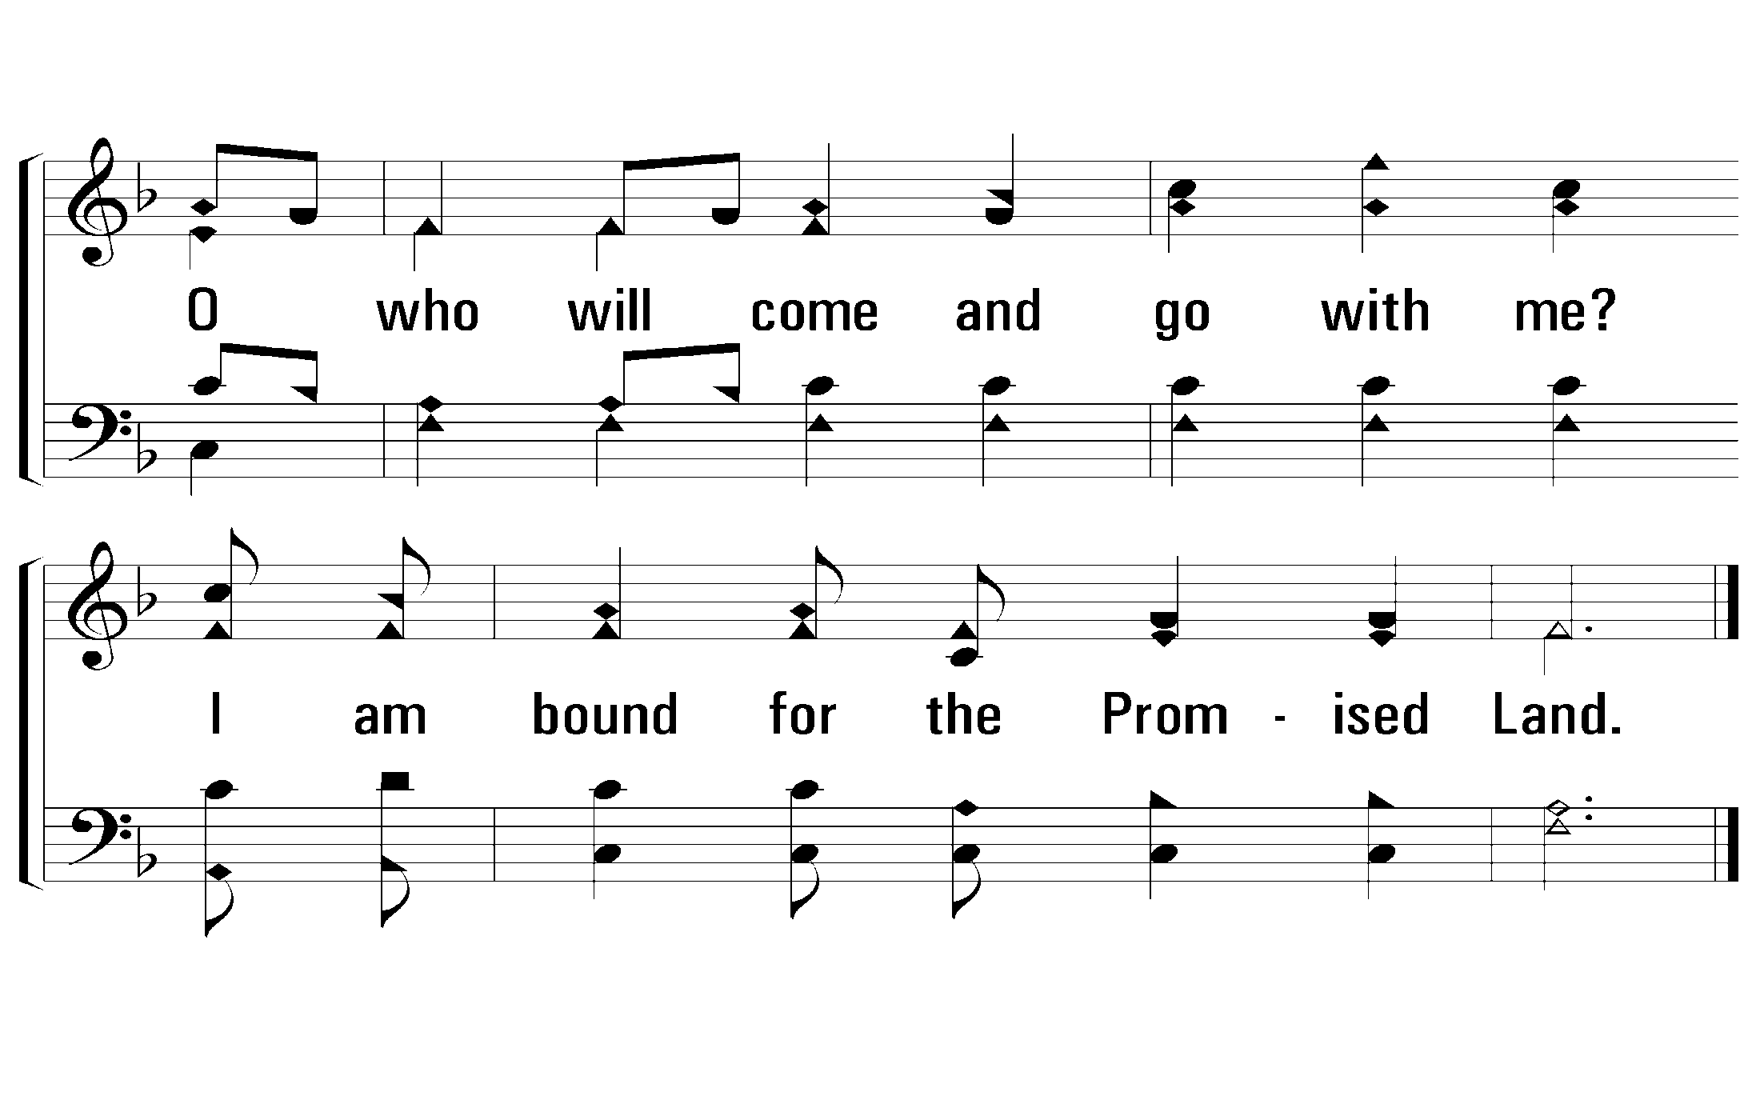
c – On Jordan’s Stormy Banks
509
© 2001 The Paperless Hymnal™
© 2001 The Paperless Hymnal™

Slide 34
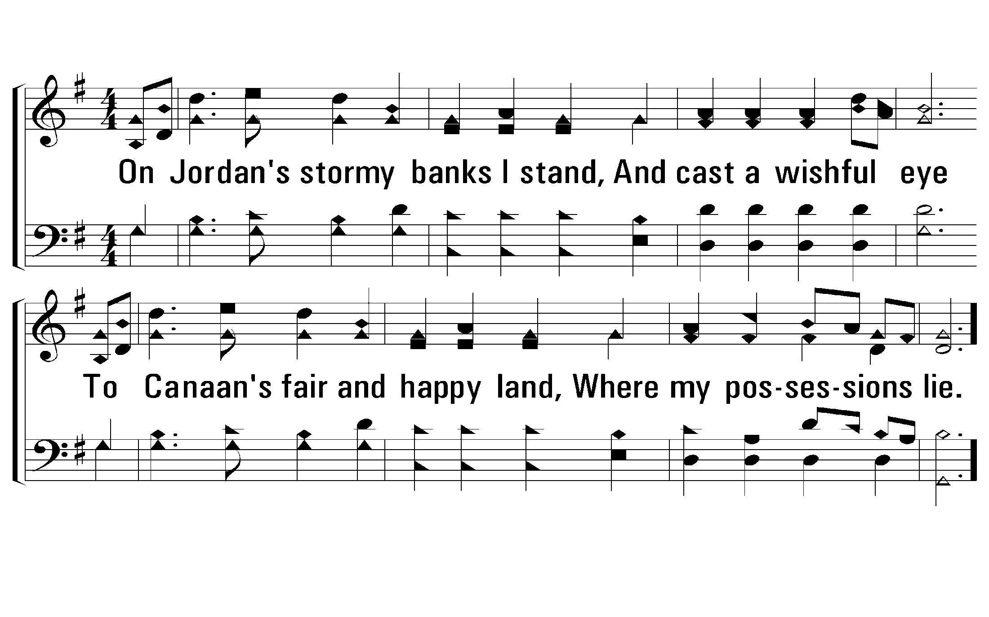
1 - On Jordan’s Stormy Banks
510
1.
On Jordan's stormy banks I stand,
And cast a wishful eye
To Canaan's fair and happy land,
Where my possessions lie.
Words: Samuel Stennett / Cho.: Tullius C. O’Kane
Music: Tullius C. O’Kane
© 2001 The Paperless Hymnal™

Slide 35
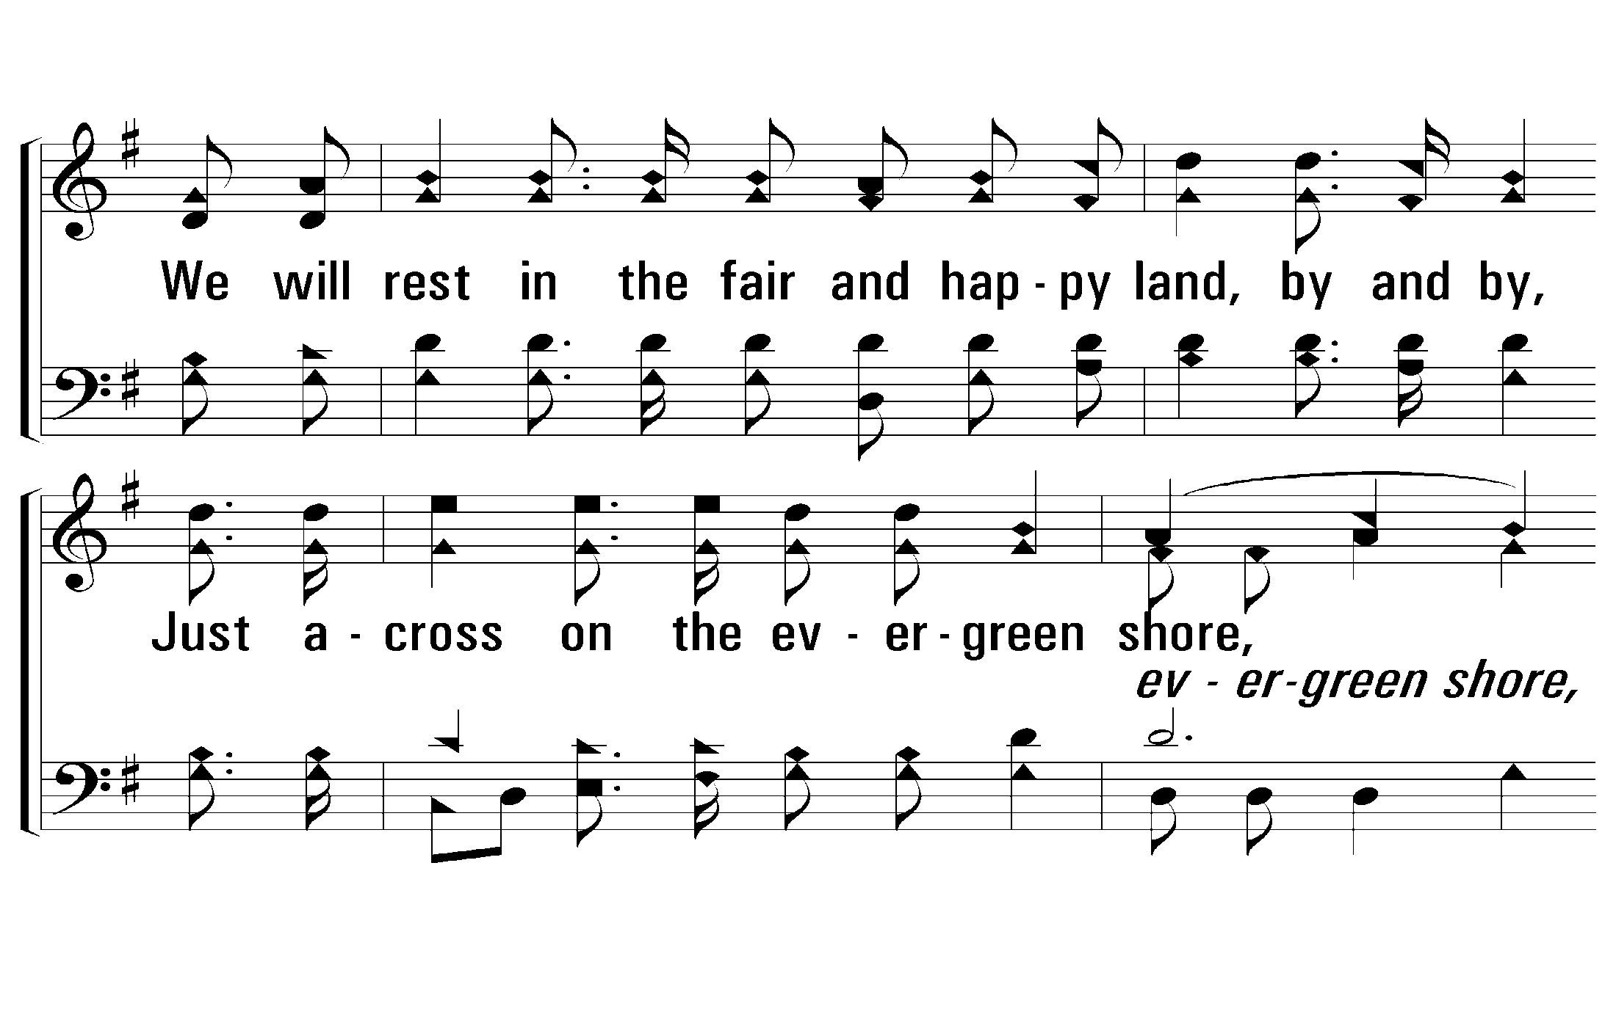
c - On Jordan’s Stormy Banks
510
We will rest in the fair and happy land, by and by,
Just across on the evergreen shore,
Sing the song of Moses and the Lamb, by and by,
And dwell with Jesus evermore.
© 2001 The Paperless Hymnal™

Slide 36
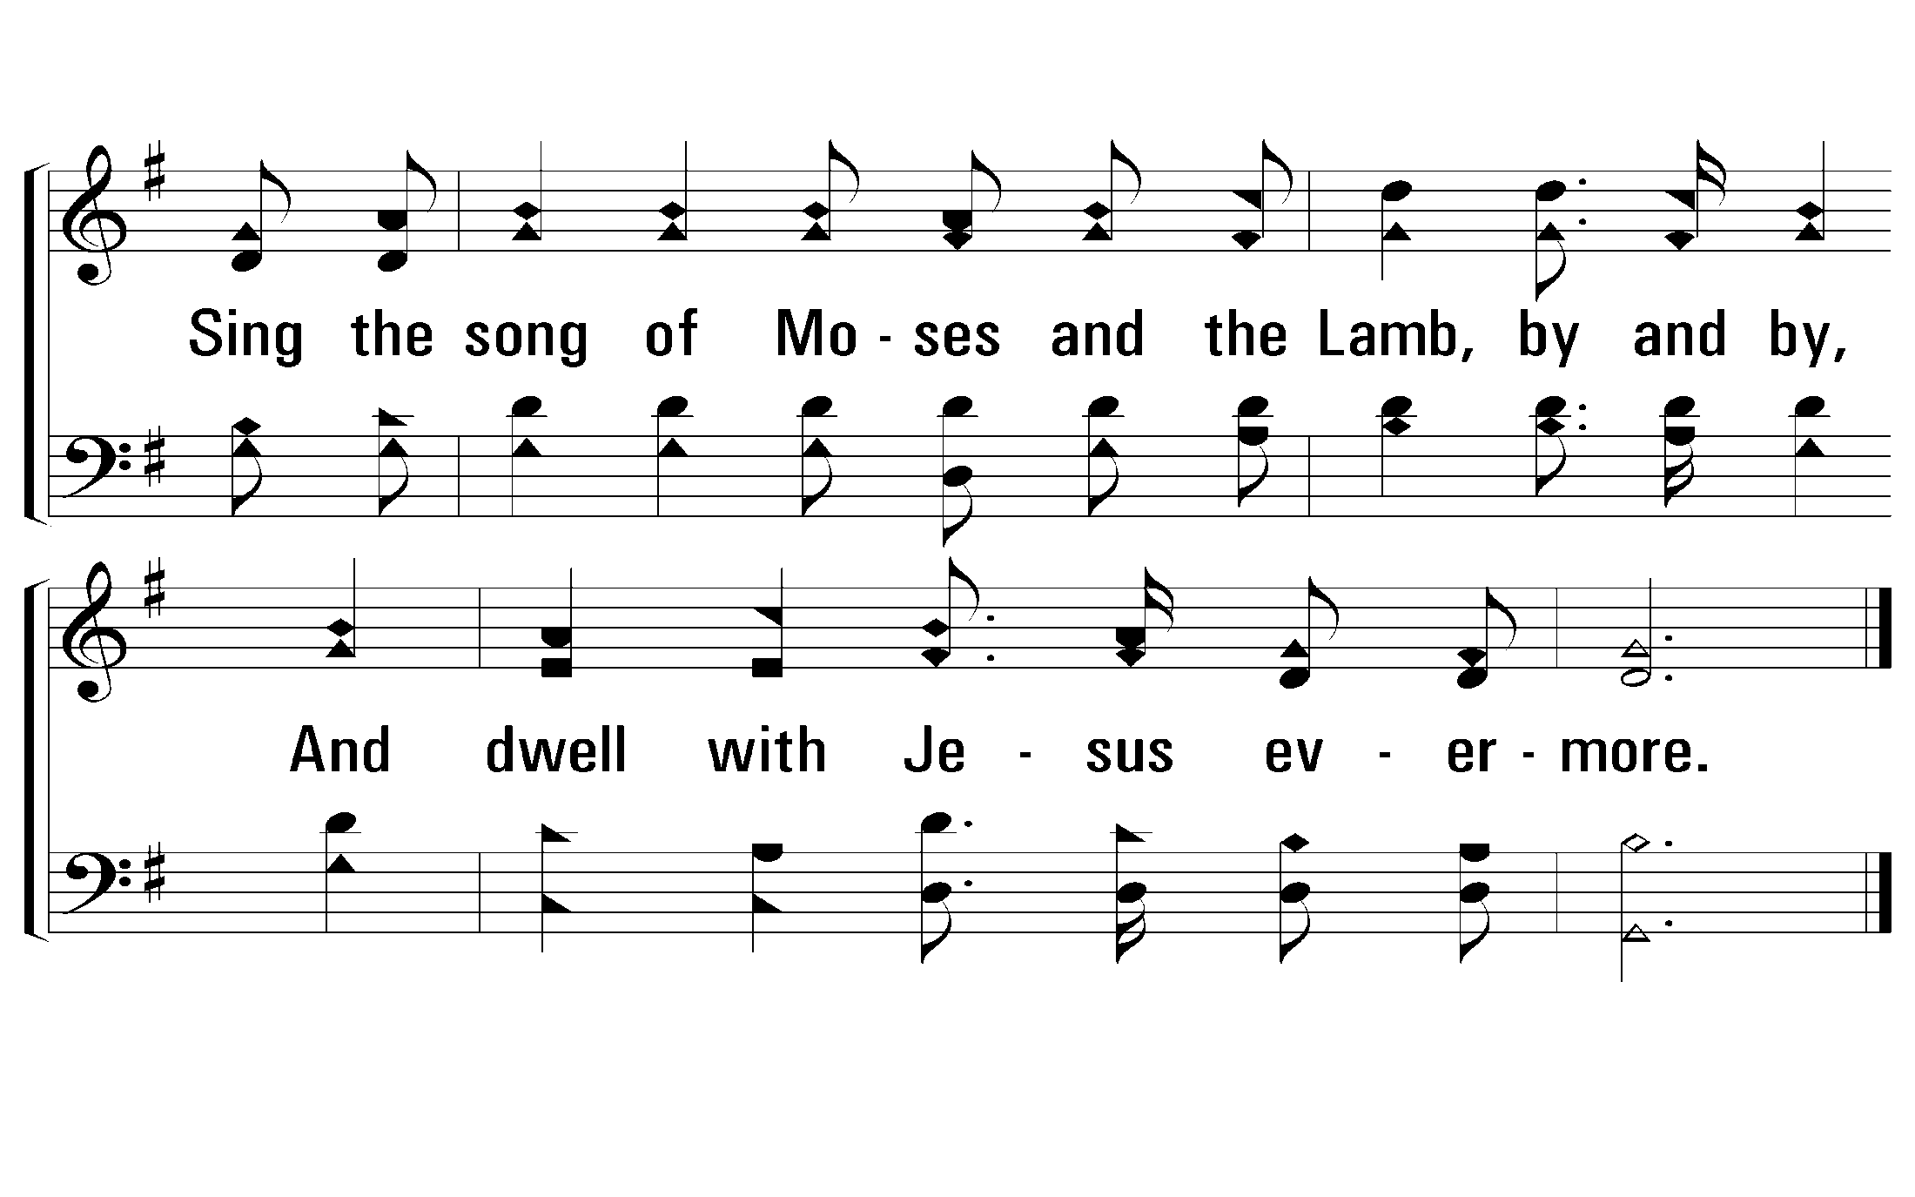
c - On Jordan’s Stormy Banks
510
© 2001 The Paperless Hymnal™

