Slide 1

Book of Joshua
Lesson 4
Crossing the Jordan

Slide 2
Class Objectives
Learn about God's fulfillment of the land promise.
Learn about Serving the Lord in the days of Joshua
Learn about the character of Joshua
Study the Geography & Archaeology of the Conquest of Canaan
Be ready to give a defense of the Conquest of Canaan

Slide 3
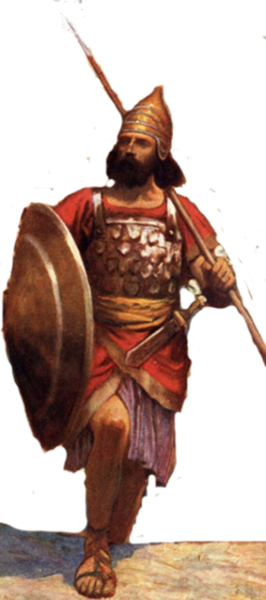
Resting in the land
Living the land
Distributing
the land
Joshua
24:29-33
Conquering the land
Joshua
13-21
Joshua
22-24
Claiming the land
Joshua
6-12
Joshua
1-5
Notes:
I. Claiming the Land (1:1–5:15)
II. Conquering the Land (6:1–12:24)
III. Distributing the Land (13:1–21:45)
IV. Living in the Land (22:1–24:28)
V. Resting in the Land (24:29–33)

Slide 4
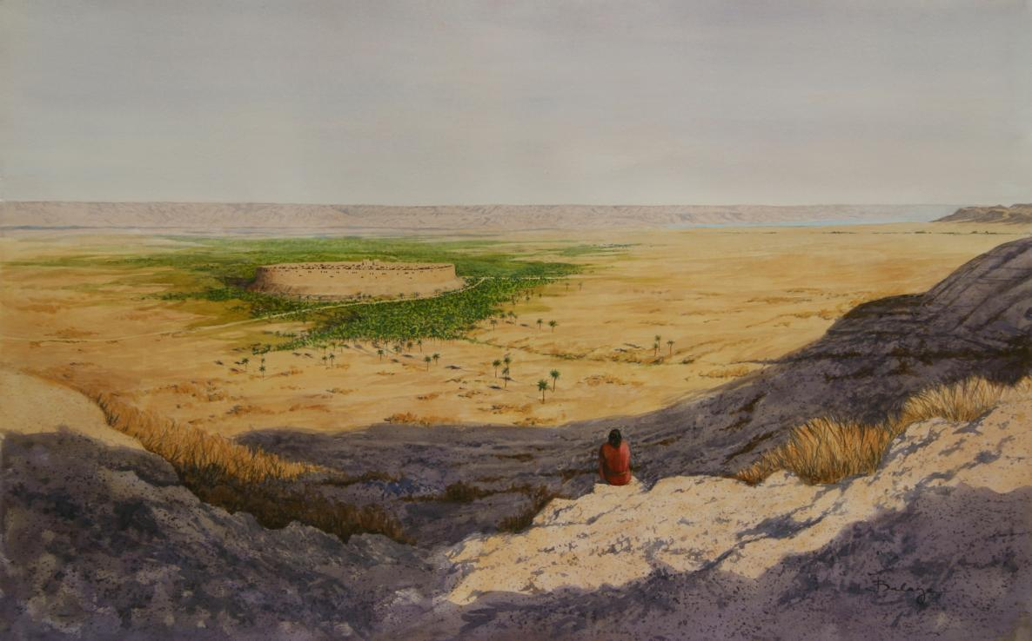

Joshua’s Challenges –
People who had failed last time – 40 yrs
New Leader
New Generation
A swollen river
A walled city
Unknown city/people

Slide 5
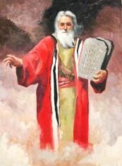
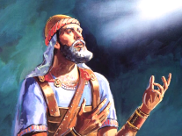
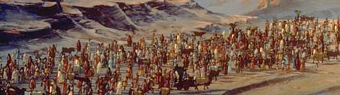
Be Strong and Courageous
GOD
Joshua was commanded to be “Strong and Courageous”
He would deliver God’s promise of the Land
He should be careful to follow God’s Law
God would be with him, he was not to fear
Deut 31:23
Josh 1:6-9 (3x)
Deut 3:28
Deut 31:6
Josh 10:25
Deut 31:7
Josh 1:18

Slide 6
Joshua’s Challenges –
People who had failed last time – 40 yrs
New Leader
New Generation
A swollen river
A walled city
Unknown city/people
Be Strong & Courageous
Just as I was with Moses, so I will be with you.
I will not leave you or forsake you
People – tell Be Strong & Courageous
Prepared people (3 days provisions)
Checked that Tribes across Jordan with him
Sent spies into Jericho
Lord took care of the river
& walled city
Jo 1:2 Now therefore arise, go over this Jordan

Slide 7
Joshua 3:1(ESV) Crossing Jordan
¹Then Joshua rose early in the morning and they set out from Shittim. And they came to the Jordan, he and all the people of Israel, and lodged there before they passed over.
Joshua 6:12 (ESV) Fall of Jericho
¹² Then Joshua rose early in the morning, and the priests took up the ark of the LORD.
Joshua 6:15 (ESV) Fall of Jericho
¹⁵ On the seventh day they rose early, at the dawn of day, and marched around the city in the same manner seven times. It was only on that day that they marched around the city seven times.
Joshua 7:16 (ESV) The Sin of Achan
¹⁶ So Joshua rose early in the morning and brought Israel near tribe by tribe, and the tribe of Judah was taken.
Abraham
Gen 21:14 Sending of Hagar away
Gen 22:3 Offering of Isaac
Moses
Exodus 24:4, 32:6, 34:4

Slide 8
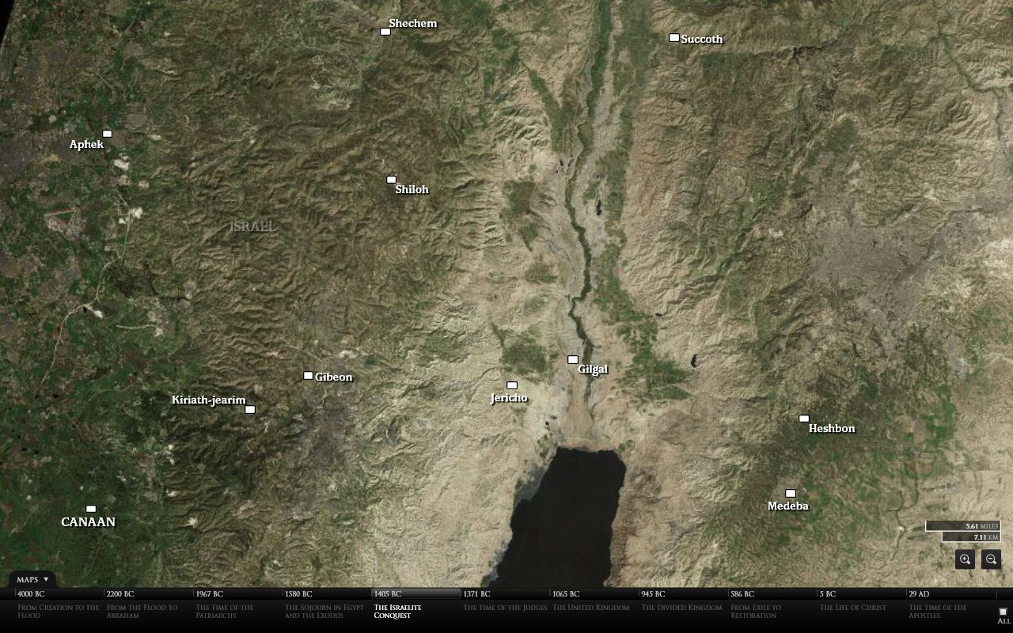
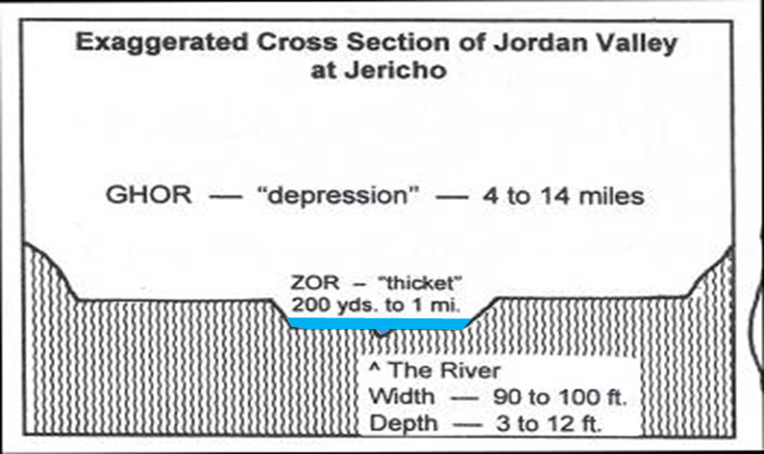
Crossing Jordan

Slide 9
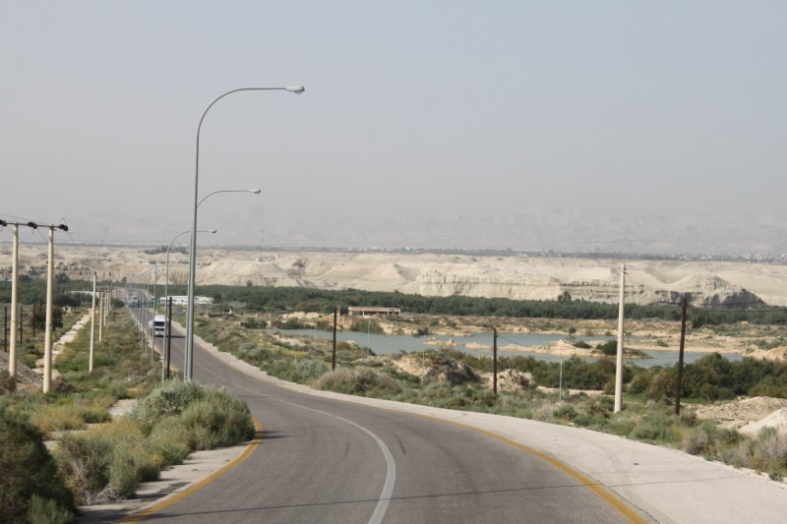
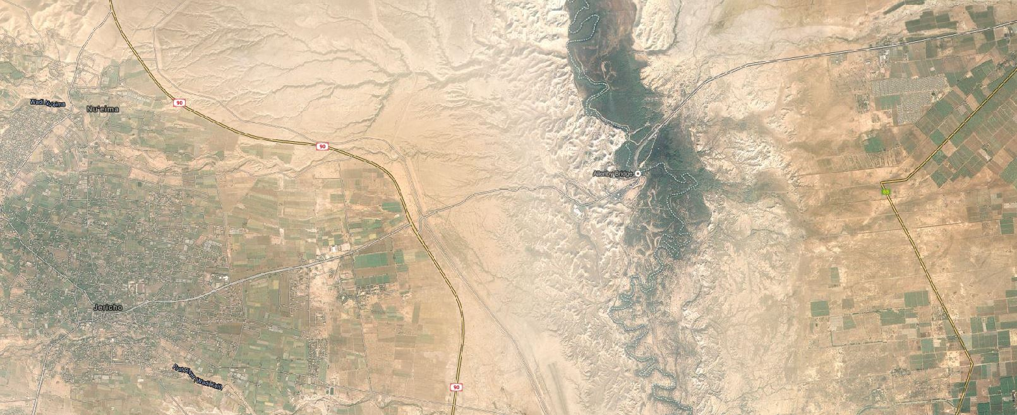
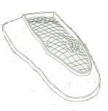
Allenby Bridge
Jericho

Slide 10
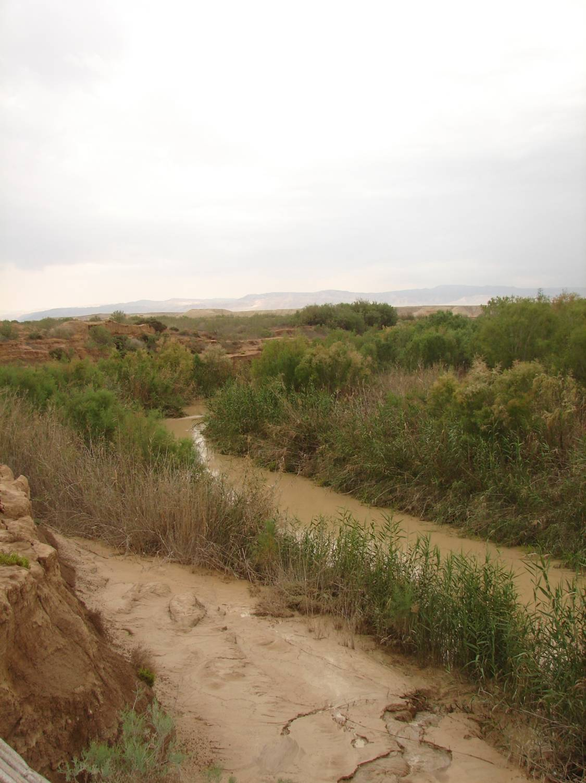
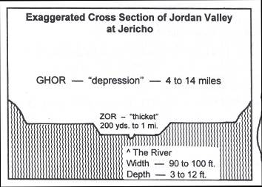
Jordan River
Jericho Area/Bethany Beyond Region

Slide 11
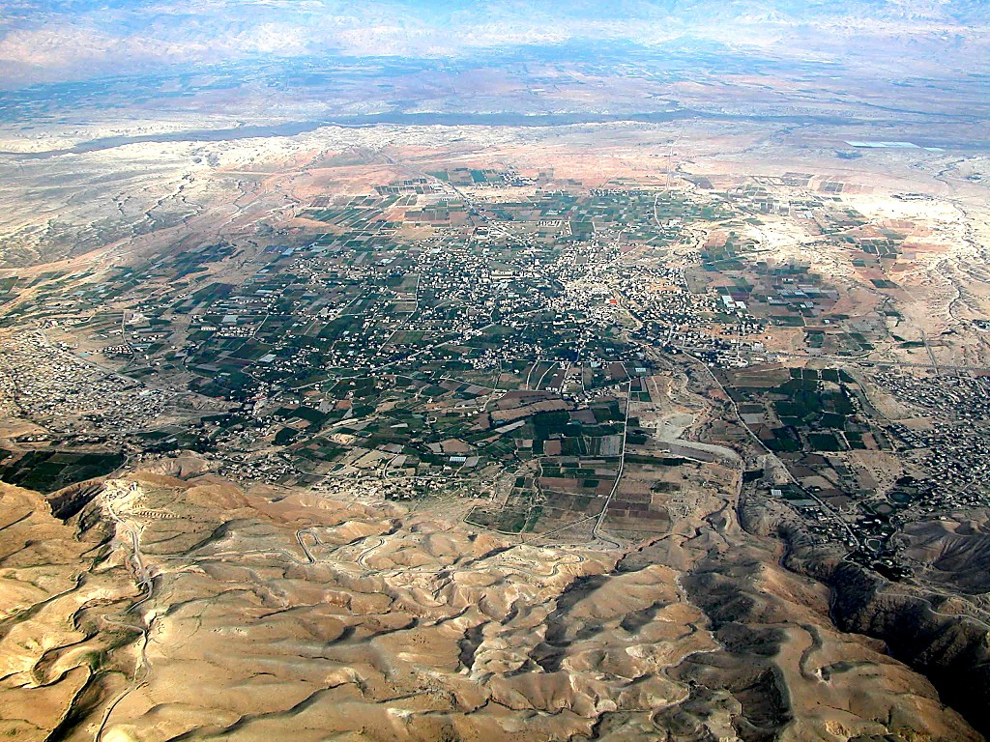
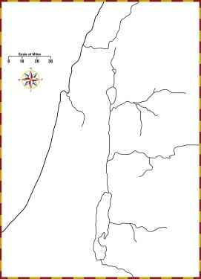
Jericho aerial from west
Jordan River
Tell Jericho
Ascent of Adumim
Wadi Qilt
Ai
Jerusalem
Jericho aerial from west

Slide 12
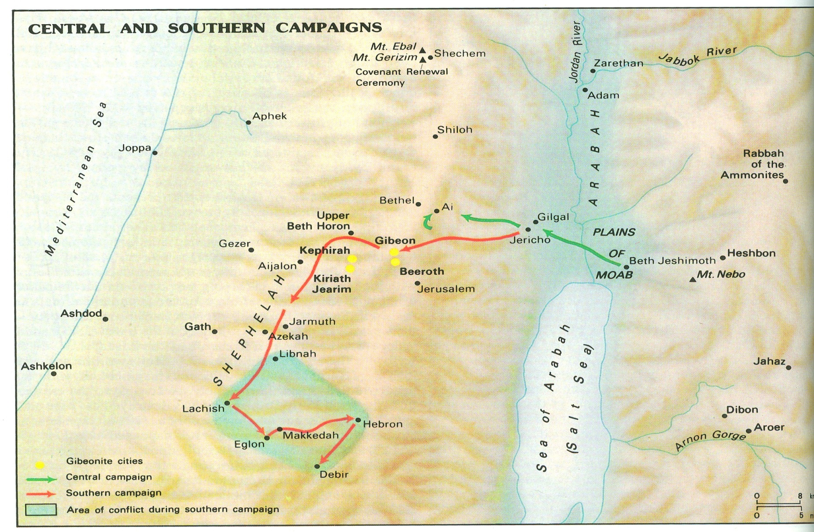

Slide 13
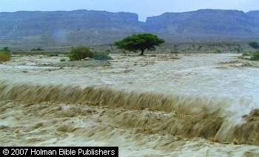
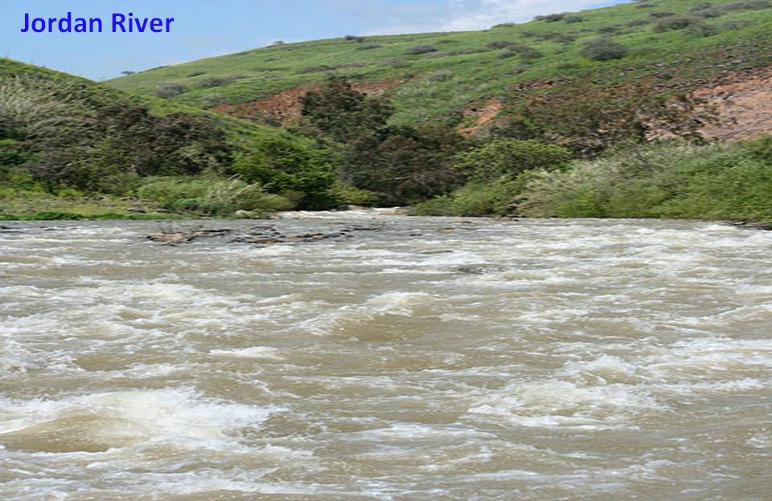
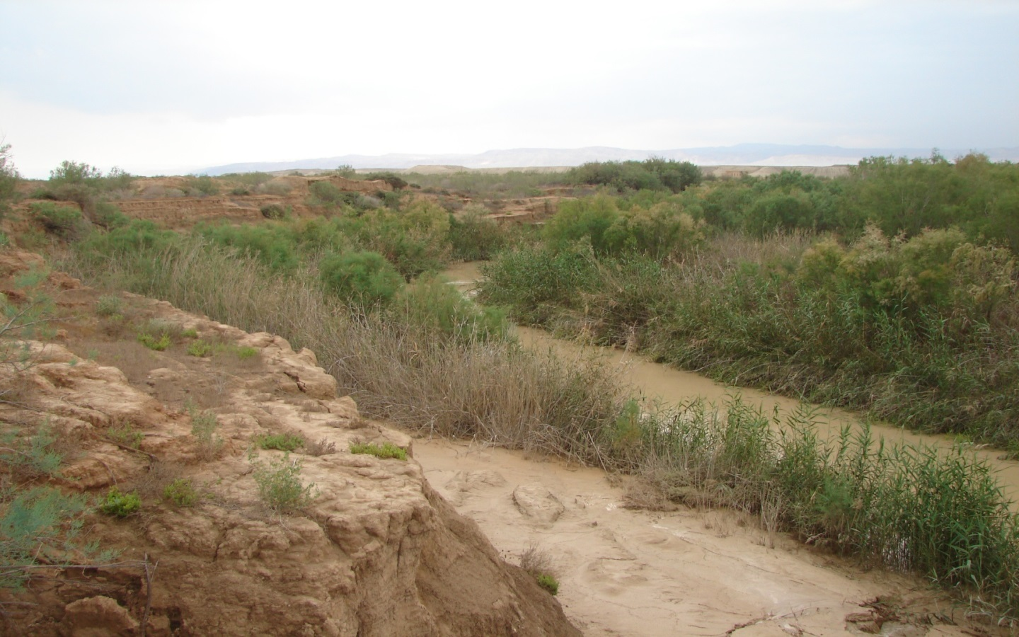
Normal vs Flooded Jordan River
Joshua 3:15(ESV)
¹⁵ …(now the Jordan overflows all its banks throughout the time of harvest),

Slide 14
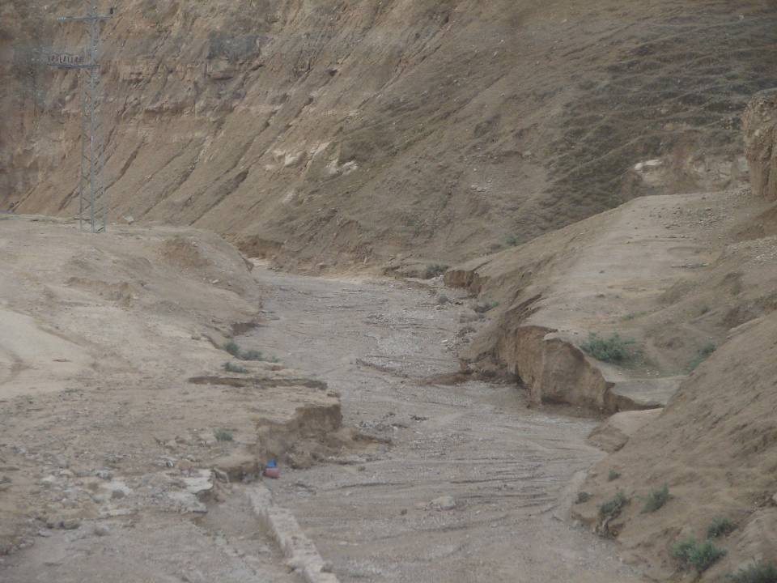
Dry Wadi on Way to Jericho

Slide 15
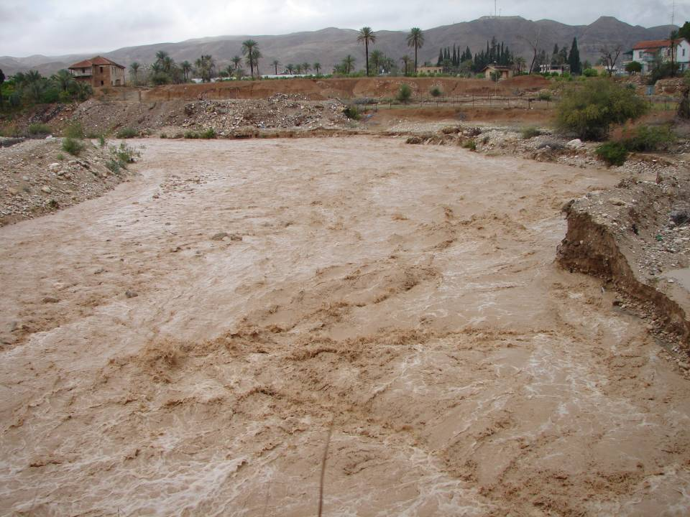
What was Lord’s Purpose in parting the Jordan River?

Slide 16
What was Lord’s Purpose in parting the Jordan River?
Exalt Joshua in sight of Israel
May know that, as I was with Moses, so I will be with you.
Crossing is how Israel shall know that the living God is among you and that he will without fail drive out from before you the Canaanites

Slide 17
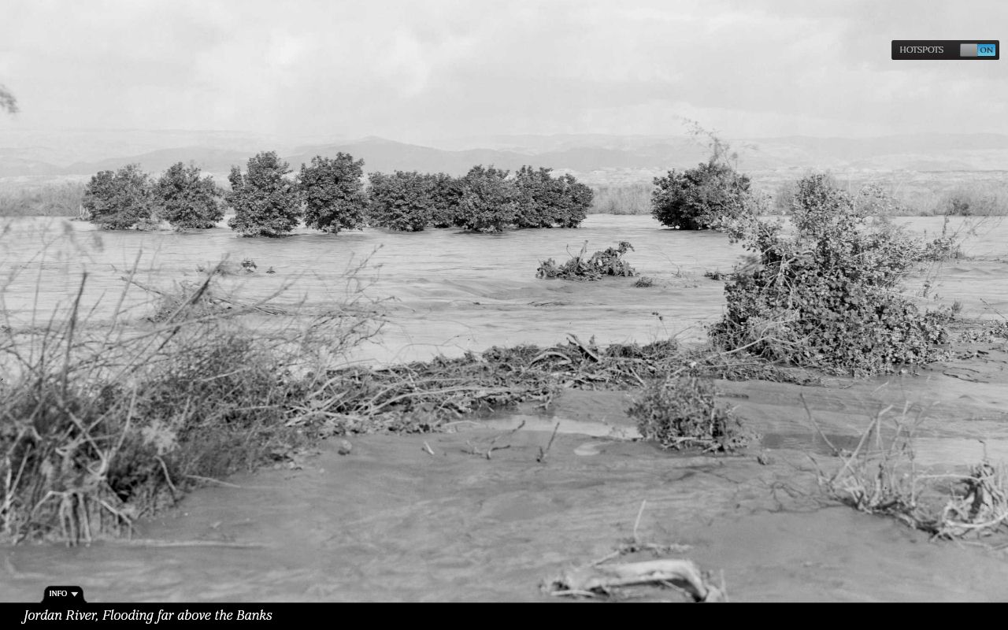

Slide 18
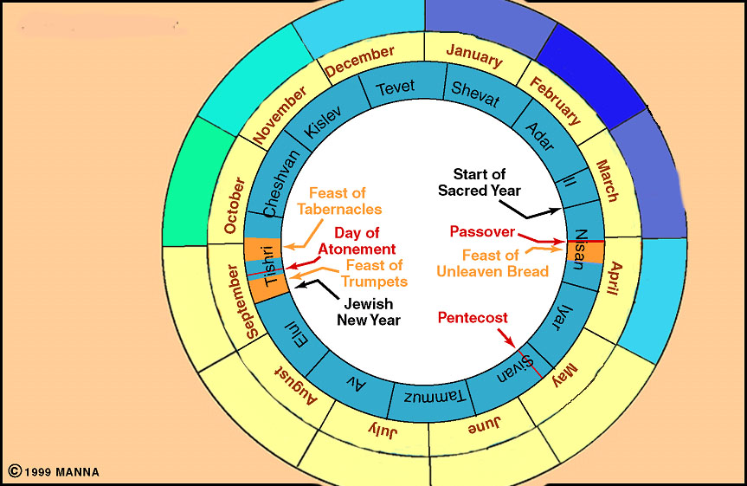
Seasonal Rains
Latter Rain fell about April, when the grain was well grown up, and served to fill the ears, and render them plump and perfect.
Early Rain, when they sowed their seed, and this served to moisten and prepare the ground for the vegetation of the seed.
4”
5”
2”
6”
1”
5”
Joshua 4:19 (ESV)
The people came up out of the Jordan on the tenth day of the first month, and they encamped at Gilgal on the east border of Jericho.
2”
Crossing Jordan River
0”
0”
0”
0”
0”
Adam Clarke’s Commentary

Slide 19
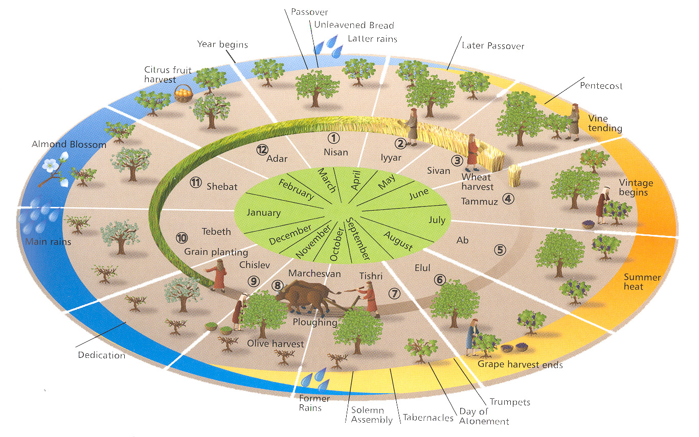

Slide 20
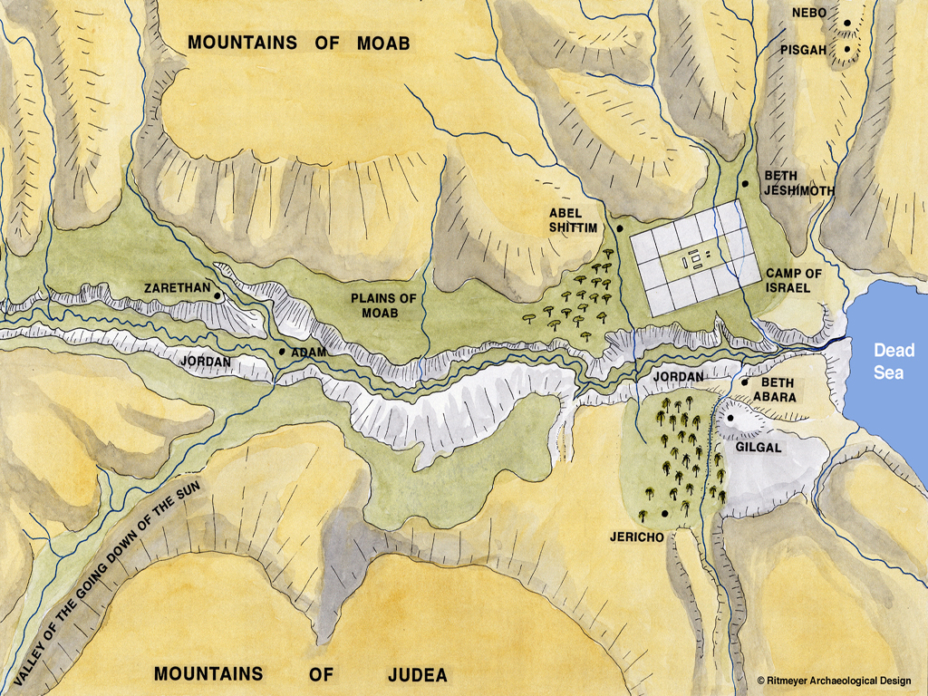

Jordan Stopped near city of Adam, about 15 miles North of where the river was crossed
X

Slide 21
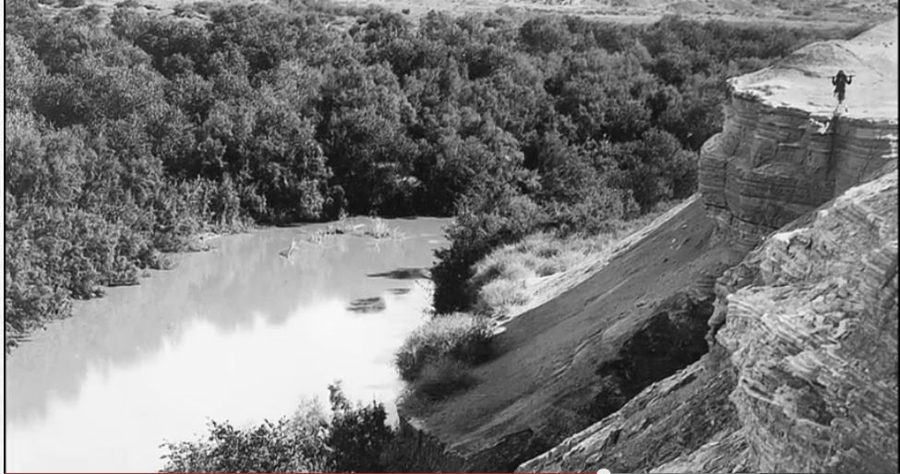
Cliffs at Adam
About 17 miles north of Jericho, at the site generally thought to have been the town of Adam there is geological evidence that numerous landslides temporarily dammed the Jordan River at various times. At least seven historical earthquakes precipitated landslides that dammed the Jordan River near Adam (Damiya):

Slide 22
Cliffs at Adam
1927 AD (July 11 – stopped flow for 22 hours)
1906 AD (stopped flow for 24 hours)
1834 AD1546 AD (Jan 14 – stopped flow for two days)
1534 AD
1267 AD (December 8 – stopped flow for 10 hours)
1160 AD

Slide 23
Importance of Jordan’s Flow Stopping at Adam
The book of Joshua reports that when the Israelites began to cross the Jordan opposite Jericho, the waters of the Jordan "rose up in one heap a great distance away at Adam" as they flowed down toward the Dead Sea (Josh. 3:14-17).
This damming of the river allowed the Israelites to walk across the riverbed on dry ground.
There is nothing historically or religiously significant about this village other than its role as a "footnote" in this account that would explain why the book of Joshua specifies it as the place where the waters were stopped.
Furthermore, a writer composing a "pious fiction" about Joshua stopping the waters of the Jordan would surely have had the waters stop right in front of the Israelites, not miles upstream.
It happened at the very site where the Bible says the water stopped for Joshua

Slide 24
as soon as those bearing the ark had come as far as the Jordan, and the feet of the priests bearing the ark were dipped in the brink of the water … were completely cut off…Now the priests bearing the ark of the covenant of the Lord stood firmly on dry ground in the midst of the Jordan, and all Israel was passing over on dry ground Josh 3:15-17
Notes:
Joshua 3:15-17(ESV)
15 and as soon as those bearing the ark had come as far as the Jordan, and the feet of the priests bearing the ark were dipped in the brink of the water (now the Jordan overflows all its banks throughout the time of harvest),
16 the waters coming down from above stood and rose up in a heap very far away, at Adam, the city that is beside Zarethan, and those flowing down toward the Sea of the Arabah, the Salt Sea, were completely cut off. And the people passed over opposite Jericho.
17 Now the priests bearing the ark of the covenant of the Lord stood firmly on dry ground in the midst of the Jordan, and all Israel was passing over on dry ground until all the nation finished passing over the Jordan.

Slide 25
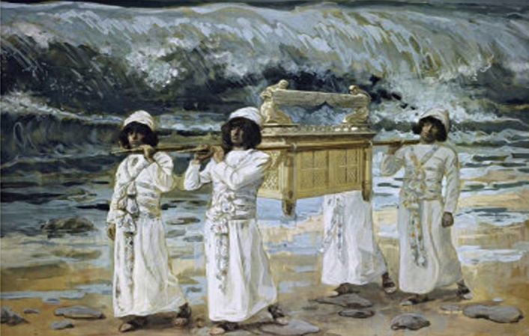
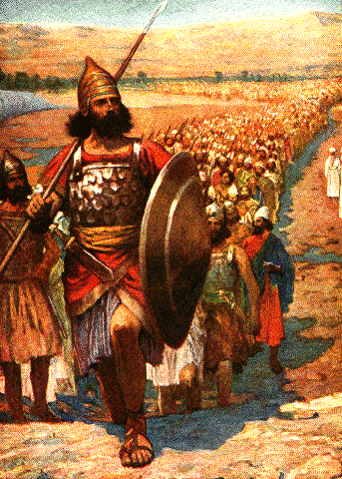
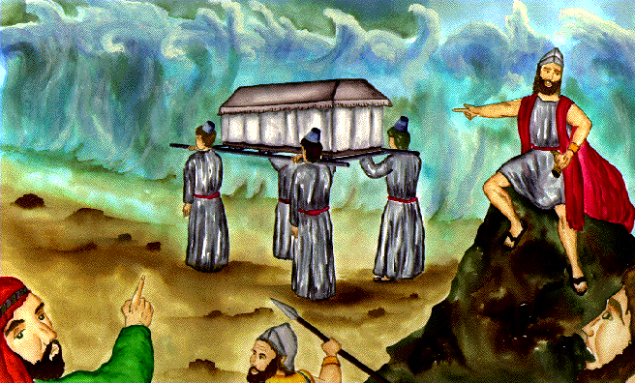
How Long did the priest bearing the ark remain in the midst of the Jordan River?
Joshua 4:17-18(ESV)
¹⁷So Joshua commanded the priests, “Come up out of the Jordan.” ¹⁸And when the priests bearing the ark of the covenant of the Lord came up from the midst of the Jordan, and the soles of the priests’ feet were lifted up on dry ground, the waters of the Jordan returned to their place and overflowed all its banks, as before.

Slide 26
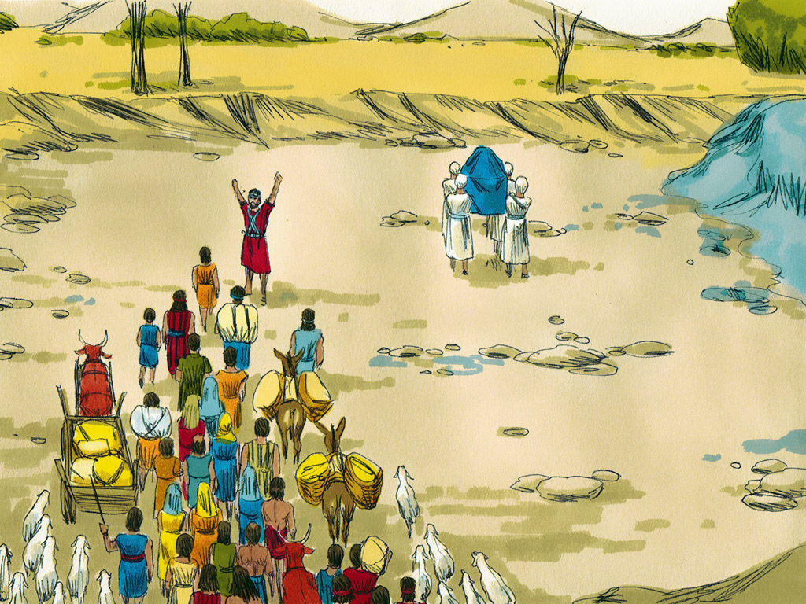
What is wrong with this
Illustration?

Slide 27
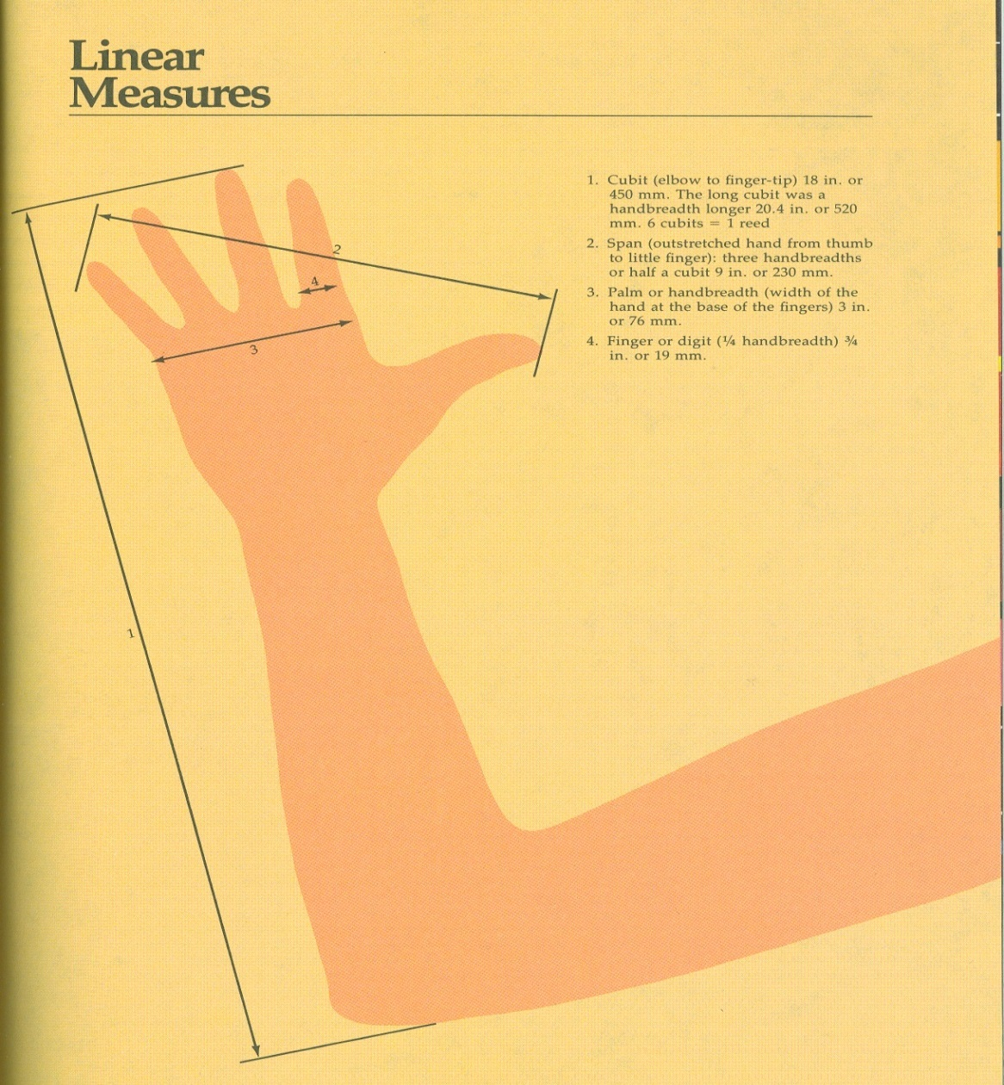
Cubit
1 Cubit is about 18 inches or 1.5 ft
Israelites told to stay about 2000 cubits from ark
2000 cubits = 3000 ft
3000 ft would be the length of 10 football fields or
5280 ft = 1 mile – stay back about 0.6 miles
Joshua 3:4(ESV)
⁴Yet there shall be a distance between you and it, about 2,000 cubits in length…

Slide 28
10 football fields
0.6 miles
What is wrong with this
Illustration?

Slide 29
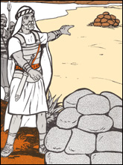
Two Mounds-Memorials
Joshua 4:8-9(ESV)
⁸And the people of Israel did just as Joshua commanded and took up twelve stones out of the midst of the Jordan, according to the number of the tribes of the people of Israel, just as the Lord told Joshua. And they carried them over with them to the place where they lodged and laid them down there.
⁹And Joshua set up twelve stones in the midst of the Jordan, in the place where the feet of the priests bearing the ark of the covenant had stood; and they are there to this day.

Slide 30
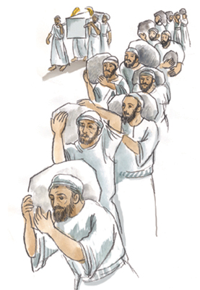
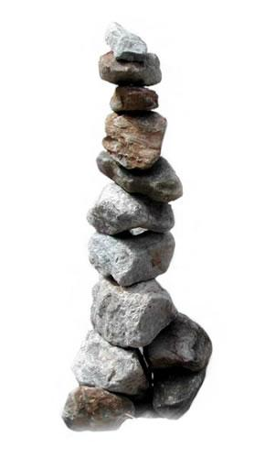
What was the purpose of Removing the Stones?
Joshua 4
⁵ And Joshua said to them, “Pass on before the ark of the Lord your God into the midst of the Jordan, and take up each of you a stone upon his shoulder, according to the number of the tribes of the people of Israel,
⁶ that this may be a sign among you. When your children ask in time to come, ‘What do those stones mean to you?’
⁷ then you shall tell them that the waters of the Jordan were cut off before the ark of the covenant of the Lord. When it passed over the Jordan, the waters of the Jordan were cut off. So these stones shall be to the people of Israel a memorial forever.”

Slide 31
What was the purpose of Removing the Stones?
Joshua 4
²⁰ And those twelve stones, which they took out of the Jordan, Joshua set up at Gilgal.
²¹ And he said to the people of Israel, “When your children ask their fathers in times to come, ‘What do these stones mean?’
²² then you shall let your children know, ‘Israel passed over this Jordan on dry ground.’
²³ For the Lord your God dried up the waters of the Jordan for you until you passed over, as the Lord your God did to the Red Sea, which he dried up for us until we passed over,
²⁴ so that all the peoples of the earth may know that the hand of the Lord is mighty, that you may fear the Lord your God forever.”

Slide 32
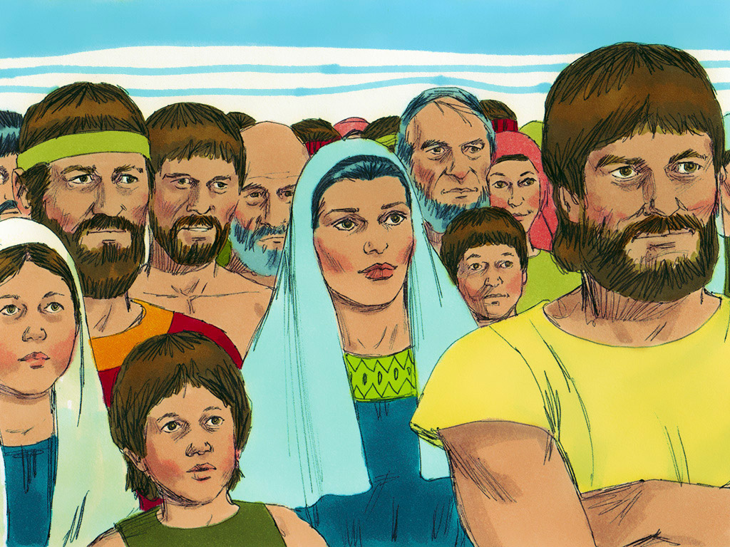
Joshua 4 ¹⁴On that day the Lord exalted Joshua in the sight of all Israel, and they stood in awe of him just as they had stood in awe of Moses, all the days of his life.

Slide 33
Some Comparisons between the Crossing of the Red/Reed Sea with the Crossing of the Jordan River
Exodus | Joshua
God separated the waters (14:21; 15:8) | God separated the waters (3:13, 15–16)
The waters piled up and stood up in a heap (15:8) | The waters stood and rose up in a heap (3:13, 16)
Israel passed through on dry ground (14:22, 29) | Israel passed through on dry ground (3:17; 4:22)
Moses affirmed (14:31) | Joshua affirmed (4:14)
Surrounding nations respond in fear (15:15–16) | Surrounding nations respond in fear (5:1)
Exiting Egypt | Entering Canaan
Enemies Behind Moses | Enemies Ahead of Joshua

Slide 34
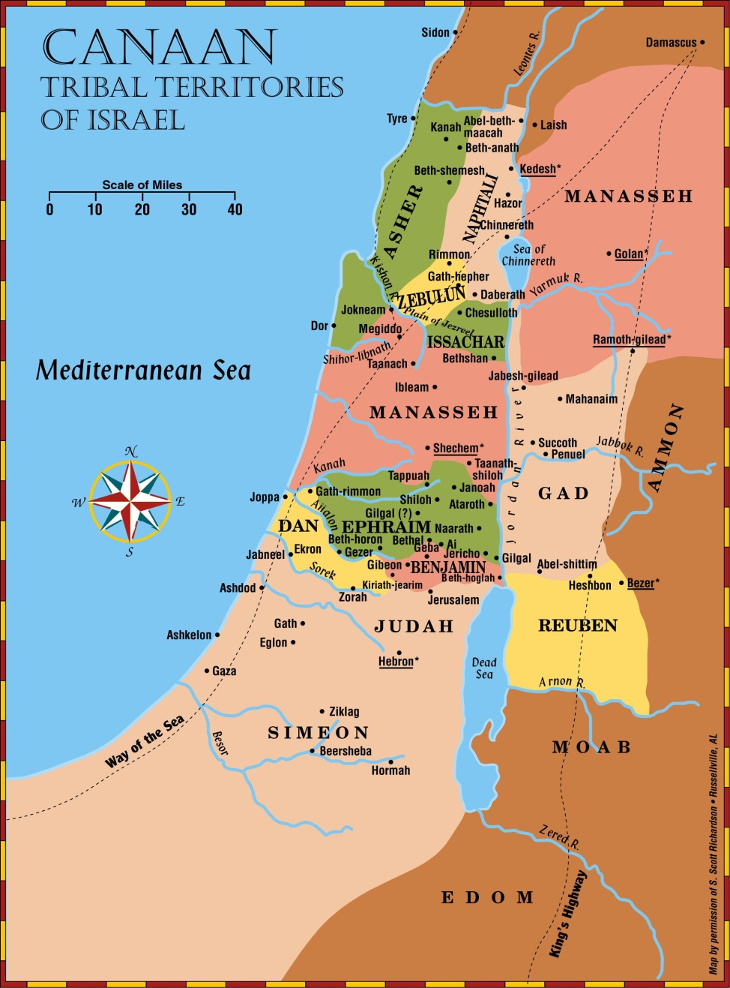
How many Reubenites,
Gadites & Manassehites crossed over?
Joshua 4
¹² The sons of Reuben and the sons of Gad and the half-tribe of Manasseh passed over armed before the people of Israel, as Moses had told them.
¹³ About 40,000 ready for war passed over before the Lord for battle, to the plains of Jericho.
Numbers 26
Reuben 43,750
Gad 40,500
Manasseh 52,700
136,930

Slide 35
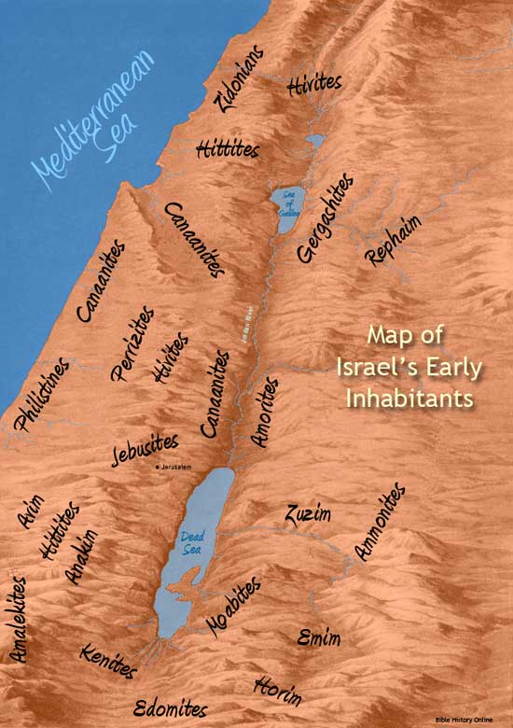
Reaction of the Amorites
Joshua 5:1(ESV)
¹As soon as all the kings of the Amorites who were beyond the Jordan to the west, and all the kings of the Canaanites who were by the sea, heard that the Lord had dried up the waters of the Jordan for the people of Israel until they had crossed over, their hearts melted and there was no longer any spirit in them because of the people of Israel.

Slide 36
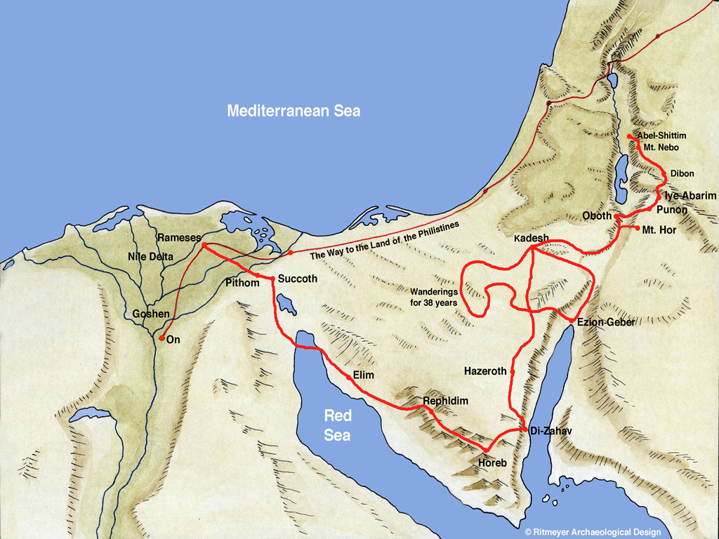
Joshua 5:4-7(ESV)
⁴And this is the reason why Joshua circumcised them: all the males of the people who came out of Egypt, all the men of war, had died in the wilderness on the way after they had come out of Egypt.
⁵Though all the people who came out had been circumcised, yet all the people who were born on the way in the wilderness after they had come out of Egypt had not been circumcised.
…until all the nation, the men of war who came out of Egypt, perished, because they did not obey the voice of the Lord…
⁷So it was their children, whom he raised up in their place, that Joshua circumcised. For they were uncircumcised, because they had not been circumcised on the way.

Slide 37
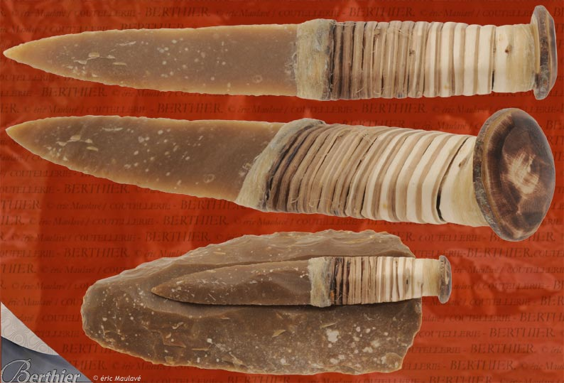
Gilgal sounds like the Hebrew word meaning "to roll", the Lord tells Joshua (5:9) that with this circumcision/consecration of the people He had "rolled away the approach of Egypt".
How would you feel upon hearing this giving what you know of Israel's past?
Joshua 5:6(ESV)
⁶For the people of Israel walked forty years in the wilderness, until all the nation, the men of war who came out of Egypt, perished, because they did not obey the voice of the Lord; the Lord swore to them that he would not let them see the land that the Lord had sworn to their fathers to give to us, a land flowing with milk and honey.

Slide 38
Manna Stops
Joshua 5
¹¹And the day after the Passover, on that very day, they ate of the produce of the land, unleavened cakes and parched grain.
¹²And the manna ceased the day after they ate of the produce of the land. And there was no longer manna for the people of Israel, but they ate of the fruit of the land of Canaan that year.
Exodus 16
¹⁴And when the dew had gone up, there was on the face of the wilderness a fine, flake-like thing, fine as frost on the ground.
¹⁵When the people of Israel saw it, they said to one another, “What is it?” For they did not know what it was. And Moses said to them, “It is the bread that the Lord has given you to eat.
¹⁶This is what the Lord has commanded: ‘Gather of it, each one of you, as much as he can eat.
³¹Now the house of Israel called its name manna. It was like coriander seed, white, and the taste of it was like wafers made with honey.

Slide 40
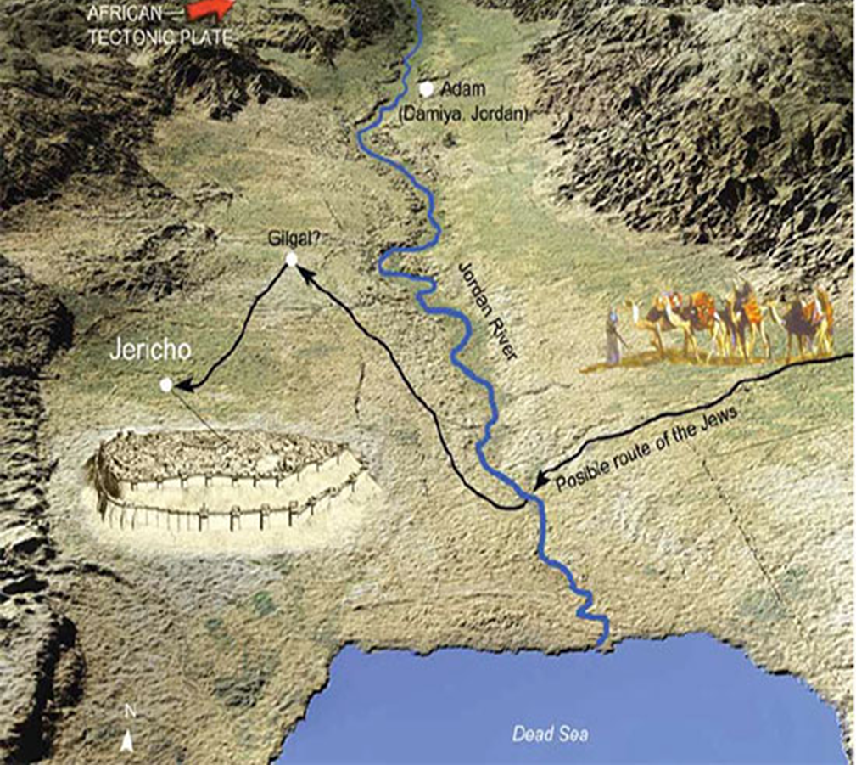

Slide 41
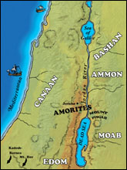
Jericho aerial from west
Jordan River
Tell Jericho
Ascent of Adumim
Wadi Qilt
Jericho aerial from west

Slide 42
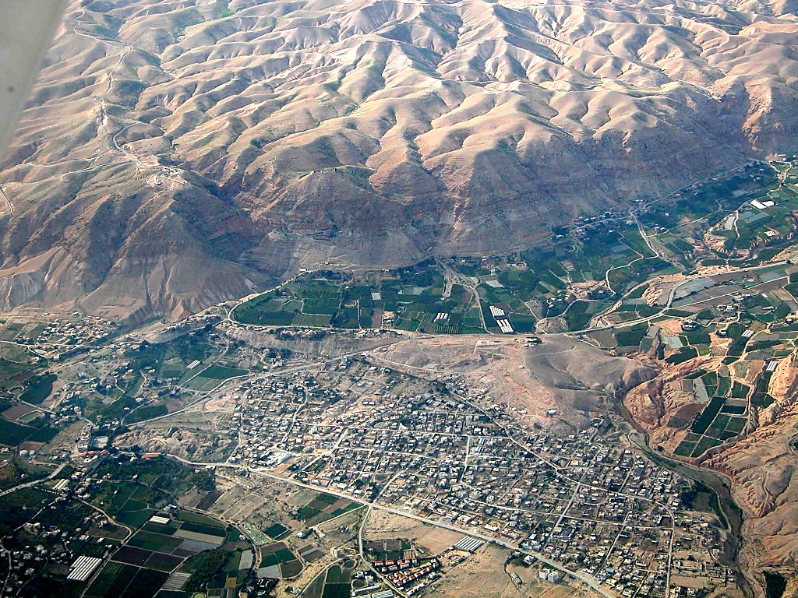
Jericho tell and cliffs aerial from east
“Monastery of Temptation”
Docus
Tell Jericho
Jericho tell and cliffs aerial from east

Slide 43
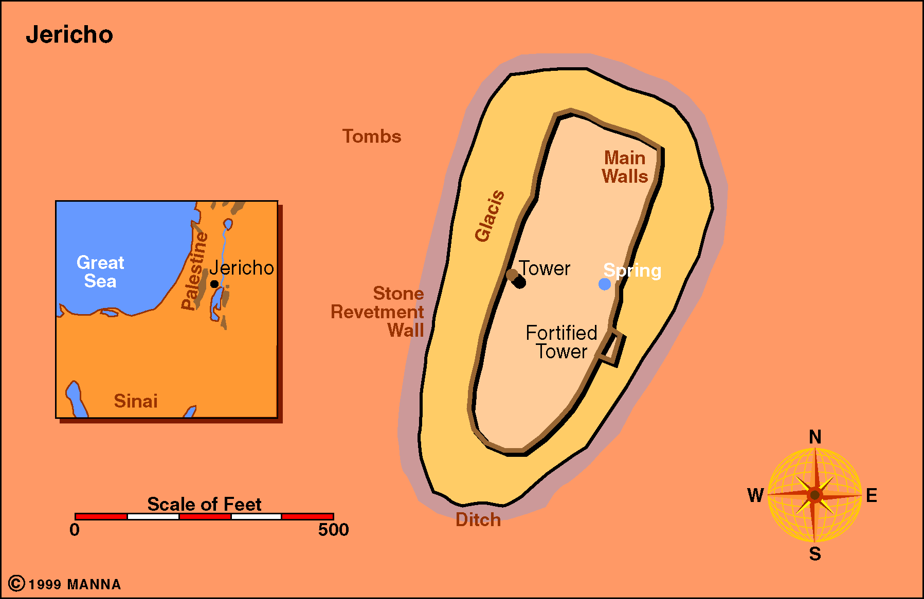
Jericho

