Slide 1

Book of Joshua
Lesson 5
Central Conquest - Jericho

Slide 2
Class Objectives
Learn about God's fulfillment of the land promise.
Learn about Serving the Lord in the days of Joshua
Learn about the character of Joshua
Study the Geography & Archaeology of the Conquest of Canaan
Be ready to give a defense of the Conquest of Canaan

Slide 3
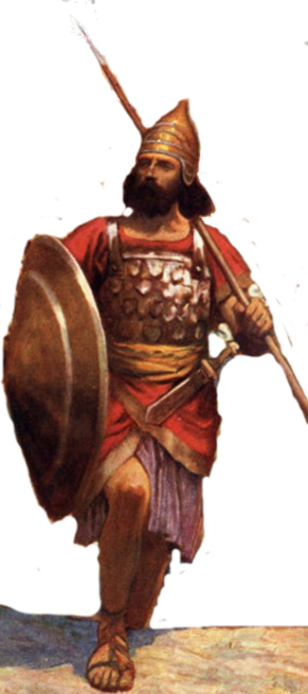
Resting in the land
Living the land
Distributing
the land
Joshua
24:29-33
Conquering the land
Joshua
13-21
Joshua
22-24
Claiming the land
Joshua
6-12
Joshua
1-5
Notes:
I. Claiming the Land (1:1–5:15)
II. Conquering the Land (6:1–12:24)
III. Distributing the Land (13:1–21:45)
IV. Living in the Land (22:1–24:28)
V. Resting in the Land (24:29–33)

Slide 4
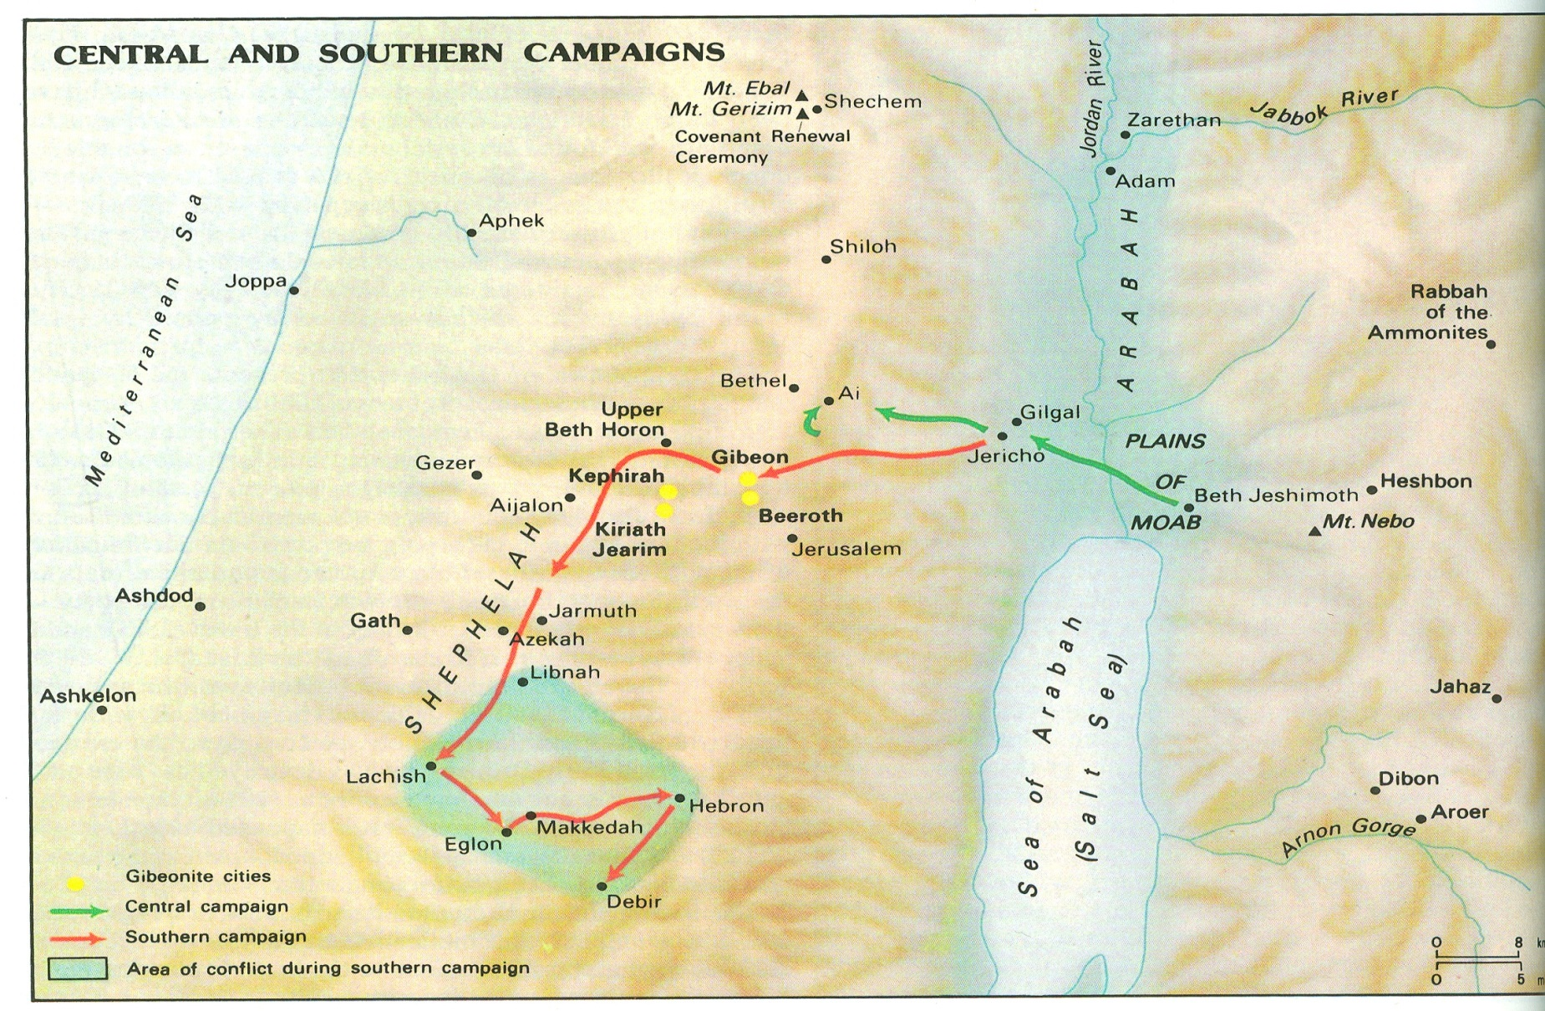
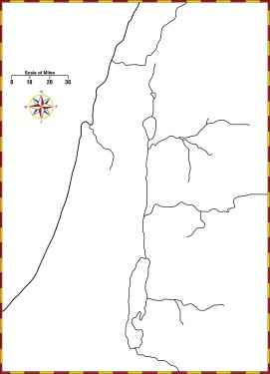

Slide 5
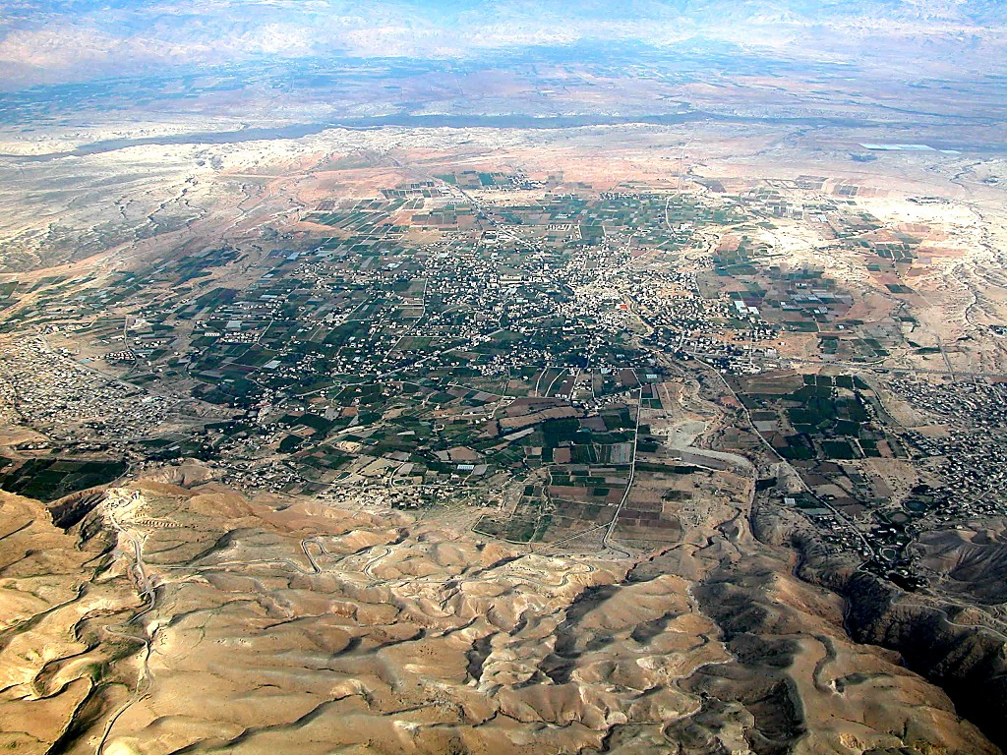
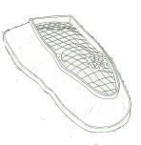
Jericho aerial from west
Jordan River
Tell Jericho
Ascent of Adumim
Wadi Qilt
Ai
Jerusalem
Jericho aerial from west

Slide 6
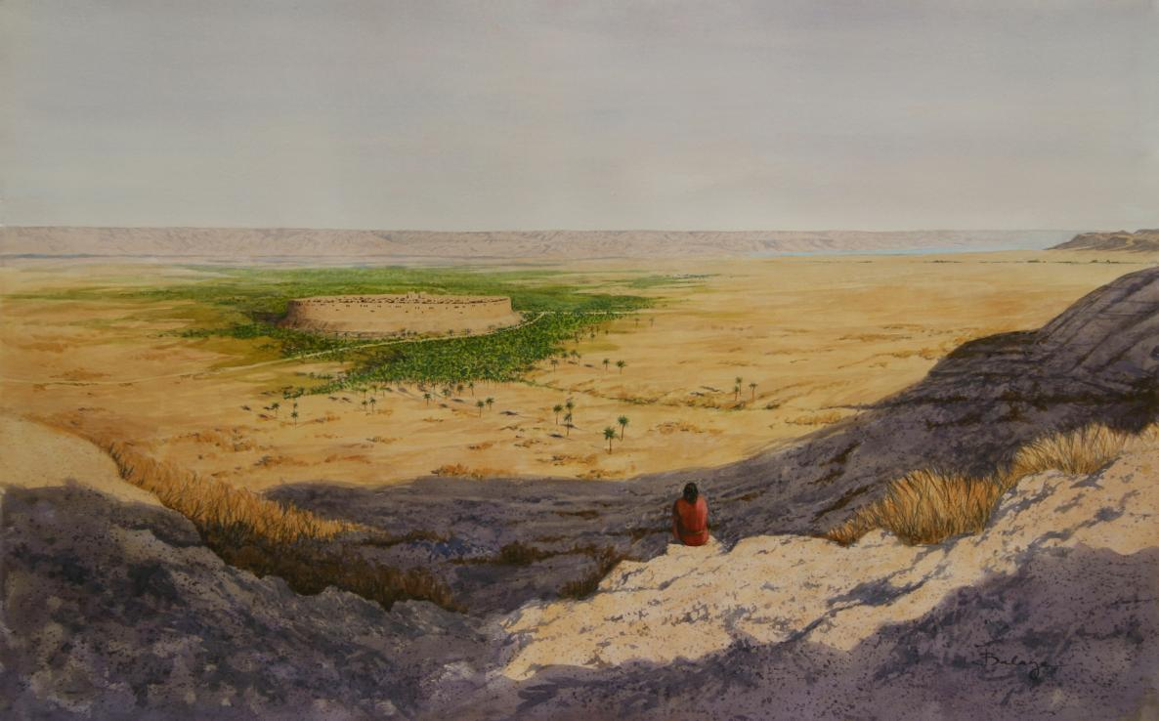

Joshua’s Challenges –
People who had failed last time – 40 yrs
New Leader
New Generation
A swollen river
A walled city
Unknown city/people
Be Strong & Courageous
Just as I was with Moses, so I will be with you.
I will not leave you or forsake you
People – tell Be Strong & Courageous
Prepared people (3 days provisions)
Checked that Tribes across Jordan with him
Sent spies into Jericho
Lord took care of the river
& walled city
Jo 1:2 Now therefore arise, go over this Jordan

Slide 7
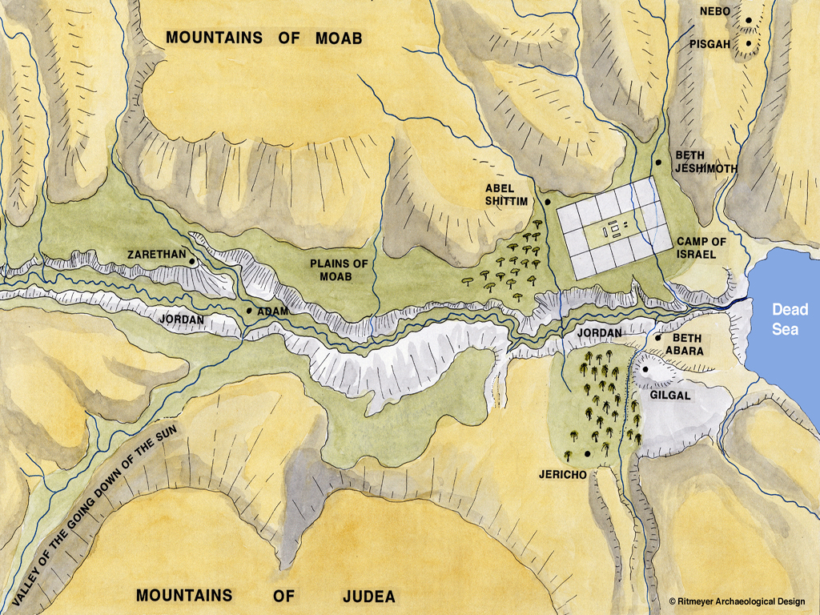

Jordan Stopped near city of Adam, about 15 miles North of where the river was crossed
X

Slide 8
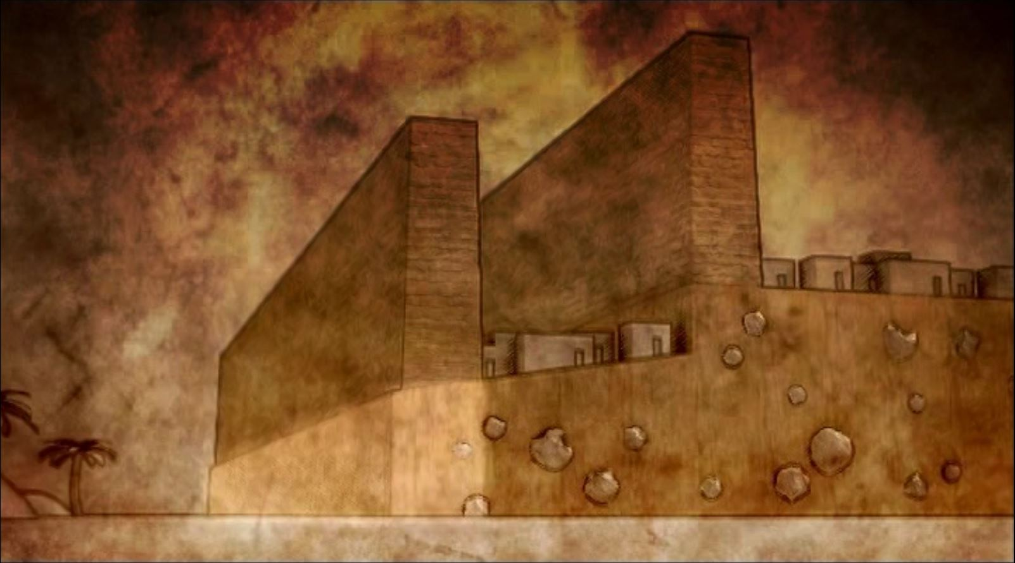
A Double
Walled City
Inner Wall
Outer Wall
Retaining Wall

Slide 9
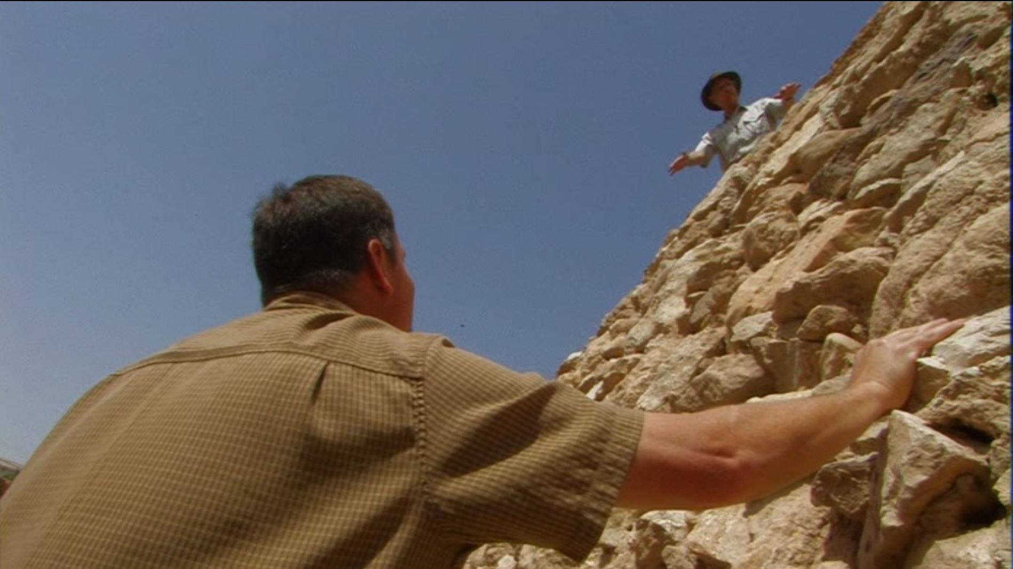
A High Walled City
Inner Wall
Outer Wall
Just the
Retaining Wall

Slide 10
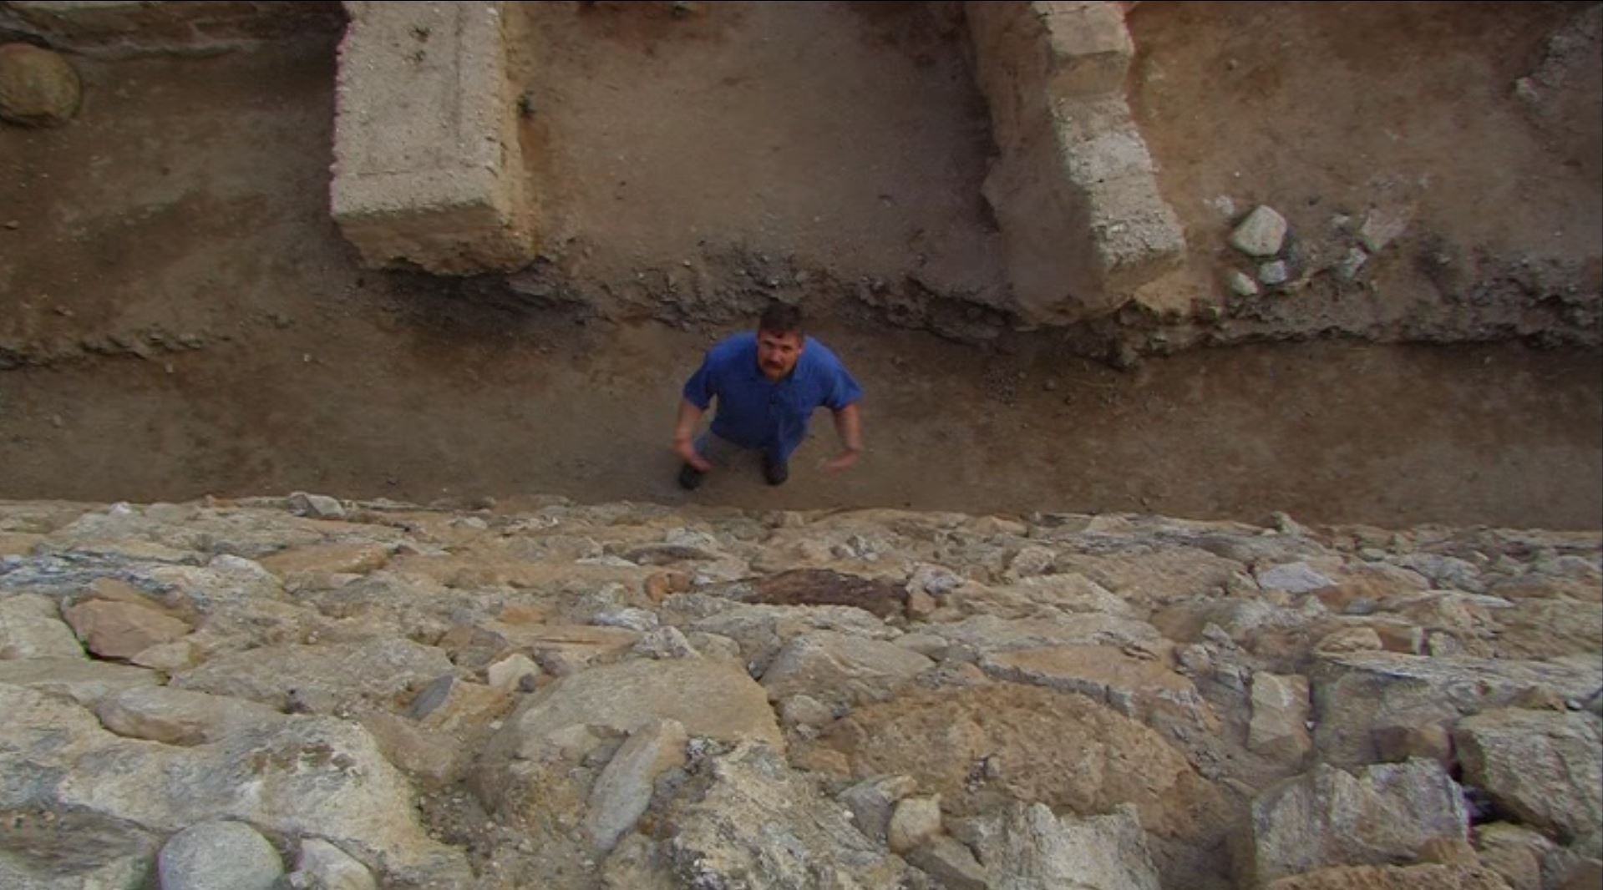
A High Walled City
Just the
Retaining Wall

Slide 11
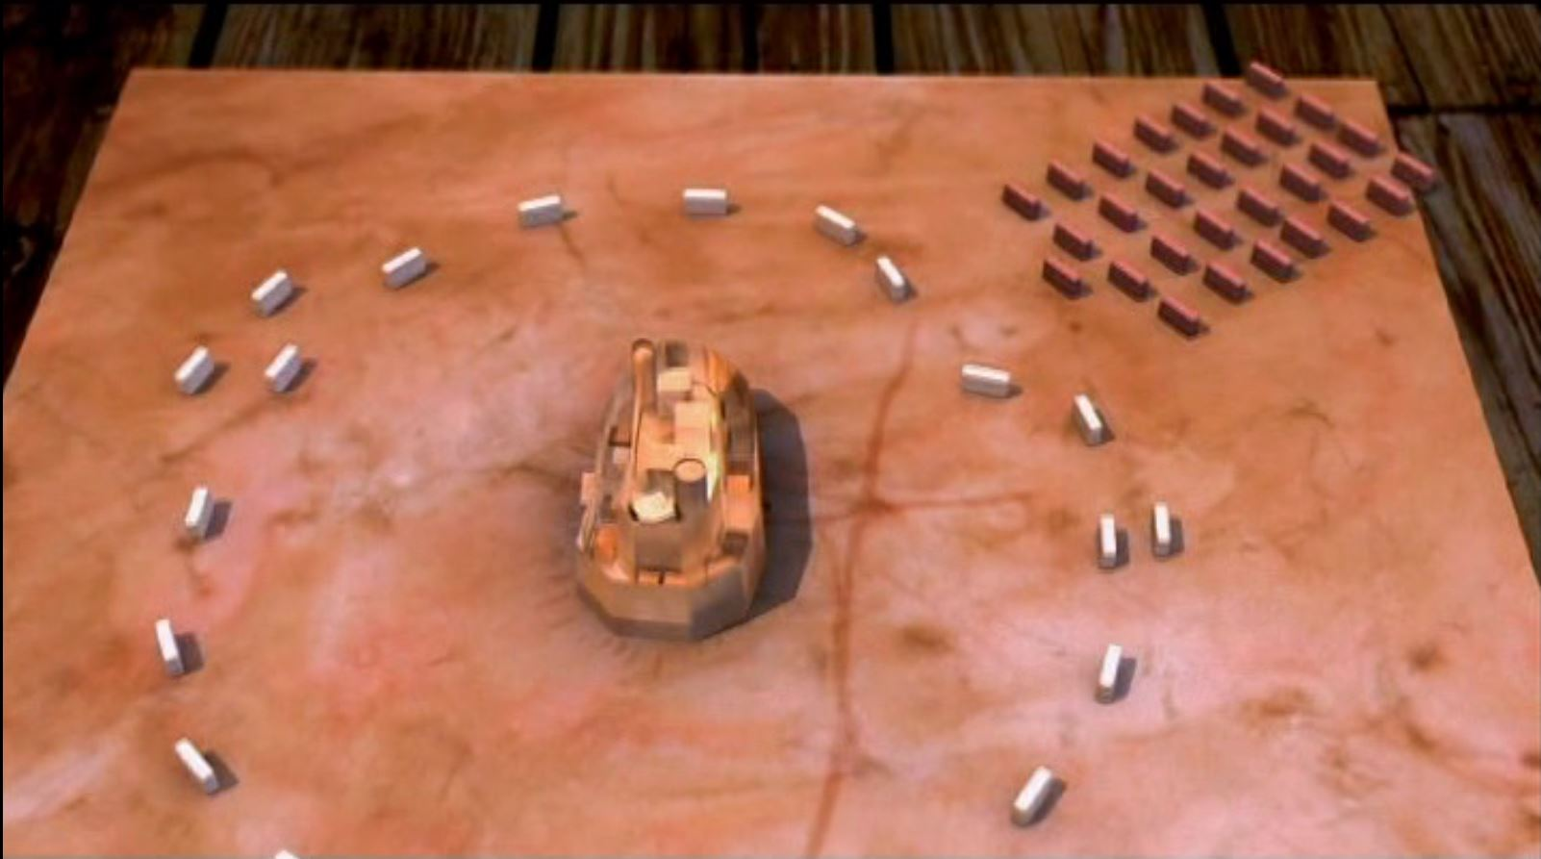
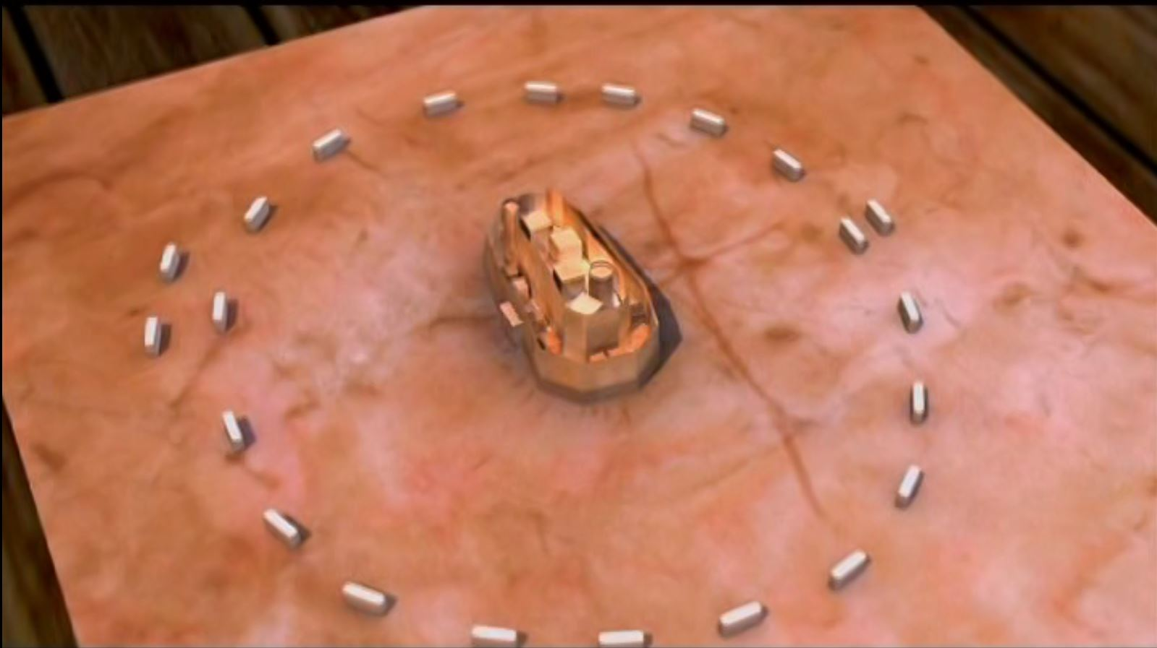
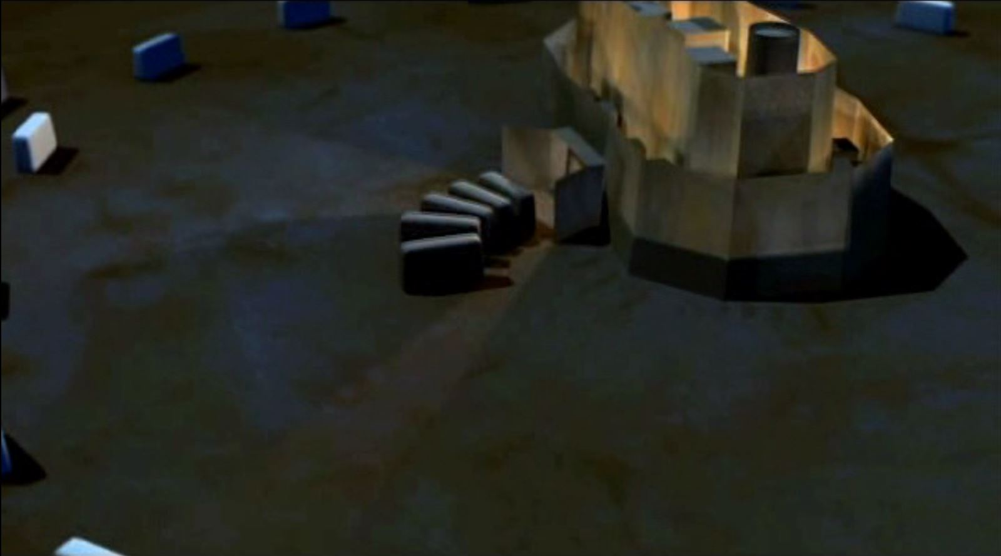
Lay Siege
Amorites
Unite to Attack
Attack Sortie

Slide 12
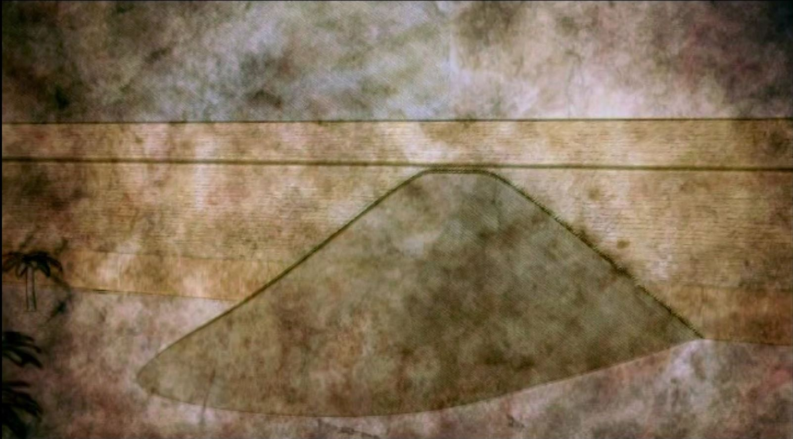
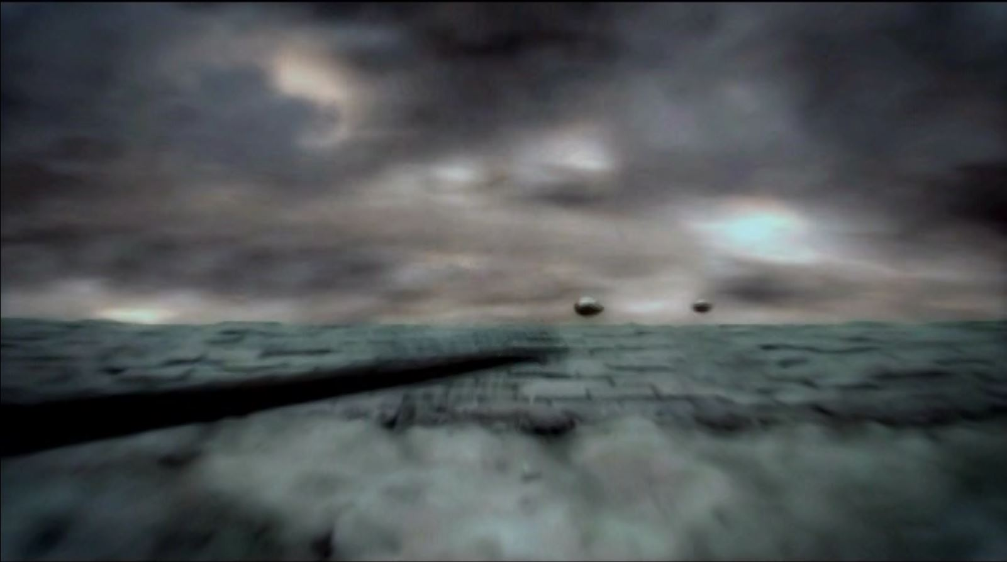
Build a Ramp
Drop Stones on Your Head

Slide 13
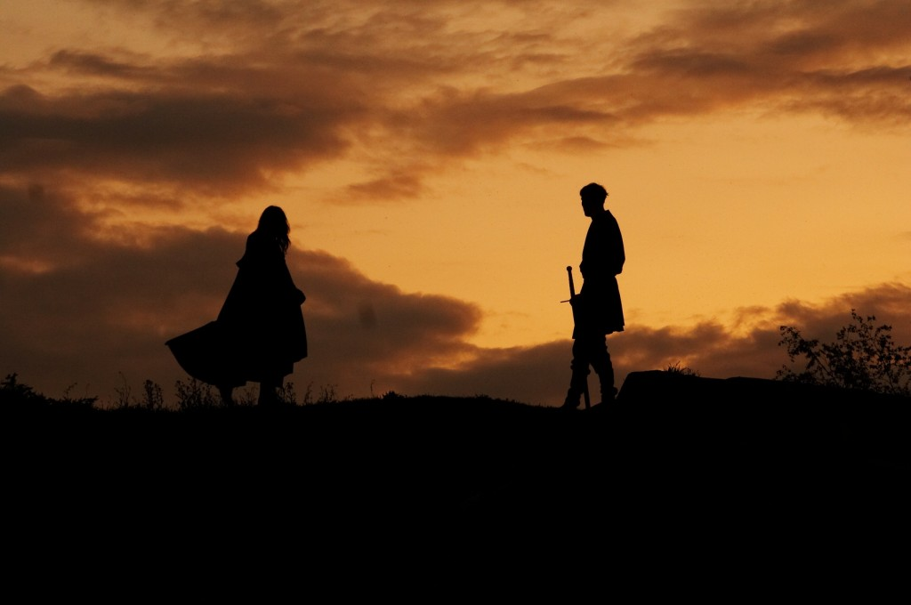
Commander of the Lord’s Army
Joshua 5:13-15(ESV)
¹³When Joshua was by Jericho, he lifted up his eyes and looked, and behold, a man was standing before him with his drawn sword in his hand. And Joshua went to him and said to him, “Are you for us, or for our adversaries?”

Slide 14
Commander of the Lord’s Army
Joshua 5:14-15(ESV) ¹⁴And he said, “No; but I am the commander of the army of the Lord. Now I have come.”
And Joshua fell on his face to the earth and worshiped and said to him, “What does my lord say to his servant?” ¹⁵And the commander of the Lord’s army said to Joshua, “Take off your sandals from your feet, for the place where you are standing is holy.” And Joshua did so.

Slide 15
Holy Ground
Moses – Burning Bush
Exodus 3
Joshua – Commander of the Lord’s Army
Joshua 5
²And the angel of the Lord appeared to him in a flame of fire out of the midst of a bush.
¹³When Joshua was by Jericho, he lifted up his eyes and looked, and behold, a man was standing before him with his drawn sword in his hand…
⁴When the Lord saw that he turned aside to see, God called to him out of the bush, “Moses, Moses!” And he said, “Here I am.”
¹⁴And he said, “No; but I am the commander of the army of the Lord. Now I have come.” And Joshua fell on his face to the earth and worshiped…
⁵Then he said, “Do not come near; take your sandals off your feet, for the place on which you are standing is holy ground
¹⁵And the commander of the Lord’s army said to Joshua, “Take off your sandals from your feet, for the place where you are standing is holy.” And Joshua did so.
⁶And he said, “I am the God of your father, the God of Abraham, the God of Isaac, and the God of Jacob.” And Moses hid his face, for he was afraid to look at God.
Notes:
6And he said, “I am the God of your father, the God of Abraham, the God of Isaac, and the God of Jacob.” And Moses hid his face, for he was afraid to look at God.

Slide 16
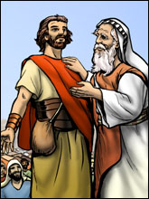
Deut 31:3-6
Deuteronomy 31:3-6(ESV)
³The Lord your God himself will go over before you.
He will destroy these nations before you, so that you shall dispossess them, and Joshua will go over at your head, as the Lord has spoken.
⁴And the Lord will do to them as he did to Sihon and Og, the kings of the Amorites, and to their land, when he destroyed them.
⁵And the Lord will give them over to you, and you shall do to them according to the whole commandment that I have commanded you.
⁶Be strong and courageous. Do not fear or be in dread of them, for it is the Lord your God who goes with you. He will not leave you or forsake you.”

Slide 17
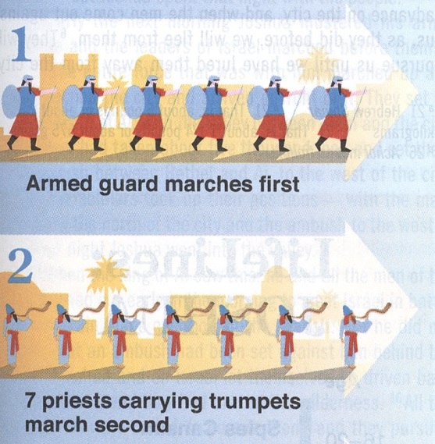
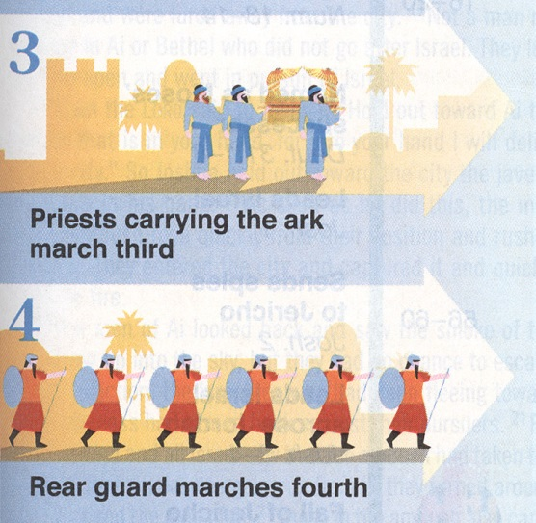
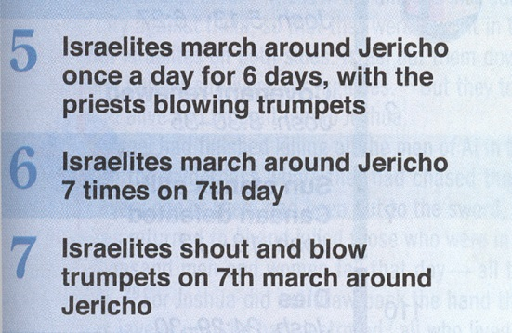
Commander of the Lord’s Army Plan

Slide 18
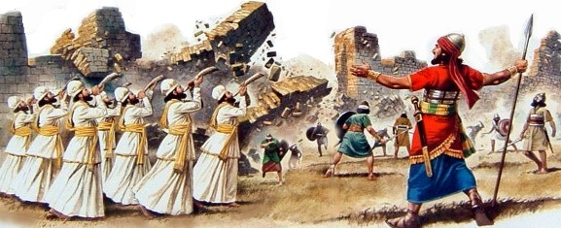
Hebrews 11:30-31(ESV)
³⁰By faith the walls of Jericho fell down after they had been encircled for seven days.
³¹By faith Rahab the prostitute did not perish with those who were disobedient, because she had given a friendly welcome to the spies.

Slide 19
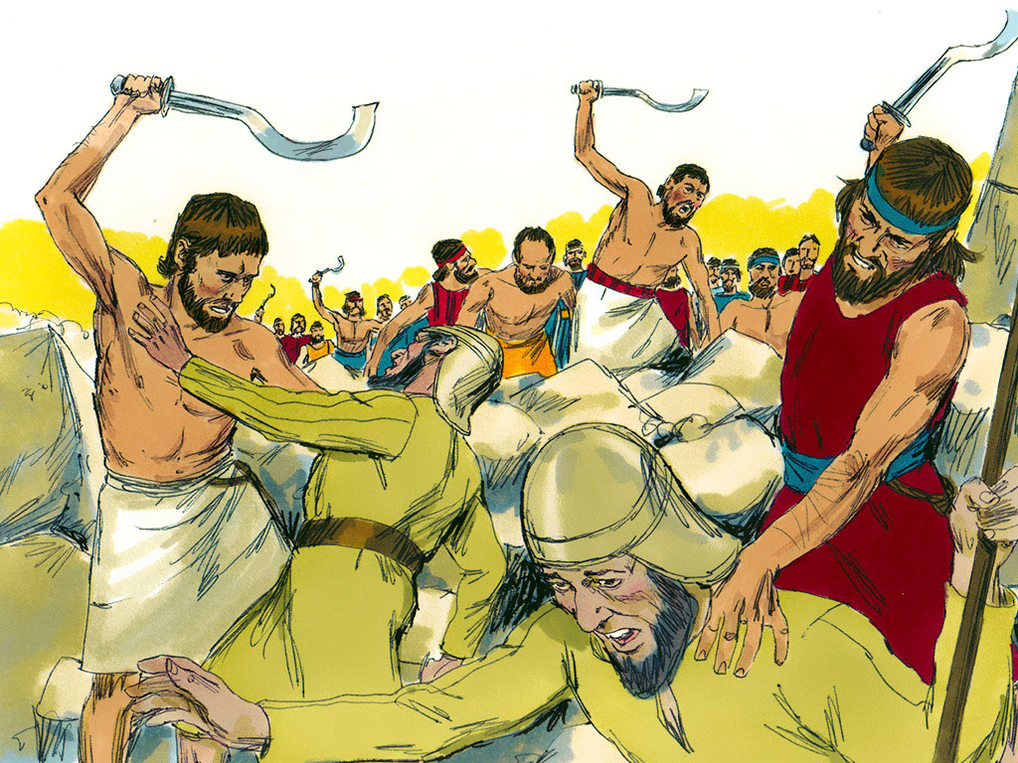
Joshua 6:16-17, 21(ESV)
¹⁶And at the seventh time, when the priests had blown the trumpets, Joshua said to the people, “Shout, for the Lord has given you the city.
¹⁷And the city and all that is within it shall be devoted to the Lord for destruction.
Only Rahab the prostitute and all who are with her in her house shall live, because she hid the messengers whom we sent.
²¹Then they devoted all in the city to destruction, both men and women, young and old, oxen, sheep, and donkeys, with the edge of the sword.

Slide 20
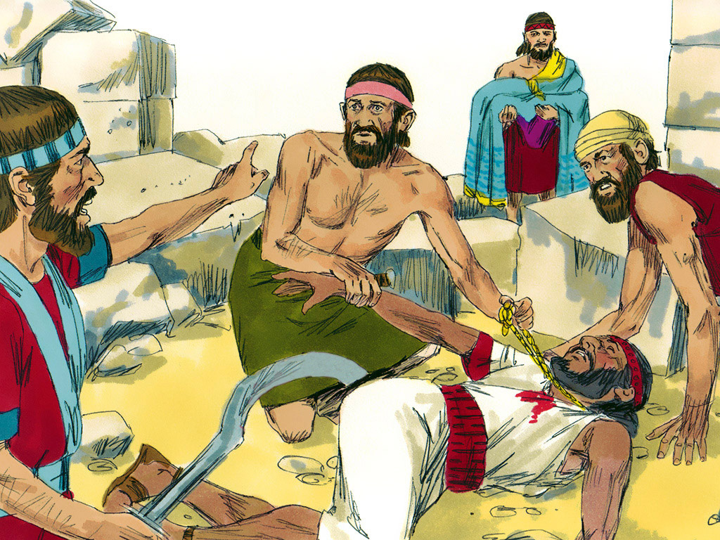
Joshua 6:16 (ESV)
¹⁷And the city and all that is within it shall be devoted to the Lord for destruction.

Slide 21
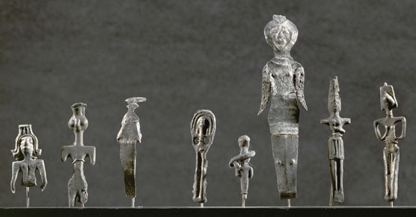
Deuteronomy 7:23-26(ESV)
²³But the Lord your God will give them over to you and throw them into great confusion, until they are destroyed.
²⁴And he will give their kings into your hand, and you shall make their name perish from under heaven.
No one shall be able to stand against you until you have destroyed them.
²⁵The carved images of their gods you shall burn with fire. You shall not covet the silver or the gold that is on them or take it for yourselves, lest you be ensnared by it, for it is an abomination to the Lord your God.
²⁶And you shall not bring an abominable thing into your house and become devoted to destruction like it. You shall utterly detest and abhor it, for it is devoted to destruction.

Slide 22
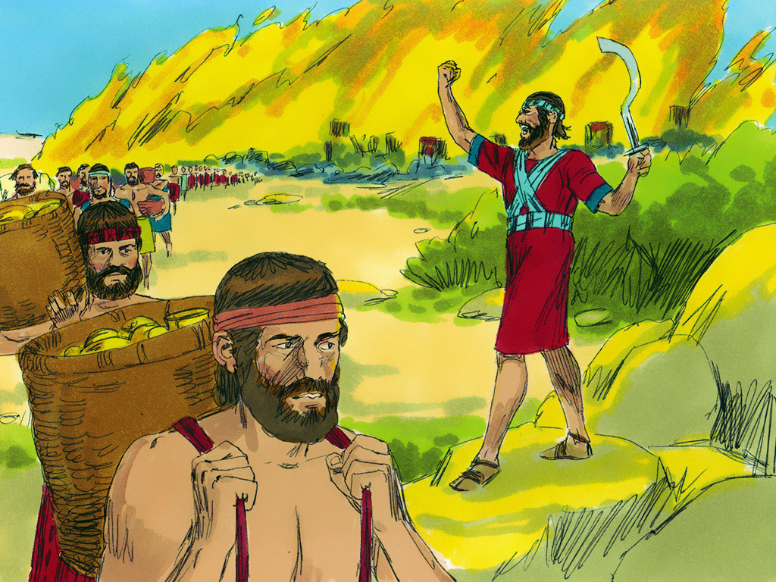
Joshua 6:19 (ESV)
¹⁹But all silver and gold, and every vessel of bronze and iron, are holy to the Lord; they shall go into the treasury of the Lord.”

Slide 23
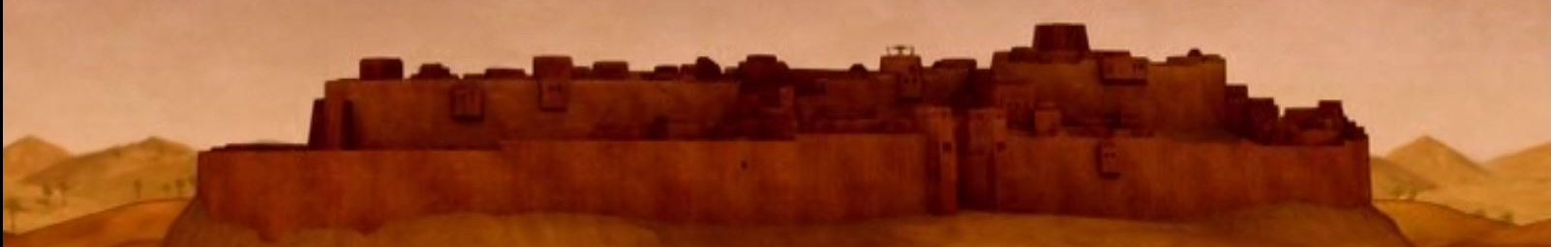
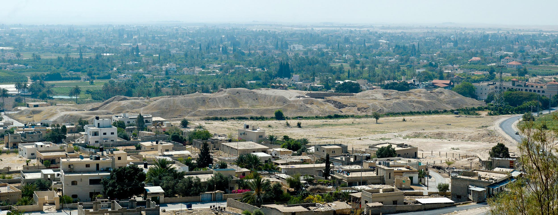
Jericho, Tell es-Sultan from west panorama
Notes:
Jericho in the Persian Period
Jericho became a Persian administrative center during late 6th century BC.
The city was rebuilt by the Jews after their return from Babylon (Ezra 2:34; Neh 2:35; 7:36), and the residents here also helped to rebuild the walls of Jerusalem (Neh 3:2).
tb05110685p

Slide 24
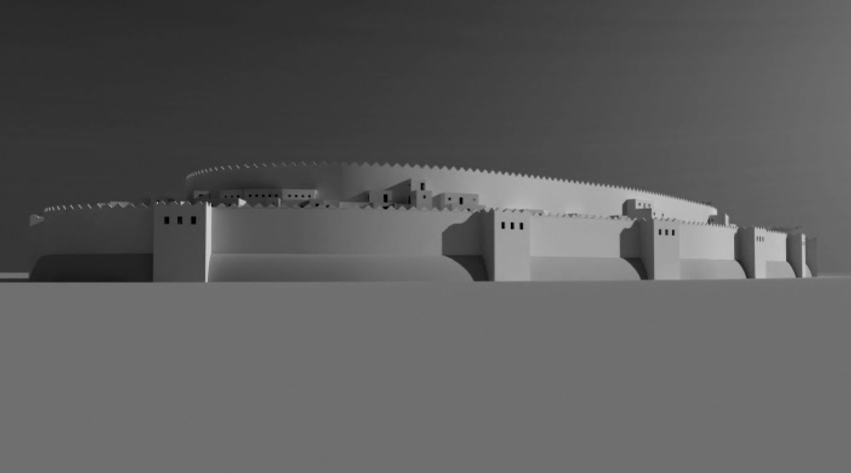

Slide 25
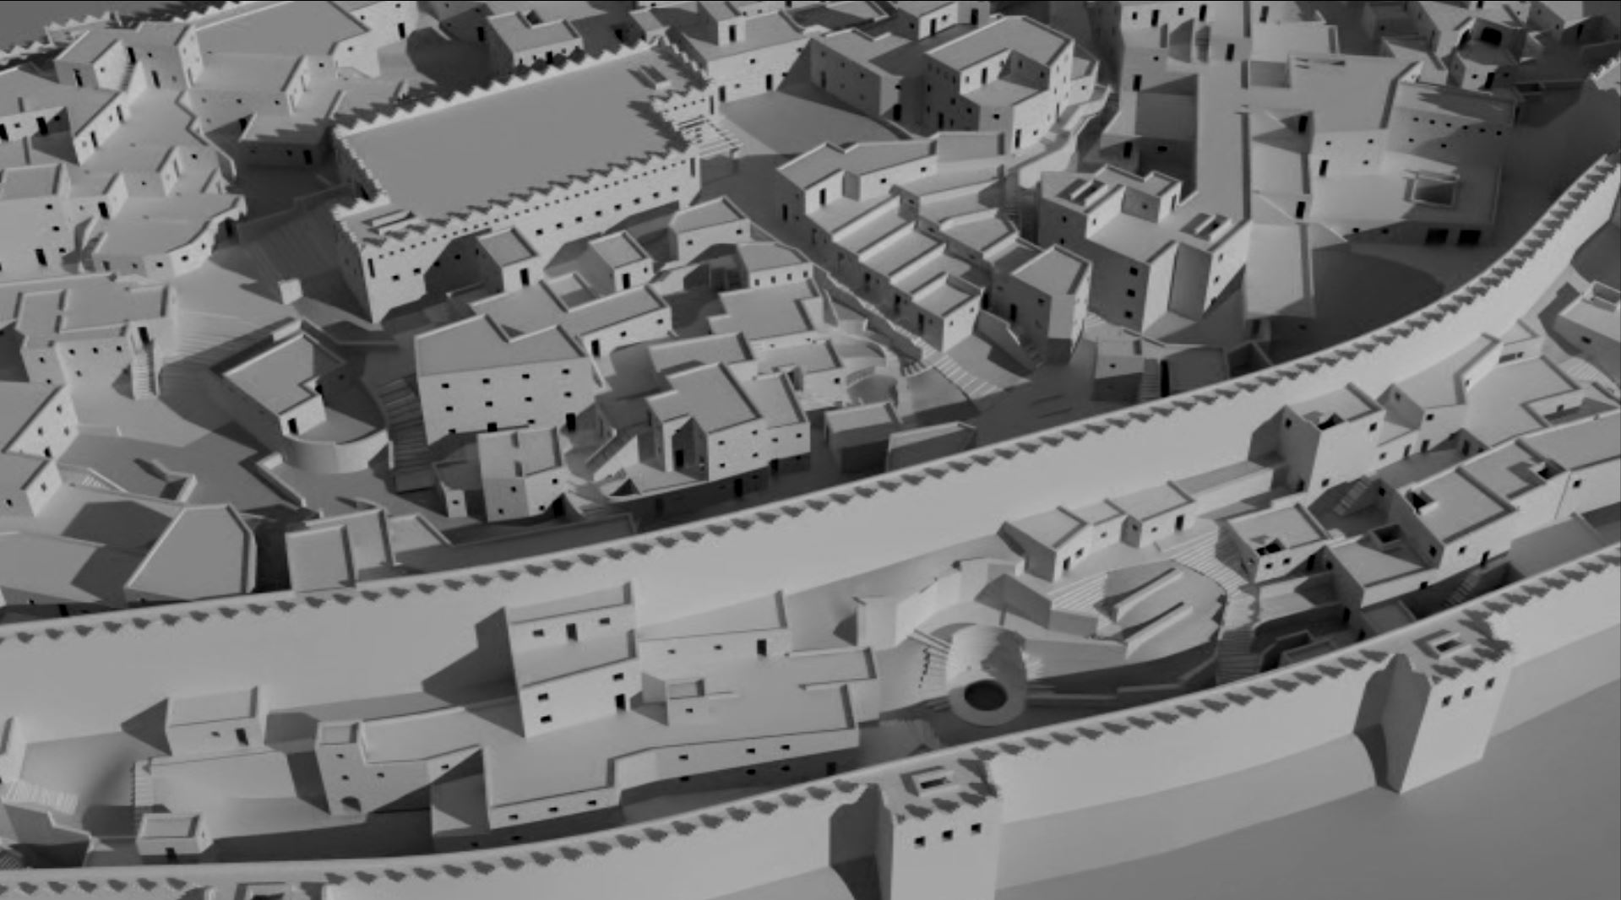

Slide 26
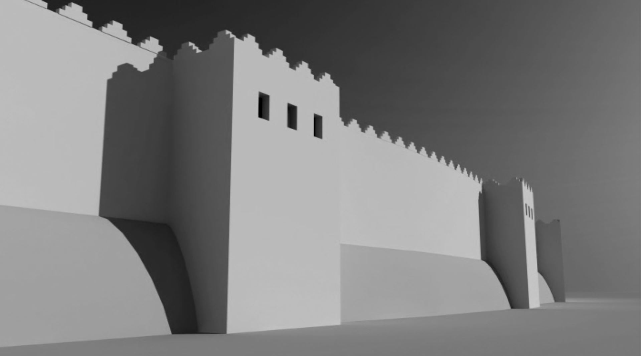

Slide 27
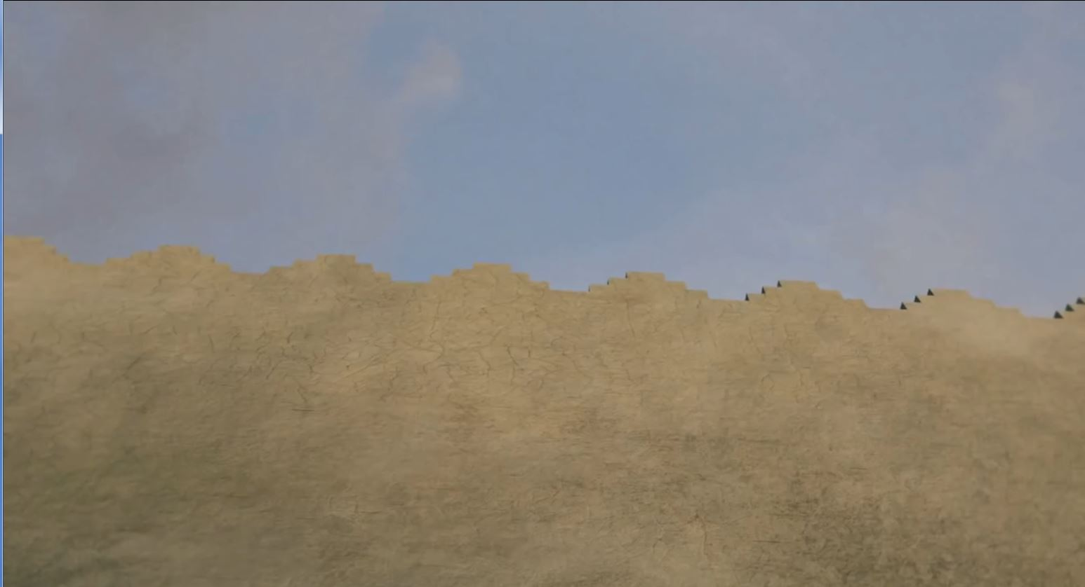

Slide 28
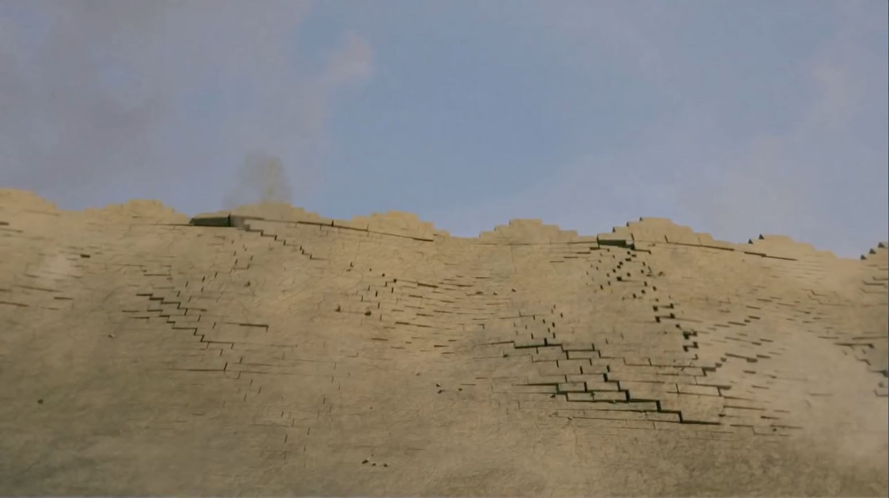

Slide 29
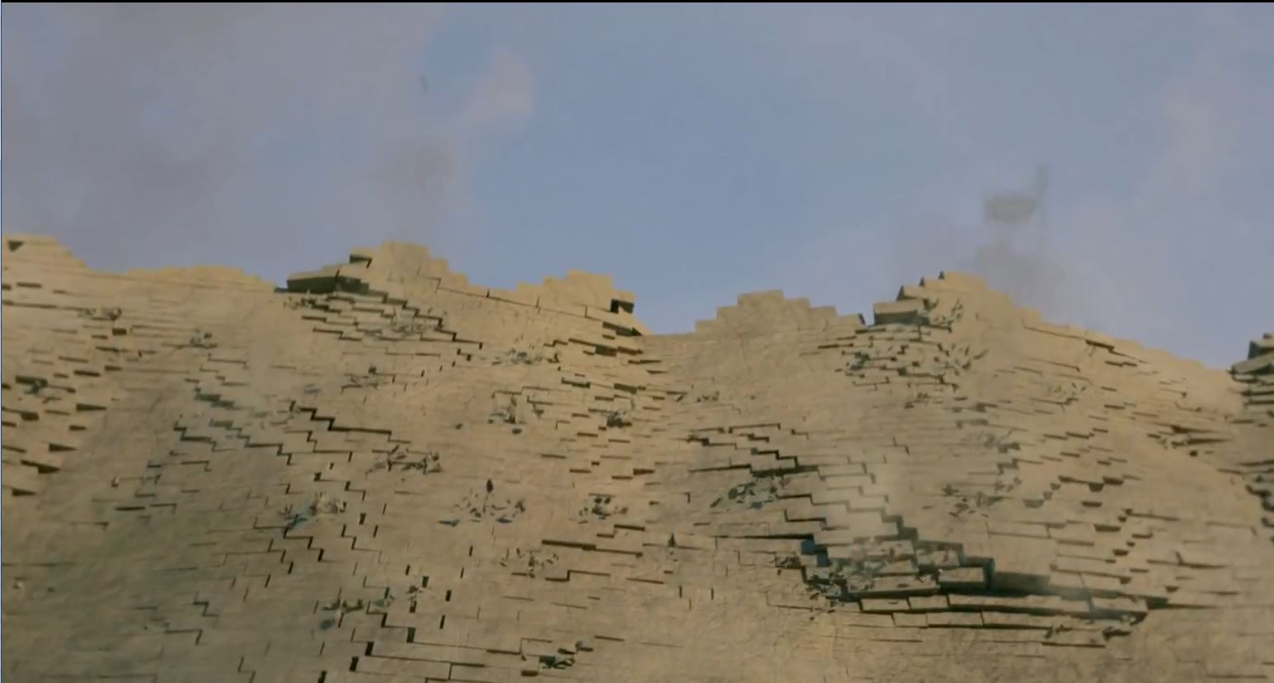

Slide 30
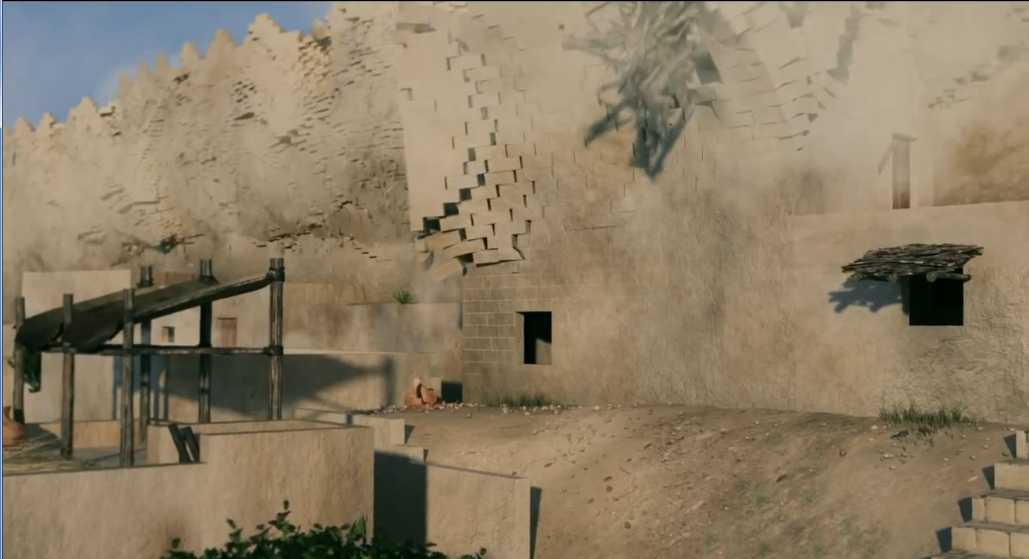

Slide 31
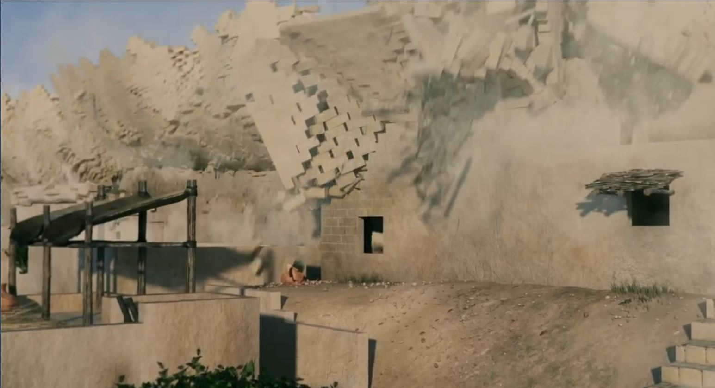

Slide 32
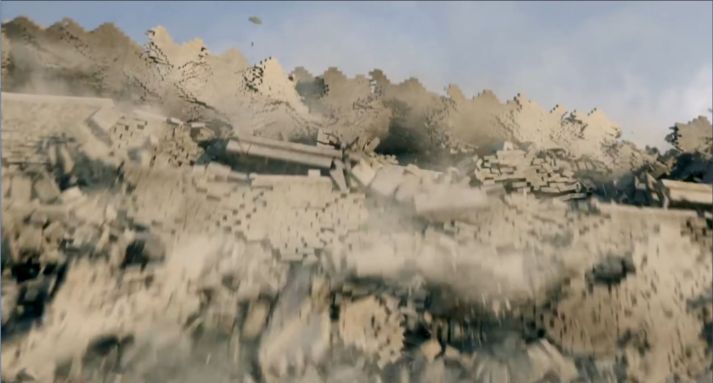

Slide 33
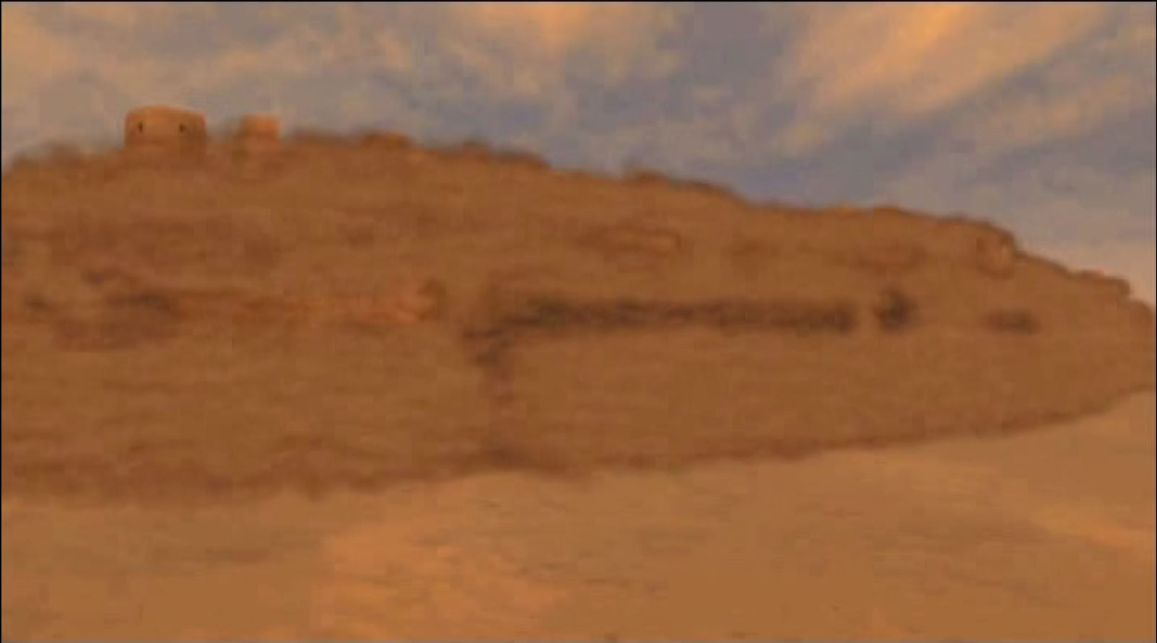

Slide 34
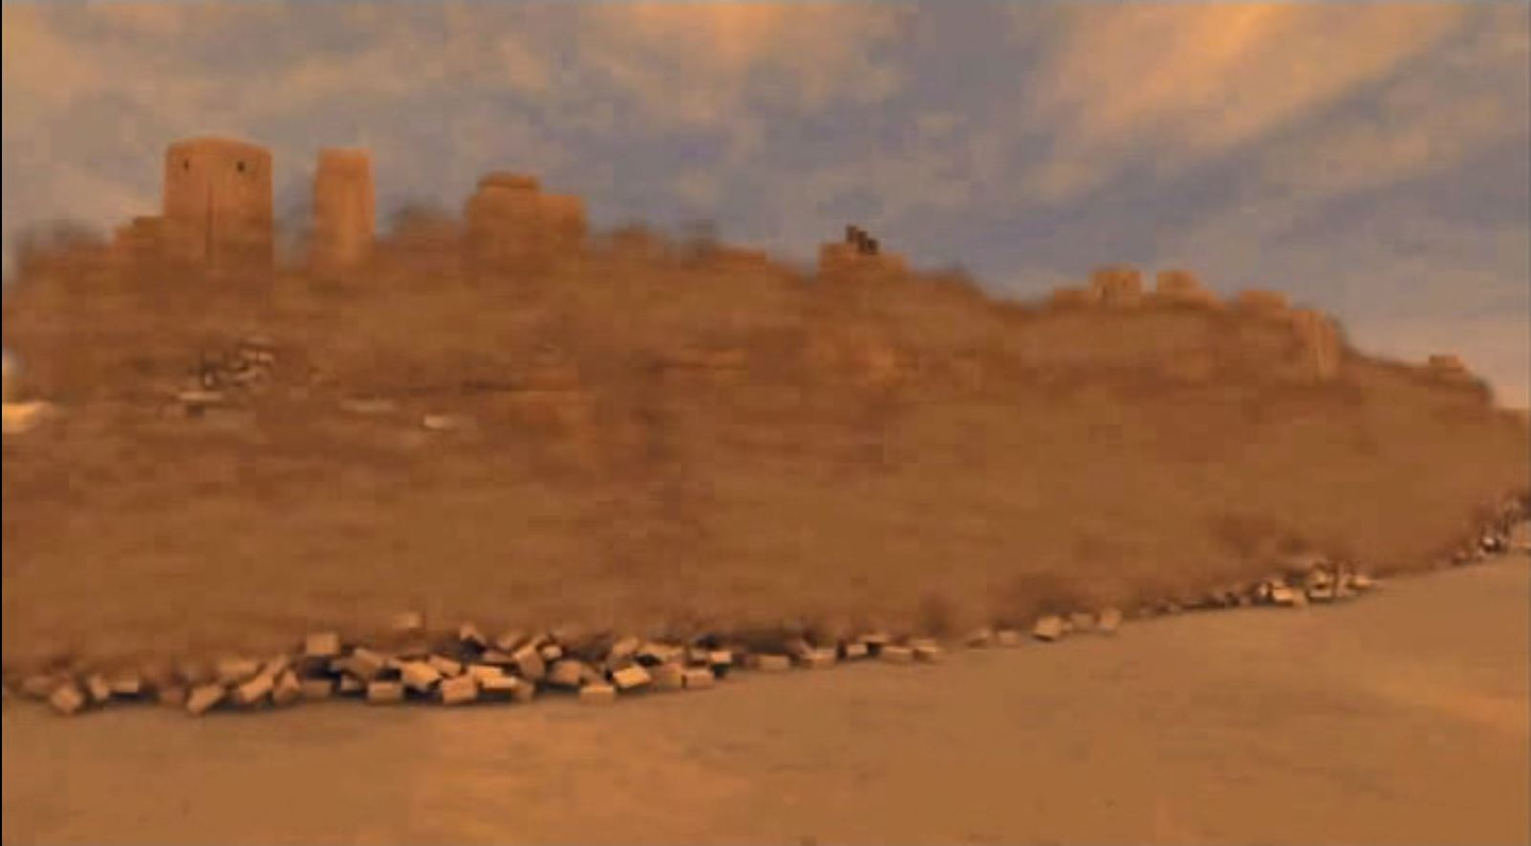

Slide 35
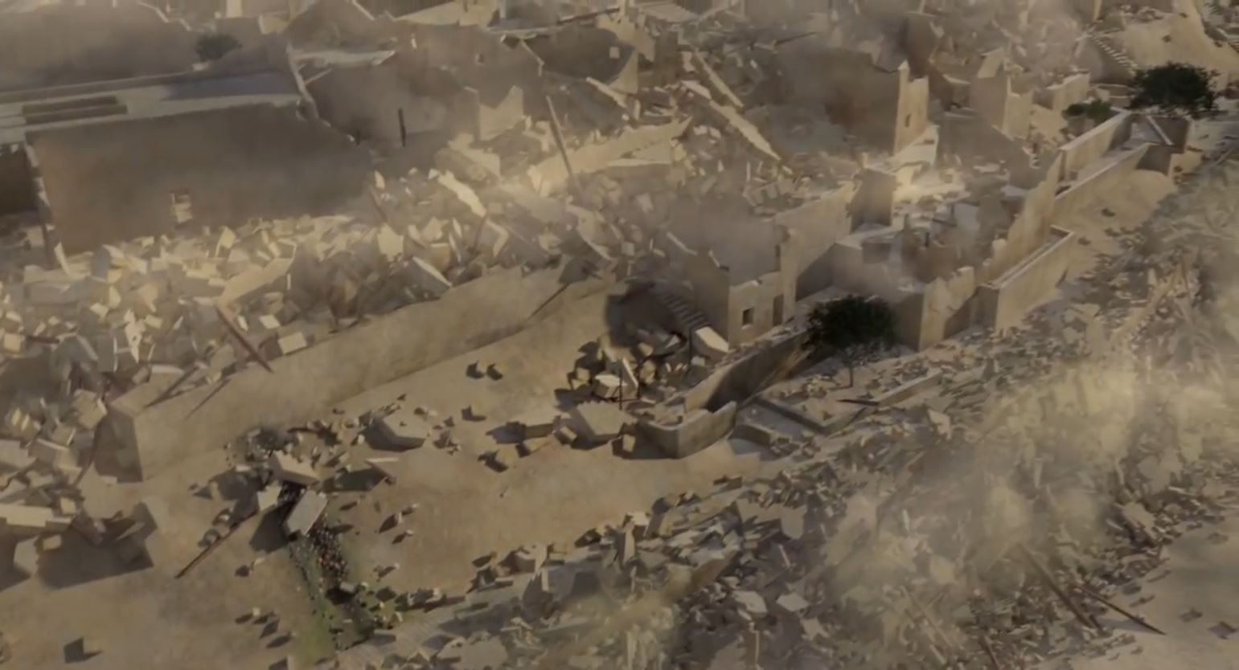

Slide 36
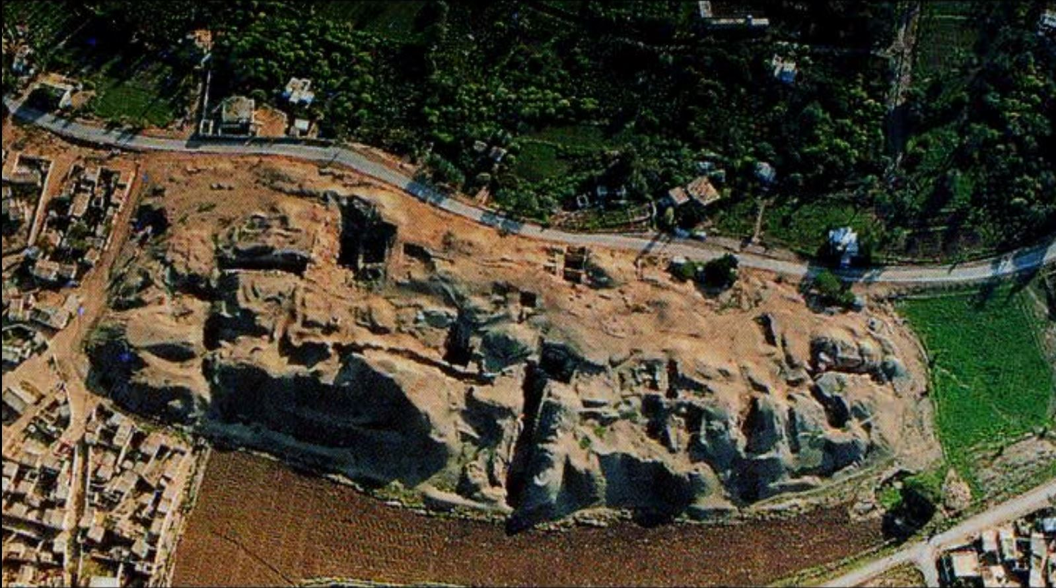
Today

Slide 37
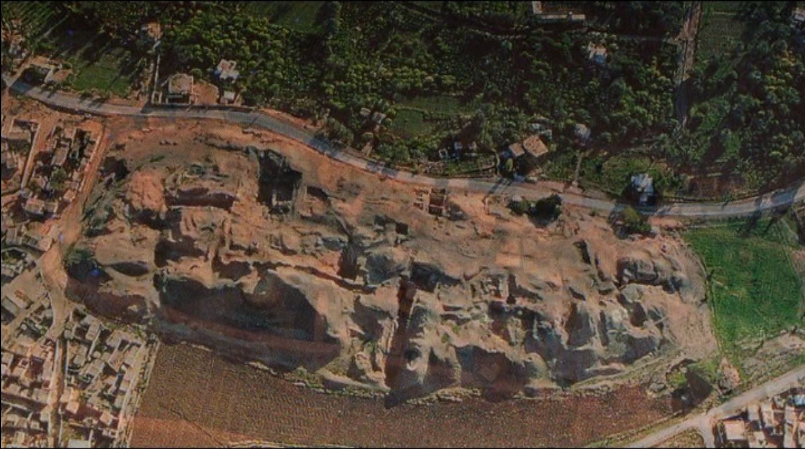

Slide 38
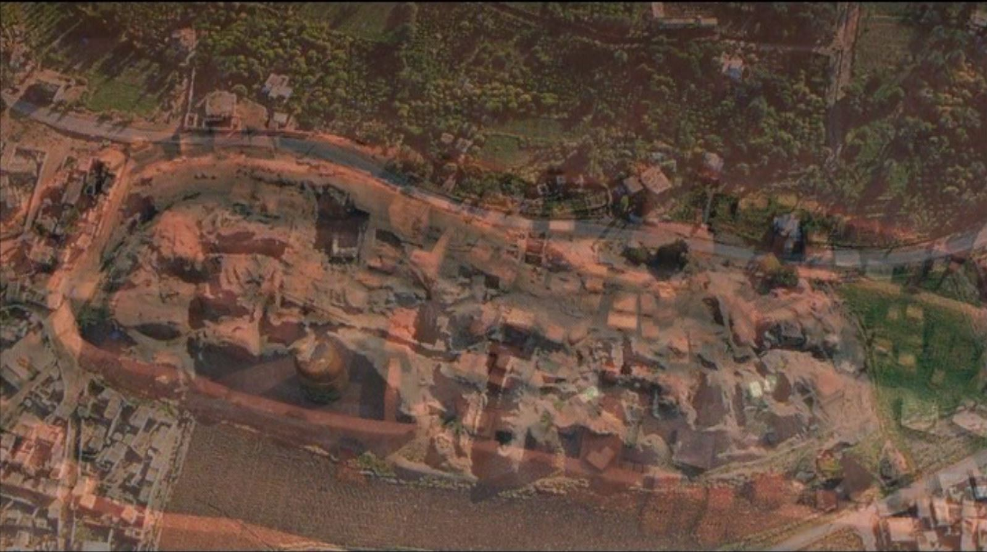

Slide 39
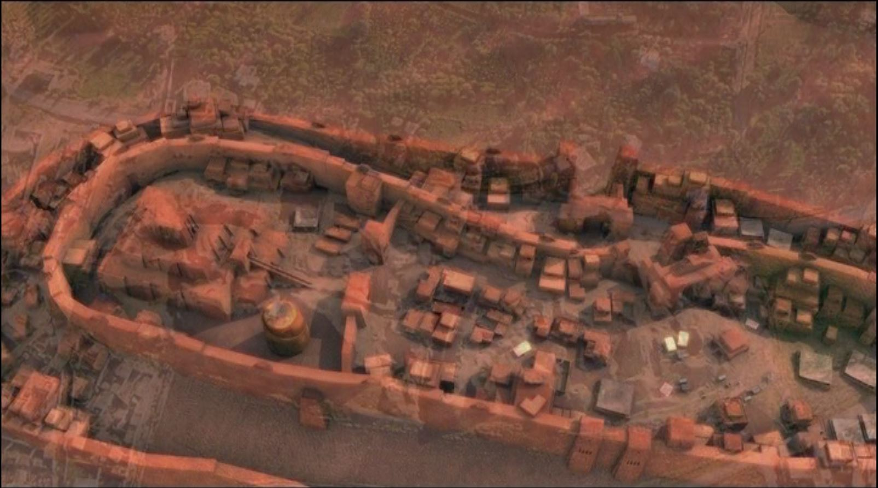

Slide 40
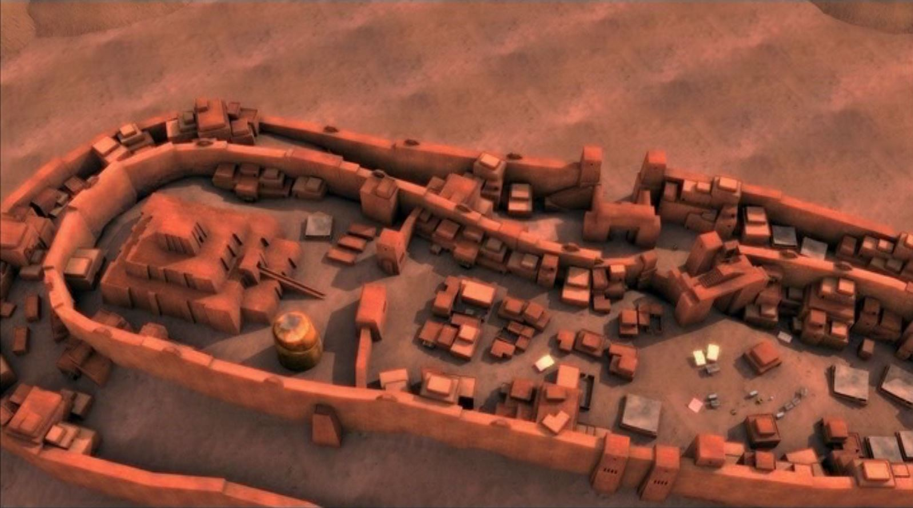
Then

Slide 41
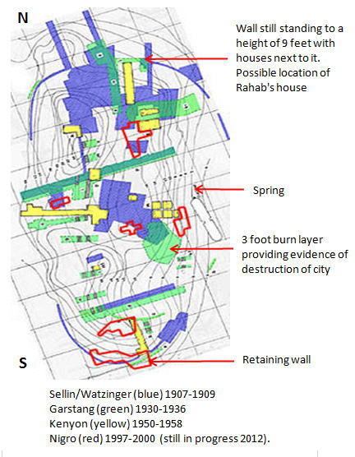
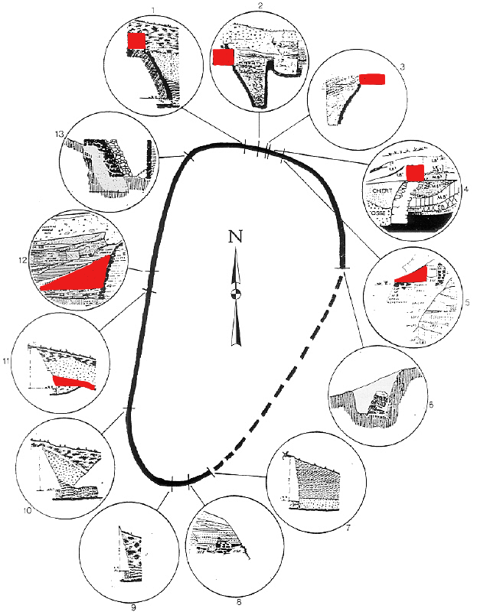

Slide 42
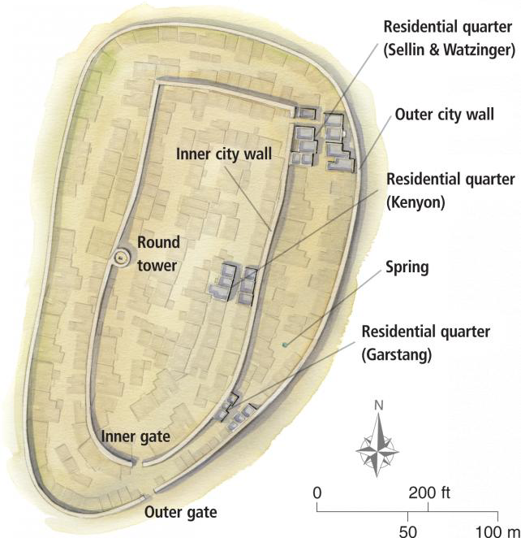

Slide 43
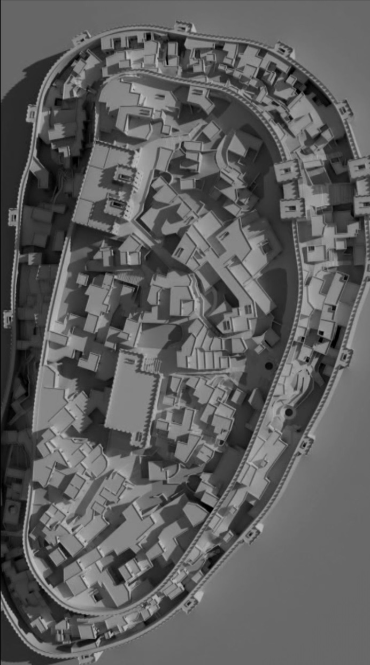

Slide 44
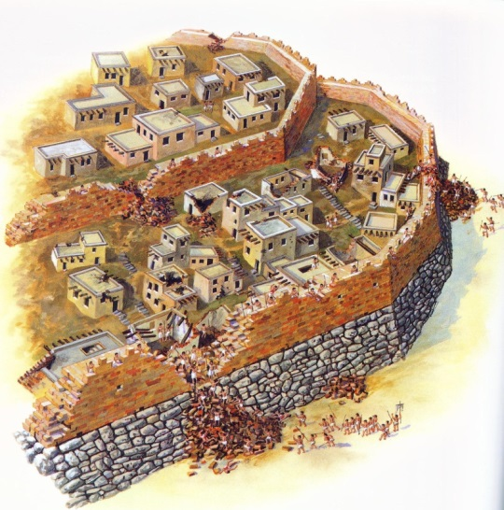
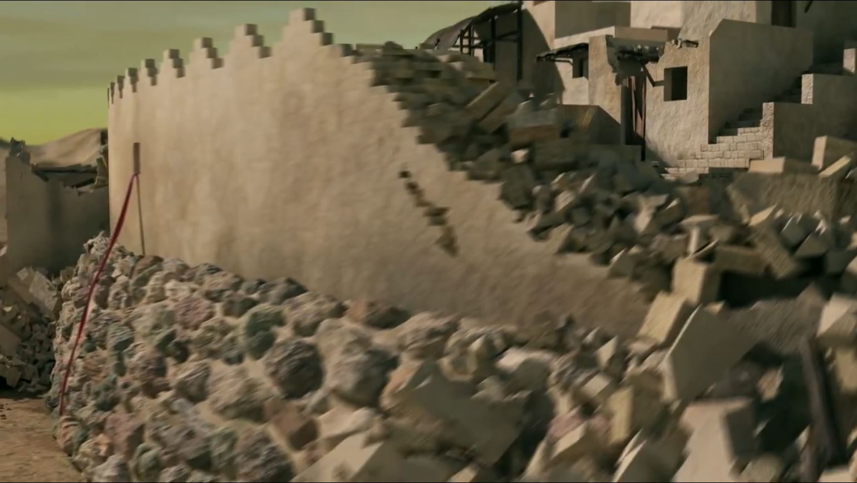

Walls survived on
Northern End
Rahab’s House?

Slide 45
What should be seen at Jericho?
Houses in wall (2:15) she lived in the wall
Harvest Time (3:15) find grain??
Walls Fallen (6:20) wall fell down flat
Wall Make a Ramp (6:20) people went up into the city
City Burned (6:24) burned the city
Sign saying Joshua was here

Slide 46



What should be seen at Jericho?
Houses in wall (2:15) she lived in the wall
Outer
Wall
Retaining Wall

Slide 47


What should be seen at Jericho?
Harvest Time (3:15) find grain??

Slide 48

Jericho, Tell es-Sultan grain storejars in balk
Notes:
Storage Jars of Grain
Both Garstang and Kenyon found dozens of storejars full of burnt grain from the last Canaanite city of Jericho. Bryant Wood has suggested that this fits the biblical account of the destruction of the city by Joshua:
Joshua’s destruction occurred in the spring just after harvest time.
The city was not looted by God’s command. Any other conquering army would have taken the grain for food supplies.
The city was burned.
The storage jars pictured here still remain in one of Kenyon's balks at Jericho.
tb052006445

Slide 49

Jericho, Tell es-Sultan grain storejars in balk
Notes:
tb020707494

Slide 50


A Mighty Wall Taking By Faith

Slide 51

Jericho, Tell es-Sultan mudbrick wall
Notes:
tb052205944

Slide 52

Walls Fallen (6:20) wall fell down flat
Fallen Wall flat
City has history of walls falling

Slide 53
Wall Make a Ramp (6:20) people went up into the city
Retaining Wall

Slide 54

City Burned (6:24) – layer showing
City was burnt

Slide 55
JOSHUA WAS HERE

Slide 56
What should be seen at Jericho?
City Burned (6:24) burned the city – burnt grain / 3 ft of burnt debris
Fallen Walls
Sign saying Joshua was here - Nope

Slide 57



Sources of Jericho Visuals

Slide 58


Slide 59

Jericho falls about 1400 BC
King Ahab rules 874-853 BC
>500 yrs
Joshua 6:26 (ESV)
²⁶Joshua laid an oath on them at that time, saying, “Cursed before the Lord be the man who rises up and rebuilds this city, Jericho.
“At the cost of his firstborn shall he lay its foundation,
and at the cost of his youngest son shall he set up its gates.”
Dating Strata not easy due to erosion

Slide 60



Slide 61
Jericho, Tell es-Sultan from west panorama
Notes:
Jericho in the Persian Period
Jericho became a Persian administrative center during late 6th century BC.
The city was rebuilt by the Jews after their return from Babylon (Ezra 2:34; Neh 2:35; 7:36), and the residents here also helped to rebuild the walls of Jerusalem (Neh 3:2).
tb05110685p

Slide 62


Kathleen Kenyon’s conclusion that the conquest of Jericho was a myth that the Israelites invented because they saw a destroyed city.
John Garstung
Jericho fell to Joshua
1400 BC

Slide 63

No Cypriot Pottery
= no Jericho around 1400 BC
Kathleen Kenyon’s conclusion that the conquest of Jericho was a myth that the Israelites invented because they saw a destroyed city.

Slide 64


No Cypriot Pottery
= no Jericho around 1400 BC
Kathleen Kenyon’s conclusion that the conquest of Jericho was a myth that the Israelites invented because they saw a destroyed city.
Dr Bryant Wood -Garstung
found local copies of
Cypriot Pottery = Jericho
around 1400 BC

Slide 65
Dating the Conquest #1
Samuel
Saul
David
Solomon
1400 BC
1300 BC
1200 BC
1100 BC
1000 BC
900 BC
480 yrs
1446
~300 yrs
~1100
966
~40 yrs wilderness
Reign of Solomon started – 970 BC
1 Kings 6:1(ESV)
¹ In the four hundred and eightieth year after the people of Israel came out of the land of Egypt, in the fourth year of Solomon’s reign over Israel, in the month of Ziv, which is the second month, he began to build the house of the Lord.
Dating of Exodus Based on –
1 Kings 6:1
Jephthah’s statement Judges 11:26
Late date shortens the time of the Judges
1 Chron 6:33-37 the 19 Generations for Heman from Moses to Solomon

Slide 66
Dating the Conquest #2
Samuel
Saul
David
Solomon
1400 BC
1300 BC
1200 BC
1100 BC
1000 BC
900 BC
480 yrs
1446
~300 yrs
~1100
966
~40 yrs wilderness
Jephthah & the Ammonite King ~ 1100 BC
Judges 11:12-13,26 (ESV)
¹²Then Jephthah sent messengers to the king of the Ammonites and said, “What do you have against me, that you have come to me to fight against my land?” ¹³And the king of the Ammonites answered the messengers of Jephthah, “Because Israel on coming up from Egypt took away my land, from the Arnon to the Jabbok and to the Jordan; now therefore restore it peaceably.” … ²⁶ While Israel lived in Heshbon and its villages, and in Aroer and its villages, and in all the cities that are on the banks of the Arnon, 300 years, why did you not deliver them within that time?
Dating of Exodus Based on –
1 Kings 6:1
Jephthah’s statement Judges 11:26
Late date shortens the time of the Judges
1 Chron 6:33-37 the 19 Generations for Heman from Moses to Solomon

Slide 67
Dating the Conquest #3
Late Date
Samuel
Saul
David
Solomon
1400 BC
1300 BC
1200 BC
1100 BC
1000 BC
900 BC
480 yrs
1446
~300 yrs
~1100
966
~40 yrs wilderness
Early Date
Dating of Exodus Based on –
1 Kings 6:1
Jephthah’s statement Judges 11:26
Late date shortens the time of the Judges
1 Chron 6:33-37 the 19 Generations for Heman from Moses to Solomon

Slide 68
Dating the Conquest #4
Samuel
Saul
David
Solomon
1400 BC
1300 BC
1200 BC
1100 BC
1000 BC
900 BC
480 yrs
1446
~300 yrs
~1100
966
~40 yrs wilderness
Dating of Exodus Based on –
1 Kings 6:1
Jephthah’s statement Judges 11:26
Late date shortens the time of the Judges
1 Chron 6:33-37 the 19 Generations for Heman from Moses to Solomon
Genealogy of Heman in 1 Chron 6:33–37 lists 19 generations - Wikepedia gives a length of a generation of 25.2 to 27.4 years or 479 to 521 years , the lower would put it at about 1446 BC

