Slide 1

Book of Joshua
Lesson 8
Gibeon & Southern Conquest of Canaan

Slide 2
Class Objectives
Learn about God's fulfillment of the land promise.
Learn about Serving the Lord in the days of Joshua
Learn about the character of Joshua
Study the Geography & Archaeology of the Conquest of Canaan
Be ready to give a defense of the Conquest of Canaan

Slide 3
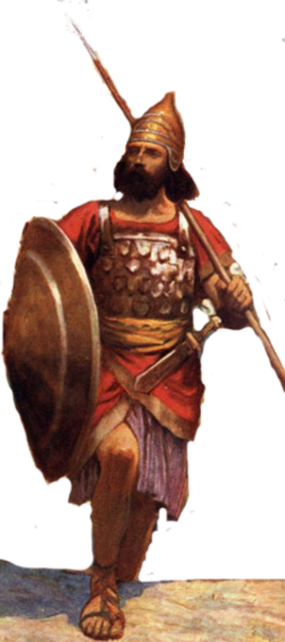
Resting in the land
Living the land
Distributing
the land
Joshua
24:29-33
Conquering the land
Joshua
13-21
Joshua
22-24
Claiming the land
Joshua
6-12
Joshua
1-5
Notes:
I. Claiming the Land (1:1–5:15)
II. Conquering the Land (6:1–12:24)
III. Distributing the Land (13:1–21:45)
IV. Living in the Land (22:1–24:28)
V. Resting in the Land (24:29–33)

Slide 4
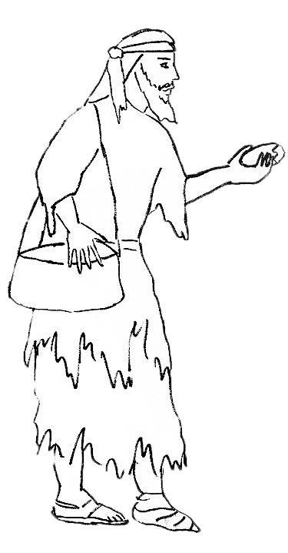
The Gibeonite Deception – Josh 9
⁴they on their part acted with cunning and went and made ready provisions and
took worn-out
sacks for their donkeys,
wineskins- torn and mended,
⁵ patched sandals on their feet, and
clothes.
And all their provisions were dry/crumbly.
“From a very distant country your servants have come, because of the name of the Lord your God.
For we have heard a report of him, and all that he did in Egypt,
¹⁰and all that he did to the two kings of the Amorites who were beyond the Jordan
All new when we started
Warm from oven

Slide 5
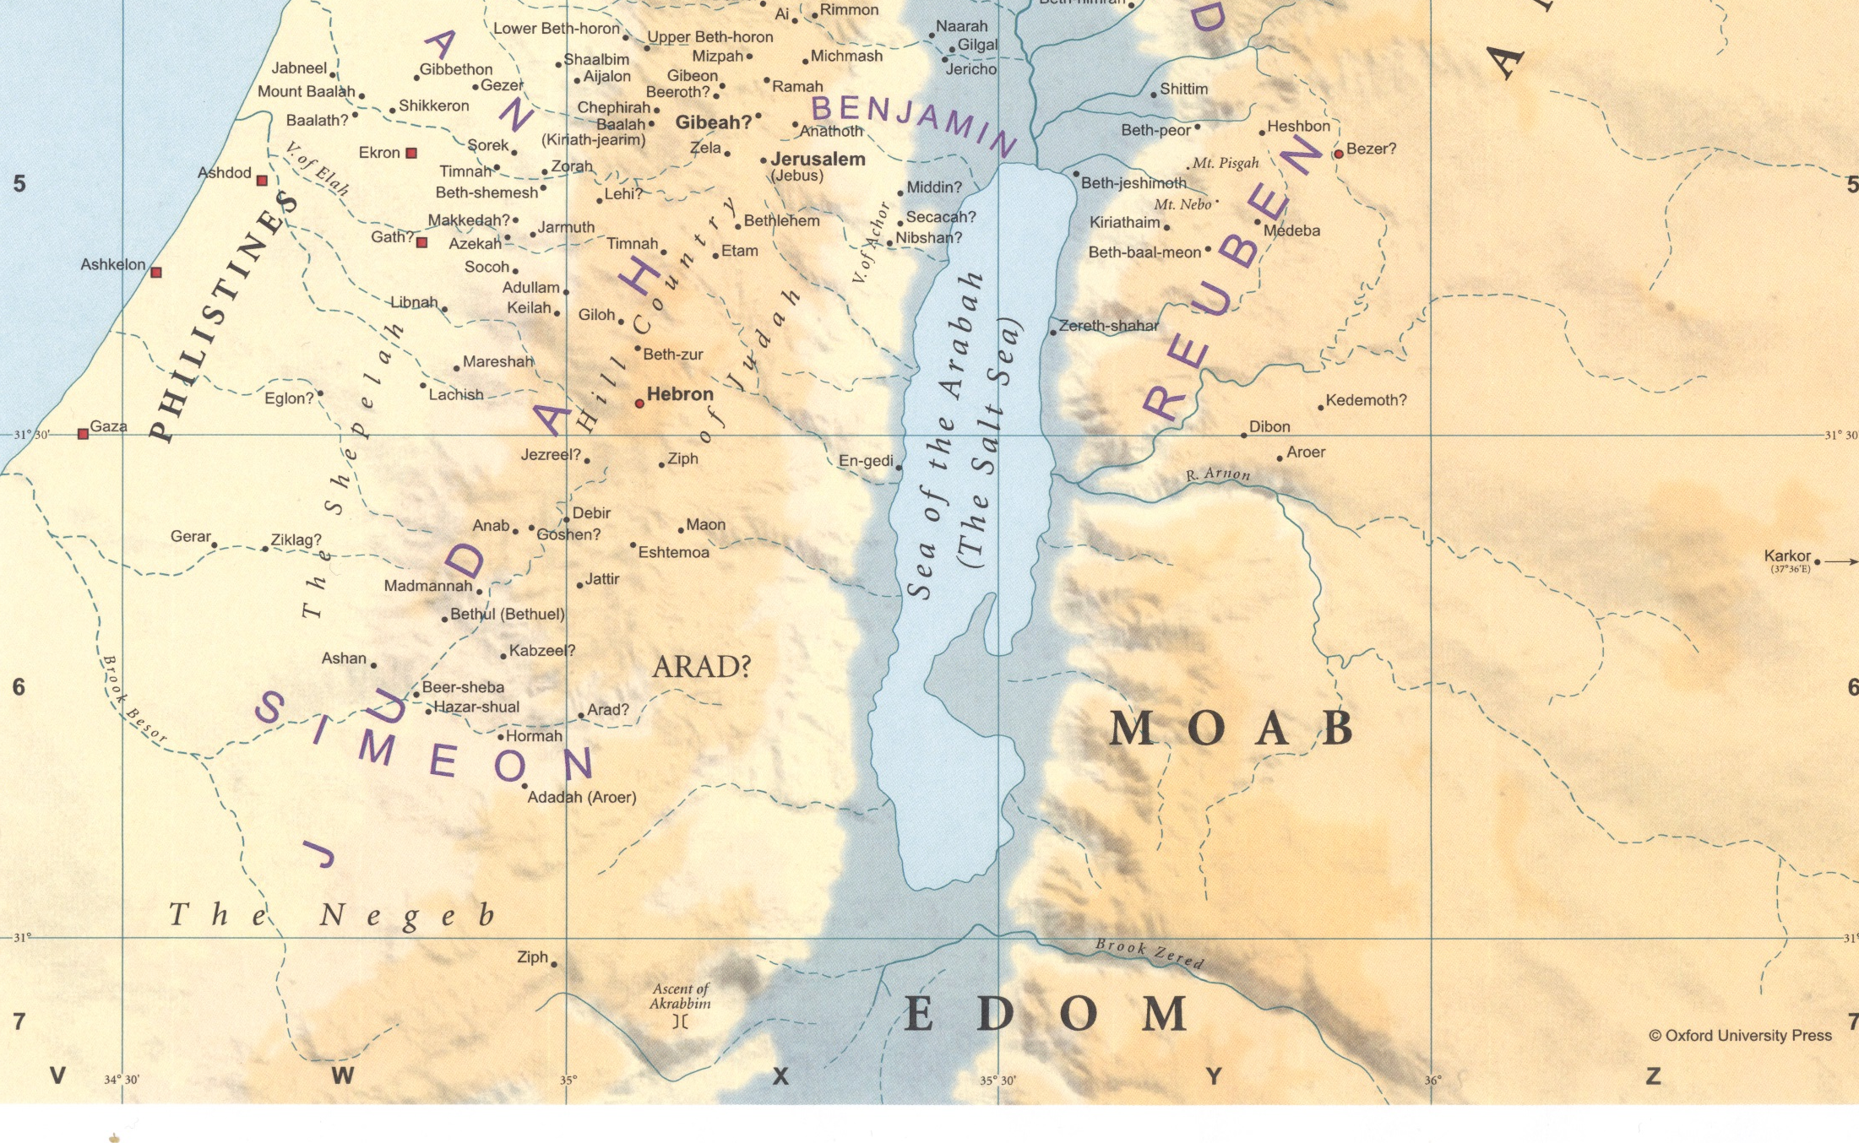
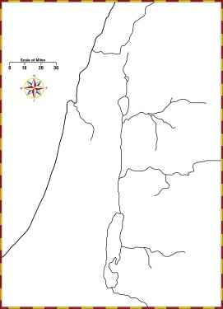
Where was Joshua when the Gibeonites came to make a covenant?
Cities of Gibeon
Chephirah, Beeroth, and Kiriath-jearim.

Slide 6
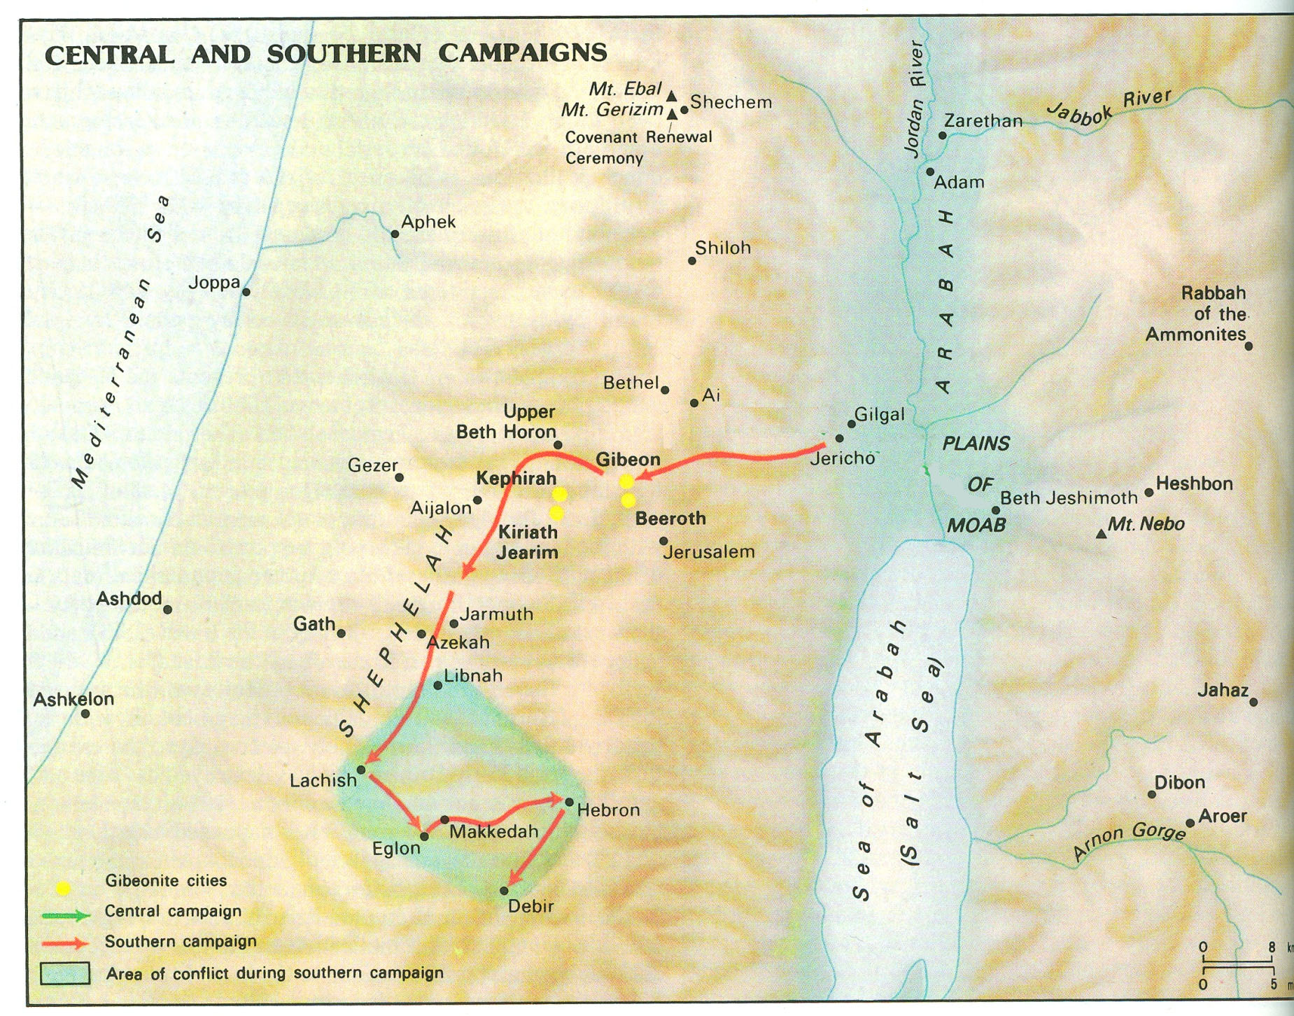
~15 miles
Rate of Travel in Biblical Times
Type of Travel | Speed | Unit
On Foot | 18 to 20 | Miles/day
Armies | 15 | Miles/day
6

Slide 7
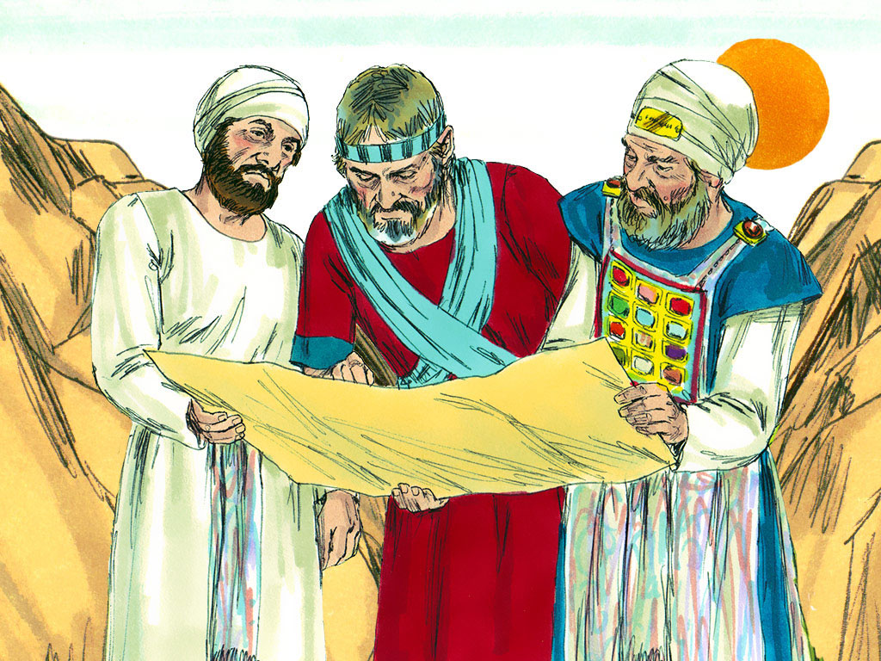
⁶And they went to Joshua in the camp at Gilgal and said to him and to the men of Israel, “We have come from a distant country, so now make a covenant with us.”
⁷But the men of Israel said to the Hivites, “Perhaps you live among us; then how can we make a covenant with you?”
⁸They said to Joshua, “We are your servants.”
“Who are you? And where do you come from?”
⁹They said to him, “From a very distant country your servants have come, because of the name of the Lord your God. For we have heard a report of him, and all that he did in Egypt, ¹⁰and all that he did to the two kings of the Amorites who were beyond the Jordan
¹¹So our elders and all the inhabitants of our country said to us, ‘Take provisions in your hand for the journey and go to meet them and say to them, “We are your servants. Come now, make a covenant with us.”’

Slide 8
⁶And they went to Joshua in the camp at Gilgal and said to him and to the men of Israel, “We have come from a distant country, so now make a covenant with us.”
¹²Here is our bread. It was still warm when we took it from our houses as our food for the journey on the day we set out to come to you, but now, behold, it is dry and crumbly.
¹³These wineskins were new when we filled them, and behold, they have burst. And these garments and sandals of ours are worn out from the very long journey.”
¹⁴So the men took some of their provisions,
but did not ask counsel from the Lord.
¹⁵And Joshua made peace with them
and made a covenant with them, to let them live,
and the leaders of the congregation swore to them.

Slide 9
¹⁴So the men took some of their provisions,
but did not ask counsel from the Lord.
¹⁵And Joshua made peace with them
and made a covenant with them, to let them live,
and the leaders of the congregation swore to them.
Deuteronomy 7:1-2 (ESV)
1 “When the LORD your God brings you into the land that you are entering to take possession of it, and clears away many nations before you, the Hittites, the Girgashites, the Amorites, the Canaanites, the Perizzites, the Hivites, and the Jebusites, seven nations more numerous and mightier than you, 2 and when the LORD your God gives them over to you, and you defeat them, then you must devote them to complete destruction.
You shall make no covenant with them and show no mercy to them.
⁷But the men of Israel said to the Hivites, “Perhaps you live among us; then how can we make a covenant with you?”

Slide 10
¹⁴So the men took some of their provisions,
but did not ask counsel from the Lord.
¹⁵And Joshua made peace with them
and made a covenant with them, to let them live,
and the leaders of the congregation swore to them.
Deuteronomy 20:10-15(ESV)
¹⁰“When you draw near to a city to fight against it, offer terms of peace to it.
¹¹And if it responds to you peaceably and it opens to you, then all the people who are found in it shall do forced labor for you and shall serve you…
¹⁵Thus you shall do to all the cities that are very far from you, which are not cities of the nations here.
⁷But the men of Israel said to the Hivites, “Perhaps you live among us; then how can we make a covenant with you?”

Slide 11
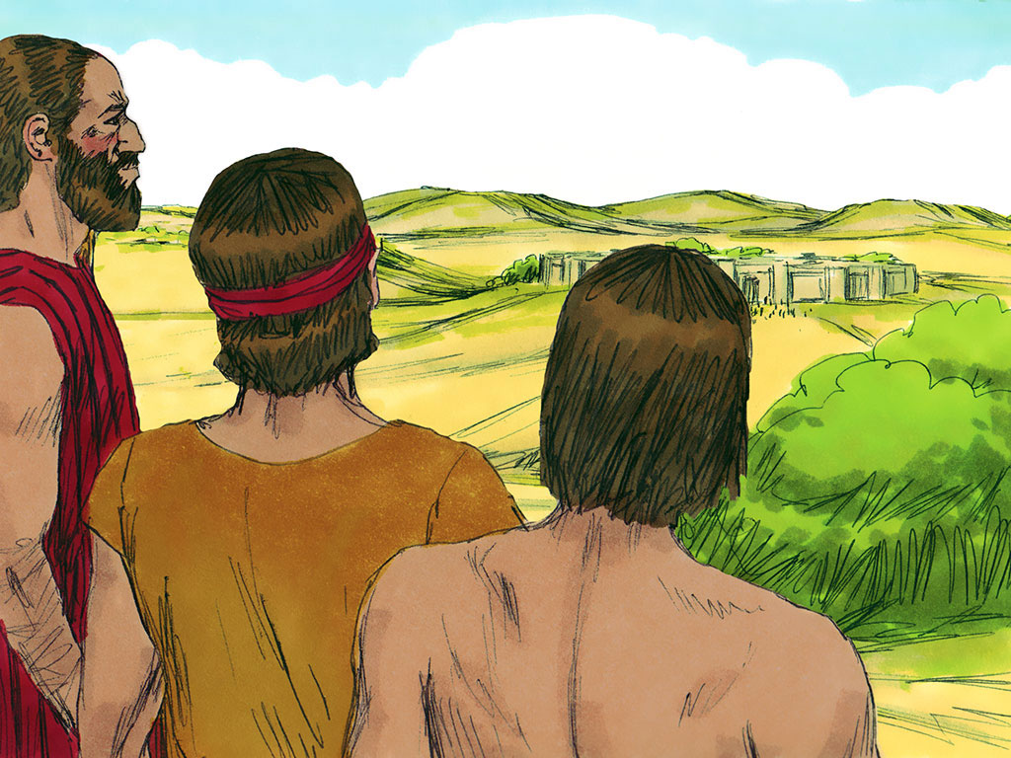
Joshua 9
¹⁶At the end of three days after they had made a covenant with them, they heard that they were their neighbors and that they lived among them.
3 Days Later

Slide 12
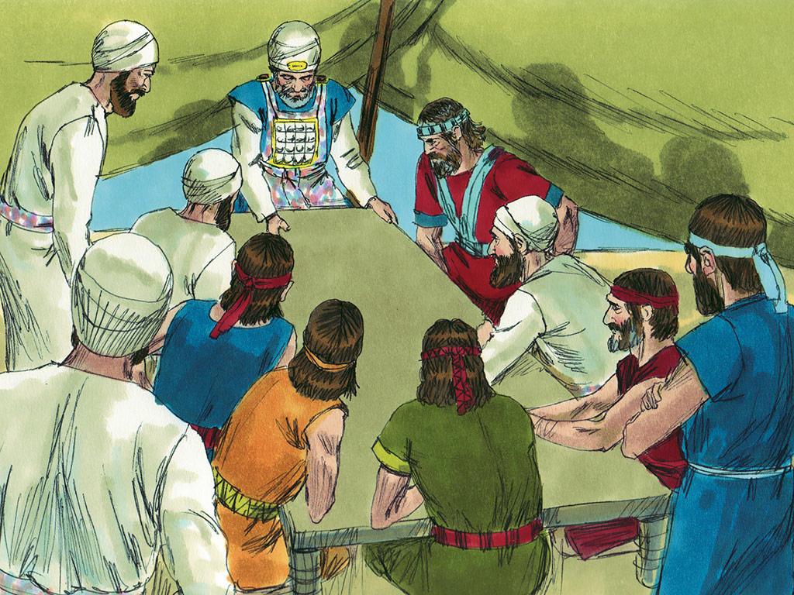
Joshua 9
¹⁸But the people of Israel did not attack them, because the leaders of the congregation had sworn to them by the Lord, the God of Israel.
Then all the congregation murmured against the leaders.
¹⁹But all the leaders said to all the congregation, “We have sworn to them by the Lord, the God of Israel, and now we may not touch them.
²⁰This we will do to them: let them live, lest wrath be upon us, because of the oath that we swore to them.”
²¹And the leaders said to them, “Let them live.” So they became cutters of wood and drawers of water for all the congregation, just as the leaders had said of them.

Slide 13
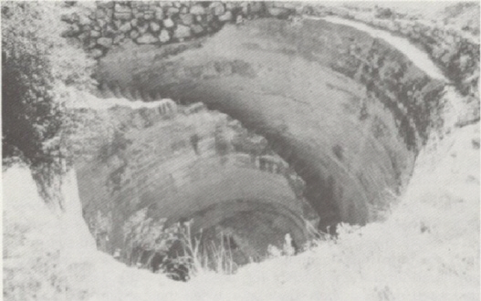
Gibeon Well
One of the sources of water from which they drew was most certainly the pool of Gibeon. And if it had not been unearthed, people could not know for certain to this day exactly where Gibeon had been. Prior to the excavation, it was a controversy among archaeologists although most tended to accept El Jib as the site.
When James B. Pritchard and his archaeological team sponsored by the University of Pennsylvania began digging in their first season in 1957 they had no idea what a wealth of discoveries awaited them
Bible and Spade (1974) Volume 3.

Slide 14
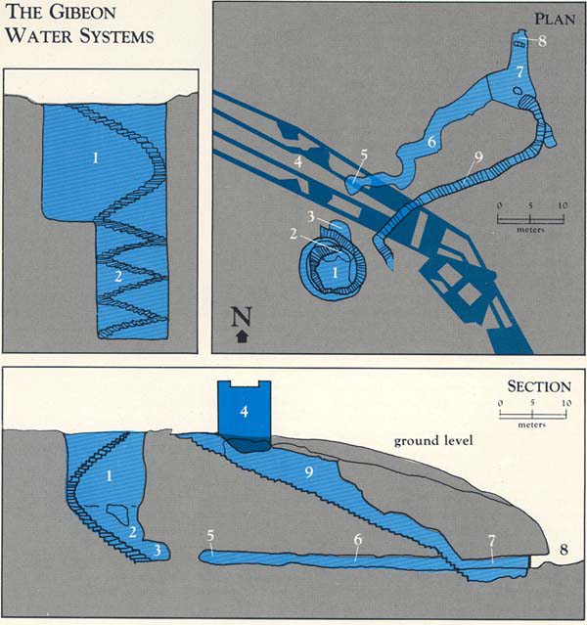
1 Chronicles 12:4(ESV)
One of David’s Mighty Men
⁴Ishmaiah of Gibeon, a mighty man among the thirty and a leader over the thirty;
2 Samuel 2 – Abner & Joab fought at well of Gibeon
2 Samuel 21:1-14 Saul breaks Oath
²So the king called the Gibeonites and spoke to them. Now the Gibeonites were not of the people of Israel but of the remnant of the Amorites. Although the people of Israel had sworn to spare them, Saul had sought to strike them down in his zeal for the people of Israel and Judah.
Dates to after the Conquest

Slide 15
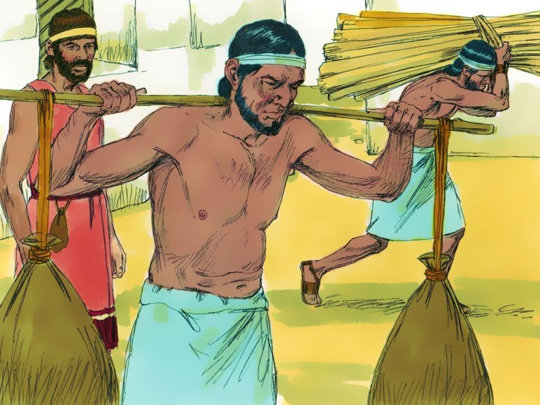
1 Chronicles 16:37-40
Ark in Jerusalem-Tabernacle in Gibeon
³⁷So David left Asaph and his brothers there before the ark of the covenant of the Lord to minister regularly before the ark as each day required…
³⁹And he left Zadok the priest and his brothers the priests before the tabernacle of the Lord in the high place that was at Gibeon
⁴⁰to offer burnt offerings to the Lord on the altar of burnt offering regularly morning and evening, to do all that is written in the Law of the Lord that he commanded Israel.
Dates to after the Conquest

Slide 16
1 Chronicles 16:37-40
Ark in Jerusalem-Tabernacle in Gibeon
³⁷So David left Asaph and his brothers there before the ark of the covenant of the Lord to minister regularly before the ark as each day required…
³⁹And he left Zadok the priest and his brothers the priests before the tabernacle of the Lord in the high place that was at Gibeon
⁴⁰to offer burnt offerings to the Lord on the altar of burnt offering regularly morning and evening, to do all that is written in the Law of the Lord that he commanded Israel.
Dates to after the Conquest

Slide 17
1 Kings 3:4-6 – Solomon’s Dream
⁴And the king went to Gibeon to sacrifice there, for that was the great high place. Solomon used to offer a thousand burnt offerings on that altar.
⁵At Gibeon the Lord appeared to Solomon in a dream by night, and God said, “Ask what I shall give you.”
⁶And Solomon said, “You have shown great and steadfast love to your servant David my father, because he walked before you in faithfulness, in righteousness, and in uprightness of heart toward you. And you have kept for him this great and steadfast love and have given him a son to sit on his throne this day.
Dates to after the Conquest

Slide 18
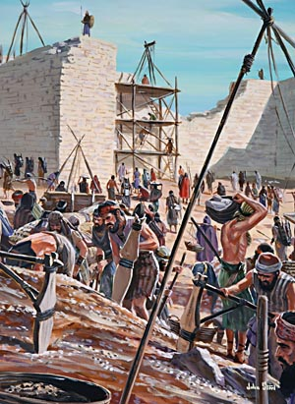
Nehemiah 3:7-8 Gibeonites help rebuild the wall
⁷And next to them repaired Melatiah the Gibeonite and Jadon the Meronothite, the men of Gibeon and of Mizpah, the seat of the governor of the province Beyond the River.
⁸Next to them Uzziel the son of Harhaiah, goldsmiths, repaired. Next to him Hananiah, one of the perfumers, repaired, and they restored Jerusalem as far as the Broad Wall.

Slide 19

Reflected his mentor, Moses Exodus 24:13; 33:11
Loyal – Numbers 11
Courageous – Numbers 14:6-10
Emotional – Joshua 7:6
Intelligence/Wise military man – Joshua 8:3-29
Could be beguiled – Joshua 9:3-27
Prophetic – Joshua 6:26-27
Strong religious leader Judges 2:7
Obedient/Devoted to God Joshua 23-24
Good Example – Joshua 24:14-15
Focused – spied out Canaan Numbers 14
Endurance – Joshua 12
Speaking Ability – Joshua 24
Kept Oath – Joshua 9-10

Slide 20
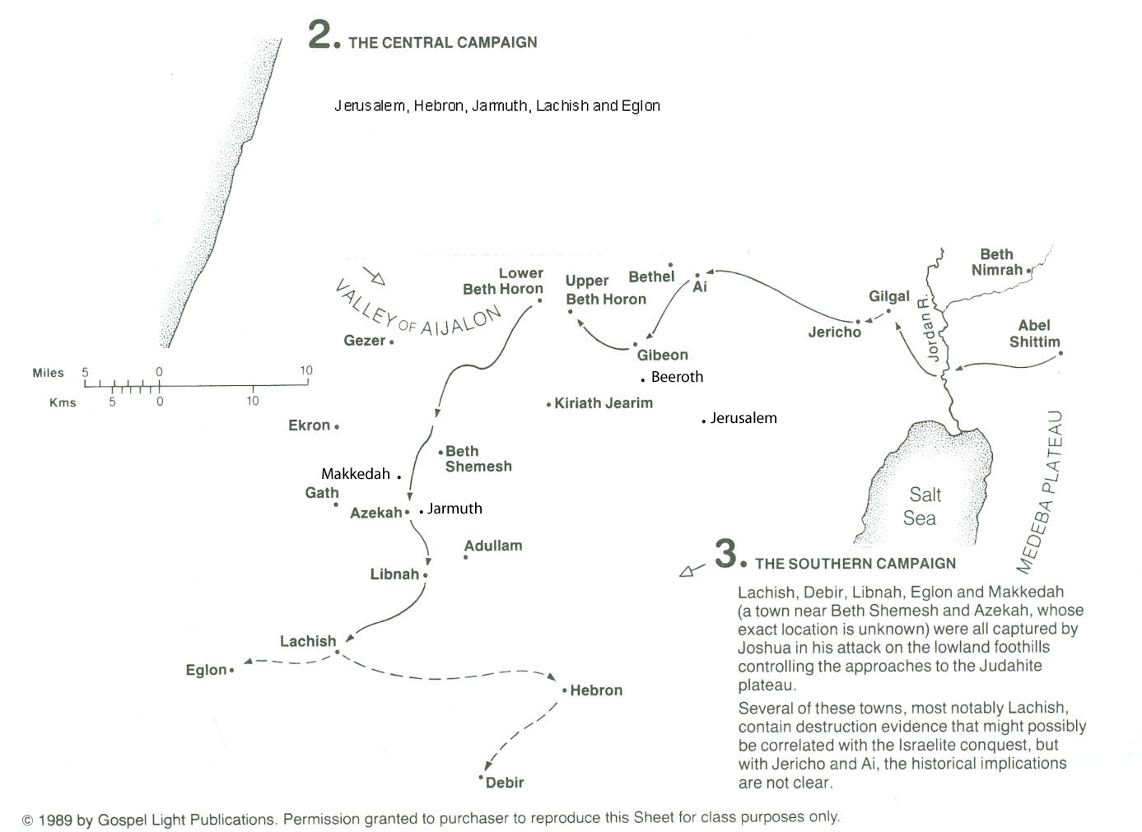
Five Amorite Kings
Chephirah .
Joshua 10:3-4
So Adoni-zedek king of Jerusalem sent to Hoham king of Hebron, to Piram king of Jarmuth, to Japhia king of Lachish, and to Debir king of Eglon, “Come up to me and help me, and let us strike Gibeon. For it has made peace with Joshua and with the people of Israel.”
Cities of Gibeon
Five Kings

Slide 21
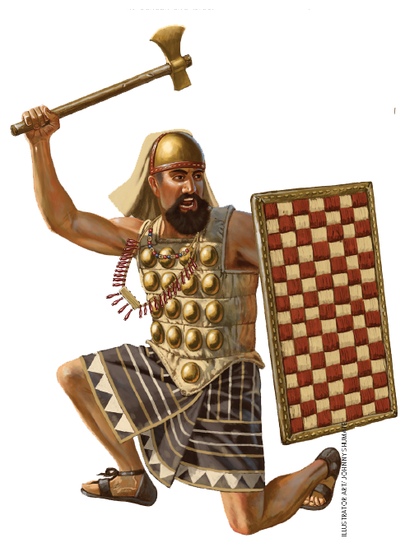
Joshua 10
¹As soon as Adoni-zedek, king of Jerusalem, heard
how Joshua had captured Ai and had devoted it to destruction,
doing to Ai and its king as he had done to Jericho and its king, and
how the inhabitants of Gibeon had made peace with Israel and were among them,
²he feared greatly, because
  Gibeon was a great city,
  like one of the royal cities, and
  because it was greater than Ai, and
  all its men were warriors.

Slide 22
~15 miles
Rate of Travel in Biblical Times
Type of Travel | Speed | Unit
On Foot | 18 to 20 | Miles/day
Armies | 15 | Miles/day
Where was Joshua when the Gibeonites sent for help?
22

Slide 23
Joshua 10
⁸And the Lord said to Joshua, “Do not fear them, for I have given them into your hands. Not a man of them shall stand before you.”

Slide 24
Five Amorite Kings
Chephirah .
Cities of Gibeon
Five Kings
Joshua 10
⁹So Joshua came upon them suddenly, having marched up all night from Gilgal.

Slide 25
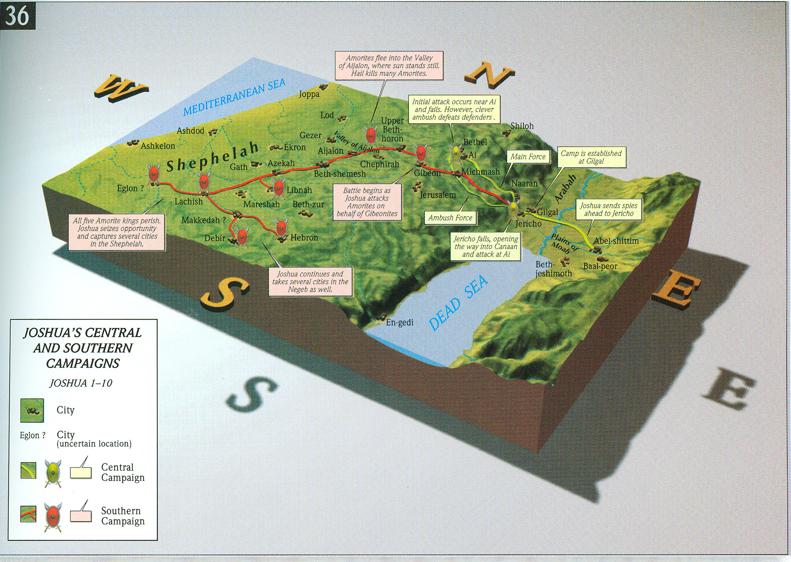
Joshua 10
⁹So Joshua came upon them suddenly, having marched up all night from Gilgal.

Slide 26
Joshua 10
⁸And the Lord said to Joshua, “Do not fear them, for I have given them into your hands. Not a man of them shall stand before you.”
¹⁰And the Lord threw them into a panic before Israel,
who struck them with a great blow at Gibeon and chased them by the way of the ascent of Beth-horon and struck them as far as Azekah and Makkedah.
¹¹And as they fled before Israel,
while they were going down the ascent of Beth-horon, the Lord threw down large stones from heaven on them as far as Azekah, and they died.
There were more who died because of the hailstones than the sons of Israel killed with the sword.

Slide 27
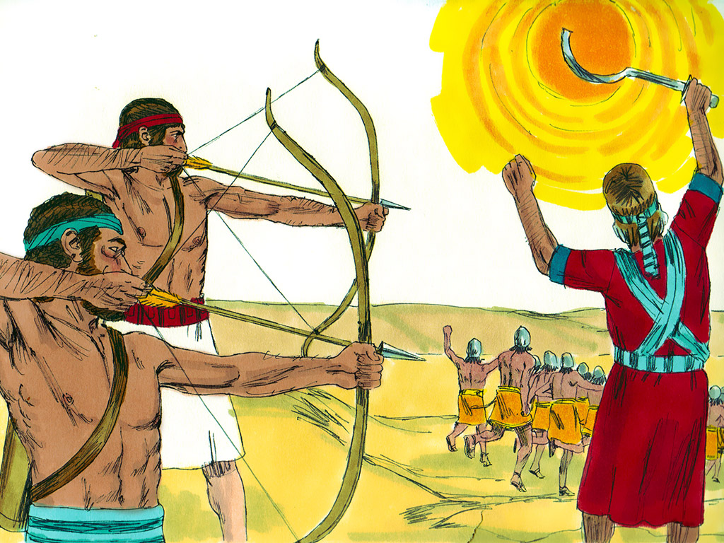
Joshua 10
⁸And the Lord said to Joshua, “Do not fear them, for I have given them into your hands. Not a man of them shall stand before you.”
Joshua 10
¹²At that time Joshua spoke to the Lord in the day when the Lord gave the Amorites over to the sons of Israel, and he said in the sight of Israel,
“Sun, stand still at Gibeon,
and moon, in the Valley of Aijalon.”
¹³ And the sun stood still, and the moon stopped,
until the nation took vengeance on their enemies.

Slide 28
Five Amorite Kings Flee
Hailstones
Chephirah .
Cities of Gibeon
Joshua 10
¹⁰And the Lord threw them into a panic before Israel, who£ struck them with a great blow at Gibeon and chased them by the way of the ascent of Beth-horon and struck them as far as Azekah and Makkedah.
Five Kings

Slide 29
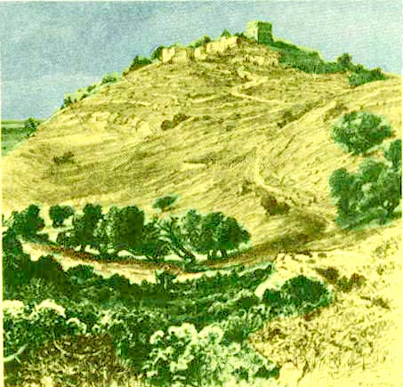
Ascent of Beth Heron

Slide 30
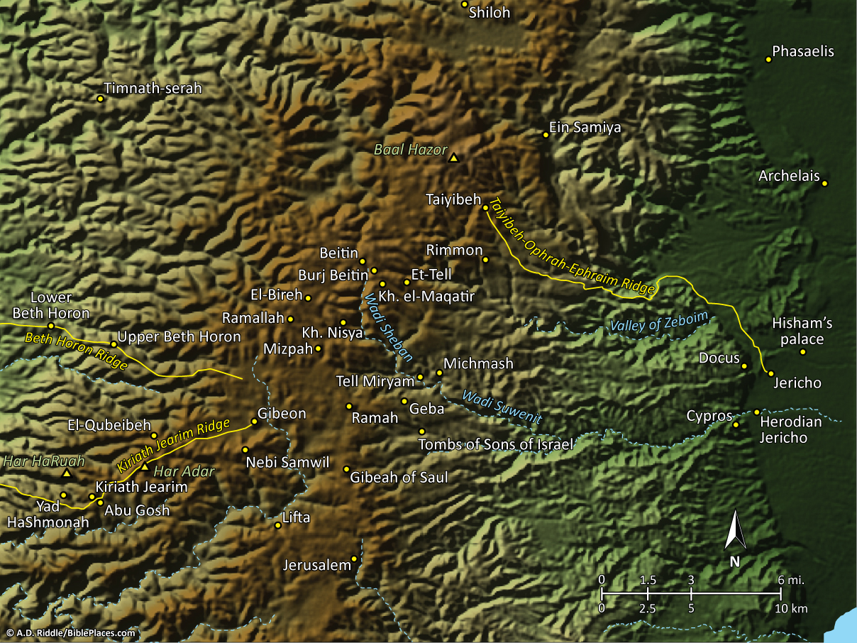
Gilgal
Pictorial Library Vol. 2: Benjamin
Notes:
This map is intended to help users locate the places which appear in the photographs in this presentation. The map therefore does not represent or label every geographic feature, and the sites are a mixture of modern and ancient place names.

Slide 31
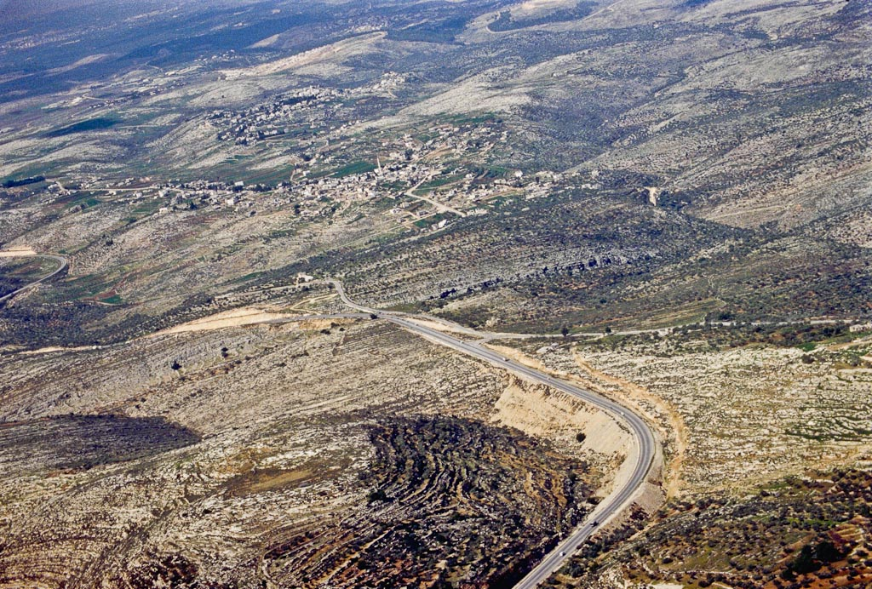
Lower Beth Horon
Beth Horon ridge aerial
Notes:
bb00010020

Slide 32
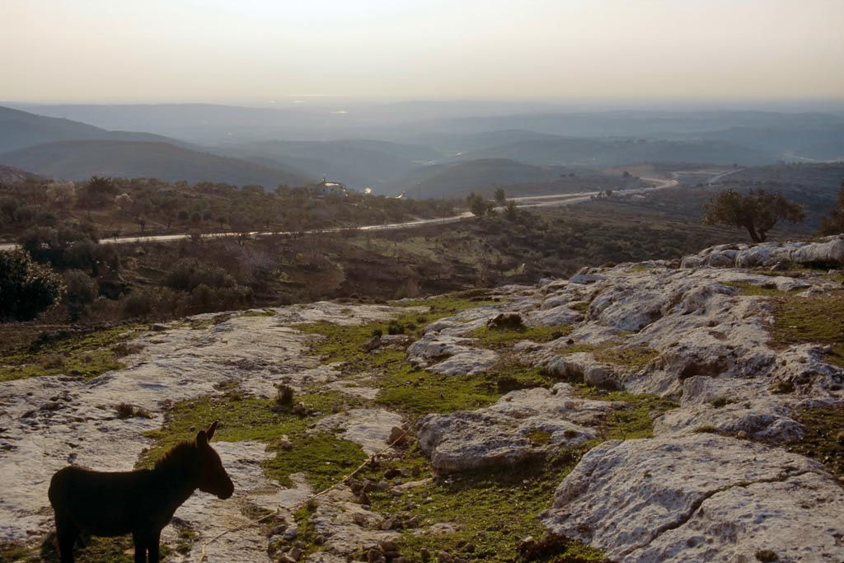
Beth Horon ridge
Notes:
The Miracle of the Sun Standing Still
The Narrative: At about 10 o’clock in the morning, a couple of weeks after the Passover, the sun stood still over Gibeon and the moon over Aijalon. “On the day that the LORD gave the Amorites over to Israel, Joshua said to the LORD in the presence of Israel: ‘O sun, stand still over Gibeon, O moon, over the Valley of Aijalon.’ So, that day only, the sun stood still, and the moon stopped, until the nation had avenged itself on its enemies, as it is written in the Book of Jashar. The sun stopped in the middle of the sky and delayed going down about a full day. There has never been a day like it before or since, a day when the LORD listened to a man. Surely the LORD was fighting for Israel!” (Josh 10:12-14, NIV).
Conservative explanations (Miller 1998).
An extension of daylight hours (allowing the battle to continue) [Woudstra].
A subjective 'extension' of daylight hours (more a miracle of 'efficiency' than 'nature') [possible conclusion of Keil and Delitzsch]
Semi-darkness during the day due to miraculous hailstorms and cloud covering (maximizing confusion, reducing heat, and divine deliverance) [Madvig].
Providential battle play-out (the sun always being in the opponents' eyes due to the slope of the enemy's descent) [Gordon].
An eclipse (as an omen, based on ANE usage of the verbs) [R.D. Wilson, Holliday].
Difficulties in explanations (Miller 1998).
The exegetical problems stem from four main factors:
The mixture of poetic and narrative elements.
The mixture of summary statements and detailed event descriptions.
The ambiguity in the word choices describing the astronomical/meteorological events.
The historical setting and the general inability of anyone present to measure time or observe the sun.
tbs74369303

Slide 33
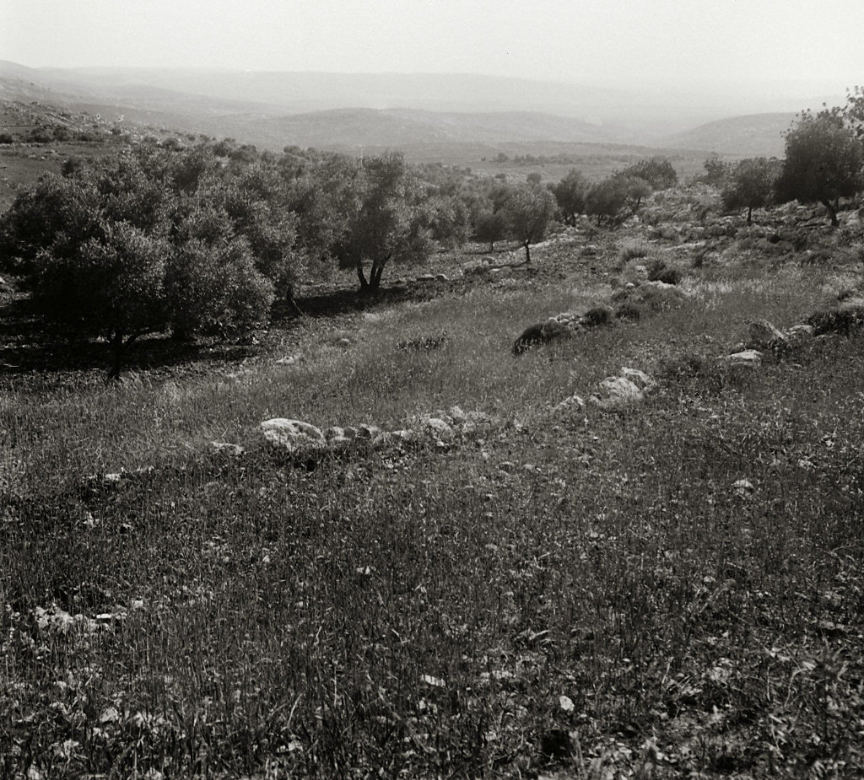
Aijalon Valley from Lower Beth Horon
Aijalon Valley from Lower Beth Horon
Notes:
“The mountains look on the Shephelah, and the Shephelah looks on the sea,—across the Philistine Plain. It curves round this plain from Gaza to Jaffa like an amphitheatre. But the amphitheatre is cut by three or four great gaps, wide valleys that come right through from the foot of the Judean hills to the sea. Between these gaps the low hills gather in clumps and in short ranges from 500 to 800 feet high, with one or two summits up to 1500. The formation is of limestone or chalk, and very soft—therefore irregular and almost featureless, with a few prominent outposts upon the plain. In the cross valleys there are perennial, or almost perennial, streams, with broad pebbly beds; the soil is alluvial and red, with great corn-fields” (Smith 1909: 208).
“The strategic importance of these valleys can hardly be overrated, for they do not belong to the Shephelah alone. Each of them is continued by a defile into the very heart of Judea, not far from an important city, and each of them has at its other end, on the coast, one of the five cities of the Philistines. To realize these valleys is to understand the wars that have been fought on the western watershed of Palestine from Joshua’s time to Saladin’s” (Smith 1909: 209).
Date of photograph: between 1910 and 1920
mat05136

Slide 34
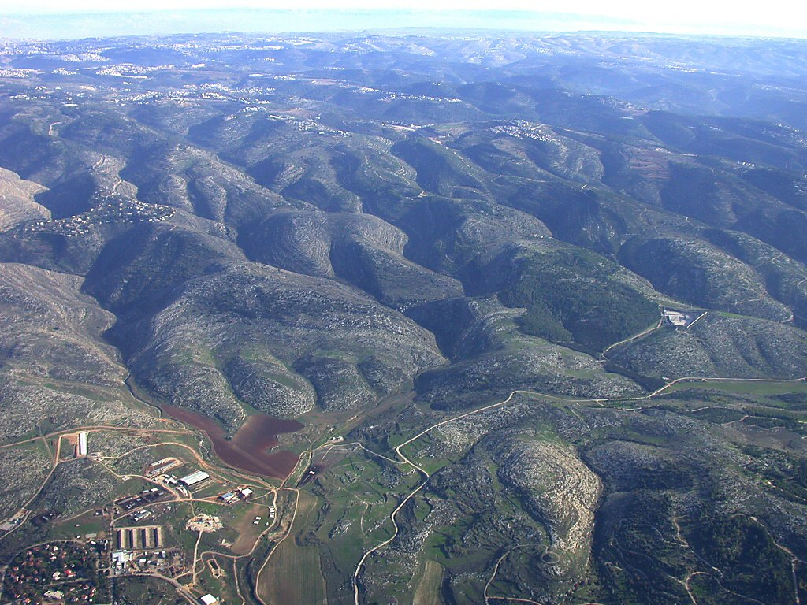
Jerusalem
Kiriath Jearim
Yad HaShmonah
Kiriath Jearim Ridge Route
Diagonal Route
to Beth Shemesh and Azekah
to Beth Horon
Ridge Route
Aijalon
(Tell Yalo)
Aijalon Valley eastern end aerial
Notes:
df010703204

Slide 35
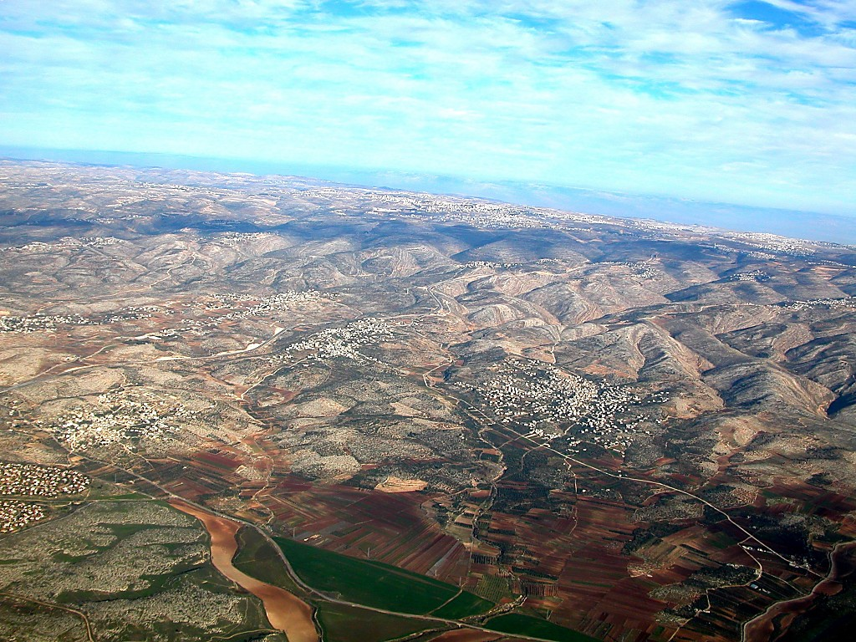
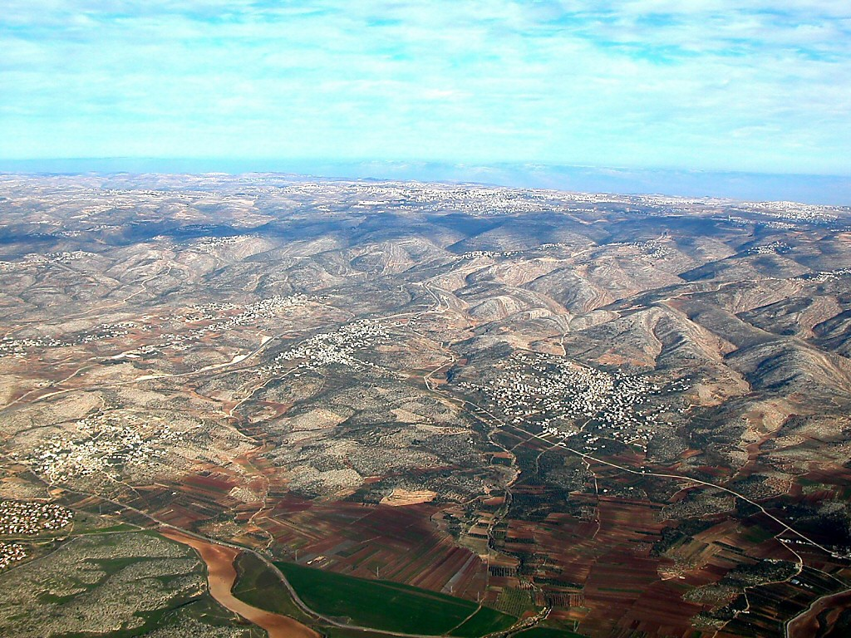
Transjordan
Gibeah of Saul
Upper Beth Horon
Lower Beth Horon
Aijalon
Valley
Beth Horon ridge aerial from west
Notes:
tb010703102

Slide 36
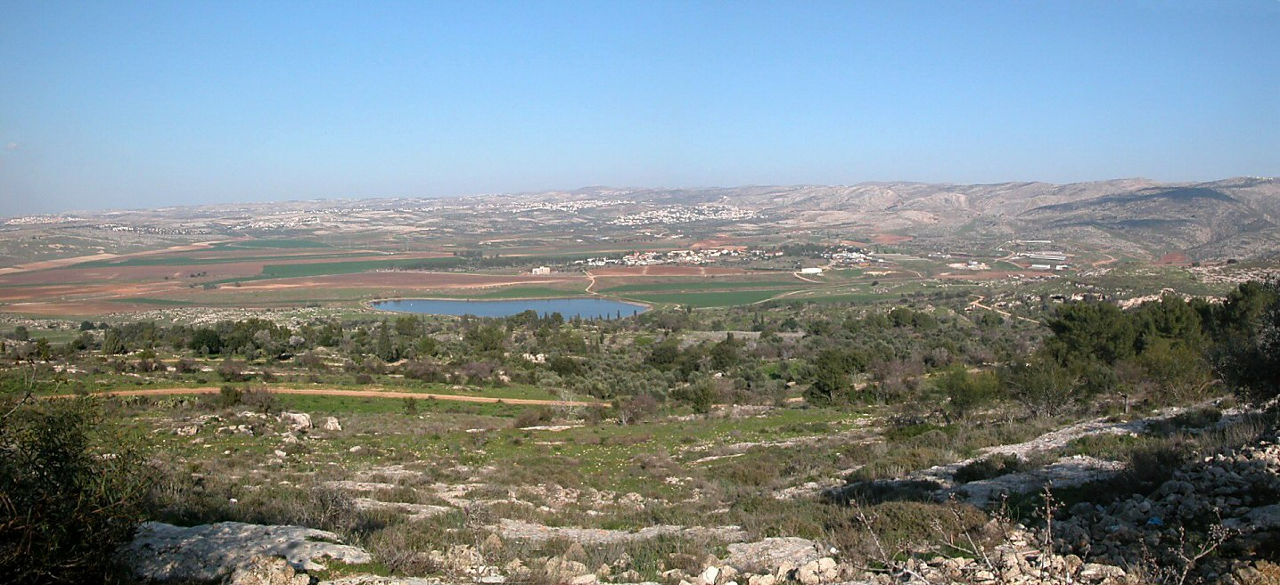
Aijalon (Tell Yalo)
Aijalon Valley eastern end from south panorama
Notes:
tb012503207

Slide 37
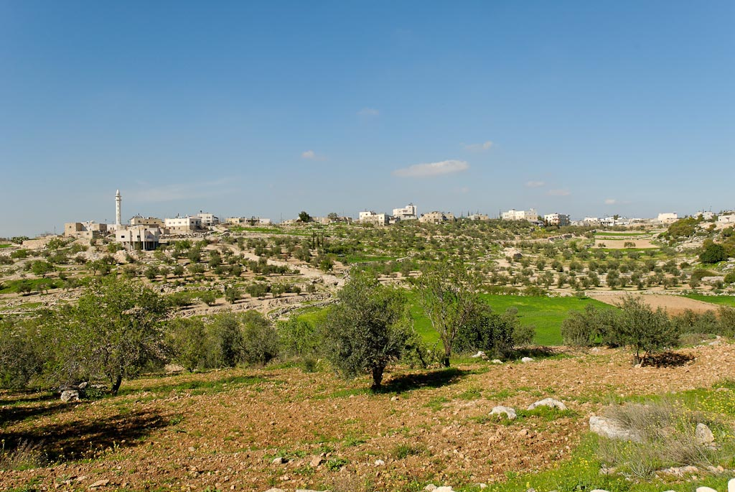
Joshua 10
¹⁷And it was told to Joshua, “The five kings have been found, hidden in the cave at Makkedah.” ¹⁸And Joshua said, “Roll large stones against the mouth of the cave and set men by it to guard them,
Makkedah, Khirbet el-Qom, from south
Notes:
The Arab village of el-Qom sits on the ruins of an Iron Age site, identified by David Dorsey as the biblical city of Makkedah (Dorsey 1980). The site is located 6.5 miles (10.5 km) east of Lachish and 6 miles (10 km) south of Keilah.
tb030407770

Slide 38
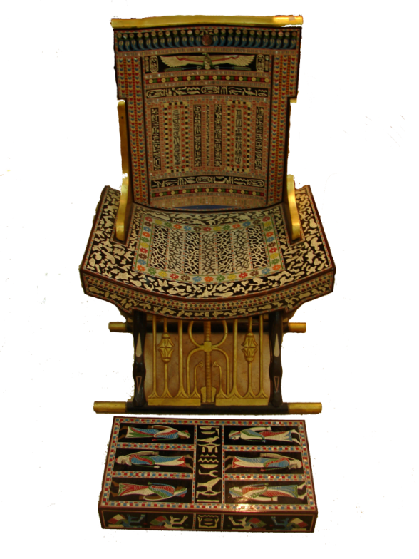
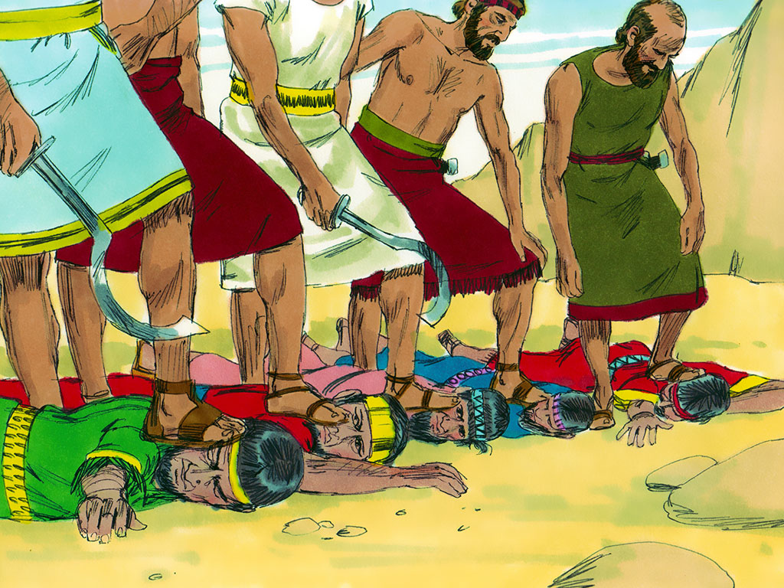
Joshua 10
²⁴And when they brought those kings out to Joshua, Joshua summoned all the men of Israel and said to the chiefs of the men of war who had gone with him, “Come near; put your feet on the necks of these kings.” Then they came near and put their feet on their necks.
²⁵And Joshua said to them, “Do not be afraid or dismayed; be strong and courageous. For thus the Lord will do to all your enemies against whom you fight.”

Slide 39
Joshua 10
Deuteronomy 21:22-23 (ESV)
A Man Hanged on a Tree Is Cursed
²² “And if a man has committed a crime punishable by death and he is put to death, and you hang him on a tree, ²³ his body shall not remain all night on the tree, but you shall bury him the same day, for a hanged man is cursed by God. You shall not defile your land that the Lord your God is giving you for an inheritance.
²⁶And afterward Joshua struck them and put them to death, and he hanged them on five trees. And they hung on the trees until evening.
²⁷But at the time of the going down of the sun, Joshua commanded, and they took them down from the trees and threw them into the cave where they had hidden themselves, and they set large stones against the mouth of the cave, which remain to this very day.

Slide 40
# | City Defeated | Chapter & Verse | King's Fate | Cities Fate | People/ Nation | Tribal Territory | 4th Oxford Atlas Map Location
3 | Jericho | Josh 6:21,24, 10:1, 12:9 | Killed | devoted all in the city to destruction burned the city with fire, precious items treasury of Lord | Canaanites | Benjamin | 5X
4 | Ai | Josh 8:19, 26-29, 12:9 | King taken alive & hanged him on a tree | burned Ai and made it forever a heap of ruins, struck down men,Israel took as their plunder, All the people of Ai killed | Canaanites | Benjamin | 5X
5 | Bethel | Josh 8:17,27 12:16 | Killed | not a man in Ai or Bethel who did not go out after Israel | Canaanites | Ephraim | 5X
6 | Gibeon - Chephirah, Beeroth, and Kiriath-jearim | Josh 9:7,16-19, 26-27 |  | day cutters of wood & drawers of water | Hivites | Benjamin | 5X

Slide 41
# | City Defeated | Chapter & Verse | King's Fate | Cities Fate | People/ Nation | Tribal Territory | 4th Oxford Atlas
7 | Jerusalem (King Adoni-Zedek) | 10:3,11,16-20,24-26,12:10 | kings fled and hid themselves in the cave, chiefs came near and put their feet on their necks, put them to death, and he hanged them on five trees | fled before Israel, Lord threw down large stones from heaven, sun stopped to allow more to be killed, | Amorite | Benjamin | 5X
8 | Hebron (King Hoham) | 10:36-37, 11:21 12:10 |  | put it to the sword, cut off the Anakim with their cities | Amorite | Judah | 5X
9 | Jarmuth (King Piram) | Josh 12:11 |  | put it to the sword | Amorite | Judah | 5W
10 | Lachish (King Japhia) | Josh 12:11 |  | put it to the sword | Amorite | Judah | 5W
11 | Eglon (King Debir) | 10:38-39, 11:21 12:12 |  | put it to the sword | Amorite | Judah | 6X
12 | Makkedah | 10:28& 12:16 | killed | put it to the sword | Amorite | Judah | 5W
13 | Libneah | 10:30 & 12:15 | Killed | put it to the sword | Amorite | Judah | 5W
14 | Gezer | 10:33, 12:12 | Horam-killed | put it to the sword |  | Ephriam | 5W

Slide 42
Gilgal
Pictorial Library Vol. 2: Benjamin
Notes:
This map is intended to help users locate the places which appear in the photographs in this presentation. The map therefore does not represent or label every geographic feature, and the sites are a mixture of modern and ancient place names.

Slide 43
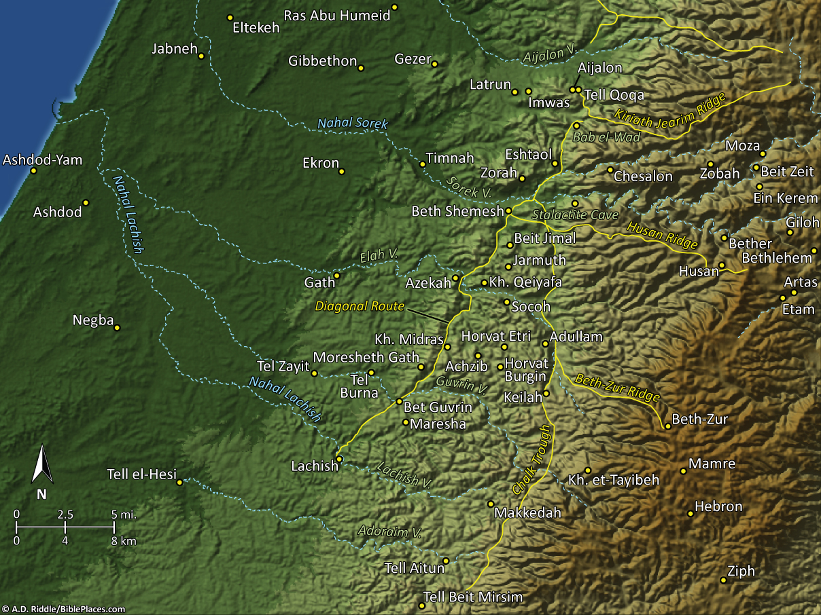
Gibeon
Libnah
Pictorial Library Vol. 4: Shephelah
Notes:
This map is intended to help users locate the places which appear in the photographs in this presentation. The map therefore does not represent or label every geographic feature, and the sites are a mixture of modern and ancient place names.

Slide 44
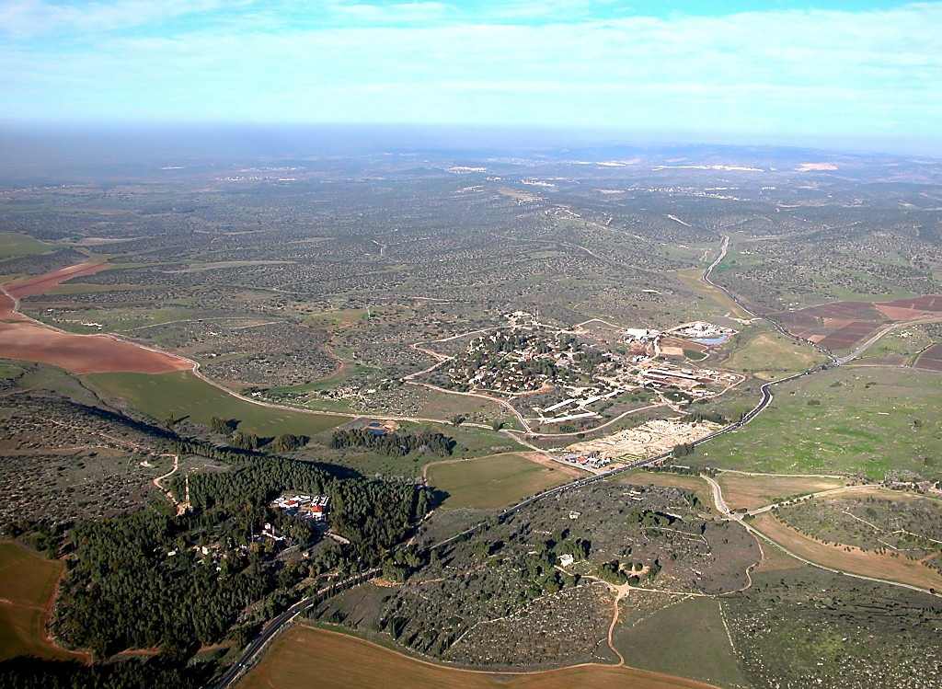
to Azekah
Libnah
to Hebron
amphitheater
Guvrin Valley
Makkedah
Diagonal Route
to Lachish
Bet Guvrin and Diagonal Route aerial from south
Notes:
tb010703217

Slide 45
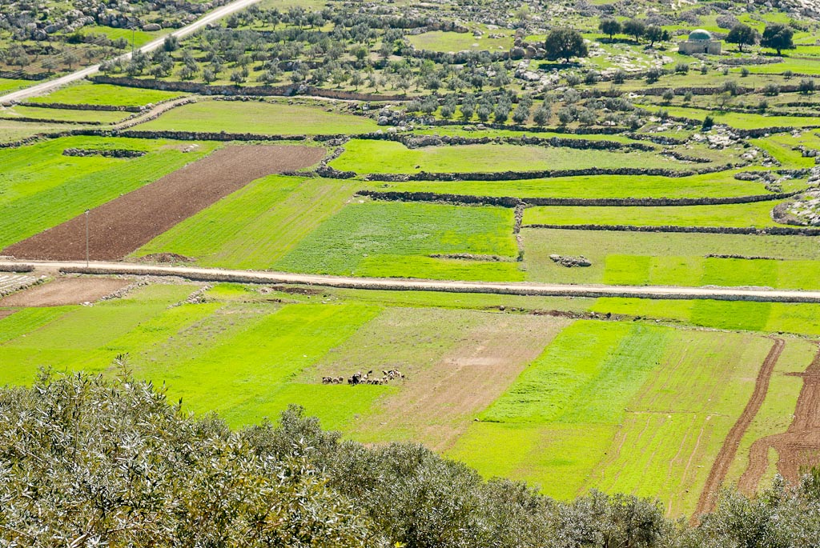
Judean hills near Guvrin Valley with shepherd
Notes:
tb030407744

Slide 46
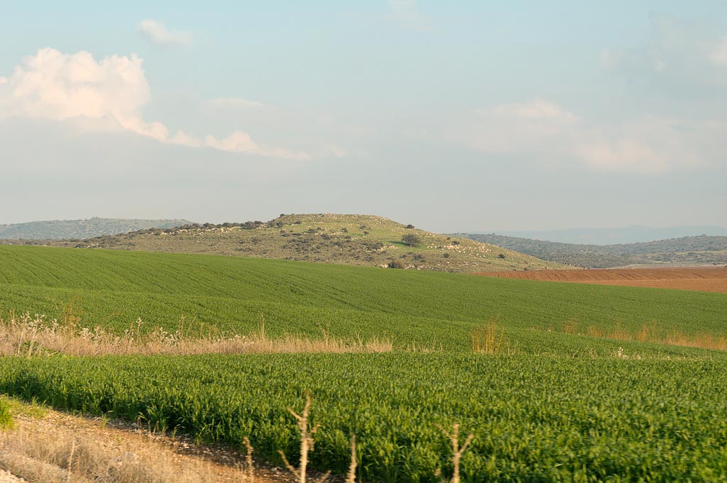
²⁹Then Joshua and all Israel with him passed on from Makkedah to Libnah and fought against Libnah.
³⁰And the Lord gave it also and its king into the hand of Israel. And he struck it with the edge of the sword, and every person in it; he left none remaining in it. And he did to its king as he had done to the king of Jericho.
Tel Burna, possible Libnah, from west
Notes:
Archaeological investigation has revealed settlement layers from the 13th and 9th-7th centuries, as well as limited remains from the Persian period. The eighth-century remains are abundant, including defensive fortifications.
tb011606860

Slide 47
Gibeon
³¹Then Joshua and all Israel with him passed on from Libnah to Lachish and laid siege to it and fought against it.
Libnah
Pictorial Library Vol. 4: Shephelah
Notes:
This map is intended to help users locate the places which appear in the photographs in this presentation. The map therefore does not represent or label every geographic feature, and the sites are a mixture of modern and ancient place names.

Slide 48
³¹Then Joshua and all Israel with him passed on from Libnah to Lachish and laid siege to it and fought against it.
to Azekah
Libnah
to Hebron
amphitheater
Guvrin Valley
Makkedah
Diagonal Route
to Lachish
Bet Guvrin and Diagonal Route aerial from south
Notes:
tb010703217

Slide 49
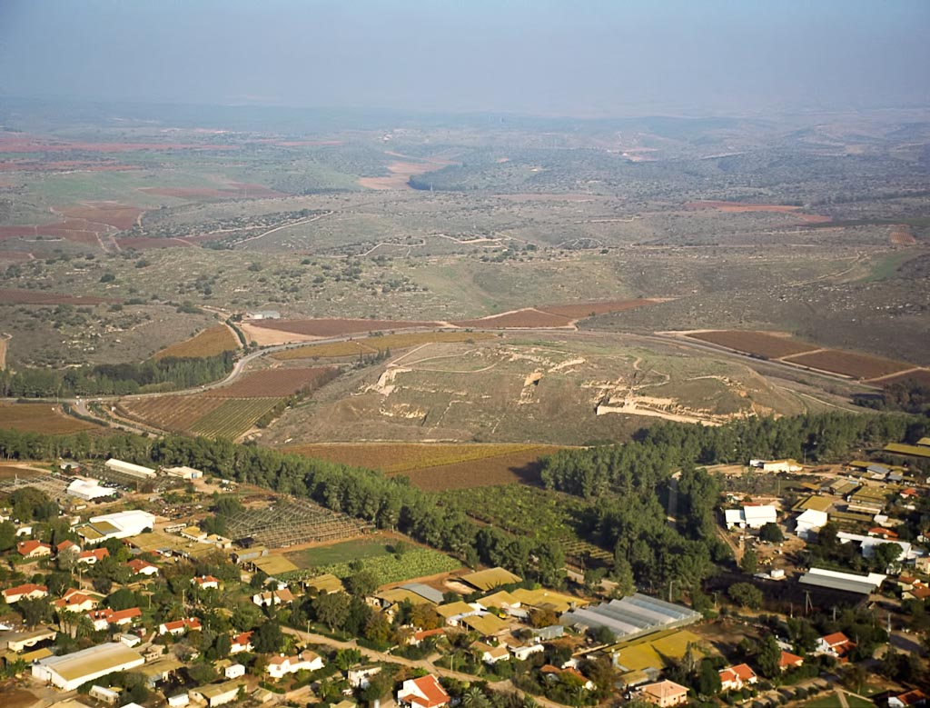
³²And the Lord gave Lachish into the hand of Israel, and he captured it on the second day and struck it with the edge of the sword, and every person in it, as he had done to Libnah.
Lachish aerial from west
Notes:
Located about 20 miles (32 km) inland from Ashdod, the tell of the ancient city of Lachish is 31 acres in size.
Lachish was particularly significant during three main events of OT history: the conquest of Joshua (1400 BC), the invasion of Sennacherib (701), and the campaign of Nebuchadnezzar (586).
tbs131150112

Slide 50
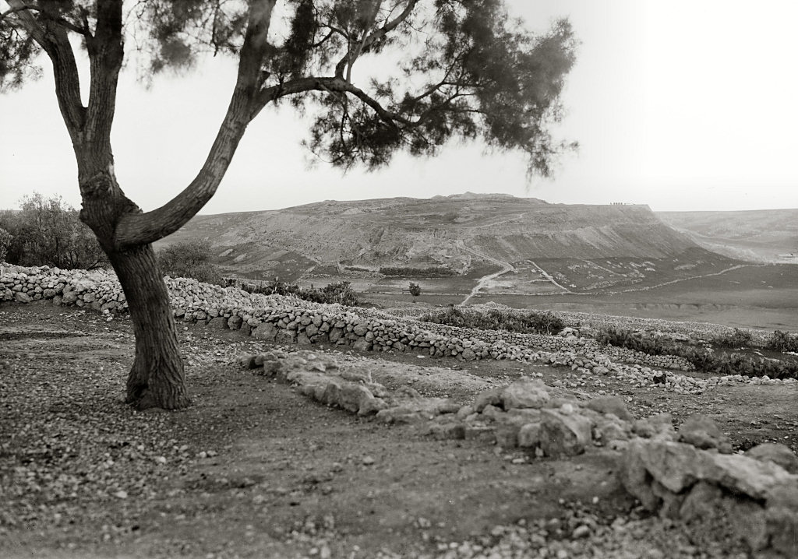
Lachish, Tell Duweir
Lachish, Tell Duweir
Notes:
In 1929, W. F. Albright identified Tell Duweir as the biblical Lachish based on Eusebius’ description of the site’s location. Albright’s identification was confirmed in excavations of the tell. The first expedition was a British excavation team supervised by J. L. Starkey in 1932. The team followed the excavation methods developed by William Petrie. A few of the discoveries made at the ancient site were city gates, a revetment wall, a palace and a palace-fort, the Great Shaft, and a Fosse Temple. In 1935, Starkey’s expedition uncovered the Lachish ostraca, one of most valuable finds in the entire country. Starkey’s controlled excavations resulted in careful dating of all the remains. His dates were proven correct in later excavations, with the exception of the Assyrian siege ramp (Ussishkin 1993: 897-98).
Date of photograph: Feb. 10, 1936
mat03321

Slide 51
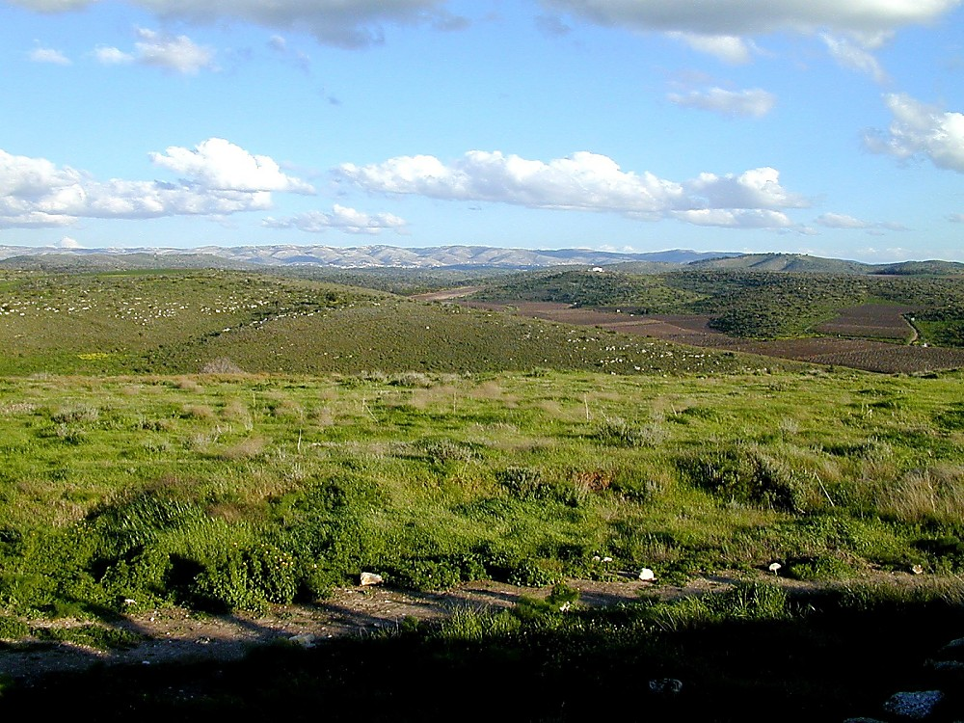
³²And the Lord gave Lachish into the hand of Israel, and he captured it on the second day and struck it with the edge of the sword, and every person in it, as he had done to Libnah.
Lachish view to east
Notes:
View of the Hill Country
The famous Lachish Letter #4 describes how the writer was looking for the signal-fires of Lachish because the signal-fires of Azekah could no longer be seen. It may be that the writer of this ostracon was viewing the destruction of the cities of the Shephelah from the nearby hill country to the west. Jeremiah 34:7 corroborates the fact that the last two cities remaining were Azekah and Lachish.
tb022201267
Helpful Sources on Lachish
Di Vito, Robert A.
1992 Lachish Letters. The Anchor Bible Dictionary, vol. 4, ed. D. N. Freedman. New York: Doubleday.
Rainey, Anson F., and R. Steven Notley.
2006 The Sacred Bridge: Carta’s Atlas of the Biblical World. Jerusalem: Carta.
Ussishkin, David.
1982 The Conquest of Lachish by Sennacherib. Tel Aviv: Tel Aviv University.
1992 Lachish (Place). The Anchor Bible Dictionary, vol. 4, ed. D. N. Freedman. New York: Doubleday.
1993 Lachish. The New Encyclopedia of Archaeological Excavations in the Holy Land, vol. 3, ed. E. Stern. New York: Simon and Schuster.

Slide 52
Gibeon
³⁴Then Joshua and all Israel with him passed on from Lachish to Eglon. And they laid siege to it and fought against it.
³⁵And they captured it on that day, and struck it with the edge of the sword. And he devoted every person in it to destruction that day, as he had done to Lachish.
Libnah
Pictorial Library Vol. 4: Shephelah
Eglon
Notes:
This map is intended to help users locate the places which appear in the photographs in this presentation. The map therefore does not represent or label every geographic feature, and the sites are a mixture of modern and ancient place names.

Slide 53
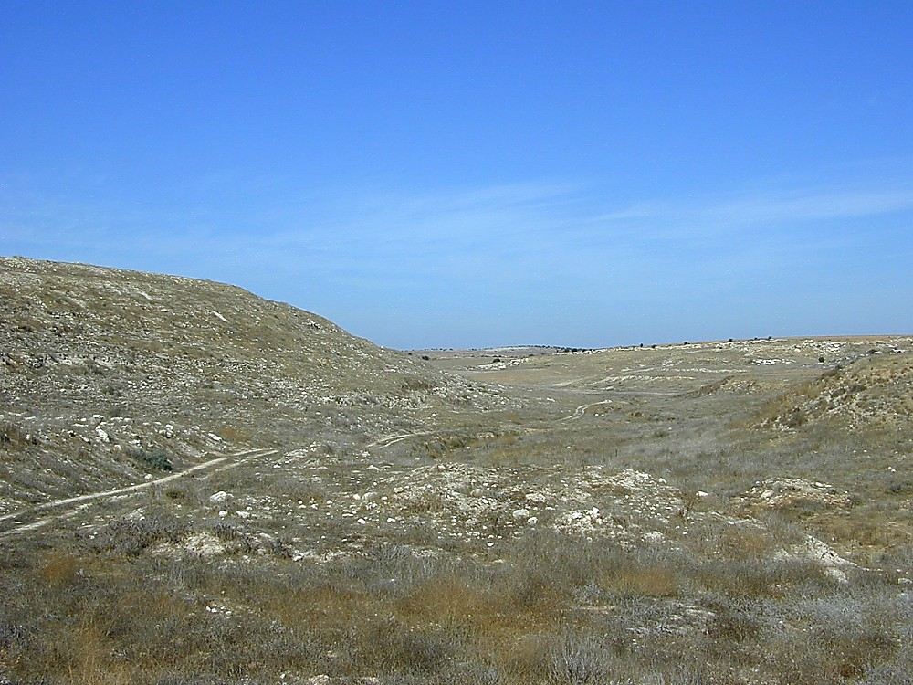
Tell Aitun, possibly Eglon, and Adoraim Valley to west
Notes:
Eglon was one of the five cities that joined together to fight against Gibeon (Josh 10). In the resulting battle fought by Joshua, the king of Eglon was defeated and killed (Josh 12:12).
Joshua 10:3-4 (NKJV) “Therefore Adoni-Zedek king of Jerusalem sent to Hoham king of Hebron, Piram king of Jarmuth, Japhia king of Lachish, and Debir king of Eglon, saying, ‘Come up to me and help me, that we may attack Gibeon, for it has made peace with Joshua and with the children of Israel.’”
tb102900329

Slide 54
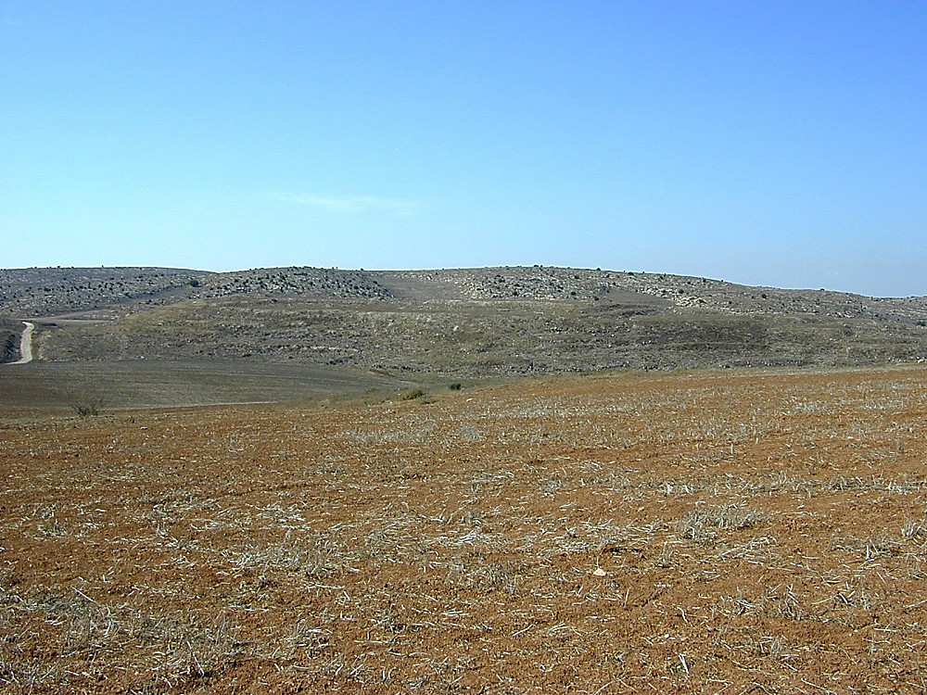
Tell Aitun, possibly Eglon, from north
Notes:
tb102900330

Slide 55
Gibeon
³⁶Then Joshua and all Israel with him went up from Eglon to Hebron. And they fought against it
³⁷and captured it and struck it with the edge of the sword, and its king and its towns, and every person in it. He left none remaining, as he had done to Eglon, and devoted it to destruction and every person in it.
Libnah
Pictorial Library Vol. 4: Shephelah
Eglon
Notes:
This map is intended to help users locate the places which appear in the photographs in this presentation. The map therefore does not represent or label every geographic feature, and the sites are a mixture of modern and ancient place names.

Slide 56
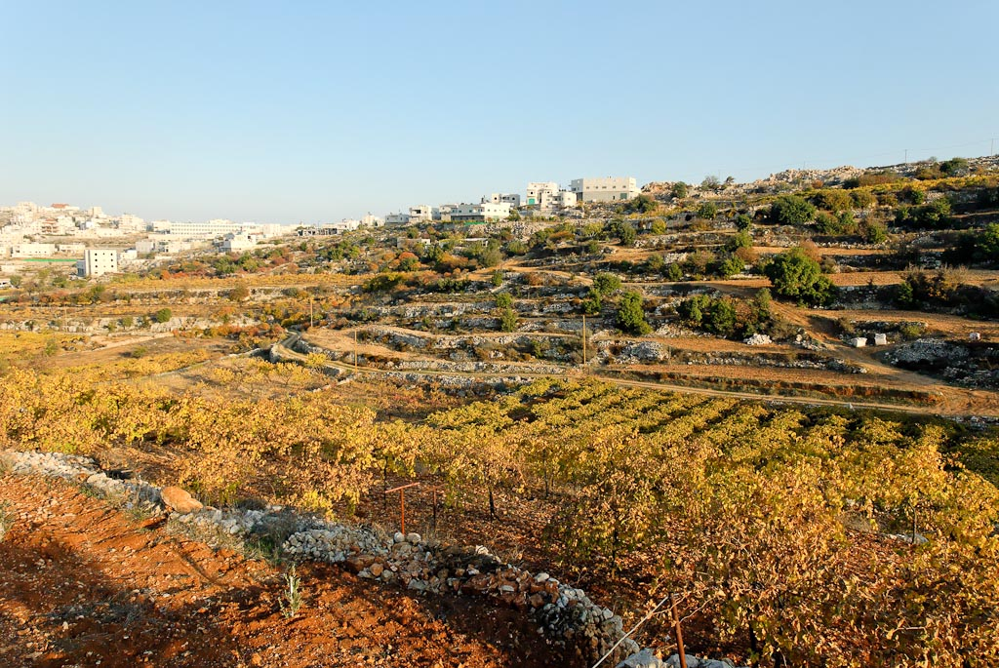
Vineyards and terraced hillside near Hebron
Notes:
tb111706185

Slide 57
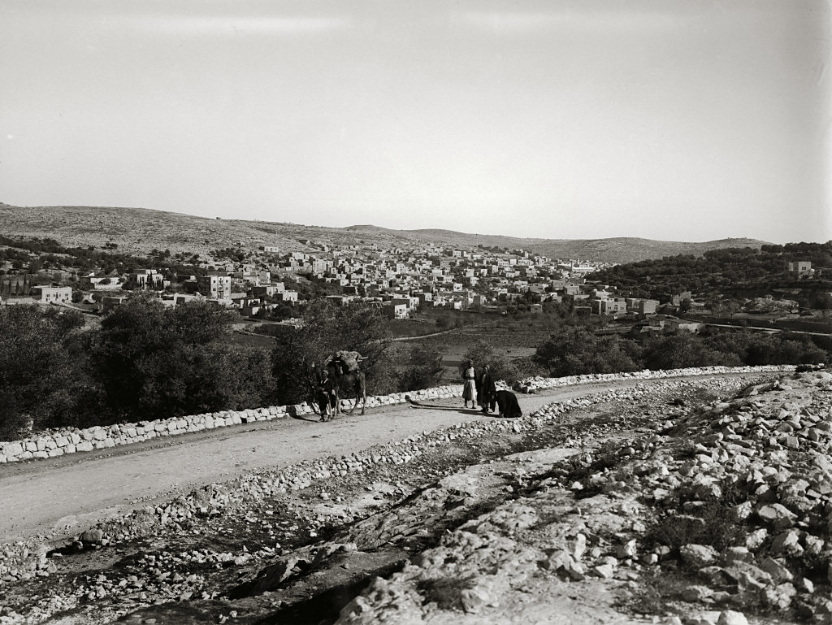
Hebron from west
Hebron from west
Notes:
“Ascending gradually another ridge, we at length from its top saw Hebron, now called el-Khulil, below us in a deep narrow valley running from N. N. W. to S. S. E. into the great Wady which flows off to Wady es-Seba’. The spot where we were, affords one of the best views of the place. The town lies low down on the sloping sides of this valley, chiefly on the eastern; but in the southern part extends across also to the western side” (Robinson and Smith 1841: 1: 315).
“The region around Hebron abounds with vineyards, and the grapes are the finest in Palestine. Each vineyard has a small house or tower of stone, which serves for a keeper’s lodge; and, during the vintage, we were told that the inhabitants of Hebron go out and dwell in these houses, and the town is almost deserted. In this little valley every thing looked thrifty; and round about were large flocks of sheep and goats, all in good condition” (Robinson and Smith 1841: 1: 314).
Date of photograph: between 1898 and 1946
mat04978

Slide 58
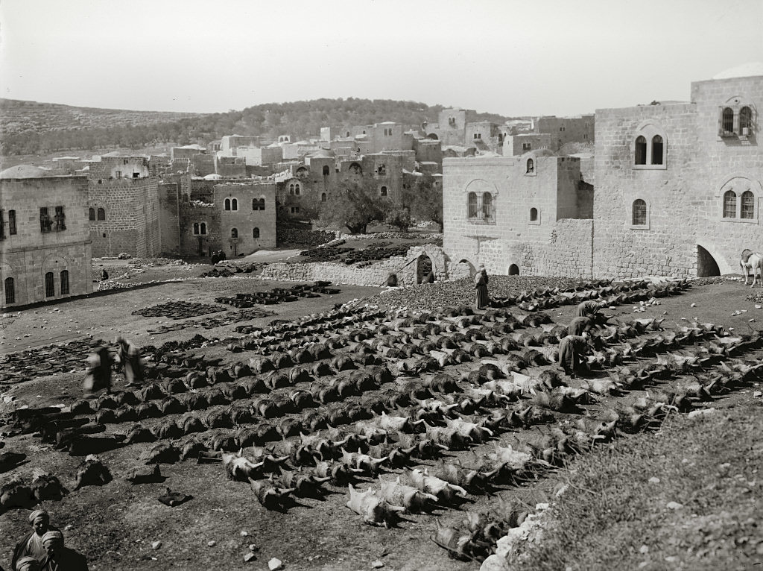
Hebron, tanning skins for water bottles
Hebron, tanning skins for water bottles
Notes:
“Water-skins are manufactured only at Hebron. After being slaughtered, animals are blown out by a small incision made in the thigh, and the air introduced between the skin and the flesh; the tissues adhere rather to the body than to the skin, and the hide is then preserved with a little salt, and sold to Hebronites, who scour the country in search of good skins. The skins, of course, must belong to healthy animals, and without the darram—a big worm often found in the skin of the living animals, which makes a hole covered over with a slight tissues, thus rendering the skin unfit for use. The larger water-skins are generally full of hair, whilst the smaller ones are clean” (Baldensperger 1904: 54).
Date of photograph: between 1898 and 1914
mat06775

Slide 59
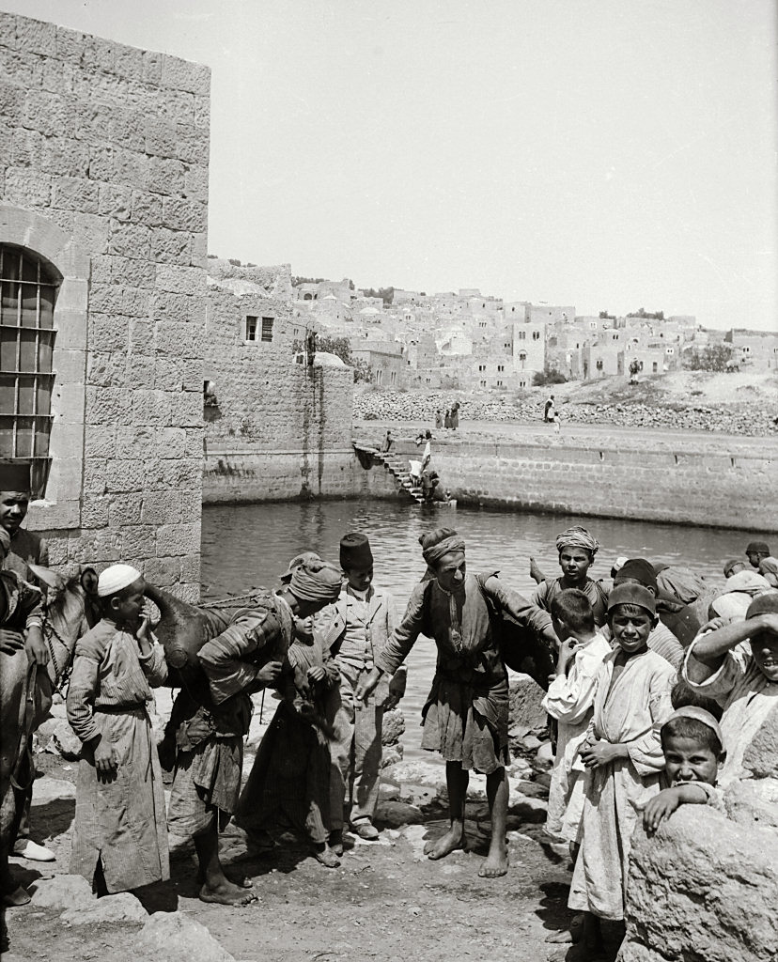
Hebron, water carriers at David's Pool
Hebron,
water carriers at David's Pool
Notes:
“This unromantic pool supplies the inhabitants and their cattle with water. Every village in this region has one or more such open pools, but in very dry seasons they entirely fail, a calamity to which there is frequent allusion in the Bible. . . . The Jews of all this region in ancient times must have been supplied with water in the same way. Natural fountains are very rare, nor can wells be dug with success. The ancient inhabitants, however, depended greatly upon cisterns, and there are countless numbers of them about the old sites. But the water, even in cisterns, is filthy, unless great care is taken to keep them clean” (Thomson 1882: 558).
Date of photograph: between 1910 and 1920
mat00993

Slide 60
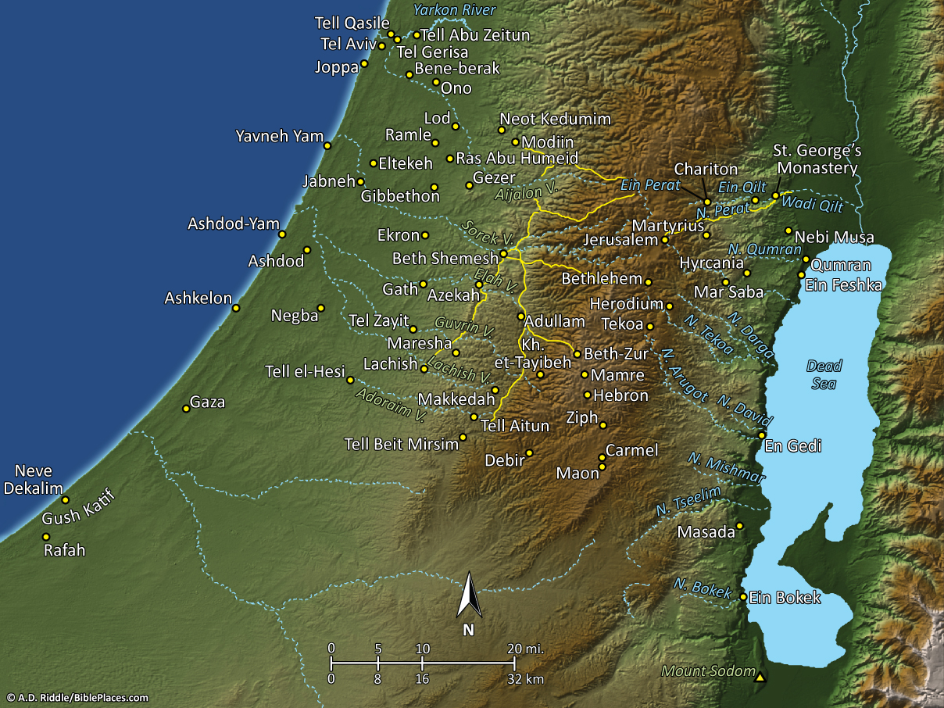
³⁸Then Joshua and all Israel with him turned back to Debir and fought against it
³⁹and he captured it with its king and all its towns. And they struck them with the edge of the sword and devoted to destruction every person in it; he left none remaining. Just as he had done to Hebron and to Libnah and its king, so he did to Debir and to its king.
Pictorial Library Vol. 4: Judah
& the Dead Sea
Notes:
This map is intended to help users locate the places which appear in the photographs in this presentation. The map therefore does not represent or label every geographic feature, and the sites are a mixture of modern and ancient place names.

Slide 61
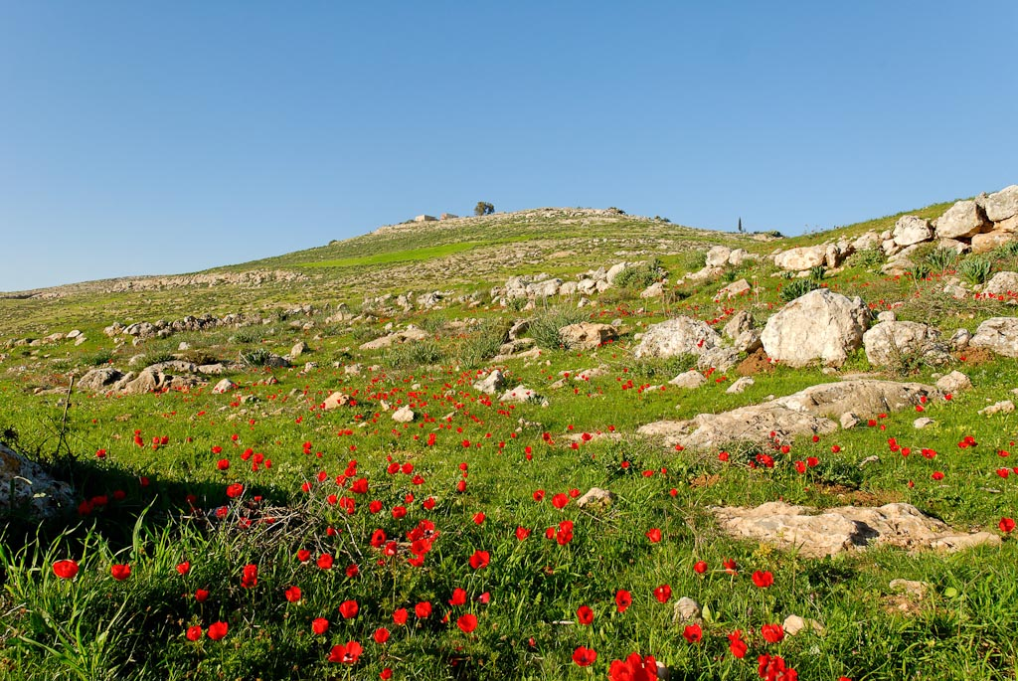
Debir, Khirbet Rabud, from south
Notes:
Khirbet Rabud
Khirbet Rabud is identified by scholars as the biblical city of Debir. Originally W. F. Albright located Debir at Tell Beit Mirsim, but since then most scholars have rejected that identification. Moshe Kochavi’s excavations of Khirbet Rabud have revealed a history of settlement which matches that suggested in the Bible. Furthermore, “the combination of cisterns with 2 nearby wells complies with the description of the site in the biblical narrative (cf. Josh 15:17–19 = Judg 1:13–15)” (Herion and Manor 1992: 112).
tb030407783

Slide 62
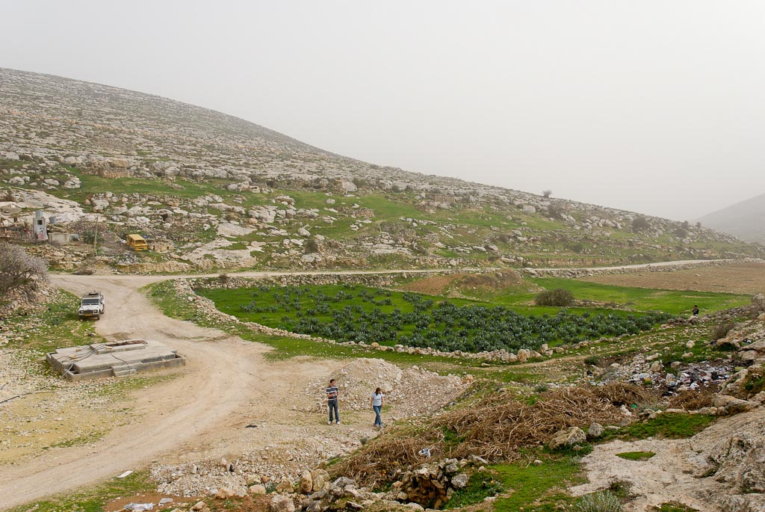
Debir, Khirbet Rabud, lower springs
Notes:
Judges 1:13–15 (ESV) — 13 And Othniel the son of Kenaz, Caleb’s younger brother, captured it. And he gave him Achsah his daughter for a wife. 14 When she came to him, she urged him to ask her father for a field. And she dismounted from her donkey, and Caleb said to her, “What do you want?” 15 She said to him, “Give me a blessing. Since you have set me in the land of the Negeb, give me also springs of water.” And Caleb gave her the upper springs and the lower springs.
tb022407398

Slide 63
Vineyards and terraced hillside near Hebron
Notes:
tb111706185

