Slide 1

Book of Joshua
Lesson 9
Northern Conquest of Canaan & Summary

Slide 2
Class Objectives
Learn about God's fulfillment of the land promise.
Learn about Serving the Lord in the days of Joshua
Learn about the character of Joshua
Study the Geography & Archaeology of the Conquest of Canaan
Be ready to give a defense of the Conquest of Canaan

Slide 3
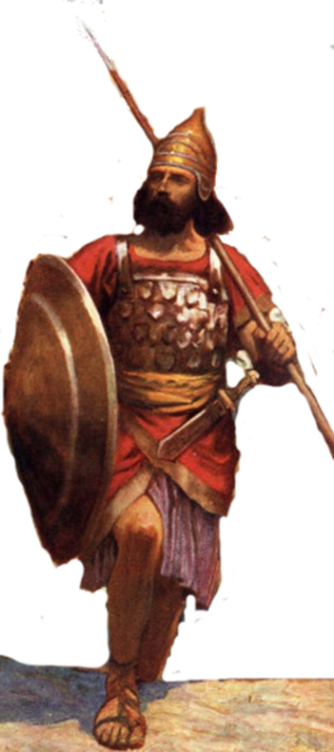
Resting in the land
Living the land
Distributing
the land
Joshua
24:29-33
Conquering the land
Joshua
13-21
Joshua
22-24
Claiming the land
Joshua
6-12
Joshua
1-5
Notes:
I. Claiming the Land (1:1–5:15)
II. Conquering the Land (6:1–12:24)
III. Distributing the Land (13:1–21:45)
IV. Living in the Land (22:1–24:28)
V. Resting in the Land (24:29–33)

Slide 4
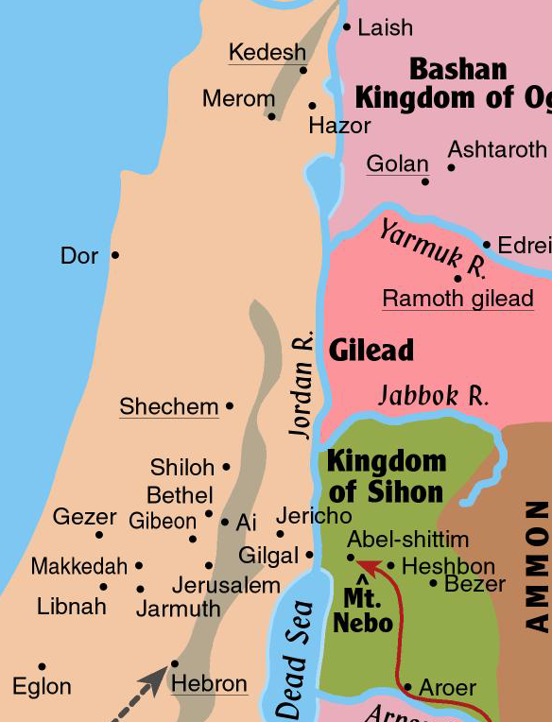
Kings of the north formed a coalition
  Led by Jabin king of Hazor
  Gathered a huge army from the northern third of the land
  Assembled at the waters of Merom
Joshua attacked and defeated them
  They fled northward

Slide 5
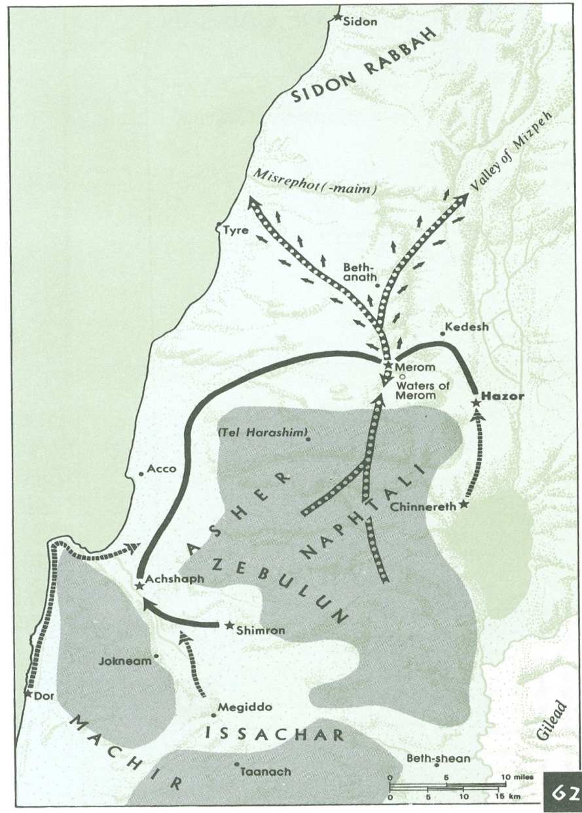
Jabin Gathers Forces – Joshua 11
Land of Mizpeh
Joshua 11
1 When Jabin, king of Hazor, heard of this, he sent to Jobab king of Madon, and to the king of Shimron, and to the king of Achshaph,
2 and to the kings who were in the northern hill country, and in the Arabah south of Chinneroth, and in the lowland, and in Naphoth-dor (Dor) on the west,
3 to the Canaanites in the east and the west, the Amorites, the Hittites, the Perizzites, and the Jebusites in the hill country, and the Hivites under Hermon in the land of Mizpah.
Madon
Arabah

Slide 6
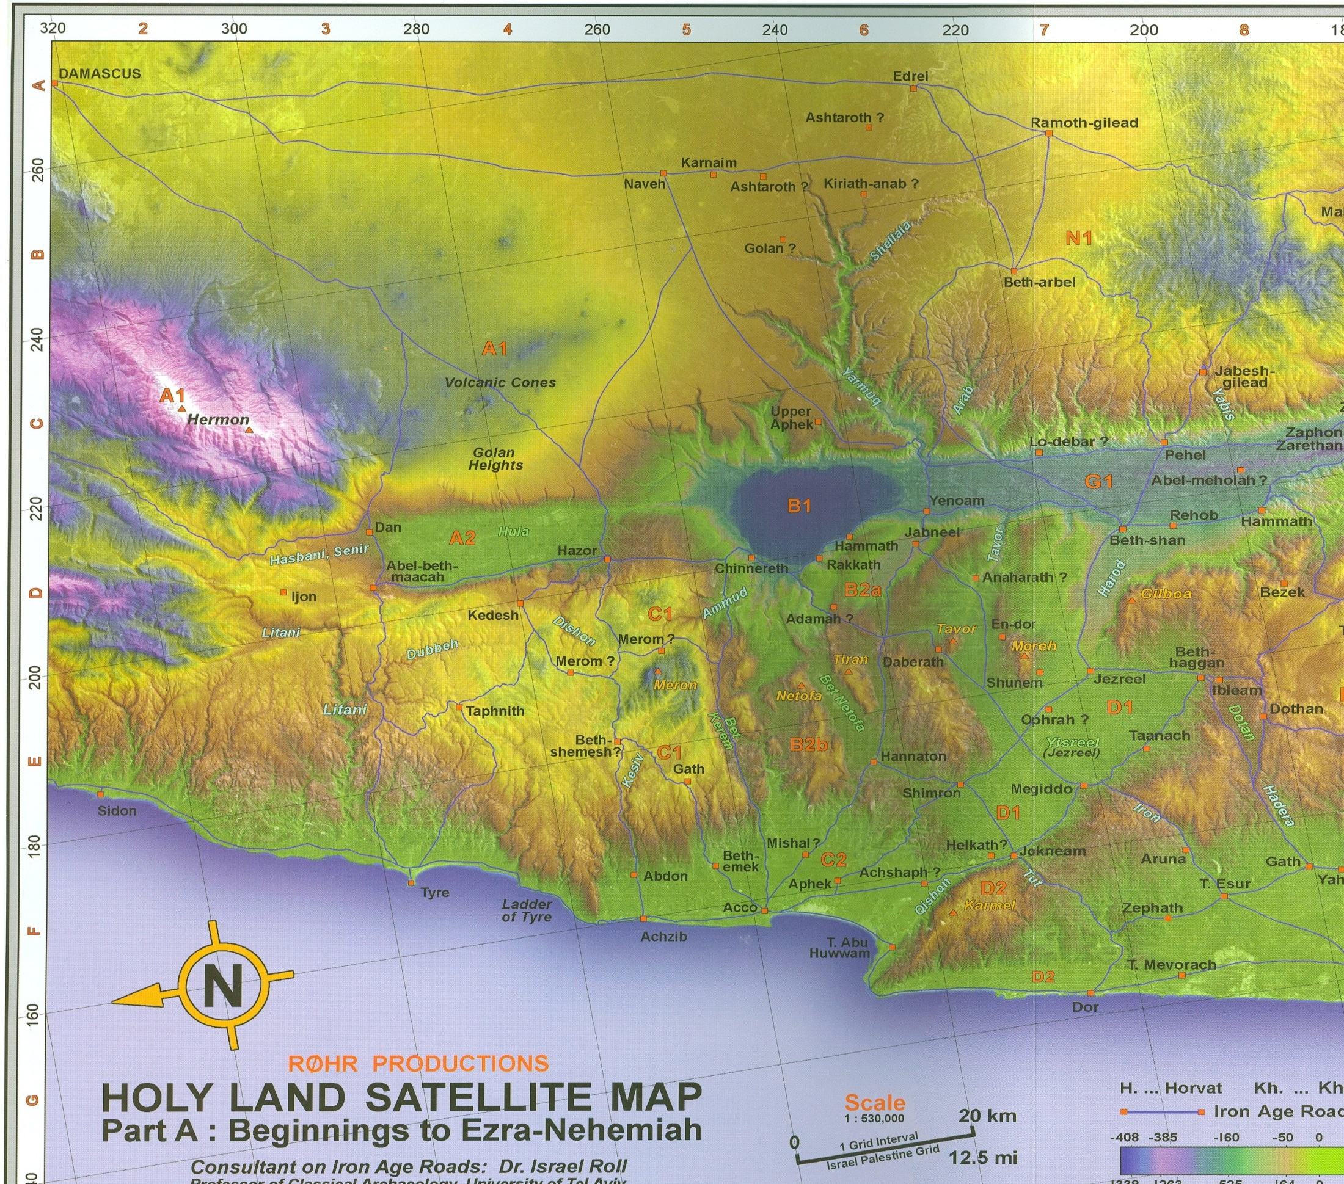
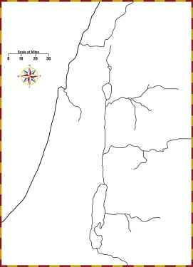

Slide 7
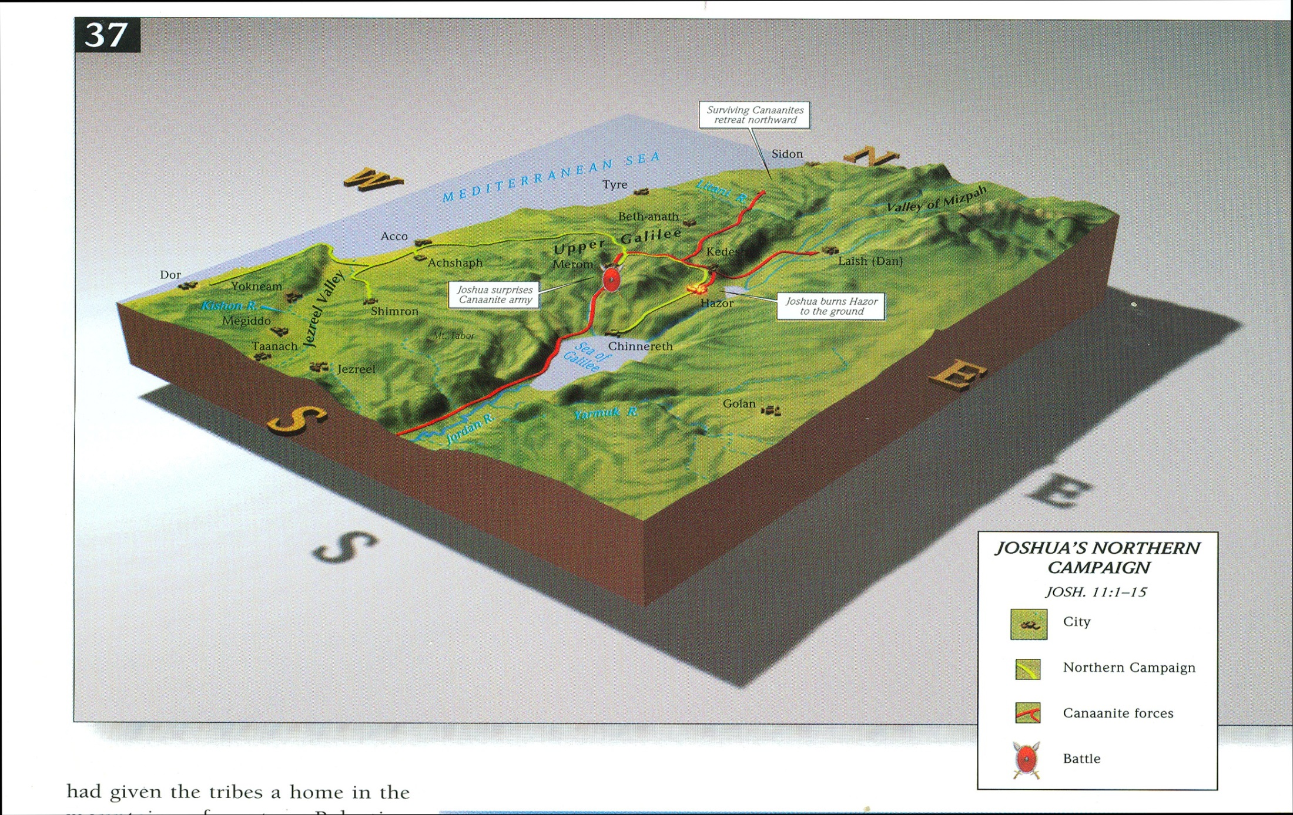

Slide 8
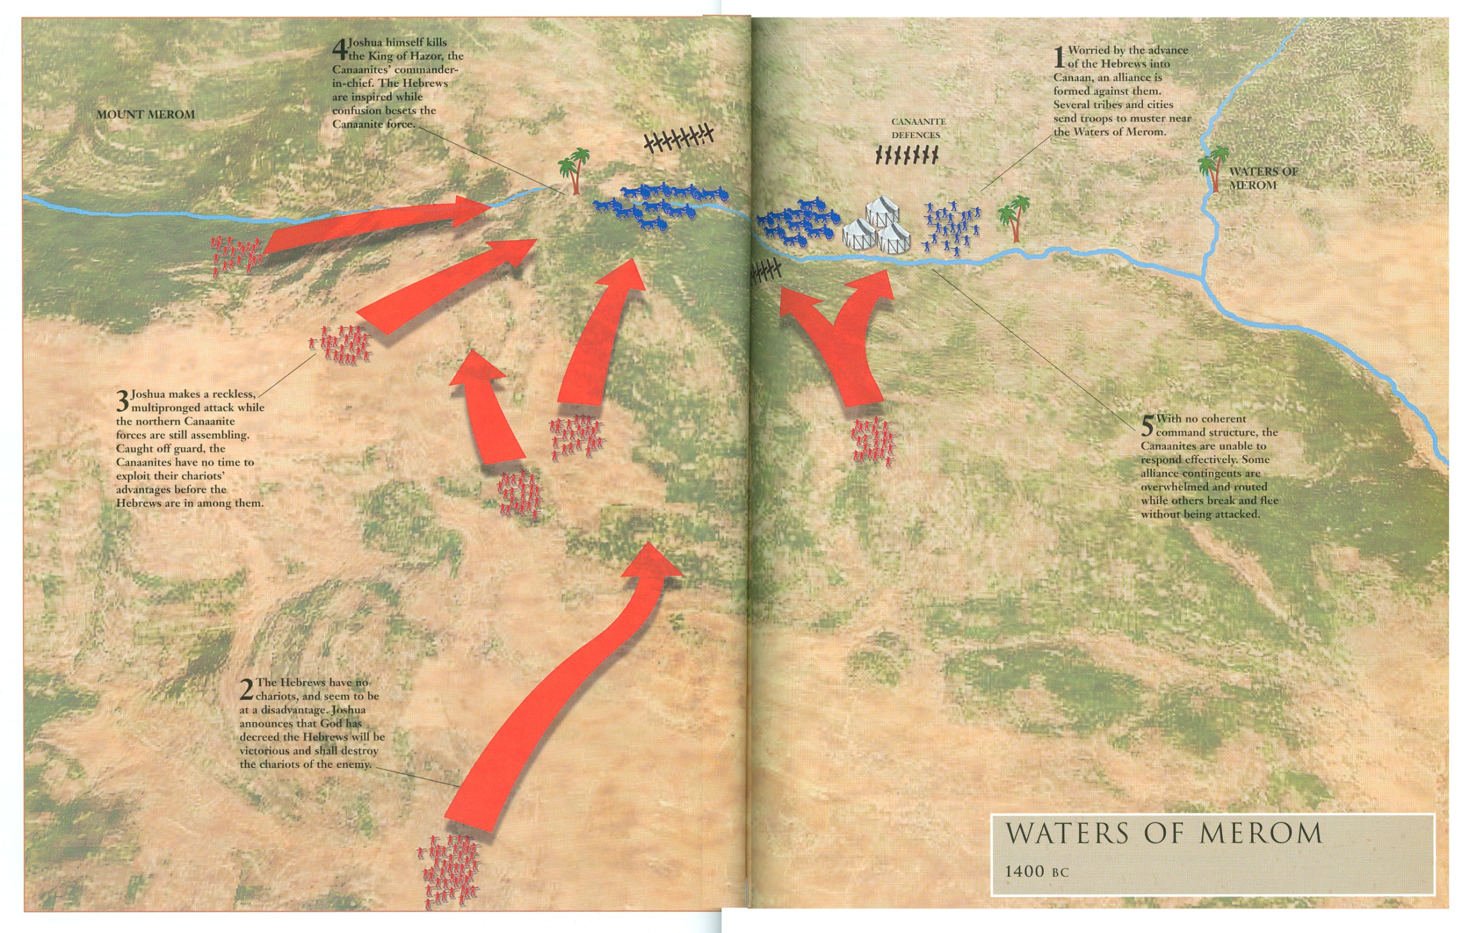
⁶And the Lord said to Joshua, “Do not be afraid of them, for tomorrow at this time I will give over all of them, slain, to Israel. You shall hamstring their horses and burn their chariots with fire.”
⁷So Joshua and all his warriors came suddenly against them by the waters of Merom and fell upon them.

Slide 9
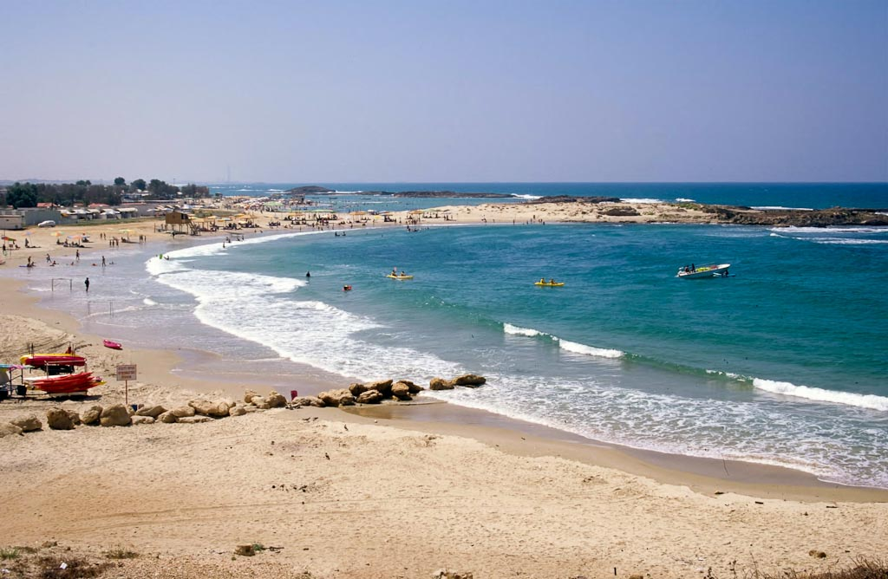
How is the Northern Army Described?
Joshua 11:4(ESV)
⁴And they came out with all their troops,
a great horde,
in number like the sand that is on the seashore,
with very many horses and chariots.
Dor harbor
Notes:
Sea Peoples
Dor was under Sikil/Tjeker control, according to Egyptian sources, from 1150 to 1050 BC. Their name may indicate a connection with the island of Sicily.
The only other location that may provide evidence of the Sikils is Tel Zeror, near Hadera. Its excavator, Moshe Kochavi, ascribed the remains of that site to these people.
The Canaanite and Phoenician culture was interrupted by a 150-year inhabitation of the Sikil people. The best source of information on the Sikil people is the tale of Wen-Amon, which dates to the first half of the 11th century BC (Pritchard 1969: 26).
This is the best, and virtually only, source of the history of Canaan in the 11th century.
Wen-Amon says of his journey: “I reached Dor, the town of the Sikils, and Beder its prince brought me bread, wine and meat.”
While docked in the port at Dor, a member of Wen-Amon’s crew stole his money and left him penniless. Wen-Amon asked the ruler, Beder, to capture the thief. But Beder said that since he was a member of Wen-Amon’s own crew, he could not help him. Beder said that he would look for the thief, but not as if it had been one of his own men. If it had been one of Beder’s men, he said he would have repaid the loss himself.
Later, Wen-Amon realized that Beder’s men had begun to chase him and so fled to Cypress. At this point, the text breaks off.
An Ugaritic text of the 12th century mentions the Sikils as pirates who lived on their ships.
The Onomasticon of Amenope, which dates to about 1100 BC, has a list of names including the Sikils in Asher. Asher is the Israelite tribe that lived on the northern coast.
The Sikils lived on the northern Sharon Plain and the Sherden lived still farther to the north in the Acco Plain.
The strongest fortification in Canaan from the 12th century was found at Dor.
Stern acknowledges that a distinction cannot yet be made between the material culture of the Philistines and that of the Sikils.
tbs93139708

Slide 10
What did the Lord tell Joshua concerning this great army (Josh 11:6)?
Joshua 11:6-7(ESV) Attack on Northern Kings
⁶And the Lord said to Joshua,
“Do not be afraid of them, for tomorrow at this time I will give over all of them, slain, to Israel.
You shall hamstring their horses and
burn their chariots with fire.”
⁷So Joshua and all his warriors came suddenly against them by the waters of Merom and fell upon them.
Joshua 10:8-9(ESV) Attack on Gibeonites
⁸And the Lord said to Joshua, “Do not fear them, for I have given them into your hands. Not a man of them shall stand before you.”
⁹So Joshua came upon them suddenly, having marched up all night from Gilgal.

Slide 11
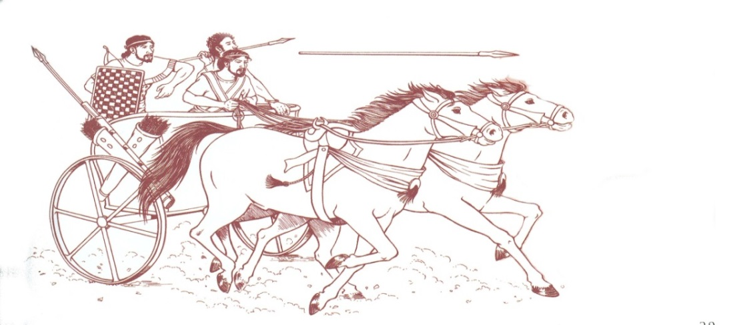
How did the Northern Army of Amorites respond?
And they came out with all their troops,
a great horde,
in number like the sand that is on the seashore,
with very many horses and chariots.
And all these kings joined their forces and came and encamped together at the waters of Merom to fight with Israel.
Joshua 11:8-9(ESV)
⁸And the Lord gave them into the hand of Israel, who struck them and chased them as far as Great Sidon and Misrephoth-maim, and eastward as far as the Valley of Mizpeh. And they struck them until he left none remaining.
⁹And Joshua did to them just as the Lord said to him: he hamstrung their horses and burned their chariots with fire.

Slide 12
Jabin Gathers Forces – Joshua 11
Land of Mizpeh
Joshua 11
⁸And the Lord gave them into the hand of Israel, who struck them and chased them as far as Great Sidon and Misrephoth-maim, and eastward as far as the Valley of Mizpeh. And they struck them until he left none remaining.
Madon

Slide 13
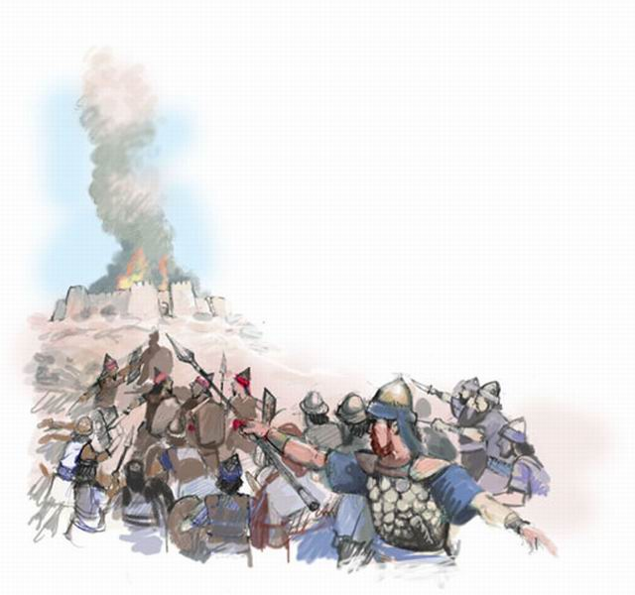
How many of the cities defeated where burned in the northern campaign
¹³But none of the cities that stood on mounds did Israel burn, except Hazor alone; that Joshua burned.

Slide 14
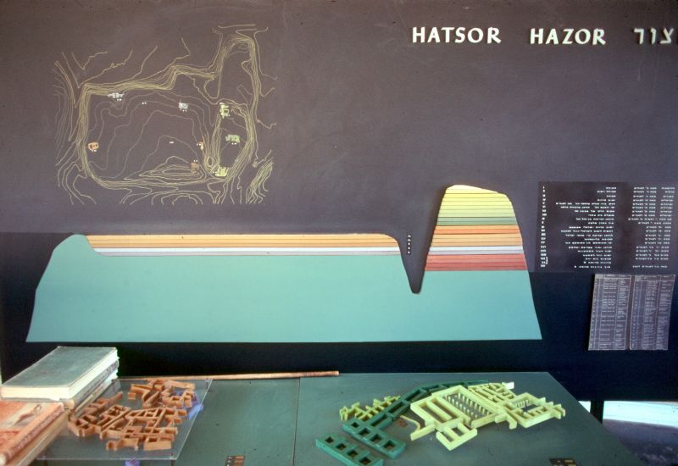
Hazor Diagram – Mound City
Upper Hazor
Lower Hazor

Slide 15
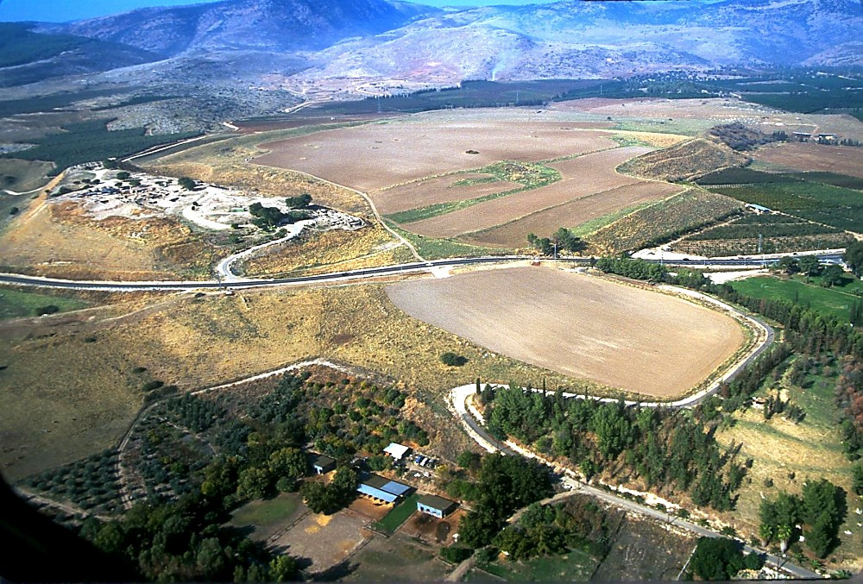
Hazor aerial from southeast
Upper Hazor
Lower Hazor
Hazor aerial from southeast – Mound City
Notes:
Hazor: Introduction
Known in Joshua's day as "the head of all those kingdoms," the 200-acre tell of Hazor is today the largest one in Israel. At its height, in the Canaanite period, the city encompassed the entire tell, both the lower section and the upper. Later, when it was inhabited by Israelites, the fortified city included only the Upper City. Anyone who passed through the main valley had to pass by Hazor. This was the route of the main International Highway (sometimes known as the “Via Maris”).

Slide 16
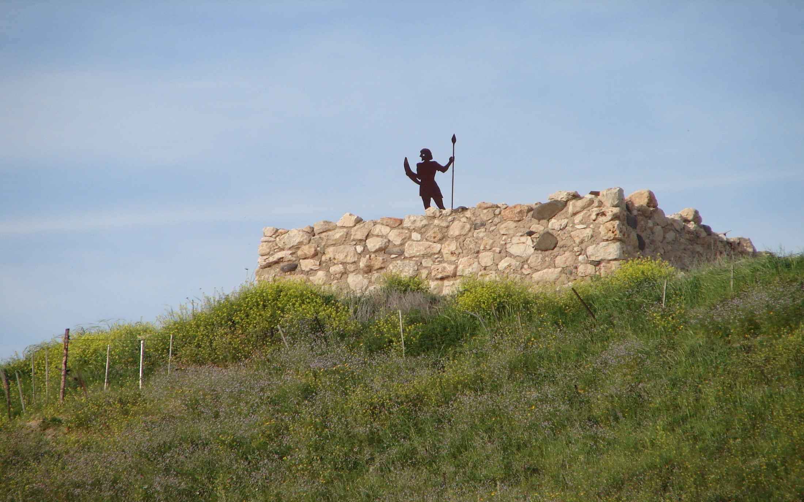

Slide 17
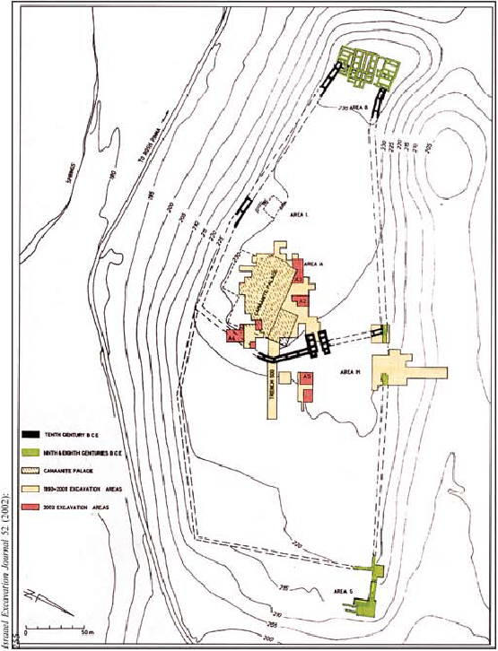
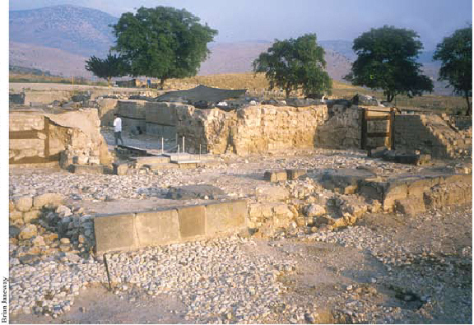
The Canaanite Palace, has provided additional evidence relating to the destruction of the city. Statues found in the rubble were seemingly intentionally decapitated and disfigured. Who where the most likely candidates for such actions?
Egyptians?
Hittites?
Israelites?
Notes:
, the Canaanite Palace, has provided additional evidence relating to the destruction of the city. Statues found in the rubble were seemingly intentionally decapitated and disfigured. Who where the most likely candidates for such actions? Would it have been the Egyptians who campaigned in the region under Seti I around 1300 BC? Or perhaps Ramses II, who traveled through the region enroute to battle the Hittites at Kadesh in 1275 BC? The evidence points instead to the Israelites, in Ben-Tor’s view (Ben-Tor 1997:123; Rabinovich and Silberman 1998:53).
Nonetheless, Ben-Tor now believes that the destruction could very well date earlier, as early as the late 14th century. He says, “If it were somewhat earlier it could still be Israelite, but the earlier you go the less the chances of that” (Rabinovich 1998:53). The earlier dating of this destruction creates a problem for “late-daters,” but not if the Israelites had been in the land for some time, as held by early-date proponents. Is this evidence of the burning of Hazor by Joshua, or could Deborah and Barak have been responsible during the period of the Judges? The latter would accord better with Biblical data.
There is also, however, evidence of an earlier destruction. In Area A, just north of the Canaanite palace, a “royal temple” was excavated in the 1968 season. It is of the migdol fortress type and is paralleled by buildings at Megiddo VII and Shechem. The structure was destroyed “at some time in the Late Bronze I” and never again restored (Yadin 1972:103; Ben-Tor 1993:604). Additionally, in Area M, the plateau area that joins the lower city to the upper city, a “huge pit,” whose function is unknown, revealed another Late Bronze destruction. In the excavator’s view, “it is so far the only clear indication of an earlier destruction, still in the Late Bronze Age, pre-dating the final destruction of the city” in ca. 1300 BC (Ben-Tor 2000:248–49). The excavator attributes this destruction to Thutmose III (ca. 1483 BC). Could the earlier destruction be assigned to Joshua and the later one to Deborah and Barak? It would seem like a tenable solution.

Slide 18
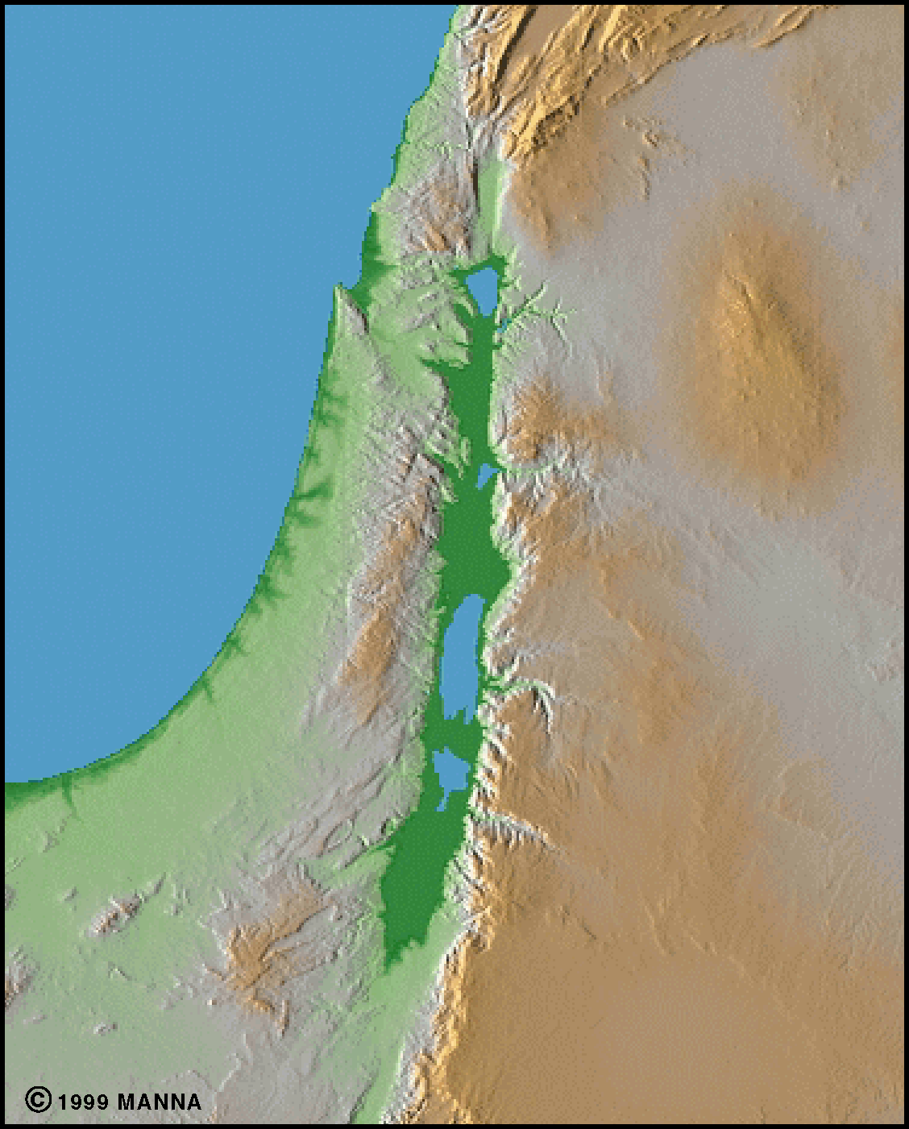
Canaanite tribes who lived in the land of Canaan (Deut 7:1)
  Hittites, Girgashites, Amorites, Canaanites, Perizzites, Hivites, Jebusites
Hittites
Hivites
Girgashites
Perizzites
Amorites
Joshua 11
¹⁸Joshua made war a long time with all those kings.
¹⁹There was not a city that made peace with the people of Israel except the Hivites, the inhabitants of Gibeon. They took them all in battle.
²⁰For it was the Lord’s doing to harden their hearts that they should come against Israel in battle, in order that they should be devoted to destruction and should receive no mercy but be destroyed, just as the Lord commanded Moses.
Canaanites
Jebusites

Slide 19
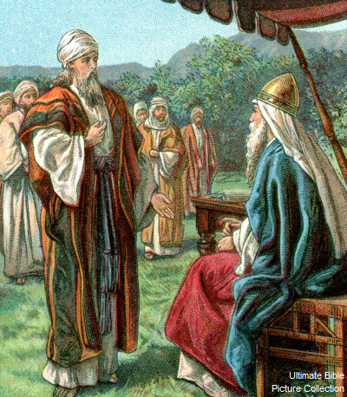
Joshua 11:18(ESV)
¹⁸Joshua made war a long time with all those kings.
Joshua 14
⁷ I was forty years old when Moses the servant of the Lord sent me from Kadesh-barnea to spy out the land, and I brought him word again as it was in my heart.
⁸But my brothers who went up with me made the heart of the people melt; yet I wholly followed the Lord my God.
⁹And Moses swore on that day, saying, ‘Surely the land on which your foot has trodden shall be an inheritance for you and your children forever, because you have wholly followed the Lord my God.’
¹⁰And now, behold, the Lord has kept me alive, just as he said, these forty-five years since the time that the Lord spoke this word to Moses, while Israel walked in the wilderness. And now, behold, I am this day eighty-five years old.
Deuteronomy 2:14-15(ESV)
¹⁴And the time from our leaving Kadesh-barnea until we crossed the brook Zered was thirty-eight years, until the entire generation, that is, the men of war, had perished from the camp, as the Lord had sworn to them.
85 yr – 38 yrs = 7 yrs
85 yr – 40 yrs = 5 yrs

Slide 20
Joshua 11:21-22(ESV)
²¹And Joshua came at that time and cut off the Anakim from the hill country, from Hebron, from Debir, from Anab, and from all the hill country of Judah, and from all the hill country of Israel. Joshua devoted them to destruction with their cities.
²²There was none of the Anakim left in the land of the people of Israel. Only in Gaza, in Gath, and in Ashdod did some remain.
ANAK, ANAKIM (ay' nak, an' uh kihm) Personal and clan name meaning, “long-necked” or “strong-necked.”
The ancestor named Anak had three children: Ahiman, Sheshai, Talmai (Num. 13:22).
They lived in Hebron and the hill country (Josh. 11:21) before being destroyed by Joshua.
Their remnants then lived among the Philistines (Josh. 11:22). These tall giants were part of the Nephilim (Gen. 6:4; Num. 13:33).
Arba was a hero of the Anakim (Judg. 14:15).

Slide 21
Conquest as Described by the Bible
A unified military conquest of the central hill country under Joshua at the end of the Late Bronze I period, ca. 1410–1400 BC (Jos 1–12).
The Israelites lived initially as pastoralists under the leadership of judges in the Late Bronze II period, ca. 1400–1200 BC (Jgs 1–5).
In the 12th century BC, still under the leadership of judges, the Israelites went through a process of sedentarization. This was a wide-spread phenomenon resulting from the collapse of the Late Bronze urban culture. The proliferation of small agricultural villages in the Iron Age I was the result of this process (Jgs 6–10).

Slide 22
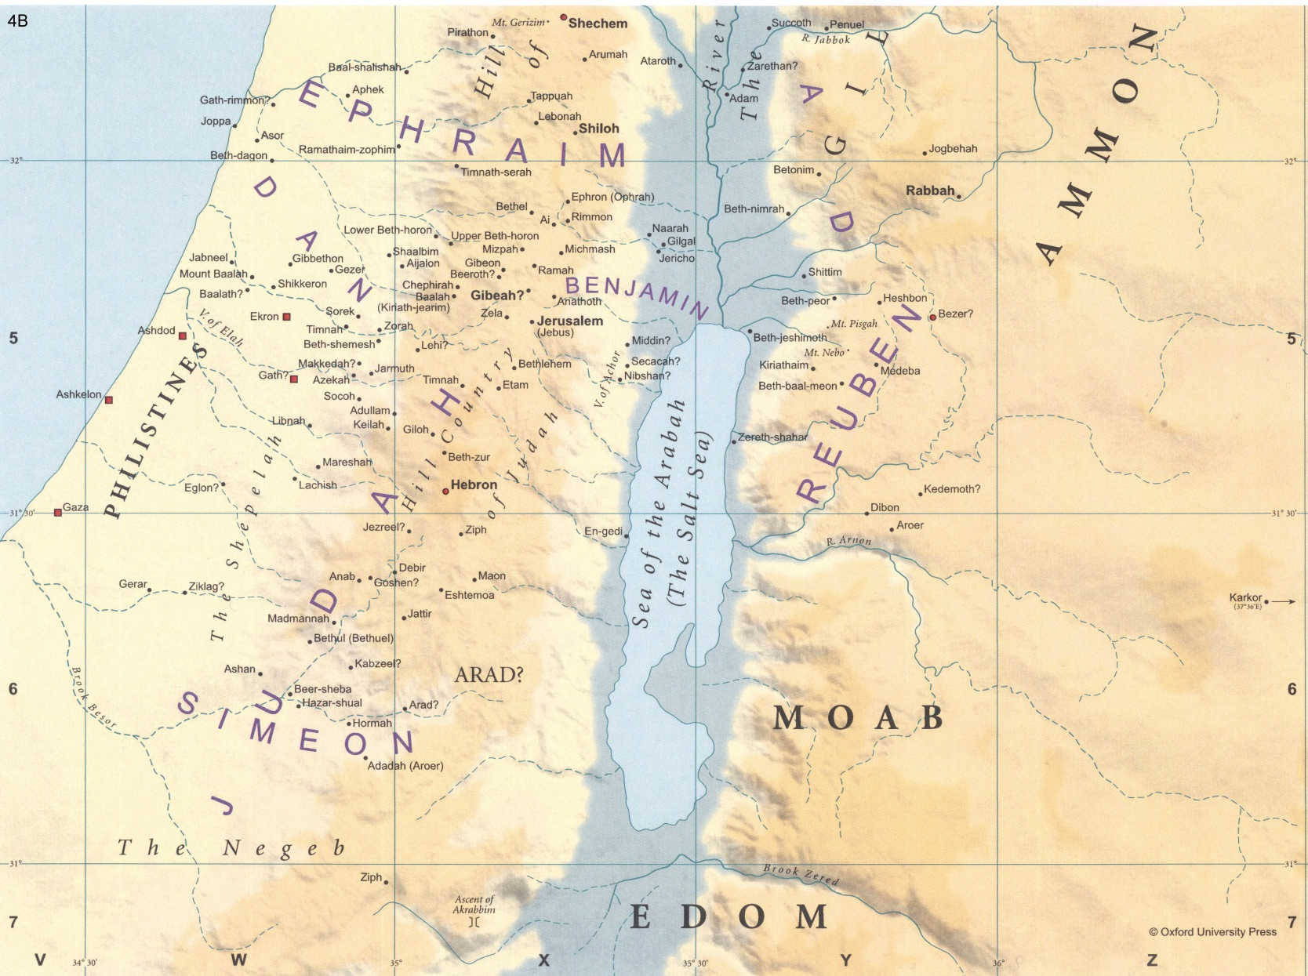

Slide 23
