Slide 1

Book of Joshua
Lesson 11
Special Allotment to Judah

Slide 2
Class Objectives
Learn about God's fulfillment of the land promise.
Learn about Serving the Lord in the days of Joshua
Learn about the character of Joshua
Study the Geography & Archaeology of the Conquest of Canaan
Be ready to give a defense of the Conquest of Canaan

Slide 3
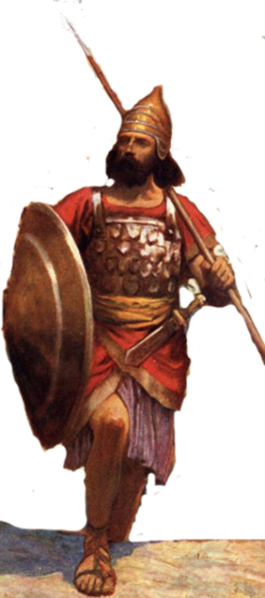
Resting in the land
Living the land
Distributing
the land
Joshua
24:29-33
Conquering the land
Joshua
13-21
Joshua
22-24
Claiming the land
Joshua
6-12
Joshua
1-5
Notes:
I. Claiming the Land (1:1–5:15)
II. Conquering the Land (6:1–12:24)
III. Distributing the Land (13:1–21:45)
IV. Living in the Land (22:1–24:28)
V. Resting in the Land (24:29–33)

Slide 4
Corrections
Lesson 2 – Age of Joshua – assumed same age as Caleb
Lesson 9- Patriarchs buried at Shechem

Slide 5

Character of Joshua
Events in His Life
0 Born a slave in Egypt, Tribe of Ephraim
45 Exodus from Egypt (1445)
a. Leader Battle with Amalek-Ex 17
b. With Moses/Tablet of Law-Ex 24/32
c. Guarded Tent of Meeting
d. One of the 12 spies
47 38 Yrs Wonder in Wilderness (1407 BC)
85 7 yrs conquering the land (1400 BC)
92 18 years consolidating (1393 BC)
110 Death and Burial in the Land (1375 BC)

Slide 6
Character of Joshua
Similar age
as Caleb?
Events in His Life-estimated
0 Born a slave in Egypt, Tribe of Ephraim
5/10? Youth Serving Moses before he flees Egypt
45-50 Exodus from Egypt (1445)
a. Leader Battle with Amalek-Ex 17
b. With Moses/Tablet of Law-Ex 24/32
c. Guarded Tent of Meeting-Ex 33:11
d. One of the 12 spies
83-88 38 Yrs Wonder in Wilderness (1407 BC)
90-95 7 yrs conquering the land (1400 BC)
20-25 years consolidating
110 Death and Burial in the Land (~1375 BC)
(Num 11:28)

Slide 7
Character of Joshua
Youth Serving Moses
Young man guarding
tent
Events in His Life-young man
0 Born a slave in Egypt, Tribe of Ephraim
20 Exodus from Egypt (1445)
a. Leader Battle with Amalek-Ex 17
b. With Moses/Tablet of Law-Ex 24/32
c. Guarded Tent of Meeting-Ex 33:11
d. One of the 12 spies
58 38 Yrs Wonder in Wilderness (1407 BC)
65 7 yrs conquering the land (1400 BC)
45 years consolidating
110 Death and Burial in the Land (1355 BC)

Slide 8
Joshua Timeline
Joshua 13
¹Now Joshua was old and advanced in years, and the Lord said to him, “You are old and advanced in years, and there remains yet very much land to possess. ²This is the land that yet remains: all the regions of the Philistines, and all those of the Geshurites
Only allot the land to Israel for an inheritance, as I have commanded you.
⁷Now therefore divide this land for an inheritance to the nine tribes and half the tribe of Manasseh.”
Joshua 14
⁶Then the people of Judah came to Joshua at Gilgal. And Caleb ... ‘Surely the land on which your foot has trodden shall be an inheritance for you and your children forever, because you have wholly followed the Lord my God.’ ¹⁰And now, behold, the Lord has kept me alive, just as he said, these forty-five years since the time that the Lord spoke this word to Moses, while Israel walked in the wilderness. And now, behold, I am this day eighty-five years old.
Joshua 23
¹A long time afterward, when the Lord had given rest to Israel from all their surrounding enemies, and Joshua was old and well advanced in years,
²Joshua summoned all Israel, its elders and heads, its judges and officers, and said to them, “I am now old and well advanced in years.
Joshua 24
¹Joshua gathered all the tribes of Israel to Shechem and summoned the elders, the heads, the judges, and the officers of Israel. And they presented themselves before God.
²⁹After these things Joshua the son of Nun, the servant of the Lord, died, being 110 years old.
Joshua 18
¹Then the whole congregation of the people of Israel assembled at Shiloh and set up the tent of meeting there. The land lay subdued before them.
²There remained among the people of Israel seven tribes whose inheritance had not yet been apportioned.
Judges 1
¹After the death of Joshua, the people of Israel inquired of the Lord, “Who shall go up first for us against the Canaanites, to fight against them?” - Judah

Slide 9
Judges Timeline
Judges 1
¹After the death of Joshua, the people of Israel inquired of the Lord, “Who shall go up first for us against the Canaanites, to fight against them?” - Judah
Judges 1
⁵They found Adoni-bezek at Bezek and fought against him and defeated the Canaanites and the Perizzites.
Judges 1
⁸And the men of Judah fought against Jerusalem and captured it and struck it with the edge of the sword and set the city on fire.
Judges 1
⁹And afterward the men of Judah went down to fight against the Canaanites who lived in the hill country, in the Negeb, and in the lowland. ¹⁰And Judah went against the Canaanites who lived in Hebron …¹¹From there they went against the inhabitants of Debir…¹²And Caleb said, “He who attacks and captures it, I will give him Achsah my daughter for a wife.” ¹³And Othniel the son of Kenaz, Caleb’s younger brother, captured it.
Judges 1
¹⁷And Judah went with Simeon his brother, and they defeated the Canaanites who inhabited Zephath and devoted it to destruction…
¹⁸Judah also captured Gaza with its territory, and Ashkelon with its territory, and Ekron with its territory.
Judges 1
¹⁹And the Lord was with Judah, and he took possession of the hill country, but he could not drive out the inhabitants of the plain because they had chariots of iron.

Slide 10
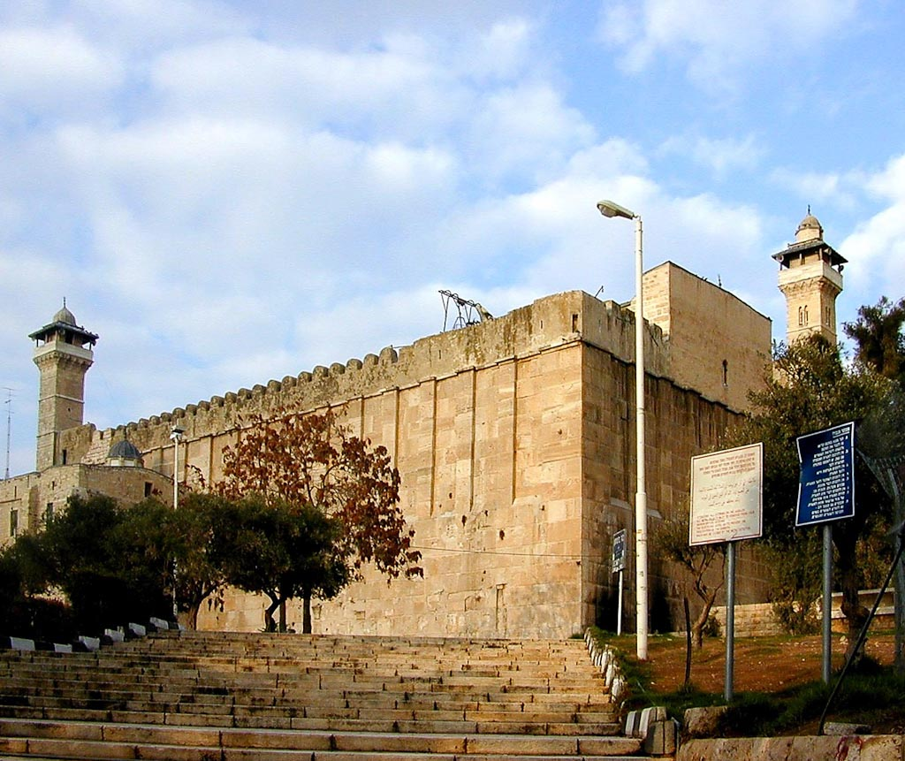
King Herod constructed a large edifice atop the traditional
burial place of the patriarchs.
Genesis 49:30-33
Abraham & Sarah
Isaac & Rebekah
Jacob & Leah (Rachel in Bethlehem)
Hebron Machpelah
Notes:
Herodian Construction
King Herod constructed a large edifice atop the traditional burial place of the patriarchs.
Its architectural style is similar to that of Jerusalem’s Temple Mount, including the size of the stones (up to 24 feet [7.5 m] long), the type of masonry (dry), and the pilasters (or engaged columns).
The largest stone is more than 24 feet long by 4.5 feet high (7.5 x 1.4 m). The largest stones were placed near the corners in order to strengthen them.
Tb112799205
Genesis 49:30-33(ESV)
³⁰in the cave that is in the field at Machpelah, to the east of Mamre, in the land of Canaan, which Abraham bought with the field from Ephron the Hittite to possess as a burying place.
³¹There they buried Abraham and Sarah his wife. There they buried Isaac and Rebekah his wife, and there I buried Leah—
³²the field and the cave that is in it were bought from the Hittites.”
³³When Jacob finished commanding his sons, he drew up his feet into the bed and breathed his last and was gathered to his people.

Slide 11
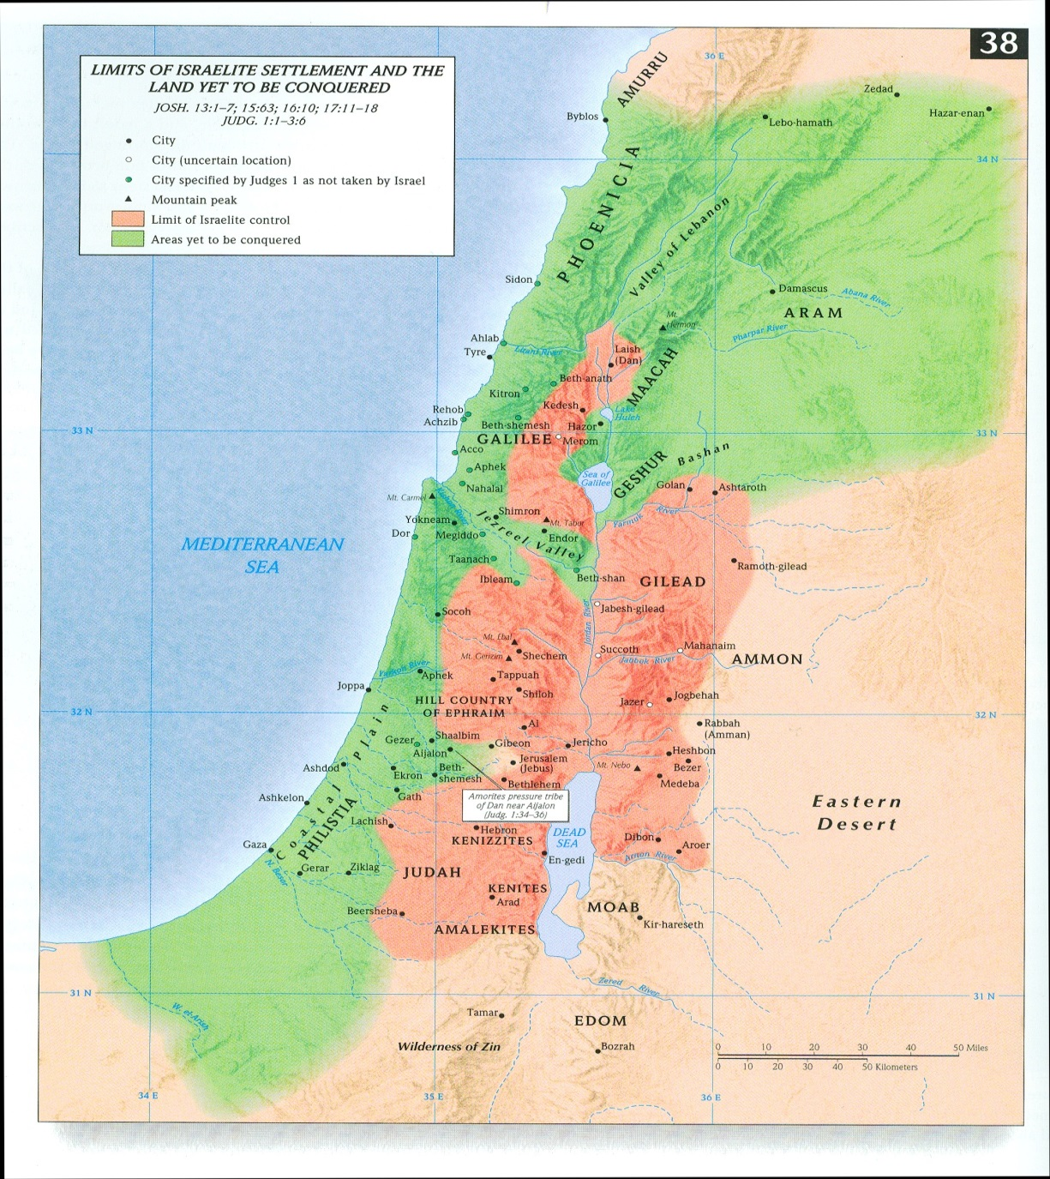
This is the land that yet remain
. Mearah
Joshua 13:2-3(ESV)
²This is the land that yet remains: all the regions of the Philistines, and all those of the Geshurites
³(from the Shihor, which is east of Egypt, northward to the boundary of Ekron, it is counted as Canaanite; there are five rulers of the Philistines, those of Gaza, Ashdod, Ashkelon, Gath, and Ekron), and those of the Avvim,
Geshur
Land of the Philistines
Avvim/Hivites?
Geshurites?

Slide 12
This is the land that yet remain
Sidon
. Mearah
Joshua 13:4-6(ESV)
⁴ …all the land of the Canaanites, and Mearah that belongs to the Sidonians, to Aphek, to the boundary of the Amorites,
⁵and the land of the Gebalites, and all Lebanon, toward the sunrise, from Baal-gad below Mount Hermon to Lebo-hamath,
⁶all the inhabitants of the hill country from Lebanon to Misrephoth-maim, even all the Sidonians. I myself will drive them out from before the people of Israel. Only allot the land to Israel for an inheritance, as I have commanded you.
⁷Now therefore divide this land for an inheritance to the nine tribes and half the tribe of Manasseh.”
Geshur
Aphek
Land of the Philistines
Avvim/Hivites?
Geshurites?

Slide 13
This is the land that yet remain
. Mearah
Sidonians
Geshur
Amorites
Land of the Philistines
Avvim/Hivites

Slide 14
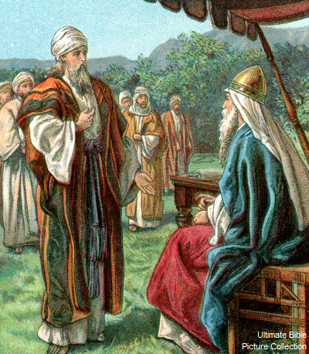
Joshua 13
¹Now Joshua was old and advanced in years, and the Lord said to him, “You are old and advanced in years, and there remains yet very much land to possess.
Joshua 14
⁷ I was forty years old when Moses the servant of the Lord sent me from Kadesh-barnea to spy out the land, and I brought him word again as it was in my heart.
⁸But my brothers who went up with me made the heart of the people melt; yet I wholly followed the Lord my God.
⁹And Moses swore on that day, saying, ‘Surely the land on which your foot has trodden shall be an inheritance for you and your children forever, because you have wholly followed the Lord my God.’
¹⁰And now, behold, the Lord has kept me alive, just as he said, these forty-five years since the time that the Lord spoke this word to Moses, while Israel walked in the wilderness. And now, behold, I am this day eighty-five years old.

Slide 15
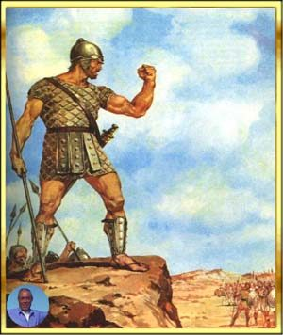
Joshua 14
⁹And Moses swore on that day, saying, ‘Surely the land on which your foot has trodden shall be an inheritance for you and your children forever, because you have wholly followed the Lord my God.’
¹²So now give me this hill country of which the Lord spoke on that day, for you heard on that day how the Anakim were there, with great fortified cities. It may be that the Lord will be with me, and I shall drive them out just as the Lord said.” ¹³Then Joshua blessed him, and he gave Hebron to Caleb the son of Jephunneh for an inheritance.

Slide 16
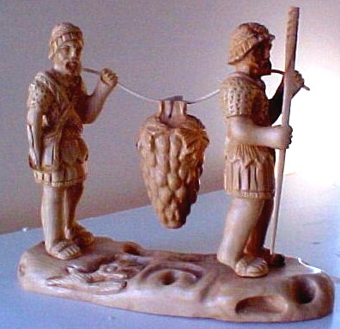
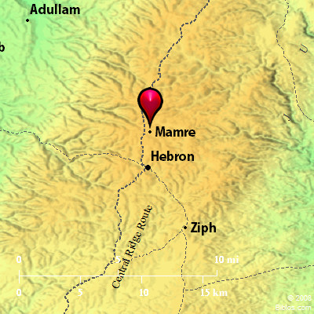
Deut 2 (Land of Moab)
¹⁰(The Emim formerly lived there, a people great and many, and tall as the Anakim.
¹¹Like the Anakim they are also counted as Rephaim, but the Moabites call them Emim.
Numbers 13
²²They went up into the Negeb and came to Hebron. Ahiman, Sheshai, and Talmai, the descendants of Anak, were there. (Hebron was built seven years before Zoan in Egypt.)
²³And they came to the Valley of Eshcol and cut down from there a branch with a single cluster of grapes, and they carried it on a pole between two of them;

Slide 17
Numbers 13
²⁷And they told him, “We came to the land to which you sent us. It flows with milk and honey, and this is its fruit.
²⁸However, the people who dwell in the land are strong, and the cities are fortified and very large. And besides, we saw the descendants of Anak there.
¹⁵Now the name of Hebron formerly was Kiriath-arba. (Arba was the greatest man among the Anakim.) And the land had rest from war.

Slide 18
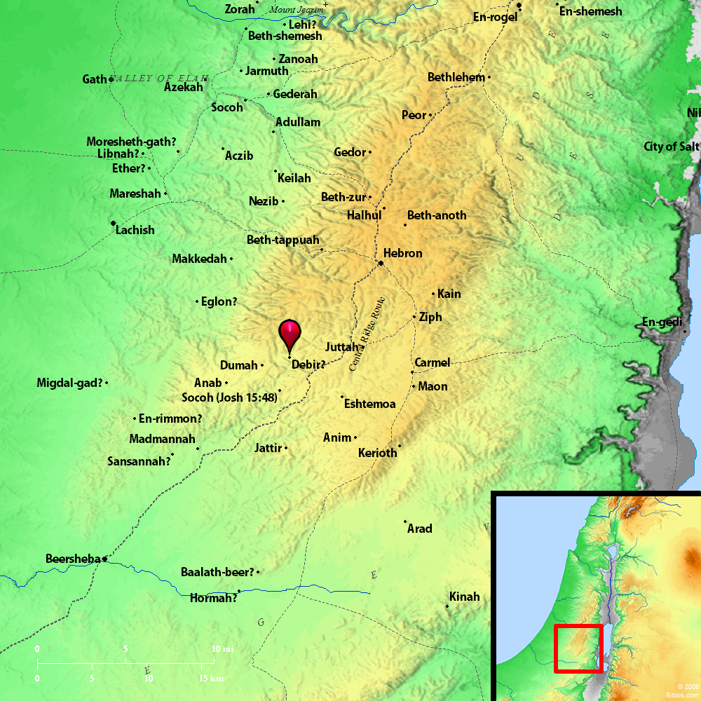
Joshua 15:13-18
¹³According to the commandment of the Lord to Joshua, he gave to Caleb the son of Jephunneh a portion among the people of Judah, Kiriath-arba, that is, Hebron (Arba was the father of Anak).
¹⁴And Caleb drove out from there the three sons of Anak, Sheshai and Ahiman and Talmai, the descendants of Anak.
¹⁵And he went up from there against the inhabitants of Debir. Now the name of Debir formerly was Kiriath-sepher.
¹⁶And Caleb said, “Whoever strikes Kiriath-sepher and captures it, to him will I give Achsah my daughter as wife.”
¹⁷And Othniel the son of Kenaz, the brother of Caleb, captured it. And he gave him Achsah his daughter as wife.

Slide 19
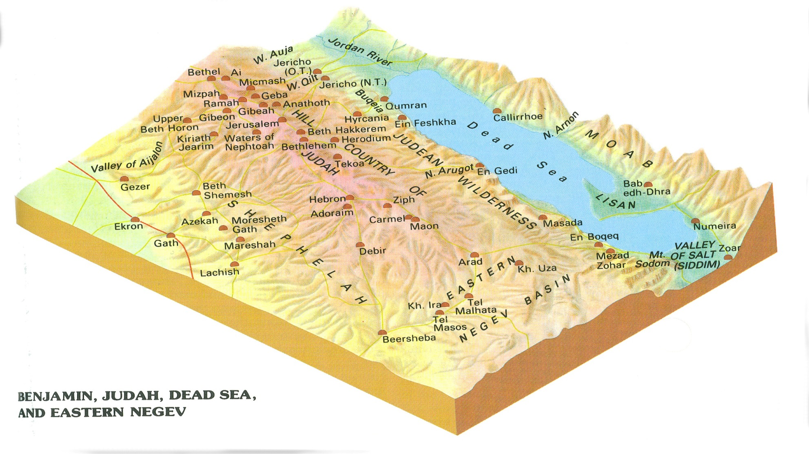
Judah - 1

Slide 20
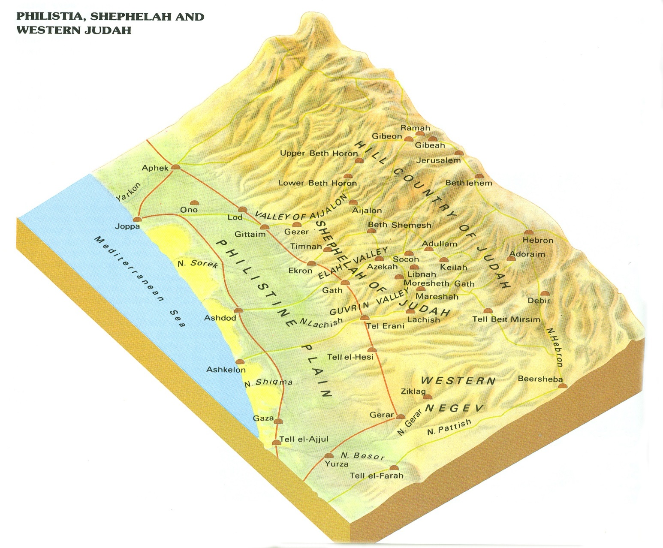
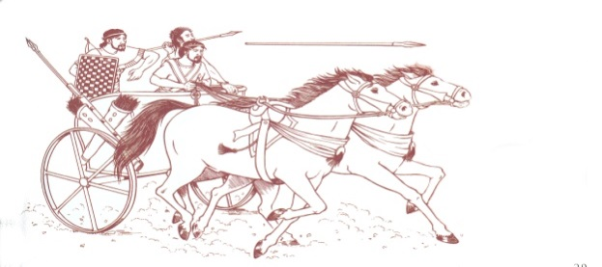
Judah - 2
Judges 1
¹⁸Judah also captured Gaza with its territory, and Ashkelon with its territory, and Ekron with its territory.
¹⁹And the Lord was with Judah, and he took possession of the hill country, but he could not drive out the inhabitants of the plain because they had chariots of iron.

Slide 21
Joshua 15
The Allotment for Judah
Walking the Border
Via BiblePlaces.com

Slide 22
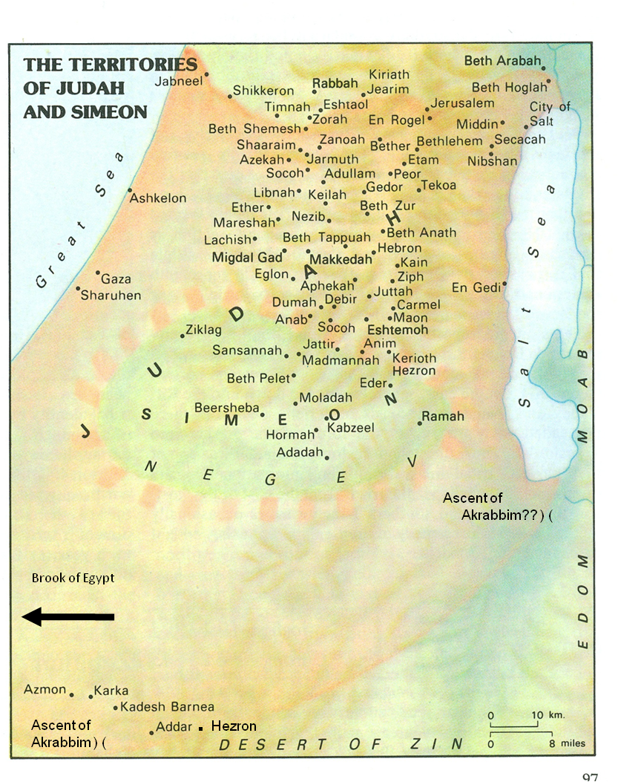
Southern Border – Judah Joshua 15:1-4
southward to the boundary of Edom
to the wilderness of Zin at the farthest south
their south boundary ran from the end of the Salt Sea, from the bay that faces southward.
It goes out southward of the ascent of Akrabbim,
passes along to Zin,
goes up south of Kadesh-barnea, along by Hezron,
up to Addar, turns about to Karka,
passes along to Azmon, goes out by the Brook of Egypt, and comes to its end at the sea.

Slide 23
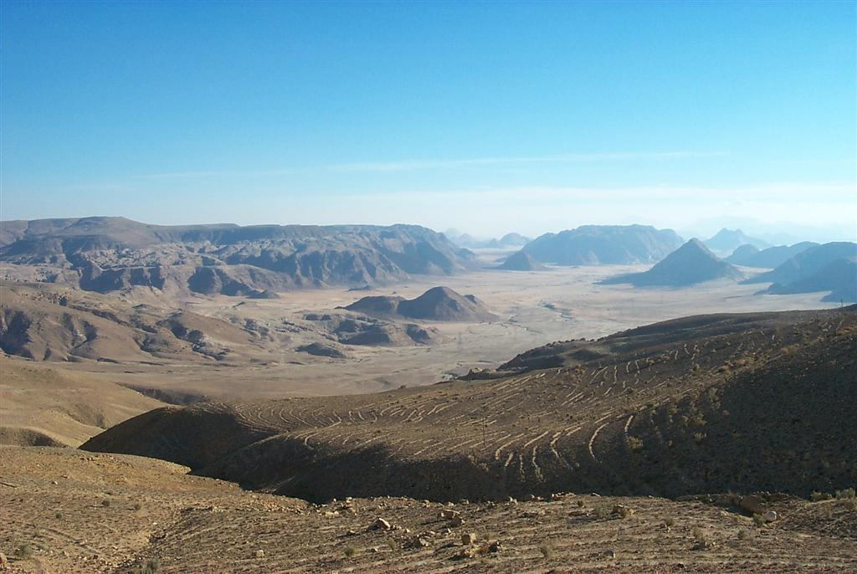
Wadi Rum
southward to the boundary of Edom
Edom/Wadi Rum
Notes:
Origin of the Edomites
The Edomites are the descendants of Esau, who is Isaac’s son and Jacob’s twin brother (Gen 36:1, 8-9).
Genesis 36 gives some interesting genealogical information related to Edom/Esau.
The Amalekites were descendants of Esau’s son (Eliphaz) by a concubine (36:12, 15).
Eight Edomite kings ruled before Israel had a king (36:31-39). It seems that the Edomite monarchy must have been set up around the same time as the Moabite and Ammonite monarchies.
The Edomites were not Arabic peoples. The Arabs did not appear on the scene until about the 4th century B.C.
The region of Edom is also called Se’ir (Mt. Se’ir), meaning “hairy,” in this case, “wooded” (cf. Gen 27:11 and 36:20, which designates the name already to Horite days; Gen 33:15-16; Dt 2:1, 4, 8). The Arabic word for trees is related, it is “shajar.” The chief Nabatean deity was Dushara, Du-esh-shara, He of Shara (Seir).
Mt. Seir (Edom) was formerly inhabited by the Horites (Hurrians?), but by divine measure, the Edomites dispossessed them. It is noteworthy that Esau had intermarried with the Horites (one of his three wives was a Horite, Gen 36:5, 20, 25). When the Israelites ended their wilderness journeys, they asked Edom for passage through their territory, but Edom refused. The Israelites were instructed by God not to harass Edom, and go around (south and east of) Edom via Elath and the Way of the Wilderness toward Moab.
History of Enmity between Israel and Edom
In general, Edom-Israel relations were not cordial. Saul battled with the Edomites (1 Sam 14:47), as did David (2 Sam 8:13-14, 1 Ki 11:15-16), Jehoshaphat (2 Chr 20), and Je(ho)ram of Judah when “Edom revolted from the rule of Judah to this day” (c. 845 B.C., 2 Ki 8:20-22).
Edom remained independent under its own king until about 55 years later (790 B.C.) when Amaziah of Judah tried to restore Judah’s hegemony over Edom. Amaziah killed 10,000 Edomites in the Valley of Salt (either the Aravah or Eastern Negev) and dashed another 10,000 to pieces by tossing them off a cliff (2 Chr 25:5-13; 2 Ki 14:7). Amaziah kept and worshipped the idols of Edom and as a consequence he was judged by God for doing so (2 Ki 14:8-14; 2 Chr 25:14-24).
Israelite victory songs over Edom were included in Psalms (Ps 60:6-9 and title; Ps 108:8-12).
Edom often took advantage of Jerusalem’s weak moments (Ps 137:7; Ezek 35:1-10; Amos 1:11) and for this (among other reasons) was sharply condemned by the prophets (Isa 63:1, 21:11-12; Jer 49:7-22). Obadiah dedicated his whole prophecy to Edom’s doom.
Edom appeared in the writings of the exile, as still being in existence, but yet guilty and threatened (Lam 4:21-22; Ezek 25:12-14, 35:1-10).
Earlier prophetic predictions of Edom’s doom probably found fulfillment in the reign of the last king of Babylon, Nabonidus (556-539 B.C.). By Malachi’s time (450-400 B.C.) the Lord had turned Edom’s “mountains into a wasteland and left his inheritance to the desert jackals” (Mal 1:1-4).
By Hellenistic and Roman times, the Edomites had been dispossessed of Mt. Seir by the Arabic peoples, the Nabateans. The remnant Edomites moved west and settled in southern Judah (e.g., Tel Maresha). By then they were called Idumeans and they were forcibly converted to Judaism by the Hasmoneans. Herod the Great descended from this Idumean stock. In the NT, some Idumeans followed Christ (Mk 3:7-8).

Slide 24
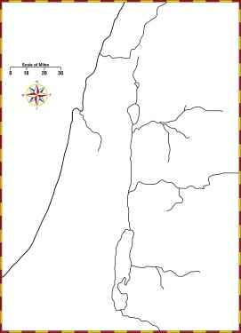
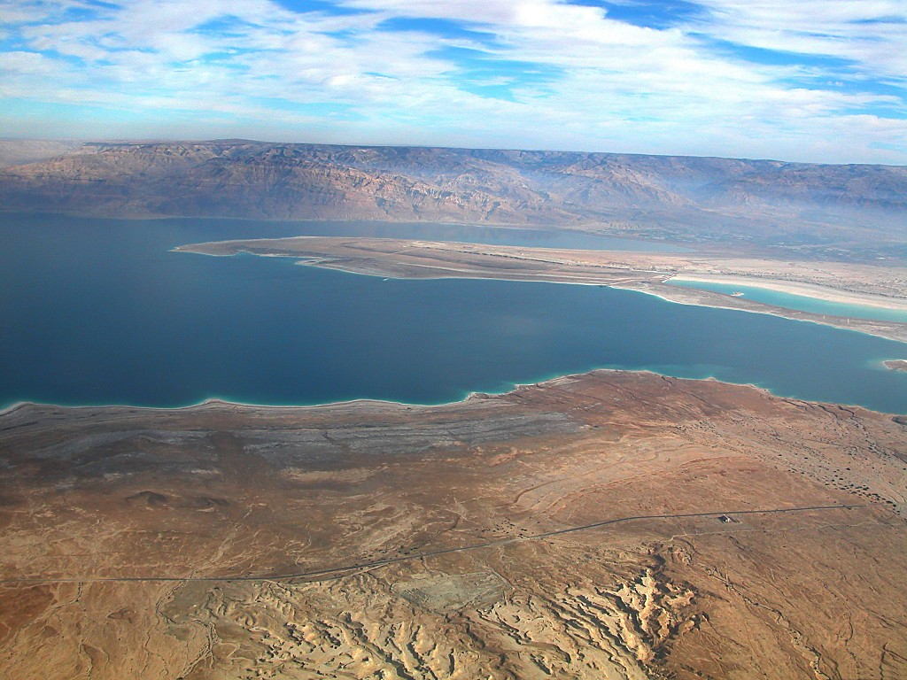
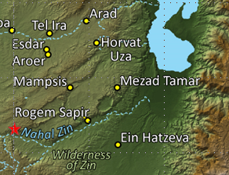
Dead Sea Lisan aerial from west
their south boundary ran from the end of the Salt Sea, from the bay that faces southward.
Southern End/Dead Sea Lisan aerial from west
Notes:
The Lisan Peninsula
The Sea is divided into two sections created by a peninsula extending across from the Transjordan called the Lisan (or Lashon in Hebrew), meaning “tongue.” The Lisan “is formed of strata of clay, marl, soft chalk, and gypsum interbedded with sand and gravel” (Encyclopaedia Britannica).
The current, lower water level has caused a detachment of the two sea basins at the Lisan, and has resulted in the exposure of the floor of most of the southern basin. The issue of whether the southern basin was covered with water throughout the biblical period is a controversial question.
The surface area of the northern section is 294 square miles, while the southern surface area is 99 square miles.
History records the crossings of this peninsula several times, by individual as well as troops. Today the border situation does not permit it, but it would be easily crossable. The Lisan had a passable ford as recently as 1846 (Aharoni 1979: 35).

Slide 25
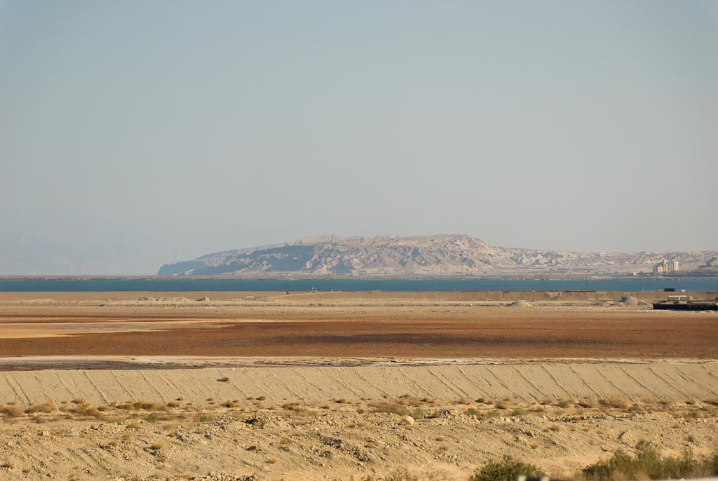
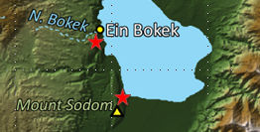
Mount Sodom from north
Notes:
tb052307915

Slide 26
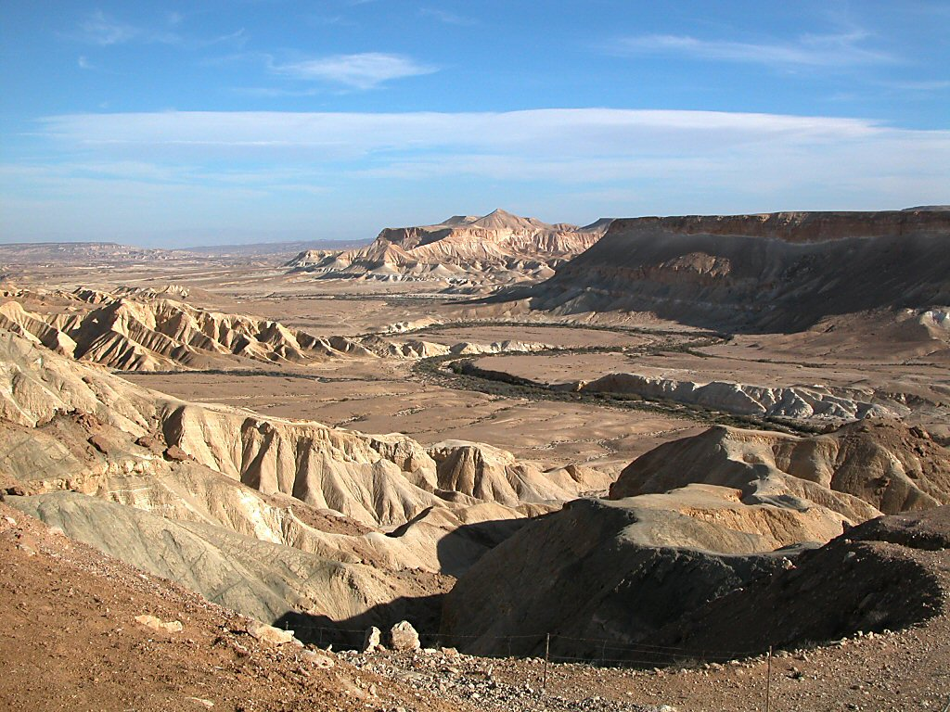
Nahal Zin from northwest
to the wilderness of Zin at the farthest south
Wilderness of Zin/Nahal Zin from northwest
Notes:
Nahal Zin
The Nahal Zin is 75 miles (120 km) long and drains 600 sq. miles (1550 sq. km). It is the largest wadi that begins in the Negev.
Nahal Zin was created by reverse erosion. The great height difference between the Negev Highlands and the Jordan Rift caused the underlayers to erode during the rainy season and the collapse of the harder strata of rock above.
The landscape is mostly Eocene limestone, consisting of some brown-black layers of low-grade flint. The flint in this canyon slows down the erosion of the limestone.

Slide 27
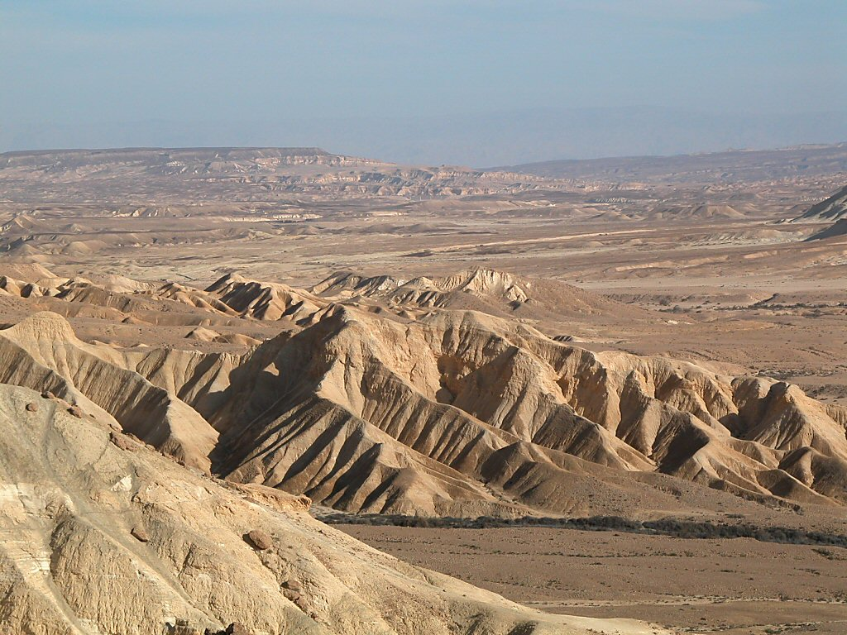
Nahal Zin mountains
to the wilderness of Zin at the farthest south
Wilderness of Zin/Nahal Zin mountains
Notes:
Southern Border
The Nahal Zin was the southern border of Canaan.
Numbers 34:3-4 (KJV) “Then your south quarter shall be from the wilderness of Zin along by the coast of Edom, and your south border shall be the outmost coast of the salt sea eastward: And your border shall turn from the south to the ascent of Akrabbim, and pass on to Zin: and the going forth thereof shall be from the south to Kadeshbarnea, and shall go on to Hazaraddar, and pass on to Azmon:”

Slide 28
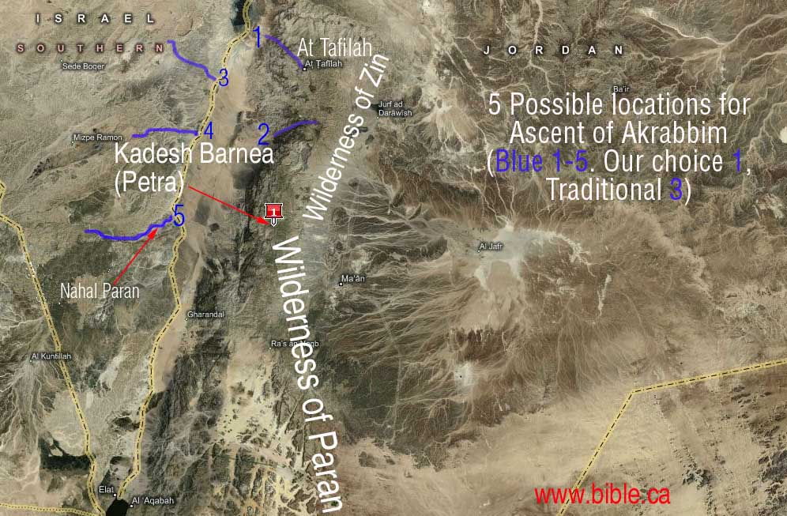
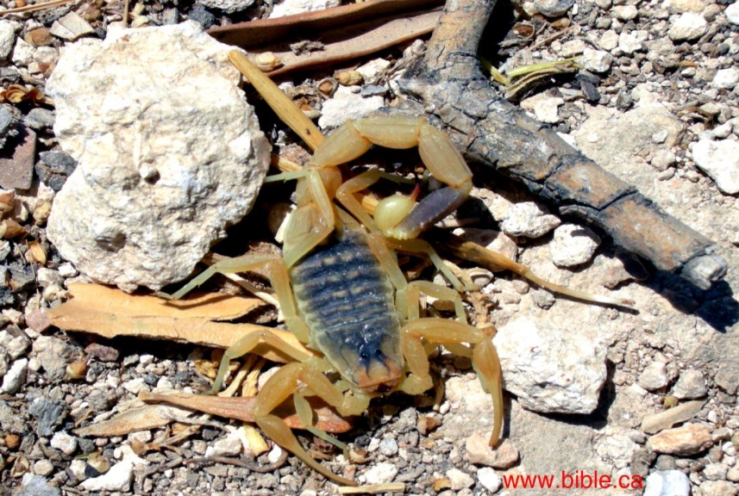
Ascent of Akrabbim
Akrabbim is the word for scorpion, so it is literally the "ascent of scorpions".

Slide 29
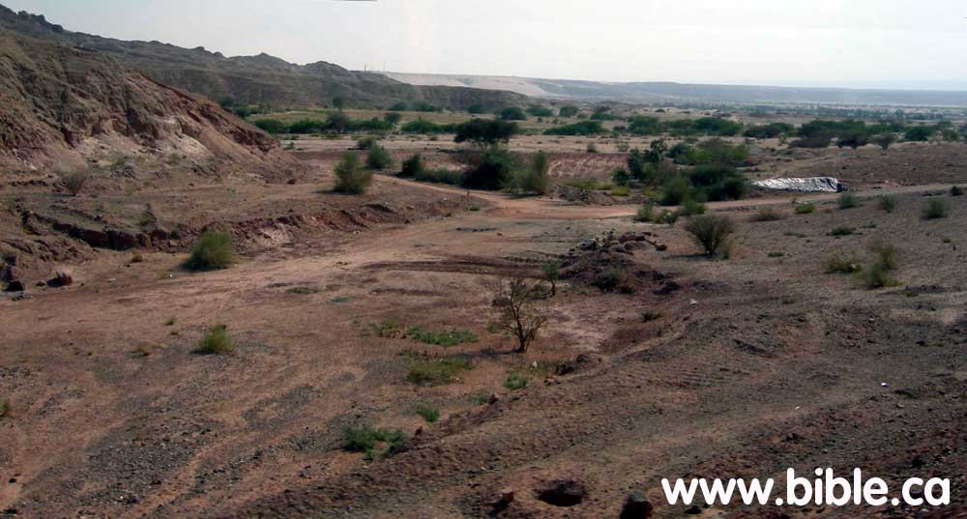
Ascent of Akrabbim
Site 1/Wilderness of Zin

Slide 30
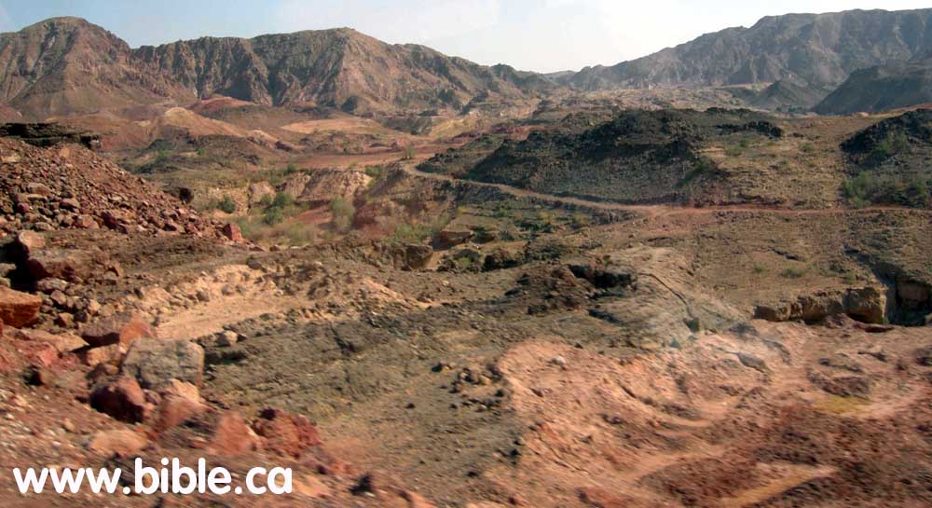
Ascent of Akrabbim
Site 1/Wilderness of Zin

Slide 31
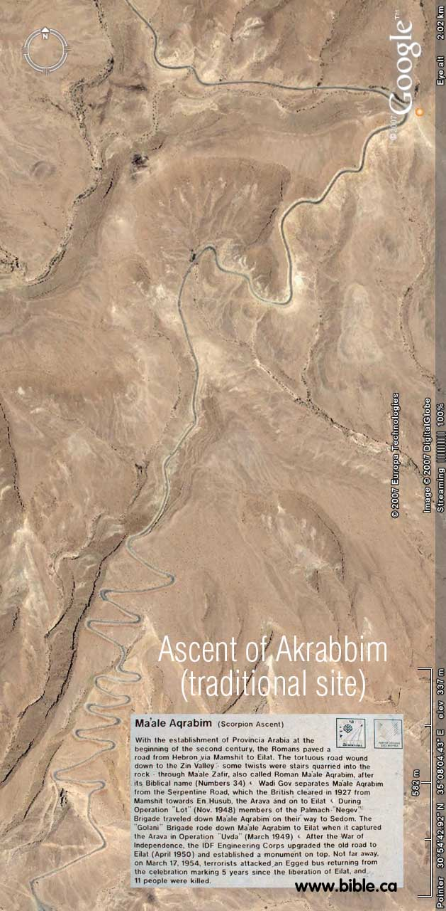
Ascent of Akrabbim
Site 3 /South
This route does indeed travel along an ancient route from the Arabah valley, through one of Solomon's border fortresses he built at Ein Haseva and into the promised land and was an ancient route used from the time of Solomon.

Slide 32
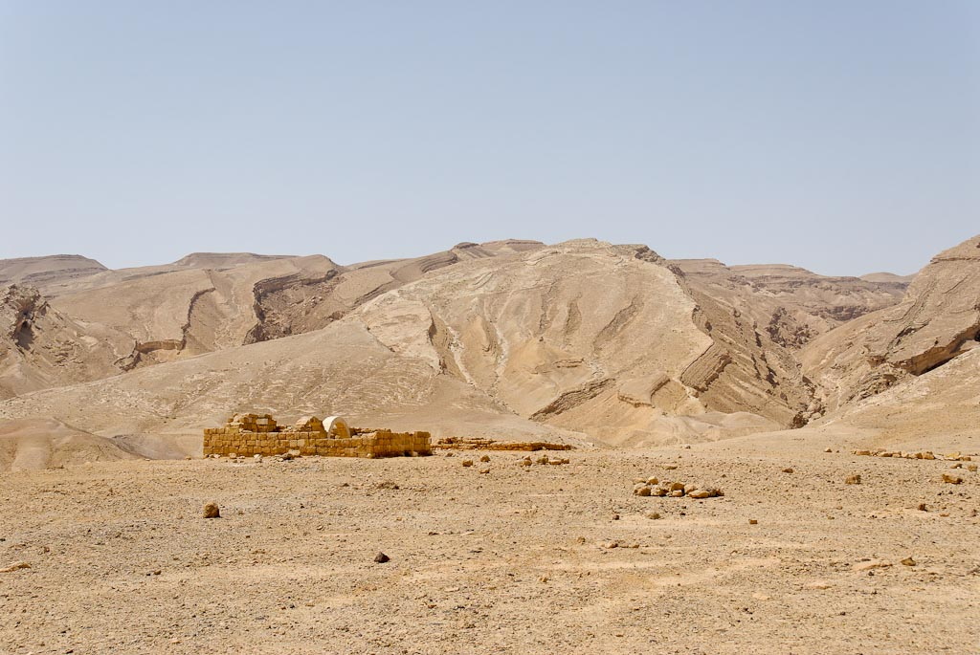
Maale Aqrabbim
Rogem Sapir below Ascent of Scorpions, Maale Aqrabbim
Notes:
tb042207890

Slide 33
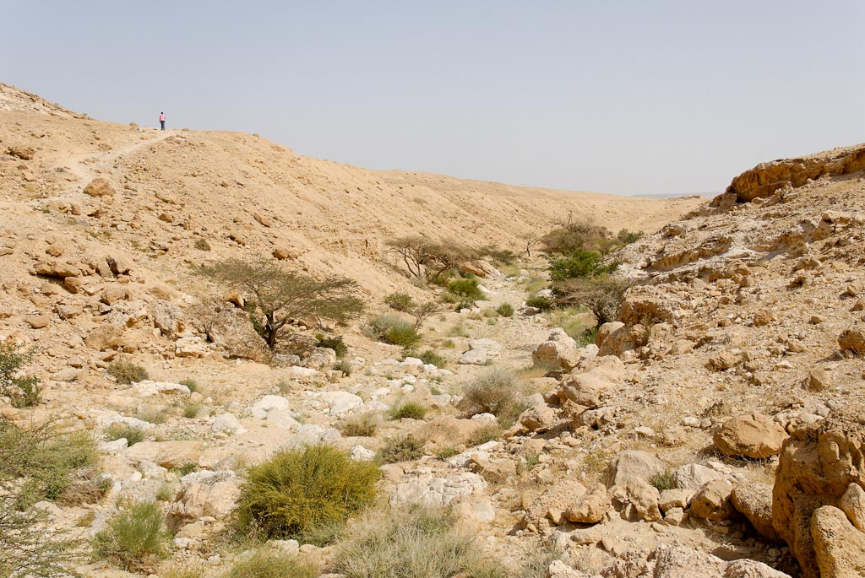
Wadi Gov by Ascent of Scorpions, Maale Aqrabbim
Notes:
tb042207923

Slide 34
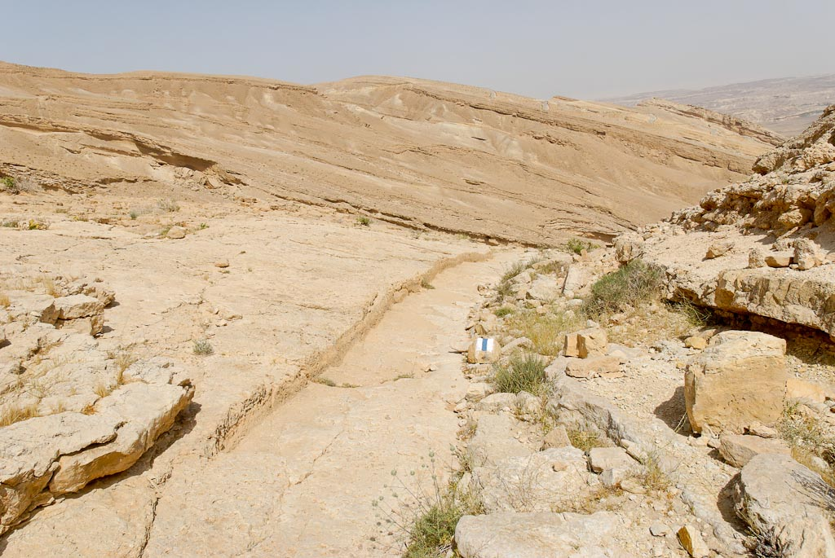
Ascent of Scorpions, Maale Aqrabbim, Roman steps
Notes:
tb042207920

Slide 35
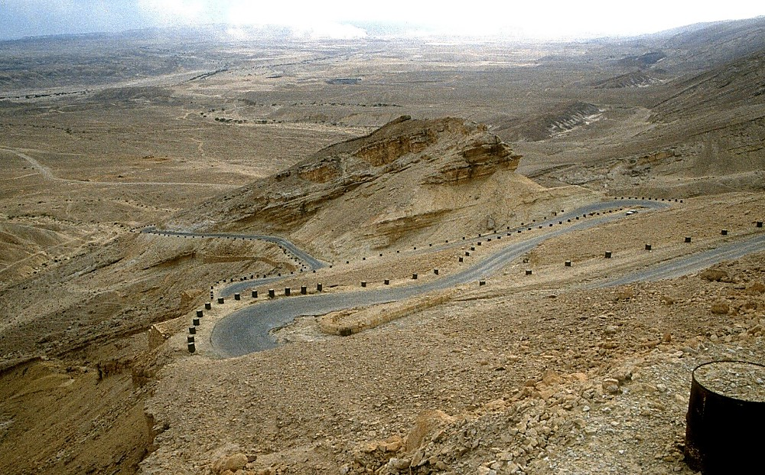
Maale Aqrabbim looking down switchbacks
ascent of Akrabbim/Maale Aqrabbim looking down switchbacks
Notes:
The modern Israeli road travels up the ridge north of the ancient road. It is such a steep ascent that many switchbacks are required.

Slide 36
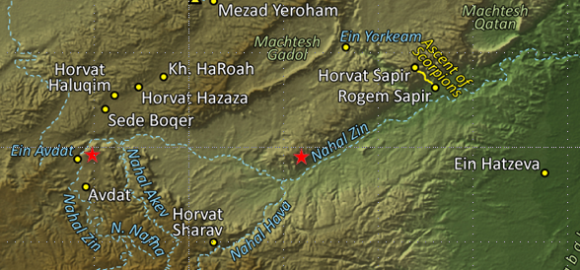
Nahal Zin mountains
Notes:
tb010503589

Slide 37
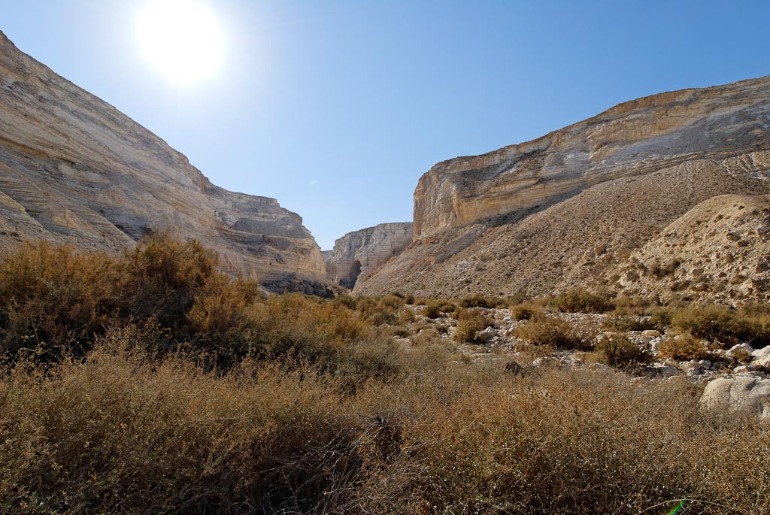
Nahal Zin
Notes:
tb010512830

Slide 38
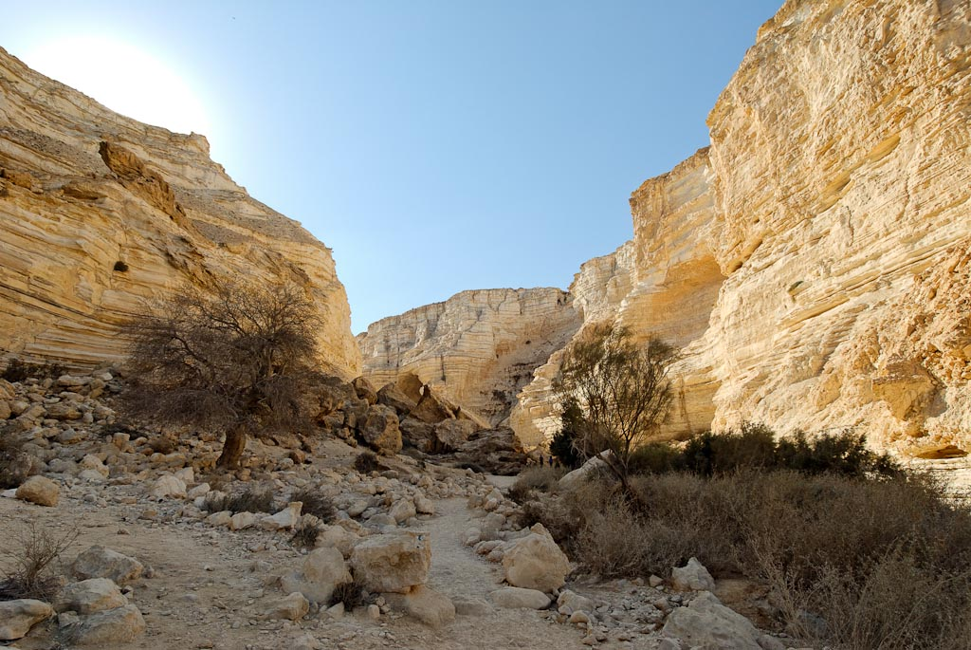
Nahal Zin
Notes:
tb010512832

Slide 39
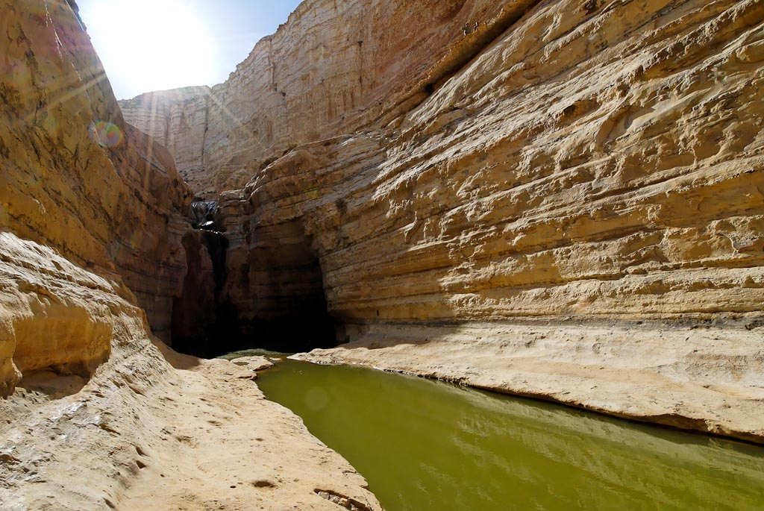
Nahal Zin waterfall and Ein Avdat
Notes:
Nahal Zin, also called the Ein Avdat canyon, is characterized by a quick drop of 500 feet (150 m) in a series of waterfalls, a sharp drop necessary to reach the level of the Jordan Rift.
tb030607866

Slide 40
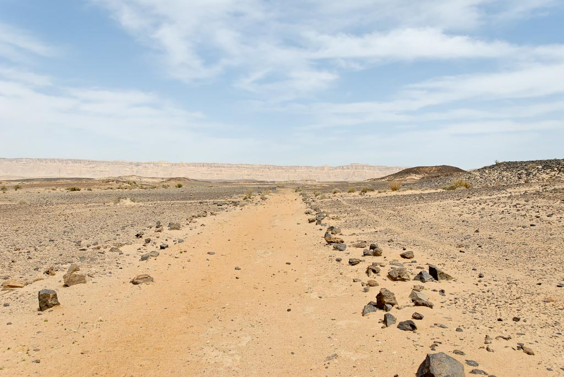
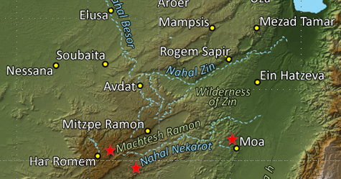
It goes out southward of the ascent of Akrabbim,
passes along to Zin,
Spice Route in Machtesh Ramon
Notes:
tb042107630

Slide 41
Southern Border – Judah Joshua 15:1-4
southward to the boundary of Edom
to the wilderness of Zin at the farthest south
their south boundary ran from the end of the Salt Sea, from the bay that faces southward.
It goes out southward of the ascent of Akrabbim,
passes along to Zin,
goes up south of Kadesh-barnea, along by Hezron,
up to Addar, turns about to Karka,
passes along to Azmon, goes out by the Brook of Egypt, and comes to its end at the sea.

Slide 42
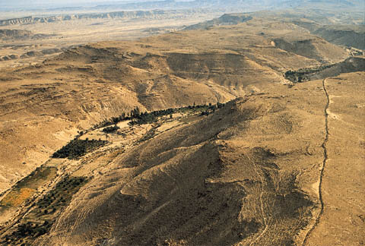
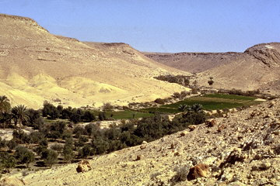
Kadesh-barnea
This is a northeastern view of the great desert valley (also called a wadi) where Kadesh-barnea is situated. The stream that flows here during the rainy season makes this a well-watered and fruitful spot in the wilderness of Zin.
This is the likely spot from which Moses sent 12 men to spy out the land of Canaan (Num. 13:17-30). It served as a base camp for the Israelites during 38 of their nearly 40 years of wandering in the wilderness (Deut. 2:14). Miriam died and was buried here (Num. 20:1). This was the scene of Korah’s rebellion, the murmuring of the people, and the budding of Aaron’s rod (Num. 16-17). Near here Moses smote a rock and water came forth (Num. 20:7-11).

Slide 43
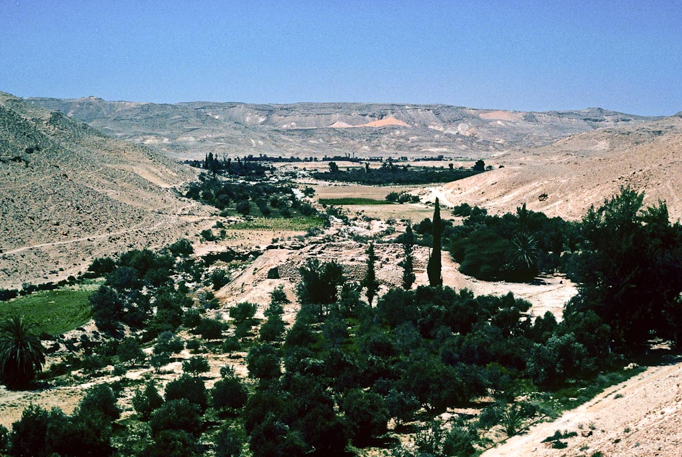
goes up south of Kadesh-barnea, along by Hezron,
Kadesh Barnea from northeast
Notes:
Kadesh Barnea: Biblical References
Kadesh Barnea, also known simply as Kadesh, is first mentioned as a destination in the campaign of the Mesopotamian kings (Gen 14:7).
Hagar was near Kadesh when the angel told her that she would bear Ishmael (Gen 16:11-14).
The Israelites encamped at Kadesh Barnea shortly after their departure from Mount Sinai (Num 13:26; Deut 1:2). From this place the twelve spies were sent into Canaan, and it was here that the Israelites rebelled and were sentenced to death in the wilderness.
Near the end of the forty-year journey in the wilderness, Miriam died in Kadesh (Num 20:1). It appears that the Israelites began and ended their years of “wandering” at this site (cf. Deut 1:46; 2:14; 9:23).
Photo provided by Gary Pratico.
gp035

Slide 44
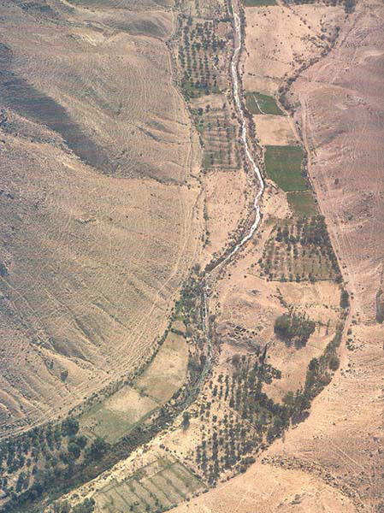
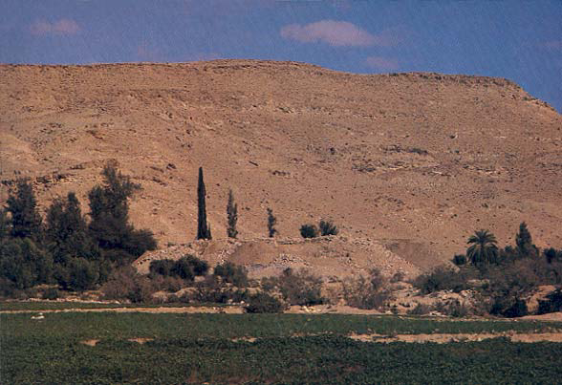
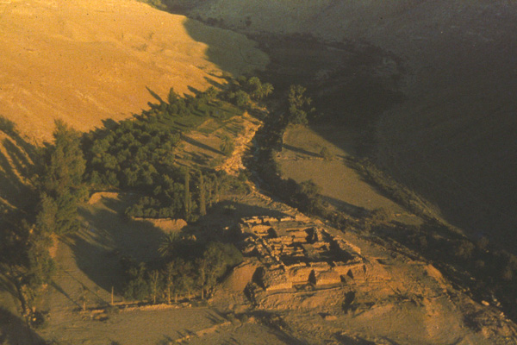
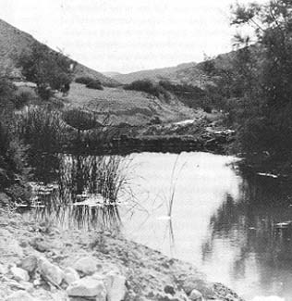
Kadesh-barnea

Slide 45
Southern Border – Judah Joshua 15:1-4
southward to the boundary of Edom
to the wilderness of Zin at the farthest south
their south boundary ran from the end of the Salt Sea, from the bay that faces southward.
It goes out southward of the ascent of Akrabbim,
passes along to Zin,
goes up south of Kadesh-barnea, along by Hezron,
up to Addar, turns about to Karka,
passes along to Azmon, goes out by the Brook of Egypt, and comes to its end at the sea.

Slide 46
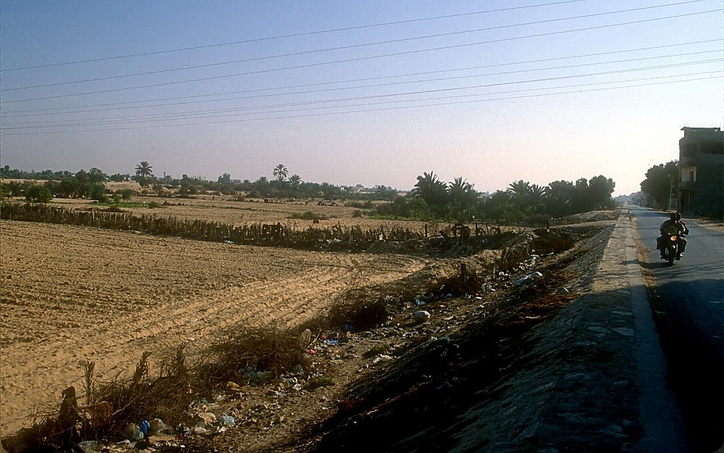
Wadi el-Arish looking south
passes along to Azmon, goes out by the Brook of Egypt, and comes to its end at the sea.
Brook of Egypt/Wadi el-Arish looking south
Notes:
Wadi El-Arish
This was known as the Brook of Egypt or “wadi of Egypt” in the Bible (nahal mitzraim; to be distinguished from nahar mitzraim, which is the “River of Egypt,” the Nile ).
Today the wadi is not easily visible because the wadi is broad and flat and the wadi bed is planted with date palms.

Slide 47
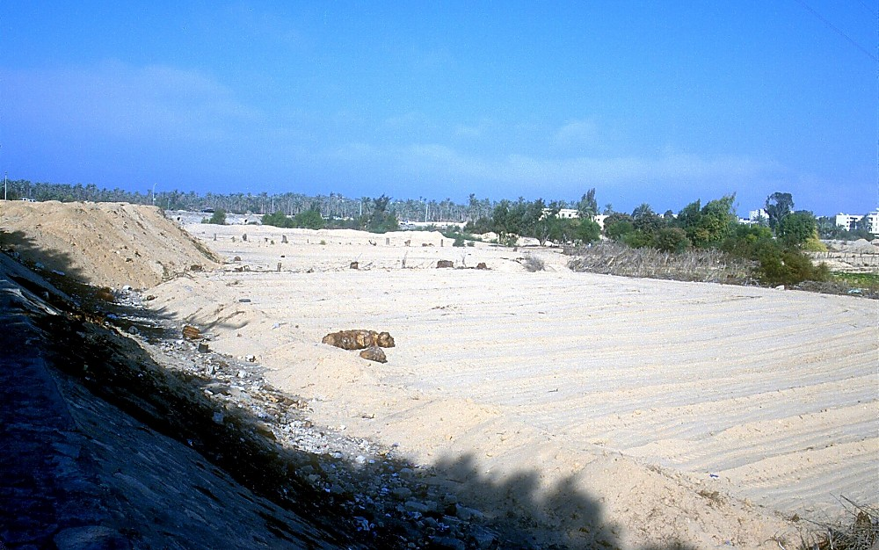
Wadi el-Arish looking north
passes along to Azmon, goes out by the Brook of Egypt, and comes to its end at the sea.
Brook or River of Egypt/Wadi el-Arish looking north
Notes:
Southern Border
The Wadi el-Arish is the southern border of the Promised Land.
Numbers 34:3-5 (NIV) “Your southern side will include…the Wadi of Egypt and end at the Sea.”
Ezekiel 47:15-19 (NIV) “This is to be the boundary of the land… 19 On the south side it will run from Tamar as far as the waters of Meribah Kadesh, then along the Wadi of Egypt to the Great Sea. This will be the south boundary.”

Slide 48
Eastern Border – Judah
Joshua 15:5
And the east boundary is the Salt Sea, to the mouth of the Jordan. And the boundary on the north side runs from the bay of the sea at the mouth of the Jordan.

Slide 49
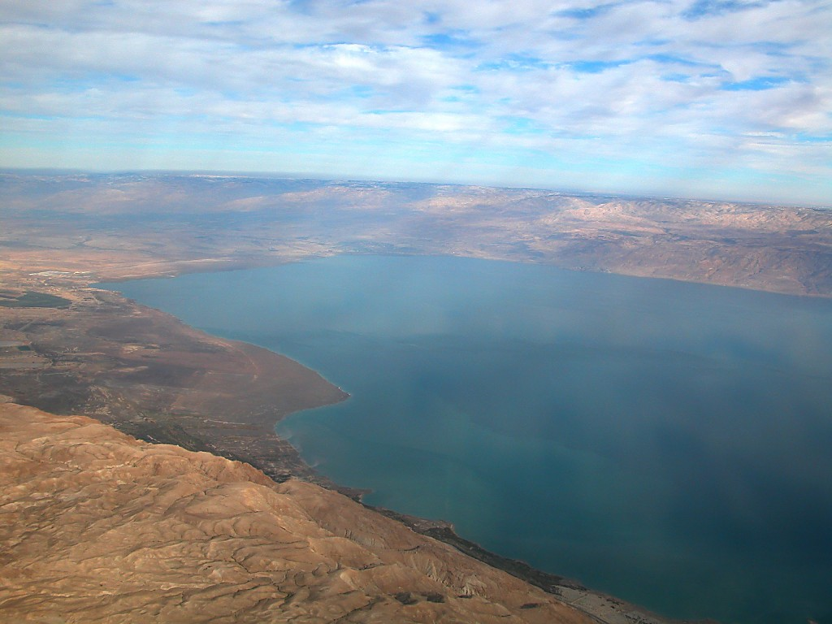
Dead Sea northern end aerial from west
Dead Sea northern end aerial from west
Notes:
The Dead Sea is known in the Bible as the "Salt Sea" or the "Sea of the Arabah." This inland body of water is appropriately named because its high mineral content allows nothing to live in its waters.

Slide 50
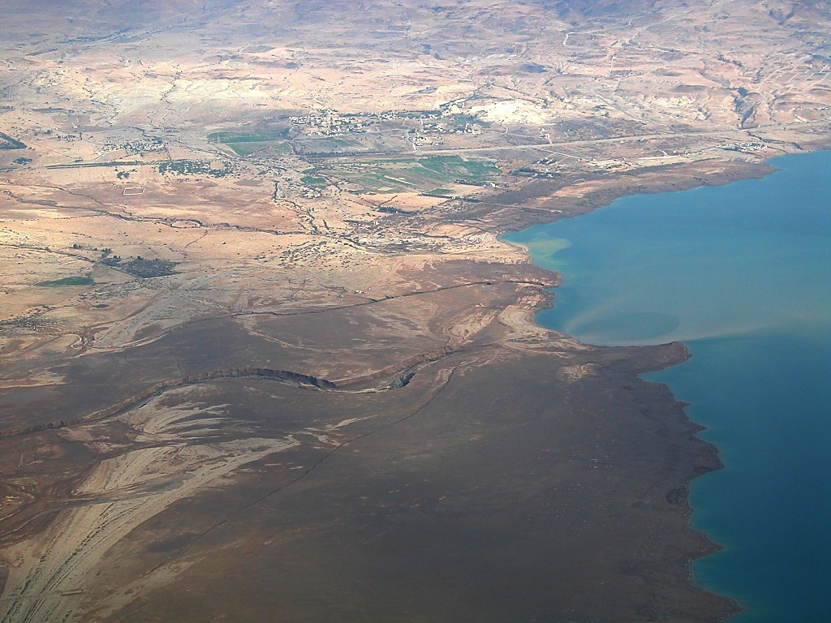
mouth of the Jordan
Jordan River entering Dead Sea aerial from west
Notes:
tb010703283

Slide 51
Jordan River entering Dead Sea aerial from west
And the boundary on the north side runs from the bay of the sea at the mouth of the Jordan.
Jordan River entering Dead Sea aerial from west
Notes:
“The fresh water of the Jordan stays on the surface; in the spring its muddy colour can be traced across the lake as far as 30 miles (50 km) south of the point where the river empties into the Dead Sea” (Encyclopaedia Britannica).

Slide 52
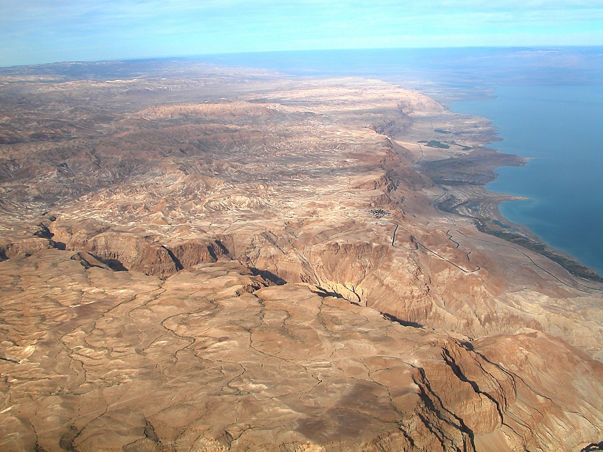
Nahal Darga
Wilderness, Dead Sea, Nahal Darga aerial from south

Slide 53
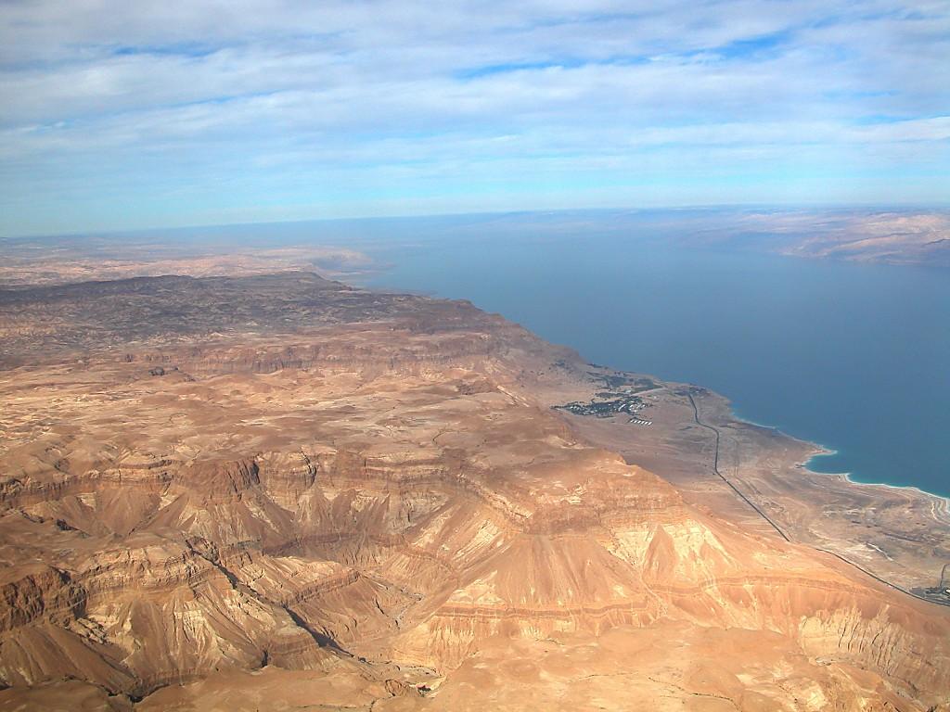
En Gedi
En Gedi area aerial from south

Slide 54
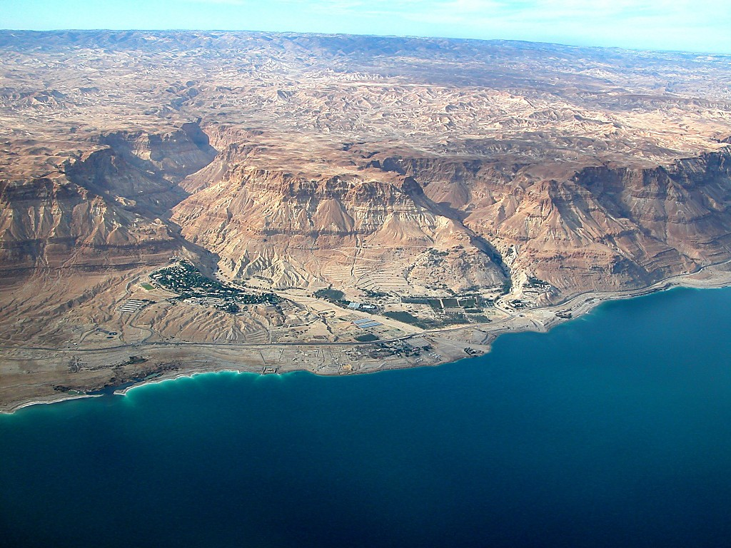
Nahal Arugot
Nahal David
Chalcolithic
Temple
Ein Gedi
Spring
En Gedi with wilderness aerial from east

Slide 55
Dead Sea Lisan aerial from west

Slide 56
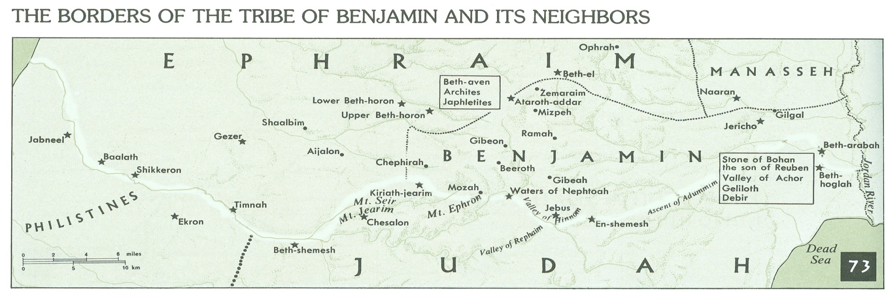
Northern Border – Judah Part A
Joshua 15:5-11
And the boundary goes up to Beth-hoglah
passes along north of Beth-arabah.
And the boundary goes up to the stone of Bohan the son of Reuben.
And the boundary goes up to Debir from the Valley of Achor,
and so northward, turning toward Gilgal, which is opposite the ascent of Adummim, which is on the south side of the valley.
And the boundary passes along to the waters of En-shemesh and ends at En-rogel.

Slide 57

Jordan River aerial from west
And the boundary goes up to Beth-hoglah passes along north of Beth-arabah.
Jordan River aerial from west
Notes:
Everyday, seismologists record at least a dozen (small) tremors in the Jordan Rift near Jericho.

Slide 58

Jericho aerial from west
Jordan River
Benjamin
Judah
Tell Jericho
Ascent of Adumim
To Jerusalem
Wadi Qilt
Jericho aerial from west
Notes:
Jericho’s Situation
At 825 ft (244 m) below sea level, Jericho is the lowest city on earth.
The city is 4 mi west of the Jordan River and 17 mi east of Jerusalem.

Slide 59

Wadi Qilt near Ein Perat
Notes:
tb020503375

Slide 60

Jericho, Ascent of Adumim, Wadi Qilt aerial from east
turning toward Gilgal, which is opposite the ascent of Adummim
Wadi Qilt
Cypros
Benjamin
Judah
Ascent of Adumim
Herod’s Palaces
Jericho, Ascent of Adumim, Wadi Qilt aerial from east
Notes:
Ascent of Adumim
The “Ascent of Adumim” was the main route from Jericho to Jerusalem. It followed a ridge south of the Wadi Qilt and north of Nahal Og. Near Jerusalem, the route was forced to cross the Nahal Og at a more passable location. Some of the biblical events which likely occurred on this route include: David’s flight from Absalom (2 Sam 15-16), Zedekiah’s flight from the Babylonians (2 Ki 25:4), the story of the Good Samaritan (Luke 10:25-37), and Jesus’ travels from Jericho to Jerusalem (e.g., Luke 19:28).

Slide 61
Northern Border – Judah Part A
Joshua 15:5-11
And the boundary goes up to Beth-hoglah
passes along north of Beth-arabah.
And the boundary goes up to the stone of Bohan the son of Reuben.
And the boundary goes up to Debir from the Valley of Achor,
and so northward, turning toward Gilgal, which is opposite the ascent of Adummim, which is on the south side of the valley.
And the boundary passes along to the waters of En-shemesh and ends at En-rogel.
61

Slide 62

And the boundary passes along to the waters of En-shemesh and ends at En-rogel.
Pictorial Library Vol. 3: Jerusalem
Notes:
This map is intended to help users locate the places which appear in the photographs in this presentation. The map therefore does not represent or label every geographic feature, and the sites are a mixture of modern and ancient place names.

Slide 63

Ein Rogel
Pool of Siloam
Pool of Siloam and En Rogel from north
Notes:
adr080718253

Slide 64
Northern Border – Judah Part B
Joshua 15:5-11
Then the boundary goes up by the Valley of the Son of Hinnom at the southern shoulder of the Jebusite (that is, Jerusalem).
And the boundary goes up to the top of the mountain that lies over against the Valley of Hinnom, on the west, at the northern end of the Valley of Rephaim.
Then the boundary extends from the top of the mountain to the spring of the waters of Nephtoah,
and from there to the cities of Mount Ephron.
Then the boundary bends around to Baalah (that is, Kiriath-jearim).

Slide 65
Then the boundary goes up by the Valley of the Son of Hinnom at the southern shoulder of the Jebusite (that is, Jerusalem).
And the boundary passes along to the waters of En-shemesh and ends at En-rogel.
Pictorial Library Vol. 3: Jerusalem
Notes:
This map is intended to help users locate the places which appear in the photographs in this presentation. The map therefore does not represent or label every geographic feature, and the sites are a mixture of modern and ancient place names.

Slide 66

Hebrew University
Mount Scopus
Kidron Valley
Silwan
Central Valley
Jaffa Gate
Sultan’s Pool
Hinnom Valley
Jerusalem aerial from southwest
Notes:
tb010703209

Slide 67

Jerusalem aerial from east
Knesset
Hinnom Valley
Kidron Valley
Hill of Offense
Jerusalem aerial from east

Slide 68


Jerusalem southern area aerial from east
Bethlehem
Giloh
Rephaim Valley
Ramat Rahel
Har Homa
Jerusalem southern area aerial from east

Slide 69

Solomon’s Pools
Bethlehem
Har Giloh
Beit Jalla
Giloh
Tumulus 1
Ein Yael
Rephaim Valley
zoo
Teddy Stadium
mall
Holyland Hotel
Rephaim Valley aerial from north
Notes:
df010703357

Slide 70

Kiriath Jearim from north aerial
Abu Gosh
Telshe Stone
Kiriath Jearim
Yad HaShmonah
Kiriath Jearim from north aerial
Notes:
The biblical city of Kiriath Jearim is best known for the house of Abinadab which held the Ark of the Covenant from the time of Samuel until the time of David (about 120 years). Kiriath Jearim was originally a Gibeonite city. The Danites camped near here on their migration to the north. The prophet Uriah, a contemporary of Jeremiah, was from Kiriath Jearim.

Slide 71
Northern Border – Judah Part C
Joshua 15:5-11
And the boundary circles west of Baalah to Mount Seir,
passes along to the northern shoulder of Mount Jearim (that is, Chesalon),
and goes down to Beth-shemesh
and passes along by Timnah.
The boundary goes out to the shoulder of the hill north of Ekron,
then the boundary bends around to Shikkeron and passes along to Mount Baalah
and goes out to Jabneel.
Then the boundary comes to an end at the sea.
71

Slide 72

Jerusalem
Mozah
Kiriah-Jearim
Beth-Shemesh
Timnah

Slide 73

Beth-Shemesh
Timnah
Ekron
Jabneel

Slide 74

and goes down to Beth-shemesh
Zorah
Tel Beth Shemesh
Sorek Valley and Zorah aerial from south

Slide 75

and goes down to Beth-shemesh
Beth Shemesh aerial from south

Slide 76

and goes down to Beth-shemesh
and passes along by Timnah.
Timnah
Tel Beth Shemesh
“Diagonal Route” to Azekah
Beth Shemesh and Sorek Valley aerial from southeast

Slide 77

Timnah from south
and passes along by Timnah.
Timnah from south
Notes:
Timnah
Timnah is usually identified with Tel Batash in the Sorek Valley (pictured).
Timnah was allotted to the tribe of Judah, near the border of Dan (Josh 15:7; 19:43).
The Philistines controlled this city at times. This was reflected in the presence of Samson’s Philistine girlfriend in Timnah (Judges 14).
Tel Batash was excavated by George Kelm and Amihai Mazar in the 1980s. Evidence from that excavation seems to confirm the site’s identification as Timnah.

Slide 78

Sorek Valley from north panorama
Northern Border – Judah Part C
Joshua 15:5-11
Sorek Valley from north panorama
Notes:
Judges 16:4 (KJV) “And it came to pass afterward, that he loved a woman in the valley of Sorek, whose name was Delilah.”

Slide 79

Tell Miqne, Ekron
The boundary goes out to the shoulder of the hill north of Ekron
Ekron
Notes:
The History of Ekron
Canaanite City
The tell was shaped by Middle Bronze fortifications that surrounded both the upper and lower cities. Fragmentary Middle Bronze pottery and architecture have been found throughout the tell. Also, three infant burials have been found at Ekron.
The Late Bronze occupation was apparently limited to the upper city.
There has been a diversity of pottery found, including Cypriote, Mycenean, and Anatolian imported wares. This indicates trade and the international character of the Late Bronze Age. A lack of fortifications indicates the stability of the age.
Ekron was part of the “land that yet remains” (Josh 13:3).
The border of Judah and Dan ran through Ekron (Josh 15:45-46; 19:43). In Judges 1:18, it was conquered by Judah.
The final stratum of Late Bronze was totally destroyed by fire. “The destruction was dramatically illustrated by a severely burned storeroom complex with jars containing carbonized grains, lentils, and figs” (Dothan and Gitin 1997: 31).
The Emergence of the Philistines (Iron I)
The Iron Age began with the influx of the Philistines. The emergence of Philistine culture is clear from the pottery and architecture at these levels.
Four, clear occupation zones are evident at this time in the city: fortifications, industry, domestic, and upper-class areas.
The city was apparently destroyed and temporarily abandoned, possibly in connection with David.
Iron II
The 10th century was a period of decline at Ekron. The city shrank to 10 acres, possibly as a result of the Davidic dynasty and the subjugation of the Philistines. There is a 250-year occupational gap in the lower city.
The acropolis was refortified with a new mudbrick city wall, and a 7-meter-thick (23 ft.) mudbrick tower was faced with ashlar masonry.
King Azariah of Israel sent messengers to Ekron in order to consult Baal-Zebub, the gods of Ekron (2 Ki 1:2).
Ekron was under Judah’s control during the reign of King Uzziah.
The destruction of Ekron was prophesied in Amos 1:5; Jeremiah 25:20; Zephaniah 2:4; and Zechariah 9:5-6.
Upon the death of Sargon II, Hezekiah rebelled against Assyria. He led a coalition of states that likewise refused to pay taxes. Padi resisted, so Hezekiah placed him in jail at Jerusalem. When Assyria returned, Padi was reinstated.
Three LMLK seals were found at Ekron, apparently from the time when the city was under Hezekiah’s control.
Sennacherib’s conquest of Ekron in 701 B.C. is described in his royal annals.

Slide 80
Northern Border – Judah Part C
Joshua 15:5-11
And the boundary circles west of Baalah to Mount Seir,
passes along to the northern shoulder of Mount Jearim (that is, Chesalon),
and goes down to Beth-shemesh
and passes along by Timnah.
The boundary goes out to the shoulder of the hill north of Ekron,
then the boundary bends around to Shikkeron and passes along to Mount Baalah
and goes out to Jabneel.
Then the boundary comes to an end at the sea.
80

Slide 81

Taananim River and Sharon Plain from above
Taananim River and Sharon Plain from above
Notes:
Helpful Sources on the Sites in the Sharon Plain
Beck, P. and M. Kochavi.
1993 Aphek (in Sharon). The New Encyclopedia of Archaeological Excavations in the Holy Land, vol. 3, ed. E. Stern. New York: Simon and Schuster.
Burrell, B.; K. Gleason; and E. Netzer.
1993 Uncovering Herod’s Seaside Palace. Biblical Archaeology Review 19/3: 50-57, 76.
Crisler, B. C.
1976 The Acoustics and Crowd Capacity of Natural Theaters in Palestine. Biblical Archaeologist 39/4: 128-41.
Holum, R. G. and A. Raban.
1993 Caesarea. The New Encyclopedia of Archaeological Excavations in the Holy Land, vol. 1, ed. E. Stern. New York: Simon and Schuster.
Johns, C. N.
1993 ‘Atlit. The New Encyclopedia of Archaeological Excavations in the Holy Land, vol. 1, ed. E. Stern. New York: Simon and Schuster.
Murphy-O’Connor, J.
1998 The Holy Land: An Oxford Archaeological Guide from Earliest Times to 1700, 4th rev. ed. New York: Oxford University.
Pritchard, J. B., ed.
1969 Ancient Near Eastern Relating to the Old Testament, 3rd ed. with supplement. Princeton, NJ: Princeton University.
Raban, A. and E. Linder.
1993 ‘Atlit: Maritime ‘Atlit. The New Encyclopedia of Archaeological Excavations in the Holy Land, vol. 1, ed. E. Stern. New York: Simon and Schuster.
Richardson, P.
1996 Herod: King of the Jews and Friend of the Romans. Minneapolis: Fortress.
Sailhamer, J. H.
1998 Biblical Archaeology. Zondervan Quick Reference Library. Grand Rapids: Zondervan.
Shanks, H.
1994 Caesarea Maritima Yields More Treasures. Biblical Archaeology Review 20/1: 52.
Stern, E.
1993a The Many Masters of Dor Part II: How Bad Was Ahab? Biblical Archaeology Review 19/2: 18-29.
1993b The Many Masters of Dor Part 1: When Canaanites Became Phoenician Sailors. Biblical Archaeology Review 19/1: 22-31, 76, 78.

Slide 82

Caesarea and Sharon plain from southern end of Mt Carmel
Caesarea and Sharon plain from southern end of Mt Carmel

Slide 83
Western Border – Judah
Joshua 15:12
And the west boundary was the Great Sea with its coastline. This is the boundary around the people of Judah according to their clans.

Slide 84

Ashkelon aerial from southeast
Ashkelon aerial from southeast
Notes:
Ashkelon
Ashkelon is 35 miles south of Tel Aviv on the Mediterranean coast, and 12 miles north of Gaza.
Ashkelon is a 130-acre site. There are no springs on the tell, but it has good wells.

Slide 85
Eastern Tribes

Slide 86

¹⁶So their territory was from Aroer, which is on the edge of the Valley of the Arnon, and the city that is in the middle of the valley, and all the tableland by Medeba;
¹⁷with Heshbon, and all its cities that are in the tableland; Dibon, and Bamoth-baal, and Beth-baal-meon,
¹⁸and Jahaz, and Kedemoth, and Mephaath,
¹⁹and Kiriathaim, and Sibmah, and Zereth-shahar on the hill of the valley,
²⁰and Beth-peor, and the slopes of Pisgah, and Beth-jeshimoth,
²¹that is, all the cities of the tableland, and all the kingdom of Sihon king of the Amorites, who reigned in Heshbon, whom Moses defeated with the leaders of Midian, Evi and Rekem and Zur and Hur and Reba, the princes of Sihon, who lived in the land.
²³And the border of the people of Reuben was the Jordan as a boundary.
Mt Pisgah

Slide 87

Arnon River view to southeast
Arnon River view to southeast
Notes:
The Arnon River
The Arnon River was the technical northern border of Moab (Num 21:13-14; Dt 3:16).
Isaiah 16:2 (NASB95) “Then, like fleeing birds or scattered nestlings, the daughters of Moab will be at the fords of the Arnon. ”

Slide 88

Arnon River view to south
Arnon River view to south
Notes:
Deuteronomy 2:32-36 (NIV) “When Sihon and all his army came out to meet us in battle at Jahaz, the LORD our God delivered him over to us and we struck him down… From Aroer on the rim of the Arnon Gorge, and from the town in the gorge, even as far as Gilead, not one town was too strong for us. The LORD our God gave us all of them.”

Slide 89

Arnon River view to north with Aroer
Arnon River view to north with Aroer
Notes:
Numbers 21:13 (NKJV) “From there they moved and camped on the other side of the Arnon, which is in the wilderness that extends from the border of the Amorites; for the Arnon is the border of Moab, between Moab and the Amorites.”

Slide 90

Dhiban Nabatean temple ruins
Dhiban Nabatean temple ruins
Notes:
Historical References to Dibon
Sihon the Amorite captured Dibon from Moab before the coming of the Israelites (Num 21:26).
The Israelites passed through Dibon on their way to the Plains of Moab. Shortly thereafter the site (also called Dibon-Gad) was settled by the tribe of Gad (Num 33:45-46, 32:34; Josh 13:9).
Though mentioned in the biblical account of the Conquest, the lack of archaeological remains at Dibon from the Late Bronze period has led scholars to question the historicity of Scripture. It should be noted that Dibon was mentioned in several Egyptian texts during this same period of time, including those of Thutmose III (15th century B.C.) and of Rameses II (13th century B.C.) For this reason, some think that Late Bronze Dibon should be located elsewhere.

Slide 91

Kerak view of Dead Sea
Kerak view of Dead Sea

Slide 92

Mt Nebo valley to north
Mt Nebo valley to north – Region of Mt Pisgah
Notes:
Moses was buried near Mt. Nebo, possibly at Ein Musa in the valley to the north of Mt. Nebo.
Deuteronomy 34:6 (NIV) “He buried him in Moab, in the valley opposite Beth Peor, but to this day no one knows where his grave is.”

Slide 93

Mt Nebo view to Dead Sea
Mt Nebo view to Dead Sea
Notes:
Deuteronomy 34:1-4 (ESV) “Then Moses went up from the plains of Moab to Mount Nebo, to the top of Pisgah, which is opposite Jericho. And the Lord showed him all the land, Gilead as far as Dan, all Naphtali, the land of Ephraim and Manasseh, all the land of Judah as far as the western sea, the Negeb, and the Plain, that is, the Valley of Jericho the city of palm trees, as far as Zoar. And the Lord said to him, ‘This is the land of which I swore to Abraham, to Isaac, and to Jacob, ‘I will give it to your offspring.’ I have let you see it with your eyes, but you shall not go over there.’”

Slide 94
²⁴Moses gave an inheritance also to the tribe of Gad, to the people of Gad, according to their clans.
²⁵Their territory was Jazer, and all the cities of Gilead, and half the land of the Ammonites, to Aroer, which is east of Rabbah,
²⁶and from Heshbon to Ramath-mizpeh and Betonim,
and from Mahanaim to the territory of Debir,
²⁷and in the valley Beth-haram, Beth-nimrah, Succoth, and Zaphon, the rest of the kingdom of Sihon king of Heshbon, having the Jordan as a boundary, to the lower end of the Sea of Chinnereth, eastward beyond the Jordan.
²⁸This is the inheritance of the people of Gad according to their clans, with their cities and villages.

Slide 95

Mt Nebo looking northwest at Jordan Rift
Mt Nebo looking northwest at Jordan Rift
Notes:
Scripture References to Mt. Nebo in the Time of Moses
One of the locations where the Israelites camped (Num 21:20, 27:12; 33:47-48). The area was also called the mountains of Avarim (“across”). Ezekiel 39:11-12 claims that the slain multitudes of Gog are to be buried in the Valley of Avarim, east of the Dead Sea.
Pisgah is one of the three heights to which Balak brought Balaam to view and curse Israel (Num 23:11-14; also Bamot Baal, Num 22:41; and Peor, Num 23:28). At that time the Israelites were “encamped on the plains of Moab beyond (i.e., east of) Jordan, opposite Jericho” (Num 22:1-2, 26:63, 33:47-48).
Three times from three different peaks of the mountain overlooking the Plains of Moab Balak tried to get Balaam to curse Israel, but all three (or was it four?) times, Balaam blessed Israel instead.
Bamoth Baal (Num 22:41) must have been an eastern peak of Nebo since Balaam could only see the farthest edge of Israel’s camp. The steep cliffs of the Rift blocked his view. “How can I curse those whom God has not cursed? How can I denounce those whom the LORD has not denounced?” (Num 23:8, NIV).
Zophim, the head of Pisgah, is where he built seven more altars (Num 23:14): “No misfortune is seen in Jacob…the Lord their God is with them…!” (Num 23:21, NIV).
Head of Peor (Baal Peor) that looks down on the Jeshimon (Num 23:8). The westernmost of Nebo’s peaks, probably where the monastery is today, is a spot which affords a clear view of the entire Plains of Moab, and Jeshimon, opposite the Dead Sea.
Gad and Reuben settled in the regions of Nebo (Num 32:3, 37; Dt 3:17; 1 Chr 5:8).
Moses gave to Reuben “the tableland (plateau) of Moab” (Josh 13:16, 21).

Slide 96

Mt Nebo view to northwest
Mt Nebo view to northwest

Slide 97

Tell Deir Alla excavations and view north
Tell Deir Alla, possible Succoth, excavations and view north
Notes:
Scripture References to Succoth
Between Penuel and Succoth, Jacob and Esau met. Jacob built booths (Succoth) for his cattle at Succoth (Gen 33:1-17).
Gideon’s pursuit of the Midianites brought him through Succoth and Penuel (Jud 8:8-17). The local inhabitants were not hospitable, and paid for it.
Shishak’s Karnak inscription lists Sukkot, Penuel and Mahanaim as conquered. This region and its routes were obviously important to him.

Slide 98

Tell Deir Alla view to west
Tell Deir Alla, possible Succoth, view to west

Slide 99
²⁹And Moses gave an inheritance to the half-tribe of Manasseh. It was allotted to the half-tribe of the people of Manasseh according to their clans.
³⁰Their region extended from Mahanaim, through all Bashan, the whole kingdom of Og king of Bashan, and all the towns of Jair, which are in Bashan, sixty cities,
³¹and half Gilead, and Ashtaroth, and Edrei, the cities of the kingdom of Og in Bashan. These were allotted to the people of Machir the son of Manasseh for the half of the people of Machir according to their clans.

Slide 100

Jabbok River eastern end
Jabbok River eastern end
Notes:
Though not explicitly stated, it seems likely that Abraham passed this way along the Jabbok River as he traveled from Haran to Shechem (later Jacob would travel on this route).

Slide 101

Jabbok River view east
Jabbok River view east
Notes:
Jabbok River
Sihon was defeated “from the Arnon to the Jabbok” (Num 21:24).
In general, Reuben and Gad settled south of the Jabbok, as far as the Arnon, and half of Manasseh settled north of the Jabbok (Dt 3:12-17; Josh 13:31). The Gadites, however, seem to be found wherever there is Israelite settlement in the Transjordan, including in the area north of the Jabbok River.
The Jabbok River split Upper Gilead in two, thus the references to “half Gilead” (Josh 12:2, 5).

Slide 102

Jabbok River looking east with Mahanaim on right
Jabbok River looking east with Mahanaim on right
Notes:
Gideon
Gideon pursued the Midianites up the Jabbok River through Gilead (Jud 8:1-21). He expected assistance from the inhabitants in Gilead but did not receive it even though they also were of the tribe of Manasseh.
The inhabitants of Succoth would not give bread, though the distance from the Hill of Moreh to Succoth was 40 mi, and the traveling men were tired and hungry.
They asked Gideon, “Do you have the hands of Zebah and Zalmunna already?” (Hands is reference to practice of cutting off hands as a convenient body count; Saul required David to produce 100 Philistine foreskins to prove he had killed that many [1 Sam 18:25]; David had to circumcise 100 Philistines!)

Slide 103

Wadi Jabbok from Penuel to east
Jabbok River from Penuel to east
Notes:
Jacob’s Return
After making a treaty with Laban, Jacob continued traveling to the west. He probably traveled along the Jabbok because of the good water supply for the flocks, and the south side of this section of the river (right side of valley pictured above) is more conducive to passage.
On his return from Aram, Jacob met the “angels of God” and named the site Mahanaim (mahanaim means camps). Mahanaim, according to the author, is the hill pictured on the right side.
From here, Jacob began to send waves of gifts to his brother Esau. Because he feared Esau and the 400 men with him, Jacob divided his family up into two groups, and then sent a gift of animals from his flock to Esau.
Then he took his family across the Jabbok River, but he spent the night alone on the opposite side. That night a “man” wrestled with him until daybreak. When the man touched the socket of Jacob’s hip, it was wrenched. Jacob then told the man, “I will not let you go unless you bless me.” After this, the man changed Jacob’s name to “Israel.” Jacob called that place Peniel, saying, “It is because I saw God face to face, and yet my life was spared.”

Slide 104

Mahanaim from northwest
Mahanaim from northwest

