Slide 1

Book of Joshua
Lesson 12
Major Allotments of the Land

Slide 2
Class Objectives
Learn about God's fulfillment of the land promise.
Learn about Serving the Lord in the days of Joshua
Learn about the character of Joshua
Study the Geography & Archaeology of the Conquest of Canaan
Be ready to give a defense of the Conquest of Canaan

Slide 3
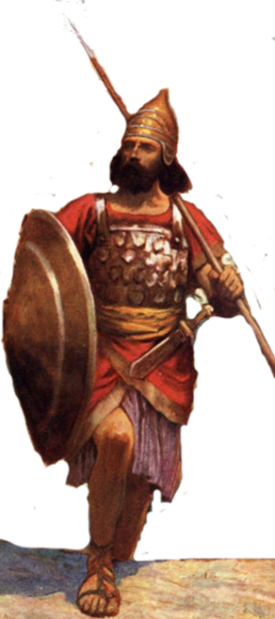
Resting in the land
Living the land
Distributing
the land
Joshua
24:29-33
Conquering the land
Joshua
13-21
Joshua
22-24
Claiming the land
Joshua
6-12
Joshua
1-5
Notes:
I. Claiming the Land (1:1–5:15)
II. Conquering the Land (6:1–12:24)
III. Distributing the Land (13:1–21:45)
IV. Living in the Land (22:1–24:28)
V. Resting in the Land (24:29–33)

Slide 4


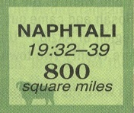
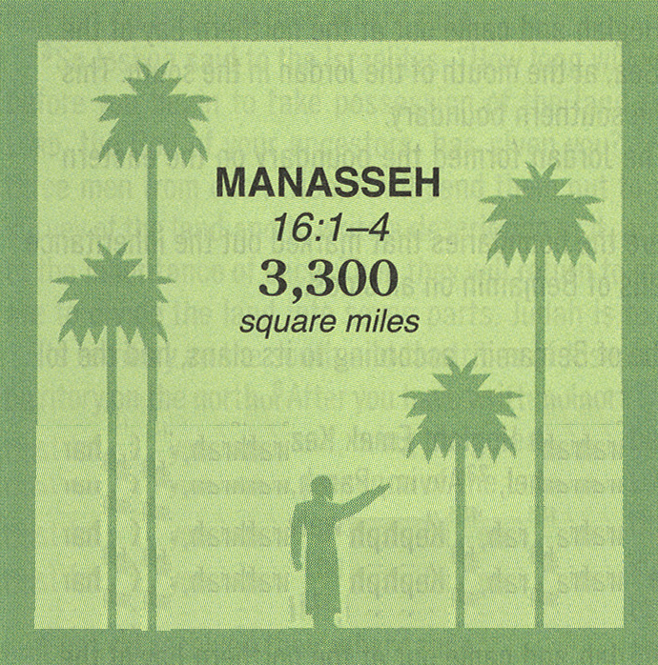
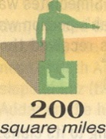


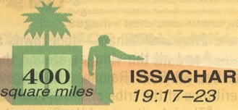



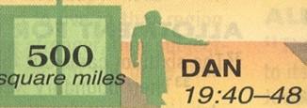
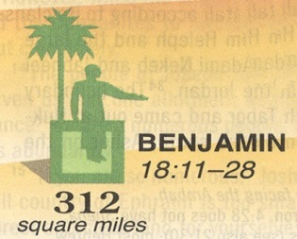
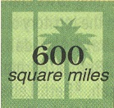



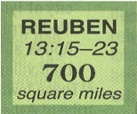

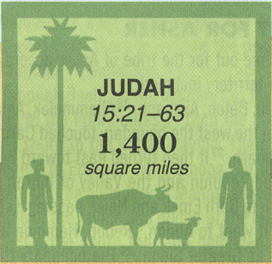
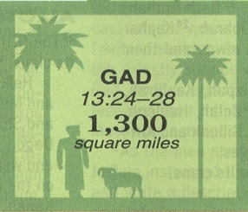
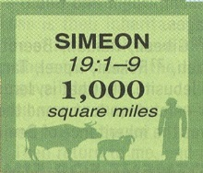
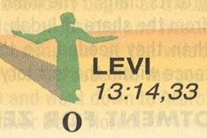
By Location
29 in
26 in
52700
Men
26 in
53400
Men
63400
Men
45500
Men
16 in
ASHER
19:24-31
24in
60500
Men
24 in
ZEBULUN
19:10-16
64400
Men
20 in
14 in
45600
Men
32500
Men
10 in
EPHRAIM
16:5-10
43700
Men
12 in
BENJAMIN
18:11-28
15 in
9 in
40500
Men
76500
Men
22200
Men

Slide 5
12 in
52700
Men
10 in
20 in
26 in
43700
Men
32500
Men
76500
Men
EPHRAIM
16:5-10
14 in
45600
Men
24 in
9 in
64400
Men
BENJAMIN
18:11-28
22200
Men
26 in
16 in
63400
Men
29 in
45500
Men
53400
Men
15 in
24in
40500
Men
By
Number
60500
Men
ZEBULUN
19:10-16
ASHER
19:24-31

Slide 6
1446-1406 BC
1260-1220 BC
1 Kings 6:1 480 yrs from Temple dedication in 966 BC
Judges 11:26 Jephthah assigns 300 years between his day & the conquest

Slide 7
Dating the Conquest #3
Late Date
Samuel
Saul
David
Solomon
1400 BC
1300 BC
1200 BC
1100 BC
1000 BC
900 BC
480 yrs
1446
~300 yrs
~1100
966
~40 yrs wilderness
Early Date
Dating of Exodus Based on –
1 Kings 6:1
Jephthah’s statement Judges 11:26
Late date shortens the time of the Judges
1 Chron 6:33-37 the 19 Generations for Heman from Moses to Solomon

Slide 8
1446-1406 BC
1260-1220 BC
1 Kings 6:1 480 yrs from Temple dedication in 966 BC
Judges 11:26 Jephthah assigns 300 years between his day & the conquest
Archaeology has found no evidence of widespread destruction
Israelite population in hill country (4-room house)
Jericho has the evidence
Kenyon put it at 1550 BC because no Cypriot Pottery
Bryant says local copies there
Collapse of Late Bronze Age Cities
Iron Age – able to support more people

Slide 9
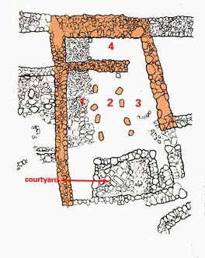
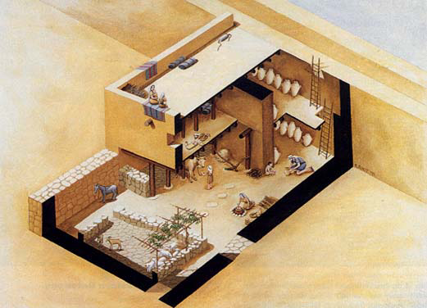
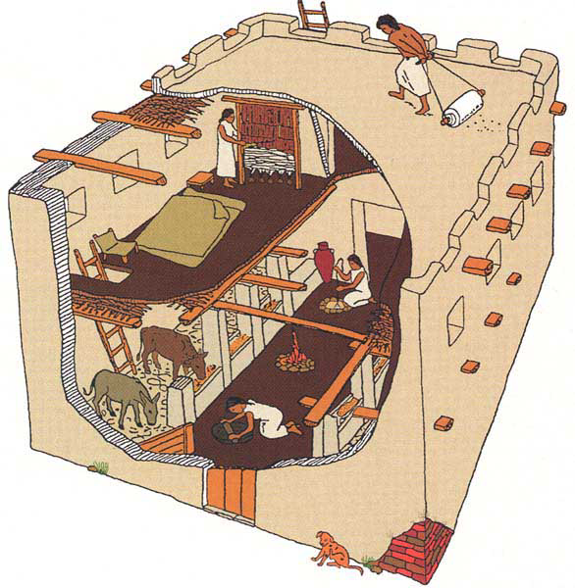
Paving Stones – 8 tons (2 men & donkey)
Ground floor walls -3 ft thick
Perimeter wall portion 7 to 8 ft thick
Total Wall Stones – 280 tons (4 men & donkey an intensive month
for walls + a week for interior walls)
Mortar & Plaster – 14 tons would take
(28 tons of limestone & 28 tons of wood to make mortar)
Wooden Posts and beams – 27 tons of lumber
Ceiling & Roof (15 in) – 14 tons of material
Mud brocks for 2nd floor walls – 2000 bricks (124 tons of clay)
The transitional period between the Late Bronze Age and the early Iron Age (the late 13th to early 12th centuries B.C.E.) is represented at ‘Umayri by two settlements: a short-lived one that was destroyed by an earthquake around 1200 B.C.E.† and a rebuilt town with beautifully preserved houses and a fortification system. We know very little about the earlier settlement except for its pottery, which was found in layers that date to before the earthquake. † The evidence for the earthquake is very clear: collapsed slabs of bedrock and rapidly deposited fills in open fissures in the ground.
Editor, Hershel Shanks: BAR 27:02 (March/April 2001). Biblical Archaeology Society, 2004; 2004
Israelite House about
1200 BC from tribe of Reuben at beginning
Of Iron Age 1
= ~470 tons
Notes:
Rhonda Root/Madaba Plains Project
Excavators have uncovered an early example of a four-room house, a type of domestic dwelling often associated with the Israelites and found only infrequently east of the Jordan River. The cutaway drawing allows us to look into ‘Umayri’s Building B, the best-preserved Iron Age I four-room house from anywhere in the Levant. The two-story structure was divided into three long rooms by two rows of pillars, and a broad room spanned the back of the house (see photo and plan, opposite). The first floor was given over to animals and to food storage. The inhabitants, probably three generations of an extended family, ate, entertained and slept on the second floor (and possibly on the roof).
Editor, Hershel Shanks: BAR 27:02 (March/April 2001). Biblical Archaeology Society, 2004; 2004
The Four-Room House: What It Took to Get It Built
By Douglas R. Clark
Building a home for an extended family during Iron Age I (1200–1000 B.C.E.) was a huge task. An analysis of Building B, the well-preserved four-room house at ‘Umayri, shows just how large an investment in manpower and material was needed to assemble such a structure. We know because we have been restoring the first story of Building B and plan to build a full-size replica of it to use as a visitor center.
Let’s look at what went into each component of the house.
Floor
Building B had two types of floors: stone and beaten earth. Stone floors, not surprisingly, required greater labor, including finding and gathering flat stones, hauling them to the house and installing them carefully so they would be even. It would have taken at least two men and a donkey to locate, transport and lay the stones. The paving stones in Building B together weighed 8 tons. The sections of the floor that were of beaten earth consisted of finely laminated layers of ash and clay. Although this part of the floor would not have required as much effort to build as the stone floor, it still would have needed a fair bit of expertise and labor to make it level and smooth.
Walls
The exterior stone walls at ground level were about 3 feet thick. The exterior wall of the broad room, however, was between 7 and 8 feet thick, since it was built against, and formed part of, the perimeter wall of the city and served to thicken the city’s defenses. The stones ranged from small field stones to large boulders; they had been either transported from the surrounding slopes or reused from earlier structures at the site. The wall was chinked with cobbles to give it more stability. Raouf Abujaber, a local historian and landowner, estimates that it would take four men and a donkey about a month of intensive labor to collect the stones and to erect the first-story exterior walls. The interior walls and the animal pen would take another week. The stones in the walls weighed more than 280 tons.
Mortar and Plaster
Stable and smooth walls required mortar and plaster, which required lime, not an easy product to manufacture. Laborers had to carve large kilns in a hillside and fill them with wood and limestone; it took three to six days of continuous burning at 900 degrees centigrade to turn the stone into lime. Two tons of limestone and two tons of chopped wood were needed to produce one ton of lime. The mortar and plaster in the house weighed about 14 tons.
Supports
Large wooden posts, capable of bearing many tons of weight, supported the house’s second story. The ancient builders had to locate, fell, transport, trim and securely install these posts. Much lumber was also needed for beams spanning walls and posts and for branches to give additional support to the first-floor ceiling and the roof. All this lumber would have weighed 27 tons.
Ceiling and Roof
Small branches served as the base of the house’s two ceilings. Above the first-story ceiling these branches supported 8 to 10 inches of clay and mud mixed with sand, charcoal, ash and other types of temper; the second-story ceiling, because it also served as the roof, had a mixture 15 inches thick. The material in the two ceilings weighed about 14 tons.
Mudbrick Walls
The walls of the second story and the parapets were built entirely of large mudbricks measuring about 20 by 16 by 6 inches. The mudbricks were laid with mortar and were evidently plastered to form smooth, finished surfaces. Making the bricks required digging, collecting and transporting the clay, mixing the wet clay with straw or dung (about 130 pounds of straw were needed per 100 bricks), molding the bricks and laying them in place. The ‘Umayri house contained more than 2,000 bricks, which weighed 124 tons.
The total weight of the four-room house? About 470 tons!
Our partial reconstruction of the four-room house is part of a wider restoration project at ‘Umayri. The first phase of the project involved consolidating the stone walls of Building B. We then rebuilt the first story to show visitors what the structure originally looked like. For the sake of low maintenance, we used old utility poles as posts and beams (covering them with branches to give them a more authentic look), and we used concrete imitations to recreate the ceiling and mudbricks. In the next phase, undertaken just this past summer, we drew up plans for a platform from which visitors can view the site, and we installed fences, walls and a guardhouse to protect against grazing animals and would-be looters. The last and most ambitious phase calls for a full-size replica of the four-room house, which will serve as a visitor center, and the installation of directional signs to the site and interpretive labels at the site itself. Initial funding came from Jordanian royal and government sources, as well as from foreign sources, but the remainder—about $100,000—has to be raised by our project. If you would like to support us, write to Douglas Clark, Walla Walla College, College Place, WA 99234 (e-mail: clardo@wwc.edu). Contributions are tax deductible in the United States and Canada. For more photos and information, visit our Web site at http://mpp.wwc.edu.
Shanks, H. (Ed.). (2001). BAR 27:02 (March/April 2001).

Slide 10
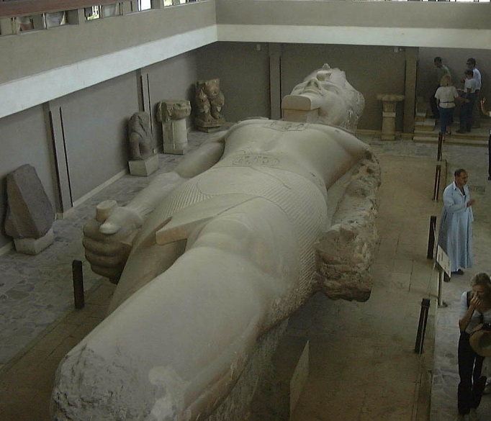
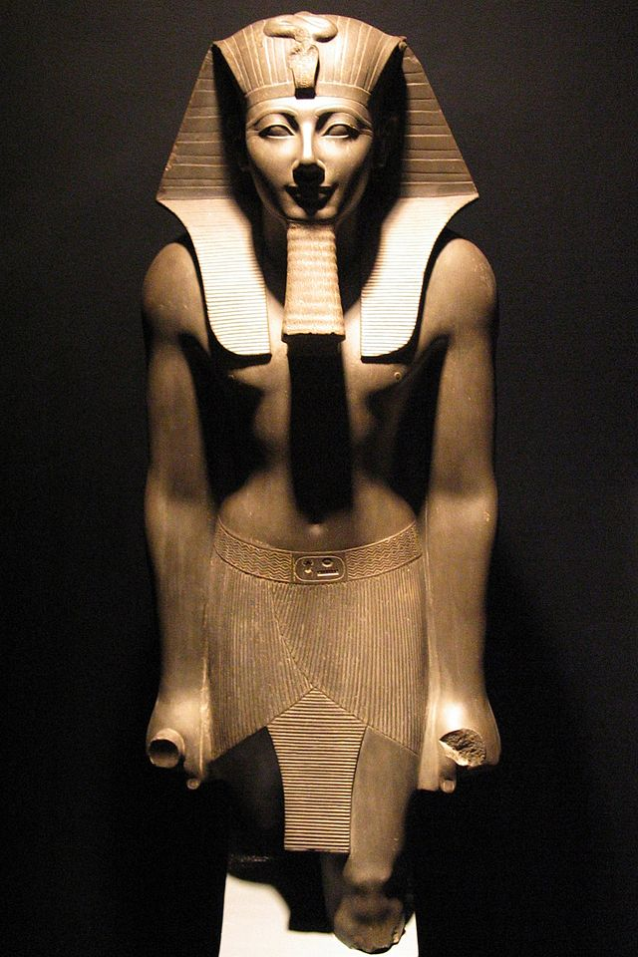
1446-1406 BC
1260-1220 BC
Pharaoh to reign for 40 yrs while Moses in wilderness – Thutmose III?
Pharaoh to reign for 40 yrs while Moses in wilderness – Rameses II?
Sixth Pharaoh of the Eighteenth Dynasty ruled for 54 years. During the first twenty-two years of Thutmose's reign he was co-regent with his stepmother and aunt, Hatshepsut, who was named the pharaoh
Known as Ramesses the Great, was the third pharaoh of the Nineteenth Dynasty of Egypt. He is often regarded as the greatest, most celebrated, and most powerful pharaoh of the Egyptian Empire he ruled 69 yrs

Slide 11
1446-1406 BC
1260-1220 BC
1 Kings 6:1 480 yrs from Temple dedication in 966 BC
Judges 11:26 Jephthah assigns 300 years between his day & the conquest
Archaeology has found no evidence of widespread destruction
Israelite population in hill country (4-room house)
Pharaoh to reign for 40 yrs while Moses in wilderness – Thutmose III
Pharaoh to reign for 40 yrs while Moses in wilderness – Rameses II
Amarna Tablets (~1350) from cities not in Israelite control – Habiru could be Hebrew
Habiru can not be identified with Israelites

Slide 12
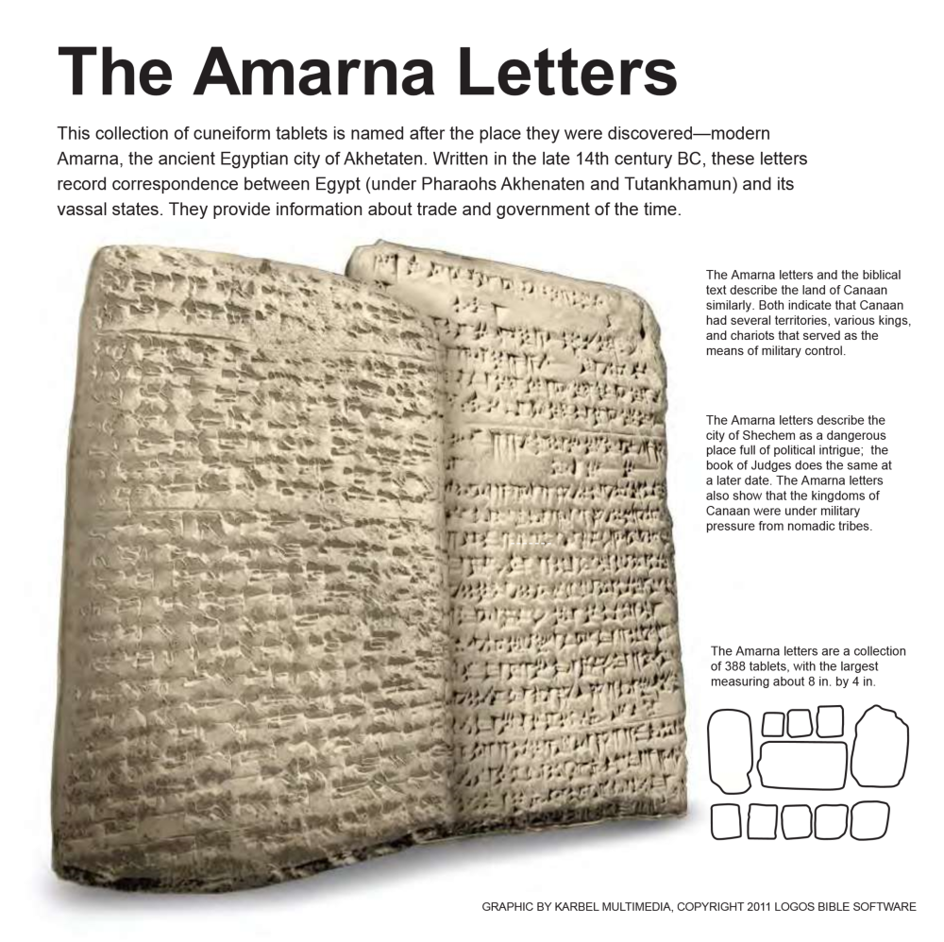
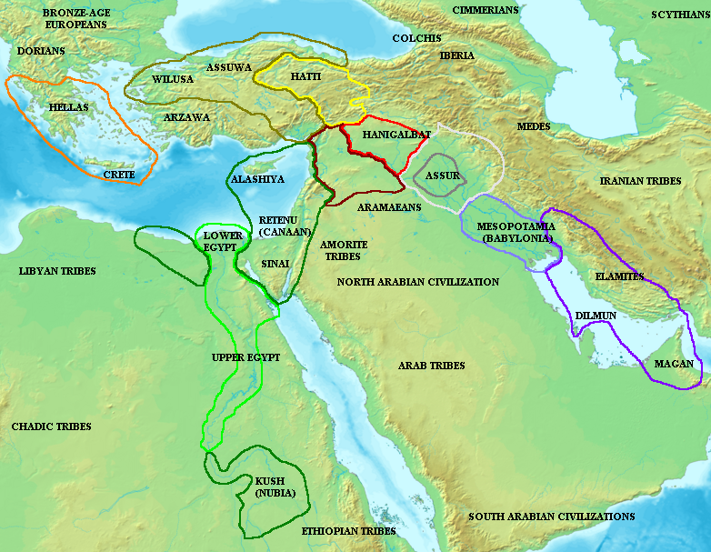
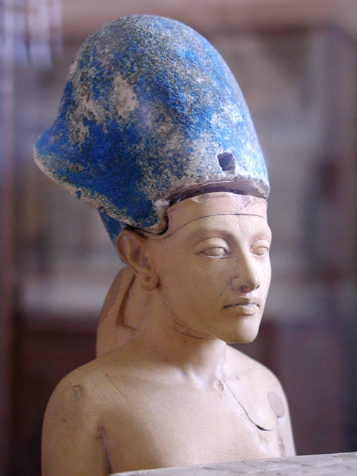
Akhenaten is thought to have been born 1379 BC or 1362 BC.
He succeeded his father in 1367 BC or 1350 BC at the age of twelve.
He reigned from 1367 BC to 1350 BC
or from 1350 BC/1349 BC
to 1334 BC/ 1333 BC
during the Eighteenth Dynasty.

Slide 13
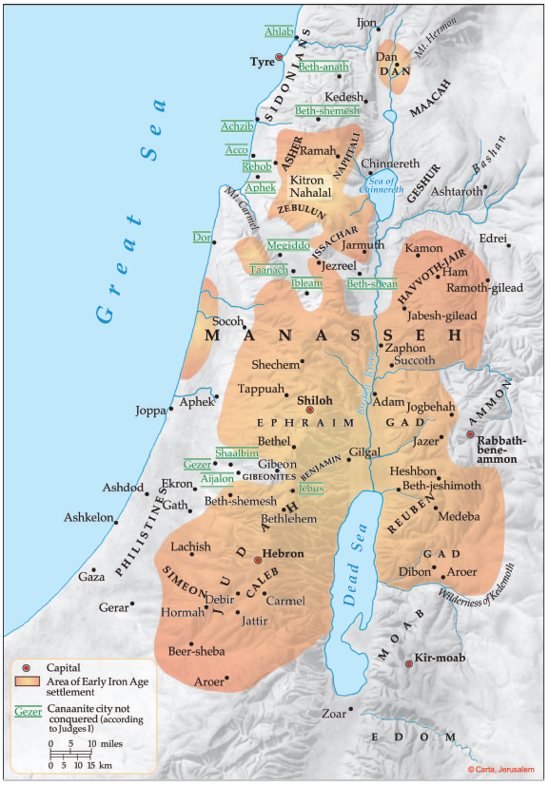
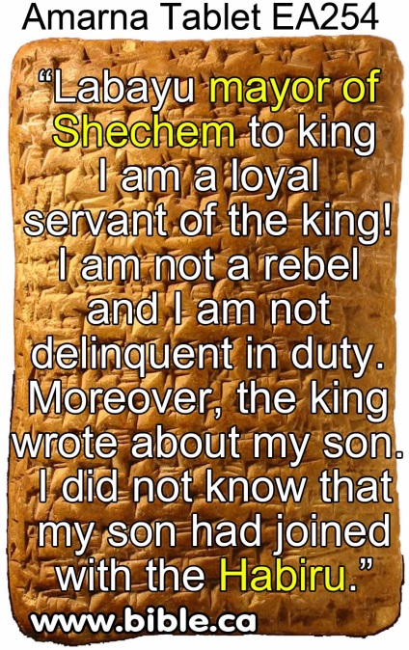
Acco
232-234
235+327
Hazor
227-228
Gath Padalla
249-250
Megiddo
242-248
365
Beth Shan 0
Gezer
292-294
267-277
297-300
378
Pella
255-256
Gath
63-65
278-284
335, 366
Shechem
252-254
Jerusalem
285-291
Ashkelon 320-326
Jericho 0
Gaza 0
Hebron 0?
Lachish
328-332

Slide 14
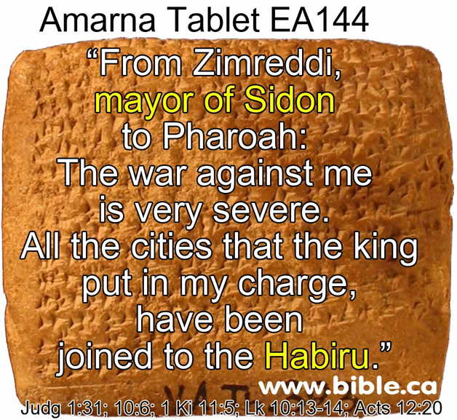
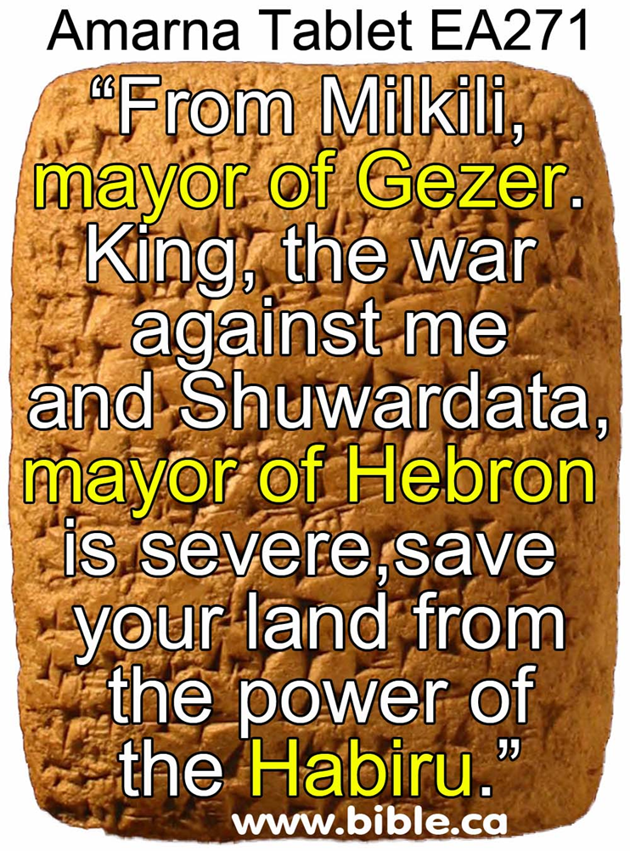

Slide 15
1446-1406 BC
1260-1220 BC
1 Kings 6:1 480 yrs from Temple dedication in 966 BC
Judges 11:26 Jephthah assigns 300 years between his day & the conquest
Archaeology has found no evidence of widespread destruction
Israelite population in hill country (4-room house)
Pharaoh to reign for 40 yrs while Moses in wilderness – Thutmose III
Pharaoh to reign for 40 yrs while Moses in wilderness – Rameses II
Amarna Tablets (~1350) from cities not in Israelite control – Habiru could be Hebrew
Habiru can not be identified with Israelites
Days of the Judges not an issue
Merneptah Stela 1220 BC mentions defeating Israel the nation – little time

Slide 16
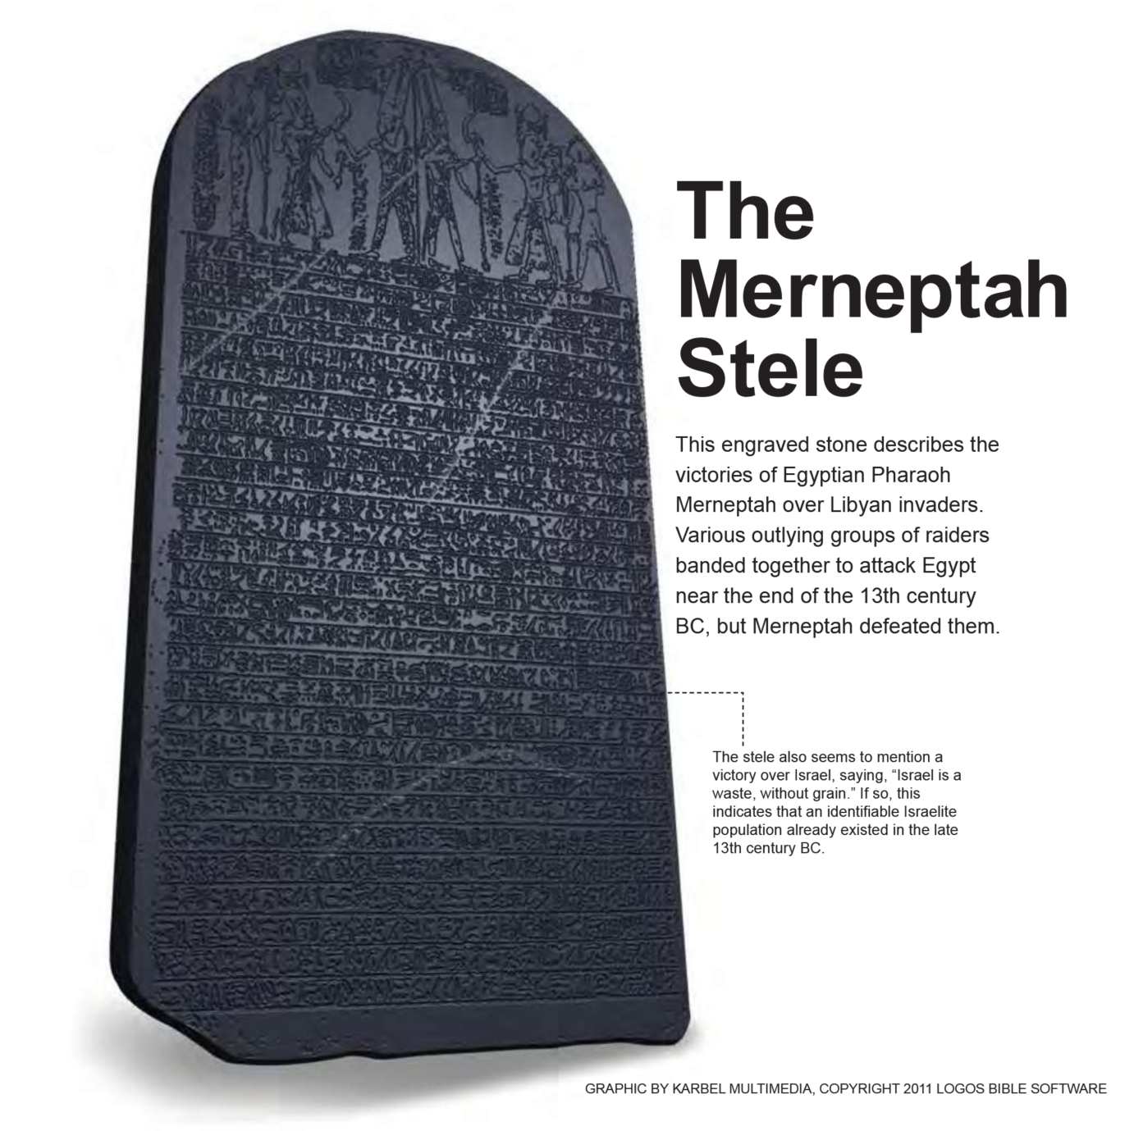
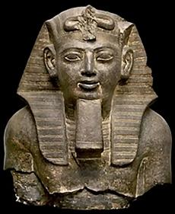

Slide 17
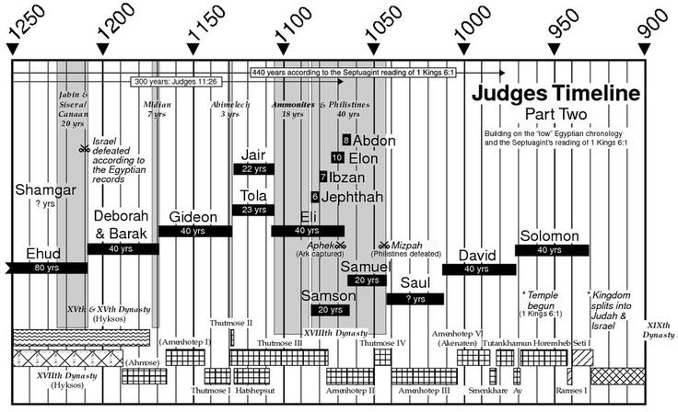
1446-1406 BC
1260-1220 BC
Adequate time to fit Judges into time period of 1370 to 1010 BC
Difficult to fit Judges into shorten time period of 1200 to 1050 BC

Slide 18
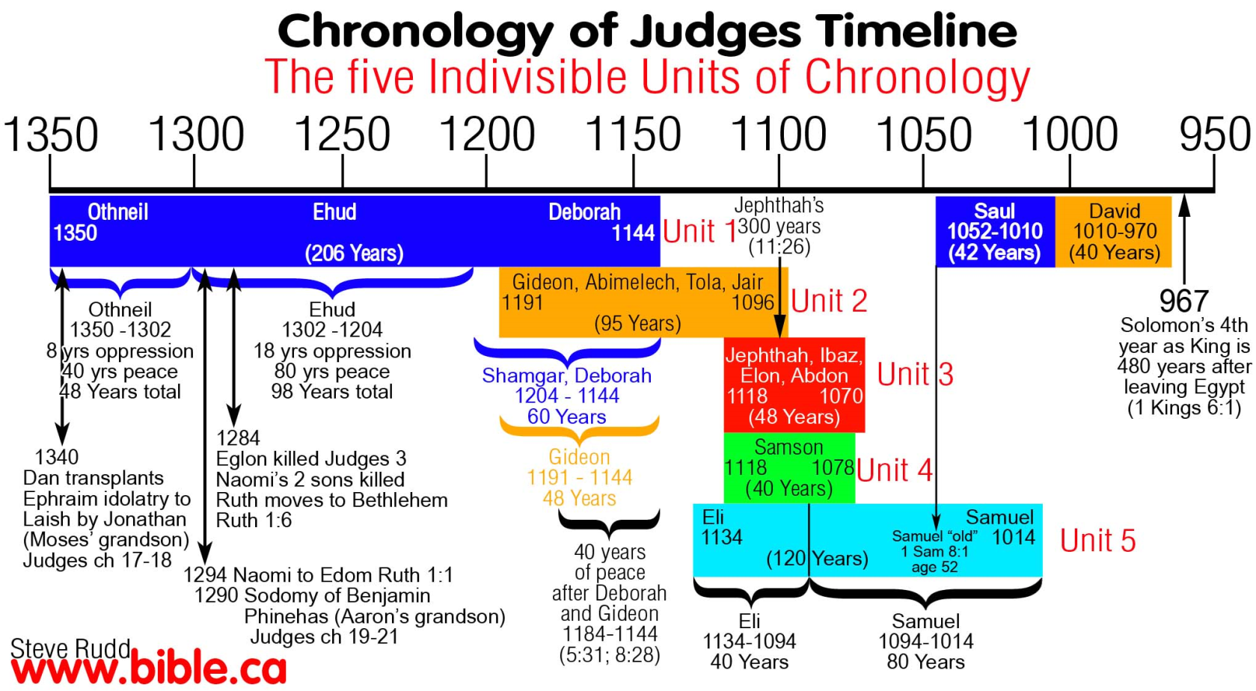
1446-1406 BC
1260-1220 BC
Adequate time to fit Judges into time period of 1350 to 1050 BC
Difficult to fit Judges into shorten time period of 1200 to 1050 BC

Slide 19
1446-1406 BC
1260-1220 BC
Adequate time to fit Judges into time period of 1370 to 1010 BC
Difficult to fit Judges into shorten time period of 1200 to 1050 BC
City being built in days before birth of Moses – Rameses used earlier than 1300
Exodus 1:11 says Israelites building city of Ramses, Pharaoh of Exodus
430 yrs in Egypt fits with fall of Hyksos rise of Pharaohs did not know Joseph
Hyksos not part of the discussion – Whole time under New Kingdom
1446 BC+ 430yrs = 1876 BC Entering Egypt
Hyksos/Semites rule from 1786 to 1580BC

Slide 20
1446-1406 BC
1260-1220 BC
Adequate time to fit Judges into time period of 1370 to 1010 BC
Difficult to fit Judges into shorten time period of 1200 to 1050 BC
City being built in days before birth of Moses – Rameses used earlier than 1300
Exodus 1:11 says Israelites building city of Ramses, Pharaoh of Exodus
430 yrs in Egypt fits with fall of Hyksos rise of Pharaohs did not know Joseph
Hyksos not part of the discussion – Whole time under New Kingdom
Land of the Philistines not conquered-
Joshua 2:2-3 (1200 BC)
Philistines arrival fit in times of the Conquest
Hittite texts from the reign of King Suppiluliumas (1380-1340 BC) indicate that a migration of people had already taken place from Asia minor (modern Turkey) into the Levant
Charles River - The Sea Peoples: The Mysterious Nomads Who Ushered in the Iron Age

Slide 21
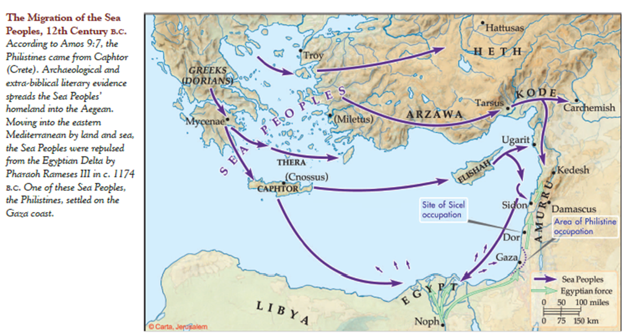

Slide 22
1446-1406 BC
1260-1220 BC
Adequate time to fit Judges into time period of 1370 to 1010 BC
Difficult to fit Judges into shorten time period of 1200 to 1050 BC
City being built in days before birth of Moses – Rameses used earlier than 1300
Exodus 1:11 says Israelites building city of Ramses, Pharaoh of Exodus
430 yrs in Egypt fits with fall of Hyksos rise of Pharaohs did not know Joseph
Hyksos not part of the discussion – Whole time under New Kingdom
Land of the Philistines not conquered-
Joshua 2:2-3 (1200 BC)
Philistines arrival fit in times of the Conquest
Israel not mentioned in Palestine invasions of Seti I & or Ramses II
Israel not there so no mention
Adequate time to fit Judges into time period of 1370 to 1010 BC
Hazor burned only once – not Joshua & Deborah & Barak

Slide 23
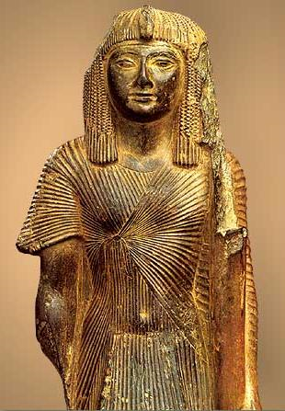
Seti I about 1289 BC
Ramses II passes thru to fight Hittite
Wenamon traveled Levant about 1180 BC
Egyptians avoid region of Israel

Slide 24
Joshua Timeline
This is your allotment
Joshua 23
¹A long time afterward, when the Lord had given rest to Israel from all their surrounding enemies, and Joshua was old and well advanced in years,
²Joshua summoned all Israel, its elders and heads, its judges and officers, and said to them, “I am now old and well advanced in years.
Joshua 24
¹Joshua gathered all the tribes of Israel to Shechem and summoned the elders, the heads, the judges, and the officers of Israel. And they presented themselves before God.
²⁹After these things Joshua the son of Nun, the servant of the Lord, died, being 110 years old.
Joshua 13
¹Now Joshua was old and advanced in years, and the Lord said to him, “You are old and advanced in years, and there remains yet very much land to possess. ²This is the land that yet remains: all the regions of the Philistines, and all those of the Geshurites
Only allot the land to Israel for an inheritance, as I have commanded you.
⁷Now therefore divide this land for an inheritance to the nine tribes and half the tribe of Manasseh.”
Joshua 14
⁶Then the people of Judah came to Joshua at Gilgal. And Caleb ... ‘Surely the land on which your foot has trodden shall be an inheritance for you and your children forever, because you have wholly followed the Lord my God.’ ¹⁰And now, behold, the Lord has kept me alive, just as he said, these forty-five years since the time that the Lord spoke this word to Moses, while Israel walked in the wilderness. And now, behold, I am this day eighty-five years old.
How long are you going to wait
Judges 1
¹After the death of Joshua, the people of Israel inquired of the Lord, “Who shall go up first for us against the Canaanites, to fight against them?” - Judah
Joshua 18
¹Then the whole congregation of the people of Israel assembled at Shiloh and set up the tent of meeting there. The land lay subdued before them.
²There remained among the people of Israel seven tribes whose inheritance had not yet been apportioned.

Slide 25
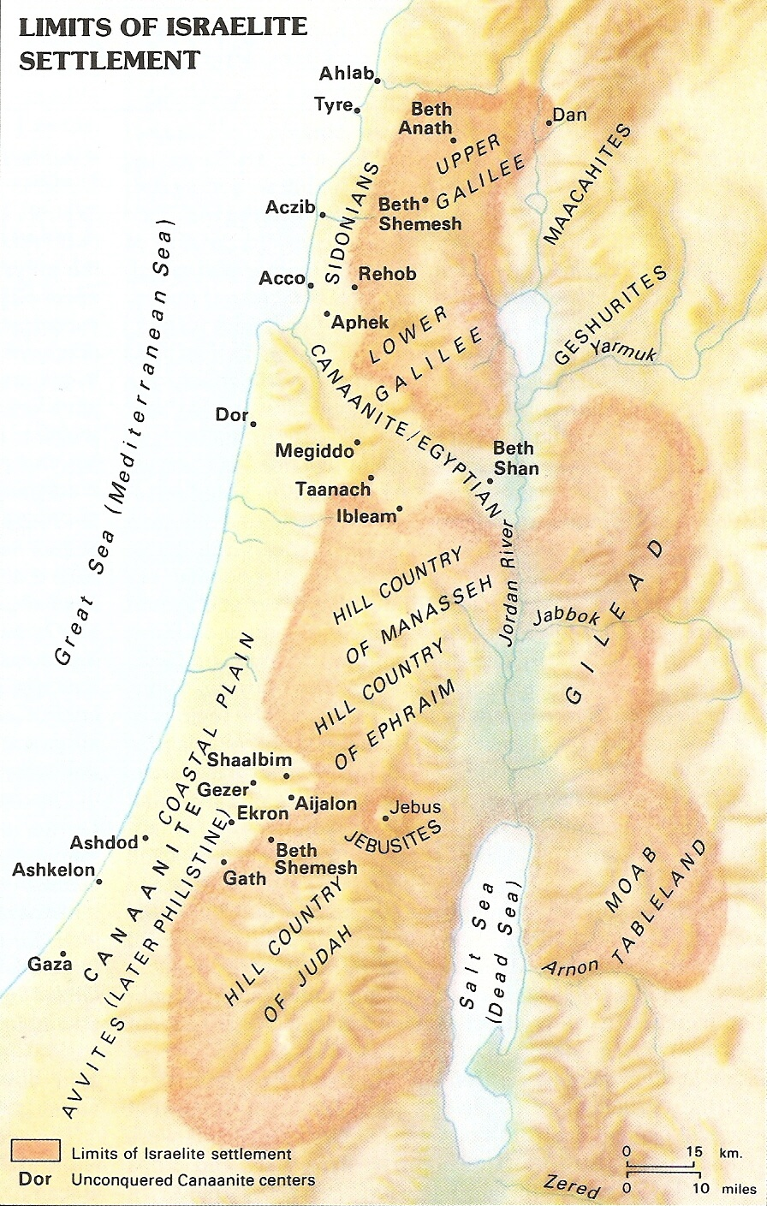
BENJAMIN – did not drive out the Jebusites who live in Jerusalem… Jdg 1:21
JUDAH – ‘but he could not drive out the inhabitants of the plain because they had chariots of iron’. Jdg 1:19
MANASSEH – did not drive out the inhabitants of Beth-shean and its villages, or Taanach…or Dor…or Ibleam…or Megiddo Jdg 1:27 Yet the people of Israel did not drive out the Geshurites or the Maacathites… Josh 13:13
EPHRAIM – did not drive out the Canaanites who lived in Gezer…
ZEBULUN – did not drive out the inhabitants of Kitron…or… Nahalol… Jdg 1:30
ASHER – did not drive out the inhabitants of Acco… or…Sidon… Ahlab… Achzib… Helbah… Aphik.. Rehob… Jdg 1:31
NAPHTALI – did not drive out the inhabitants of Beth-shemesh…or … Beth-anath Jdg 1:33
DAN – When the territory of the people of Dan was lost to them… Josh 19:47

Slide 26
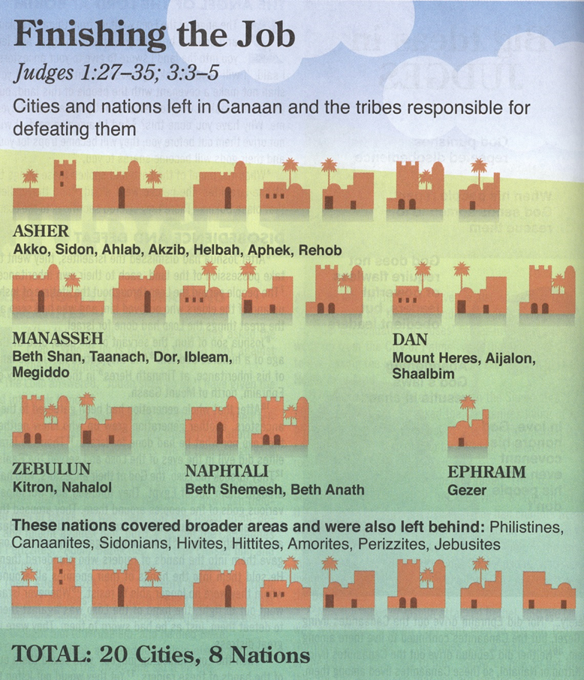

Slide 27
Allotment for
Eastern Tribes – Reuben, Gad, ½ Manasseh
Judah
Ephraim &
½ Manasseh
Much not inhabited

Slide 28
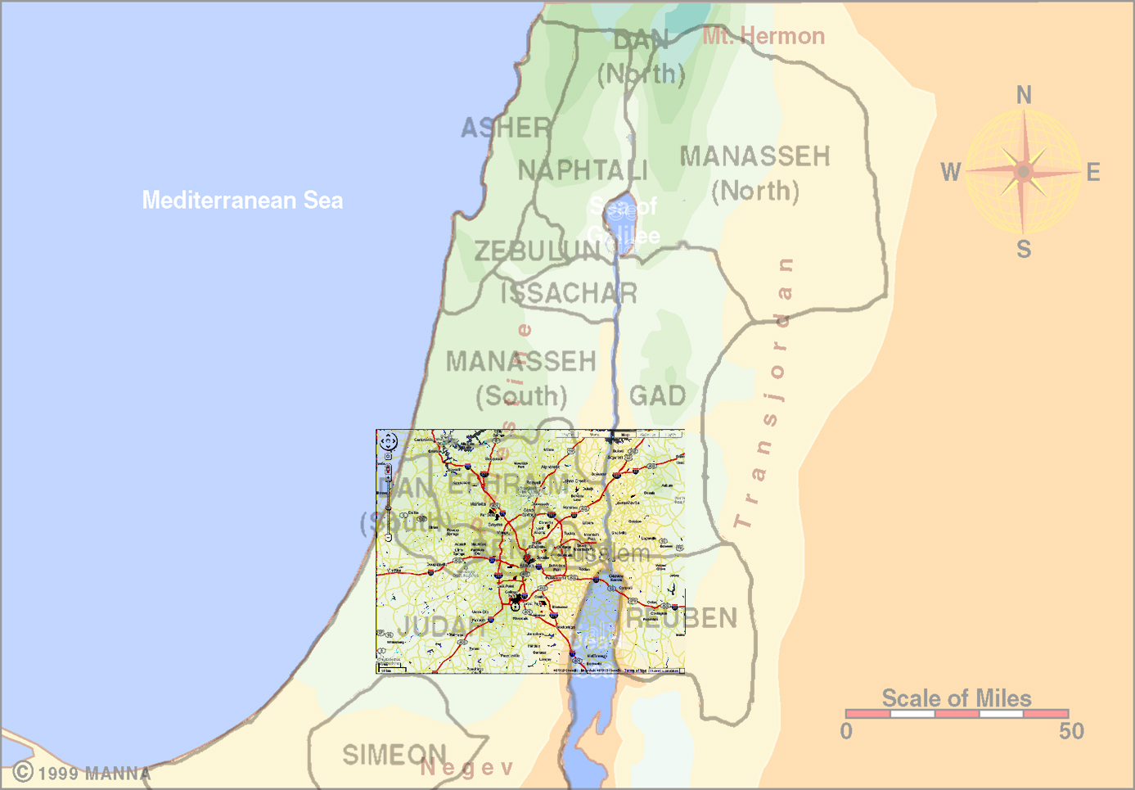
31 County Atlanta
Metropolitan Statistical Area

Slide 29
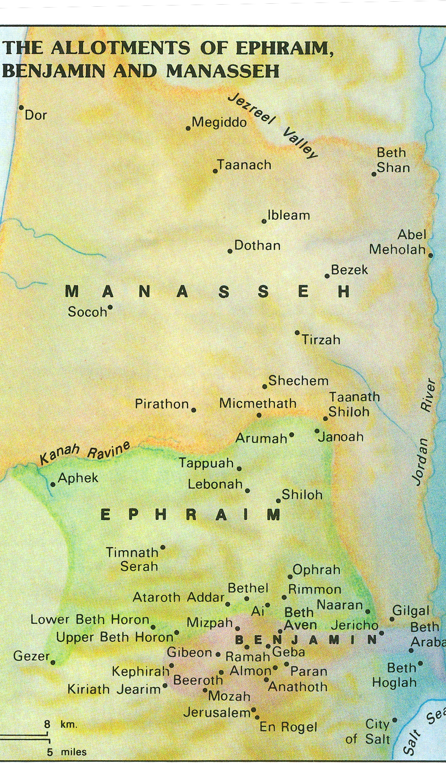
Border – Ephraim
Joshua 16:1-8
going up from Jericho into the hill country to Bethel.
Then going from Bethel to Luz, it passes along to Ataroth, the territory of the Archites.
Then it goes down westward to the territory of the Japhletites, as far as the territory of Lower Beth-horon, then to Gezer, and it ends at the sea.
the boundary of their inheritance on the east was Ataroth-addar
as far as Upper Beth-horon, and the boundary goes from there to the sea.
On the north is Michmethath.
Then on the east the boundary turns around toward Taanath-shiloh and passes along beyond it on the east to Janoah,
then it goes down from Janoah to Ataroth and to Naarah, and touches Jericho, ending at the Jordan.
From Tappuah the boundary goes westward to the brook Kanah and ends at the sea.
Allotment for
Joshua

Slide 30


Border – Ephraim
Joshua 16:1-8
King Defeated
City Burned
☹
Not Driven Out
J
Allotment to Joshua
J
☹

Slide 31
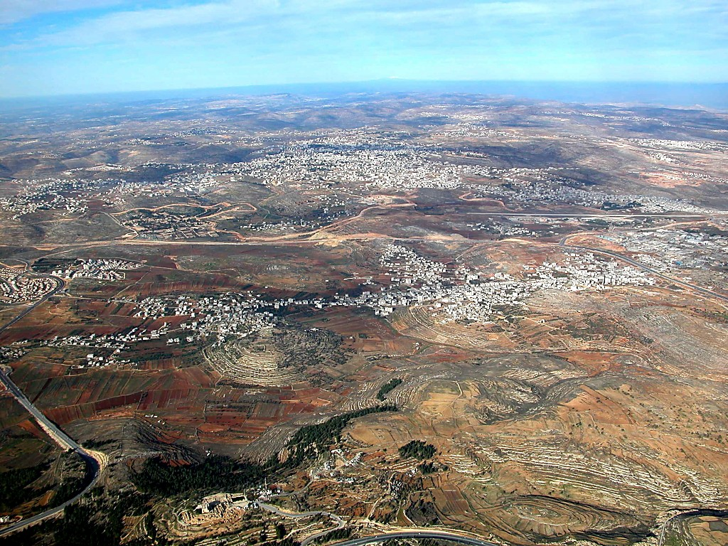
Ephraim
Ramallah/
El-Bireh(=Bethel?)
Mt. Hermon
Beth Horon Ridge
Mizpah
Benjamin
Ramah
Gibeon
Nebi
Samwil
Central Benjamin Plateau aerial from south

Slide 32
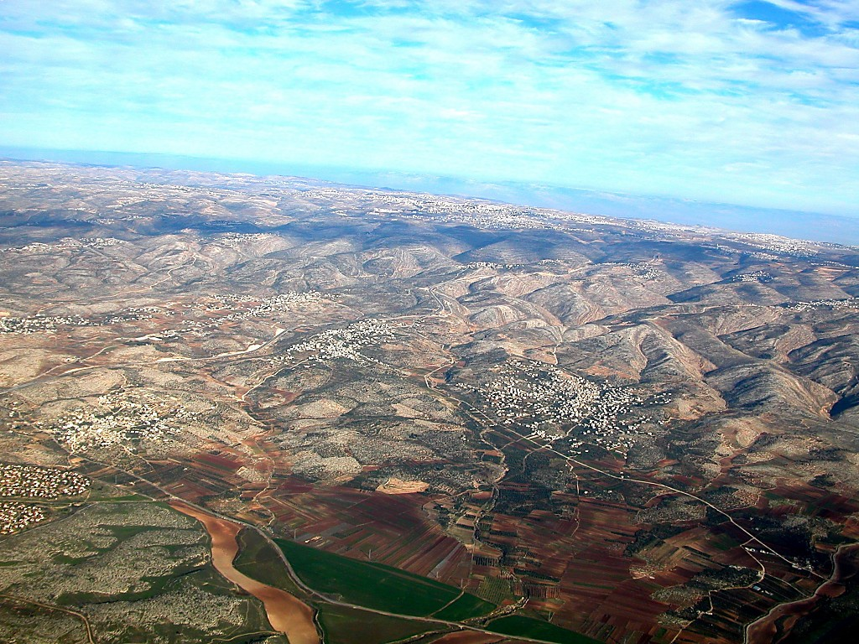
Ephraim
Jordan
Upper Beth Horon
Gibeah of Saul
Lower Beth Horon
Aijalon
Valley
Beth Horon ridge aerial from west

Slide 33
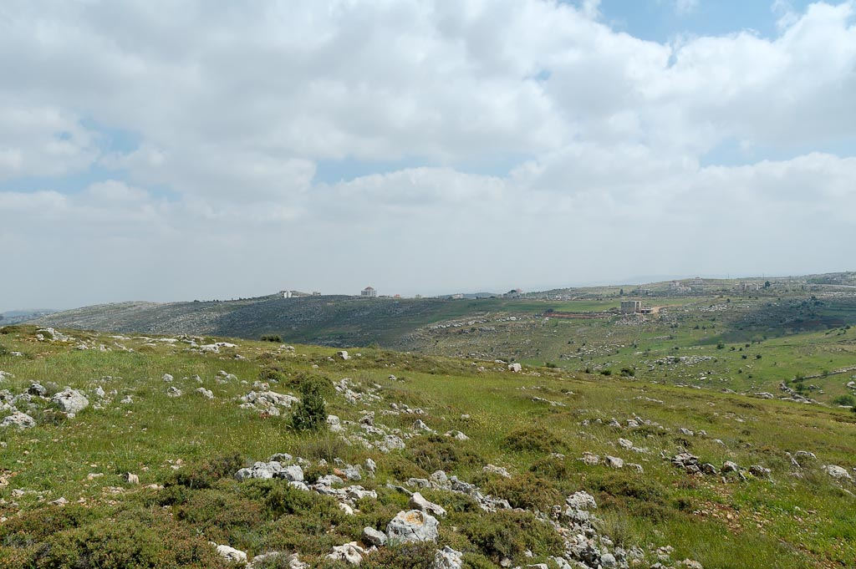
Khirbet el-Maqatir
Et-Tell
Ephraim – Ai/Bethel Region - Khirbet el-Maqatir and et-Tell from north
Notes:
tb041106366

Slide 34
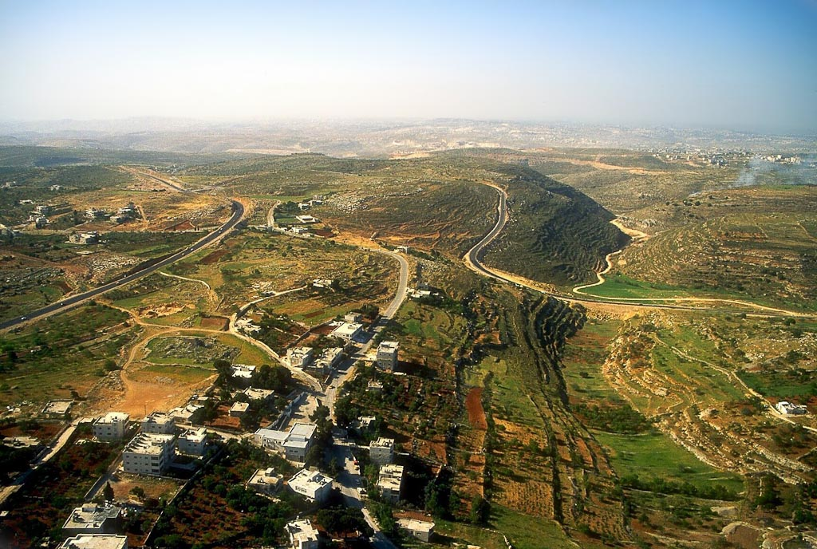
Et-Tell
Khirbet el-Maqatir
(Ai?)
Jerusalem
Wadi Sheban
(Ambush Force)
Khirbet el-Maqatir and Wadi Sheban aerial
Notes:
tbs104369905

Slide 35
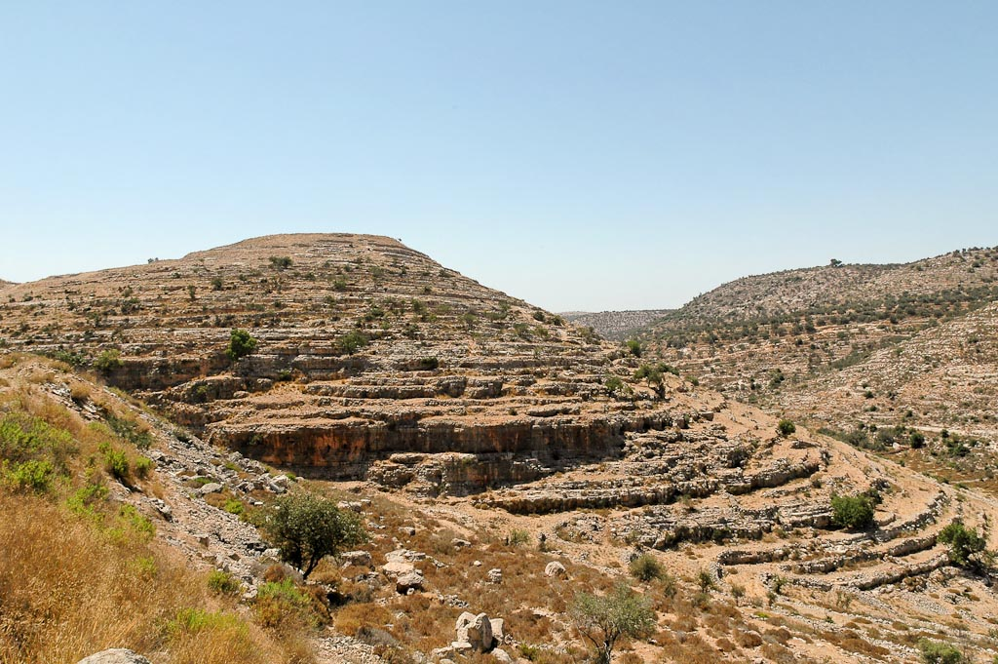
Timnath-serah, Khirbet Tibnah, from east
Notes:
Timnath Serah: Biblical Significance
Timnath Serah is mentioned in Joshua 19:50, 24:30, and Judges 2:9. In the book of Joshua the site goes by the name Timnath Serah, but in the book of Judges it is called Timnath Heres. The site was given to Joshua as his inheritance after the land had been divided among the twelve tribes. Joshua “built the city and settled in it” (Josh 19:50, NASB) and eventually was buried there.
tb071304492

Slide 36
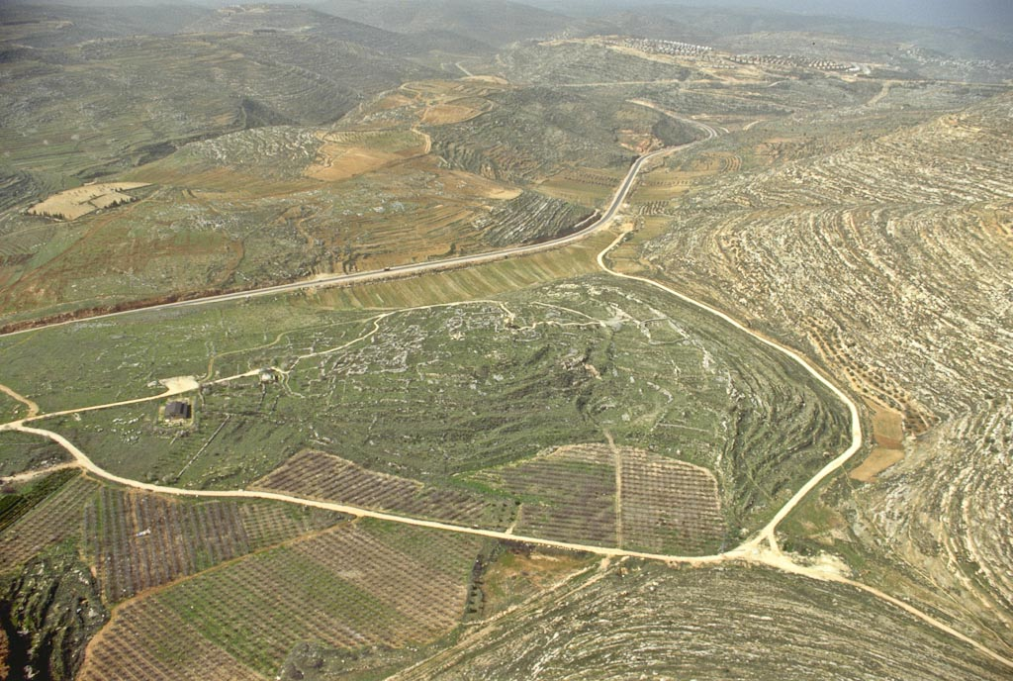
Mosque of
the Orphans
Tel Shiloh
area of
tabernacle
Byzantine basilica
Shiloh aerial from east
Notes:
bb00120068

Slide 37
Beth Horon ridge aerial from west
Jordan
Upper Beth Horon
Gibeah of Saul
Lower Beth Horon
Aijalon
Valley
Beth Horon ridge aerial from east
Notes:
Beth Horon: Geography
The route connects the Central Benjamin Plateau with the Aijalon Valley.
This is the best route to Jerusalem from the west because the climb is long and gradual.

Slide 38
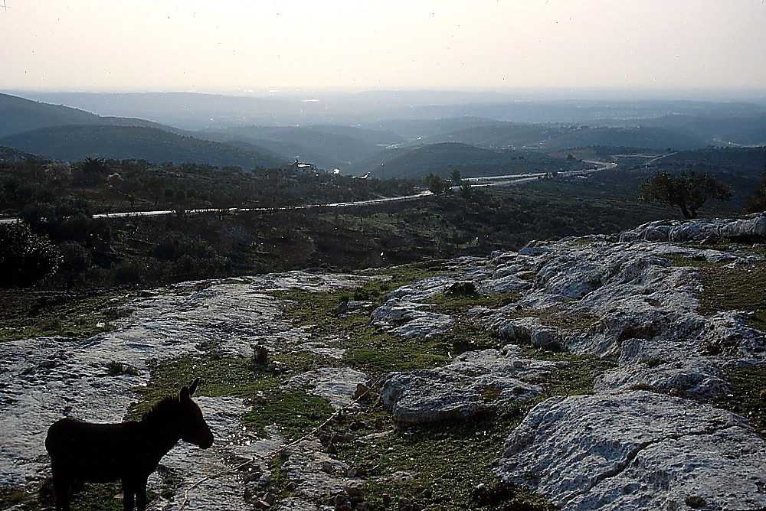
Beth Horon ridge
Beth Horon ridge
Notes:
The Miracle of the Sun Standing Still
The Narrative: The sun stood still over Gibeon and the moon over Aijalon. This event would have occurred at about 10 o’clock in the morning, a couple of weeks after the Passover. “On the day that the LORD gave the Amorites over to Israel, Joshua said to the LORD in the presence of Israel: ‘O sun, stand still over Gibeon, O moon, over the Valley of Aijalon.’ So, that day only, the sun stood still, and the moon stopped, until the nation had avenged itself on its enemies, as it is written in the Book of Jashar. The sun stopped in the middle of the sky and delayed going down about a full day. There has never been a day like it before or since, a day when the LORD listened to a man. Surely the LORD was fighting for Israel!” (Josh 10:12-14, NIV).
Conservative explanations (Miller 1998).
Extension of daylight hours (allowing the battle to continue) [Woudstra in NICOT]
Subjective 'extension' of daylight hours (more a miracle of 'efficiency' than 'nature') [possible conclusion of Keil and Delitzsch]
Semi-darkness during the day due to miraculous hailstorms and cloud covering (maximizing confusion, reducing heat, and divine deliverance) [Madvig in EBC, Walt Kaiser]
Providential battle play-out (the sun always being in the opponents' eyes due to the slope of the enemy's descent) [Gordon]
An eclipse (as an omen, based on ANE usage of the verbs) [R.D. Wilson, Holliday]
Difficulties in explanations (Miller 1998).
The exegetical problems stem from four main factors:
The mixture of poetic and narrative elements.
The mixture of summary statements and detailed event descriptions.
The ambiguity in the word choices describing the astronomical/meteorological events.
The historical setting and the general inability of anyone present to measure time or observe the sun.

Slide 39
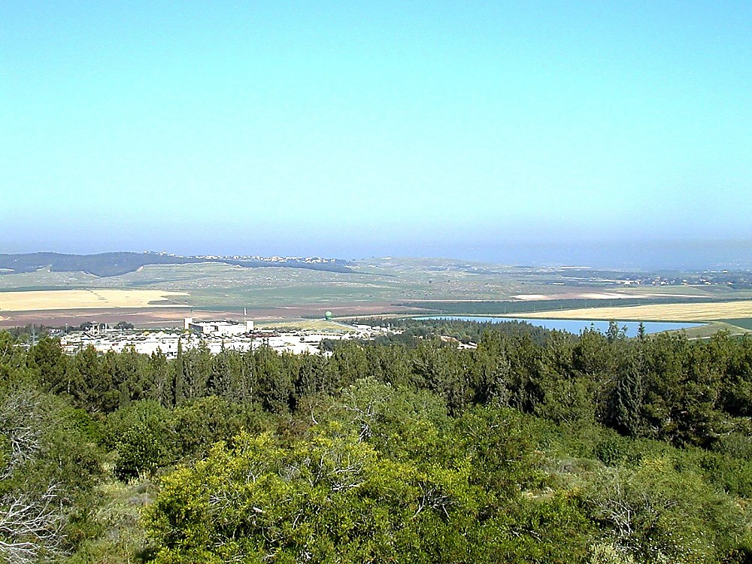
Gezer
Latrun
Aijalon Valley, Latrun and Gezer from Canada Park

Slide 40
Border – Ephraim
Joshua 17
¹⁷Then Joshua said to the house of Joseph, to Ephraim and Manasseh, “You are a numerous people and have great power. You shall not have one allotment only,
¹⁸but the hill country shall be yours, for though it is a forest, you shall clear it and possess it to its farthest borders. For you shall drive out the Canaanites, though they have chariots of iron, and though they are strong.”
X
Notes:
Kings Defeated by Joshua
⁷And these are the kings of the land whom Joshua and the people of Israel defeated on the west side of the Jordan, from Baal-gad in the Valley of Lebanon to Mount Halak, that rises toward Seir (and Joshua gave their land to the tribes of Israel as a possession according to their allotments,
⁸in the hill country, in the lowland, in the Arabah, in the slopes, in the wilderness, and in the Negeb, the land of the Hittites, the Amorites, the Canaanites, the Perizzites, the Hivites, and the Jebusites):
⁹the king of Jericho, one; the king of Ai, which is beside Bethel, one;
¹⁰the king of Jerusalem, one; the king of Hebron, one;
¹¹the king of Jarmuth, one; the king of Lachish, one;
¹²the king of Eglon, one; the king of Gezer, one;
¹³the king of Debir, one; the king of Geder, one;
¹⁴the king of Hormah, one; the king of Arad, one;
¹⁵the king of Libnah, one; the king of Adullam, one;
¹⁶the king of Makkedah, one; the king of Bethel, one;
¹⁷the king of Tappuah, one; the king of Hepher, one;
¹⁸the king of Aphek, one; the king of Lasharon, one;
¹⁹the king of Madon, one; the king of Hazor, one;
²⁰the king of Shimron-meron, one; the king of Achshaph, one;
²¹the king of Taanach, one; the king of Megiddo, one;
²²the king of Kedesh, one; the king of Jokneam in Carmel, one;
²³the king of Dor in Naphath-dor, one; the king of Goiim in Galilee,£ one;
²⁴the king of Tirzah, one: in all, thirty-one kings.

Slide 41
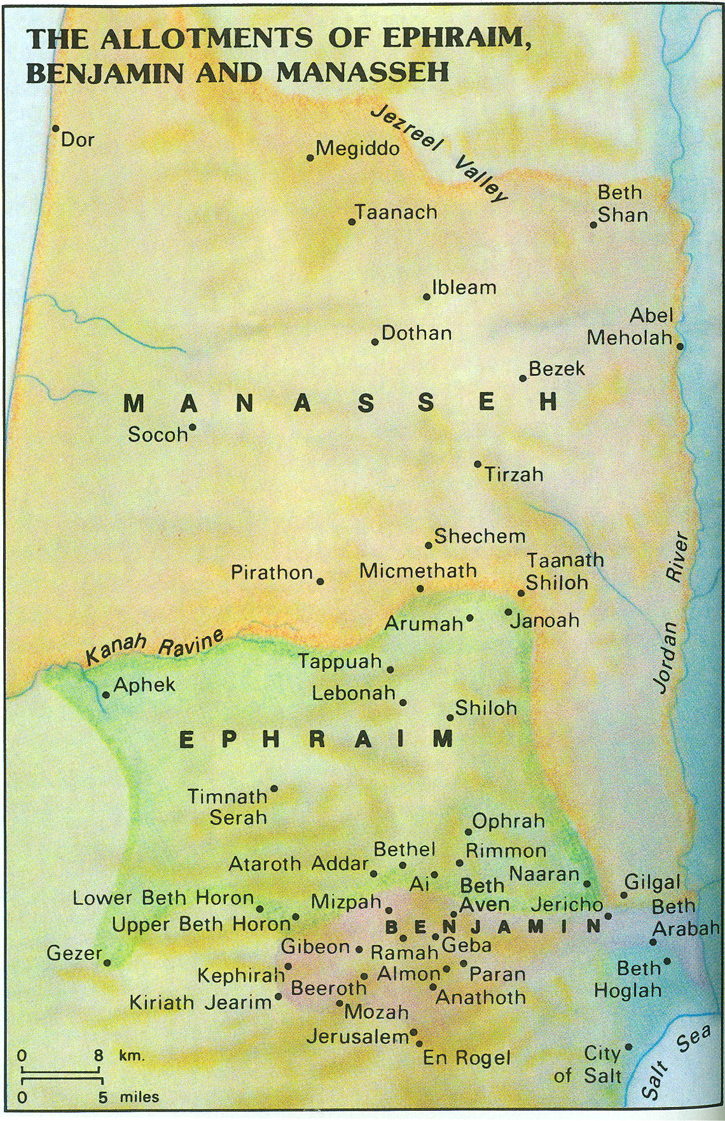
Border – Manasseh
Joshua 17:7-11
Asher
Issachar
The territory of Manasseh reached from Asher to Michmethath, which is east of Shechem.
Then the boundary goes along southward to the inhabitants of En-tappuah. The land of Tappuah belonged to Manasseh, but the town of Tappuah on the boundary of Manasseh belonged to the people of Ephraim. Then the boundary went down to the brook Kanah. These cities, to the south of the brook, among the cities of Manasseh, belong to Ephraim. Then the boundary of Manasseh goes on the north side of the brook and ends at the sea, the land to the south being Ephraim’s and that to the north being Manasseh’s, with the sea forming its boundary.
On the north Asher is reached, and on the east Issachar. ¹¹Also in Issachar and in Asher Manasseh had Beth-shean and its villages,
Ibleam and its villages
the inhabitants of Dor and its villages, and
the inhabitants of En-dor and its villages,
the inhabitants of Taanach and its villages,
inhabitants of Megiddo and its villages; the third is Naphath.

Slide 42
Asher
Border – Manasseh
Joshua 17:7-11
Issachar
☹
☹
☹
☹
King Defeated
☹
City Burned
☹
Not Driven Out
J
Allotment to Joshua
Color or shade in those places where the nations were not driven out
Notes:
Kings Defeated by Joshua
⁷And these are the kings of the land whom Joshua and the people of Israel defeated on the west side of the Jordan, from Baal-gad in the Valley of Lebanon to Mount Halak, that rises toward Seir (and Joshua gave their land to the tribes of Israel as a possession according to their allotments,
⁸in the hill country, in the lowland, in the Arabah, in the slopes, in the wilderness, and in the Negeb, the land of the Hittites, the Amorites, the Canaanites, the Perizzites, the Hivites, and the Jebusites):
⁹the king of Jericho, one; the king of Ai, which is beside Bethel, one;
¹⁰the king of Jerusalem, one; the king of Hebron, one;
¹¹the king of Jarmuth, one; the king of Lachish, one;
¹²the king of Eglon, one; the king of Gezer, one;
¹³the king of Debir, one; the king of Geder, one;
¹⁴the king of Hormah, one; the king of Arad, one;
¹⁵the king of Libnah, one; the king of Adullam, one;
¹⁶the king of Makkedah, one; the king of Bethel, one;
¹⁷the king of Tappuah, one; the king of Hepher, one;
¹⁸the king of Aphek, one; the king of Lasharon, one;
¹⁹the king of Madon, one; the king of Hazor, one;
²⁰the king of Shimron-meron, one; the king of Achshaph, one;
²¹the king of Taanach, one; the king of Megiddo, one;
²²the king of Kedesh, one; the king of Jokneam in Carmel, one;
²³the king of Dor in Naphath-dor, one; the king of Goiim in Galilee,£ one;
²⁴the king of Tirzah, one: in all, thirty-one kings.

Slide 43
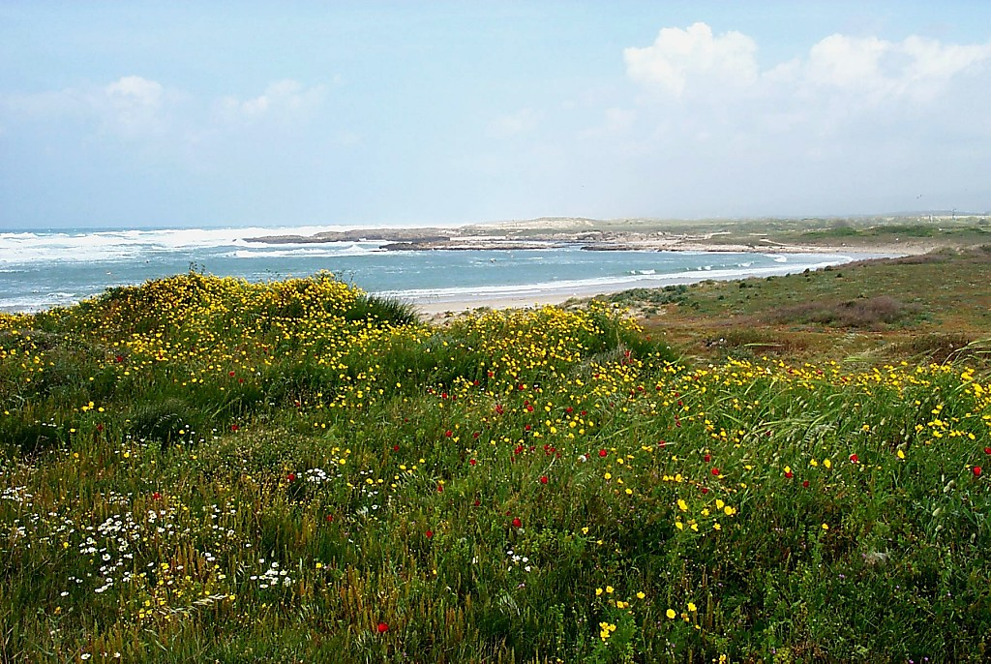
Dor from south
Dor from south
Notes:
Dor
Dor was named after Doros, the son of Poseidon, the sea god.
Dor had four civilizations for inhabitants: the Canaanites, the Sikil, the Phoenicians, and the Hellenistic-Roman culture.
Tel Dor used to be almost surrounded by water. However the lagoon on the east is now blocked with silt. The tell rises over 45 ft above sea level, and 15 percent of the tell has been washed away by the ocean on the west.
Virtually nothing is known of the great, lower city at the base of Tel Dor. The city apparently extended nearly a mile to a sandstone ridge on the east. Cypriot material in the early level of Phoenician occupation during the 11th century B.C. indicates trade relationships between the mainland and one of Phoenicia’s earliest colonies in Cypress.

Slide 44
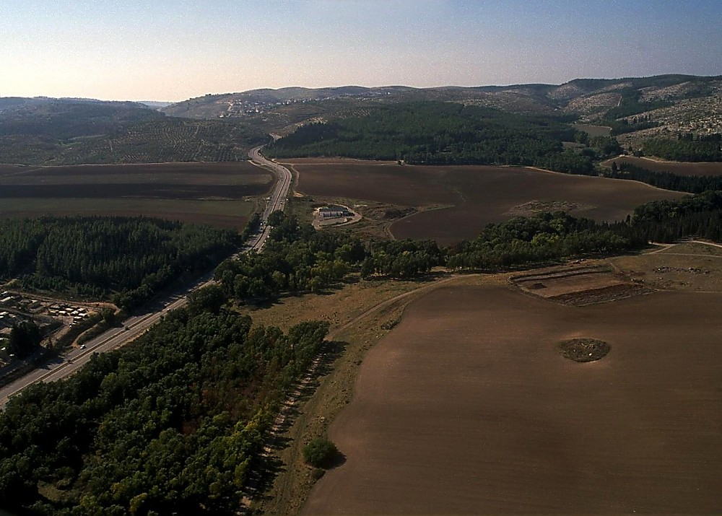
Megiddo pass aerial from northeast
Megiddo pass aerial from northeast
Notes:
The Megiddo Pass
From its earliest mention in the historical records of Thutmose III to the future of Revelation 16, Megiddo is a city of prominence. The tell of Megiddo is very strategically located astride the Megiddo Pass (Wadi Ara) and inside the busy Jezreel Valley. The modern road shown here follows the ancient one, and the tell is just off the bottom right corner of this photograph.

Slide 45
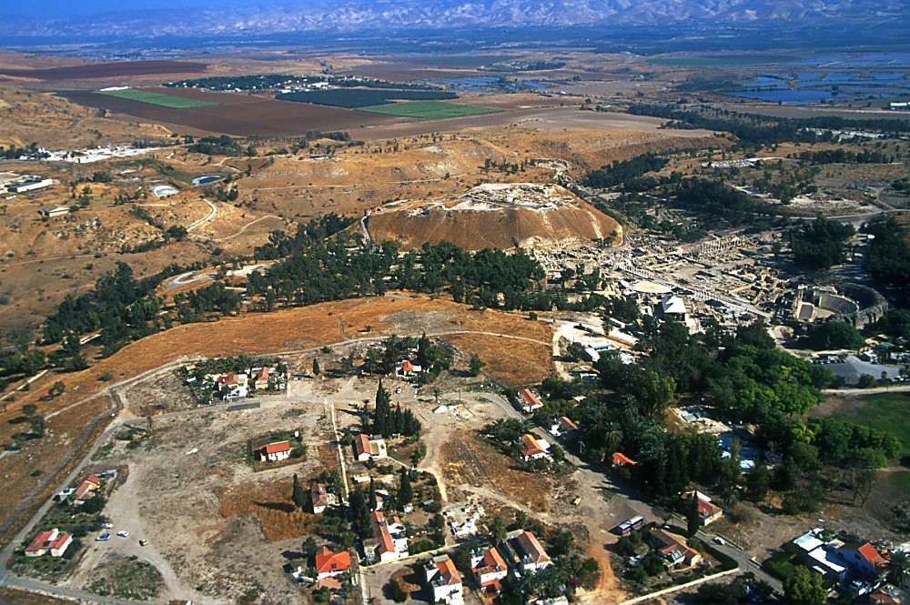
Beth Shean aerial from west
Beth Shean aerial from west
Notes:
Beth Shean Excavations
Excavations were conducted in 1921-33 by the University of Pennsylvania under C. S. Fisher, then A. Rowe, and finally G. M. FitzGerald. At that time, almost the entire top five levels on the summit of the tell were cleared.
Yadin and Geva conducted a short season in the 1980s.
More recently (1989-1996), the tell was excavated by the Hebrew University led by Amihai Mazar.
Over 20 levels of occupation are found at the site beginning in the Early Bronze Age.
The main finds on the tell include a series of temples from the Middle and Late Bronze Ages.

Slide 46
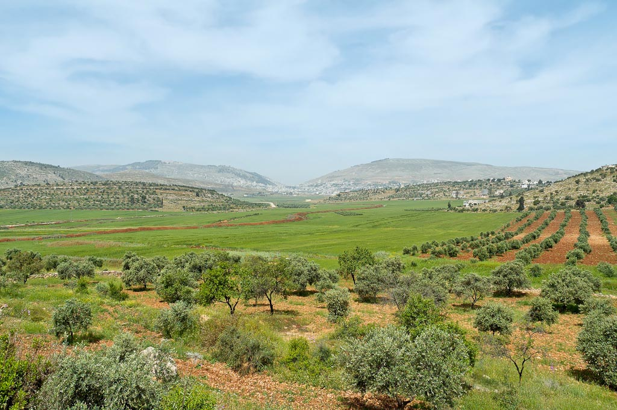
Mount Gerizim, Shechem, and Mount Ebal from east
Notes:
tb050106458

Slide 47
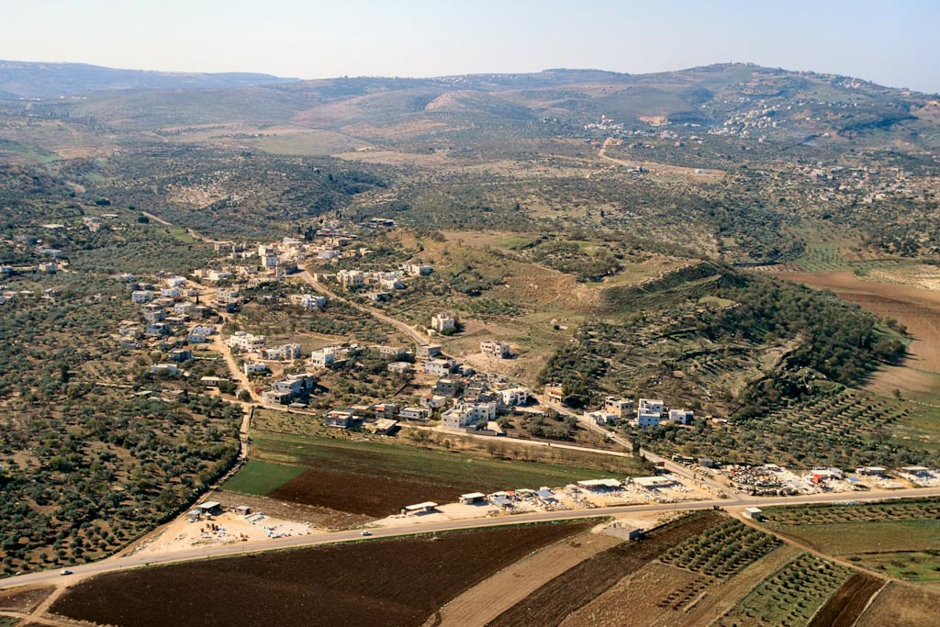
Taanach aerial from north
Notes:
Taanach
The king of Taanach was listed as one of the 31 Canaanite rulers defeated by Joshua (Josh 12:21).
Although Taanach was defeated in the conquest, the tribe of Manasseh failed to drive out the city’s inhabitants (Judg 1:27).
Taanach was the scene of fighting when Deborah and Barak defeated the forces of Sisera (Judg 5:19).
During the time of Solomon, Taanach was governed by Baana, son of Ahilud (1 Kgs 4:12).
tbs120040011

Slide 48
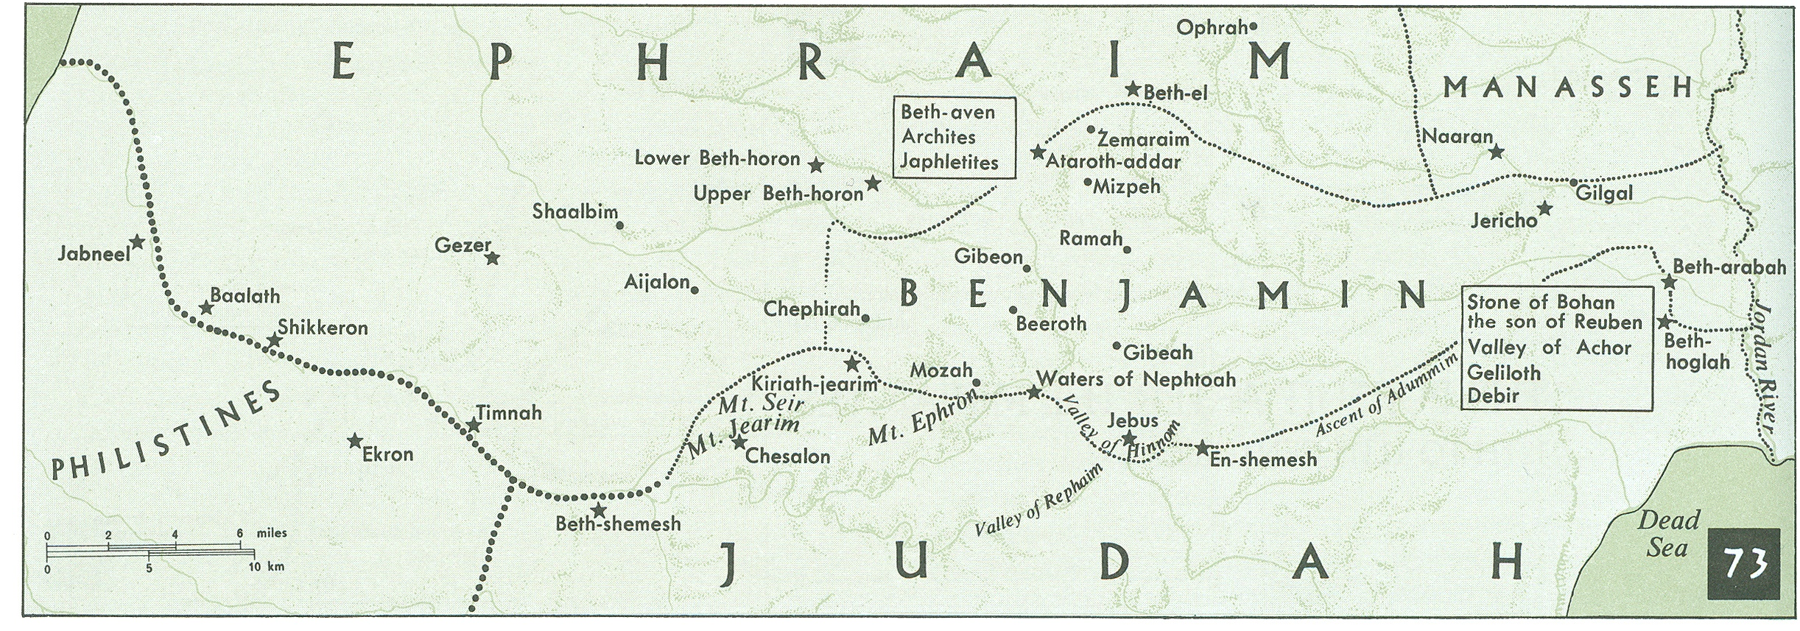
Border – Benjamin
Joshua 18:11-20
¹¹The lot of the tribe of the people of Benjamin according to its clans came up, and the territory allotted to it fell between the people of Judah and the people of Joseph.
¹²On the north side their boundary began at the Jordan. Then the boundary goes up to the shoulder north of Jericho, then up through the hill country westward, and it ends at the wilderness of Beth-aven.
¹³From there the boundary passes along southward in the direction of Luz, to the shoulder of Luz (that is, Bethel),
then the boundary goes down to Ataroth-addar, on the mountain that lies south of Lower Beth-horon.

Slide 49

Border – Benjamin
Joshua 18:11-20
Border – Manasseh
Joshua 17:7-11
King Defeated
City Burned
☹
Not Driven Out
J
Allotment to Joshua
☹
Color or shade in those places where the nations were not driven out
Notes:
Kings Defeated by Joshua
⁷And these are the kings of the land whom Joshua and the people of Israel defeated on the west side of the Jordan, from Baal-gad in the Valley of Lebanon to Mount Halak, that rises toward Seir (and Joshua gave their land to the tribes of Israel as a possession according to their allotments,
⁸in the hill country, in the lowland, in the Arabah, in the slopes, in the wilderness, and in the Negeb, the land of the Hittites, the Amorites, the Canaanites, the Perizzites, the Hivites, and the Jebusites):
⁹the king of Jericho, one; the king of Ai, which is beside Bethel, one;
¹⁰the king of Jerusalem, one; the king of Hebron, one;
¹¹the king of Jarmuth, one; the king of Lachish, one;
¹²the king of Eglon, one; the king of Gezer, one;
¹³the king of Debir, one; the king of Geder, one;
¹⁴the king of Hormah, one; the king of Arad, one;
¹⁵the king of Libnah, one; the king of Adullam, one;
¹⁶the king of Makkedah, one; the king of Bethel, one;
¹⁷the king of Tappuah, one; the king of Hepher, one;
¹⁸the king of Aphek, one; the king of Lasharon, one;
¹⁹the king of Madon, one; the king of Hazor, one;
²⁰the king of Shimron-meron, one; the king of Achshaph, one;
²¹the king of Taanach, one; the king of Megiddo, one;
²²the king of Kedesh, one; the king of Jokneam in Carmel, one;
²³the king of Dor in Naphath-dor, one; the king of Goiim in Galilee,£ one;
²⁴the king of Tirzah, one: in all, thirty-one kings.

Slide 50

Central Benjamin Plateau view southeast to Gibeah
Notes:
tb051407479

Slide 51

Central Benjamin Plateau aerial from southwest
Ramallah/
El-Bireh(=Bethel?)
Alexandrium/Sartaba
Mizpah
Ramah
Gibeon
Central Benjamin Plateau aerial from southwest

Slide 52

Borders of Simeon
Joshua 19:1-9
¹ The second lot came out for the tribe of Simeon, clan by clan. Their inheritance lay within the territory of Judah. ² It included:
Beersheba (or Sheba), ^{[a]} Moladah, ³ Hazar Shual, Balah, Ezem, ⁴ Eltolad, Bethul, Hormah, ⁵ Ziklag, Beth Marcaboth, Hazar Susah, ⁶ Beth Lebaoth and Sharuhen—thirteen towns and their villages; ⁷ Ain, Rimmon, Ether and Ashan—four towns and their villages- ⁸ and all the villages around these towns as far as Baalath Beer (Ramah in the Negev).
This was the inheritance of the tribe of the Simeonites, clan by clan. ⁹ The inheritance of the Simeonites was taken from the share of Judah, because Judah's portion was more than they needed. So the Simeonites received their inheritance within the territory of Judah.
Notes:
Kings Defeated by Joshua
⁷And these are the kings of the land whom Joshua and the people of Israel defeated on the west side of the Jordan, from Baal-gad in the Valley of Lebanon to Mount Halak, that rises toward Seir (and Joshua gave their land to the tribes of Israel as a possession according to their allotments,
⁸in the hill country, in the lowland, in the Arabah, in the slopes, in the wilderness, and in the Negeb, the land of the Hittites, the Amorites, the Canaanites, the Perizzites, the Hivites, and the Jebusites):
⁹the king of Jericho, one; the king of Ai, which is beside Bethel, one;
¹⁰the king of Jerusalem, one; the king of Hebron, one;
¹¹the king of Jarmuth, one; the king of Lachish, one;
¹²the king of Eglon, one; the king of Gezer, one;
¹³the king of Debir, one; the king of Geder, one;
¹⁴the king of Hormah, one; the king of Arad, one;
¹⁵the king of Libnah, one; the king of Adullam, one;
¹⁶the king of Makkedah, one; the king of Bethel, one;
¹⁷the king of Tappuah, one; the king of Hepher, one;
¹⁸the king of Aphek, one; the king of Lasharon, one;
¹⁹the king of Madon, one; the king of Hazor, one;
²⁰the king of Shimron-meron, one; the king of Achshaph, one;
²¹the king of Taanach, one; the king of Megiddo, one;
²²the king of Kedesh, one; the king of Jokneam in Carmel, one;
²³the king of Dor in Naphath-dor, one; the king of Goiim in Galilee,£ one;
²⁴the king of Tirzah, one: in all, thirty-one kings.

Slide 53

Beersheba region of tell aerial from northwest
Jordan Rift (Arabah)
Tell Sheba
Beersheba region of tell aerial from northwest

Slide 54

Nahal Beersheba from tell to east
Nahal Beersheba from tell to east
Notes:
Nahal Beersheba
The tell is along the northern bank of Nahal Beersheba, close to its junction with Nahal Hebron.
Nahal Beersheba is part of the Nahal Besor system.
Badland formations exist because of the loess sand erosion.

Slide 55
Borders of Simeon
Joshua 19:1-9
Mark with a circle those cities listed as having been taking during the battles of conquest.
Mark with an "X" those cities that were burned during the battles of conquest.
Color or shade in those places where the nations were not driven out.
Notes:
Kings Defeated by Joshua
⁷And these are the kings of the land whom Joshua and the people of Israel defeated on the west side of the Jordan, from Baal-gad in the Valley of Lebanon to Mount Halak, that rises toward Seir (and Joshua gave their land to the tribes of Israel as a possession according to their allotments,
⁸in the hill country, in the lowland, in the Arabah, in the slopes, in the wilderness, and in the Negeb, the land of the Hittites, the Amorites, the Canaanites, the Perizzites, the Hivites, and the Jebusites):
⁹the king of Jericho, one; the king of Ai, which is beside Bethel, one;
¹⁰the king of Jerusalem, one; the king of Hebron, one;
¹¹the king of Jarmuth, one; the king of Lachish, one;
¹²the king of Eglon, one; the king of Gezer, one;
¹³the king of Debir, one; the king of Geder, one;
¹⁴the king of Hormah, one; the king of Arad, one;
¹⁵the king of Libnah, one; the king of Adullam, one;
¹⁶the king of Makkedah, one; the king of Bethel, one;
¹⁷the king of Tappuah, one; the king of Hepher, one;
¹⁸the king of Aphek, one; the king of Lasharon, one;
¹⁹the king of Madon, one; the king of Hazor, one;
²⁰the king of Shimron-meron, one; the king of Achshaph, one;
²¹the king of Taanach, one; the king of Megiddo, one;
²²the king of Kedesh, one; the king of Jokneam in Carmel, one;
²³the king of Dor in Naphath-dor, one; the king of Goiim in Galilee,£ one;
²⁴the king of Tirzah, one: in all, thirty-one kings.

Slide 56

Beersheba region of tell aerial from northwest
Notes:
Beersheba: Geography
Beersheba is often considered the southernmost city of Israel in the Bible: “from Dan to Beersheba.”
Beersheba is located in the Central Negev basin, where the terrain is composed of powdery windblown loess soil. Because of the fineness of the soil, clouds of dust are common.
The tell of Beersheba is 2.5 acres in size and 980 feet (300 m) above sea level.
The tell is located east of the modern city of Beersheba.
Beersheba was situated on the trade route which stretched from Edom in the east to Gaza and Egypt in the west.
The area has an average annual rainfall of 8 inches (200 mm).
tb010703522

Slide 57

Borders of Zebulun
Joshua 19:10-16
¹⁰The third lot came up for the people of Zebulun, according to their clans. And the territory of their inheritance reached as far as Sarid. ¹¹Then their boundary goes up westward and on to Mareal and touches Dabbesheth, then the brook that is east of Jokneam.
¹²From Sarid it goes in the other direction eastward toward the sunrise to the boundary of Chisloth-tabor.
From there it goes to Daberath, then up to Japhia.
¹³From there it passes along on the east toward the sunrise to Gath-hepher, to Eth-kazin, and going on to Rimmon it bends toward Neah,
¹⁴then on the north the boundary turns about to Hannathon, and it ends at the Valley of Iphtahel;
Notes:
Kings Defeated by Joshua
⁷And these are the kings of the land whom Joshua and the people of Israel defeated on the west side of the Jordan, from Baal-gad in the Valley of Lebanon to Mount Halak, that rises toward Seir (and Joshua gave their land to the tribes of Israel as a possession according to their allotments,
⁸in the hill country, in the lowland, in the Arabah, in the slopes, in the wilderness, and in the Negeb, the land of the Hittites, the Amorites, the Canaanites, the Perizzites, the Hivites, and the Jebusites):
⁹the king of Jericho, one; the king of Ai, which is beside Bethel, one;
¹⁰the king of Jerusalem, one; the king of Hebron, one;
¹¹the king of Jarmuth, one; the king of Lachish, one;
¹²the king of Eglon, one; the king of Gezer, one;
¹³the king of Debir, one; the king of Geder, one;
¹⁴the king of Hormah, one; the king of Arad, one;
¹⁵the king of Libnah, one; the king of Adullam, one;
¹⁶the king of Makkedah, one; the king of Bethel, one;
¹⁷the king of Tappuah, one; the king of Hepher, one;
¹⁸the king of Aphek, one; the king of Lasharon, one;
¹⁹the king of Madon, one; the king of Hazor, one;
²⁰the king of Shimron-meron, one; the king of Achshaph, one;
²¹the king of Taanach, one; the king of Megiddo, one;
²²the king of Kedesh, one; the king of Jokneam in Carmel, one;
²³the king of Dor in Naphath-dor, one; the king of Goiim in Galilee,£ one;
²⁴the king of Tirzah, one: in all, thirty-one kings.

Slide 58

Gath Hepher aerial from south
Notes:
Gath Hepher
Gath Hepher was Jonah’s hometown: “He restored the boundaries of Israel from Labo-of-Hamath to the sea of the Arabah, just as the LORD, the God of Israel, had prophesied through his servant, the prophet Jonah, son of Amittai, from Gath-hepher” (2 Kgs 14:25, NASB).
tbs122020011

Slide 59
Borders of Zebulun
Joshua 19:10-16
Judges 1
³⁰Zebulun did not drive out the inhabitants of Kitron, or the inhabitants of Nahalol,
King Defeated
City Burned
☹
Not Driven Out
J
Allotment to Joshua
. Kitron
. Nahalol
☹
Color or shade in those places where the nations were not driven out
☹
Notes:
Kings Defeated by Joshua
⁷And these are the kings of the land whom Joshua and the people of Israel defeated on the west side of the Jordan, from Baal-gad in the Valley of Lebanon to Mount Halak, that rises toward Seir (and Joshua gave their land to the tribes of Israel as a possession according to their allotments,
⁸in the hill country, in the lowland, in the Arabah, in the slopes, in the wilderness, and in the Negeb, the land of the Hittites, the Amorites, the Canaanites, the Perizzites, the Hivites, and the Jebusites):
⁹the king of Jericho, one; the king of Ai, which is beside Bethel, one;
¹⁰the king of Jerusalem, one; the king of Hebron, one;
¹¹the king of Jarmuth, one; the king of Lachish, one;
¹²the king of Eglon, one; the king of Gezer, one;
¹³the king of Debir, one; the king of Geder, one;
¹⁴the king of Hormah, one; the king of Arad, one;
¹⁵the king of Libnah, one; the king of Adullam, one;
¹⁶the king of Makkedah, one; the king of Bethel, one;
¹⁷the king of Tappuah, one; the king of Hepher, one;
¹⁸the king of Aphek, one; the king of Lasharon, one;
¹⁹the king of Madon, one; the king of Hazor, one;
²⁰the king of Shimron-meron, one; the king of Achshaph, one;
²¹the king of Taanach, one; the king of Megiddo, one;
²²the king of Kedesh, one; the king of Jokneam in Carmel, one;
²³the king of Dor in Naphath-dor, one; the king of Goiim in Galilee,£ one;
²⁴the king of Tirzah, one: in all, thirty-one kings.

Slide 60

Borders of Issachar Joshua 19:17-23
¹⁷ The fourth lot came out for Issachar, clan by clan. ¹⁸ Their territory included:
Jezreel, Kesulloth, Shunem, ¹⁹ Hapharaim, Shion, Anaharath, ²⁰ Rabbith, Kishion, Ebez, ²¹ Remeth, En Gannim, En Haddah and Beth Pazzez. ²² The boundary touched Tabor, Shahazumah and Beth Shemesh, and ended at the Jordan. There were sixteen towns and their villages. ²³ These towns and their villages were the inheritance of the tribe of Issachar, clan by clan.
Notes:
Kings Defeated by Joshua
⁷And these are the kings of the land whom Joshua and the people of Israel defeated on the west side of the Jordan, from Baal-gad in the Valley of Lebanon to Mount Halak, that rises toward Seir (and Joshua gave their land to the tribes of Israel as a possession according to their allotments,
⁸in the hill country, in the lowland, in the Arabah, in the slopes, in the wilderness, and in the Negeb, the land of the Hittites, the Amorites, the Canaanites, the Perizzites, the Hivites, and the Jebusites):
⁹the king of Jericho, one; the king of Ai, which is beside Bethel, one;
¹⁰the king of Jerusalem, one; the king of Hebron, one;
¹¹the king of Jarmuth, one; the king of Lachish, one;
¹²the king of Eglon, one; the king of Gezer, one;
¹³the king of Debir, one; the king of Geder, one;
¹⁴the king of Hormah, one; the king of Arad, one;
¹⁵the king of Libnah, one; the king of Adullam, one;
¹⁶the king of Makkedah, one; the king of Bethel, one;
¹⁷the king of Tappuah, one; the king of Hepher, one;
¹⁸the king of Aphek, one; the king of Lasharon, one;
¹⁹the king of Madon, one; the king of Hazor, one;
²⁰the king of Shimron-meron, one; the king of Achshaph, one;
²¹the king of Taanach, one; the king of Megiddo, one;
²²the king of Kedesh, one; the king of Jokneam in Carmel, one;
²³the king of Dor in Naphath-dor, one; the king of Goiim in Galilee,£ one;
²⁴the king of Tirzah, one: in all, thirty-one kings.

Slide 61
Borders of Issachar Joshua 19:17-23
Mark with a circle those cities listed as having been taking during the battles of conquest.
Mark with an "X" those cities that were burned during the battles of conquest.
Color or shade in those places where the nations were not driven out.
Notes:
Kings Defeated by Joshua
⁷And these are the kings of the land whom Joshua and the people of Israel defeated on the west side of the Jordan, from Baal-gad in the Valley of Lebanon to Mount Halak, that rises toward Seir (and Joshua gave their land to the tribes of Israel as a possession according to their allotments,
⁸in the hill country, in the lowland, in the Arabah, in the slopes, in the wilderness, and in the Negeb, the land of the Hittites, the Amorites, the Canaanites, the Perizzites, the Hivites, and the Jebusites):
⁹the king of Jericho, one; the king of Ai, which is beside Bethel, one;
¹⁰the king of Jerusalem, one; the king of Hebron, one;
¹¹the king of Jarmuth, one; the king of Lachish, one;
¹²the king of Eglon, one; the king of Gezer, one;
¹³the king of Debir, one; the king of Geder, one;
¹⁴the king of Hormah, one; the king of Arad, one;
¹⁵the king of Libnah, one; the king of Adullam, one;
¹⁶the king of Makkedah, one; the king of Bethel, one;
¹⁷the king of Tappuah, one; the king of Hepher, one;
¹⁸the king of Aphek, one; the king of Lasharon, one;
¹⁹the king of Madon, one; the king of Hazor, one;
²⁰the king of Shimron-meron, one; the king of Achshaph, one;
²¹the king of Taanach, one; the king of Megiddo, one;
²²the king of Kedesh, one; the king of Jokneam in Carmel, one;
²³the king of Dor in Naphath-dor, one; the king of Goiim in Galilee,£ one;
²⁴the king of Tirzah, one: in all, thirty-one kings.

Slide 62

Mt. Tabor
Nain
Hill of Moreh
Endor
Chesulloth
Jezreel Valley from Nazareth ridge panorama
Notes:
tb05300545p

Slide 64

Border – Asher
Joshua 19:24-31
²⁴ The fifth lot came out for the tribe of Asher, clan by clan. ²⁵ Their territory included:
Helkath, Hali, Beten, Acshaph, ²⁶ Allammelech, Amad and Mishal. On the west the boundary touched Carmel and Shihor Libnath. ²⁷ It then turned east toward Beth Dagon, touched Zebulun and the Valley of Iphtah El, and went north to Beth Emek and Neiel, passing Cabul on the left. ²⁸ It went to Abdon, ^{[b]} Rehob, Hammon and Kanah, as far as Greater Sidon. ²⁹ The boundary then turned back toward Ramah and went to the fortified city of Tyre, turned toward Hosah and came out at the sea in the region of Aczib, ³⁰ Ummah, Aphek and Rehob. There were twenty-two towns and their villages.
Notes:
Kings Defeated by Joshua
⁷And these are the kings of the land whom Joshua and the people of Israel defeated on the west side of the Jordan, from Baal-gad in the Valley of Lebanon to Mount Halak, that rises toward Seir (and Joshua gave their land to the tribes of Israel as a possession according to their allotments,
⁸in the hill country, in the lowland, in the Arabah, in the slopes, in the wilderness, and in the Negeb, the land of the Hittites, the Amorites, the Canaanites, the Perizzites, the Hivites, and the Jebusites):
⁹the king of Jericho, one; the king of Ai, which is beside Bethel, one;
¹⁰the king of Jerusalem, one; the king of Hebron, one;
¹¹the king of Jarmuth, one; the king of Lachish, one;
¹²the king of Eglon, one; the king of Gezer, one;
¹³the king of Debir, one; the king of Geder, one;
¹⁴the king of Hormah, one; the king of Arad, one;
¹⁵the king of Libnah, one; the king of Adullam, one;
¹⁶the king of Makkedah, one; the king of Bethel, one;
¹⁷the king of Tappuah, one; the king of Hepher, one;
¹⁸the king of Aphek, one; the king of Lasharon, one;
¹⁹the king of Madon, one; the king of Hazor, one;
²⁰the king of Shimron-meron, one; the king of Achshaph, one;
²¹the king of Taanach, one; the king of Megiddo, one;
²²the king of Kedesh, one; the king of Jokneam in Carmel, one;
²³the king of Dor in Naphath-dor, one; the king of Goiim in Galilee,£ one;
²⁴the king of Tirzah, one: in all, thirty-one kings.

Slide 65

Haifa overview from University tower

Slide 66

Coastline south of Rosh HaNiqra

Slide 67

Acco fortress looking south to Mt Carmel

Slide 68

Acco harbor

Slide 69

Tyre, al-Mina site, Roman sarcophagus
Notes:
adr090508597

Slide 70
Border – Asher
Joshua 19:24-31
Judges 1
³¹Asher did not drive out the inhabitants of Acco, or the inhabitants of Sidon or of Ahlab or of Achzib or of Helbah or of Aphik or of Rehob,
Mark with a circle those cities listed as having been taking during the battles of conquest.
Mark with an "X" those cities that were burned during the battles of conquest.
Color or shade in those places where the nations were not driven out.
Notes:
Kings Defeated by Joshua
⁷And these are the kings of the land whom Joshua and the people of Israel defeated on the west side of the Jordan, from Baal-gad in the Valley of Lebanon to Mount Halak, that rises toward Seir (and Joshua gave their land to the tribes of Israel as a possession according to their allotments,
⁸in the hill country, in the lowland, in the Arabah, in the slopes, in the wilderness, and in the Negeb, the land of the Hittites, the Amorites, the Canaanites, the Perizzites, the Hivites, and the Jebusites):
⁹the king of Jericho, one; the king of Ai, which is beside Bethel, one;
¹⁰the king of Jerusalem, one; the king of Hebron, one;
¹¹the king of Jarmuth, one; the king of Lachish, one;
¹²the king of Eglon, one; the king of Gezer, one;
¹³the king of Debir, one; the king of Geder, one;
¹⁴the king of Hormah, one; the king of Arad, one;
¹⁵the king of Libnah, one; the king of Adullam, one;
¹⁶the king of Makkedah, one; the king of Bethel, one;
¹⁷the king of Tappuah, one; the king of Hepher, one;
¹⁸the king of Aphek, one; the king of Lasharon, one;
¹⁹the king of Madon, one; the king of Hazor, one;
²⁰the king of Shimron-meron, one; the king of Achshaph, one;
²¹the king of Taanach, one; the king of Megiddo, one;
²²the king of Kedesh, one; the king of Jokneam in Carmel, one;
²³the king of Dor in Naphath-dor, one; the king of Goiim in Galilee,£ one;
²⁴the king of Tirzah, one: in all, thirty-one kings.

Slide 71
Border – Naphtali
Joshua 19:32-39
³² The sixth lot came out for Naphtali, clan by clan: ³³ Their boundary went from Heleph and the large tree in Zaanannim, passing Adami Nekeb and Jabneel to Lakkum and ending at the Jordan. ³⁴ The boundary ran west through Aznoth Tabor and came out at Hukkok. It touched Zebulun on the south, Asher on the west and the Jordan ^{[c]} on the east. ³⁵ The fortified cities were Ziddim, Zer, Hammath, Rakkath, Kinnereth, ³⁶ Adamah, Ramah, Hazor, ³⁷ Kedesh, Edrei, En Hazor, ³⁸ Iron, Migdal El, Horem, Beth Anath and Beth Shemesh. There were nineteen towns and their villages.
³⁹ These towns and their villages were the inheritance of the tribe of Naphtali, clan by clan.
Notes:
Kings Defeated by Joshua
⁷And these are the kings of the land whom Joshua and the people of Israel defeated on the west side of the Jordan, from Baal-gad in the Valley of Lebanon to Mount Halak, that rises toward Seir (and Joshua gave their land to the tribes of Israel as a possession according to their allotments,
⁸in the hill country, in the lowland, in the Arabah, in the slopes, in the wilderness, and in the Negeb, the land of the Hittites, the Amorites, the Canaanites, the Perizzites, the Hivites, and the Jebusites):
⁹the king of Jericho, one; the king of Ai, which is beside Bethel, one;
¹⁰the king of Jerusalem, one; the king of Hebron, one;
¹¹the king of Jarmuth, one; the king of Lachish, one;
¹²the king of Eglon, one; the king of Gezer, one;
¹³the king of Debir, one; the king of Geder, one;
¹⁴the king of Hormah, one; the king of Arad, one;
¹⁵the king of Libnah, one; the king of Adullam, one;
¹⁶the king of Makkedah, one; the king of Bethel, one;
¹⁷the king of Tappuah, one; the king of Hepher, one;
¹⁸the king of Aphek, one; the king of Lasharon, one;
¹⁹the king of Madon, one; the king of Hazor, one;
²⁰the king of Shimron-meron, one; the king of Achshaph, one;
²¹the king of Taanach, one; the king of Megiddo, one;
²²the king of Kedesh, one; the king of Jokneam in Carmel, one;
²³the king of Dor in Naphath-dor, one; the king of Goiim in Galilee,£ one;
²⁴the king of Tirzah, one: in all, thirty-one kings.

Slide 72

Chinnereth tell aerial from northeast

Slide 73

Plain of Genneseret from Arbel

Slide 74
Border – Naphtali
Joshua 19:32-39
Judges 1
³³Naphtali did not drive out the inhabitants of Beth-shemesh, or the inhabitants of Beth-anath, so they lived among the Canaanites, the inhabitants of the land. Nevertheless, the inhabitants of Beth-shemesh and of Beth-anath became subject to forced labor for them.
Mark with a circle those cities listed as having been taking during the battles of conquest.
Mark with an "X" those cities that were burned during the battles of conquest.
Color or shade in those places where the nations were not driven out.
X
Notes:
Kings Defeated by Joshua
⁷And these are the kings of the land whom Joshua and the people of Israel defeated on the west side of the Jordan, from Baal-gad in the Valley of Lebanon to Mount Halak, that rises toward Seir (and Joshua gave their land to the tribes of Israel as a possession according to their allotments,
⁸in the hill country, in the lowland, in the Arabah, in the slopes, in the wilderness, and in the Negeb, the land of the Hittites, the Amorites, the Canaanites, the Perizzites, the Hivites, and the Jebusites):
⁹the king of Jericho, one; the king of Ai, which is beside Bethel, one;
¹⁰the king of Jerusalem, one; the king of Hebron, one;
¹¹the king of Jarmuth, one; the king of Lachish, one;
¹²the king of Eglon, one; the king of Gezer, one;
¹³the king of Debir, one; the king of Geder, one;
¹⁴the king of Hormah, one; the king of Arad, one;
¹⁵the king of Libnah, one; the king of Adullam, one;
¹⁶the king of Makkedah, one; the king of Bethel, one;
¹⁷the king of Tappuah, one; the king of Hepher, one;
¹⁸the king of Aphek, one; the king of Lasharon, one;
¹⁹the king of Madon, one; the king of Hazor, one;
²⁰the king of Shimron-meron, one; the king of Achshaph, one;
²¹the king of Taanach, one; the king of Megiddo, one;
²²the king of Kedesh, one; the king of Jokneam in Carmel, one;
²³the king of Dor in Naphath-dor, one; the king of Goiim in Galilee,£ one;
²⁴the king of Tirzah, one: in all, thirty-one kings.

Slide 75

Border – Dan
Joshua 19:40-48
⁴⁰ The seventh lot came out for the tribe of Dan, clan by clan. ⁴¹ The territory of their inheritance included:
Zorah, Eshtaol, Ir Shemesh, ⁴² Shaalabbin, Aijalon, Ithlah, ⁴³ Elon, Timnah, Ekron, ⁴⁴ Eltekeh, Gibbethon, Baalath, ⁴⁵ Jehud, Bene Berak, Gath Rimmon, ⁴⁶ Me Jarkon and Rakkon, with the area facing Joppa. ⁴⁷ (But the Danites had difficulty taking possession of their territory, so they went up and attacked Leshem, took it, put it to the sword and occupied it. They settled in Leshem and named it Dan after their forefather.)
⁴⁸ These towns and their villages were the inheritance of the tribe of Dan, clan by clan
Notes:
Kings Defeated by Joshua
⁷And these are the kings of the land whom Joshua and the people of Israel defeated on the west side of the Jordan, from Baal-gad in the Valley of Lebanon to Mount Halak, that rises toward Seir (and Joshua gave their land to the tribes of Israel as a possession according to their allotments,
⁸in the hill country, in the lowland, in the Arabah, in the slopes, in the wilderness, and in the Negeb, the land of the Hittites, the Amorites, the Canaanites, the Perizzites, the Hivites, and the Jebusites):
⁹the king of Jericho, one; the king of Ai, which is beside Bethel, one;
¹⁰the king of Jerusalem, one; the king of Hebron, one;
¹¹the king of Jarmuth, one; the king of Lachish, one;
¹²the king of Eglon, one; the king of Gezer, one;
¹³the king of Debir, one; the king of Geder, one;
¹⁴the king of Hormah, one; the king of Arad, one;
¹⁵the king of Libnah, one; the king of Adullam, one;
¹⁶the king of Makkedah, one; the king of Bethel, one;
¹⁷the king of Tappuah, one; the king of Hepher, one;
¹⁸the king of Aphek, one; the king of Lasharon, one;
¹⁹the king of Madon, one; the king of Hazor, one;
²⁰the king of Shimron-meron, one; the king of Achshaph, one;
²¹the king of Taanach, one; the king of Megiddo, one;
²²the king of Kedesh, one; the king of Jokneam in Carmel, one;
²³the king of Dor in Naphath-dor, one; the king of Goiim in Galilee,£ one;
²⁴the king of Tirzah, one: in all, thirty-one kings.

Slide 76

Coast of Joppa

Slide 77
Border – Dan
Joshua 19:40-48
Judges 1
³⁴The Amorites pressed the people of Dan back into the hill country, for they did not allow them to come down to the plain.
Mark with a circle those cities listed as having been taking during the battles of conquest.
Mark with an "X" those cities that were burned during the battles of conquest.
Color or shade in those places where the nations were not driven out.
Notes:
Kings Defeated by Joshua
⁷And these are the kings of the land whom Joshua and the people of Israel defeated on the west side of the Jordan, from Baal-gad in the Valley of Lebanon to Mount Halak, that rises toward Seir (and Joshua gave their land to the tribes of Israel as a possession according to their allotments,
⁸in the hill country, in the lowland, in the Arabah, in the slopes, in the wilderness, and in the Negeb, the land of the Hittites, the Amorites, the Canaanites, the Perizzites, the Hivites, and the Jebusites):
⁹the king of Jericho, one; the king of Ai, which is beside Bethel, one;
¹⁰the king of Jerusalem, one; the king of Hebron, one;
¹¹the king of Jarmuth, one; the king of Lachish, one;
¹²the king of Eglon, one; the king of Gezer, one;
¹³the king of Debir, one; the king of Geder, one;
¹⁴the king of Hormah, one; the king of Arad, one;
¹⁵the king of Libnah, one; the king of Adullam, one;
¹⁶the king of Makkedah, one; the king of Bethel, one;
¹⁷the king of Tappuah, one; the king of Hepher, one;
¹⁸the king of Aphek, one; the king of Lasharon, one;
¹⁹the king of Madon, one; the king of Hazor, one;
²⁰the king of Shimron-meron, one; the king of Achshaph, one;
²¹the king of Taanach, one; the king of Megiddo, one;
²²the king of Kedesh, one; the king of Jokneam in Carmel, one;
²³the king of Dor in Naphath-dor, one; the king of Goiim in Galilee,£ one;
²⁴the king of Tirzah, one: in all, thirty-one kings.

