Slide 1
Book of Joshua
Lesson 13
Joshua's Farewell

Slide 2
Class Objectives
Learn about God's fulfillment of the land promise.
Learn about Serving the Lord in the days of Joshua
Learn about the character of Joshua
Study the Geography & Archaeology of the Conquest of Canaan
Be ready to give a defense of the Conquest of Canaan

Slide 3
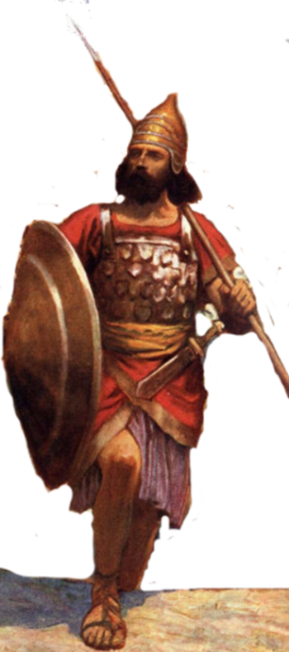
Resting in the land
Living the land
Distributing
the land
Joshua
24:29-33
Conquering the land
Joshua
13-21
Joshua
22-24
Claiming the land
Joshua
6-12
Joshua
1-5
Notes:
I. Claiming the Land (1:1–5:15)
II. Conquering the Land (6:1–12:24)
III. Distributing the Land (13:1–21:45)
IV. Living in the Land (22:1–24:28)
V. Resting in the Land (24:29–33)

Slide 4
1446-1406 BC
1260-1220 BC
Adequate time to fit Judges into time period of 1370 to 1010 BC
Difficult to fit Judges into shorten time period of 1200 to 1050 BC
City being built in days before birth of Moses – Rameses used earlier than 1300
Exodus 1:11 says Israelites building city of Ramses, Pharaoh of Exodus
430 yrs in Egypt fits with fall of Hyksos rise of Pharaohs did not know Joseph
Hyksos not part of the discussion – Whole time under New Kingdom
Land of the Philistines not conquered-
Joshua 2:2-3 (1200 BC)
Philistines arrival fit in times of the Conquest
Israel not mentioned in Palestine invasions of Seti I & or Ramses II
Israel not there so no mention
Adequate time to fit Judges into time period of 1370 to 1010 BC
Hazor burned only once – not Joshua & Deborah & Barak (critics view)

Slide 5
Hazor Diagram – Mound City Two Destructions
1230BC Last Canaanite city
Joshua Conquest
Deborah & Barak?
Upper Hazor
Egyptian Reference
Lower Hazor
1400’s BC Ends with this Time?
Bible mentions one burning – Joshua
Bible Critics – say Joshua/Judges same event

Slide 6
Reflected his mentor, Moses Exodus 24:13; 33:11
Loyal – Numbers 11
Courageous – Numbers 14:6-10
Emotional – Joshua 7:6
Intelligence/Wise military man – Joshua 8:3-29
Could be beguiled – Joshua 9:3-27
Prophetic – Joshua 6:26-27
Strong religious leader Judges 2:7
Obedient/Devoted to God Joshua 23-24
Good Example – Joshua 24:14-15
Focused – spied out Canaan Numbers 14
Endurance – Joshua 12
Speaking Ability – Joshua 24
Kept Oath – Joshua 9-10

Slide 7
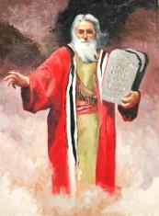
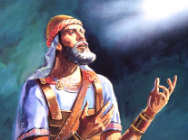
Be Strong and Courageous
GOD
Joshua was commanded to be “Strong and Courageous”
He would deliver God’s promise of the Land
He should be careful to follow God’s Law
God would be with him, he was not to fear
Deut 31:23
Josh 1:6-9 (3x)
Deut 3:28
Deut 31:6
Josh 10:25
Deut 31:7
Josh 1:18

Slide 8
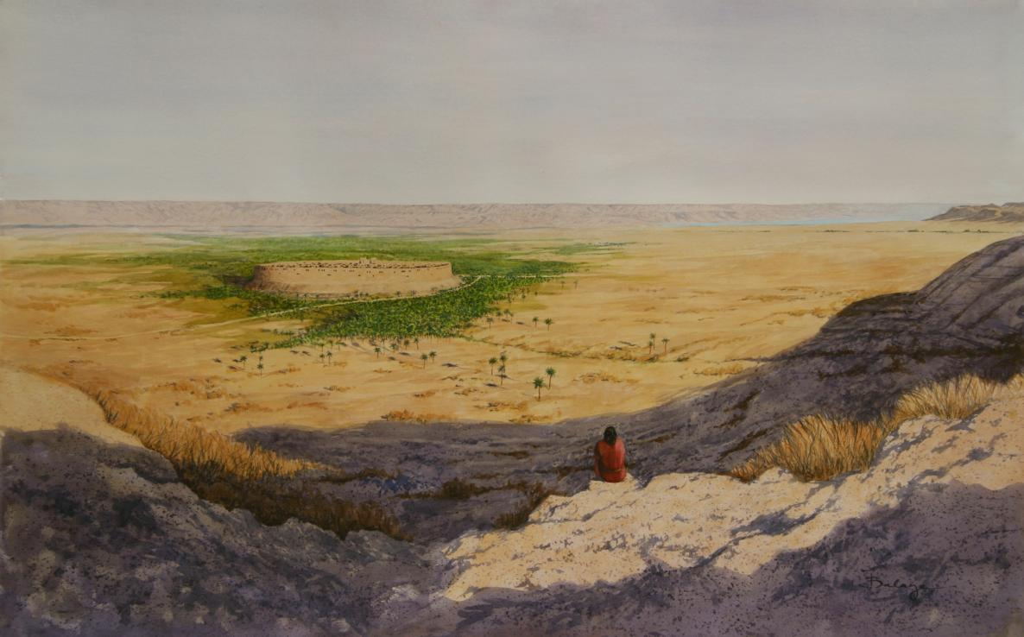
Joshua’s Challenges –
People who had failed last time – 40 yrs
New Leader
New Generation
A swollen river
A walled city
Unknown city/people
Be Strong & Courageous
Just as I was with Moses, so I will be with you.
I will not leave you or forsake you
People – tell Be Strong & Courageous
Prepared people (3 days provisions)
Checked that Tribes across Jordan with him
Sent spies into Jericho
Lord took care of the river
& walled city
Jo 1:2 Now therefore arise, go over this Jordan

Slide 9
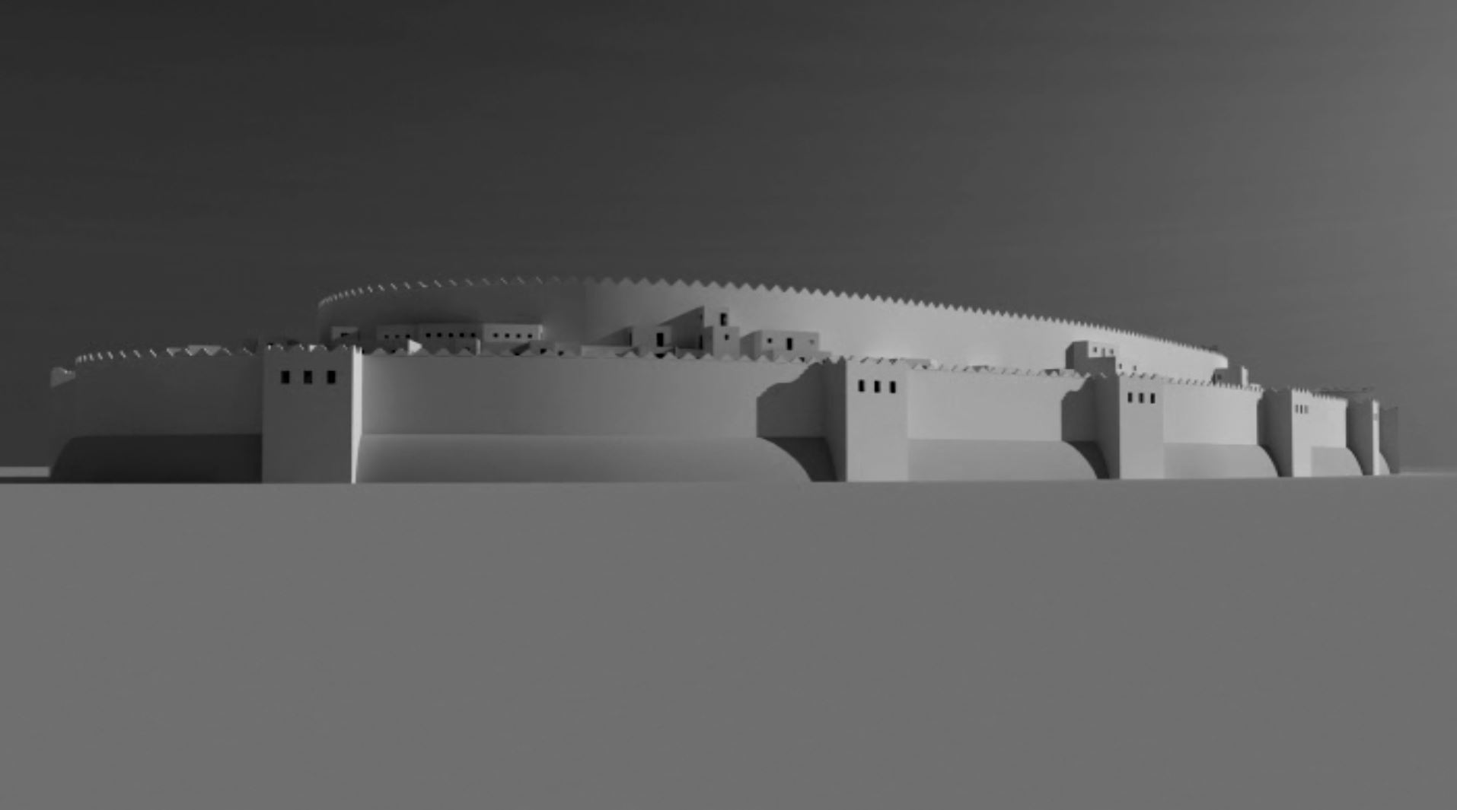
Hebrews 11:30-31(ESV) ³⁰By faith the walls of Jericho fell down after they had been encircled for seven days.
³¹By faith Rahab the prostitute did not perish with those who were disobedient, because she had given a friendly welcome to the spies.

Slide 10
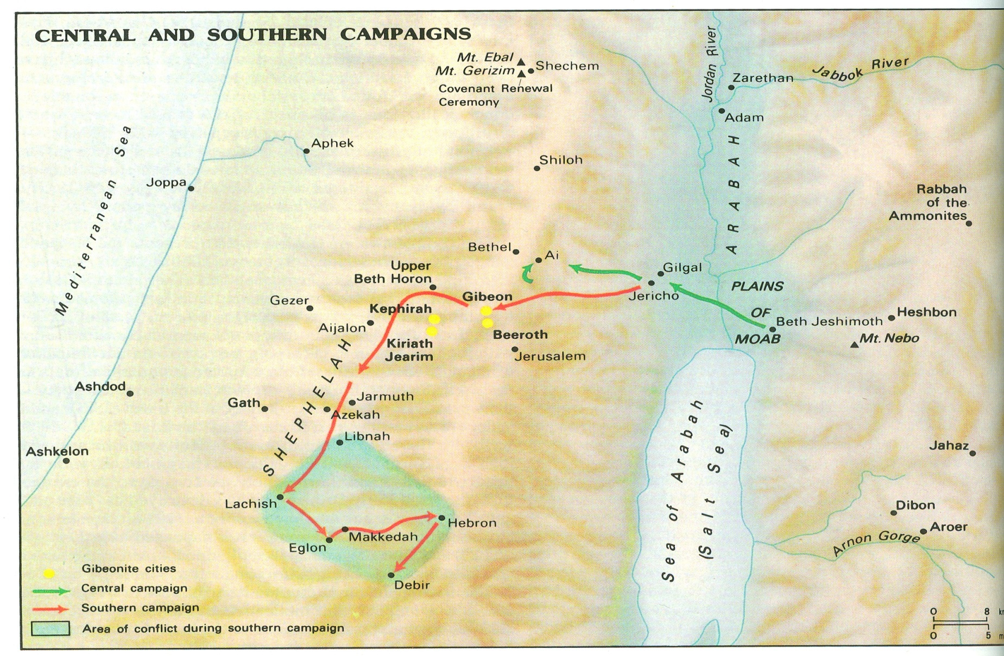
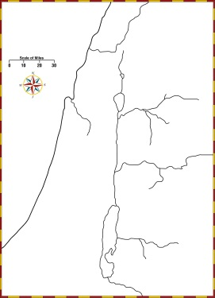

Slide 11
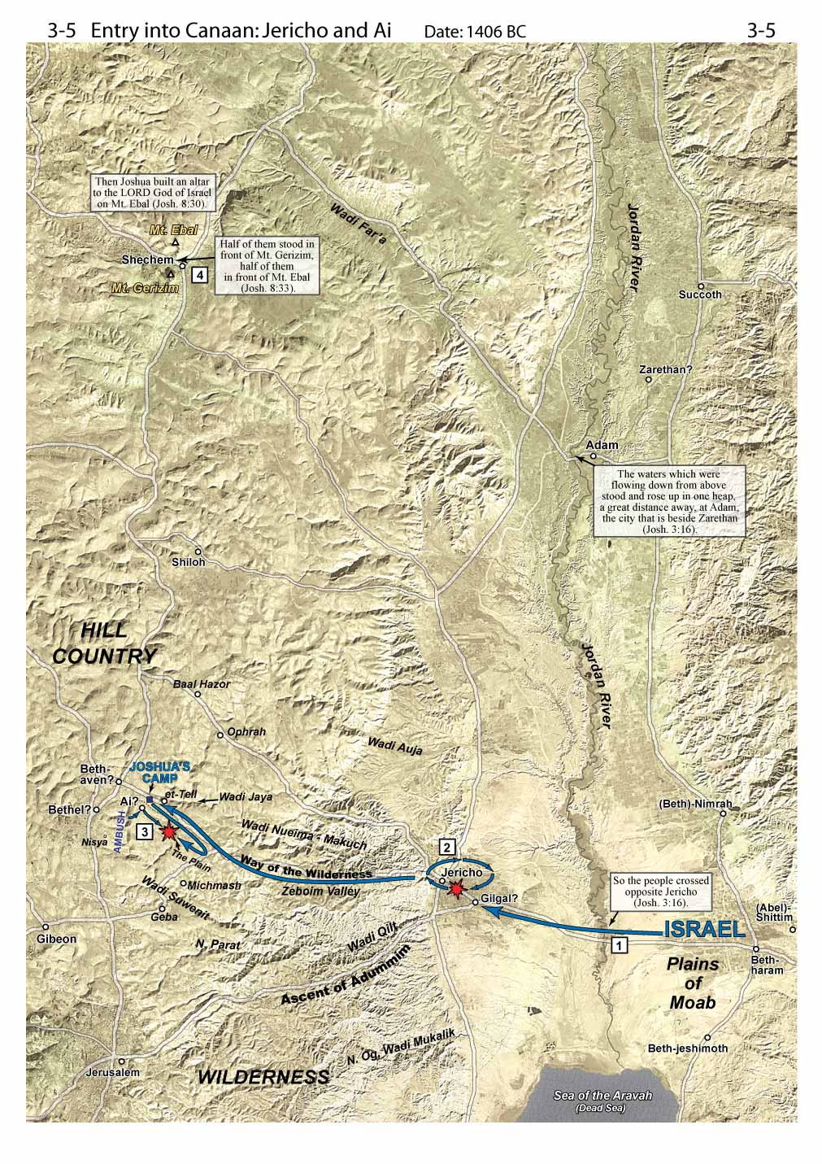
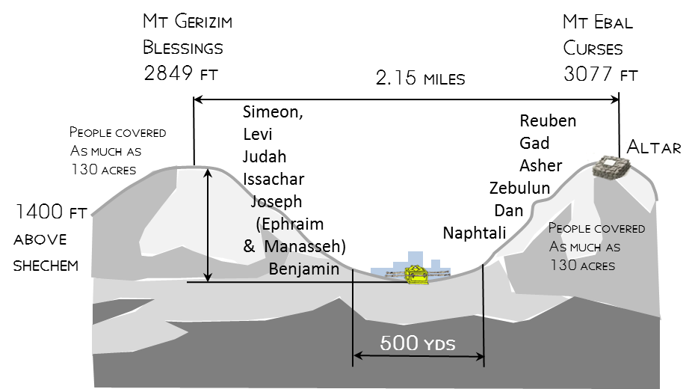

Slide 12
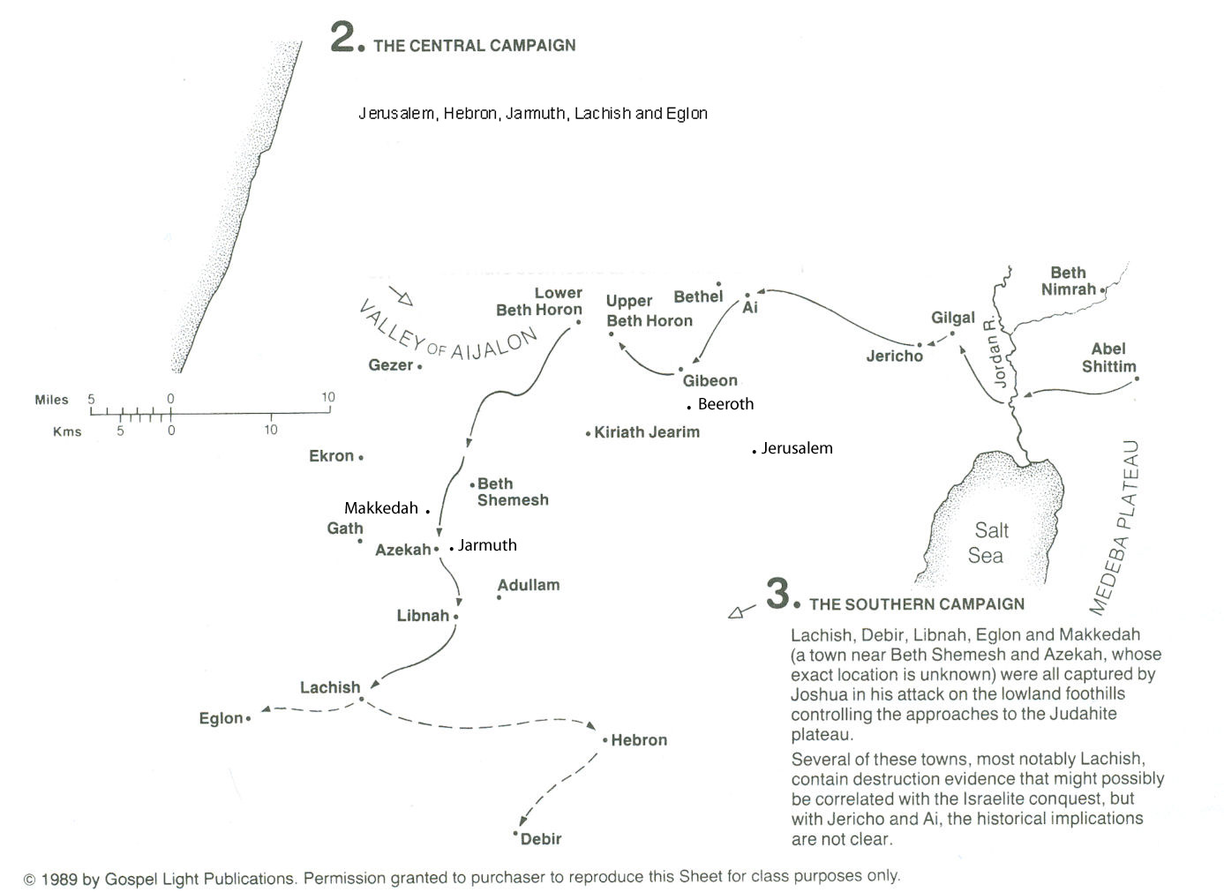
Five Amorite Kings
Chephirah .
Cities of Gibeon
Five Kings
Joshua 10
⁹So Joshua came upon them suddenly, having marched up all night from Gilgal.

Slide 13
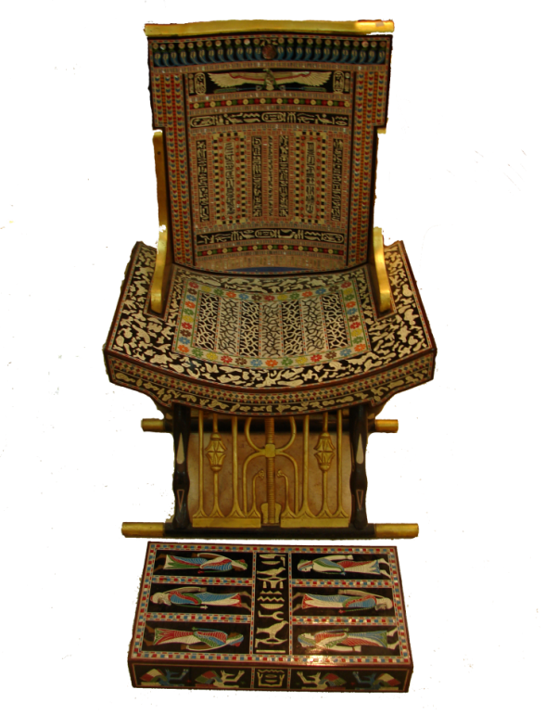
Joshua 10
²⁴And when they brought those kings out to Joshua, Joshua summoned all the men of Israel and said to the chiefs of the men of war who had gone with him, “Come near; put your feet on the necks of these kings.” Then they came near and put their feet on their necks. ²⁵And Joshua said to them, “Do not be afraid or dismayed; be strong and courageous. For thus the Lord will do to all your enemies against whom you fight.”

Slide 14
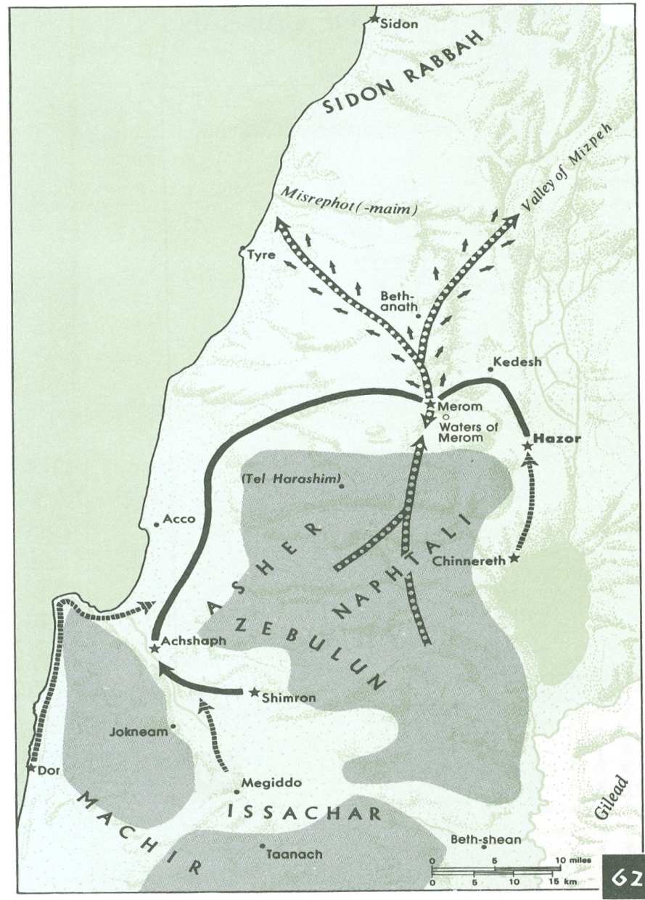
Jabin Gathers Forces – Joshua 11
Land of Mizpeh
Joshua 11
⁸And the Lord gave them into the hand of Israel, who struck them and chased them as far as Great Sidon and Misrephoth-maim, and eastward as far as the Valley of Mizpeh. And they struck them until he left none remaining.
Madon

Slide 15
Joshua Timeline
Who will you serve
Joshua 13
Joshua 14-17 at Gilgal
Joshua 18-22 at Shiloh
Joshua was old and advanced in years, and the Lord said to him, “You are old and advanced in years, and there remains yet very much land to possess.
therefore divide this land for an inheritance to the nine tribes and half the tribe of Manasseh.”
The land lay subdued before them. There remained among the people of Israel seven tribes whose inheritance had not yet been apportioned.
Cities of Refuge
Cities for Levities to live
Eastern Tribes sent home
Eastern tribe & the purpose of the altar set-up
Caleb asks for his inheritance
Allotment for
Judah
Ephraim
Manasseh
Joshua 23 at Shiloh
Joshua 23
¹A long time afterward, when the Lord had given rest to Israel from all their surrounding enemies, and Joshua was old and well advanced in years, ²Joshua summoned all Israel, its elders and heads, its judges and officers, and said to them, “I am now old and well advanced in years.
This is your allotment
Judges 1
¹After the death of Joshua, the people of Israel inquired of the Lord, “Who shall go up first for us against the Canaanites, to fight against them?” - Judah
Joshua 24
¹Joshua gathered all the tribes of Israel to Shechem and summoned the elders, the heads, the judges, and the officers of Israel. And they presented themselves before God.
²⁹After these things Joshua the son of Nun, the servant of the Lord, died, being 110 years old.
Joshua 18 at Shiloh
How long are you going to wait

Slide 16
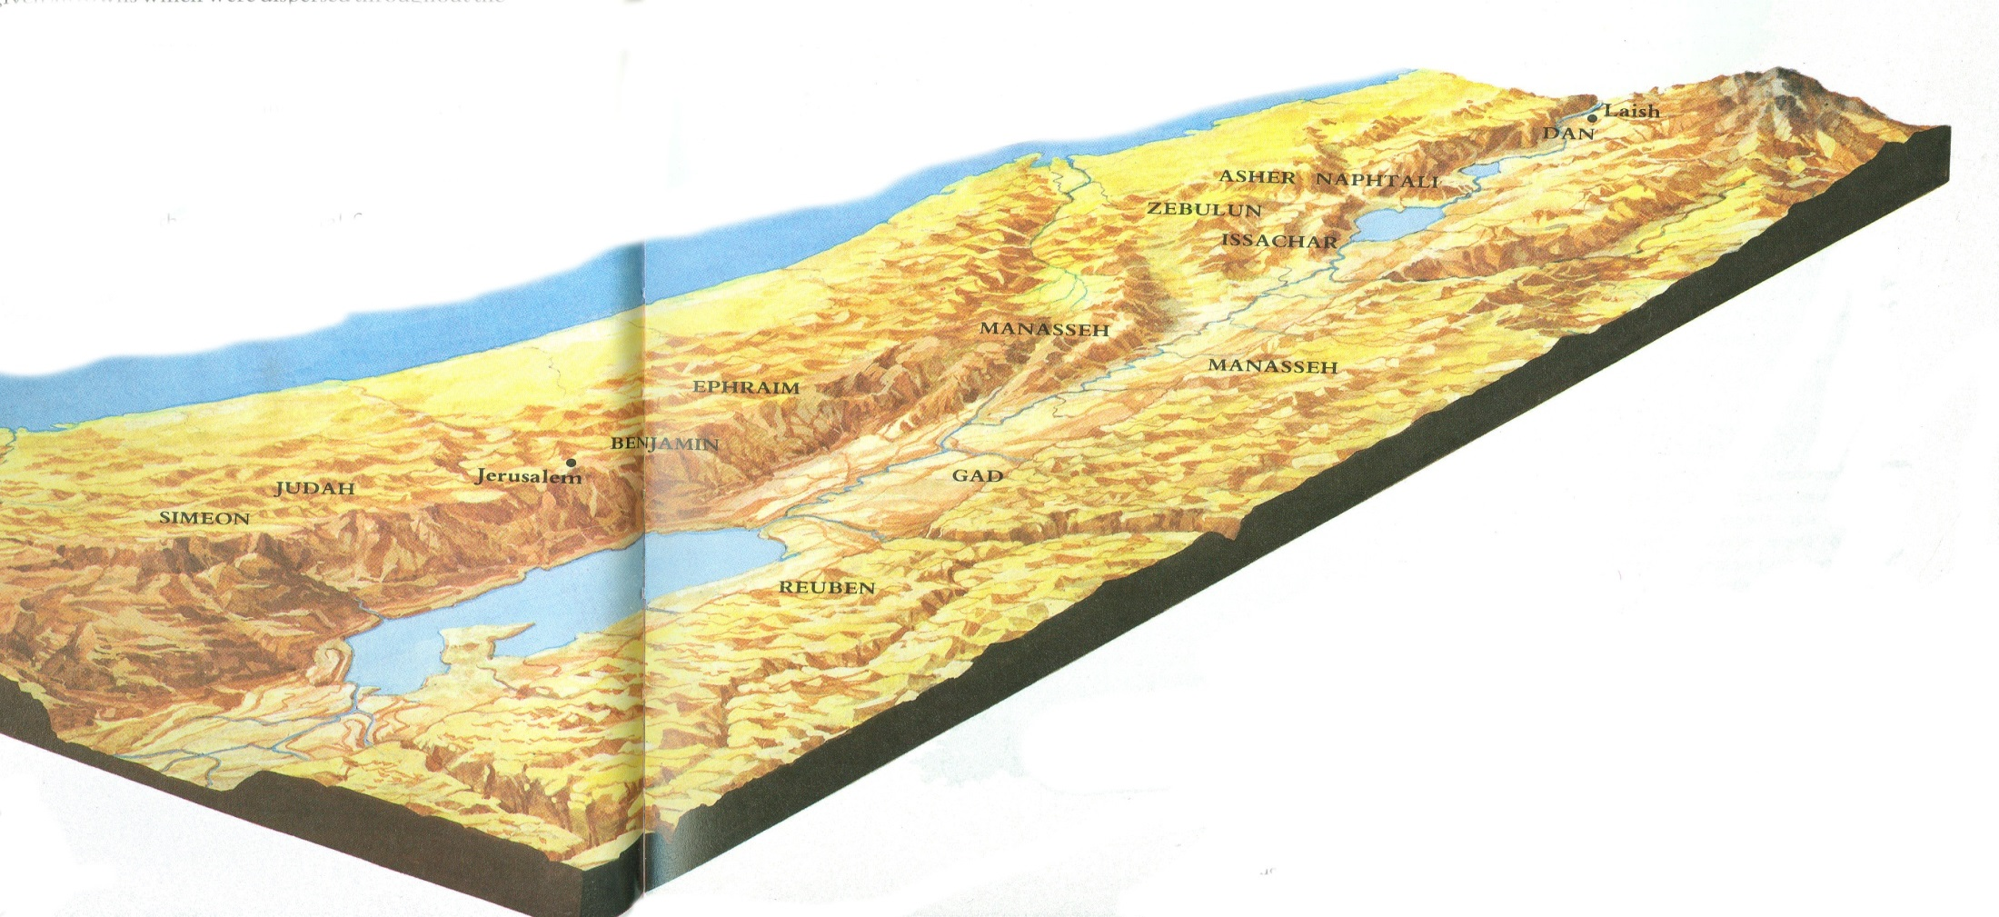
Land Promise Fulfilled
Joshua 21
⁴³ Thus the Lord gave to Israel all the land that he swore to give to their fathers. And they took possession of it,
and they settled there.
⁴⁴ And the
Lord gave them rest
rest on every side just
as he had sworn to their fathers.
Not one of all their enemies had
withstood them, for the Lord had given all their enemies into their hands.
⁴⁵ Not one word of all the good promises that the Lord had made to the house of Israel had failed; all came to pass.

Slide 17
Joshua Timeline
Judges 2- Angel at Bochim
Joshua 23 - Leaders
Joshua 24 – People
At Shechem
And he said, “I brought you up from Egypt and brought you into the land that I swore to give to your fathers. I said, ‘I will never break my covenant with you, ²and you shall make no covenant with the inhabitants of this land; you shall break down their altars.’
But you have not obeyed my voice. What is this you have done? ³So now I say, I will not drive them out before you, but they shall become thorns in your sides, and their gods shall be a snare to you.”
A long time afterward, when the Lord had given rest to Israel from all their surrounding enemies, and Joshua was old and well advanced in years, Joshua summoned all Israel, its elders and heads, its judges and officers
God has fulfilled all
History lesson of all that God has done
And if it is evil in your eyes to serve the Lord, choose this day whom you will serve, whether the gods your fathers served in the region beyond the River, or the gods of the Amorites in whose land you dwell.
But as for me and my house, we will serve the Lord.”

Slide 18
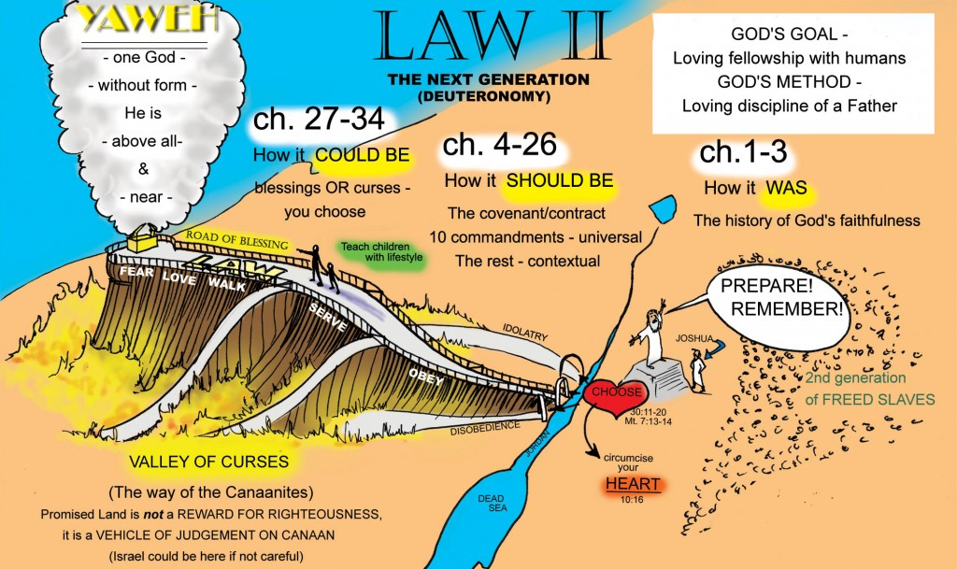
Deuteronomy 28:13-14(ESV) ¹³…if you obey the commandments of the Lord your God, which I command you today, being careful to do them, ¹⁴and if you do not turn aside from any of the words that I command you today, to the right hand or to the left, to go after other gods to serve them.

Slide 19
Joshua to Leaders
I am now old and well advanced in years. (You have to take the lead now)
You have seen what the Lord your God has done to all these nations for your sake
For it is the Lord your God who has fought for you.
I have allotted to you as an inheritance for your tribes
those nations that remain,
along with all the nations that I have already cut off
from the Jordan to the Great Sea in the west
Lord your God will push them back before you and drive them out of your sight
And you shall possess their land
just as the Lord your God promised you.

Slide 20
Joshua to Leaders
Therefore, be very strong to keep and to do all that is written in the Book of the Law of Moses,
turning aside from it neither to the right hand nor to the left,
you may not mix with these nations remaining among you
or make mention of the names of their gods
or swear by them or serve them or bow down to them
but you shall cling to the Lord your God just as you have done to this day.
For the Lord has driven out before you great and strong nations
And as for you, no man has been able to stand before you to this day.
One man of you puts to flight a thousand
since it is the Lord your God who fights for you, just as he promised you.
Be very careful, therefore, to love the Lord your God.

Slide 21
Joshua to Leaders
For if you turn back
and cling to the remnant of these nations remaining among you
and make marriages with them,
so that you associate with them and they with you,
know for certain that the Lord your God
will no longer drive out these nations before you,
but they shall be a snare and a trap for you,
a whip on your sides
and thorns in your eyes,
until you perish from off this good ground that the Lord your God has given you.

Slide 22
Joshua to Leaders
I am about to go the way of all the earth, and you know in your hearts and souls, all of you,
that not one word has failed of all the good things that the Lord your God promised concerning you.
All have come to pass for you; not one of them has failed.
But just as all the good things that the Lord your God promised concerning you have been fulfilled for you,
so the Lord will bring upon you all the evil things, until he has destroyed you from off this good land that the Lord your God has given you,
if you transgress the covenant of the Lord your God, which he commanded you,
and go and serve other gods and bow down to them.
Then the anger of the Lord will be kindled against you,
and you shall perish quickly from off the good land that he has given to you.”

Slide 23
Questions?
How could being strong to keep what was in the Book of the Law of Moses help Israel is possessing the land?
Why should Joshua expect bad things to happen to Israel, if he knows that not one word has failed of all the good things that God had promised?

Slide 24
Who brought Israel into the Promised Land? Joshua 24
I took your father Abraham from beyond the River vs 3
I gave him (Abraham) Isaac vs 3
to Isaac I gave Jacob and Esau vs 4
I gave Esau the hill country of Seir to possess vs 4
I sent Jacob and his children went down to Egypt vs 4
I sent Moses and Aaron vs 5
I plagued Egypt with what I did in the midst of it vs 5
Then I brought your fathers out of Egypt vs 6
Lord put darkness between you and the Egyptians and made the sea come upon them and cover them vs 7
I brought you to the land of the Amorites vs 8
I gave them (Amorites) into your hand vs 8
I destroyed them (Amorites) before you vs 8
I would not listen to Balaam. Indeed, he blessed you vs 10
I delivered you out of his (Balaam) hand. Vs 10
And I gave them (people of Canaan) into your hand vs 11
And I sent the hornet before you, which drove them out before you vs 12
I gave you a land on which you had not labored and cities that you had not built, and you dwell in them. You eat the fruit of vineyards and olive orchards that you did not plant.’ vs 13
Now therefore fear the Lord and serve him in sincerity and in faithfulness – vs 14

Slide 25
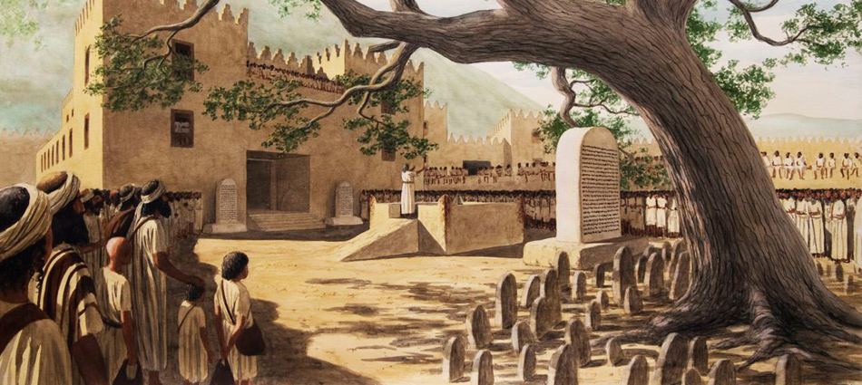
Joshua 24
²⁵So Joshua made a covenant with the people that day, and put in place statutes and rules for them at Shechem. ²⁶And Joshua wrote these words in the Book of the Law of God. And he took a large stone and set it up there under the terebinth that was by the sanctuary of the Lord.

Slide 26
Questions?
What was the value in God spending hundreds of years to bring Israel to this point in time?
Could He not have made a nation and given them a land in less time?
Why should a review of their history with God lead them to "Now therefore fear the Lord and to serve him in sincerity and in faithfulness?

Slide 27
Joshua 24
²⁷And Joshua said to all the people, “Behold, this stone shall be a witness against us, for it has heard all the words of the Lord that he spoke to us. Therefore it shall be a witness against you, lest you deal falsely with your God.”

Slide 28
Shechem standing stone
Standing stone
A witness to covenant between Joshua and People
“You are witnesses against yourselves that you have chosen the Lord, to serve him.
Then put away the foreign gods that are among you
incline your heart to the Lord, the God of Israel.”
“The Lord our God we will serve, and his voice we will obey.”
This stone shall be a witness against us, for it has heard all the words of the Lord that he spoke to us. Therefore it shall be a witness against you, lest you deal falsely with your God.”
Joshua 24
¹⁴“Now therefore fear the Lord and serve him in sincerity and in faithfulness. Put away the gods that your fathers served beyond the River and in Egypt, and serve the Lord. ¹⁵And if it is evil in your eyes to serve the Lord, choose this day whom you will serve, whether the gods your fathers served in the region beyond the River, or the gods of the Amorites in whose land you dwell. But as for me and my house, we will serve the Lord.”
Notes:
This stone pillar (massebah) found at Shechem might be similar to the one that Joshua set up as a witness to the renewal of the covenant.

Slide 29
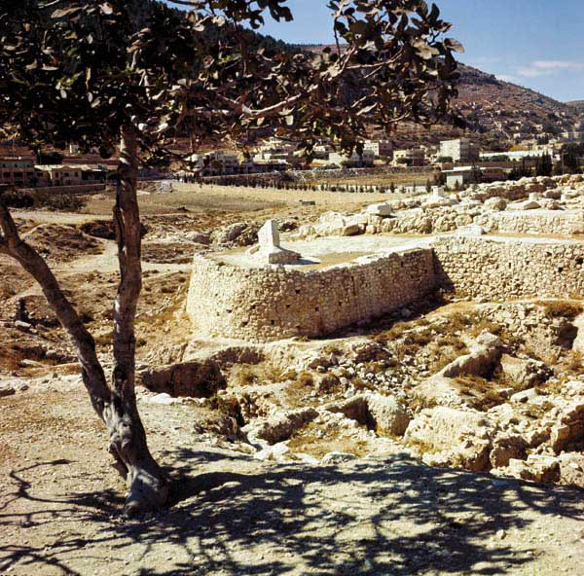
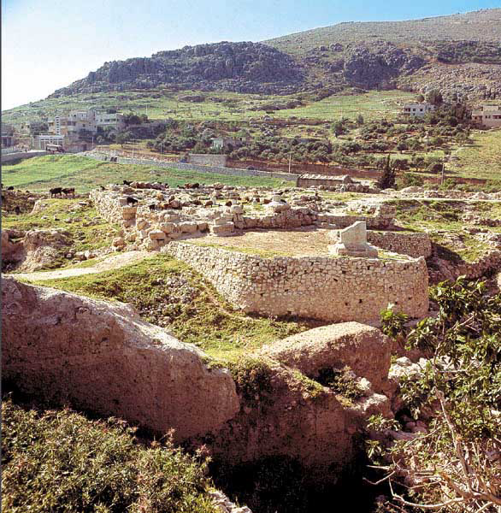
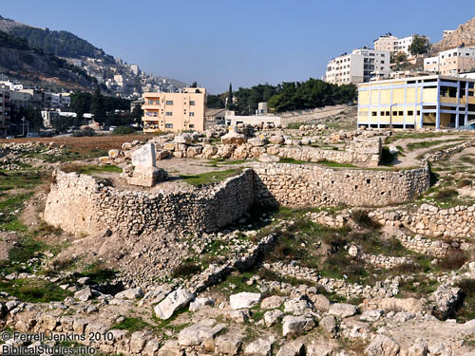

Slide 30
Shechem standing stone
Shechem standing stone
Notes:
This stone pillar (massebah) found at Shechem might be similar to the one that Joshua set up as a witness to the renewal of the covenant.

Slide 31
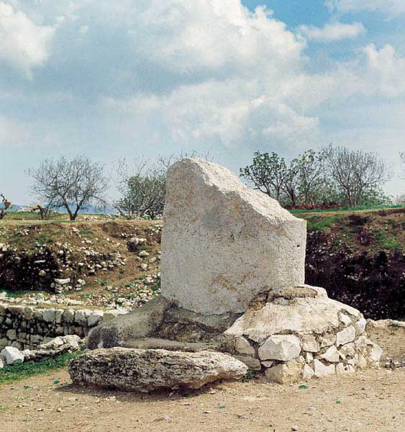
A great white slab, today only about half its original 10-foot-height, still meets visitors to Shechem’s fortress-temple. The slab, or masseba, had two smaller counterparts, which flanked the temple entrance

Slide 32
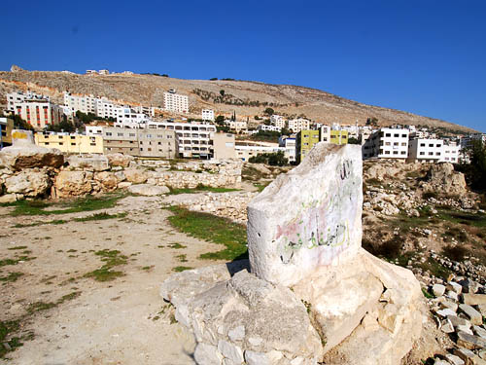
The sacred standing stone at Shechem.
Dr. Bryant Wood says,
Since the temple existed in Joshua’s day, it is possible this was the “large stone” he set up “under the oak that was by the sanctuary of the Lord” at Shechem (Josh. 24:26). The stela is undoubtedly the “pillar” where Abimelech was made king (Judges 9:6)”
(Bryant Wood. “From Ramesses to Shiloh.” Giving the Sense. Kregel, 2003).
Photo by Ferrell Jenkins

Slide 33
Joshua 8
³²And there, in the presence of the people of Israel, he wrote on the stones a copy of the law of Moses, which he had written.
Deuteronomy 27
²And on the day you cross over the Jordan to the land that the Lord your God is giving you, you shall set up large stones and plaster them with plaster.
³And you shall write on them all the words of this law, when you cross over to enter the land that the Lord your God is giving you, a land flowing with milk and honey, as the Lord, the God of your fathers, has promised you.

Slide 34
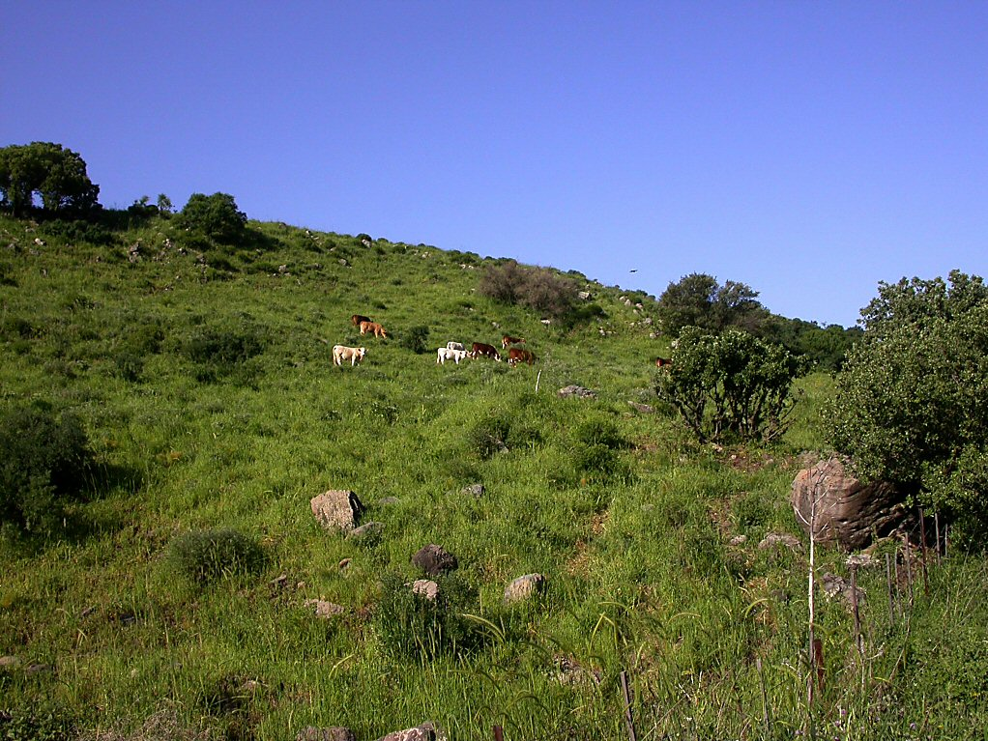
Cows of Bashan near Hippos
Promise of a Land of Milk & Honey
Cows of Bashan near Hippos
Notes:
Cattle have been raised in this area, in ancient times as well as today. Both beef and dairy cattle are currently raised in the Golan Heights.

Slide 35
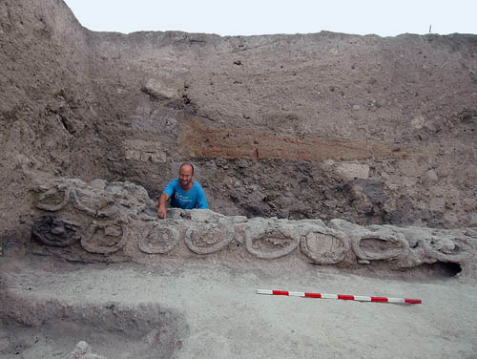
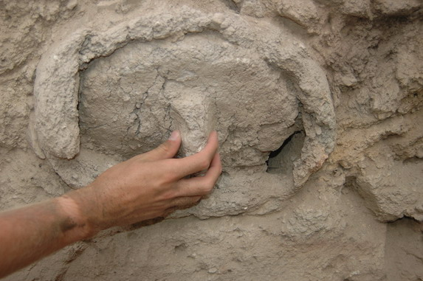
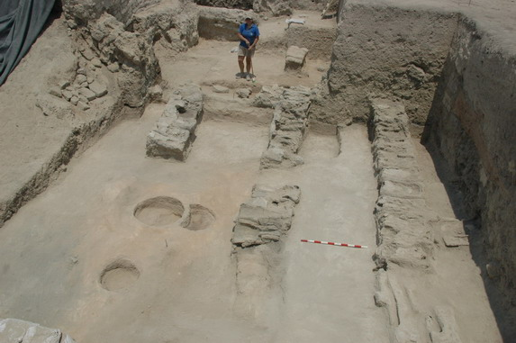
Promise of a Land of Milk & Honey
Clay lid of a beehive found in situ
Beehives Discovered at Tel Rehov in 2007. Archaeologist Amichai Mazar. Photo: Copyright - The Beth-Valley Archaeological Project, Hebrew University of Jerusalem

Slide 36
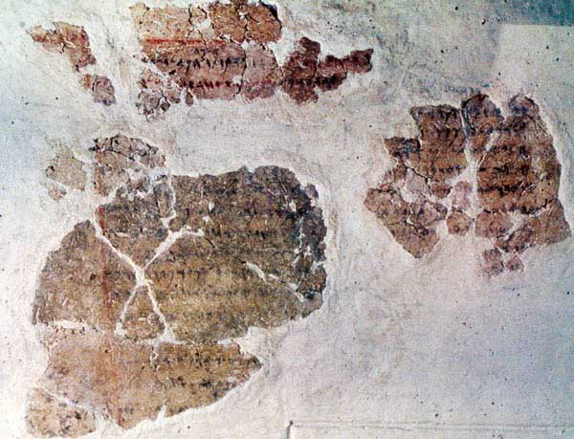
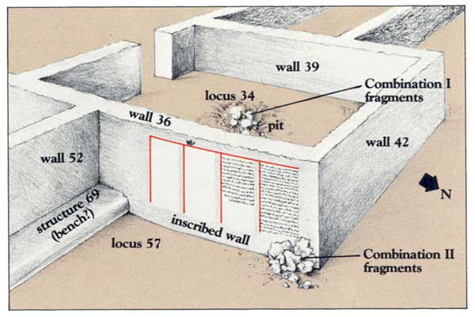
This inscription found at Deir ‘Alla, in Jordan, begins,
“The sayings of Balaam, son of Beor, the man who was a seer of the gods.” It is written with ink on plaster and refers to the non-Israelite prophet known from Numbers 22–24;
BAR 29:04 (July/Aug 2003).

Slide 37
What in the class has helped you in being better prepared to give a ready defense of Joshua and the conquest?

Slide 39
Conquest of the Land

Slide 40
Conquest of the Land

Slide 41
Conquest of the Land

Slide 42
Conquest of the Land

