Slide 1
Choosing a Teacher
⁴⁰ A disciple is not above his teacher, but everyone who is perfectly trained will be like his teacher. (Luke 6:40)

Slide 2
Definition of a Disciple
A student
Merriam-Webster takes it farther:
: one who accepts and assists in spreading the doctrines of another:
: a convinced adherent of a school or individual
Examples:
Disciples of Jesus Christ
Disciples of Sigmund Freud

Slide 3
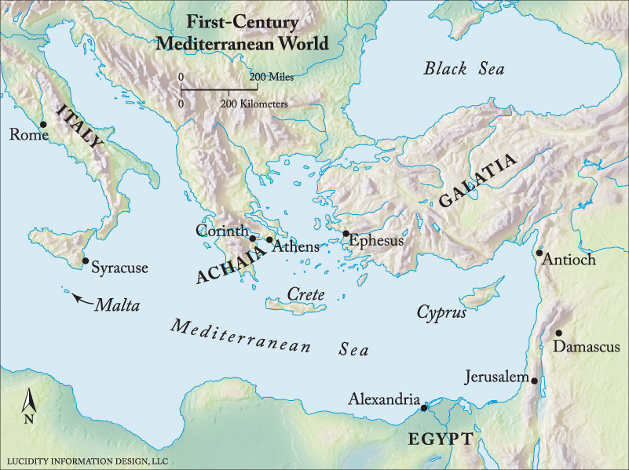
A Young Man from Tarsus
Tarsus

Slide 4
The First Disciples of Jesus
Andrew
“We have found the Messiah” (John 1:41)
Peter
“Lord, to whom shall we go? You have the words of eternal life.” (John 6:68)
“You are the Christ, the Son of the living God.” (Mt. 16:16)
Phillip
“We have found Him of whom Moses in the law, and also the prophets, wrote…” (John 1:45)
Nathaniel
“Rabbi, You are the Son of God! You are the King of Israel!” (John 1:49)
Disciples
“Truly, You are the Son of God” (Matt. 14:33)
John 2:11
Matt. 4:18-22
Only the Beginning!

Slide 5
Remember Our Definition:
“one who accepts and assists in spreading the doctrines of another”
During the Lifetime of Jesus
The Twelve “departed and went through the towns, preaching the gospel and healing everywhere.” (Luke 9:6)
“And they went out and preached everywhere, the Lord working with them and confirming the word through the accompanying signs.” (Mark 16:20)
They were “begotten…again to a living hope by the resurrection.” (1 Peter 1:3)
They were shaken by His Crucifixion

Slide 6
“spreading the doctrines of another”
Peter indicted Jews for crucifixion of Jesus
-- Acts 2:23; 3:14-15; 4:10; 4:19-20; 5:30-32
-- Wrote 2 letters glorifying Jesus (2 Pet. 1:16-18)
James died early for his testimony (Acts 12:1-2)
John wrote his gospel “that you may believe that Jesus is the Christ, the Son of God” (Jn. 20:32)
-- Recorded heaven’s praise (Rev. 5:9-14)
All the apostles gave their lives for Jesus.
Now when they saw the boldness of Peter and John, and perceived that they were uneducated and untrained men, they marveled. And they realized that they had been with Jesus. (Acts 4:13)

Slide 7
Objection:
These disciples lived in an ignorant and superstitious age.
How can we believe on the basis of their observations?

Slide 8
They were not as ignorant and gullible as we might think!
Read John 20:24-28

Slide 9
But I did not see Him!
I did not “see in His hands the print of the nails, and put my finger into the print of the nails, and put my hand into His side”
I did not see Him in a Heavenly vision!
²⁹ Jesus said to Thomas, “because you have seen Me, you have believed. Blessed are those who have not seen and yet have believed.” (John 20:29)

Slide 10
That Young Man from Tarsus
Let him tell his own story – Acts 26:9-20
Ask him a question--

Slide 11
Why Did He Change Discipleship?
Jesus answered all his questions.
Re: Past
Re: Present
Re: Future
Romans 7:24-25
Philippians 3:7-11
1 Thess. 4:14-18
Can I be a disciple of one I have never seen?

Slide 12
If not to Jesus, “To whom shall we go?”
All teachers of the past must be accepted on the basis of testimony.

Slide 13
What other teacher, living or dead:
Was prophesied centuries before He was born?
Has claimed to be the Son of God and proved it by His miracles and His resurrection from the dead?
Has lived a sinless life and provided such a perfect example for mankind to follow?
Has had such a beneficial influence on history?
Can provide the hope of resurrection from death and an eternal home with our Creator?

Slide 14
“Well, I think I will just not follow any teacher.”
Are you ready to make all the decisions of life guided by your own wisdom?
Suppose you come to the end of life and find that all your choices were a mistake?
Do you believe in judgment after death?
What hope do you have for eternity? (Jn. 14:6)

Slide 15
Only One Teacher is Worthy!
¹⁸ And Jesus came and spoke to them, saying, “All authority has been given to Me in heaven and on earth. ¹⁹ Go therefore and make disciples of all the nations, baptizing them in the name of the Father and of the Son and of the Holy Spirit, ²⁰ teaching them to observe all things that I have commanded you; and lo, I am with you always, even to the end of the age.”

Slide 16
Tarsus

Slide 17
Tarsus

Slide 18
The Appeal of the Man from Tarsus
⁷ King Agrippa, do you believe the prophets? I know that you do believe.”
²⁸ Then Agrippa said to Paul, “You almost persuade me to become a Christian.”
²⁹ And Paul said, “I would to God that not only you, but also all who hear me today, might become both almost and altogether such as I am, except for these chains.”

