Slide 1
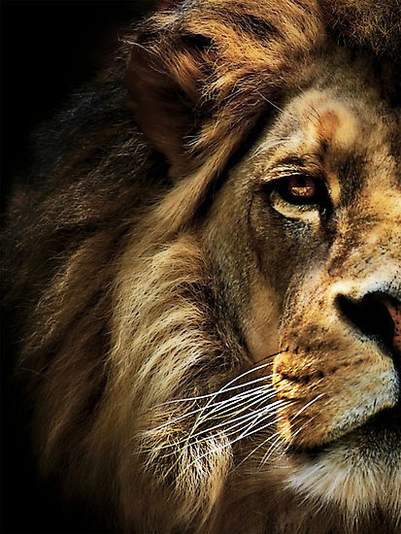
The Book of Daniel

Slide 2
Daniel
Law
History
Wisdom
Old Testament – 39
New Testament – 27
Total – 66
Major Prophets
Minor Prophets
Gospels
Acts
Letters
Rev

Slide 3
Daniel
Creation & Fall
Exodus & Conquest
Kings & Prophets
Life of Jesus
The Patriarchs
The
Judges
Exile & Return
Early Church
Law
History
Gospels
Acts
Wisdom
Letters
Prophets
Rev

Slide 4
“And your house and your kingdom shall be made sure forever before me. Your throne shall be established forever.” 2 Samuel 7:16
931 BC
722 BC
Northern Kingdom:
ISRAEL
586 BC
597 BC
Saul
David
Solomon
605 BC
Southern Kingdom:
JUDAH

Slide 5
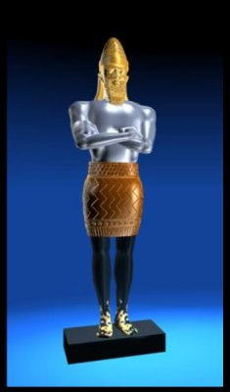
1 2 3 4 5 6 7 8 9 10 11 12
The Book of Daniel
Four empires will rise & fall before the everlasting kingdom.
Babylonian
Medo-Persian
Grecian
Roman
God rescues & exalts those who are faithful.
2
3
4
5
6
7
God humbles the proud.
Fiery Furnace
Lion’s Den
Aramaic
Nebuchad-nezzar
Belshazzar
2
3
4
5
6
7

Slide 6
The Problem of Pride

Slide 7
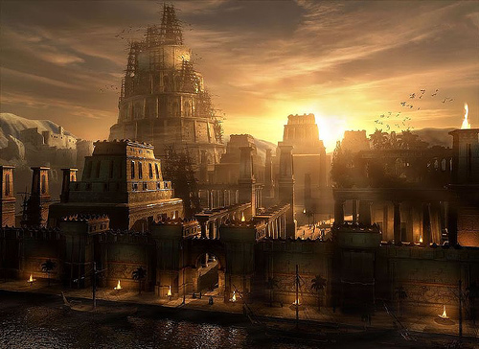

Slide 8
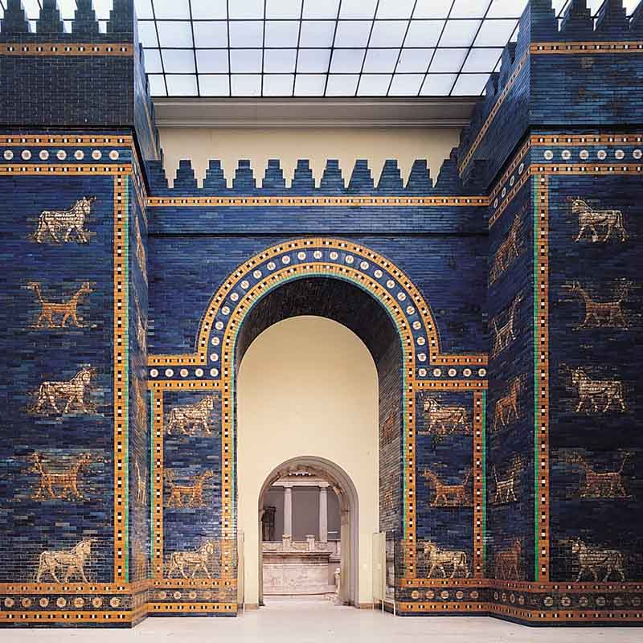

Slide 9
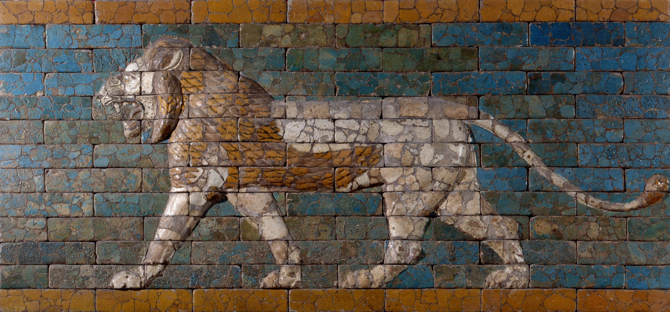

Slide 11
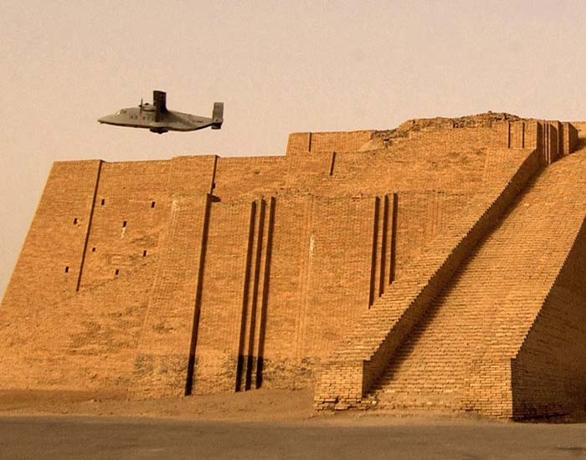

Slide 12
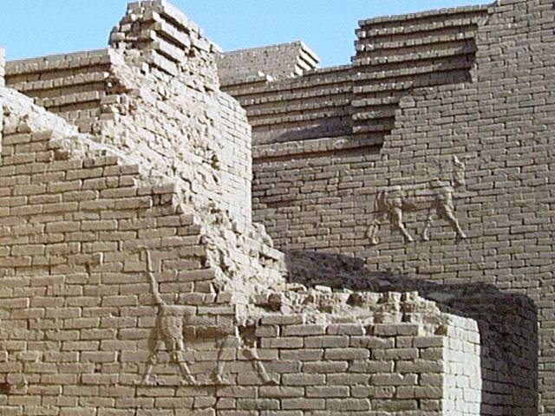

Slide 13
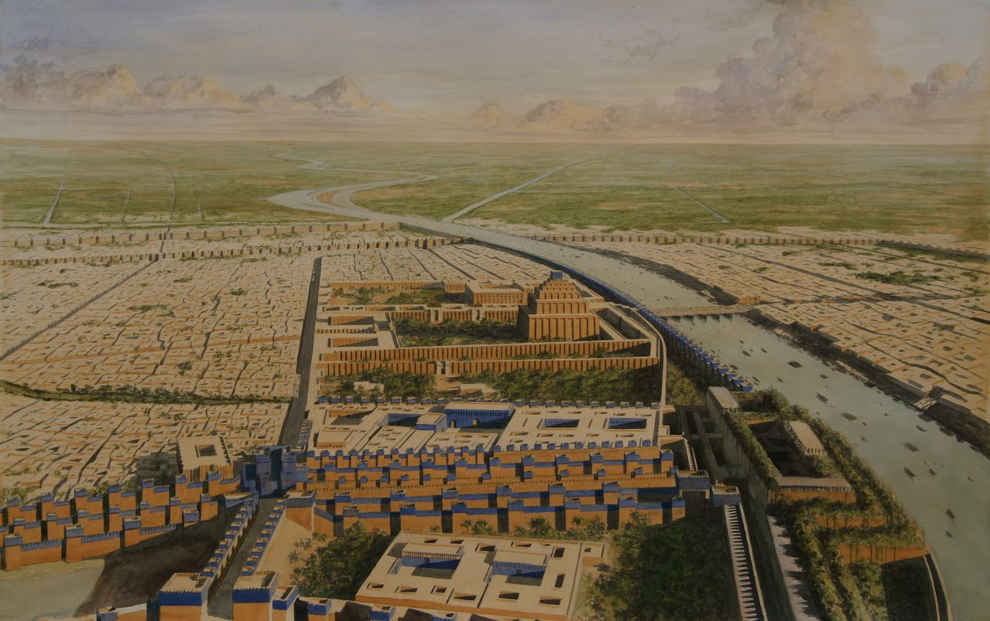

Slide 14
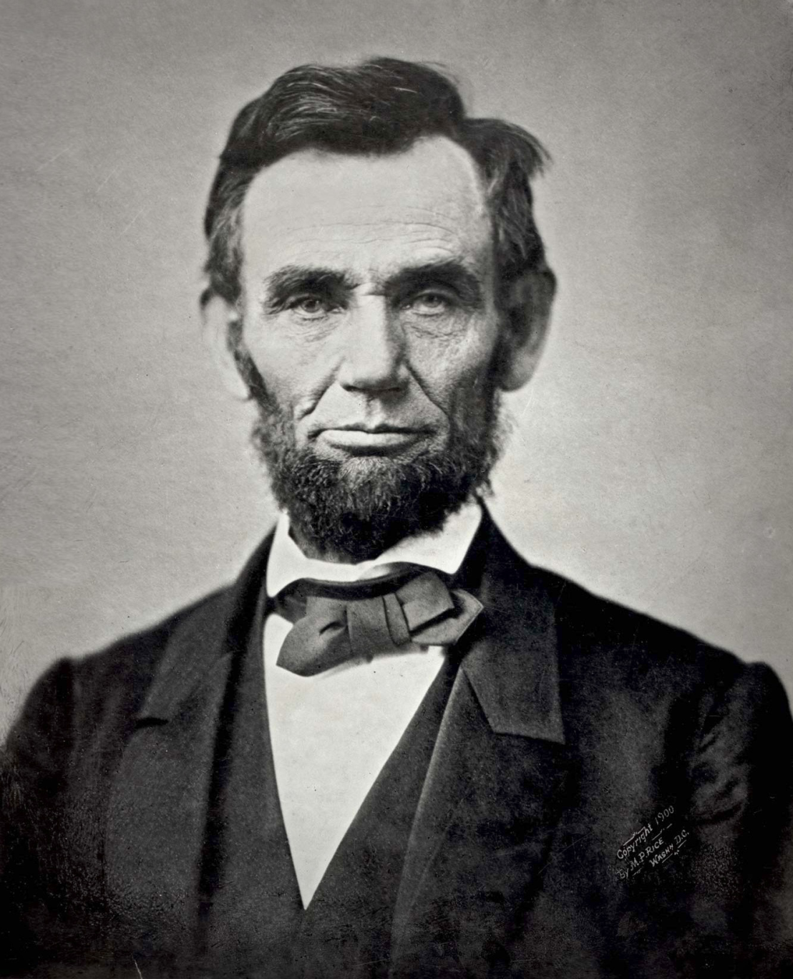

Slide 15
A recipe for pride.

Slide 16
Daniel 4:4
I, Nebuchadnezzar, was at ease in my house and prospering in my palace.

Slide 17
Daniel 4:10
I saw, and behold, a tree in the midst of the earth, and its height was great.

Slide 18
Daniel 4:11
The tree grew and became strong, and its top reached to heaven…

Slide 19
Daniel 4:12
Its leaves were beautiful and its fruit abundant, and in it was food for all.

Slide 20
The mercy of God.

Slide 21
Daniel 4:5
I saw a dream that made me afraid.

Slide 22
Daniel 4:14
“Chop down the tree and lop off its branches, strip off its leaves and scatter its fruit.”

Slide 23
Daniel 4:15
“But leave the stump…”

Slide 24
Daniel 4:19
“My lord, may the dream be for those who hate you and its interpretation for your enemies!”

Slide 25
The sovereignty of God.

Slide 26
Daniel 4:3
His kingdom is an everlasting kingdom, and his dominion endures from generation to generation. (also v 34)

Slide 27
Daniel 4:17
“…to the end that the living may know that the Most High rules the kingdom of men and gives it to whom he wills and sets over it the lowliest of men.” (also v 25, 32)

Slide 28
Daniel 4:34
I blessed the Most High, and praised and honored him who lives forever (also v 2, 25, 32)

Slide 29
Daniel 4:34
Now I, Nebuchadnezzar, praise and extol and honor the King of heaven…

Slide 30
Daniel 4:34
…he does according to his will among the host of heaven and among the inhabitants of the earth; and none can stay his hand or say to him, “What have you done?”

Slide 31
The vindication of God.

Slide 32
Daniel 4:37
…all his works are right and his ways are just; and those who walk in pride he is able to humble.

Slide 33
Humble yourselves, therefore, under the mighty hand of God so that at the proper time he may exalt you.
1 Peter 5:6

