Slide 1
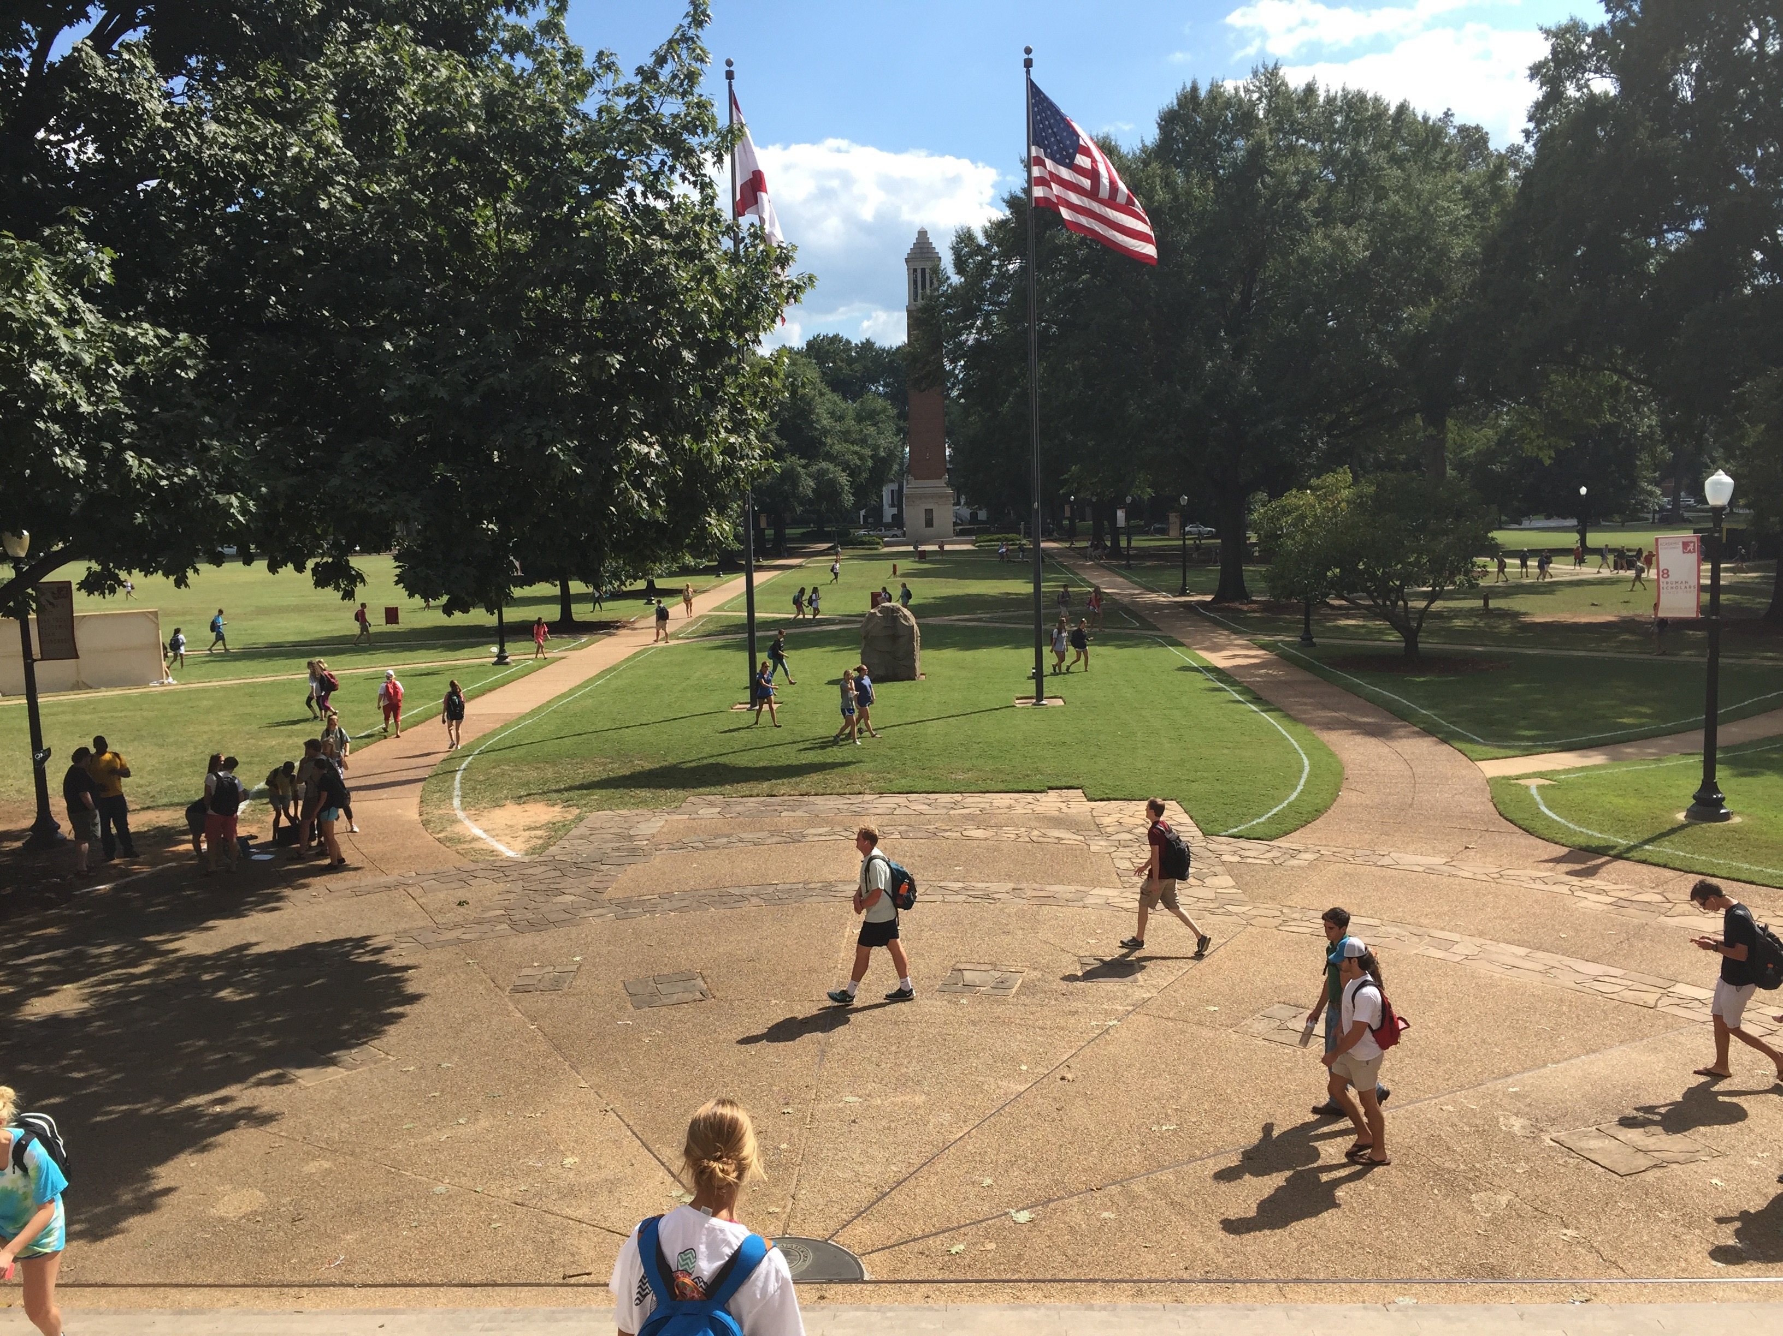
Almighty God Beyond the Veil
242
Hymn: S. Jason Hardin (2003)
Tune: C. E. Couchman (2003)
© 2003 S. J. Hardin and C. E. Couchman

Slide 2
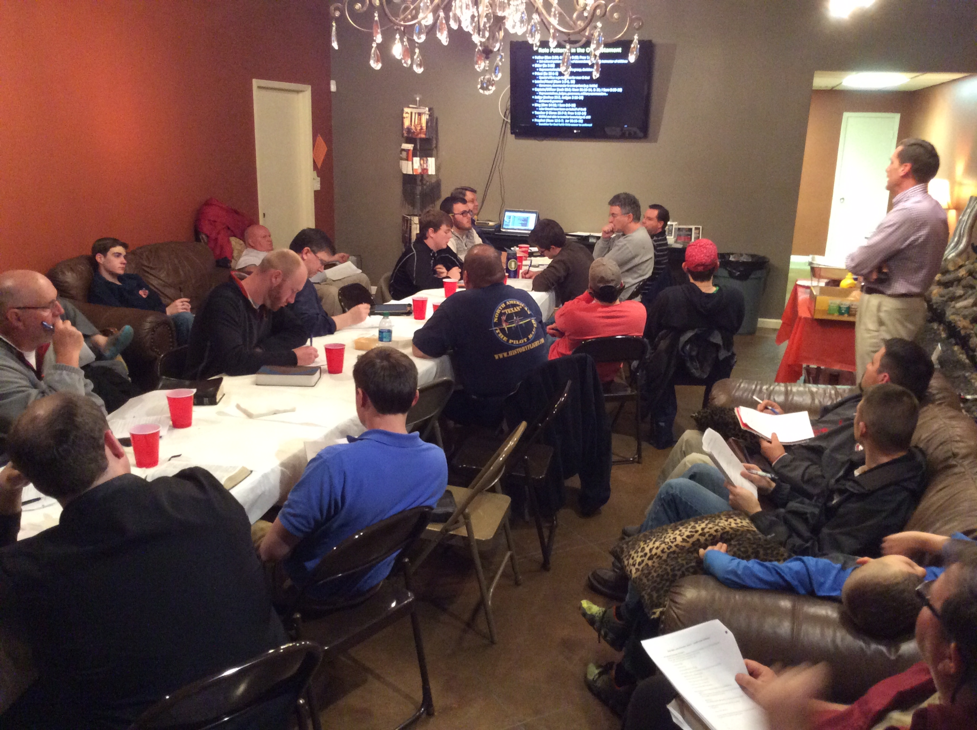
Almighty God Beyond the Veil
242
Hymn: S. Jason Hardin (2003)
Tune: C. E. Couchman (2003)
© 2003 S. J. Hardin and C. E. Couchman

Slide 3
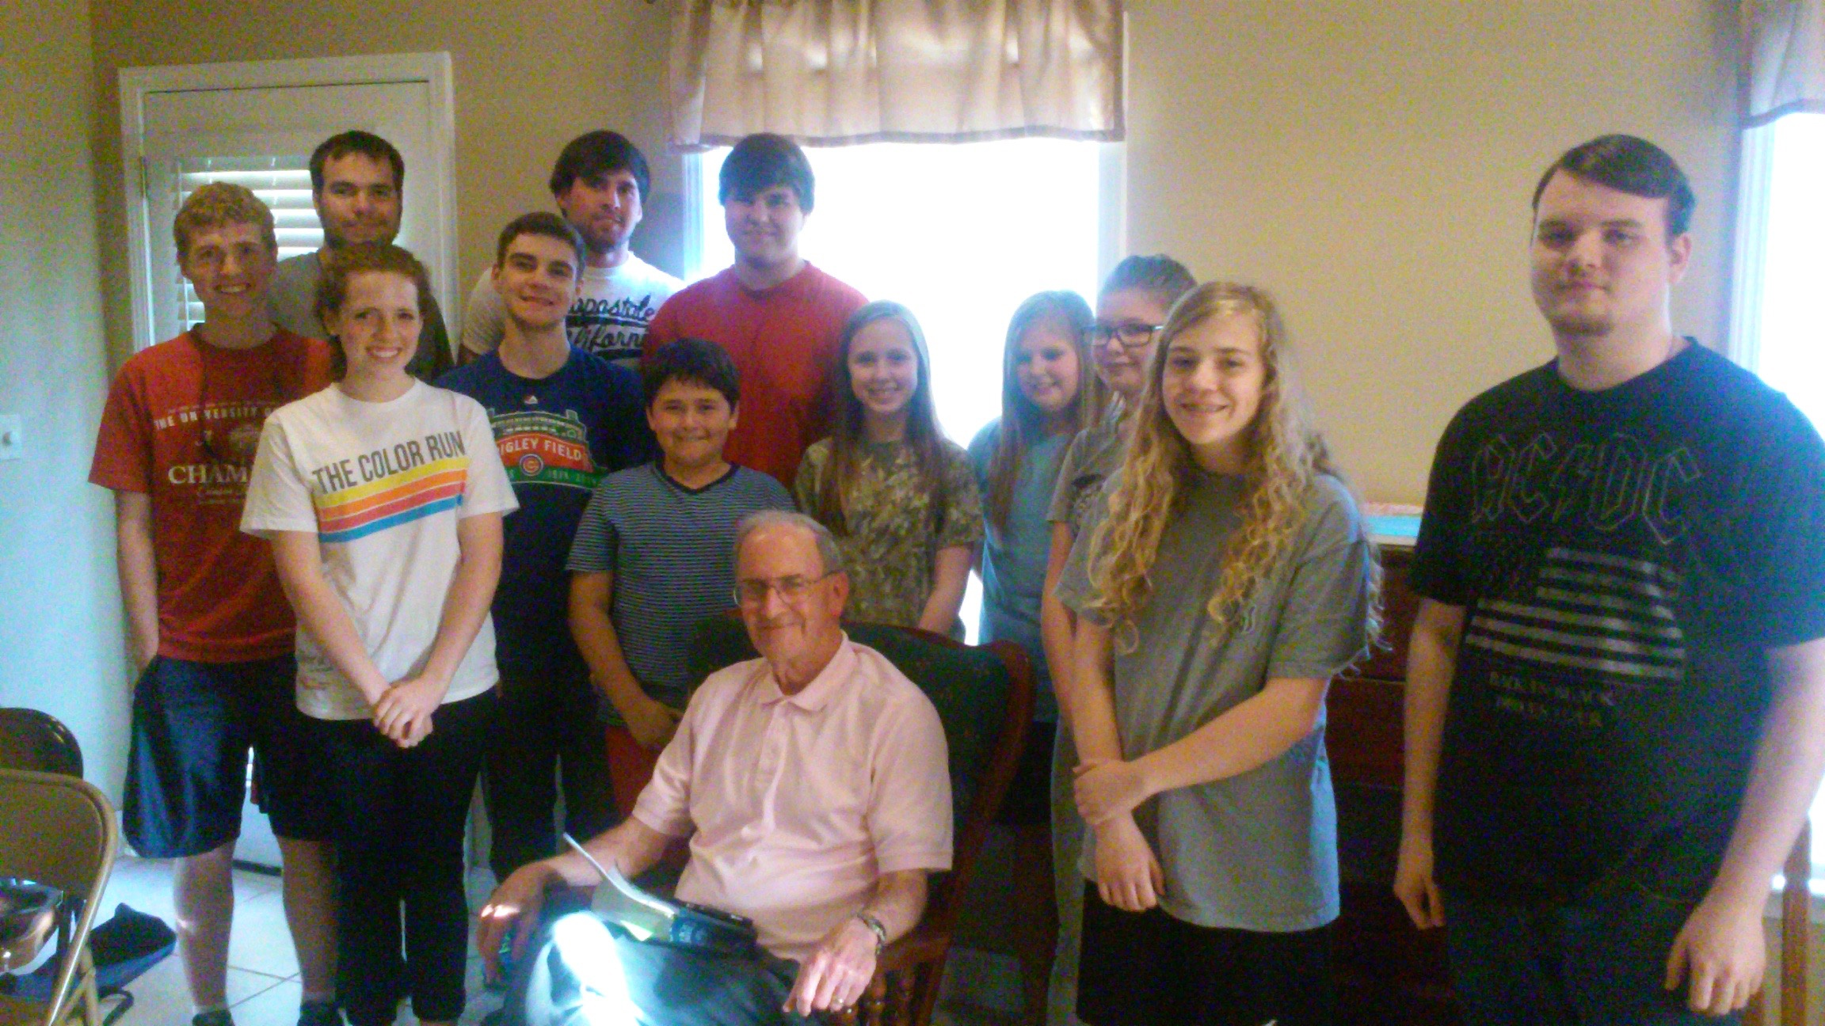
Almighty God Beyond the Veil
242
Hymn: S. Jason Hardin (2003)
Tune: C. E. Couchman (2003)
© 2003 S. J. Hardin and C. E. Couchman

Slide 4
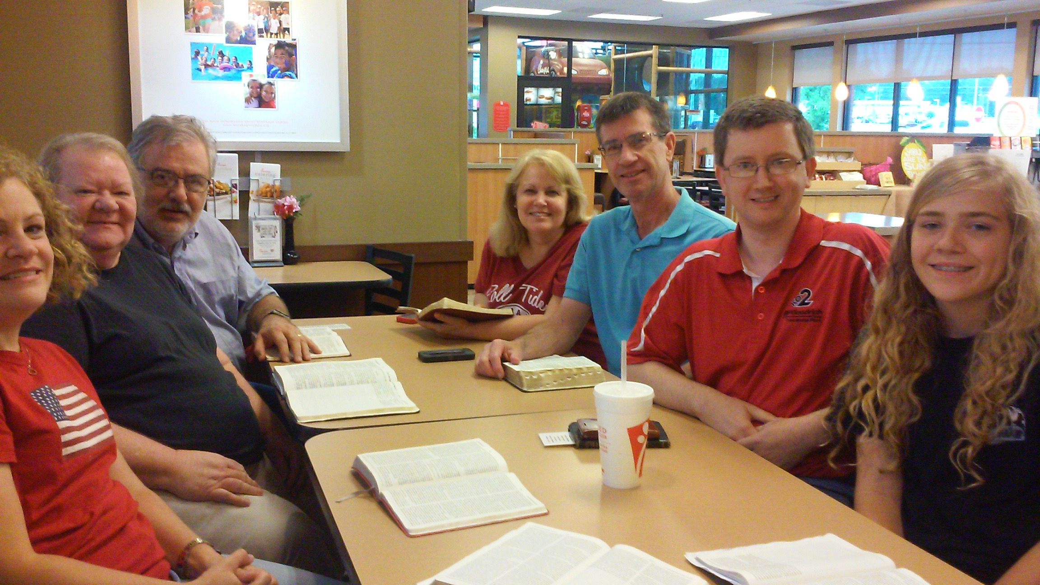
Almighty God Beyond the Veil
242
Hymn: S. Jason Hardin (2003)
Tune: C. E. Couchman (2003)
© 2003 S. J. Hardin and C. E. Couchman

Slide 5
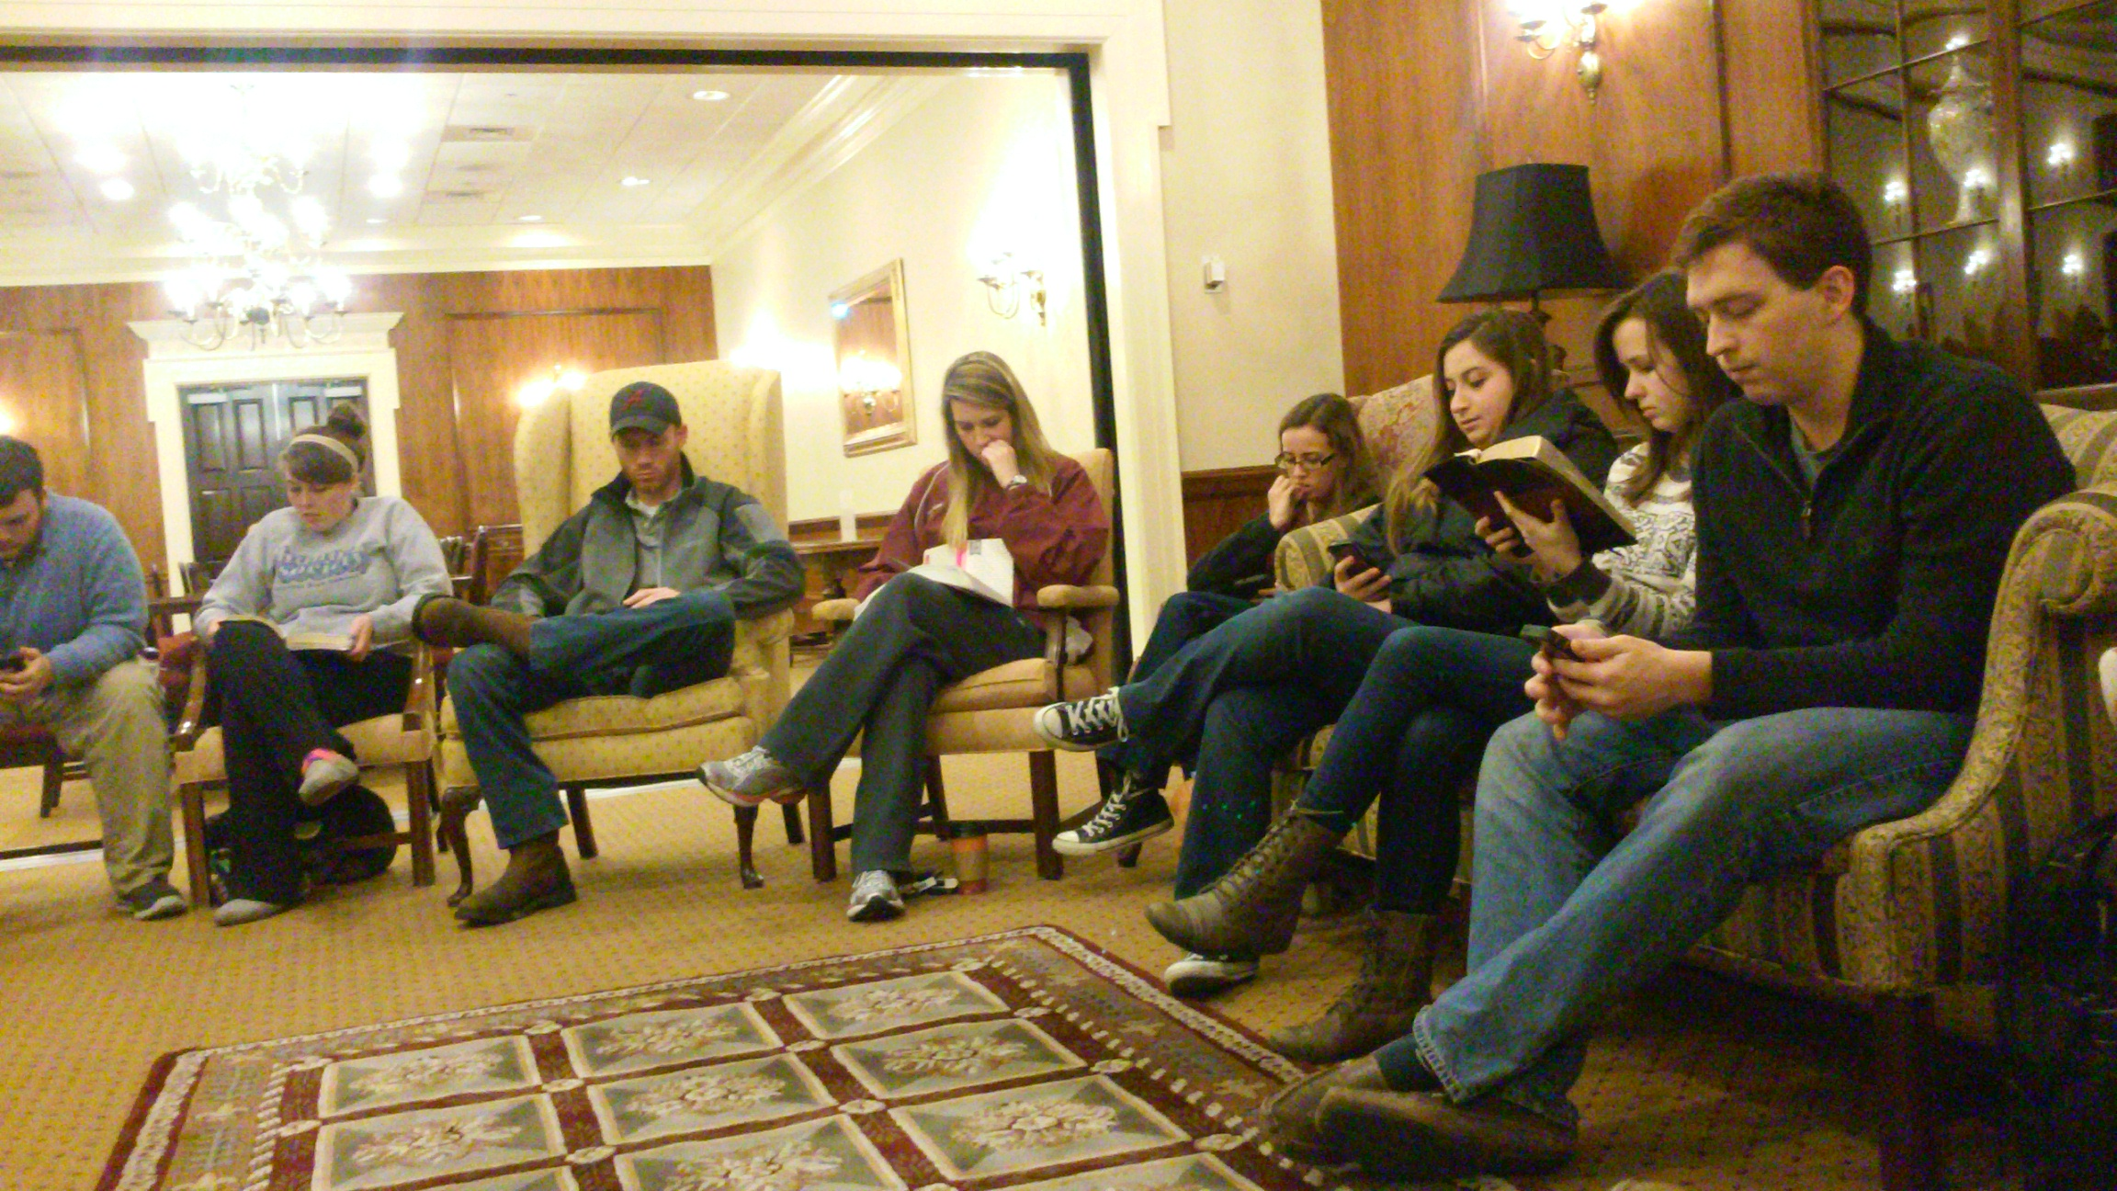
Almighty God Beyond the Veil
242
Hymn: S. Jason Hardin (2003)
Tune: C. E. Couchman (2003)
© 2003 S. J. Hardin and C. E. Couchman

Slide 6
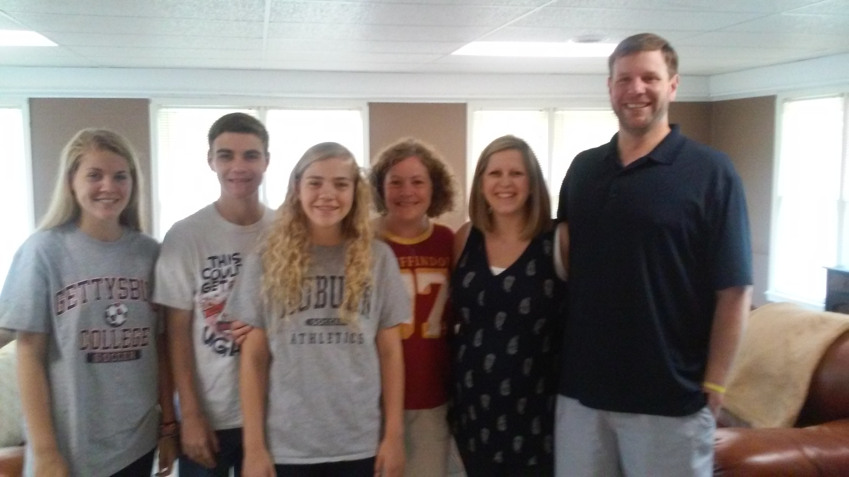
Almighty God Beyond the Veil
242
Hymn: S. Jason Hardin (2003)
Tune: C. E. Couchman (2003)
© 2003 S. J. Hardin and C. E. Couchman

Slide 7
Almighty God Beyond the Veil
242
Hymn: S. Jason Hardin (2003)
Tune: C. E. Couchman (2003)
© 2003 S. J. Hardin and C. E. Couchman

Slide 8
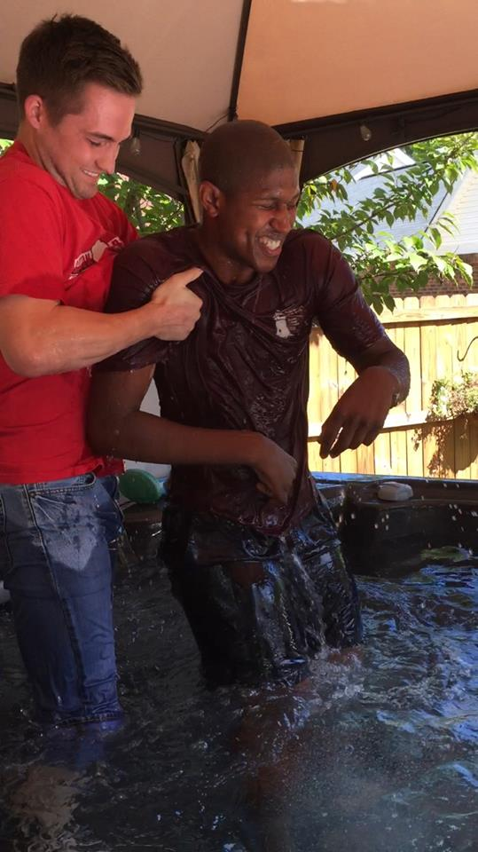
Almighty God Beyond the Veil
242
Hymn: S. Jason Hardin (2003)
Tune: C. E. Couchman (2003)
© 2003 S. J. Hardin and C. E. Couchman

Slide 9
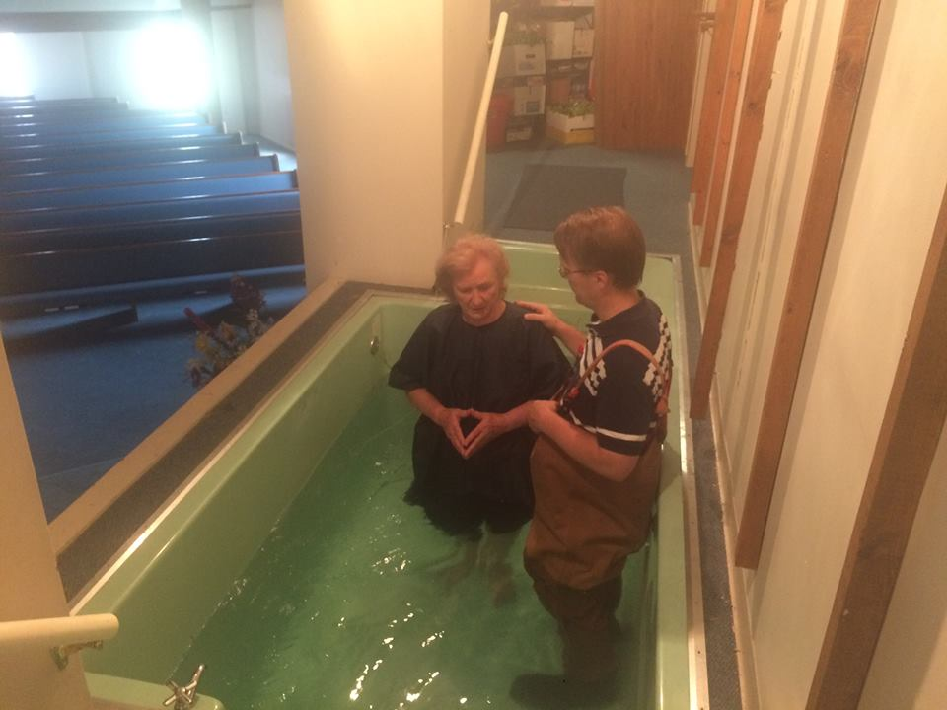

Slide 10
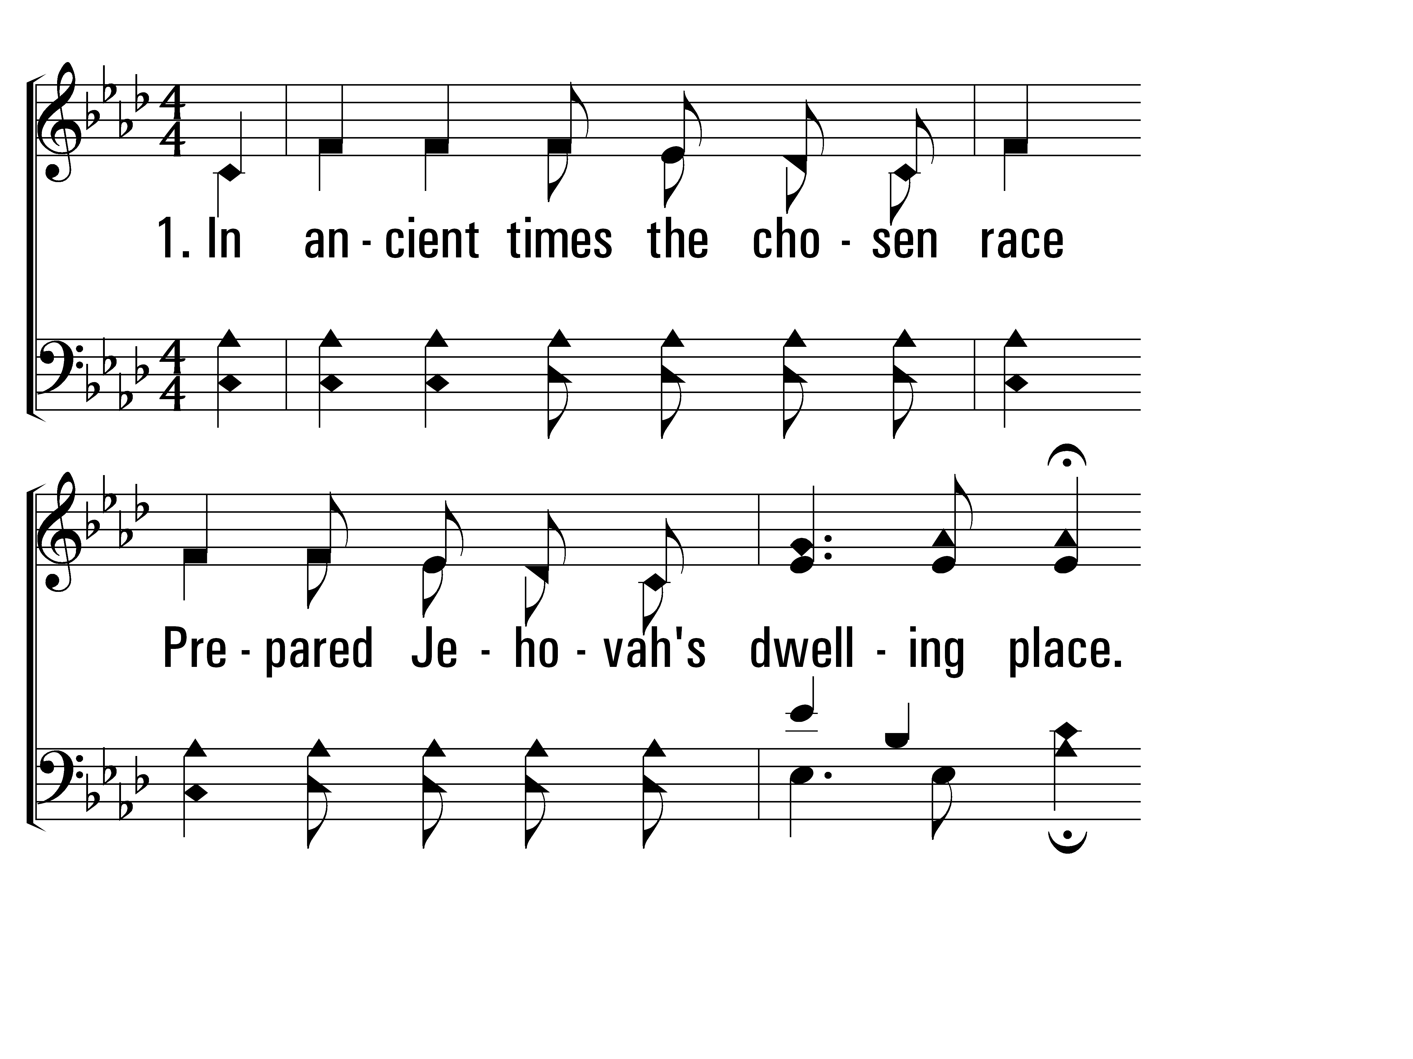
AlmightyGodBeyondTheVeil_st1_a
Vs 1
© 2014 Sumphonia Productions, LLC

Slide 11
AlmightyGodBeyondTheVeil_st1_b
Vs 1
© 2014 Sumphonia Productions, LLC

Slide 12
AlmightyGodBeyondTheVeil_st1_c
Vs 1
© 2014 Sumphonia Productions, LLC

Slide 13
AlmightyGodBeyondTheVeil_st2_a
Vs 2
© 2014 Sumphonia Productions, LLC

Slide 14
AlmightyGodBeyondTheVeil_st2_b
Vs 2
© 2014 Sumphonia Productions, LLC

Slide 15
AlmightyGodBeyondTheVeil_st2_c
Vs 2
© 2014 Sumphonia Productions, LLC

Slide 16
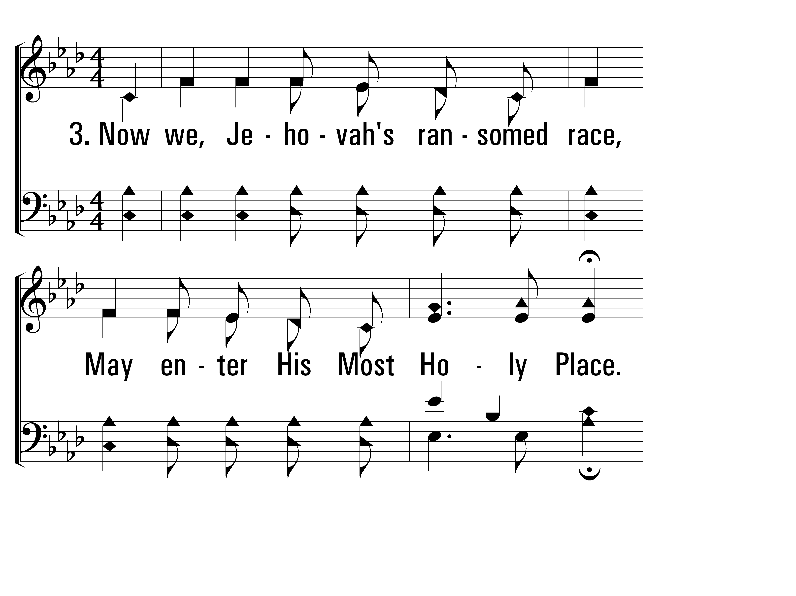
AlmightyGodBeyondTheVeil_st3_a
Vs 3
© 2014 Sumphonia Productions, LLC

Slide 17
AlmightyGodBeyondTheVeil_st3_b
Vs 3
© 2014 Sumphonia Productions, LLC

Slide 18
AlmightyGodBeyondTheVeil_st3_c
Vs 3
© 2014 Sumphonia Productions, LLC

Slide 19
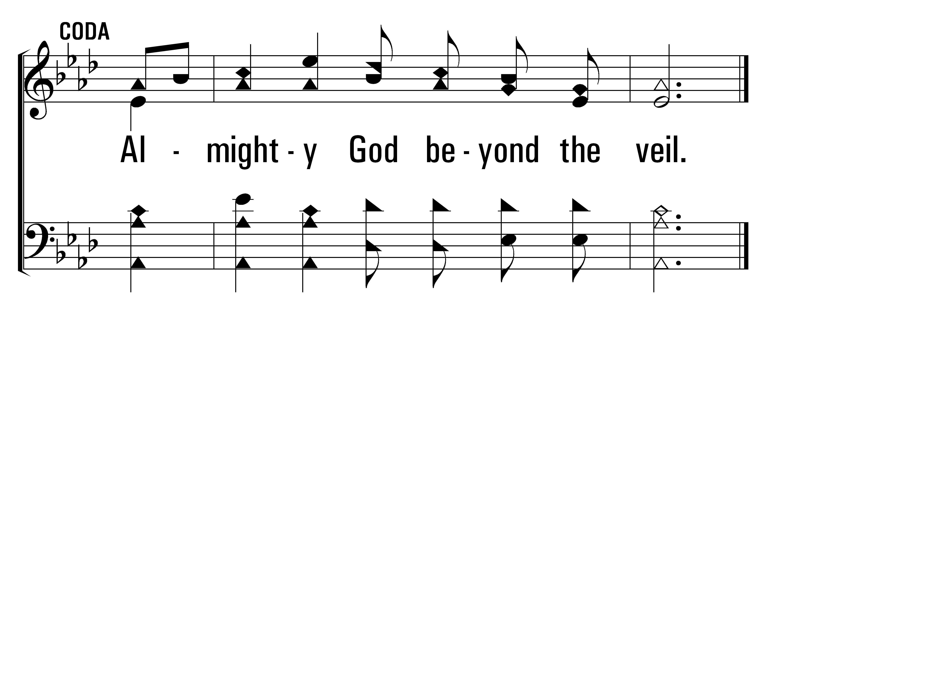
AlmightyGodBeyondTheVeil_coda_a
Coda
© 2014 Sumphonia Productions, LLC
End

Slide 20
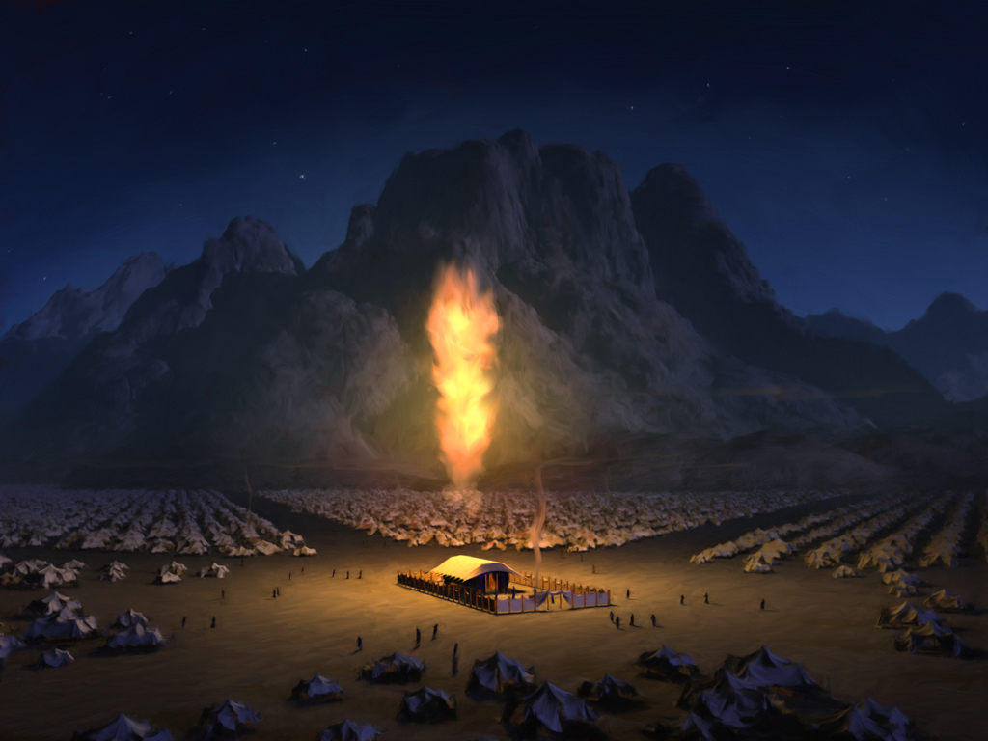
Entering
THE HOLY PLACES

Slide 21
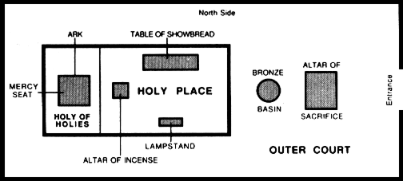
Entering
THE HOLY PLACES

Slide 22
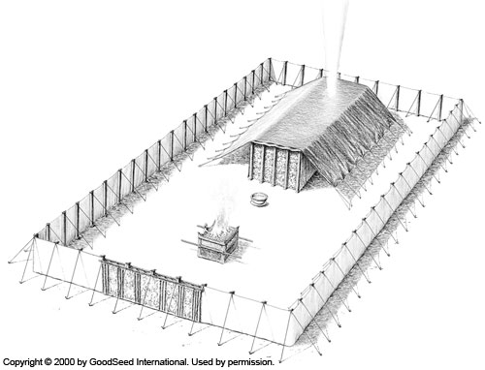
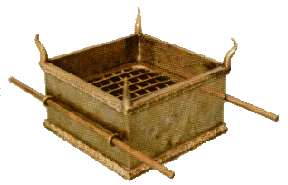
The Altar of Sacrifice

Slide 23
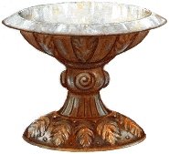
The Wash Basin

Slide 24
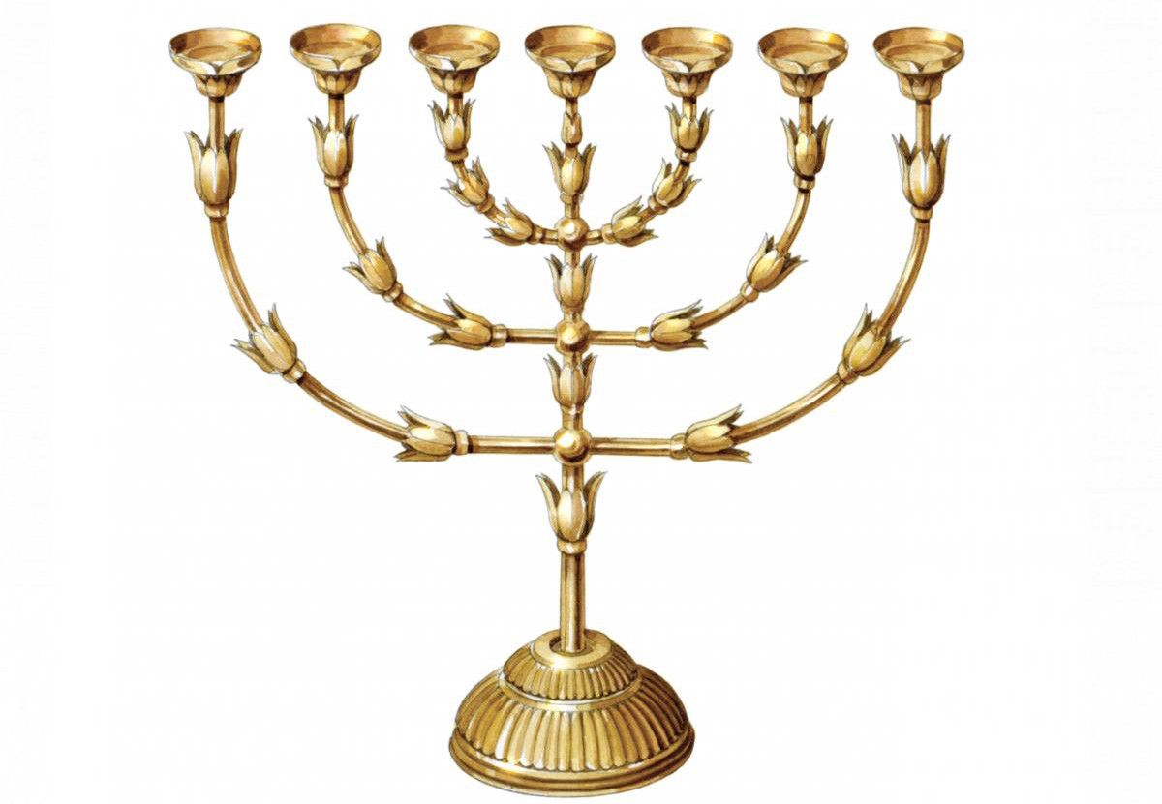
The Lampstand

Slide 25
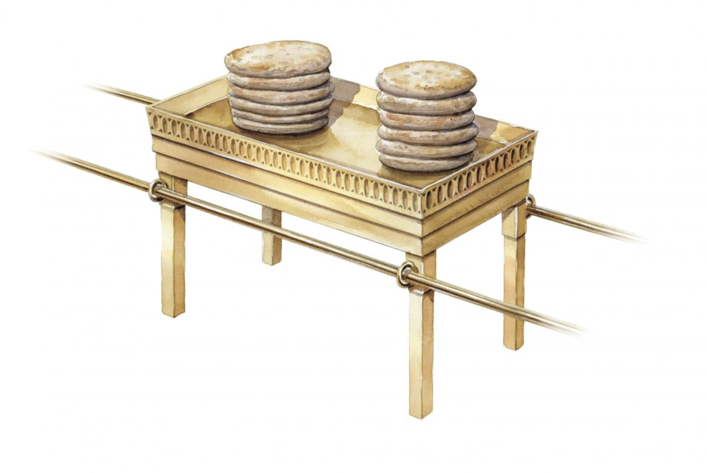
The Bread of the Presence

Slide 26
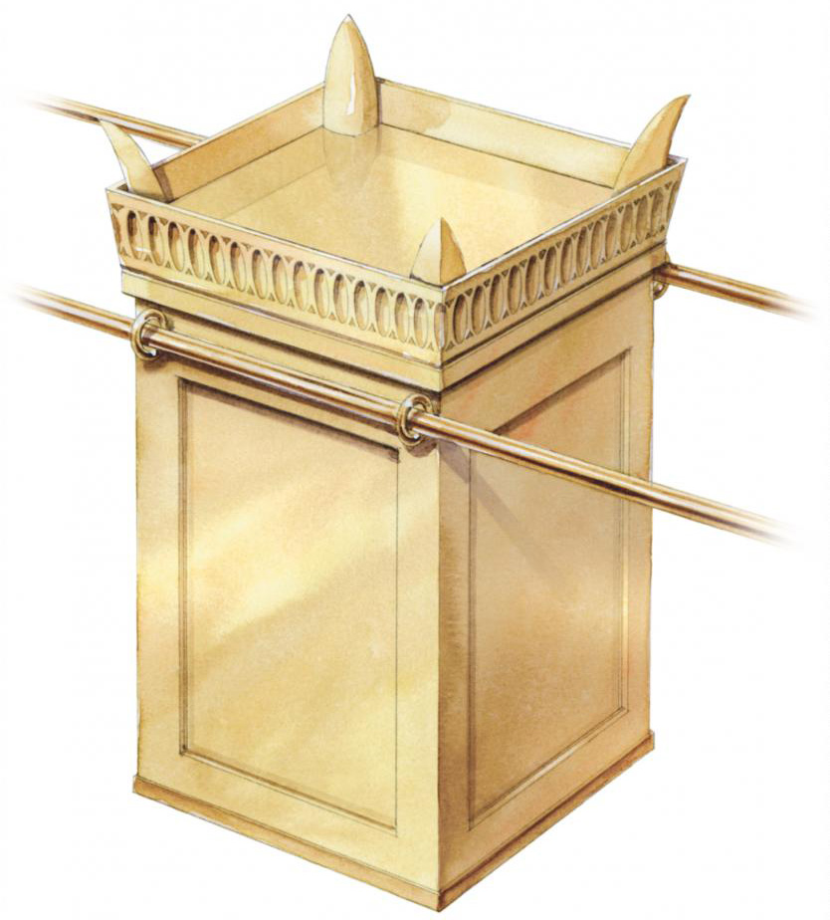
The Altar of Incense

Slide 27
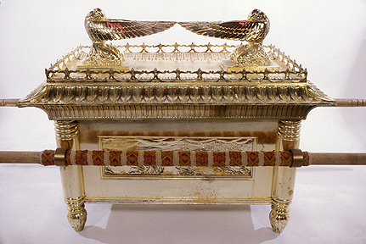
The Holy of Holies

Slide 28
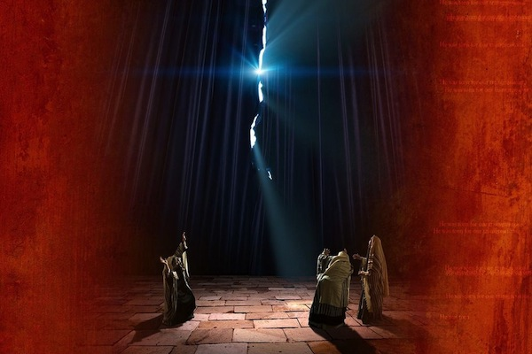

Slide 29
Almighty God Beyond the Veil
242
Hymn: S. Jason Hardin (2003)
Tune: C. E. Couchman (2003)
© 2003 S. J. Hardin and C. E. Couchman

Slide 30
AlmightyGodBeyondTheVeil_st1_a
Vs 1
© 2014 Sumphonia Productions, LLC

Slide 31
AlmightyGodBeyondTheVeil_st1_b
Vs 1
© 2014 Sumphonia Productions, LLC

Slide 32
AlmightyGodBeyondTheVeil_st1_c
Vs 1
© 2014 Sumphonia Productions, LLC

Slide 33
AlmightyGodBeyondTheVeil_st2_a
Vs 2
© 2014 Sumphonia Productions, LLC

Slide 34
AlmightyGodBeyondTheVeil_st2_b
Vs 2
© 2014 Sumphonia Productions, LLC

Slide 35
AlmightyGodBeyondTheVeil_st2_c
Vs 2
© 2014 Sumphonia Productions, LLC

Slide 36
AlmightyGodBeyondTheVeil_st3_a
Vs 3
© 2014 Sumphonia Productions, LLC

Slide 37
AlmightyGodBeyondTheVeil_st3_b
Vs 3
© 2014 Sumphonia Productions, LLC

Slide 38
AlmightyGodBeyondTheVeil_st3_c
Vs 3
© 2014 Sumphonia Productions, LLC

Slide 39
AlmightyGodBeyondTheVeil_coda_a
Coda
© 2014 Sumphonia Productions, LLC
End

Slide 40
Theophany
88
Hymn: C. A. Roberts (2001)
Tune: MAZURKA • Frederic Chopin (1829); arr. C. A. Roberts (2001)
© 2001 David and Jimona Maravilla

Slide 41
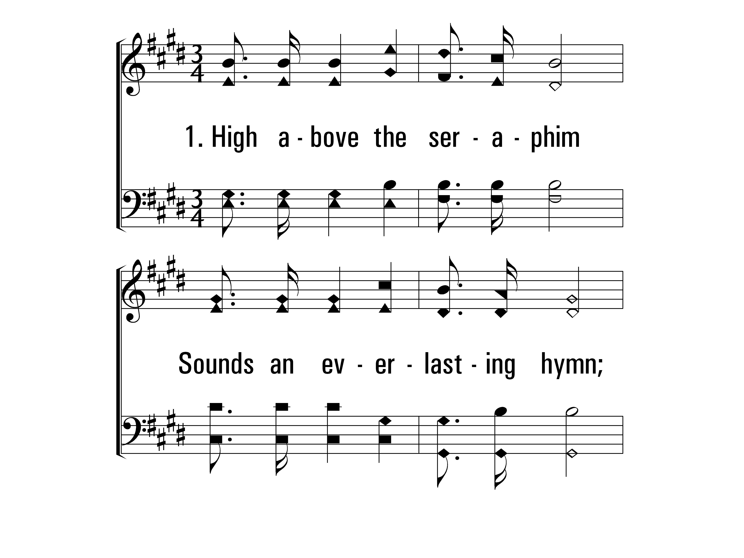
Theophany_st1_a
Vs 1
© 2014 Sumphonia Productions, LLC

Slide 42
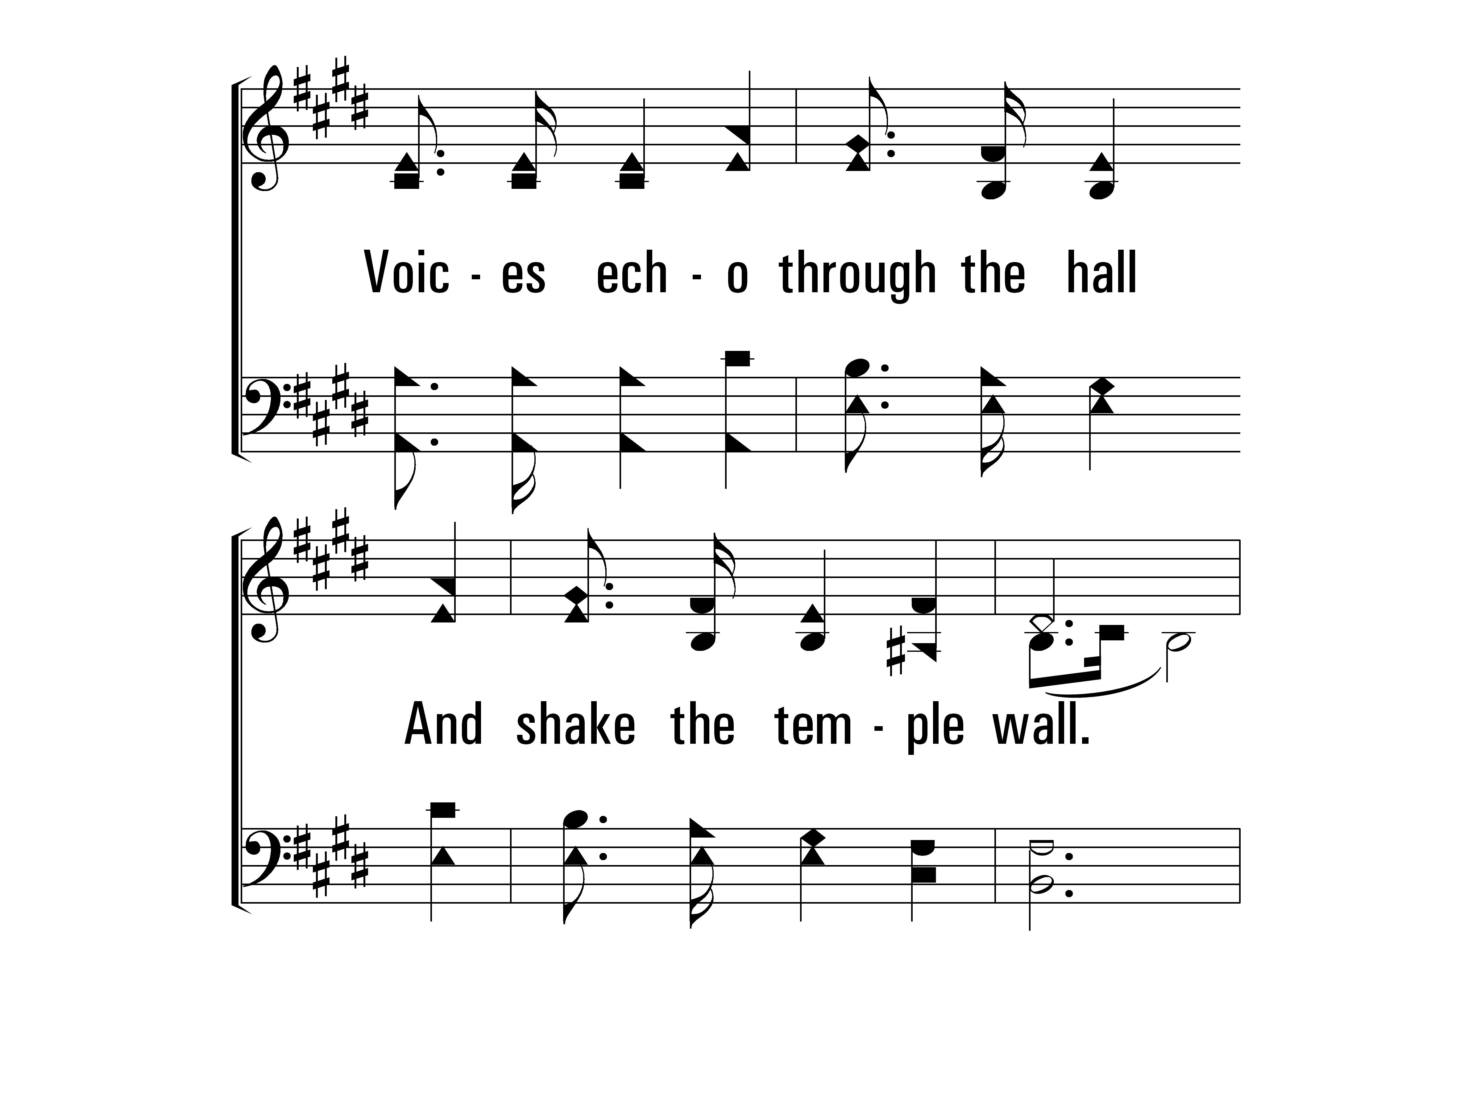
Theophany_st1_b
Vs 1
© 2014 Sumphonia Productions, LLC

Slide 43
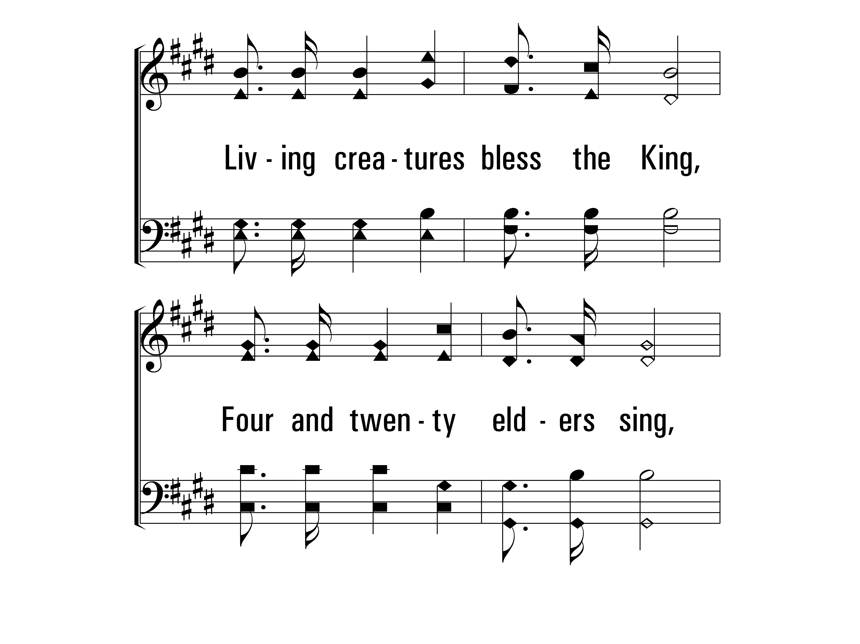
Theophany_st1_c
Vs 1
© 2014 Sumphonia Productions, LLC

Slide 44
Theophany_st1_d
Vs 1
© 2014 Sumphonia Productions, LLC

Slide 45
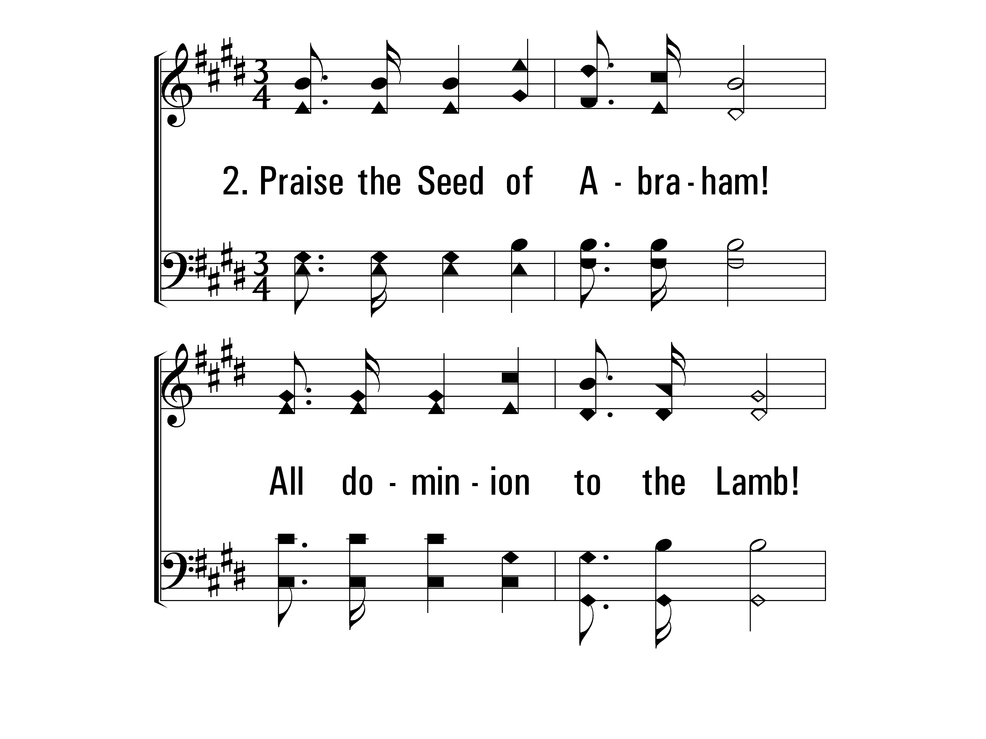
Theophany_st2_a
Vs 2
© 2014 Sumphonia Productions, LLC

Slide 46
Theophany_st2_b
Vs 2
© 2014 Sumphonia Productions, LLC

Slide 47
Theophany_st2_c
Vs 2
© 2014 Sumphonia Productions, LLC

Slide 48
Theophany_st2_d
Vs 2
© 2014 Sumphonia Productions, LLC

Slide 49
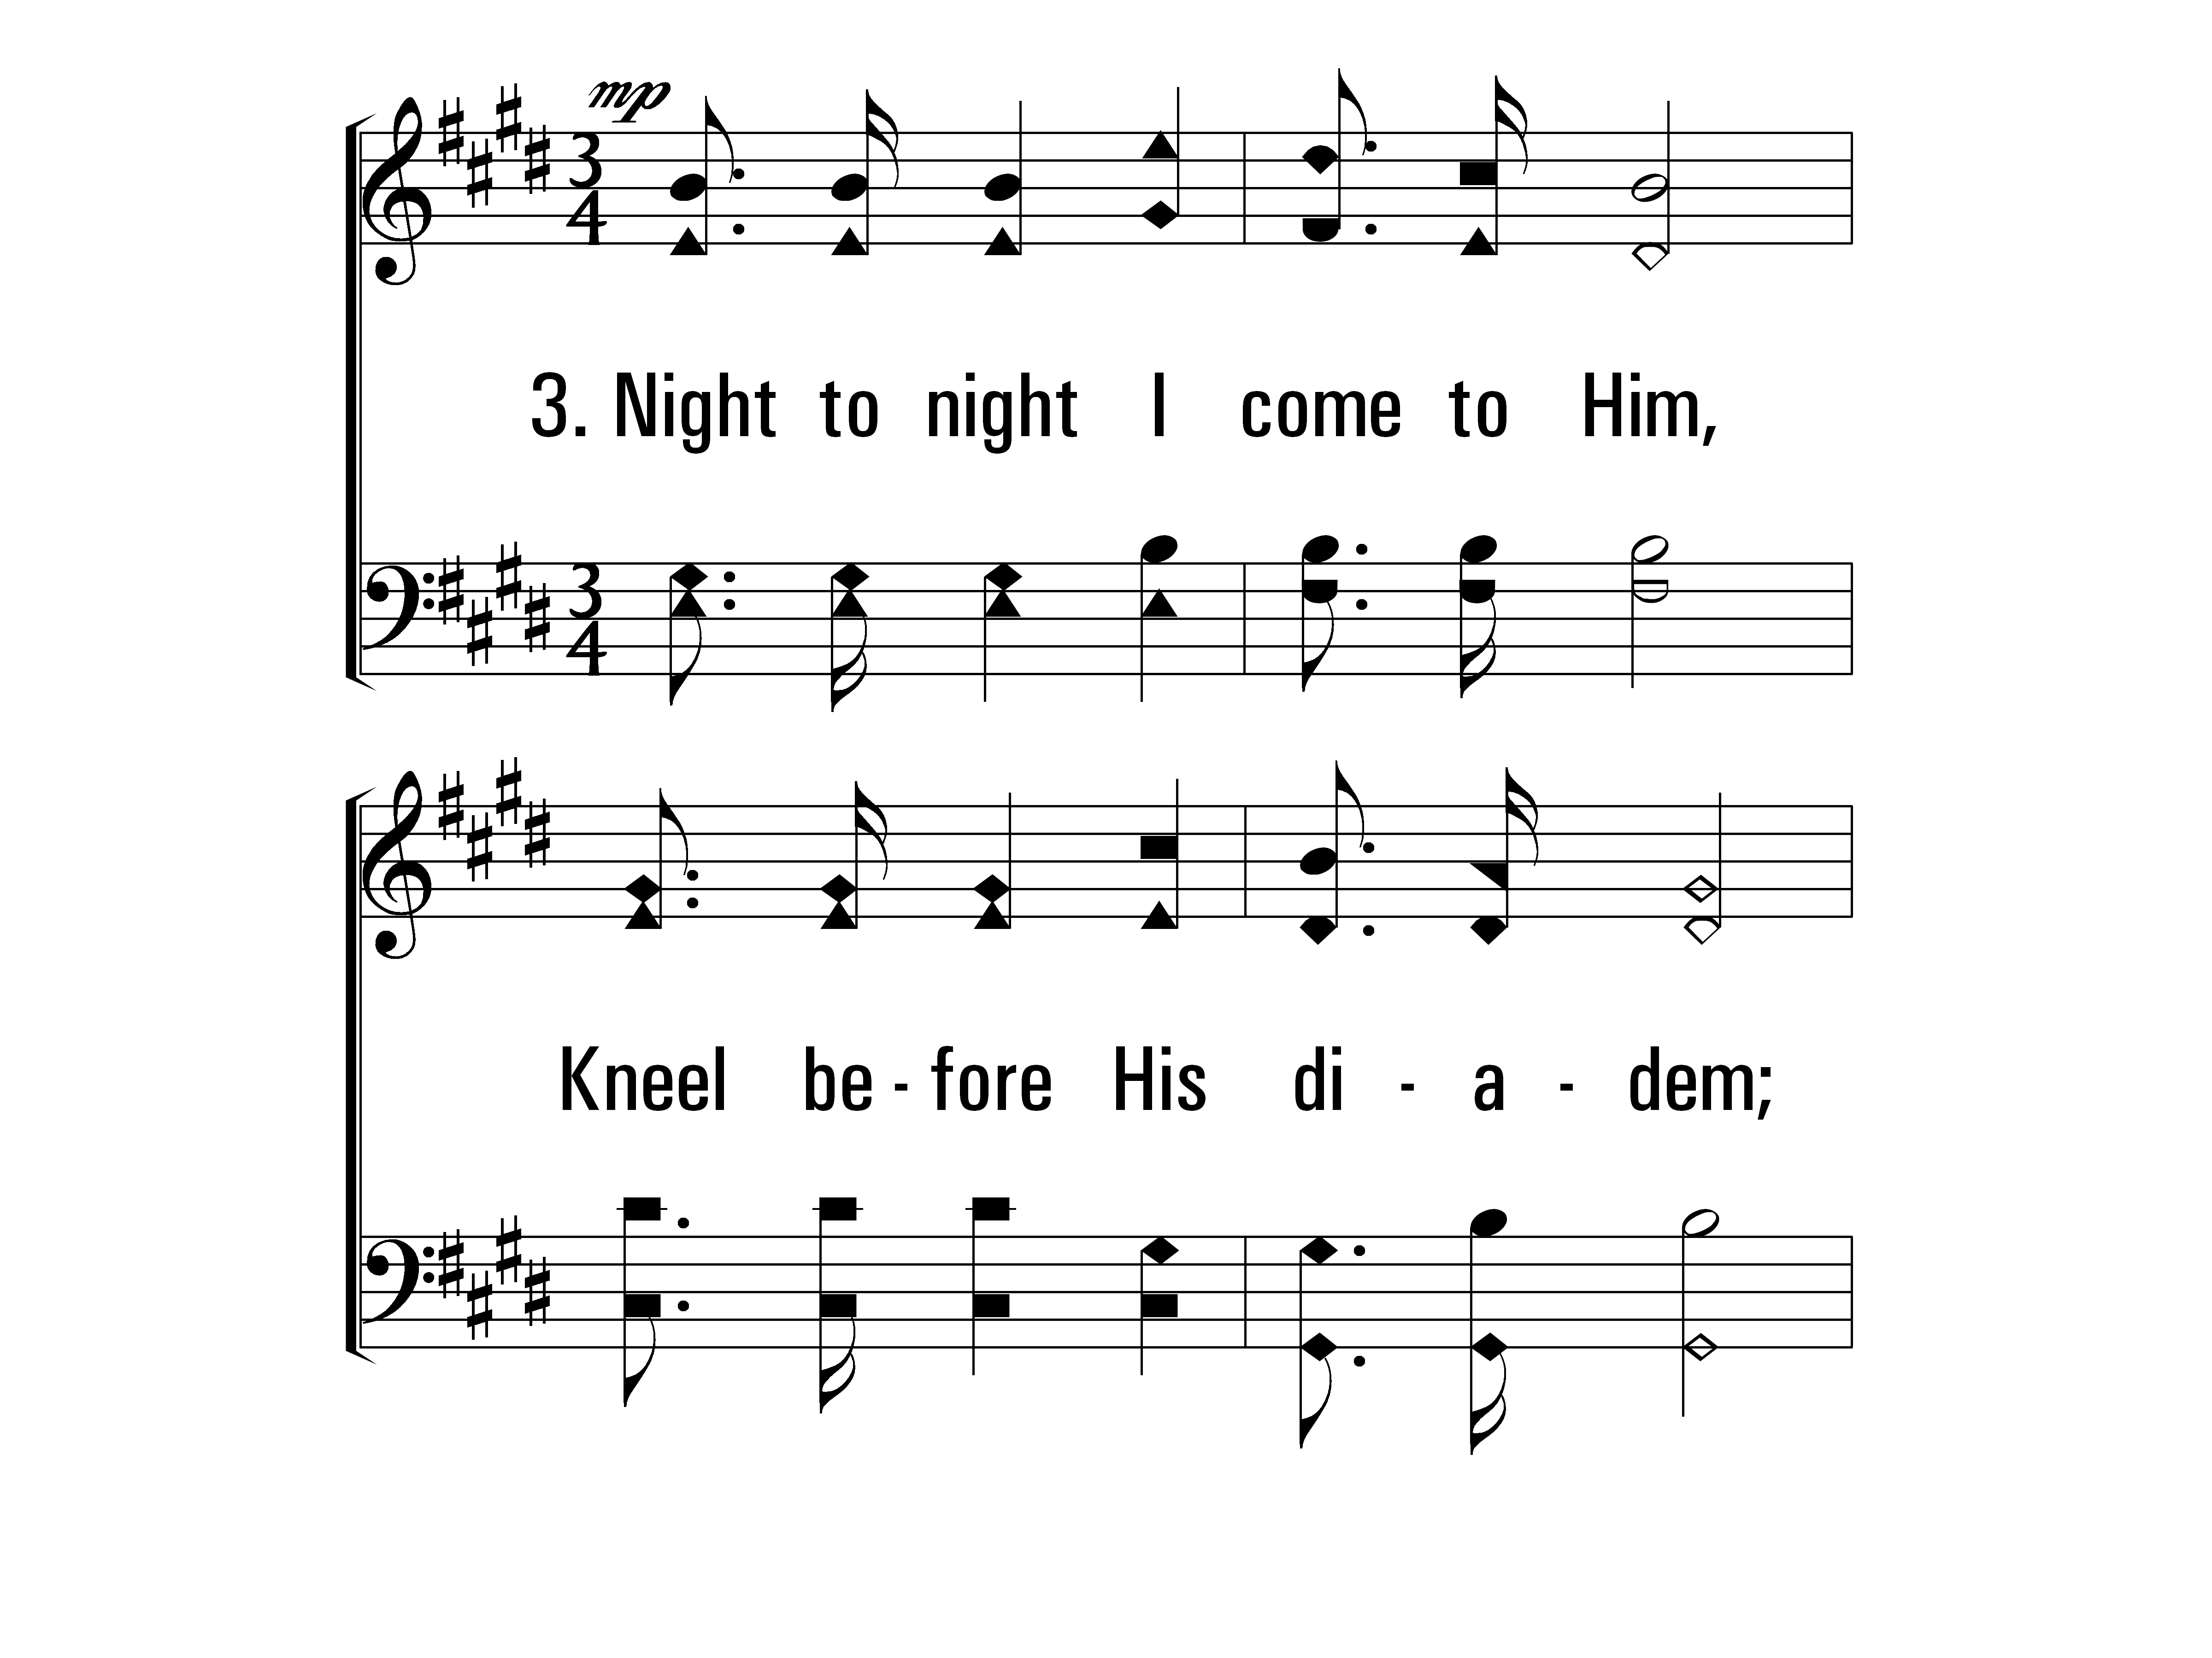
Theophany_st3_a
Vs 3
© 2014 Sumphonia Productions, LLC

Slide 50
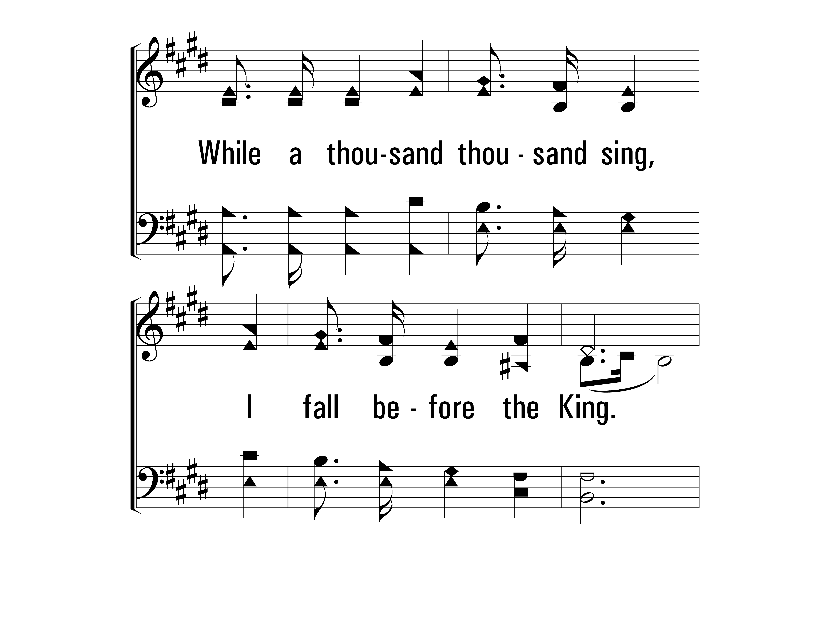
Theophany_st3_b
Vs 3
© 2014 Sumphonia Productions, LLC

Slide 51
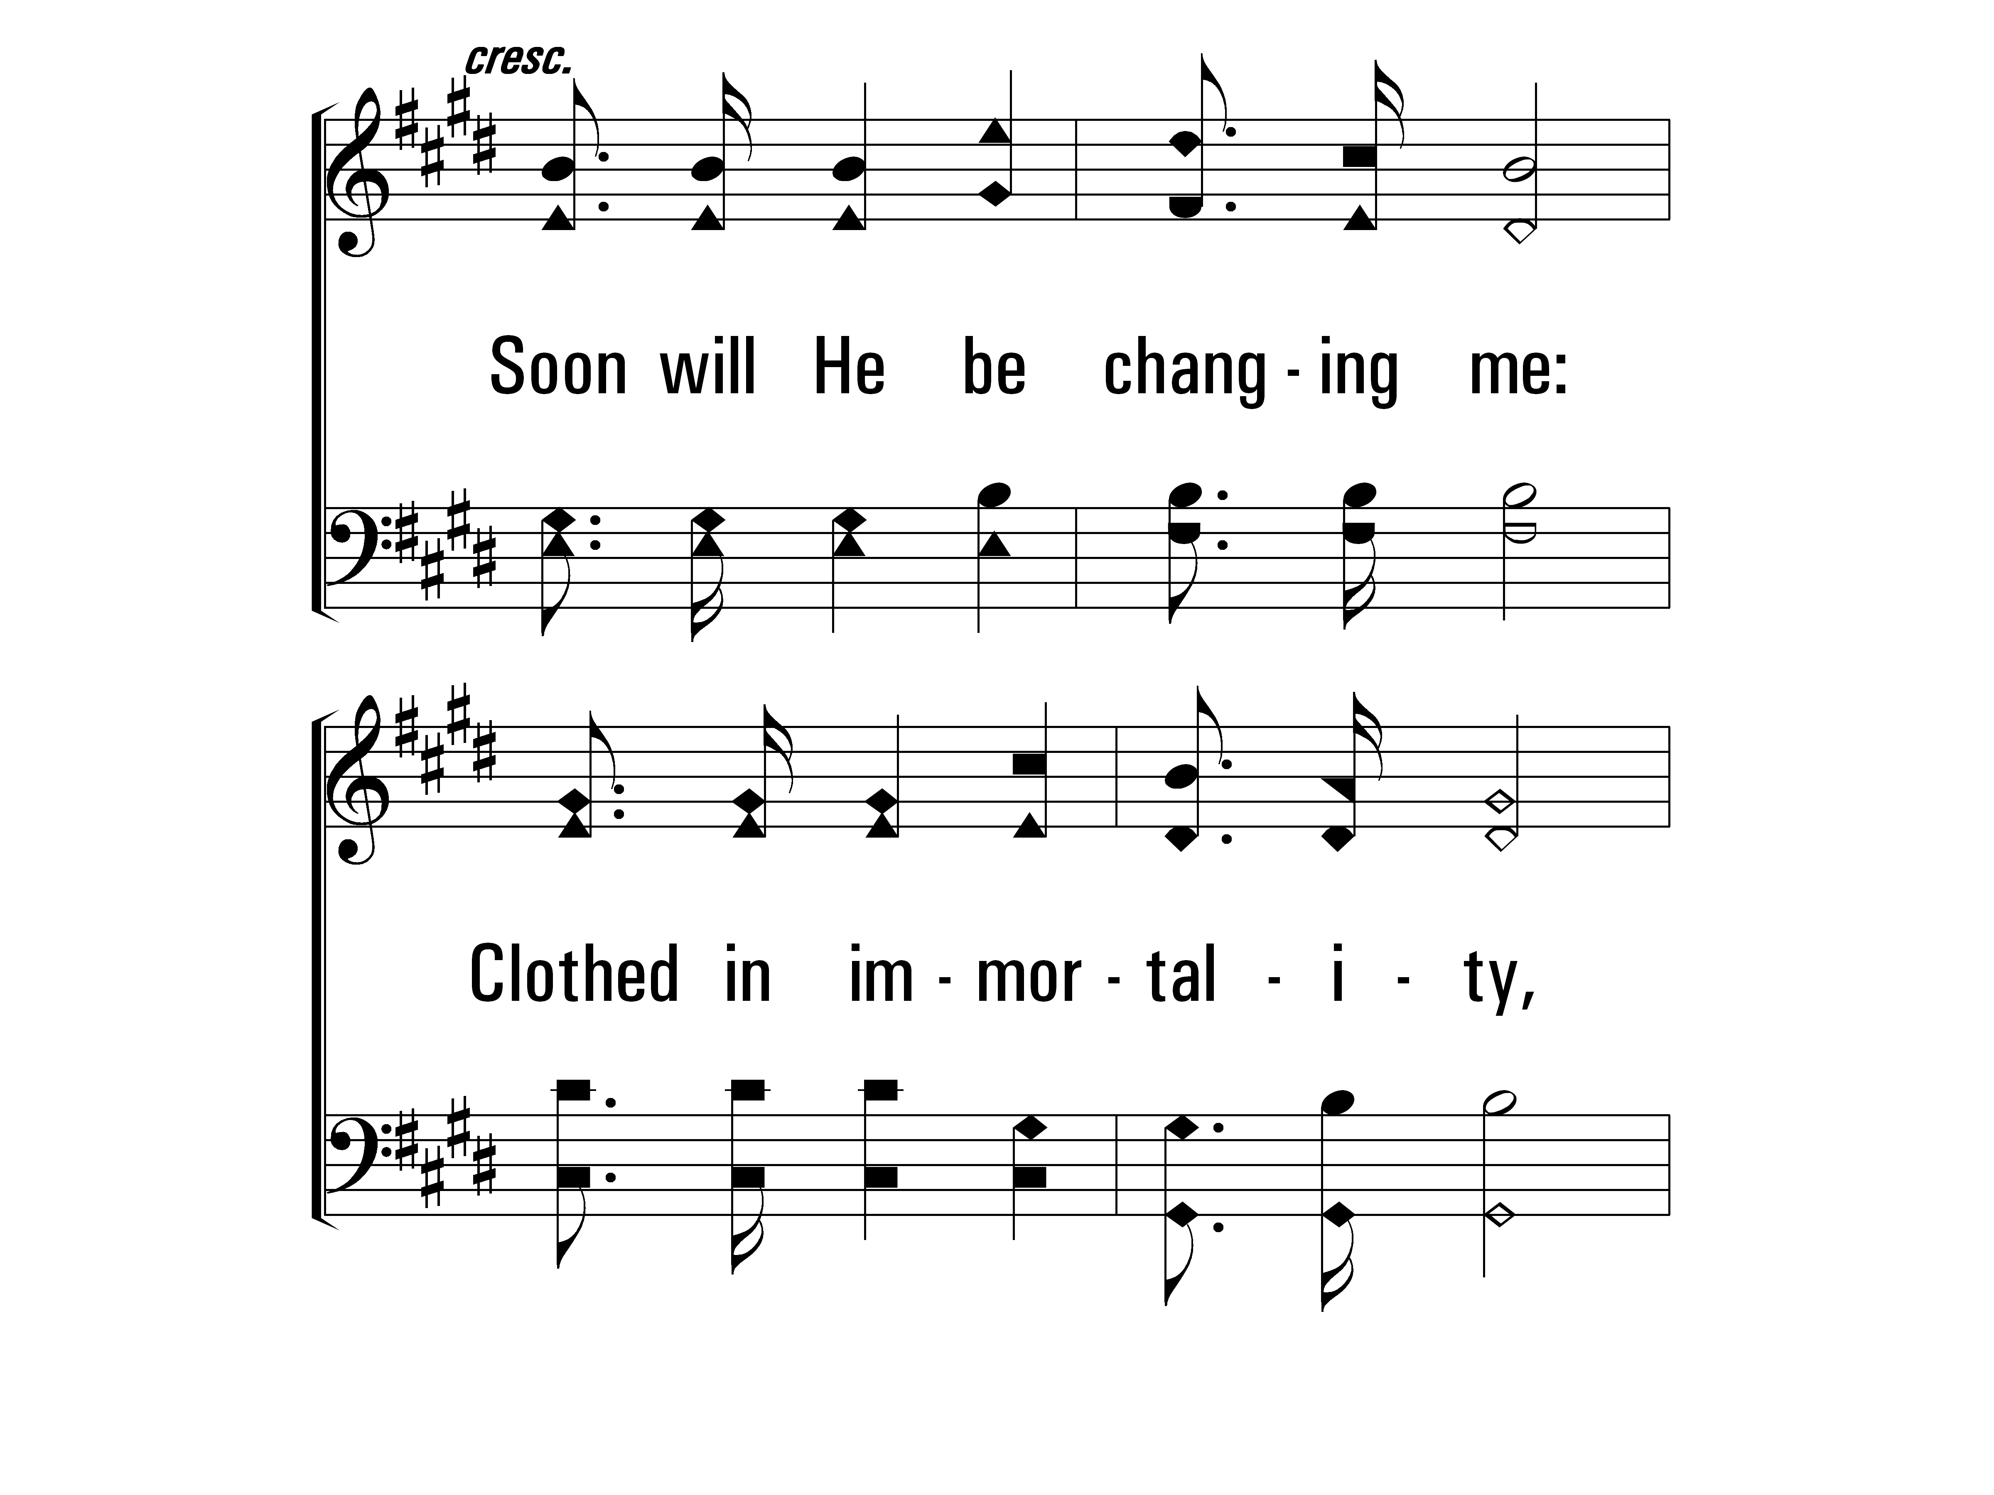
Theophany_st3_c
Vs 3
© 2014 Sumphonia Productions, LLC

Slide 52
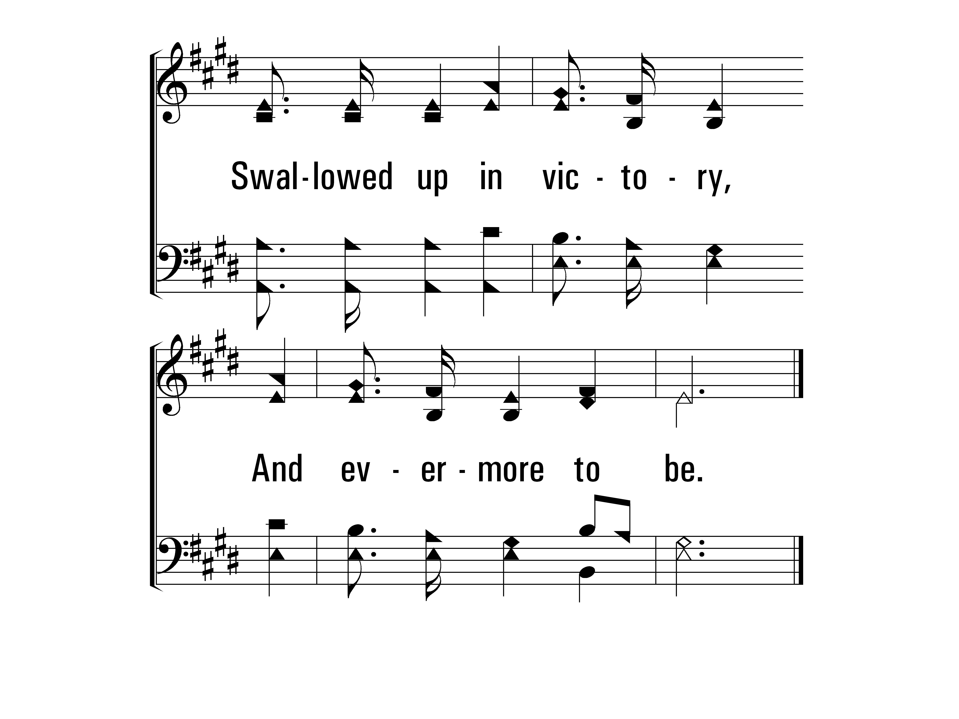
Theophany_st3_d
Vs 3
© 2014 Sumphonia Productions, LLC
End

