Slide 1
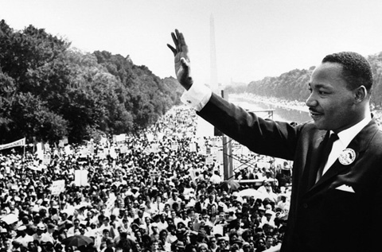
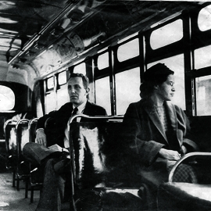

Slide 2
One Thing
Notes:
Read passages from Psalms, then show title

Slide 3
Our (Unfulfilled) Needs & Desires
Work, leisure, goals, purpose, creativity
Achievement
Strong relationships, understanding, societal participation
Respect
Family, friends, affection, community
Love
Money, government (+ other “protectors”), medical care
Security
Physical needs, money, food, shelter, air, water
Sustenance
Notes:
Obviously, we humans have many more desires than God as the “one thing” in our lives.
But are these desires/pursuits so bad? Why must I put forth all my effort in desiring, seeking, pursuing God?
All these things leave us empty because they are only a shadow of what we are really looking for…

Slide 4
Our Hope in the Glory of God
Glory Lost in Our Sin (Rom. 1:23; 3:23; Heb. 2:5-8)
Definition of “Glory”
Fame, approval, splendor
Of God?
Promise of Glory (Rom. 2:7-10; 5:1-5; 8:17-18, 28-30)
Jesus: The Glorious One (Jn. 1:14; Heb. 2:9; 2 Cor. 3:17-18)
God's glory is the radiance of his infinitely worthy and valuable perfections.
Notes:
Finish off with some personal application concepts from Col. 3:1-4; Phil. 3:17-21

Slide 5
Do I Desire God?
Do I Desire God…ONLY?

Slide 6
One thing I ask from the Lord, this only do I seek: that I may dwell in the house of the Lord all the days of my life, to gaze on the beauty of the Lord and to seek him in his temple.
For in the day of trouble he will keep me safe in his dwelling; he will hide me in the shelter of his tabernacle and set me high upon a rock.
Psalm 27:4-5

