Slide 1
Study of Daniel
Lesson 3 – Chapter 2
Fall 2015

Slide 2
Review Quiz on Lesson 1&2
Key Dates
_______ 1st Captives (incl. Daniel) taken to Babylon
_______ 2nd Set of Captives taken to Babylon
_______ Fall of Jerusalem
_______ Fall of Babylon
2. Three Prophets during Exile
____________ in Jerusalem
____________ in Babylon, among the people
____________ in Babylon, among the rulers
Four Rulers whom Daniel Served (in the Book)
_________________ Babylonian (greatest)
_________________ Babylonian (last)
_________________ Mede
_________________ Persian
Theme of the Book: ______________________________________________________
Daniel’s name means: ____________________________________________________
Three miracles in Daniel
_____________________ (chapter ______)
_____________________ (chapter ______)
_____________________ (chapter ______)
Previous Prophets, who prophesied…
______________ 70 years exile
______________ Named Cyrus as the King who would allow a return
______________ Vessels of the temple & sons to be taken to Babylon
______________ Far-away nation, different language, desolation, siege, scattering (if Israel was disobedient)
8. List the metals and kingdoms described in Nebuchadnezzar’s vision of the Metallic Man.
Metal Nation
1. _____________ ____________
2._____________ ____________
3. _____________ ____________
4. _____________ ____________

Slide 3
Review Quiz on Lesson 1&2
Key Dates
_______ 1st Captives (incl. Daniel) taken to Babylon
_______ 2nd Set of Captives taken to Babylon
_______ Fall of Jerusalem
_______ Fall of Babylon
2. Three Prophets during Exile
____________ in Jerusalem
____________ in Babylon, among the people
____________ in Babylon, among the rulers
Four Rulers whom Daniel Served (in the Book)
_________________ Babylonian (greatest)
_________________ Babylonian (last)
_________________ Mede
_________________ Persian
Theme of the Book: ______________________________________________________
Daniel’s name means: ____________________________________________________
Three miracles in Daniel
_____________________ (chapter ______)
_____________________ (chapter ______)
_____________________ (chapter ______)
Previous Prophets, who prophesied…
______________ 70 years exile
______________ Named Cyrus as the King who would allow a return
______________ Vessels of the temple & sons to be taken to Babylon
______________ Far-away nation, different language, desolation, siege, scattering (if Israel was disobedient)
605
597
586
539
8. List the metals and kingdoms described in Nebuchadnezzar’s vision of the Metallic Man.
Metal Nation
1. _____________ ____________
2._____________ ____________
3. _____________ ____________
4. _____________ ____________
Jeremiah
Ezekiel
Daniel
Gold
Babylon
Silver
Medo-Persian
Nebuchadnezzar
Belchazzar
Bronze
Greek
Darius
Iron/Clay
Roman
Cyrus
God rules in the kingdoms of men. (Dan 4:17)
God is my Judge.
Fiery furnace
3
Writing on Wall
5
Lion’s Den
6
Jeremiah
Isaiah
Isaiah
Moses

Slide 4
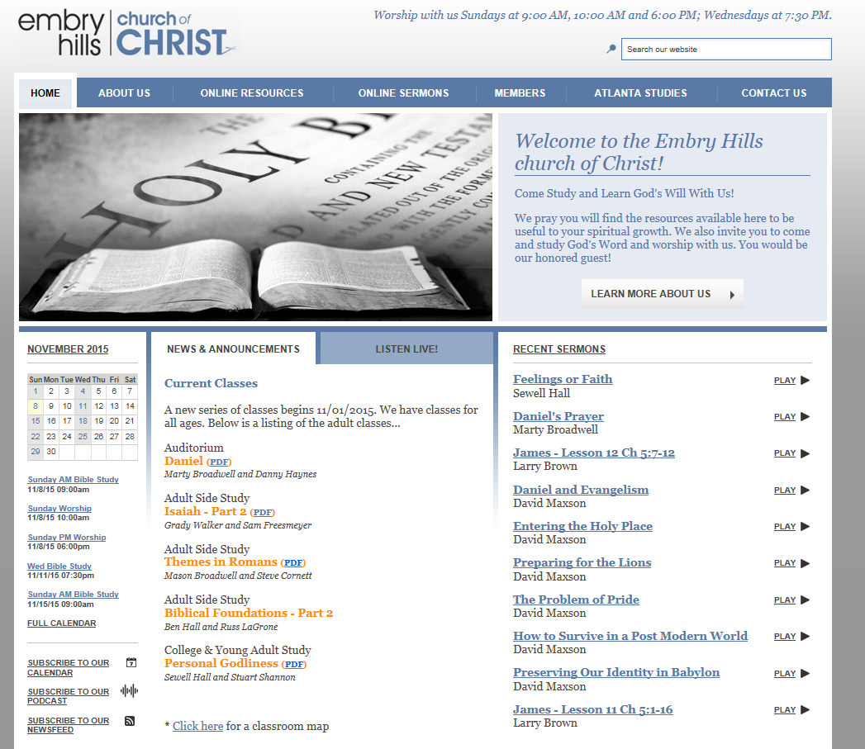
Lessons Available
Embryhills.com

Slide 5
1445-1405 BC
Wilderness
Wanderings
931-722 BC
Divided
Kingdom
605-538 BC
Babylonian
Captivity
444 BC - ~4 BC
The Silent Years
(Intertestamental)
30-90 AD
The Church
NT Era
2166-1859 BC
Patriarchs
1300-1050 BC
Judges
Slavery in Egypt
1859-1445 BC
Conquest
of Canaan
1405-1300 BC
United
Kingdom
1050-931 BC
Life of
Christ
4 BC – 30 AD
United
Kingdom
1050-931 BC
Judah
Alone
722-605 BC
Return
From Exile
538-444 BC
597 BC
2nd Captives
Ezekiel
605 BC
1st Captives
Daniel
586 BC
Fall of
Jerusalem
539BC
Fall of
Babylon
538 BC
1st Return from Exile
562-560 BC
556-539 BC
Evil-Merodach
Nabonidus
Nebuchadnezzar
Neriglassar
Belshazzar
Cyrus the Great
Darius the Mede
605-562 BC
560-556 BC
553-539 BC
539-530 BC
Daniel 1
605-603 BC
Daniel 2
603 BC
Daniel 3
603-587? BC
Daniel 4
? BC
Daniel 5-6
539 BC
Daniel 7
553 BC
Daniel 8
551 BC
Daniel 9
539 BC
Daniel 10-12
536 BC
Based on Graphics from Marc Hinds & David Maxson
Notes:
With animation

Slide 6
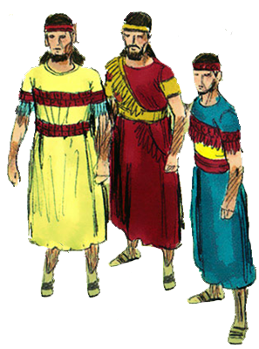
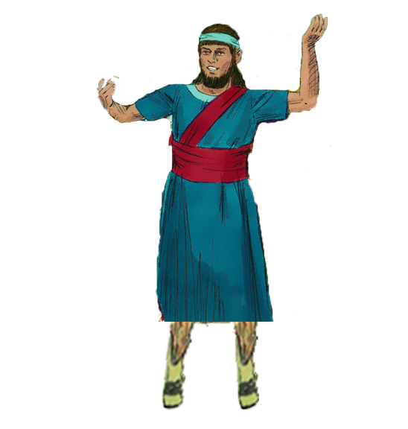
4 Hebrew Youth in Babylon
Hananiah^{H}
“The Lord is gracious”
Daniel^{H}
“God is my Judge”
Shadrach^{B}
“Command of Aku”
Belteshazzar^{B}
“May Balak protect”
Mishael^{H}
“Who is what God is”
Meshach^{B}
“Who is what Aku is”
Azariah^{H}
“The Lord has helped”
Abenego^{B}
“Servant of Nebo”

Slide 7
Chapter Content
Chapter Content
____ 1 a. Daniel’s friends in the Fiery Furnace
____ 2 b. Daniel’s final vision of the “End of the Days”
____ 3 c. Daniel’s vision of the Ram & He-goat
____ 4 d. Daniel in the Lion’s Den
____ 5 e. Daniel and his friends are selected and tested
____ 6 f. Daniel’s vision of the 4 Great Beasts
____ 7 g. Nebuchadnezzar’s dream of the Metallic Man
____ 8 h. Glorious Man tells of Kings of North and South
____ 9 i. Belshazzar’s feast and Babylon’s Fall
____ 10-11 j. Daniel’s prayer & the “70 weeks” vision
____ 12 k. Nebuchadnezzar humbled
e
g
a
k
i
d
f
c
j
h
b

Slide 8
Chapter Content of Daniel
1 Daniel and his friends are selected and tested
2 Nebuchadnezzar’s dream of the Metallic Man
Daniel’s friends in the Fiery Furnace
Nebuchadnezzar humbled
5 Belshazzar’s feast and Babylon’s Fall
6 Daniel in the Lion’s Den
7 Daniel’s vision of the 4 Great Beasts
8 Daniel’s vision of the Ram & He-goat
9 Daniel’s prayer & the “70 weeks” vision
10-11 Glorious Man tells of Kings of North and South
12 Daniel’s final vision of the “End of the Days”

Slide 9
Outline of Daniel
Chapter | Description | Language
1
2
3
4
5
6
7
8
9
10
11
12
Daniel & Friends tested in captivity
Hebrew
Daniel & Nebuchadnezzar’s
dream of 4 kingdoms
Aramaic
Faith tested in fire
Aramaic
4 Empires Rise & Fall
God Humbles Proud
Nebuchadnezzar is shown
God rules in the nations
Aramaic
Belshazzar’s feast & Babylon’s fall
Aramaic
God Rescues Faithful
Daniel’s faith in a Lion’s Den
Aramaic
Daniel’s vision of 4 beasts
Aramaic
Daniel’s vision of the ram & he-goat
Hebrew
Daniel’s prayer for return
Hebrew
Intro to Daniel’s last visions
Hebrew
Daniel’s vision Between Testaments
Hebrew
Daniel’s vision of the End Days
Hebrew
Notes:
Animated

Slide 10
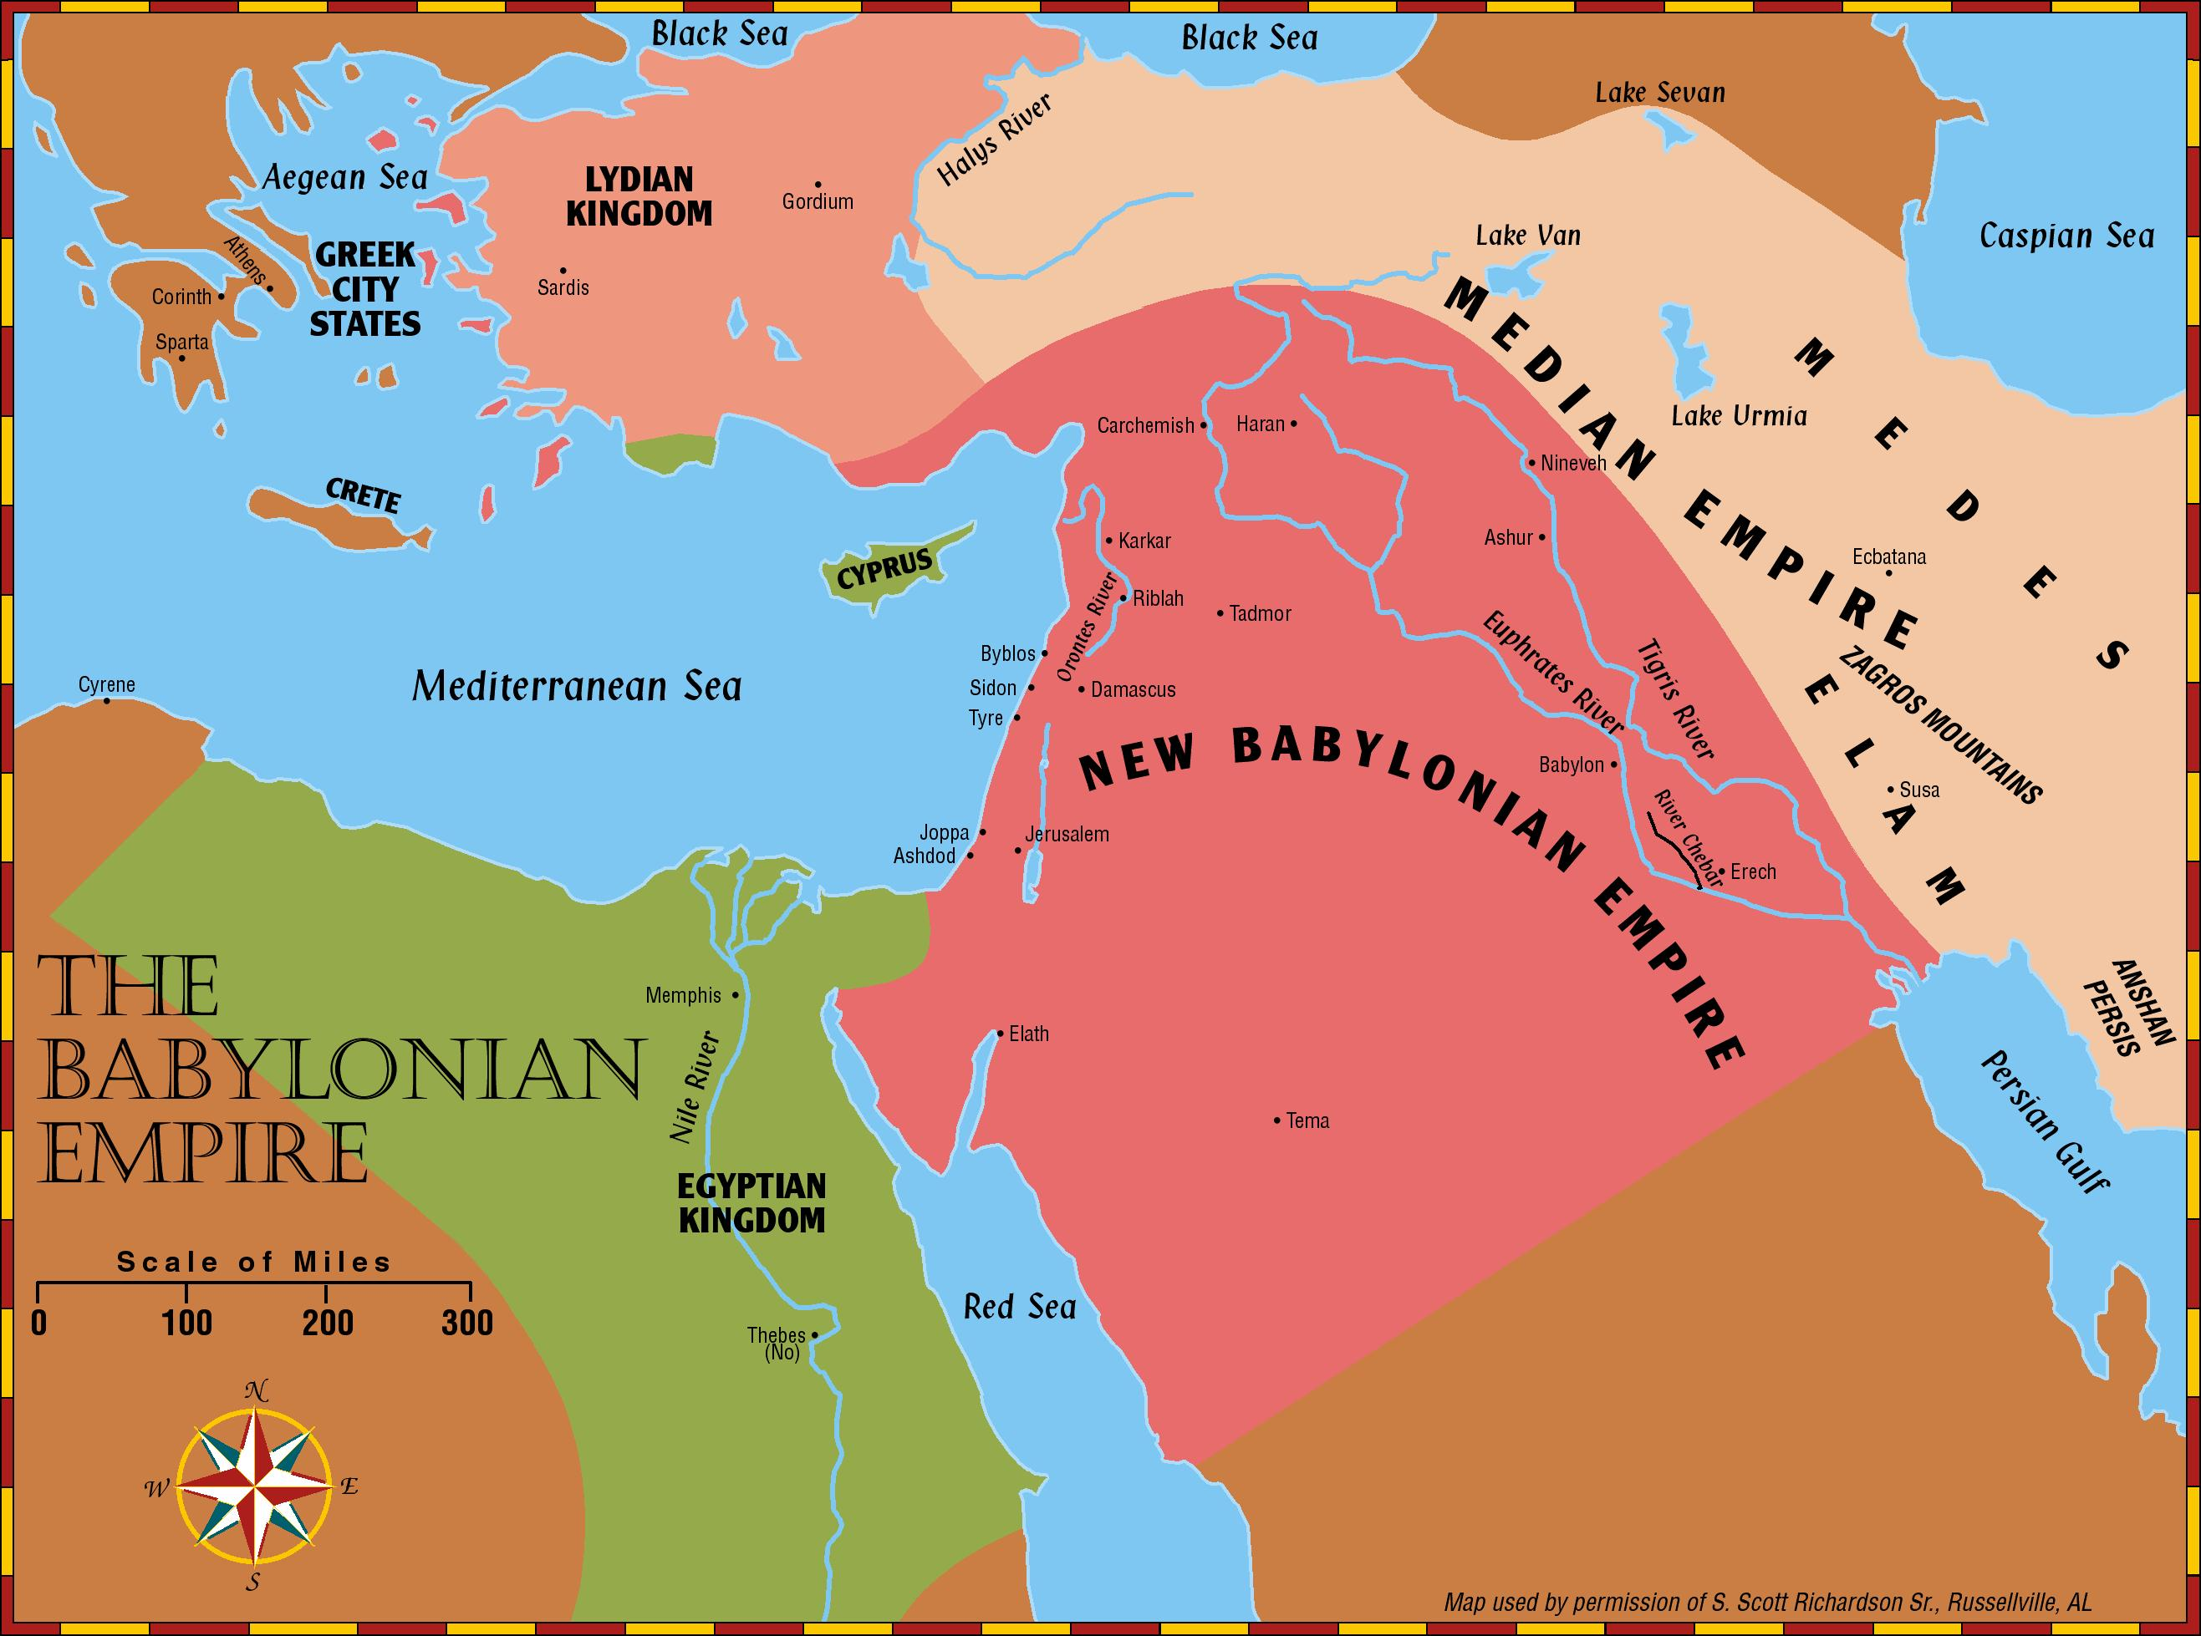
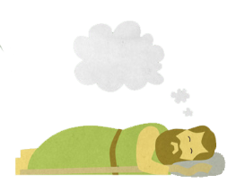
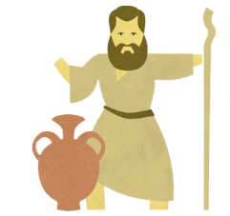
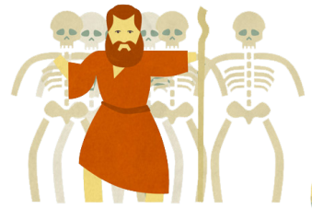
Daniel
Rulers
Jeremiah
Bad Figs
Ezekiel
Good Figs

Slide 11
Understanding the Dates
Daniel 1:1(NKJV) ¹In the third year of the reign of Jehoiakim king of Judah, Nebuchadnezzar king of Babylon came to Jerusalem and besieged it.
Start of Judah & Babylon Year
Mar/Apr
Sept
Daniel 1:5(NKJV) ⁵And the king appointed for them a daily provision… and three years of training for them, so that at the end of that time they might serve before the king.
Daniel 2:1(NKJV) ¹Now in the second year of Nebuchadnezzar’s reign, Nebuchadnezzar had dreams; and his spirit was so troubled that his sleep left him.
Accession year or postdating
Used in Assyria, Babylon, & Persia & Judah
Years of Reign start the following year
Partial year is called accession year
Jer 25
Dan 2
Dan 1:5 3 yrs
Thus Daniel done with training
Chronology of the Kings of Judah and Israel: An Illustrated Guide
Chris McKinny
Jeremiah 25:1(NKJV) ¹The word that came to Jeremiah concerning all the people of Judah, in the fourth year of Jehoiakim the son of Josiah, king of Judah (which was the first year of Nebuchadnezzar king of Babylon),

Slide 12
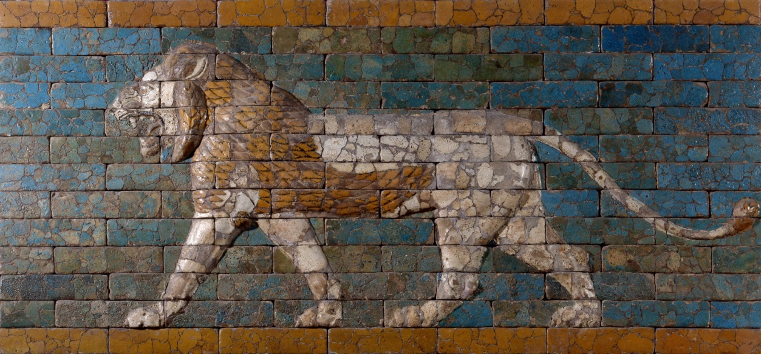
Basic thing to remember about Chronology
if it differs by a year or two then it has something to do with differences in Calendars and not a Biblical Error

Slide 13
Character of Nebuchadnezzar
Wanted & Invested in competent men to stand in the king’s palace-1:4
Willing to take heads if orders not followed 1:10
Personally inquired /examined those in training 1:19-20
Harsh –Tell me what I dreamed or
”cut in pieces” & “houses shall be made an ash heap” 2:6
Firm in sticking with decisions 2:5,8
Untrusting – you speak lying and corrupt words 2:9
Angry and very furious when demands not met 2:11-12
Fell upon his face and paid homage to Daniel 2:46
“Truly, your God is God of gods and Lord of kings, and a revealer of mysteries, 2:47

Slide 14
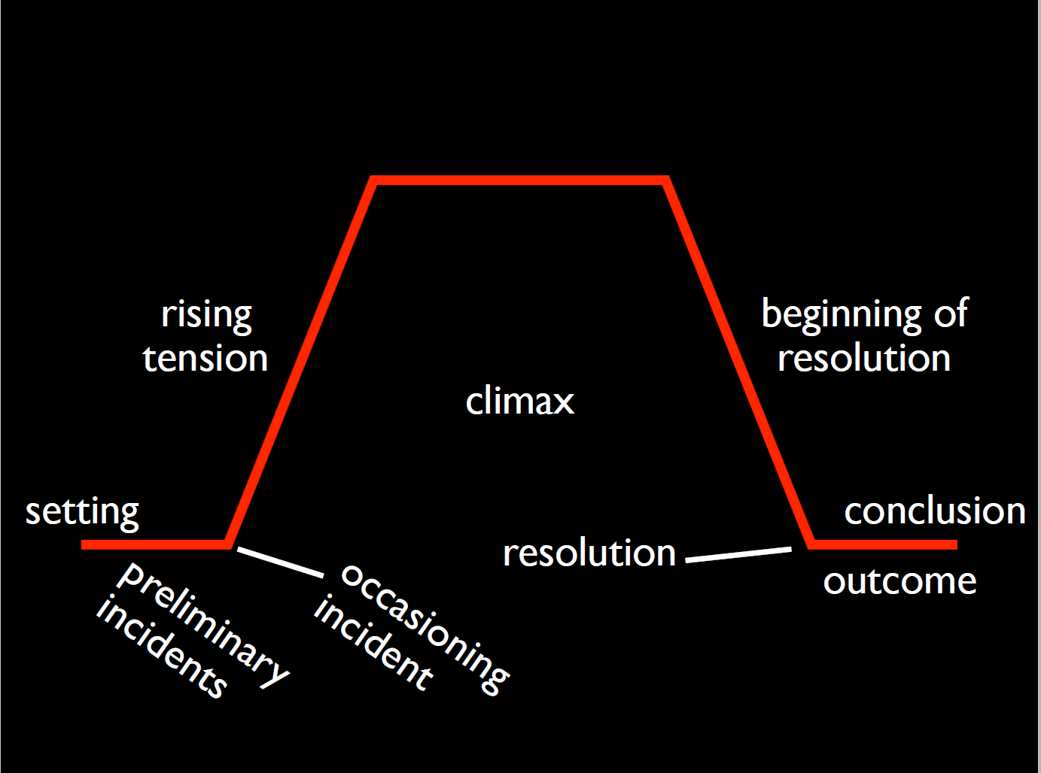
Narrative Flow
Why do you think there is so much narrative in the Bible?
Originally for listening to
Repetition
fast pace
internal connections

Slide 15
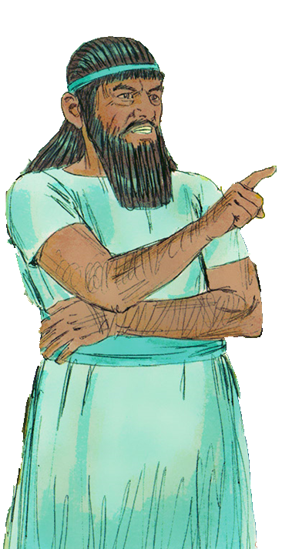
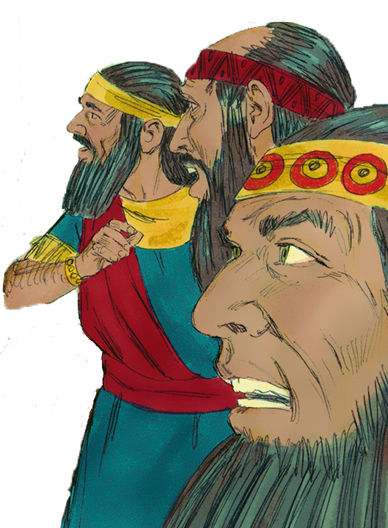
Daniel 2 - Narrative
Setting
¹Now in the second year of Nebuchadnezzar’s reign, Nebuchadnezzar had dreams; and his spirit was so troubled that his sleep left him.
Incident
²Then the king gave the command to call the magicians, the astrologers, the sorcerers, and the Chaldeans to tell the king his dreams. So they came and stood before the king. ³And the king said to them, “I have had a
dream, and my spirit is anxious to know the dream.”
⁴Then the Chaldeans spoke to the king in Aramaic, “O king, live forever! Tell your servants the dream, and we will give the interpretation.”

Slide 16
Daniel 2 - Narrative
Occasioning Incident
⁵The king answered and said to the Chaldeans, “My decision is firm: if you do not make known the dream to me, and its interpretation, you shall be cut in pieces, and your houses shall be made an ash heap. ⁶However, if you tell the dream and its interpretation, you shall receive from me gifts, rewards, and great honor.
Therefore tell me the dream and its interpretation.”

Slide 17
Differing Translations
Daniel 2:5(NKJV) ⁵The king answered and said to the Chaldeans, “My decision is firm: if you do not make known the dream to me, and its interpretation, you shall be cut in pieces, and your houses shall be made an ash heap.
Daniel 2:4-5(KJV) ⁵The king answered and said to the Chaldeans, The thing is gone from me: if ye will not make known unto me the dream, with the interpretation thereof, ye shall be cut in pieces, and your houses shall be made a dunghill.
Daniel 2:5(YLT) ⁵The king hath answered and said to the Chaldeans, ‘The thing from me is gone; if ye do not cause me to know the dream and its interpretation, pieces ye are made, and your houses are made dunghills;
Daniel 2:5(NIV) ⁵The king replied to the astrologers, “This is what I have firmly decided: If you do not tell me what my dream was and interpret it, I will have you cut into pieces and your houses turned into piles of rubble.
Daniel 2:5(ASV) ⁵The king answered and said to the Chaldeans, The thing is gone from me: if ye make not known unto me the dream and the interpretation thereof, ye shall be cut in pieces, and your houses shall be made a dunghill.

Slide 18
Daniel 2 - Narrative
Rising Tensions
⁷They answered again and said, “Let the king tell his servants the dream, and we will give its interpretation.”
⁸The king answered and said, “I know for certain that you would gain time, because you see that my decision is firm: ⁹if you do not make known the dream to me, there is only one decree for you!
For you have agreed to
speak lying and corrupt words before me till the time has changed. Therefore tell me the dream, and I shall know that you can give me its interpretation.”

Slide 19
Daniel 2 - Narrative
Rising Tensions/Climax
¹⁰The Chaldeans answered the king, and said,
“There is not a man on earth who can tell the king’s matter;
therefore no king, lord, or ruler has ever asked such things of any magician, astrologer, or Chaldean. ¹¹It is a difficult thing that the king requests,
and there is no other who can tell it to the king
except the gods, whose dwelling is not with flesh.”
¹²For this reason the king was angry and
very furious, and gave the command to
destroy all the wise men of Babylon. ¹³So the decree went out, and they began killing the wise men; and they sought Daniel and his companions,
to kill them.

Slide 20
Daniel 2 - Narrative
Beginning of Resolution
¹⁶So Daniel went in and asked the king to give him time, that he might tell the king the interpretation.
¹⁷Then Daniel went to his house, and made the decision known to Hananiah, Mishael, and Azariah, his companions, ¹⁸that they might seek mercies from the God of heaven concerning this secret, so that Daniel and his companions might not perish with the rest of the wise men of Babylon.
¹⁹Then the secret was revealed to Daniel in a night vision.

Slide 21
Daniel’s Prayer
²⁰Daniel answered and said:
“Blessed be the name of God forever and ever,
For wisdom and might are His. ²¹ And He changes the times and the seasons;
He removes kings and raises up kings;
He gives wisdom to the wise
And knowledge to those who have understanding. ²² He reveals deep and secret things;
He knows what is in the darkness,
And light dwells with Him. ²³ “I thank You and praise You,
O God of my fathers;
You have given me wisdom and might,
And have now made known to me what we asked of You,
For You have made known to us the king’s demand.”

Slide 22
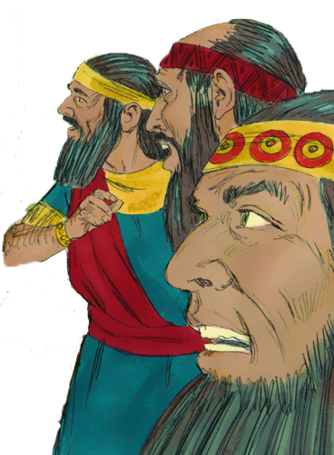
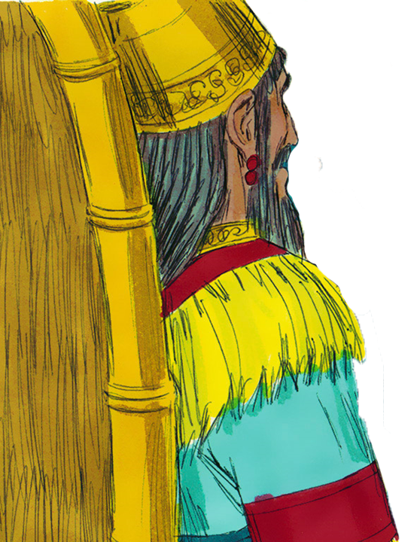
Daniel 2 - Narrative
Resolution
²⁷Daniel answered in the presence of the king, and said,
“The secret which the king has demanded, the wise men, the astrologers, the magicians, and the soothsayers cannot declare to the king. ²⁸But there is a God in heaven who reveals secrets, and He has made known to King Nebuchadnezzar what will be in the latter days. Your dream, and the visions of your head upon your bed, were these: ²⁹As for you, O king, thoughts came to your mind while on your
bed, about what would come to pass after this; and He who
reveals secrets has made known to you what will be. ³⁰But as for me, this secret has not been revealed to me
because I have more wisdom than anyone living, but for our
sakes who make known the interpretation to the king, and
that you may know the thoughts of your heart.

Slide 23
Daniel 2 - Narrative
Conclusion
³¹“You, O king, were watching; and behold, a great image!
This great image, whose splendor was excellent, stood before you; and its form was awesome. ³²This image’s head was of fine gold, its chest and arms of silver, its belly and £thighs of bronze, ³³its legs of iron, its feet partly of iron and partly of clay.
³⁴You watched while a stone was cut out without hands, which struck the image on its feet of iron and clay, and broke them in pieces. ³⁵Then the iron, the clay, the bronze, the silver, and the gold were crushed together, and became like chaff from the summer threshing floors; the wind carried them away so that no trace of them was found. And the stone that struck the image became a great mountain and filled the whole earth.

Slide 24
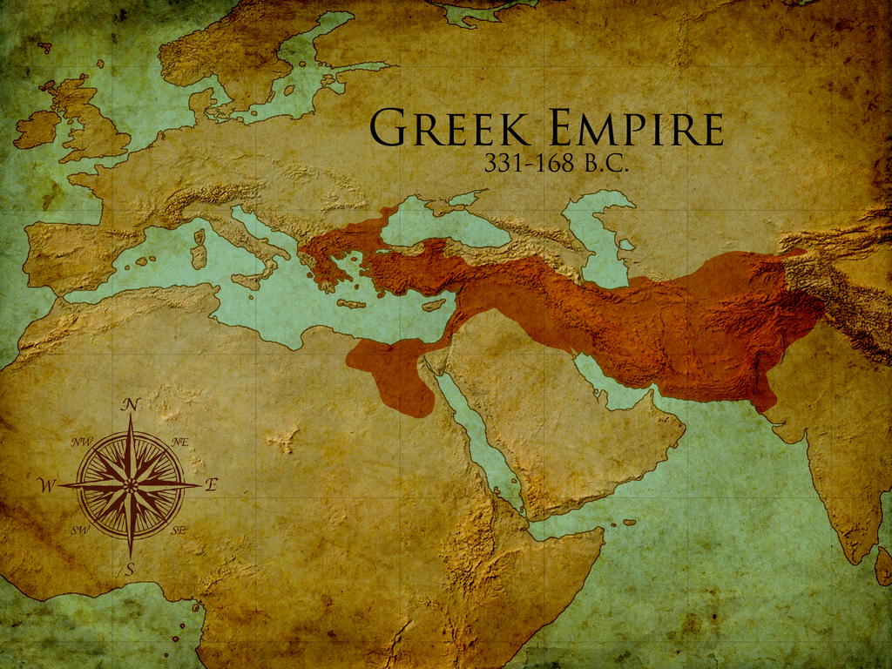
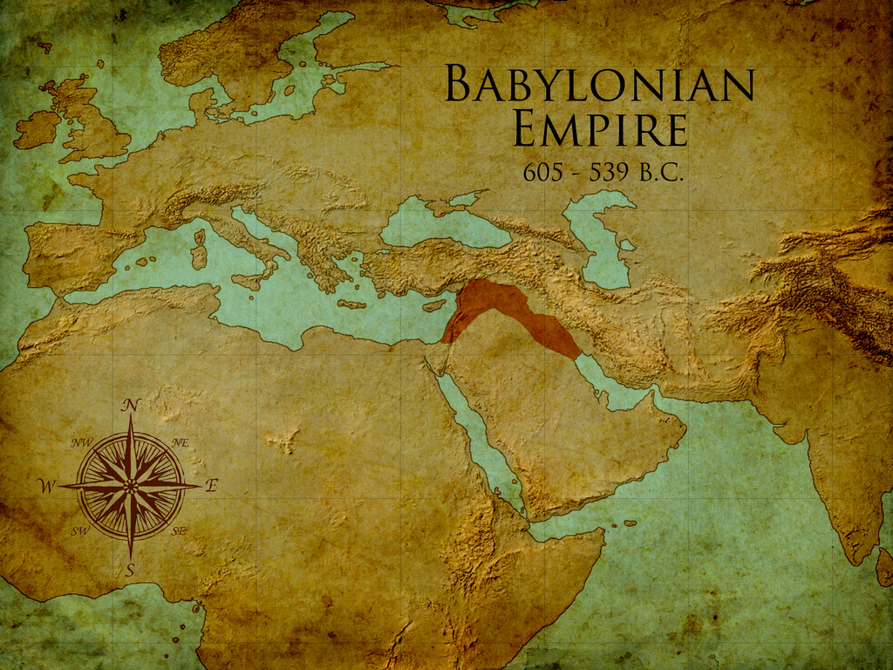
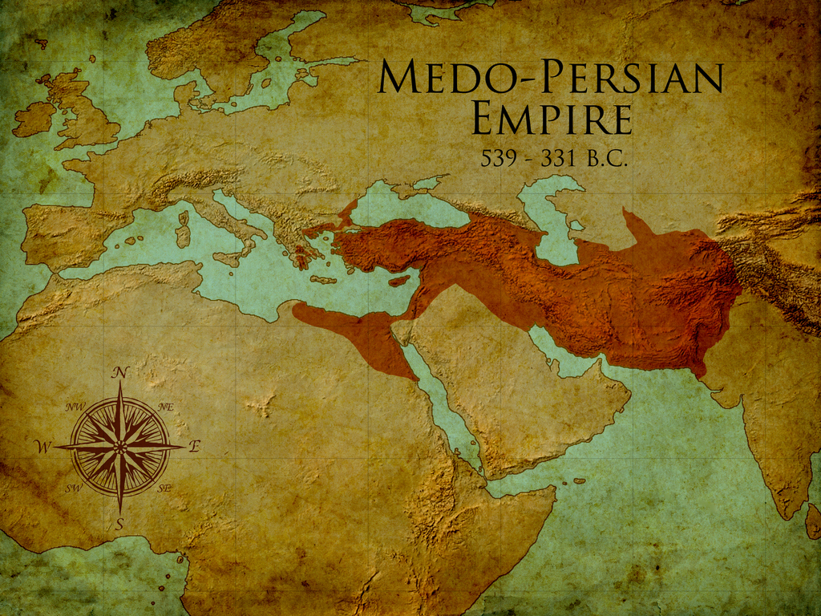
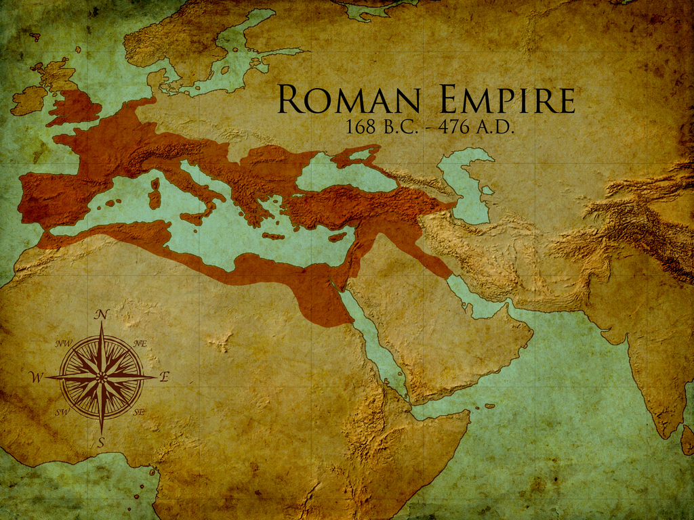
Nebuchadnezzar’s Dream Daniel 2
Babylonian
605-539 BC
Medo
-Persian
539-331 BC
70 yrs
Greek
331-168/63 BC
300 yrs
Roman
168/63 BC
-476 AD
500 yrs
Notes:
Animated

Slide 25
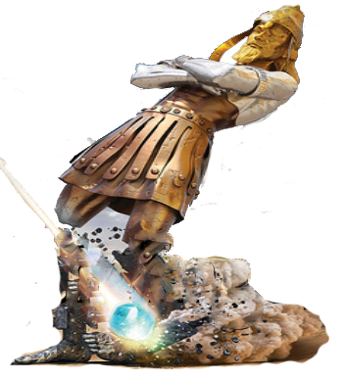
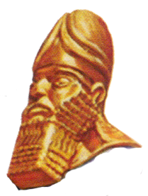
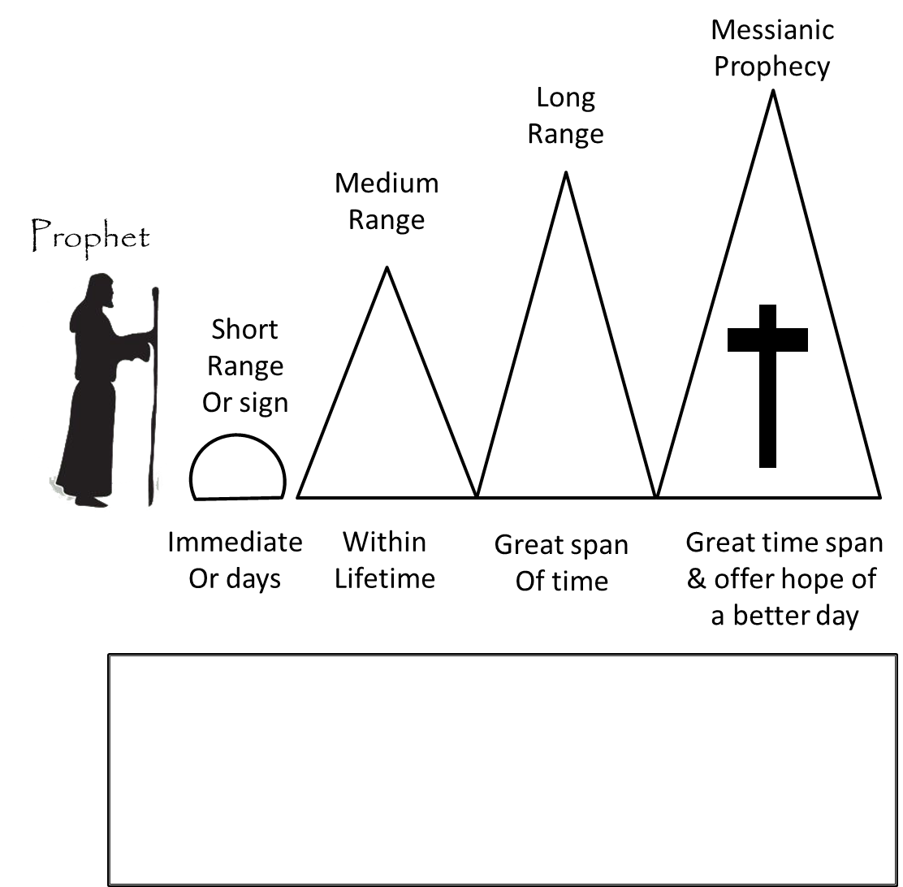
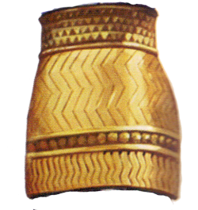
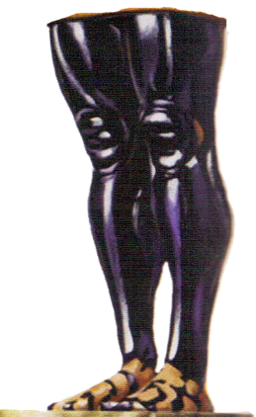
Nebuchadnezzar
“you are the head of gold”
Babylon
“and yet a third kingdom of bronze, which shall rule over all the earth” Greek 331-168/63 BC
604-568 BC
And there shall be a fourth kingdom, strong as iron …feet and toes, partly of potter’s clay and partly of iron Roman 168/63 BC– 476 AD
“Another kingdom inferior to you shall arise after you” Persia 539-331 BC
604-536 BC
Daniel 2
in the days of those kings the God of heaven will set up a kingdom that shall never be destroyed
4BC-30/33 AD

Slide 26
Nebuchadnezzar’s Dream Daniel 2
Daniel 2:34-35(NKJV) ³⁴You watched while a stone was cut out without hands, which struck the image on its feet of iron and clay, and broke them in pieces. ³⁵Then the iron, the clay, the bronze, the silver, and the gold were crushed together, and became like chaff from the summer threshing floors; the wind carried them away so that no trace of them was found.
And the stone that struck the image became
a great mountain and filled the whole earth.
Daniel 2:44-45(NKJV) ⁴⁴And in the days of these kings the God of heaven will set up a kingdom which shall never be destroyed; and the kingdom shall not be left to other people; it shall break in pieces and consume all these kingdoms, and it shall stand forever.
Notes:
Animated

Slide 27
God’s Wave of Prophets
400 yrs of
Silence

Slide 28
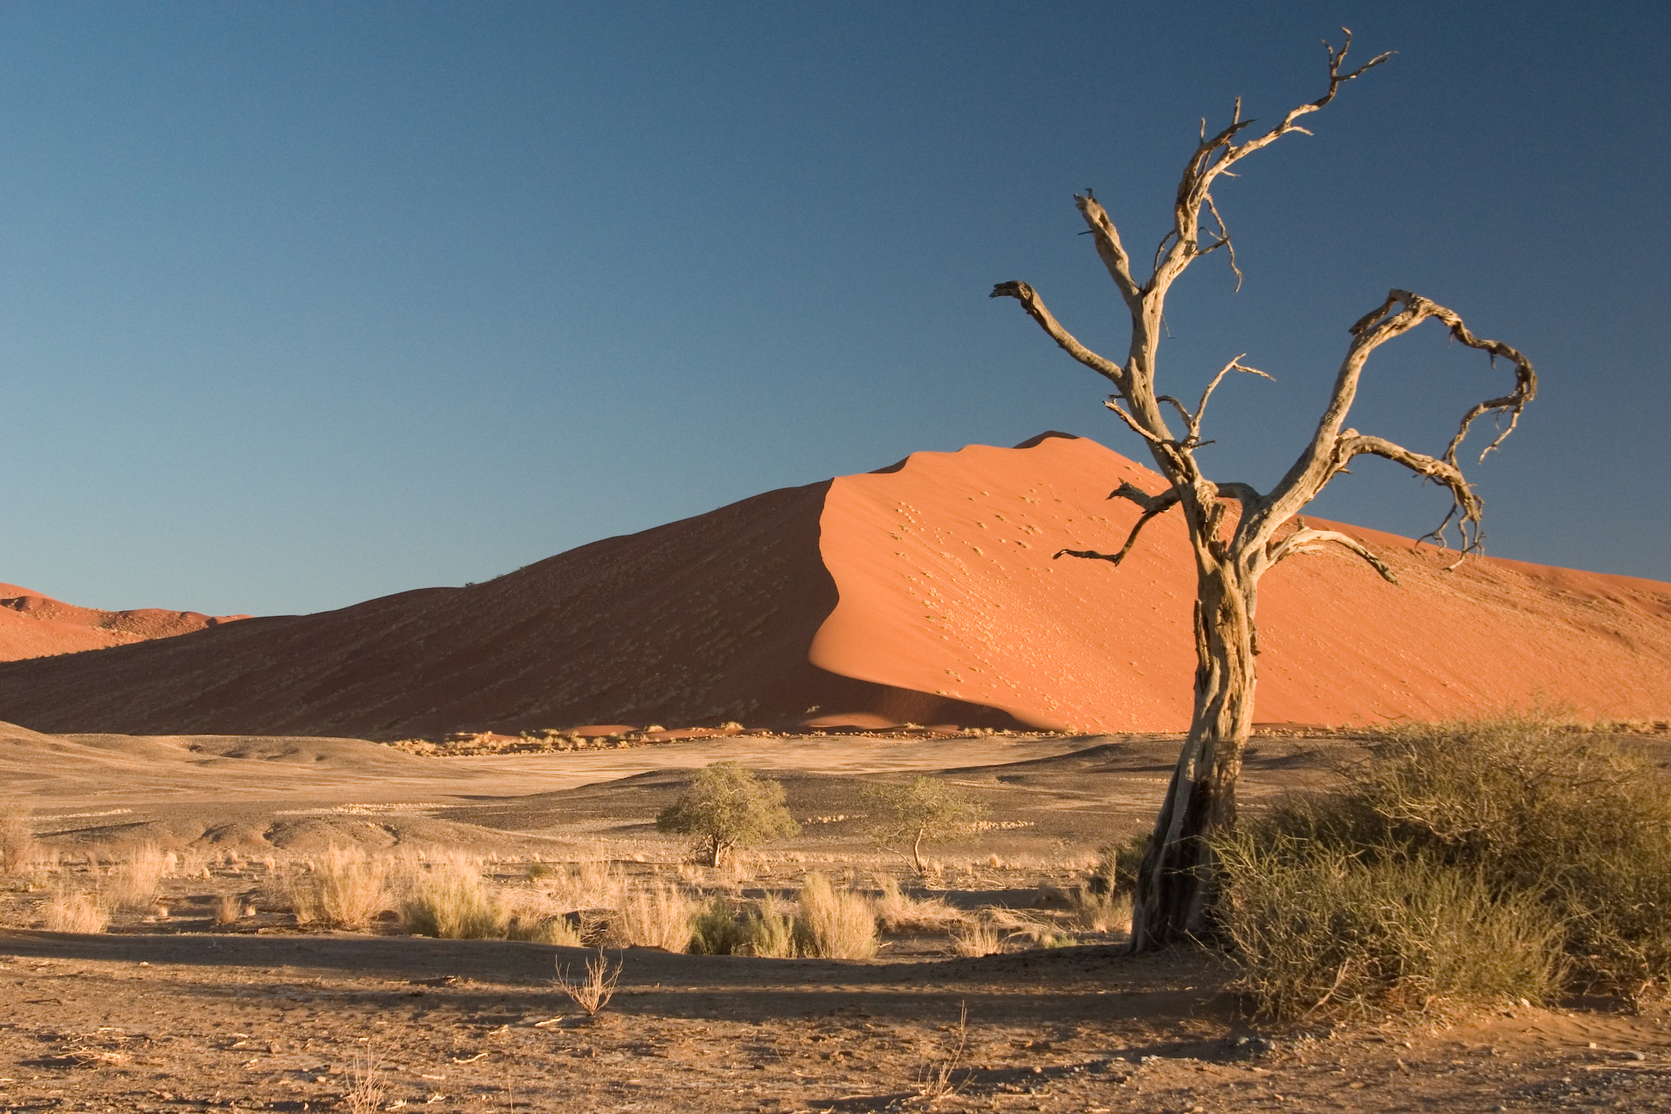
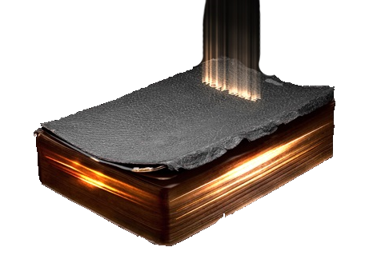
“The Silent Years”
The Intertestamental Period
Book of Daniel Roars through
the Silent Years

Slide 29
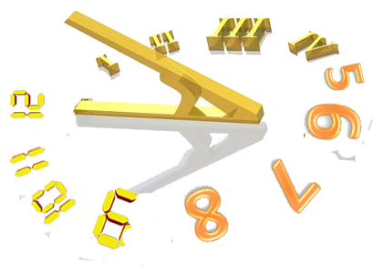
A Radical Different World in A Fullness of Time
Radical Changes | Old Testament | New Testament
Worship
Teachers
Jerusalem
Factions
Political
Language
Land of Israel
Worldview
Temple
Synagogue
Priest
Scribes
Cities in Ruins
Densely populated
Sadducees
Pharisees
Zealots
Self-rule
Roman Rulers
Hebrew/
Aramaic
Aramaic/ Greek
Southern Kingdom
Judea/Samaria & Galilee
Eastern
Western

Slide 30
Setting Up an Eternal Kingdom
Daniel 2:44(NKJV) ⁴⁴And in the days of these kings the God of heaven will set up a kingdom which shall never be destroyed; and the kingdom shall not be left to other people; it shall break in pieces and consume all these kingdoms, and it shall stand forever.
Mark 1:14-15(NKJV) ¹⁴Now after John was put in prison, Jesus came to Galilee, preaching the gospel £of the kingdom of God, ¹⁵and saying, “The time is fulfilled, and the kingdom of God is at hand. Repent, and believe in the gospel.”
Mark 9:1(NKJV) ¹And He said to them, “Assuredly, I say to you that there are some standing here who will not taste death till they see the kingdom of God present with power.”

Slide 31
Daniel 2 - Narrative
Outcome
⁴⁶Then King Nebuchadnezzar fell on his face, prostrate before Daniel, and commanded that they should present an offering and incense to him.
⁴⁷The king answered Daniel, and said, “Truly your God is the God of gods, the Lord of kings, and a revealer of secrets, since you could reveal this secret.”
⁴⁸Then the king promoted Daniel and gave him many great gifts; and he made him ruler over the whole province of Babylon, and chief administrator over all the wise men of Babylon.
⁴⁹Also Daniel petitioned the king, and he set Shadrach, Meshach, and Abed-Nego over the affairs of the province of Babylon; but Daniel sat in the gate of the king.
1
2
3
4
That is, the king’s court

