Slide 1
Embry Hills Jubilee
Embry Hills – October 27, 2013

Slide 2
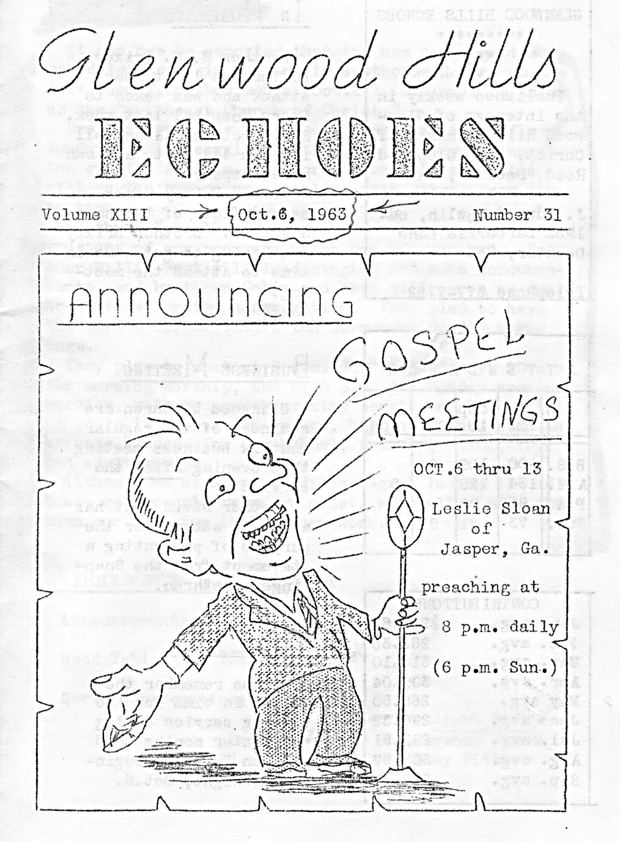
Glenwood Hills Bulletin
Oct 6, 1963

Slide 3
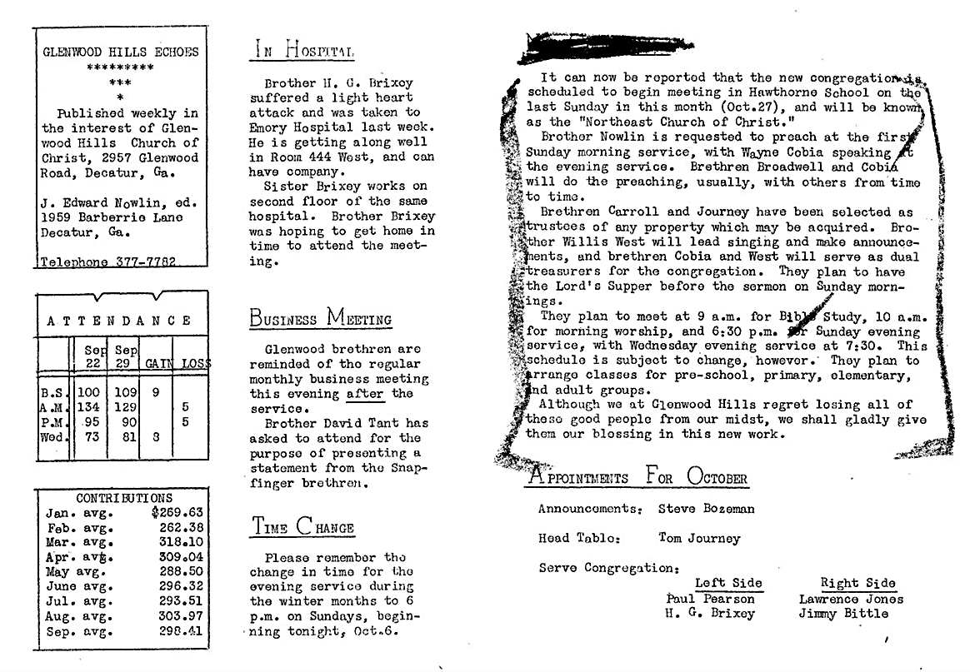


Slide 4
Year of Jubilee (Leviticus 25)
‘And you shall count seven sabbaths of years for yourself, seven times seven years; and the time of the seven sabbaths of years shall be to you forty-nine years. ⁹ Then you shall cause the trumpet of the Jubilee to sound on the tenth day of the seventh month; on the Day of Atonement you shall make the trumpet to sound throughout all your land. ¹⁰ And you shall consecrate the fiftieth year, and proclaim liberty throughout all the land to all its inhabitants…

Slide 5
Year of Jubilee (Leviticus 25)
¹¹ That fiftieth year shall be a Jubilee to you; in it you shall neither sow nor reap what grows of its own accord, nor gather the grapes of your untended vine. ¹² For it is the Jubilee; it shall be holy to you; you shall eat its produce from the field.

Slide 6
Year of Jubilee (Leviticus 25)
¹⁰ And you shall consecrate the fiftieth year, and proclaim liberty throughout all the land to all its inhabitants…
³⁹ And if one of your brethren who dwells by you becomes poor, and sells himself to you, you shall not compel him to serve as a slave. ⁴⁰ As a hired servant and a sojourner he shall be with you, and shall serve you until the Year of Jubilee. ⁴¹ And then he shall depart from you—he and his children with him—and shall return to his own family. He shall return to the possession of his fathers. ⁴² For they are My servants, whom I brought out of the land of Egypt; they shall not be sold as slaves.

Slide 7
Bible Emphasis on Remembering
Ex 12:25-27 – Passover meal (children ask…)
Dt 16:12 – Israel to remember Egyptian slavery
Josh 4:20-24 – Stones at the Jordan (Gilgal)
Acts 20:31 – Ephesians to remember Paul’s work
I Thes 2:1-12 – Paul reminds church of its origin

Slide 8
II Timothy 1:4-5
…greatly desiring to see you, being mindful of your tears, that I may be filled with joy, ⁵ when I call to remembrance the genuine faith that is in you, which dwelt first in your grandmother Lois and your mother Eunice, and I am persuaded is in you also.

Slide 9
Remembering the Past (Heb 13)
Remember those who led you, who spoke the word of God to you; and considering the result of their conduct, imitate their faith. (Heb 13:7-9, NASV)

Slide 10
Timeline of the Jerusalem Church¹
Event Date
Jesus crucified; Church established (Acts 1-2) 30
Apostles preaching, deacons, etc. (Acts 3-6) 30-35
Stephen killed, persecution begins (Acts 7) 35
Saul visits (Acts 9; Gal 1:18) 38
James killed by Herod (Acts 12) 45
Council on OT law-keeping (Acts 15) 50
Paul arrives with gift, arrested (Acts 21-22) 58
Destruction of Jerusalem 70
40
yrs
¹ http://www.blueletterbible.org/study/pnt/pnt02.cfm

Slide 11
Timeline of the Ephesian Church²
Event Date
Paul’s 1st visit (Acts 18:19) 51
Priscilla & Acquila move there (Acts 18:19) 51
Priscilla & Acquila correct Apollos (Acts 18:26) 51
Paul there for 2-3 years (Acts 19:10; 20:31) 53-55
Paul meets with Ephesian elders 55
Paul writes doctrinal letter to Jew/Gentiles 61
Paul writes to Timothy at Ephesus 64
Paul writes last letter to Timothy 68
John writes a warning letter to the church 95
45
yrs
²https://urbana.org/go-and-do/bible-studies/case-study-ephesus-40-years-3-authors-7-documents-7-leaders

Slide 12
Timeline of the Embry Hills church
1963 – Glenwood Hills members determine to start NE church
Oct 27, 1963 – 1st Service in Hawthorne School
1964 – Support of Basil Cass in S Africa begun
Aug, 1965 – Jerry Eubanks comes to preach
Fall, 1965 – Ruth & Dianne join the work
Fall, 1965 – Broke ground on a Building (Henderson Mill Rd)
Spring, 1966 – Northwest Congregation began
Summer, 1966 – Moved into Building
1966 – Paul Griffin baptized
1967 – Bill Caudill baptized
1968 – David Tant comes to preach
19?? – (Haworths, Joan Cole, Miles Brubaker join work)
1970 – New Building on Chamblee-Tucker Rd Built
1975 – Roswell church started
1975-78 – Sewell Hall preaches (eldership)
1978-80 – Ron Roark preaches
1980-82 – Ted Beaver preaches
1982 – Sewell returns (eldership established)
1983 – Eldership established (Willis, Sewell, Paul)
9 families
(12 children)

Slide 14
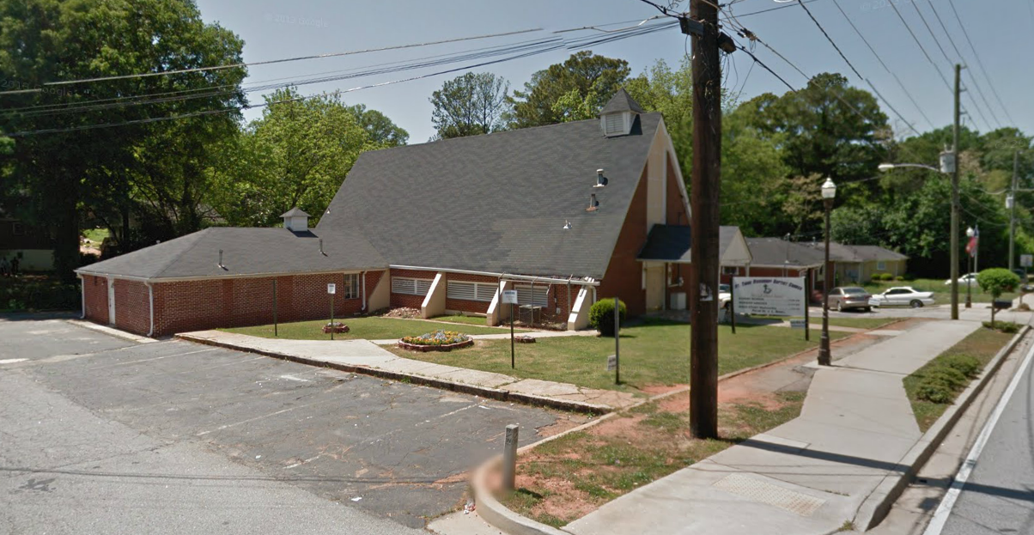
Glenwood Hills Building (today)
Notes:
Building is at the corner of Glenwood Rd and Hooper Street, south of Decatur.
2957 Glenwood Rd Decatur, GA 30032 ‎

Slide 15
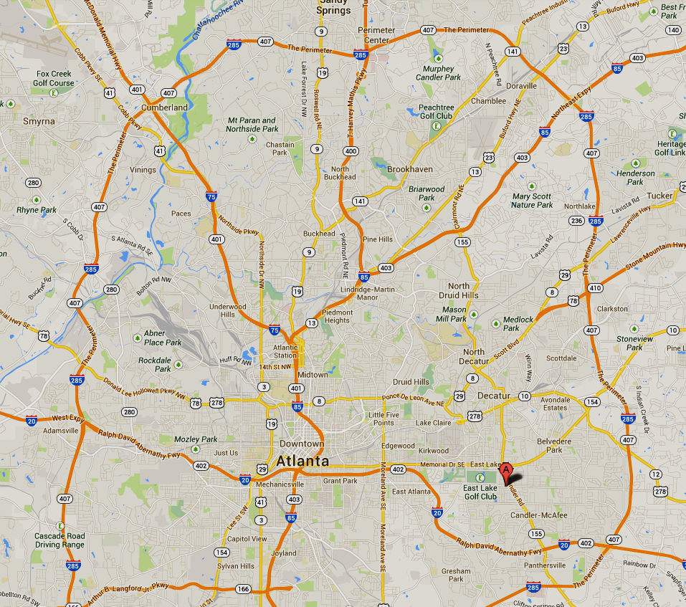
Northeast
Church

Slide 16
Timeline of the Embry Hills church
1963 – Glenwood Hills members determine to start NE church
Oct 27, 1963 – 1st Service in Hawthorne School
1964 – Support of Basil Cass in S Africa begun
Aug, 1965 – Jerry Eubanks comes to preach
Fall, 1965 – Ruth & Dianne join the work
Fall, 1965 – Broke ground on a Building (Henderson Mill Rd)
Spring, 1966 – Northwest Congregation began
Summer, 1966 – Moved into Building
1966 – Paul Griffin baptized
1967 – Bill Caudill baptized
1968 – David Tant comes to preach
19?? – (Haworths, Joan Cole, Miles Brubaker join work)
1970 – New Building on Chamblee-Tucker Rd Built
1975 – Roswell church started
1975-78 – Sewell Hall preaches (eldership)
1978-80 – Ron Roark preaches
1980-82 – Ted Beaver preaches
1982 – Sewell returns (eldership established)
1983 – Eldership established (Willis, Sewell, Paul)

Slide 17
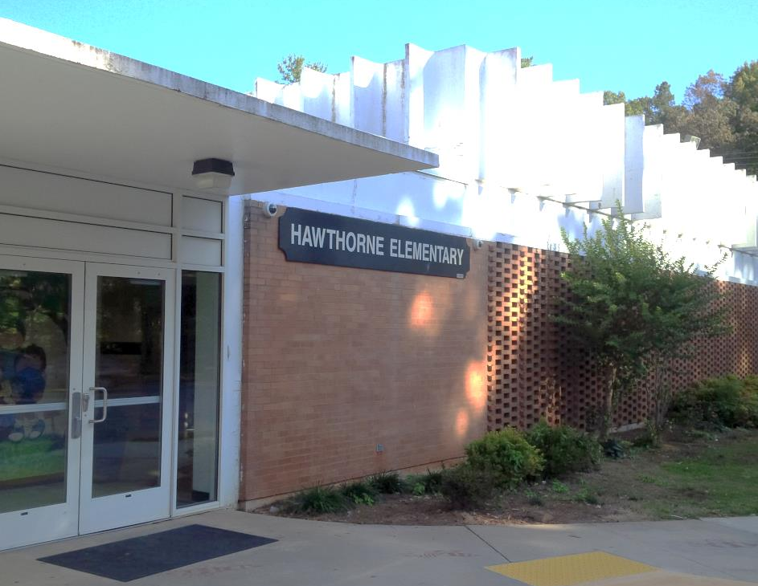
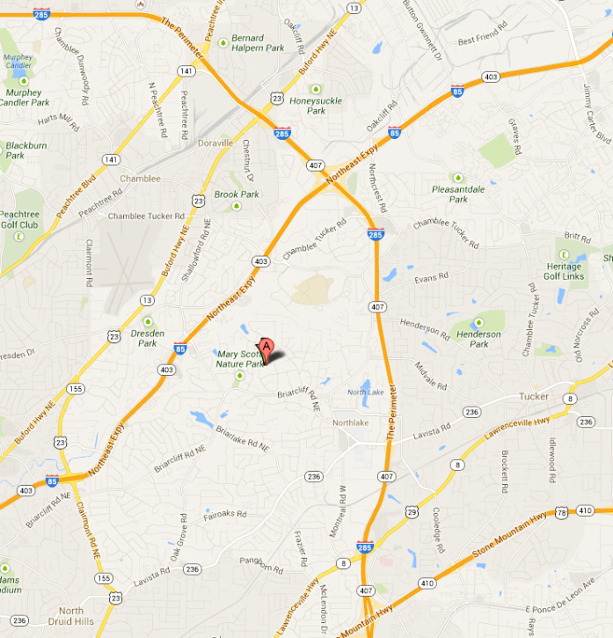
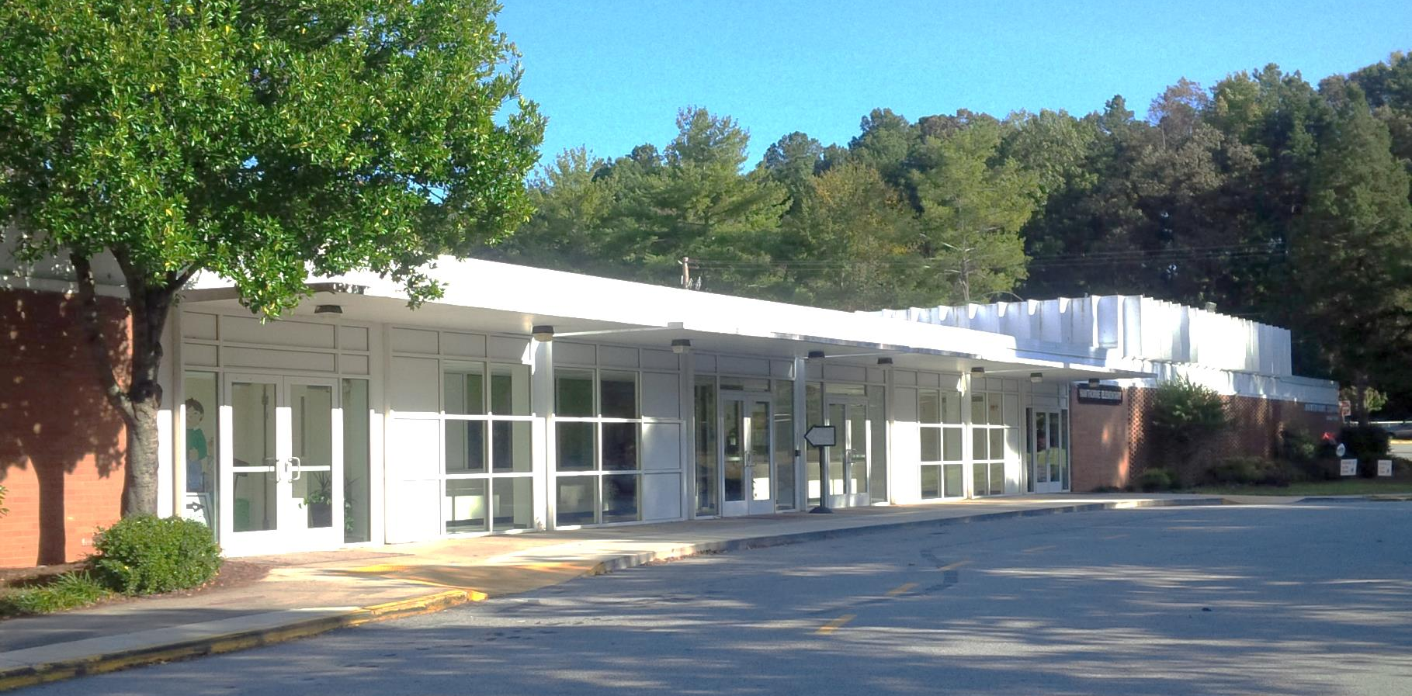
Hawthorne Elementary School

Slide 19
Timeline of the Embry Hills church
1963 – Glenwood Hills members determine to start NE church
Oct 27, 1963 – 1st Service in Hawthorne School (9 families, 12 children)
196? – Support of Basil Cass in South Africa begun
Aug, 1965 – Jerry Eubanks comes to preach
Fall, 1965 – Ruth & Dianne join the work
Fall, 1965 – Broke ground on a Building (Henderson Mill Rd)
Spring, 1966 – Northwest Congregation began
Summer, 1966 – Moved into Building
1966 – Paul Griffin baptized
1967 – Bill Caudill baptized
1968 – David Tant comes to preach
19?? – (Haworths, Joan Cole, Miles Brubaker join work)
1970 – New Building on Chamblee-Tucker Rd Built
1975 – Roswell church started
1975-78 – Sewell Hall preaches (eldership)
1978-80 – Ron Roark preaches
1980-82 – Ted Beaver preaches
1982 – Sewell returns (eldership established)
1983 – Eldership established (Willis, Sewell, Paul)

Slide 20
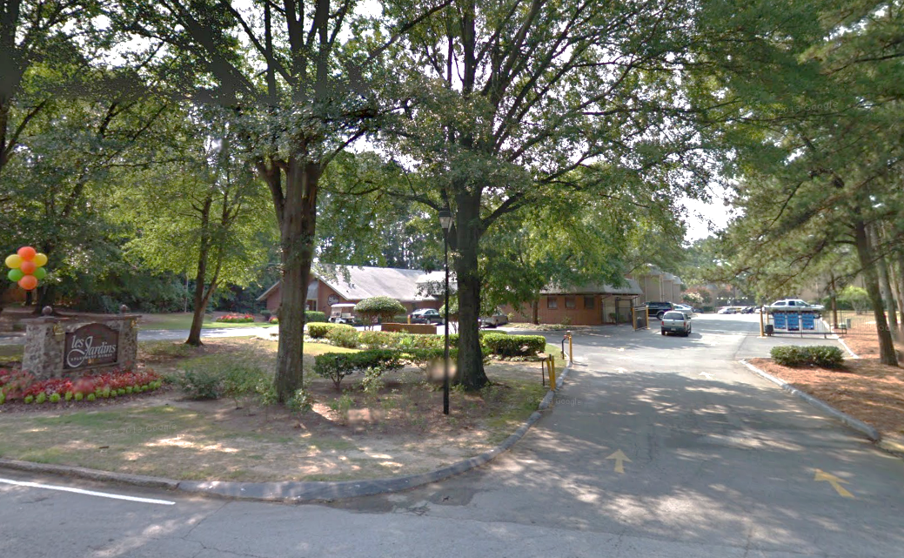
Embry Hills Building on Henderson Mill Rd.

Slide 21
Timeline of the Embry Hills church
1963 – Glenwood Hills members determine to start NE church
Oct 27, 1963 – 1st Service in Hawthorne School (9 families, 12 children)
196? – Support of Basil Cass in S Africa begun
Aug, 1965 – Jerry Eubanks comes to preach
Fall, 1965 – Ruth & Dianne join the work
Fall, 1965 – Broke ground on a Building (Henderson Mill Rd)
Spring, 1966 – Northwest Congregation began
Summer, 1966 – Moved into Building
1966 – Paul Griffin baptized
1967 – Bill Caudill baptized
1968 – David Tant comes to preach
19?? – (Haworths, Joan Cole, Miles Brubaker join work)
1970 – New Building on Chamblee-Tucker Rd Built
1975 – Roswell church started
1975-78 – Sewell Hall preaches (eldership)
1978-80 – Ron Roark preaches
1980-82 – Ted Beaver preaches
1982 – Sewell returns (eldership established)
1983 – Eldership established (Willis, Sewell, Paul)

Slide 22
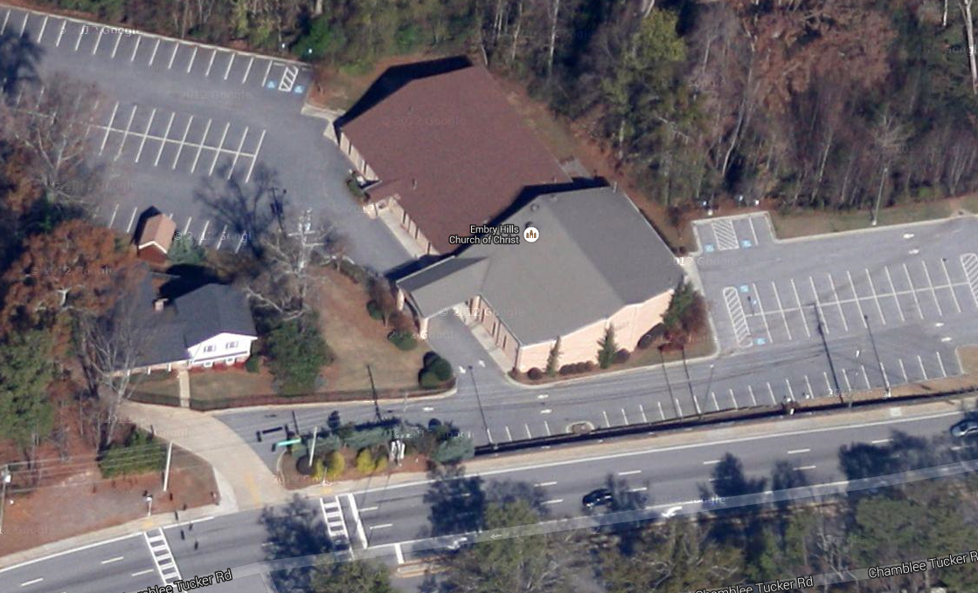
Embry Hills Building on Chamblee-Tucker Rd.

Slide 23
Timeline of the Embry Hills church
1963 – Glenwood Hills members determine to start NE church
Oct 27, 1963 – 1st Service in Hawthorne School (9 families, 12 children)
196? – Support of Basil Cass in S Africa begun
Aug, 1965 – Jerry Eubanks comes to preach
Fall, 1965 – Ruth & Dianne join the work
Fall, 1965 – Broke ground on a Building (Henderson Mill Rd)
Spring, 1966 – Northwest Congregation began
Summer, 1966 – Moved into Building
1966 – Paul Griffin baptized
1967 – Bill Caudill baptized
1968 – David Tant comes to preach
19?? – (Haworths, Joan Cole, Miles Brubaker join work)
1970 – New Building on Chamblee-Tucker Rd Built
1975 – Roswell church started
1975-78 – Sewell Hall preaches (eldership)
1978-80 – Ron Roark preaches
1980-82 – Ted Beaver preaches
1982 – Sewell returns (eldership established)
1983 – Eldership established (Willis, Sewell, Paul)

Slide 24
‘Character’ of the Embry Hills church
‘Local Talent’ Preaching
Support of Foreign Evangelists
Liberal Giving
‘Low Balance’ Treasury
High-Effort Bible Class Teaching & Learning
Worship (Songs, Lord’s Supper) Emphasizes Edification
Regular Attendance at all Assemblies
Simple Facilities
Member Diversity
Independence from other Congregations
Support of New Congregations
Continuous Eldership (34 of 50 years)
Has there been Progress?
Notes:
In 2004, the average weekly contribution by a full/confirmed member of a Christian church in the US was $13.31 per week. (http://www.pastorrickypowell.com/life_matters_with_pastor_/2009/10/startling-statistics-about-christian-giving.html)
Embry Hills giving: Attendance=350; Contribution = $11,000/week; Assume 100 children; $44 per adult per week, or $65 per household.

Slide 25
Man’s “Progress”
Descendants of Cain (progress of civilization)
Tower of Babel (technology progress)
Israel asking for a King (political progress)
Idolatry of Israelites (religious progress)
Early church (doctrinal progress)
  Acts 20:28-31 – Errors from Elders
  I Tim 4:1-2 – Departures from the faith

Slide 26
Year of Jubilee (Leviticus 25,27)
¹⁰ It shall be a Jubilee for you; and each of you shall return to his possession, and each of you shall return to his family.
¹³ In this Year of Jubilee, each of you shall return to his possession..
²⁸ But if he is not able to have it restored to himself, then what was sold shall remain in the hand of him who bought it until the Year of Jubilee; and in the Jubilee it shall be released, and he shall return to his possession.
⁴⁰ As a hired servant and a sojourner he shall be with you, and shall serve you until the Year of Jubilee. ⁴¹ And then he shall depart from you—he and his children with him—and shall return to his own family. He shall return to the possession of his fathers.
^{27:24} In the Year of Jubilee the field shall return to him from whom it was bought, to the one who owned the land as a possession.

Slide 27
“Ancient Landmarks”
Do not remove the ancient landmark
Which your fathers have set. (Prov 22:28)
‘Cursed is the one who moves his neighbor’s landmark.’ And all the people shall say, ‘Amen!’ (Dt 27:17)
You shall not remove your neighbor’s landmark, which the men of old have set, in your inheritance which you will inherit in the land that the Lord your God is giving you to possess. (Dt 19:14)

Slide 28
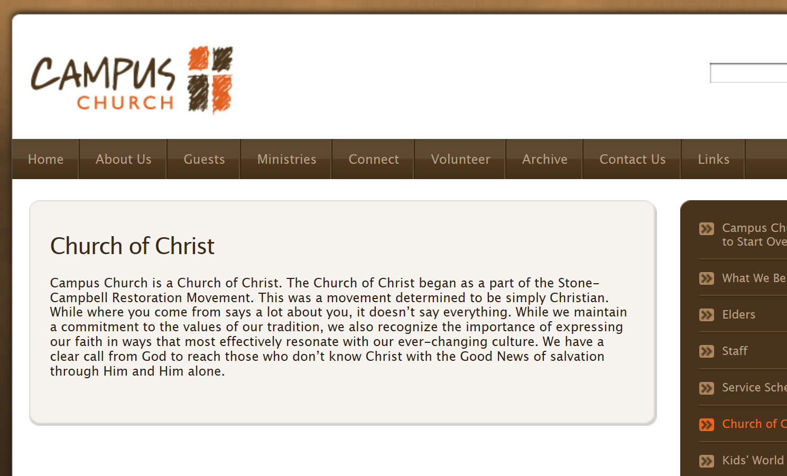

Back to What?

Slide 29
II Timothy 3
But you have carefully followed my doctrine, manner of life, purpose, faith, longsuffering, love, perseverance, ¹¹ persecutions, afflictions, which happened to me at Antioch, at Iconium, at Lystra—what persecutions I endured. And out of them all the Lord delivered me. ¹² Yes, and all who desire to live godly in Christ Jesus will suffer persecution. ¹³ But evil men and impostors will grow worse and worse, deceiving and being deceived. ¹⁴ But you must continue in the things which you have learned and been assured of, knowing from whom you have learned them, ¹⁵ and that from childhood you have known the Holy Scriptures, which are able to make you wise for salvation through faith which is in Christ Jesus.
¹⁶ All Scripture is given by inspiration of God, and is profitable for doctrine, for reproof, for correction, for instruction in righteousness, ¹⁷ that the man of God may be complete, thoroughly equipped for every good work.

Slide 30
Remembering the Past (Heb 13)
Remember those who led you, who spoke the word of God to you; and considering the result of their conduct, imitate their faith. ⁸ Jesus Christ is the same yesterday and today and forever. ⁹ Do not be carried away by varied and strange teachings; for it is good for the heart to be strengthened by grace, not by foods, through which those who were so occupied were not benefited. (Heb 13:7-9, NASV)

Slide 31
