Slide 1
The Humility of Christ

Slide 2
Gospel - First Century I Corinthians 1
Jews
Demand signs – vs. 22
Christ crucified – a stumbling block vs. 23
Gentiles/Greeks
Seek wisdom – vs. 22
Christ crucified – folly vs. 23
To Those Called, Both Jews and Greeks
Christ the power of God and the wisdom of God. ²⁵ For the foolishness of God is wiser than men, and the weakness of God is stronger than men.

Slide 3
I Corinthians 1:27-29
Wisdom of God
²⁷ But God chose what is foolish in the world to shame the wise; God chose what is weak in the world to shame the strong; ²⁸ God chose what is low and despised in the world, even things that are not, to bring to nothing things that are, ²⁹ so that no human being might boast in the presence of God

Slide 4
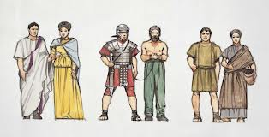
Roman Society
Stratified Society
Pantheon of Gods
Emperor
Patricians – Upper Class
Plebians – Lower Class
Freedmen/Non-Citizens
Slaves
Obsession with Status and Honor

Slide 5
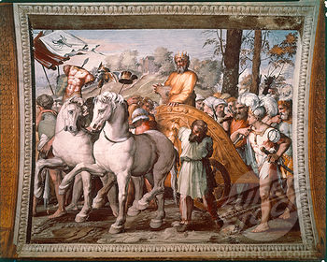
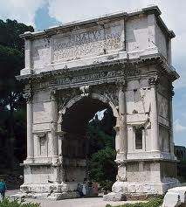
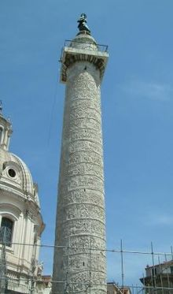
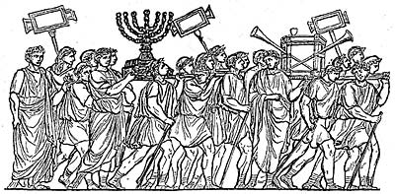
Roman Society
Stratified Society
Obsession with Status and Honor

Slide 6
Philippians 1:27
Context of 2:1-10
²⁷ Only let your manner of life be worthy of the gospel of Christ, so that whether I come and see you or am absent, I may hear of you that you are standing firm in one spirit, with one mind striving side by side for the faith of the gospel,

Slide 7
Philippians 2:2-5
A Worthy Walk
² complete my joy by being of the same mind, having the same love, being in full accord and of one mind. ³ Do nothing from selfish ambition or conceit, but in humility count others more significant than yourselves. ⁴ Let each of you look not only to his own interests, but also to the interests of others. ⁵ Have this mind among yourselves, which is yours in Christ Jesus,

Slide 8
Philippians 2:6-8
Example of Christ
⁶ who, though he was in the form of God, did not count equality with God a thing to be grasped, ⁷ but emptied himself, by taking the form of a servant, being born in the likeness of men. ⁸ And being found in human form, he humbled himself by becoming obedient to the point of death, even death on a cross.

Slide 9
Emptied Himself
Philippians 2:7
Isaiah 53:12 because he poured out his soul to death
II Corinthians 8:9 For you know the grace of our Lord Jesus Christ, that though he was rich, yet for your sake he became poor, so that you by his poverty might become rich.

Slide 10
Philippians 2:6-8
Example of Christ
⁶ who, though he was in the form of God, did not count equality with God a thing to be grasped, ⁷ but emptied himself, by taking the form of a servant, being born in the likeness of men. ⁸ And being found in human form, he humbled himself by becoming obedient to the point of death, even death on a cross.

Slide 11
Philippians 2:9-11
Exaltation of Christ
⁹ Therefore God has highly exalted him and bestowed on him the name that is above every name, ¹⁰ so that at the name of Jesus every knee should bow, in heaven and on earth and under the earth, ¹¹ and every tongue confess that Jesus Christ is Lord, to the glory of God the Father.

Slide 12
The Humility of Christ

Slide 13
The Sweetest, Most Enjoyable Rest Occurs . . .
When it comes at the end of something
When it follows great effort or work
When it follows a period of fatigue or weariness
When it follows a period of stress or anxiety

Slide 14
The Heavenly Rest . . .
Comes when this life is over
Comes to those who have made great effort or work
Often follows a life full of fatigue or weariness
Replaces stress and anxiety with abiding peace

Slide 15
Hebrews 4:7, 11
"Today, if you hear his voice, do not harden your hearts.”
¹¹Let us therefore strive to enter that rest, so that no one may fall by the same sort of disobedience.

Slide 16
Paul’s Example
Vs. 19 Served the Lord with all humility, tears and with trials
Vs. 20 Did not shrink from declaring anything profitable
Taught in public and house to house
Testified of faith and repentance to Jews and Gentiles (vs. 21)
Vs. 26 Innocent of the blood of all
Vs. 27 Declared the whole counsel of God
Vs. 31 Admonished everyone with tears night and day
Vs. 33 Coveted no one’s silver or gold or apparel
Vs. 34 With his own hands ministered to his needs and others

Slide 17
Paul’s Instructions
Vs. 28 Pay careful attention to yourself and to the flock
Vs. 28 Care for the church of God
Vs. 31 Be alert

Slide 18
Thoughts on the Future of this Church

Slide 19
Five Years of Crisis
Ephesus Fall 57 A.D.
Macedonia (Troas) Fall 57 A.D.
Greece (Corinth) Winter 57-58 A.D.
Miletus Spring 58 A.D.
Tyre 58 A.D.
Caesarea 58 A.D.
Jerusalem/Caesarea 58-60 A.D.

Slide 20
Trials in Jerusalem/Caesarea
Seized and Beaten in the Temple
Arrested by the Romans
Constant Efforts to Kill Paul
Struck by the High Priest
Romans Fear for His Life
Forty Men Take an Oath to Kill Paul
Secret Journey to Caesarea
Languished for Two Years – Felix & Festus

Slide 21
Five Years of Crisis
Ephesus Fall 57 A.D.
Macedonia (Troas) Fall 57 A.D.
Greece (Corinth) Winter 57-58 A.D.
Miletus Spring 58 A.D.
Tyre 58 A.D.
Caesarea 58 A.D.
Jerusalem/Caesarea 58-60 A.D.
Trip to Rome 60-61 A.D.
Rome – Prison 61-63 A.D.

Slide 22
Five Keys to Steadfastness
Paul Looked to God for Comfort

Slide 23
II Corinthians 1:3-5
3Blessed be the God and Father of our Lord Jesus Christ, the Father of mercies and God of all comfort, 4 who comforts us in all our affliction, so that we may be able to comfort those who are in any affliction, with the comfort with which we ourselves are comforted by God. 5 For as we share abundantly in Christ’s sufferings, so through Christ we share abundantly in comfort too.

Slide 24
Five Keys to Steadfastness
Paul Looked to God for Comfort
Paul Found Comfort in the Spiritual Accomplishments of Others

Slide 25
II Corinthians 1:6-7
6 If we are afflicted, it is for your comfort and salvation; and if we are comforted, it is for your comfort, which you experience when you patiently endure the same sufferings that we suffer. 7 Our hope for you is unshaken, for we know that as you share in our sufferings, you will also share in our comfort.

Slide 26
II Corinthians 4:8-12
8 We are afflicted in every way, but not crushed; perplexed, but not driven to despair; 9 persecuted, but not forsaken; struck down, but not destroyed; 10 always carrying in the body the death of Jesus, so that the life of Jesus may also be manifested in our bodies. 11 For we who live are always being given over to death for Jesus’ sake, so that the life of Jesus also may be manifested in our mortal flesh. 12 So death is at work in us, but life in you.

Slide 27
Five Keys to Steadfastness
Paul Looked to God for Comfort
Paul Found Comfort in the Spiritual Accomplishments of Others
Paul Maintained Close Relationships with Many Christians
Paul Focused on the Task at Hand

Slide 28
Philippians 3:13-17
But one thing I do: forgetting what lies behind and straining forward to what lies ahead, 14 I press on toward the goal for the prize of the upward call of God in Christ Jesus. 15 Let those of us who are mature think this way, and if in anything you think otherwise, God will reveal that also to you. 16 Only let us hold true to what we have attained. 17 Brothers, join in imitating me, and keep your eyes on those who walk according to the example you have in us.

Slide 29
Five Keys to Steadfastness
Paul Looked to God for Comfort
Paul Found Comfort in the Spiritual Accomplishments of Others
Paul Maintained Close Relationships with Many Christians
Paul Focused on the Task at Hand
Paul Constantly Prayed and Rejoiced in His Blessings

Slide 30
Philippians 4:11-13
11 Not that I am speaking of being in need, for I have learned in whatever situation I am to be content. 12 I know how to be brought low, and I know how to abound. In any and every circumstance, I have learned the secret of facing plenty and hunger, abundance and need. 13 I can do all things through him who strengthens me.

