Slide 1
Would Your Church Allow You To Be Like Jesus?
(1) Was circumcised on the eighth day. (2) Kept Sabbath from Friday sundown to Saturday sundown. (3) Attended a synagogue regularly. (4) Kept Passover, Shavuot, Rosh HaShanah, Yom Kippur and Hanukkah. (5) Was a citizen of Israel. (6) His Bible only contained the Torah, the Prophets and the Writings. (7) Quoted passages from the Mishnah. .

Slide 2
NO!
Jesus would not be practicing Judaism if He were on earth today.
To follow these practices today would be to say that Jesus failed in His purpose.
His purpose was to fulfill the law (The Old Covenant) Matthew 5:17
This was necessary so that a new covenant (law) could be given. Hebrews 10:5-10

Slide 3
Hebrews 10:5-10
⁵ Therefore, when He came into the world, He said:
“Sacrifice and offering You did not desire, But a body You have prepared for Me. ⁶ In burnt offerings and sacrifices for sin You had no pleasure. ⁷ Then I said, ‘Behold, I have come— In the volume of the book it is written of Me— To do Your will, O God.’”
⁸ Previously saying, “Sacrifice and offering, burnt offerings, and offerings for sin You did not desire, nor had pleasure in them” (which are offered according to the law), ⁹ then He said, “Behold, I have come to do Your will, O God.” He takes away the first that He may establish the second. ¹⁰ By that will we have been sanctified through the offering of the body of Jesus Christ once for all.

Slide 4
Other Passages
^{Galatians 3:24} Therefore the law was our tutor to bring us to Christ, that we might be justified by faith. ²⁵ But after faith has come, we are no longer under a tutor.
^{Colossians 2:14} He erased the certificate of debt, with its obligations, that was against us and opposed to us, and has taken it out of the way by nailing it to the cross. …
¹⁶ Therefore, don’t let anyone judge you in regard to food and drink or in the matter of a festival or a new moon or a Sabbath day. ¹⁷ These are a shadow of what was to come; the substance is the Messiah. (HCSB)

Slide 5
John 4:19-24
¹⁹ The woman said to Him, “Sir, I perceive that You are a prophet. ²⁰ Our fathers worshiped on this mountain, and you Jews say that in Jerusalem is the place where one ought to worship.”
²¹ Jesus said to her, “Woman, believe Me, the hour is coming when you will neither on this mountain, nor in Jerusalem, worship the Father. ²² You worship what you do not know; we know what we worship, for salvation is of the Jews. ²³ But the hour is coming, and now is, when the true worshipers will worship the Father in spirit and truth; for the Father is seeking such to worship Him. ²⁴ God is Spirit, and those who worship Him must worship in spirit and truth.”
Change is Coming!

Slide 6
John 4:19-24
Usual Explanation
Some Problems
Worship in Spirit is worshiping in the heart.
Worship in Truth is worshiping according to God’s instructions
It is certainly true that we must worship in the heart and as God instructs in His word.
God always wanted worship from the heart Isaiah 29:13, Ezek. 33:31
God has always wanted worship according to His instructions. Genesis 4:3-5 Leviticus 10:1-2 1 Kings 12:28-33

Slide 7
What is the change?
Jerusalem as the Center of Worship: “the hour is coming when you will neither on this mountain, nor in Jerusalem, worship the Father.”(John 4:21)
The tabernacle & temple were “symbolic for the present time in which both gifts and sacrifices are offered which cannot make him who performed the service perfect in regard to the conscience— ¹⁰ concerned only with foods and drinks, various washings, and fleshly ordinances imposed until the time of reformation.” (Hebrews 9:9-10)
These were necessary for primitive people.
Became substitutes for heart worship (1Sam.15:22; Mi.6:6-8)

Slide 8
Jesus was teaching that the time had come for the symbolic to give way to the true.
For Christ has not entered the holy places made with hands, which are copies of the true, but into heaven itself, now to appear in the presence of God for us. (Heb. 9:24)
We have such a High Priest, who is seated at the right hand of the throne of the Majesty in the heavens, ² a Minister of the sanctuary and of the true tabernacle which the Lord erected, and not man. (Heb. 8:2)

Slide 9
“Fleshly Ordinances” vs. “True”
Symbols
TRUE
Jerusalem
Temple
Levitical High Priest
Animal Sacrifices
Most Holy Place
Incense
Passover Feast
Musical Instruments
Circumcision
Hebrews 12:22
Hebrews 8:1-2
Hebrews 9:11
Hebrews 9:12
Hebrews 9:24
Phil. 4:18; Rev. 5:8b
1 Corinthians 5:7
Ephesians 5:19
Col. 2:11-12, Phil. 3:3
These are acts of Faith
Appealed to the Senses

Slide 10
Weakening Faith Always Tends to return to “Fleshly Ordinances”
The Great Apostasy:
These appeal to the senses: sight, smell feeling, hearing
They tend to glorify man— not God
They were no part of worship in the early church
Temple-like Cathedrals
Special Priesthood
Priestly Robes
“Sacrifice of the Mass”
Incense
Holy Water
Instrumental music and choirs

Slide 11
God is Spirit, and those who worship Him must worship in spirit and truth.” (John 4:24)
God is a Spirit and cannot be seen.
The part of man that worships God is spirit which, like God, is invisible.
The simplicity of NT worship is conducive to worship in Spirit—nothing appeals to flesh.
The “fleshly” was necessary for training in faith.

Slide 12
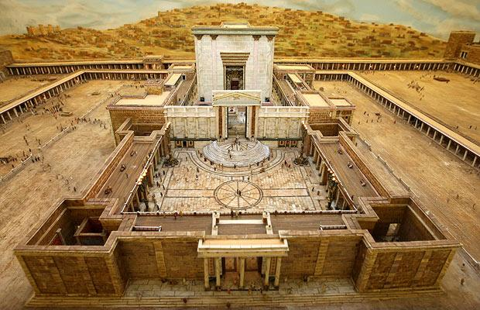
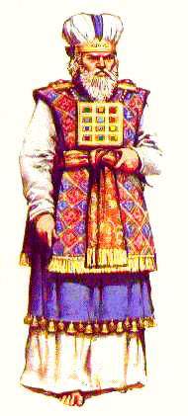
The temple was required for all of the ordinances of Old Testament Worship
Day of Atonement
Passover
Pentecost
Tabernacles
New Year
Incense
Lampstands
Peace Offerings
Meal Offerings
Sin Offerings
Guilt Offerings
Burnt Offerings

Slide 13
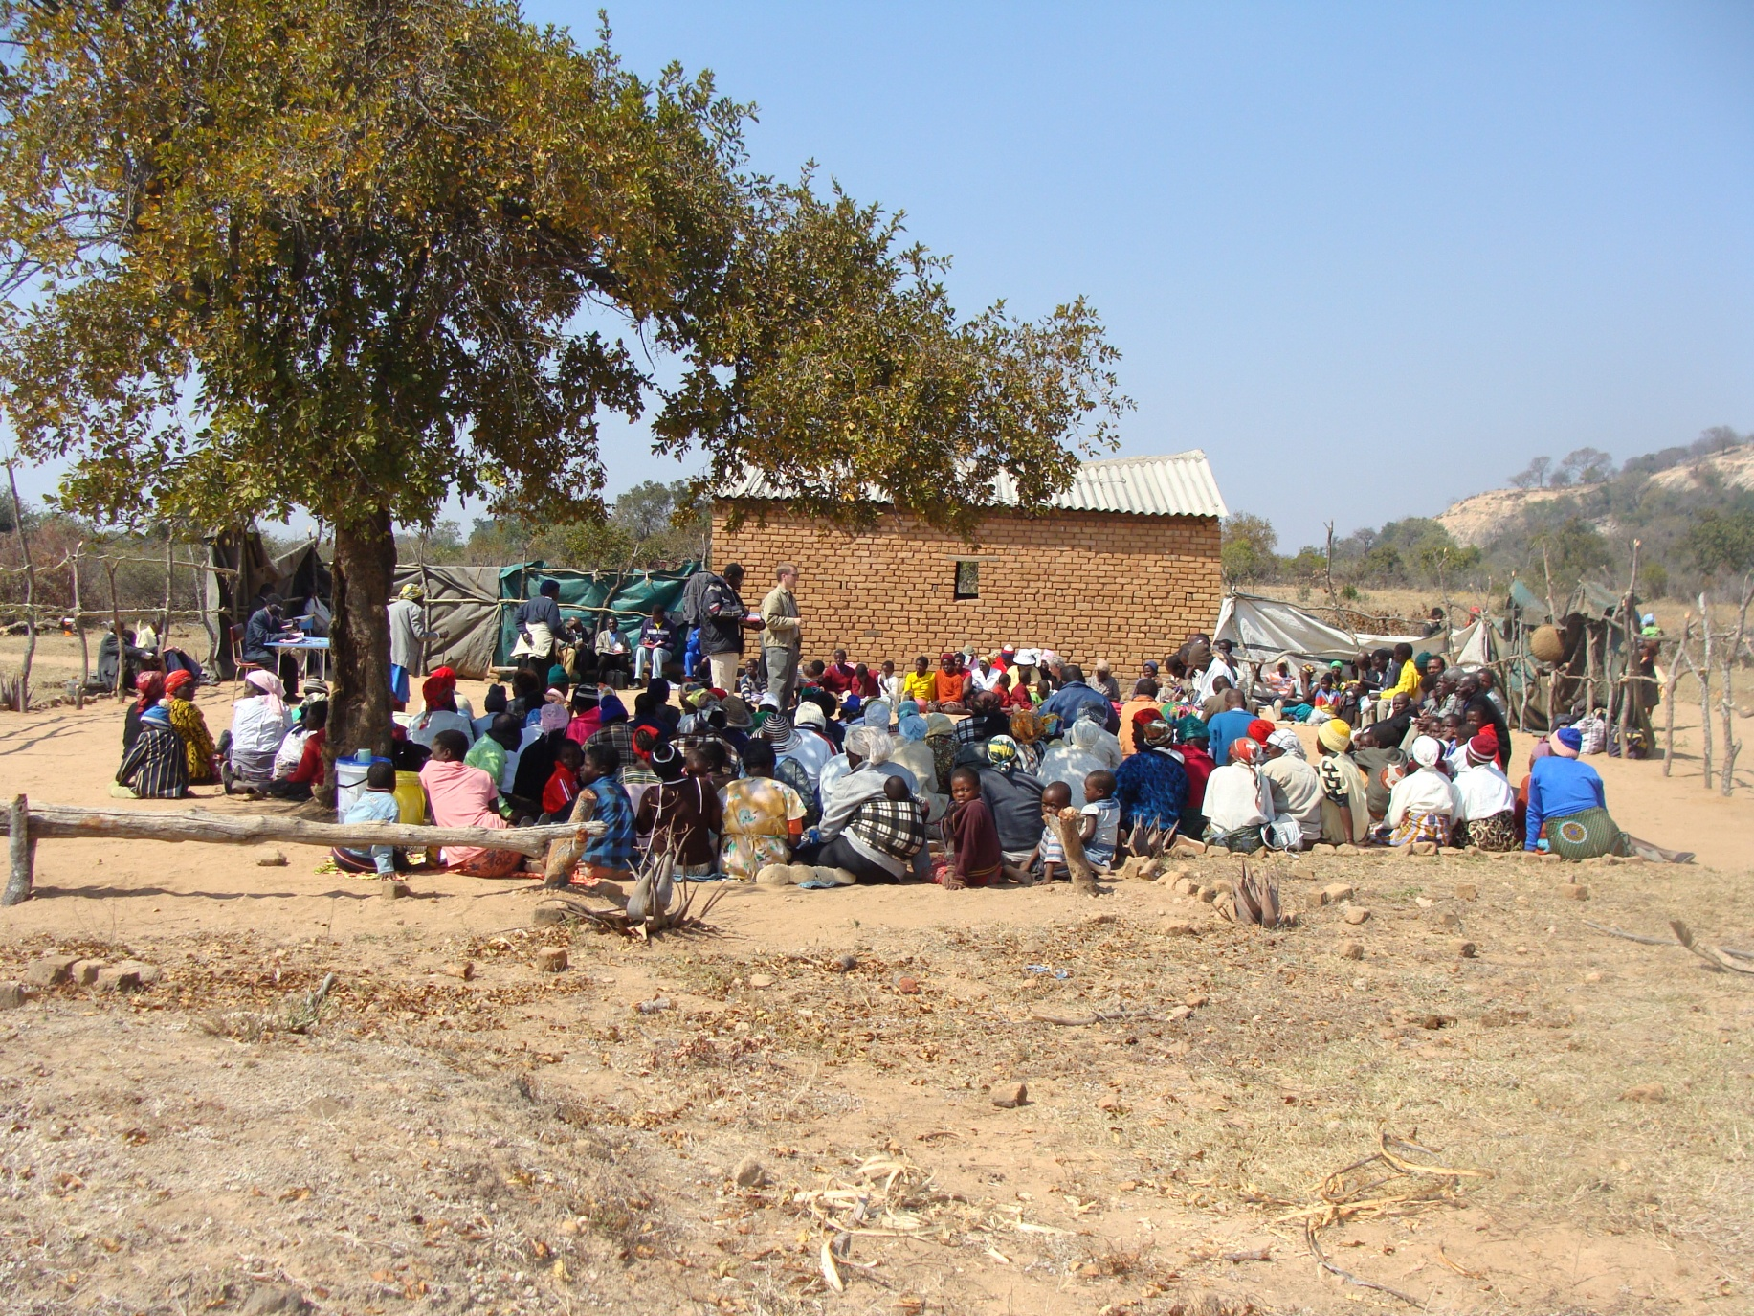
This is all that is needed for Worship in Spirit and Truth.

Slide 14
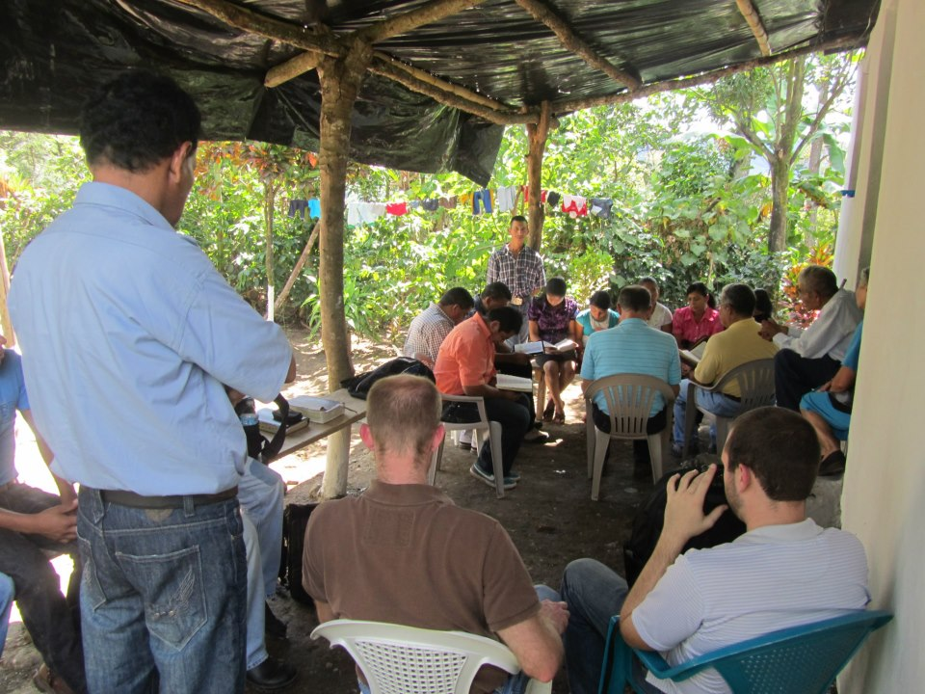
Who is glorified in such a setting?

Slide 15
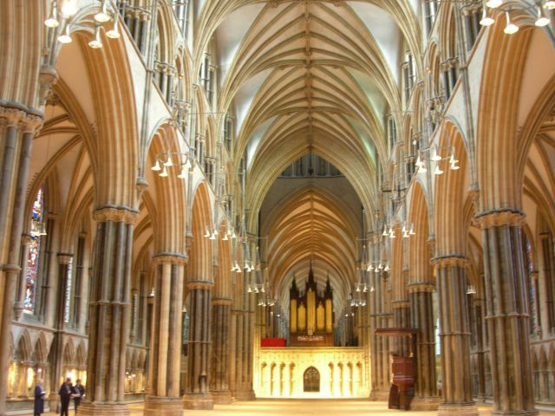
Who is glorified in such a setting as this?
Architect
Builders
One for whom named
Organ and Organist
Choir and Composer
Poets, Kings, Heroes
Official in Charge
God?

Slide 16
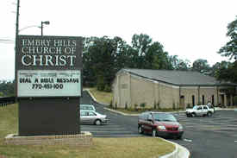
Can we worship God in Spirit and Truth in this Building?
We must!
God must be at the center of our thoughts.
Not the building.
Not the number of people present.
Not the quality of what others are doing.
Not our own outward actions .
All pride must be replaced with humility.

Slide 17
Adapting the Words of Jesus:
The hour…now is, when the true worshipers…worship the Father in spirit and truth; for the Father is seeking such to worship Him. ²⁴ God is Spirit, and those who worship Him must worship in spirit and truth.”

Slide 18
True Worship Begins with Total Submission

