Slide 1
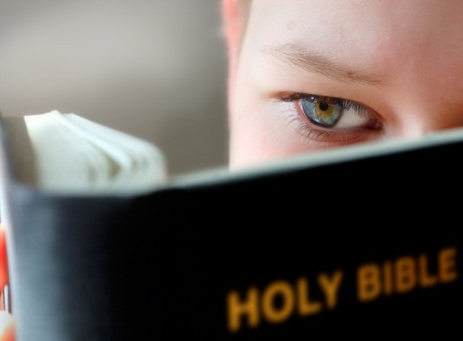
Bible 101
BIBLE 101
A Survey of God’s Word for Beginners
A GUIDED TOUR of god’s word for beginners

Slide 2
Law
History
Wisdom
Old Testament – 39 New Testament – 27
Total – 66
Major Prophets
Minor Prophets
Gospels
Acts
Letters
Rev

Slide 3
#1
#3
#4
Creation & Fall
Exodus & Conquest
Kings & Prophets
Life of Jesus
The Patriarchs
The
Judges
Exile & Return
Early Church
#2
Law
History
Gospels
Acts
Wisdom
Letters
Prophets
Rev

Slide 4
Creation & Fall
The Patriarchs
But we were not left without hope. A promise was made that the seed of woman would destroy the serpent. On the cross, Jesus became a curse for us to release us from the curse of sin, and thus destroy the work of the devil.
God called Abraham to go to a land He would show him. God made three promises: (1) He would bless Abraham with a great NATION, (2) He would give his people the LAND where he lived as a sojourner, (3) through his SEED all nations would be blessed.
Abram trusted God, even when called to do the unthinkable: to offer his only son as a burnt offering. Abraham was about to sacrifice his son when God provided a substitute. 2000 years later God would offer His only Son to take our place.
God’s eternal purpose was to create a world in which he could have a relationship with His creatures. We were made in God’s image which, among other things, included free will. We used our freedom to serve our flesh. In response to our sin, God cursed this world with pain and sorrow. More than that, our relationship with God was severed.

Slide 5
Reuben
Simeon
Levi
Judah
Dan
Napthali
Abraham
Isaac
Jacob
Gad
Asher
Isacaar
Zebulun
Joseph
Benjamin

Slide 6
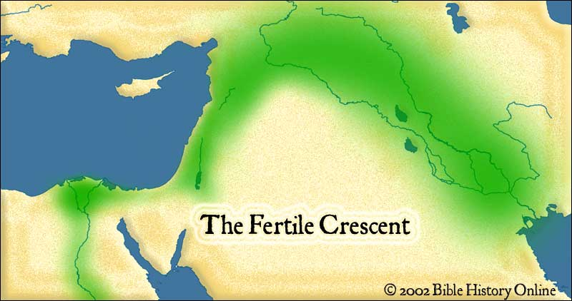
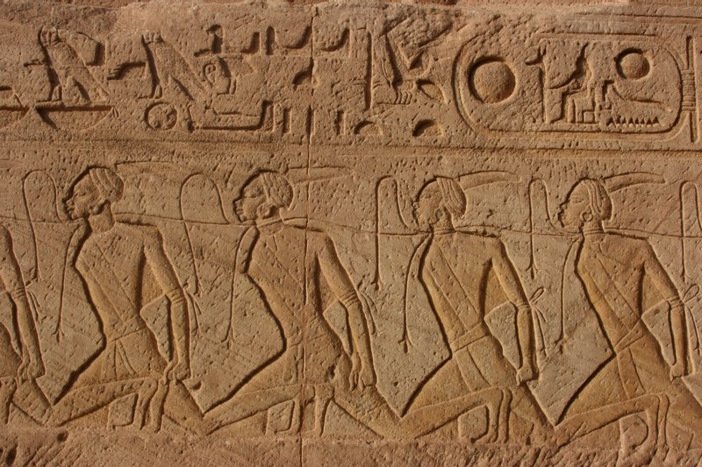

Slide 7
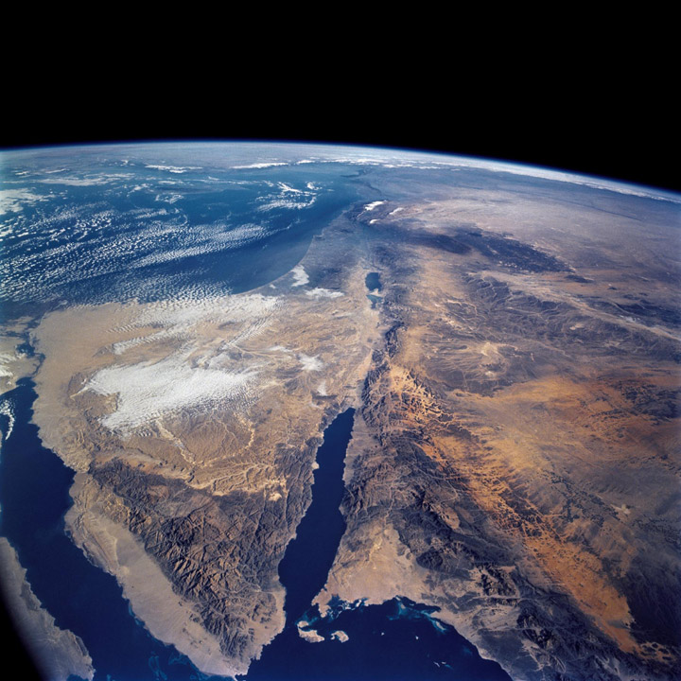
“…I have come down to deliver them out of the hand of the Egyptians and to bring them up out of that land to a good and broad land, a land flowing with milk and honey…”
Exodus 3:7-8

Slide 8
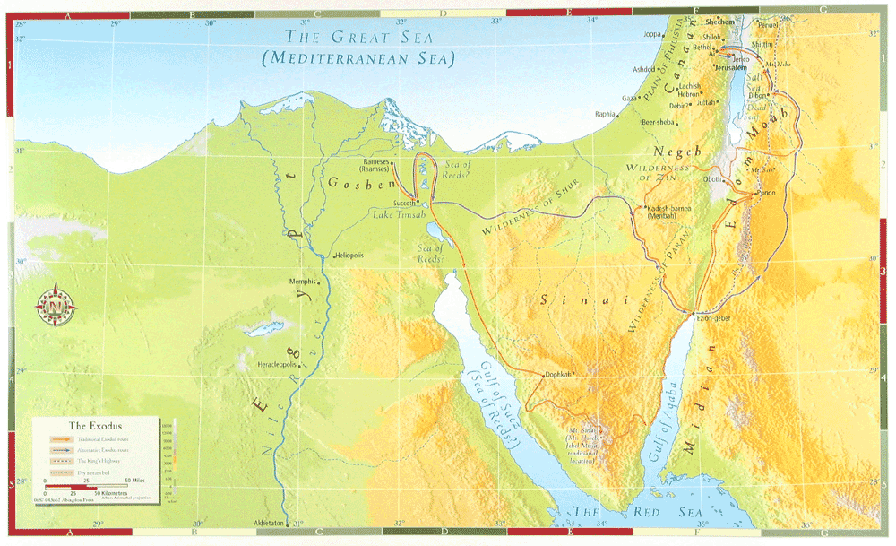
12 Spies
10 Plagues
Possession
Wandering
Red Sea
Mt Sinai

Slide 9
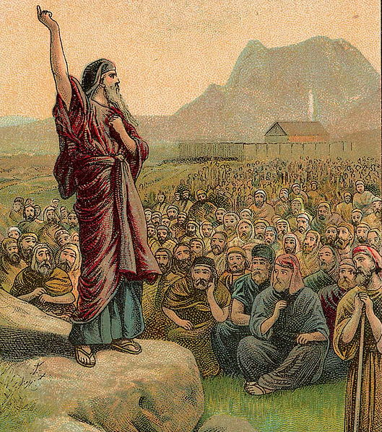
“The LORD your God will raise up for you a prophet like me from among you, from your brothers—it is to him you shall listen—just as you desired of the LORD your God at Horeb on the day of the assembly, when you said, ‘Let me not hear again the voice of the LORD my God or see this great fire any more, let I die.’”
Deuteronomy 18:15-16
For there is one God, and there is one mediator between God and men, the man Christ Jesus…
1 Timothy 2:5

Slide 10
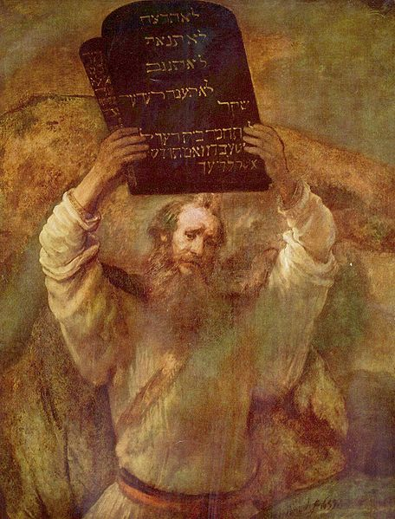
For the law was given through Moses; grace and truth came through Jesus Christ. No one has ever seen God; the only God, who is at the Father’s side, he has made him known.
John 1:17-18
And a cloud overshadowed them, and a voice came out of the cloud, “This is my beloved Son; listen to him.”
Mark 9:7

Slide 11
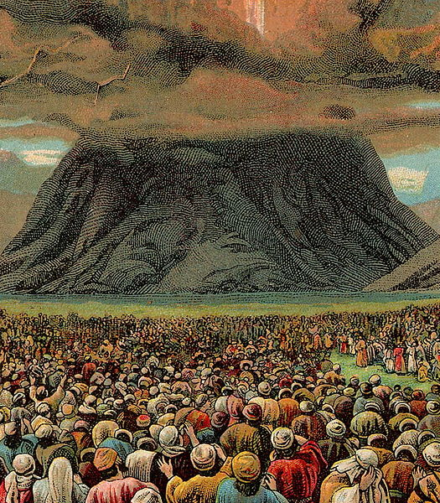
…he is able to save to the uttermost those who draw near to God through him, since he always lives to make intercession for them.
Hebrews 7:25
And there has not arisen a prophet since in Israel like Moses, whom the LORD knew face to face.
Deuteronomy 34:10
Israel encamped before the mountain, while Moses went up to God.
Exodus 19:2-3

Slide 12
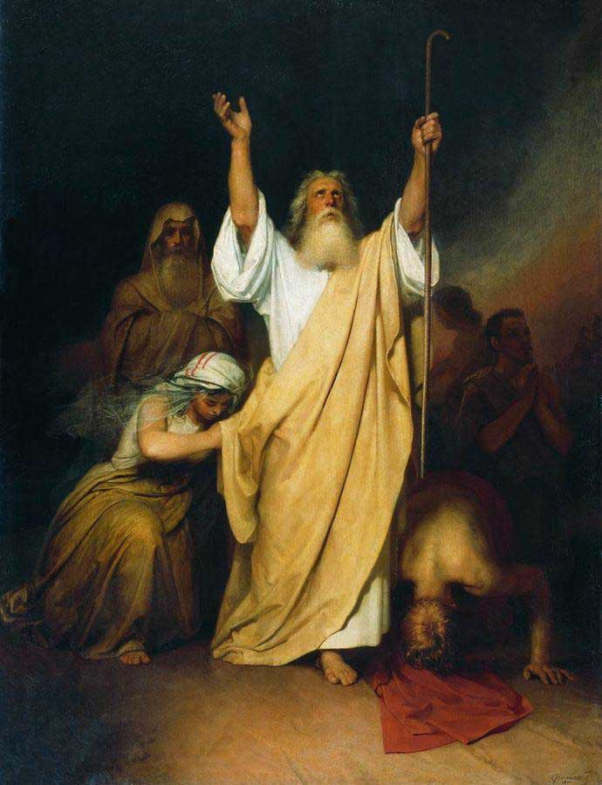
He himself bore our sins in his body on the tree, that we might die to sin and live to righteousness.
1 Peter 2:24
Jesus said, “Father, forgive them, for they know not what they do.”
Luke 23:34

Slide 13
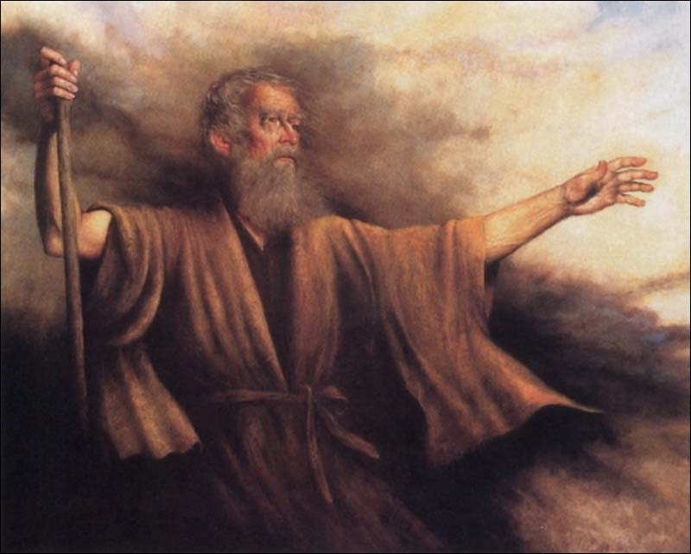
“Let the LORD... the God of the spirits of all flesh, appoint a man over the congregation who shall go out before them and come in before them, who shall lead them out and bring them in, that the congregation of the LORD may not be as sheep that have no shepherd.”
Numbers 27:17
“I am the good shepherd. The good shepherd lays down his life for the sheep.”
John 10:11
“I have led you forty years in the wilderness.”
Deuteronomy 29:5

Slide 14
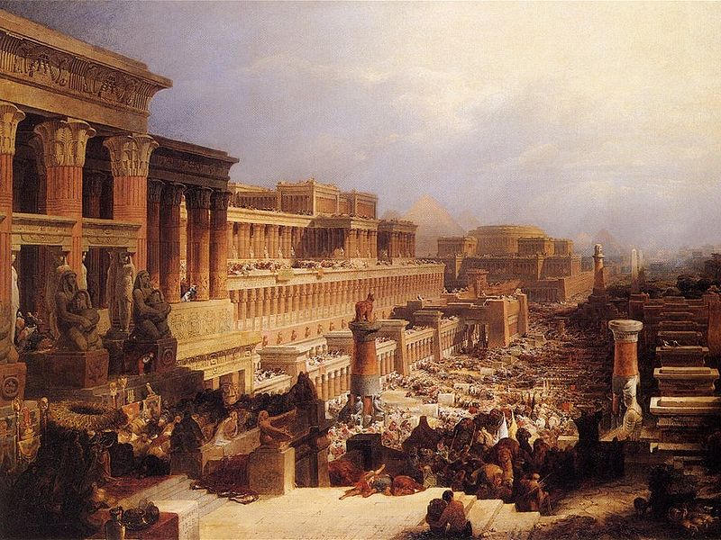
…all were baptized into Moses in the cloud and in the sea…
1 Corinthians 10:2
“If you abide in my word, you are truly my disciples, and you will know the truth, and the truth will set you free.”
John 8:31-32

Slide 15
But we all, with unveiled face, beholding as in a mirror the glory of the Lord, are being transformed into the same image from glory to glory, just as by the Spirit of the Lord.
2 Corinthians 3:18 (NKJV)
Do you not know that all of us who have been baptized into Christ were baptized into his death? We were buried therefore with him by baptism into death, in order that just as Christ was raised from the dead by the glory of the Father, we too might walk in newness of life.
Romans 6:3-4

