Slide 1
Simply church

Slide 2
goal
Remove the varnish of human tradition to uncover the original New Testament church.

Slide 3
ekklesia
ek = “out”
kaleo = “to call”
But you are a chosen race, a royal priesthood, a holy nation, a people for his own possession, that you may proclaim the excellencies of him who called you out of darkness into his marvelous light. 1 Peter 2:9

Slide 4
Why they met
Teaching (Acts 2:42)
Fellowship (Acts 2:42)
Breaking of bread (Acts 2:42)
Prayers (Acts 2:42)
Scriptures read (1 Tim 4:13; 1 Cor 14:26)
Collection (Acts 2:45; 4:35; 1 Cor 16:1-2)
Singing (1 Cor 14:26; 11:28)
Miraculous gifts (1 Cor 14:26; 11:28)
Discipline (Mt 18:17; 1 Cor 5:4)
Report of work (Acts 14:24-28)

Slide 5
Simply church
Leadership in New Testament Churches

Slide 6
Does it matter?
“No particular structure of church life is divinely ordained…
“Any form… which the Holy Spirit can inhabit and to which He may impart the life of Christ, must be accepted as valid for the church. As all forms of life adapt themselves to their environment, so does the life of Christ by His Spirit in the church.”
Donald G. Miller, The Nature and Mission of the Church

Slide 7
Does it matter?
We are a church OF Christ
And you, who once were alienated and hostile in mind, doing evil deeds, he has now reconciled in his body of flesh by his death, in order to present you holy and blameless and above reproach before him… 1:21-22
We are a church THROUGH Christ
and not holding fast to the Head, from whom the whole body, nourished and knit together through its joints and ligaments, grows with a growth that is from God. 2:19
We are a church FOR Christ
All things were created through him and for him. 1:16

Slide 8
Any form of government which gives pre-eminence to men is unbiblical.
But you are not to be called rabbi, for you have one teacher, and you are all brothers. Mt 23:8
The headship of Christ is best reflected in a plurality of elders.
…it seemed good to us, having come to one accord… Acts 15:25
We are a church…
OF Christ
THROUGH Christ
FOR Christ

Slide 9
Elders in the New Testament
Two words:
presbuteros – elder (Acts 20:17; Tit 1:5)
episcopos – bishop or overseer (Acts 20:28; Tit 1:7)
Plurality (Acts 14:23; Phil 1:1; Tit 1:5; Jas 5:14)
Work of elders:
Teach (Acts 20:28; 1 Pet 5:2)
Guard (Acts 20:28-29; Tit 1:9-14)
Oversee (1 Pet 5:3; Heb 13:7, 17)
Give counsel (Acts 21:23)
Handle disputes (Acts 15:2ff)
Visit and pray for sick (Jas 5:14)
Supervise the distribution of money (Acts 11:30)

Slide 10
Elders in the New Testament
Qualifications:
Above reproach (1 Tim 3:2; Tit 1:6)
Husband of one wife (1 Tim 3:2; Tit 1:6)
Sober-minded, self-controlled, respectable, upright, holy, & disciplined (1 Tim 3:2; Tit 1:8)
Hospitable & lover of good (1 Tim 3:2; Tit 1:8)
Able to teach (1 Tim 3:2)
Not drunkard, not violent, gentle, not quarrelsome or prideful, not lover of money (1 Tim 3:3; Tit 1:6)
Submissive, believing children (1 Tim 3:3; Tit 1:6)
Not recent convert (1 Tim 3:6)
Good reputation in world (1 Tim 3:7)
Firm convictions in the truth (Tit 1:9)

Slide 11
Teach
Guard
Oversee
Give counsel
Handle disputes
Visit and pray for sick
Supervise the distribution of money
Above reproach
Husband of one wife
Sober-minded, self-controlled, respectable, upright, holy, & disciplined
Hospitable & lover of good
Able to teach
Not drunkard, not violent, gentle, not quarrelsome or prideful, not lover of money
Submissive, believing children
Not recent convert
Good reputation in world
Firm convictions in the truth

Slide 12
Elders in the New Testament
Our duties to elders:
Obey (Heb 13:17)
Respect (1 Thess 5:13)
Remember and imitate (Heb 13:7)
Support financially (1 Tim 5:17-18)
Recognize (1 Thess 5:12)

Slide 13
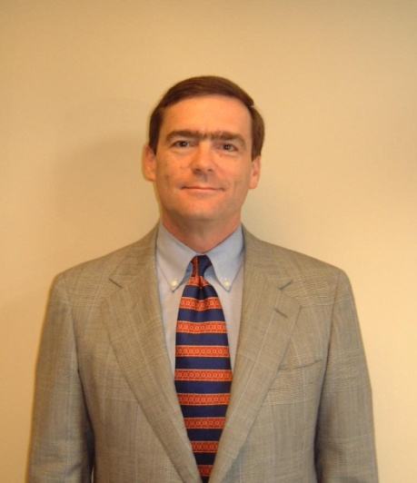
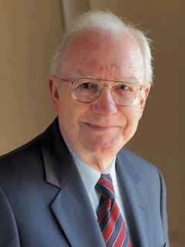
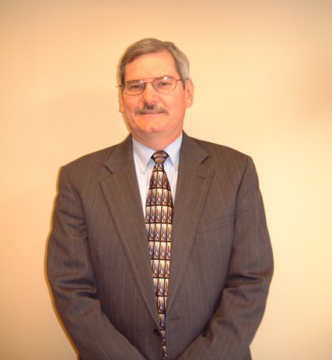
GRIEF
JOY
Waiting till a problem has become a crisis before you seek help.
Not coming to dinner.
Spreading news about problems.
Talking to others, but not the elders, about dissatisfaction or disapproval.
Asking for, and following, advice earlier.
Joyful, willing participation.
Following Mt 18:15 & Gal 6:1-2.
Offering feedback and suggestions

