Slide 1
Daniel’s 4 Kingdoms Daniel’s North & South – Ptolemies & Seleucids Between the Testaments
Lesson 5

Slide 2
Class | Lesson
1 | A Radical Different World in A Fullness of Time
2 | Daniel’s 4 Kingdoms – Babylon & Persia
3 | Daniel’s 4 Kingdoms - Life under the Persians
4 | Daniel’s 4 Kingdoms – Greek/Alexander the Great & Hellenization of the World
5 | Daniel’s North & South – Ptolemies & Seleucids
6 | Antiochus IV Epiphanes
7 | The Maccabees
8 | Daniel’s 4 Kingdoms – Roman Iron
9 | Roman Government & Justice
10 | Roman Roads & Shipping
11 | Jewish Reaction – Rise of the Sects
12 | The Herod Family
13 | The Fullness of Time - A Review
D
A
N
I
E
L

Slide 3
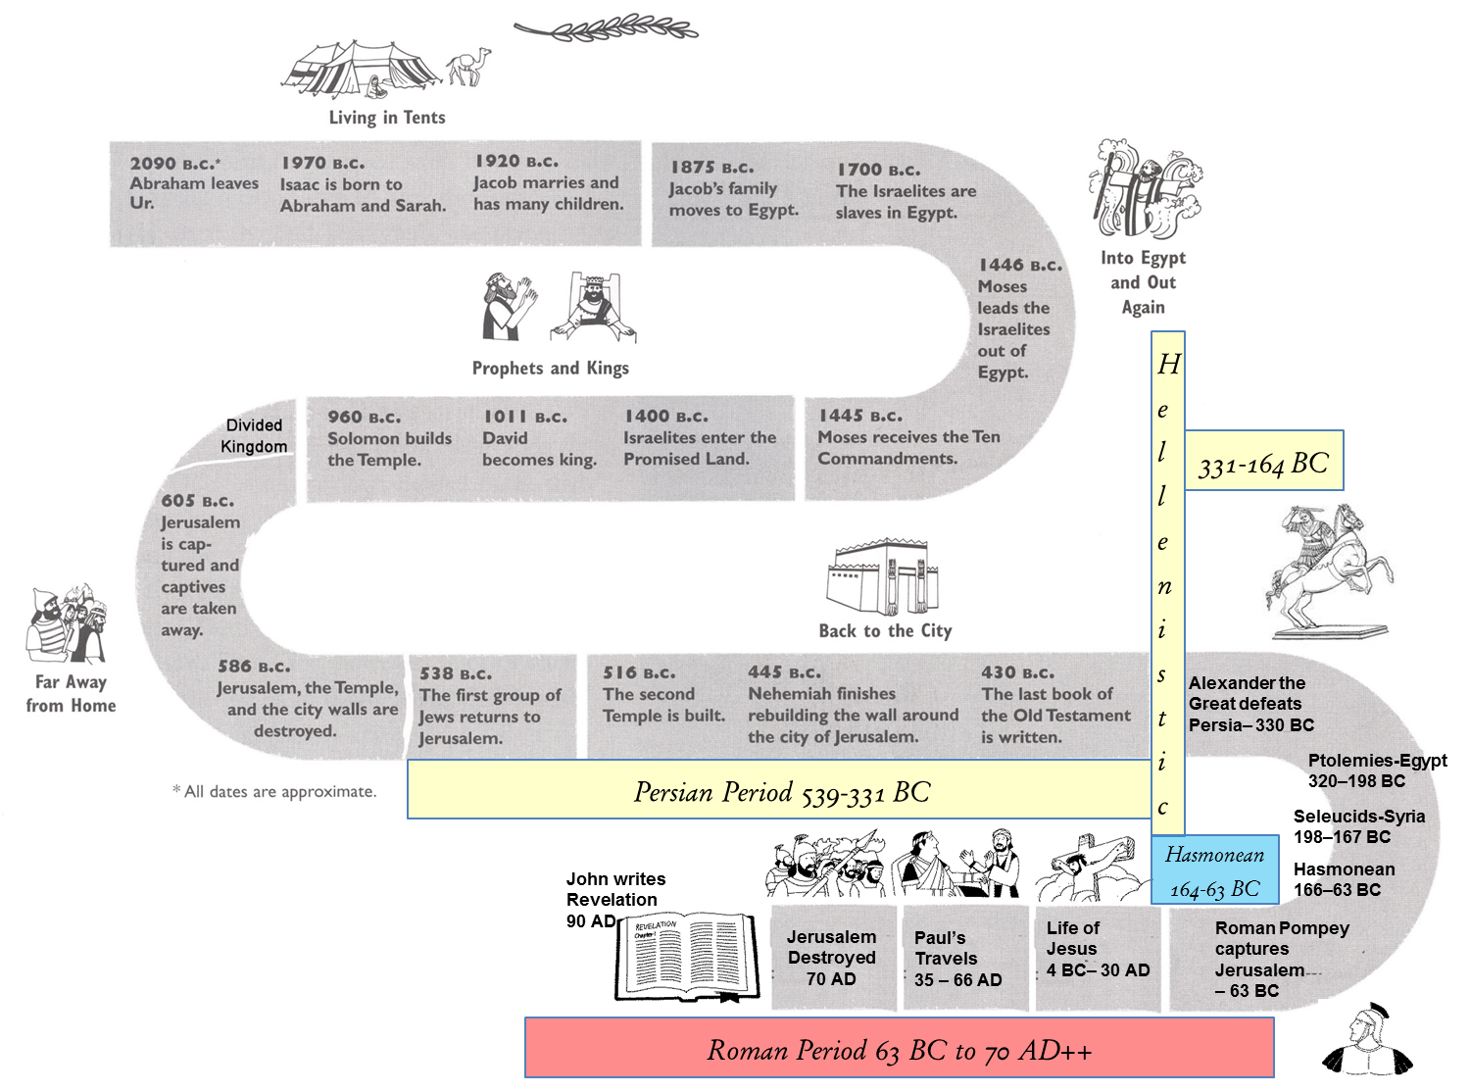

Slide 4
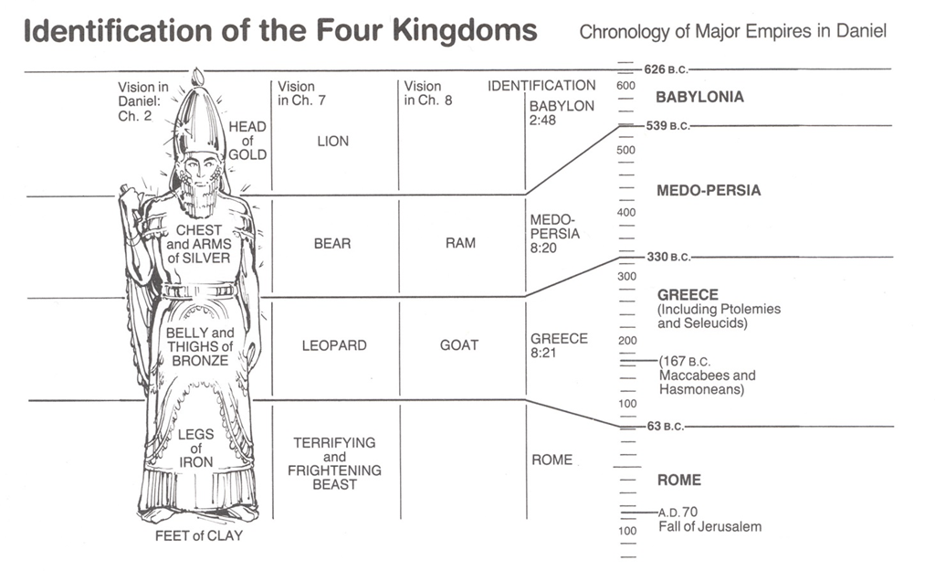
The Four Kingdoms

Slide 5
Apollos, a native of Alexandria
Acts 18:24-28(ESV) ²⁴Now a Jew named Apollos, a native of Alexandria, came to Ephesus. He was an eloquent man, competent in the Scriptures. ²⁵He had been instructed in the way of the Lord. And being fervent in spirit, he spoke and taught accurately the things concerning Jesus, though he knew only the baptism of John. ²⁶He began to speak boldly in the synagogue, but when Priscilla and Aquila heard him, they took him and explained to him the way of God more accurately. ²⁷And when he wished to cross to Achaia, the brothers encouraged him and wrote to the disciples to welcome him. When he arrived, he greatly helped those who through grace had believed, ²⁸for he powerfully refuted the Jews in public, showing by the Scriptures that the Christ was Jesus.
City had five districts & two were denominated Jewish districts,
because the majority of their inhabitants were Jews

Slide 6
Alexandria
port city on the Mediterranean Sea in northern Egypt founded in 331 BCE by Alexander the Great.
It is most famous in antiquity as the site of the Pharos, the great lighthouse, considered one of the seven wonders of the ancient world,
Temple of Serapis, the Serapion/Library

Slide 7
Alexandria
Eratosthenes (c.276-194 BCE) calculated the circumference of the earth to within 50 miles (80 km) at Alexandria.
Euclid taught at the university there.
Archimedes (287-212 BCE) the great mathematician and astronomer may have taught there and was certainly studied there.
The greatest engineer and mathematician of his day, Hero (also known as Heron, 10-70 CE) was born and lived in Alexandria.
credited with amazing feats in engineering and technology including the first vending machine, the force-pump, and a theatre of automated figures who danced, among his other inventions

Slide 8
Alexandria
The library, begun under Ptolemy I (305-285 BCE) was completed by Ptolemy II (285-246 BCE) who sent invitations to rulers and scholars asking them to contribute books.
According to historians Oakes and Gahlin, “There was room for up to 70,000 papyrus scrolls.
Most of the items were bought but other means were sometimes used. In order to procure coveted works, all ships entering the harbour were searched. Every book found was taken to the Library where it was decided whether to give it back or confiscate it and replace it with a copy”.
No one knows how many books were held in the library at Alexandria but estimates have been made of 500,000.

Slide 9
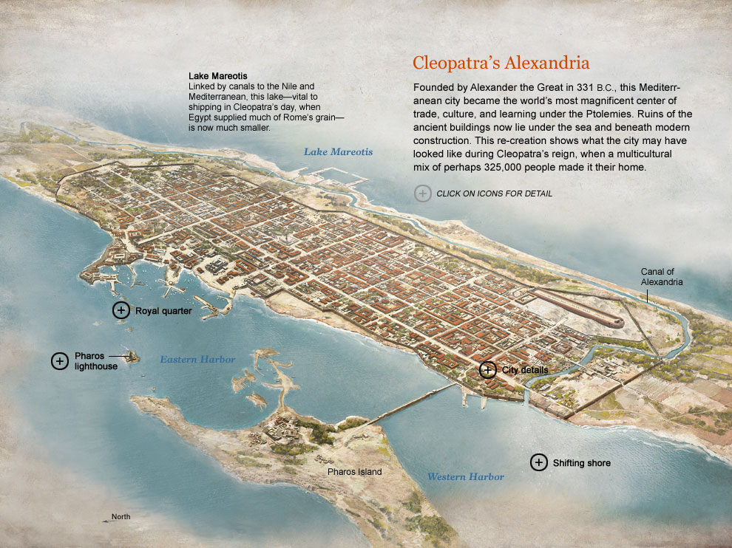

Slide 10
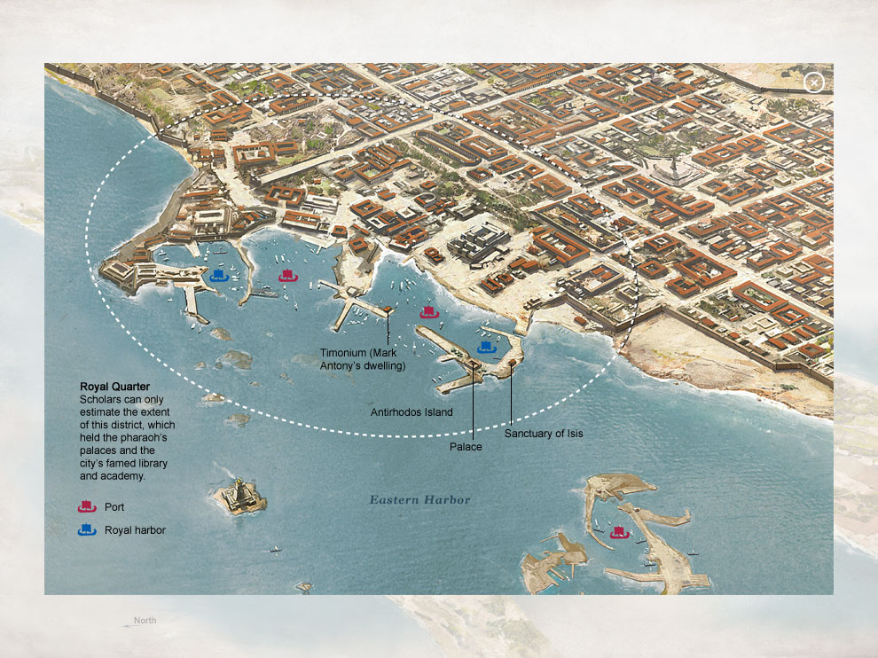

Slide 11
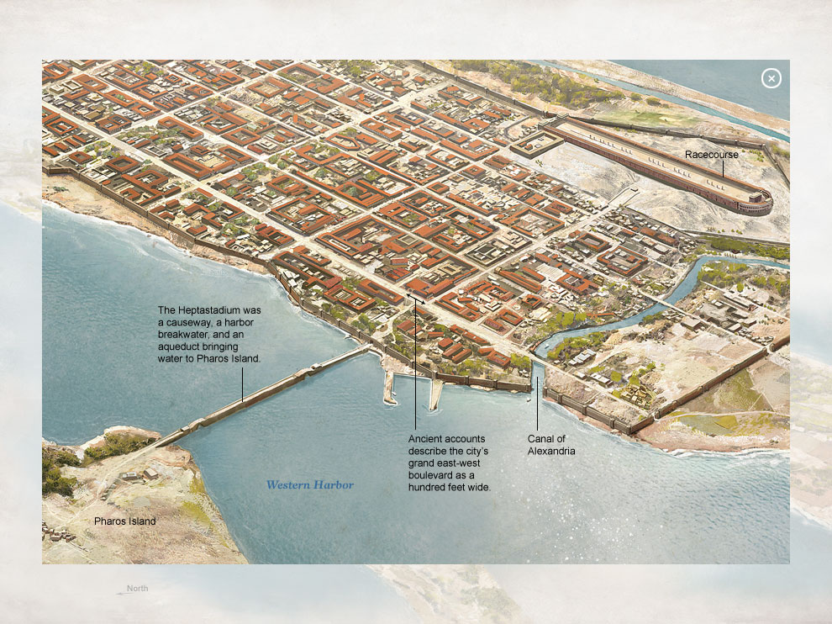

Slide 12
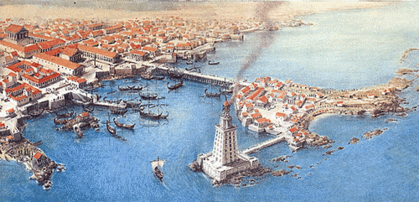
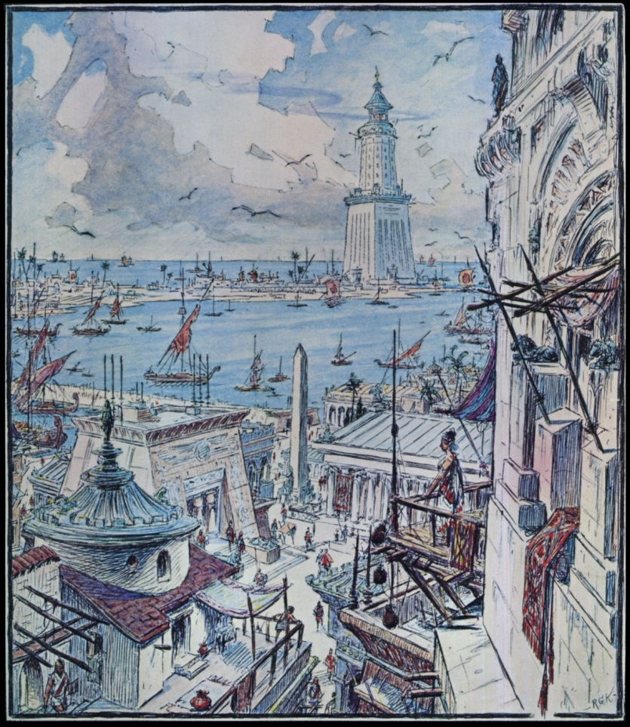
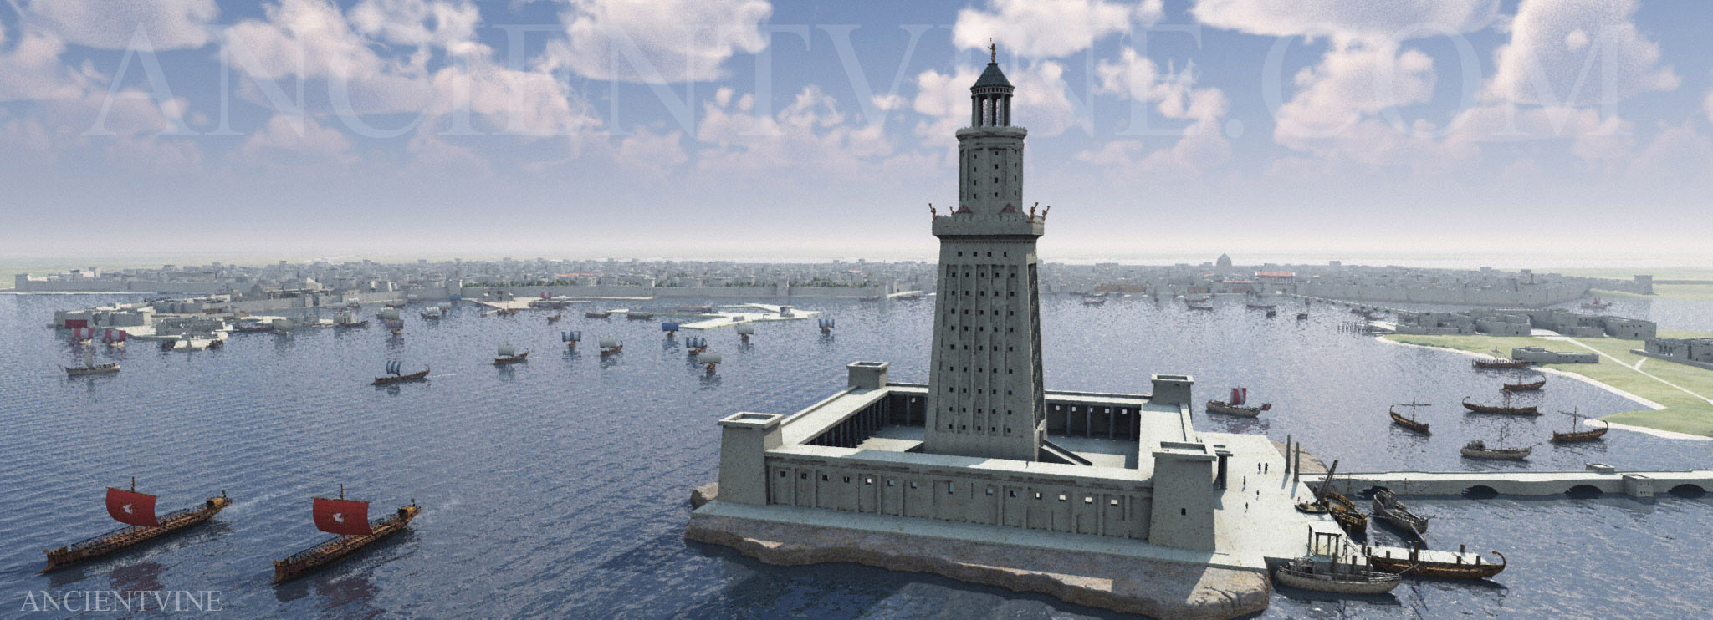

Slide 13
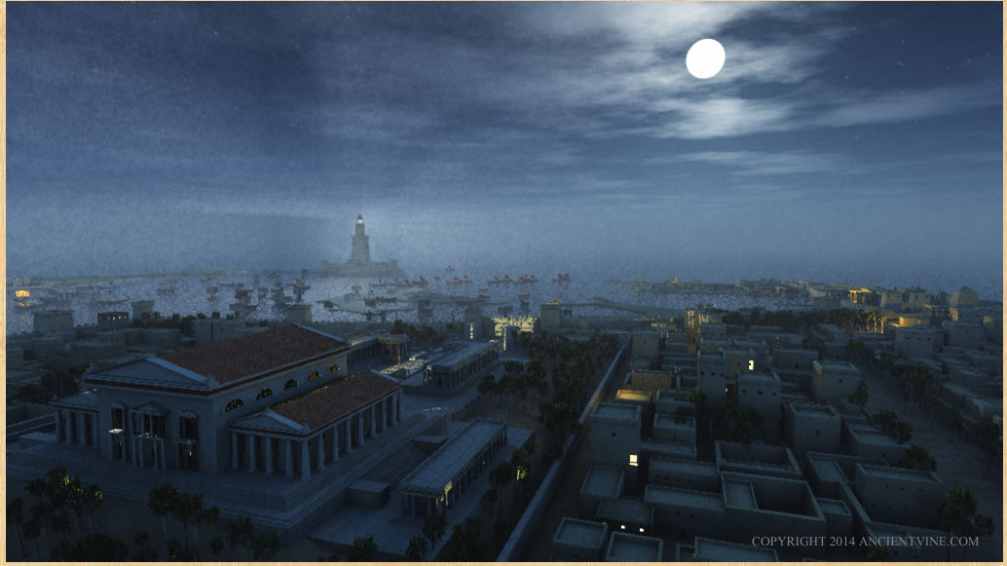

Slide 14
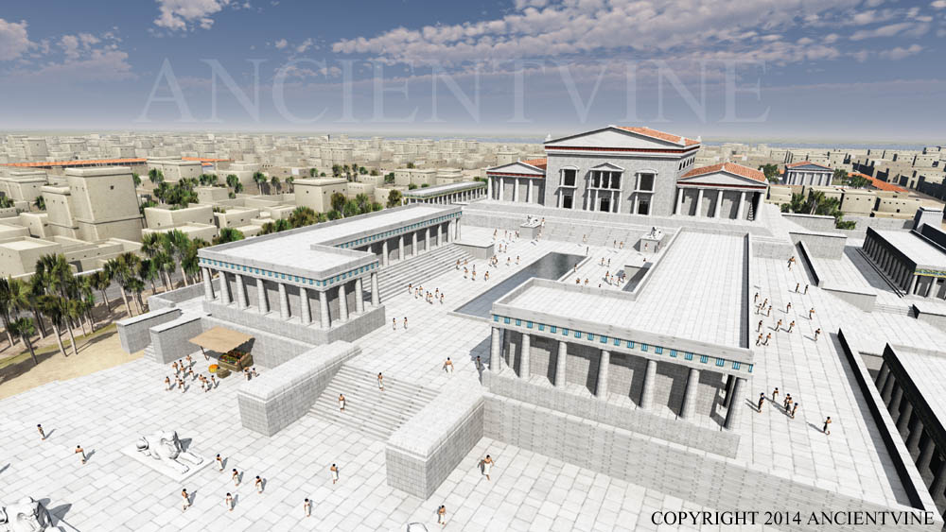

Slide 15
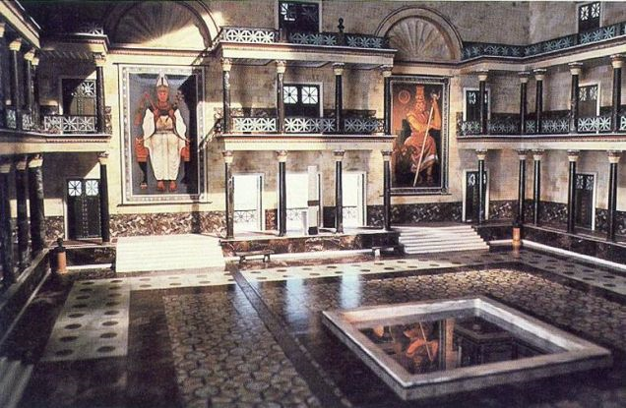
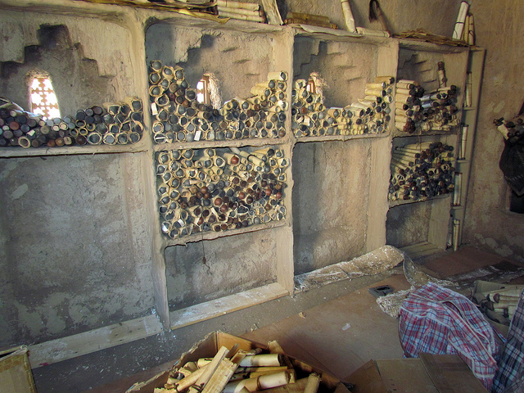
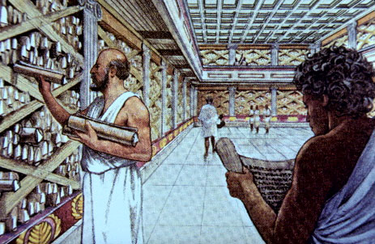
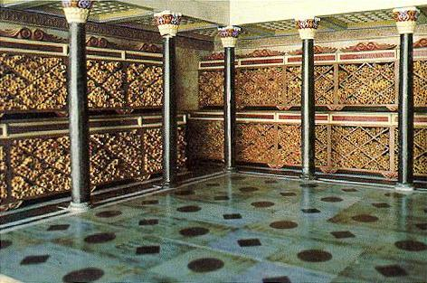

Slide 16
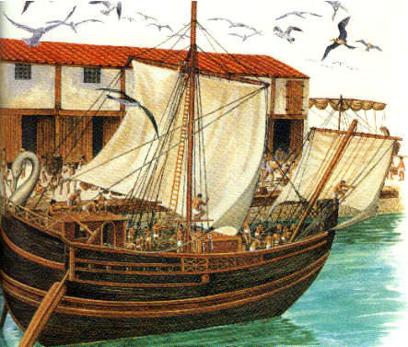
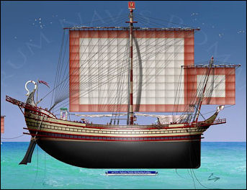
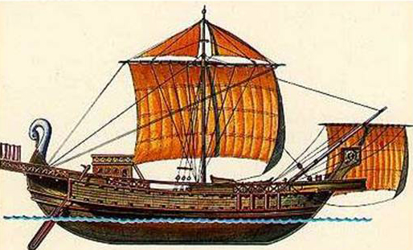
Acts 27:5-6(ESV) ⁵And when we had sailed across the open sea along the
coast of Cilicia and Pamphylia, we came to Myra in Lycia.
⁶There the centurion found a ship of Alexandria sailing
for Italy and put us on board. Acts 28:11 (ESV) ¹¹After three months we set sail in a ship that had
wintered in the island, a ship of Alexandria,
with the twin gods as a figurehead.

Slide 17
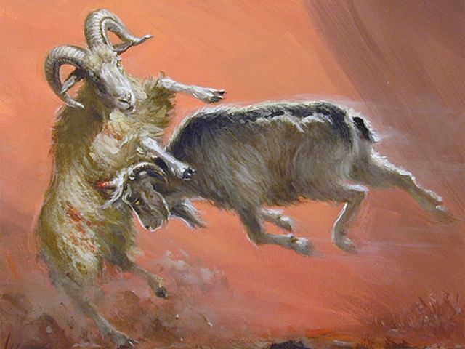
Daniel 8
²⁰ As for the ram that you saw with the two horns, these are the kings of Media and Persia. ²¹ And the goat is the king of Greece. And the great horn between his eyes is the first king. ²² As for the horn that was broken, in place of which four others arose, four kingdoms shall arise from his nation, but not with his power.

Slide 18
What to do with an Empire?
Alexander and Roxanne’s small boy was named Alexander IV and was born shortly after his father’s death.
Alexander also left a half-brother in Babylon, one of Philip II’s other children – severe mental disabilities
Division 323 BC
Asia Minor: Antigonus
Egypt: Ptolemy
Eastern territories: Seleucus
Macedonia and Greece: Antipater
Thrace: Lysimachus
275 BC
Egypt: Ptolemy
Asia Minor & Eastern territories: Seleucus
Macedonia and Greece
Thrace

Slide 19
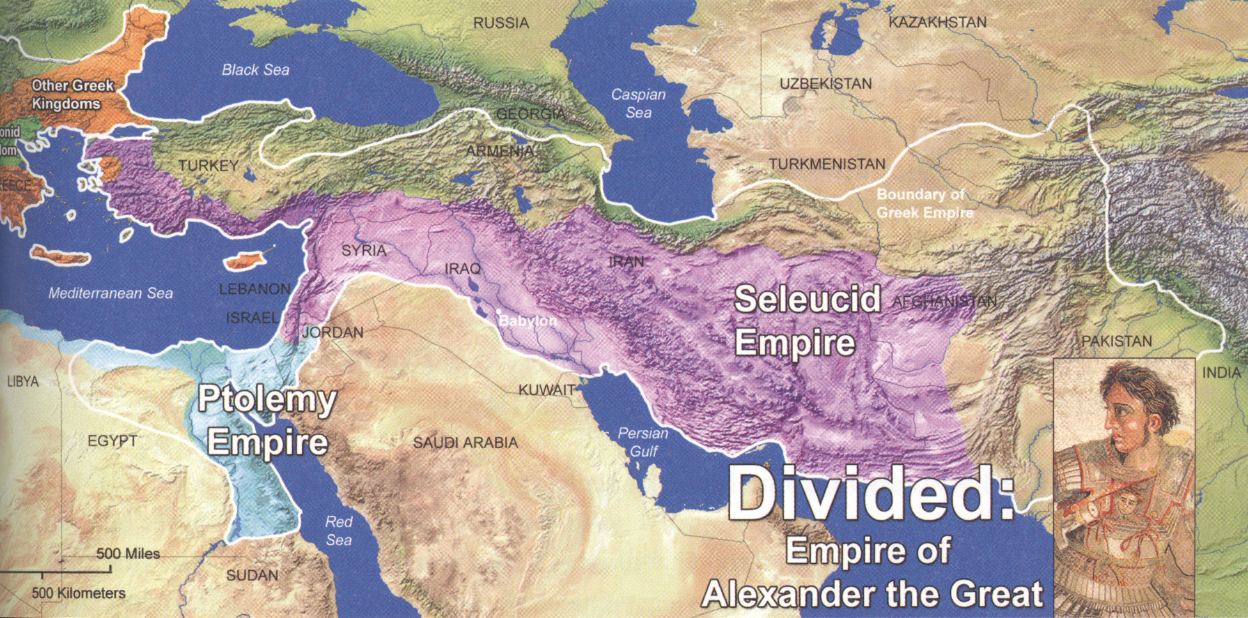
Alexander died in 323 B.C. when he was only about thirty-three years old. After some time, however, the four generals that had led Alexander’s armies divided his empire between them. We will study them in our next lesson.

Slide 20
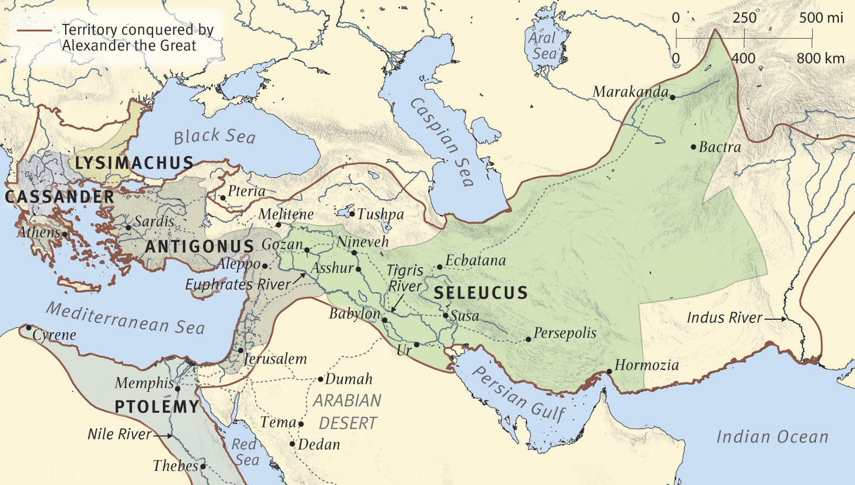

Slide 21
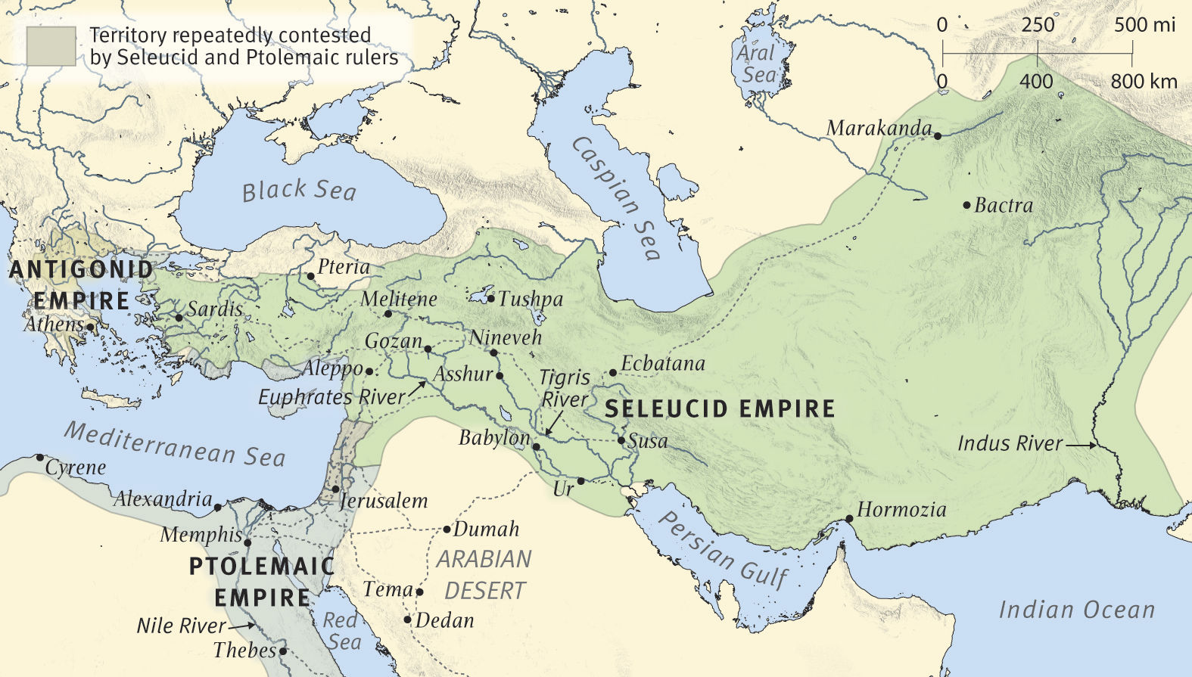

Slide 22
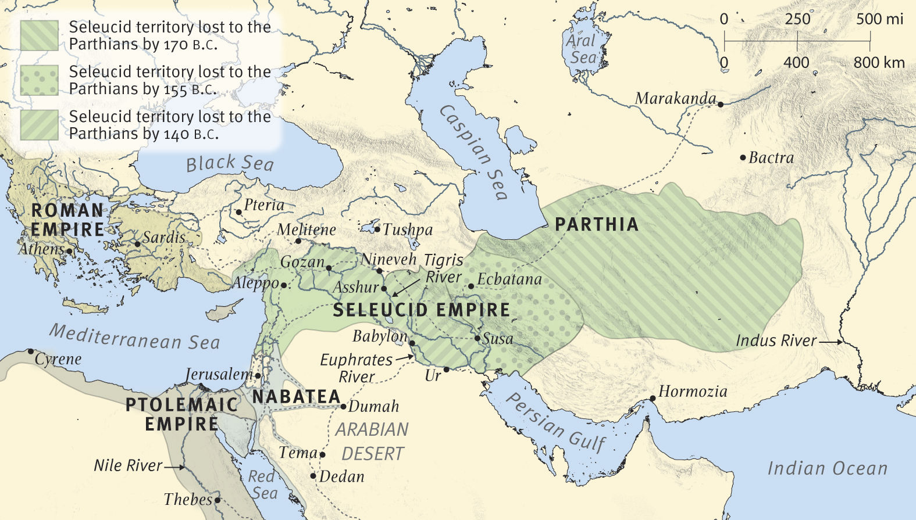

Slide 23
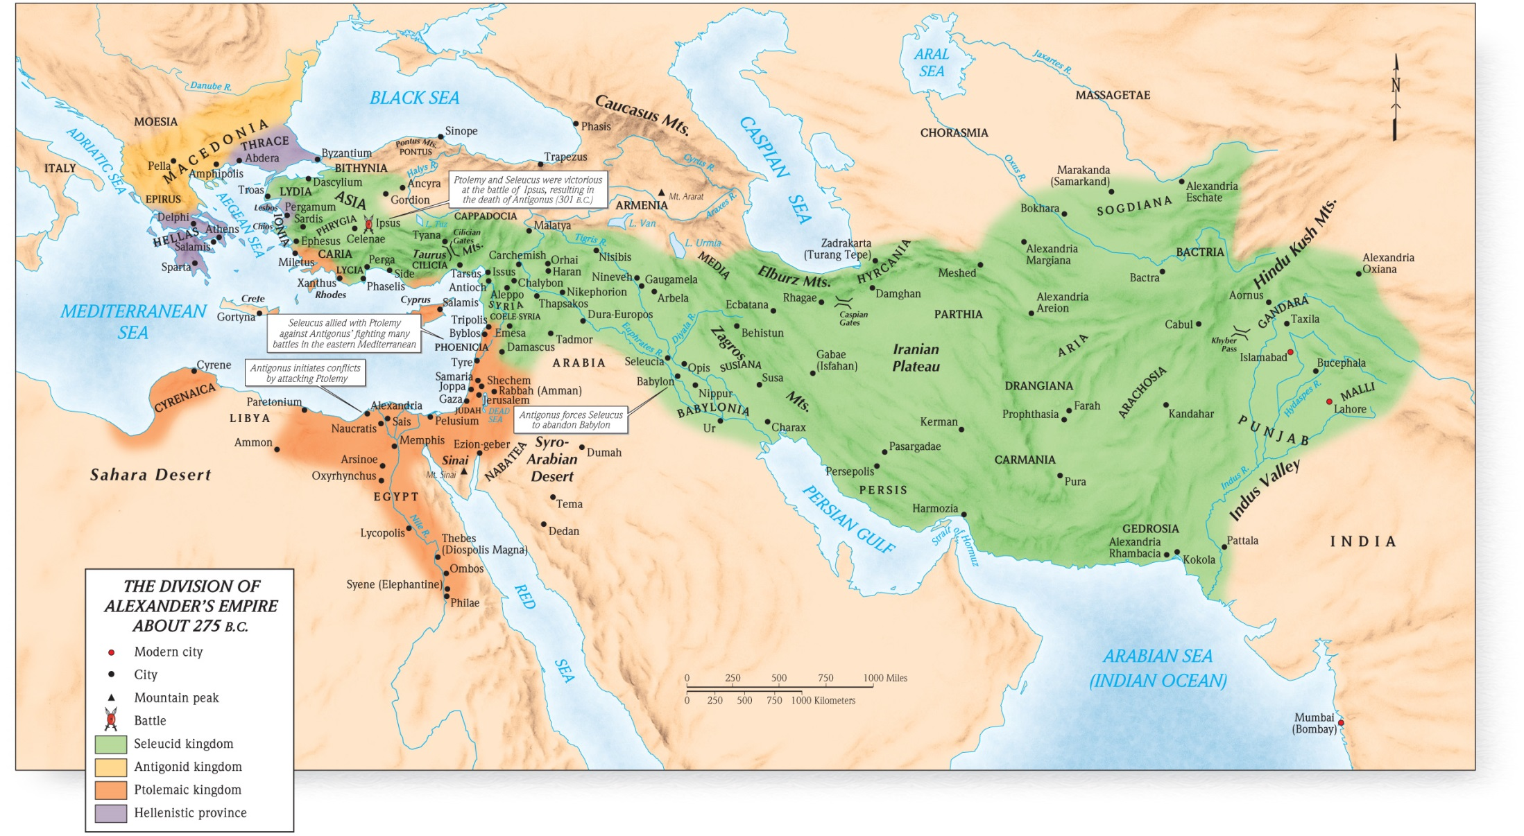

Slide 24
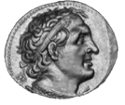
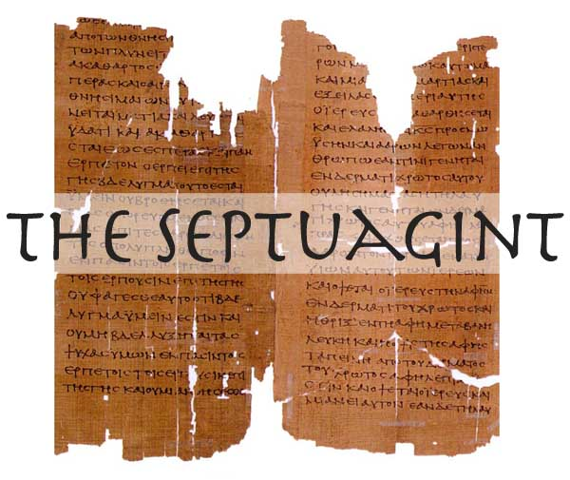
Septuagint
~280 BC Ptolemy II Philadelphus had Hebrew bible translated into Greek
Great majority of New Testament quotes from Old Testament come from the Septuagint
One source says only 33 places
come form Masoretic Text
Other 307 places from Septuagint
Notes:
In about 280 BC seventy-two Jewish scholars were asked to come from Israel to assemble in Alexandria by the ruler Ptolemy II Philadelphus for the task of translating the Hebrew Old Testament into the Greek language which was the common language of the day. We know this translation now as the Septuagint Version of the Old Testament. Of the places where the New Testament quotes the Old, the great majority is from the Septuagint version. Protestant authors Archer and Chirichigno list 340 places where the New Testament cites the Septuagint but only 33 places where it cites from the Masoretic Text rather than the Septuagint (G. Archer and G. C. Chirichigno, Old Testament Quotations in the New Testament: A Complete Survey, 25-32). But, since you ask, here is an example where the Greek gospels present Jesus as quoting the Septuagint: In Mark 7:6–7, Jesus quotes the LXX of Isaiah 29:13 when he says, "Well did Isaiah prophesy of you hypocrites, as it is written, ‘This people honors me with their lips, but their heart is far from me; in vain do they worship me, teaching as doctrines the precepts of men.’"

Slide 25
Motivation for the Translation
(1) A generation of Greek-speaking Jews in the Hellenistic period begun by the conquest of Alexander the Great (333–323 b.c.) required Greek Scriptures
(2) for the education of their young.
(3) The translation was required as a legal document
(4) as cultural heritage for the royal library being assembled in Alexandria.
(5) Aristarchus’s new edition of Homer around 150 b.c. employed textual criticism to produce an authoritative text, and this served as an incentive and a model to produce an authoritative text of the Bible for Alexandrian Jews (later date than the 280 BC)

Slide 26
New Testament (ESV) | LXX (Brenton) | Masoretic (Our Old Testament)
⁶And he said to them, “Well did Isaiah prophesy of you hypocrites, as it is written, “‘This people honors me with their lips, but their heart is far from me; ⁷ in vain do they worship me, teaching as doctrines the commandments of men.’ | Isaiah 29:13 And the Lord has said, This people draw nigh to me with their mouth, and they honour me with their lips, but their heart is far from me: but in vain do they worship me, teaching the commandments and doctrines of men. | Isaiah 29:13 Wherefore the Lord said, Forasmuch as this people draw near me with their mouth, and with their lips do honour me, but have removed their heart far from me, and their fear toward me is taught by the precept of men:

Slide 27
Daniel 11 verse | Year | Event
1 | 536 BC | first year of Darius the Mede = 3rd year of Cyrus (10:1)
2 | 530-522 522 522-486 486-465 | three more kings shall arise in Persia, and a fourth… shall stir up all against the kingdom of Greece Cambyses II (conquers Egypt) Bardiya (Smerdis) Imposter/Ursurper Darius I (490 invasion of Greece) Xerxes I (Ahasuerus) – 480 invasion of Greece/Esther
3 | 336-323 | Then a mighty king shall arise, who shall rule with great dominion and do as he wills. – Alexander the Great
4 |  | as soon as he has arisen, his kingdom shall be broken and divided toward the four winds of heaven – kingdom divided 4 ways 1) Lysimachus 3) Seleucus I 2) Cassander son of Antipater 4) Ptolemy I
4 | 323 | but not to his posterity – his wife & son born posthumously murdered wife

Slide 28
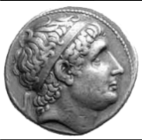
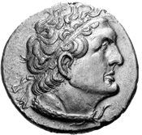
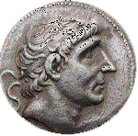
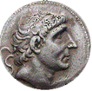
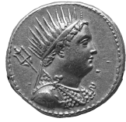
Dan 11 | Year | Event
5 | 274 – 271 | Then the king of the south shall be strong, but one of his princes shall be stronger than he and shall rule Ptolemy I of Egypt (prince stronger) & Seleucus I of Syria 1st Syrian War - a major victory for the Ptolemies via Ptolemy II
6 | ~246 death | After some years they shall make an alliance, and the daughter of the king of the south shall come to the king of the north to make an agreement. But she shall not retain the strength of her arm, and he and his arm shall not endure Berenice Daughter of Ptolemy II marries Antiochus II but his former wife Laodice poisons him, Berenice & child – 3rd Syrian War
7-8 | 246-241 | He shall come against the army and enter the fortress of the king of the north, and he shall deal with them and shall prevail. He shall also carry off to Egypt their gods with their metal images and their precious vessels of silver and gold, and for some years he shall refrain from attacking the king of the north. – Ptolemy III (Berenice’s brother) defeats Seleucus II victoriously to the Tigris or beyond (son of Laodice who had poisoned Ptolemy II & Berenice & their son)
9 | 240 | Then the latter shall come into the realm of the king of the south but shall return to his own land. – Seleucus II counter attacks but is defeated
General of Ptolemy – fled to him in 319 BC

Slide 29
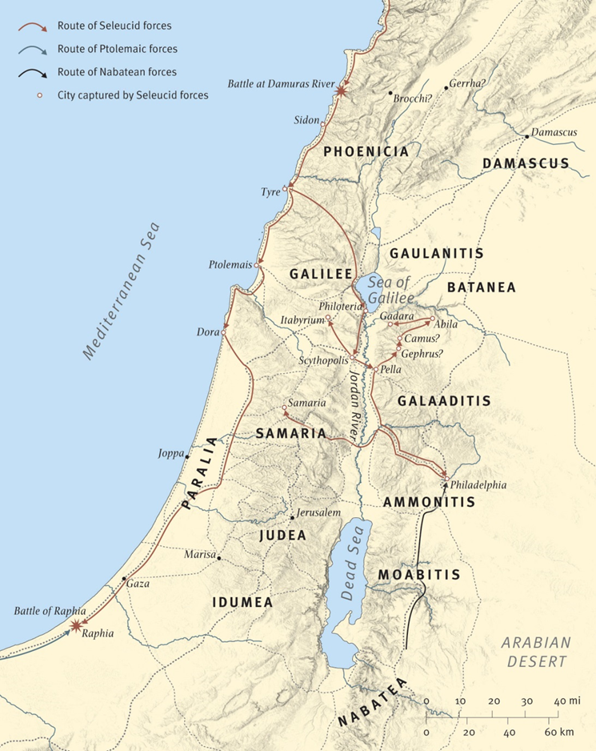
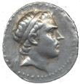
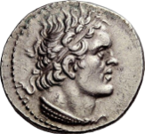
Dan 11 | Year | Event
10 | 240-187 | His sons shall wage war and assemble a multitude of great forces, which shall keep coming and overflow and pass through, and again shall carry the war as far as his fortress. 4th and 5th Syrian Wars – Antiochus’ III early campaigns against the Ptolemaic Kingdom were unsuccessful, but later years Antiochus gained several military victories
11 | 217 | Then the king of the south, moved with rage, shall come out and fight with the king of the north. (Battle of Raphia)– Ptolemy IV defeats Antiochus III – 4th Syrian War

Slide 30
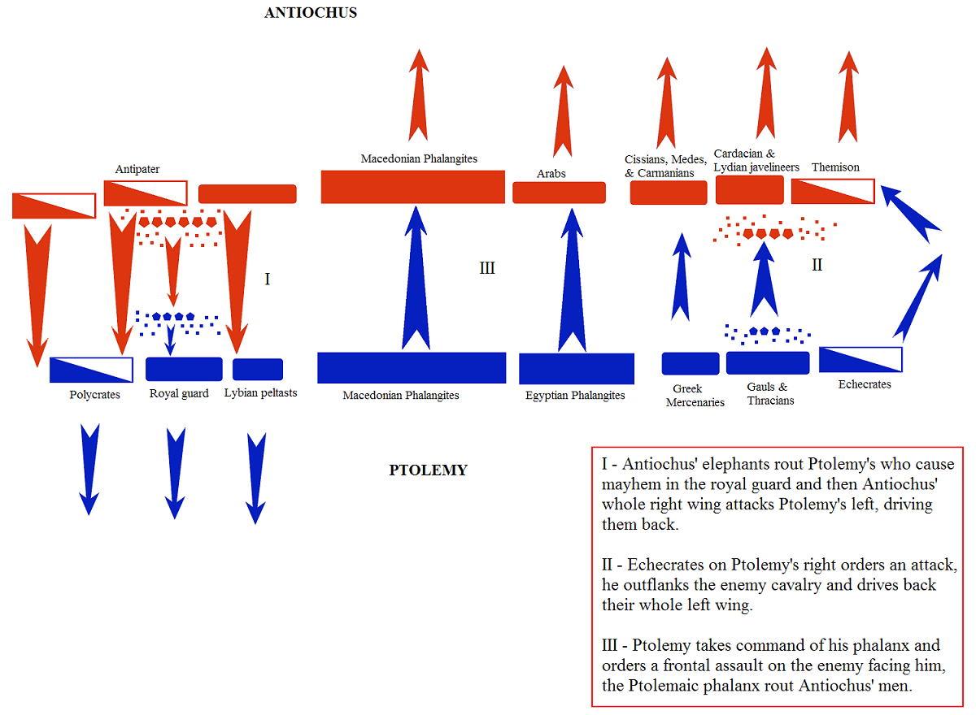
It was one of the largest battles of the Hellenistic kingdoms of the Diadochi
According to Polybius, Ptolemy had 70,000 infantry, 5,000 cavalry, and 73 war elephants and Antiochus 62,000 infantry, 6,000 cavalry, and 102 elephants

Slide 31
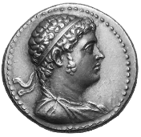
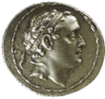
Dan 11 | Year | Event
13 | 204 | For the king of the north shall again raise a multitude, greater than the first. And after some years he shall come on with a great army and abundant supplies. Antiochus III now succeeds with Macedonian help
14 |  | the violent among your own people shall lift themselves up in order to fulfill the vision, but they shall fail – Some Jews ally themselves with Antiochus III
15 | 198 | Then the king of the north shall come and throw up siegeworks and take a well-fortified city. – Antiochus III takes Sidon & Palestine
17 |  | He shall give him the daughter of women to destroy the kingdom, but it shall not stand or be to his advantage – Antiochus III gives daughter to Ptolemy V but she sides with husband -
18 | 197-190 | he shall turn his face to the coastlands and shall capture many of them, but a commander shall put an end to his insolence – Antiochus III takes Asia Minor, Thrace, Greece-defeated by Romans at Thermopylae in 191 & Lucius Scipio defeats him at Magnesium in 190
19 | 187 | but he shall stumble and fall, and shall not be found – Antiochus III assassinated by his own people
20 |  | one who shall send an exactor of tribute for the glory of the kingdom - Seleucus IV sends Heliodorus (later poisons S IV) tax Jews & seize temple treasury

Slide 32
