Slide 1
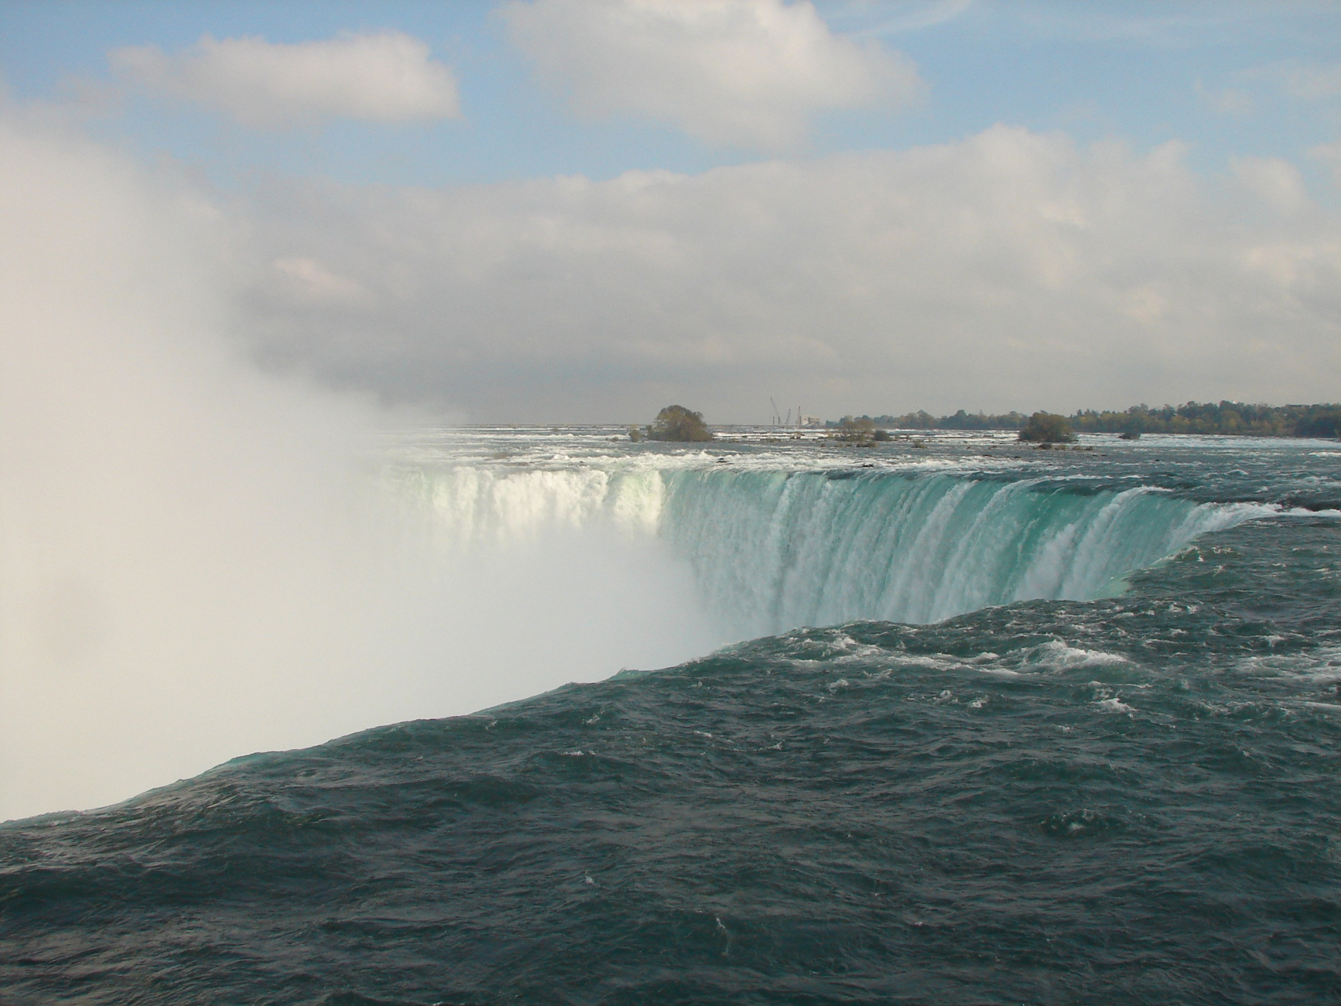
Be Strong
& Courageous

Slide 2
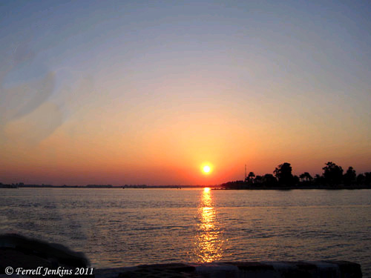
Fear of Pharaoh
Exodus 14:10-11(ESV) ¹⁰When Pharaoh drew near, the people of Israel lifted up their eyes, and behold, the Egyptians were marching after them, and they feared greatly. And the people of Israel cried out to the Lord. ¹¹They said to Moses, “Is it because there are no graves in Egypt that you have taken us away to die in the wilderness? What have you done to us in bringing us out of Egypt?

Slide 3
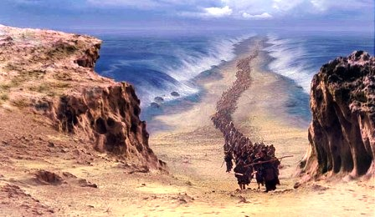
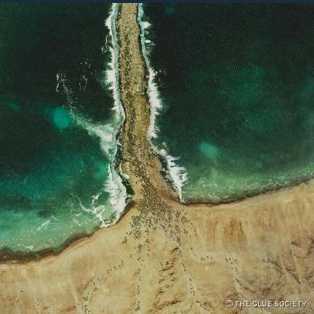
God Saves Israel
Exodus 14:13-14(ESV) 13And Moses said to the people,
“Fear not, stand firm, and see the salvation of the Lord, which he will work for you today. For the Egyptians whom you see today, you shall never see again. 14The Lord will fight for you, and you have only to be silent.”

Slide 4
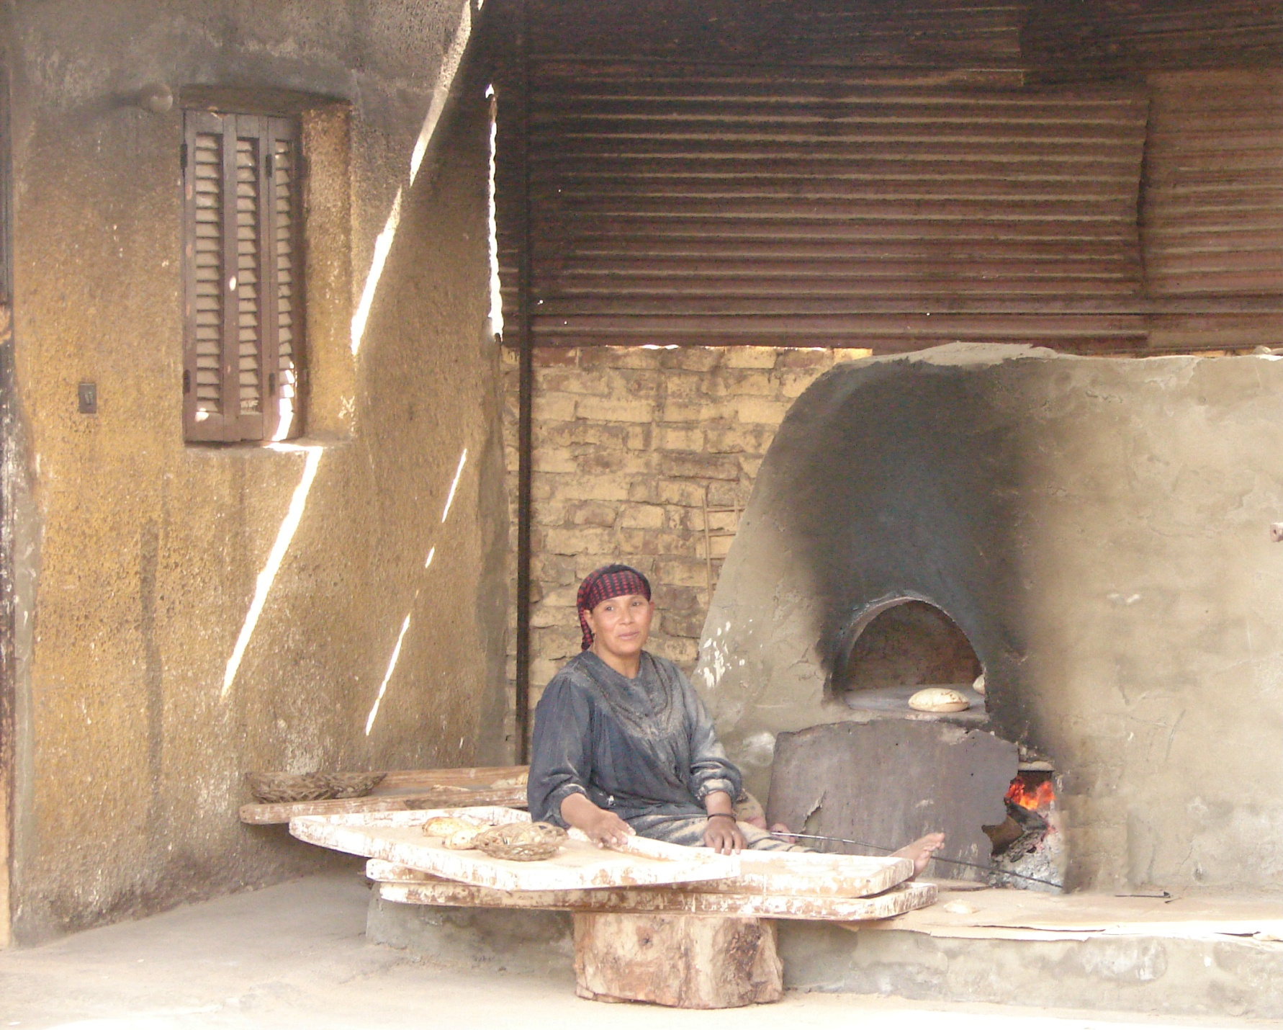
Fear of Hunger
Exodus 16:3(ESV) ³and the people of Israel said to them, “Would that we had died by the hand of the Lord in the land of Egypt, when we sat by the meat pots and ate bread to the full, for you have brought us out into this wilderness to kill this whole assembly with hunger.”

Slide 5
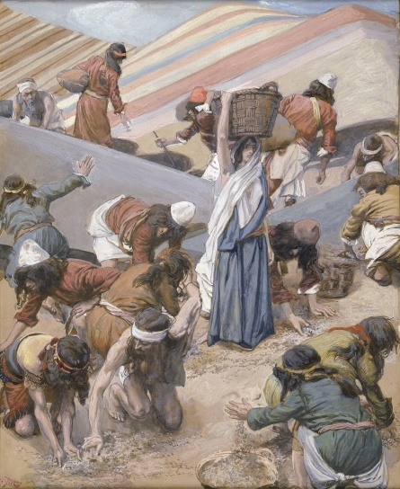
Exodus 16:13-15(ESV) ¹³In the evening quail came up and covered the camp, and in the morning dew lay around the camp. ¹⁴And when the dew had gone up, there was on the face of the wilderness a fine, flake-like thing, fine as frost on the ground. ¹⁵When the people of Israel saw it, they said to one another, “What is it?” For they did not know what it was. And Moses said to them, “It is the bread that the Lord has given you to eat.
Ex 16:35(ESV) ³⁵The people of Israel ate the manna forty years, till they came to a habitable land. They ate the manna till they came to the border of the land of Canaan.

Slide 6
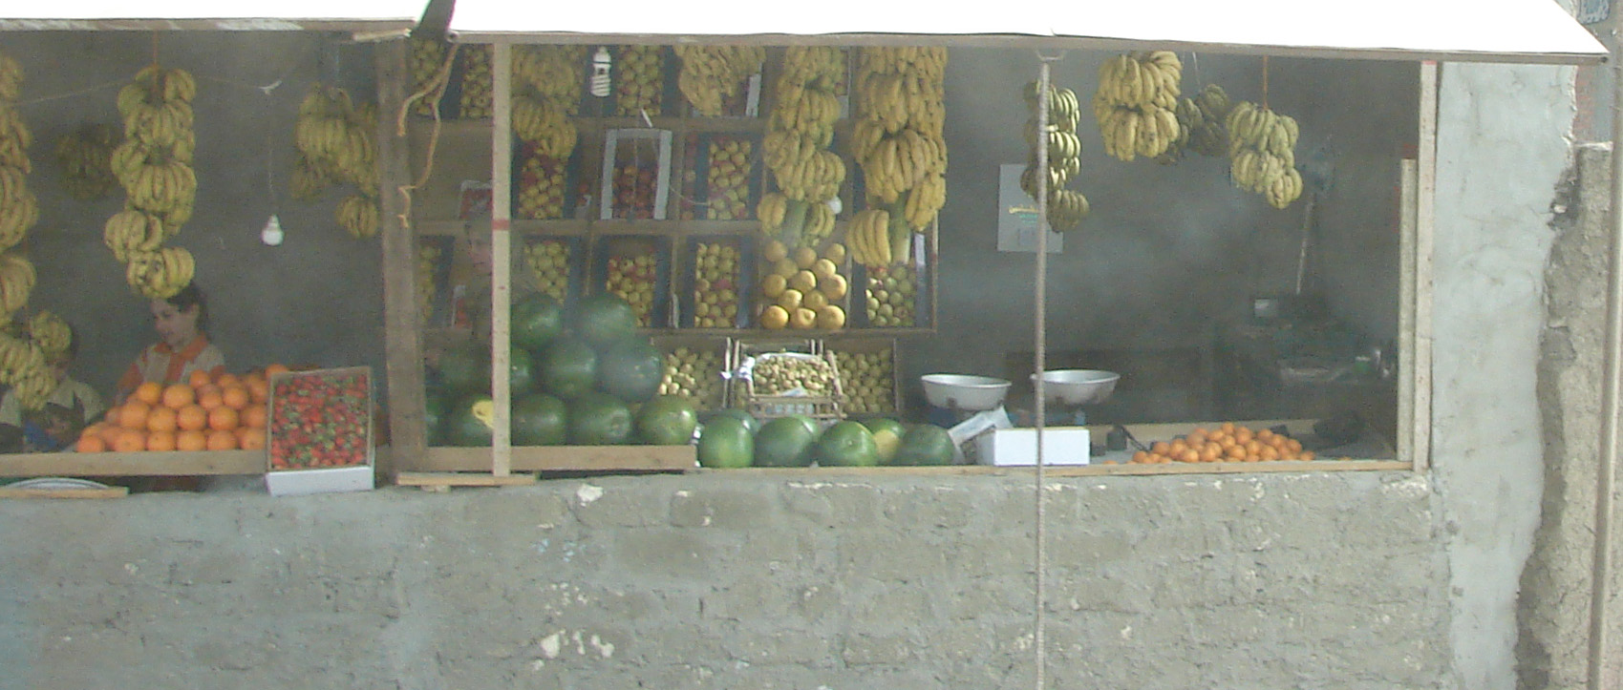
Tired of Manna
Numbers 11:4-5(ESV) ⁴ Now the rabble that was among them had a strong craving. And the people of Israel also wept again and said, “Oh that we had meat to eat! ⁵ We remember the fish we ate in Egypt that cost nothing, the cucumbers, the melons, the leeks, the onions, and the garlic.

Slide 7
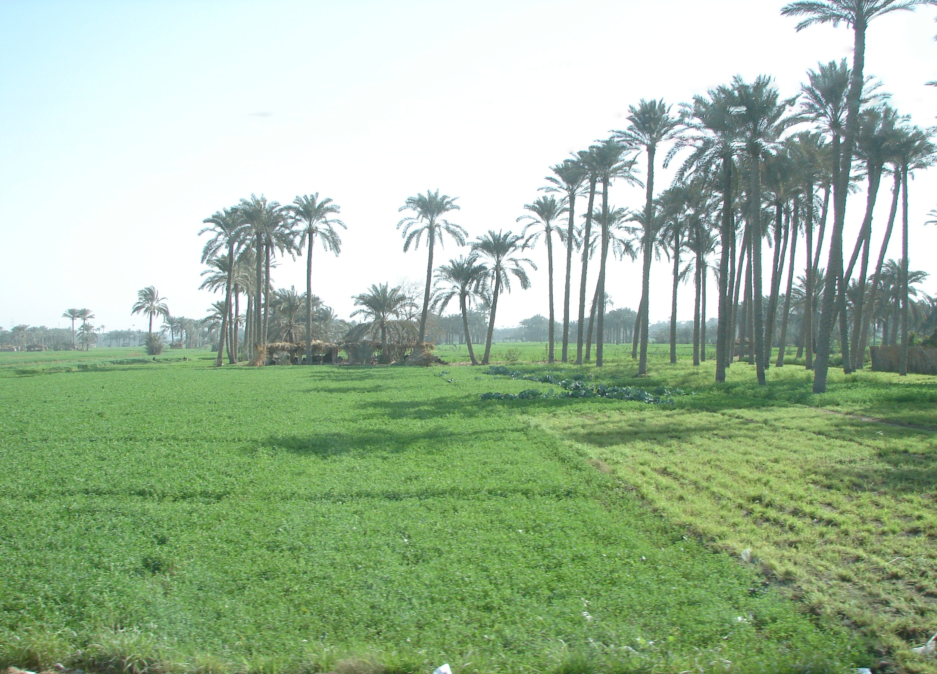
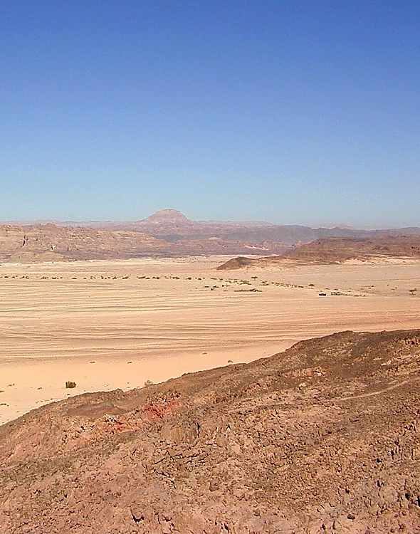
Numbers 11:6(ESV) ⁶ But now our strength is dried up, and there is nothing at all but this manna to look at.”

Slide 8
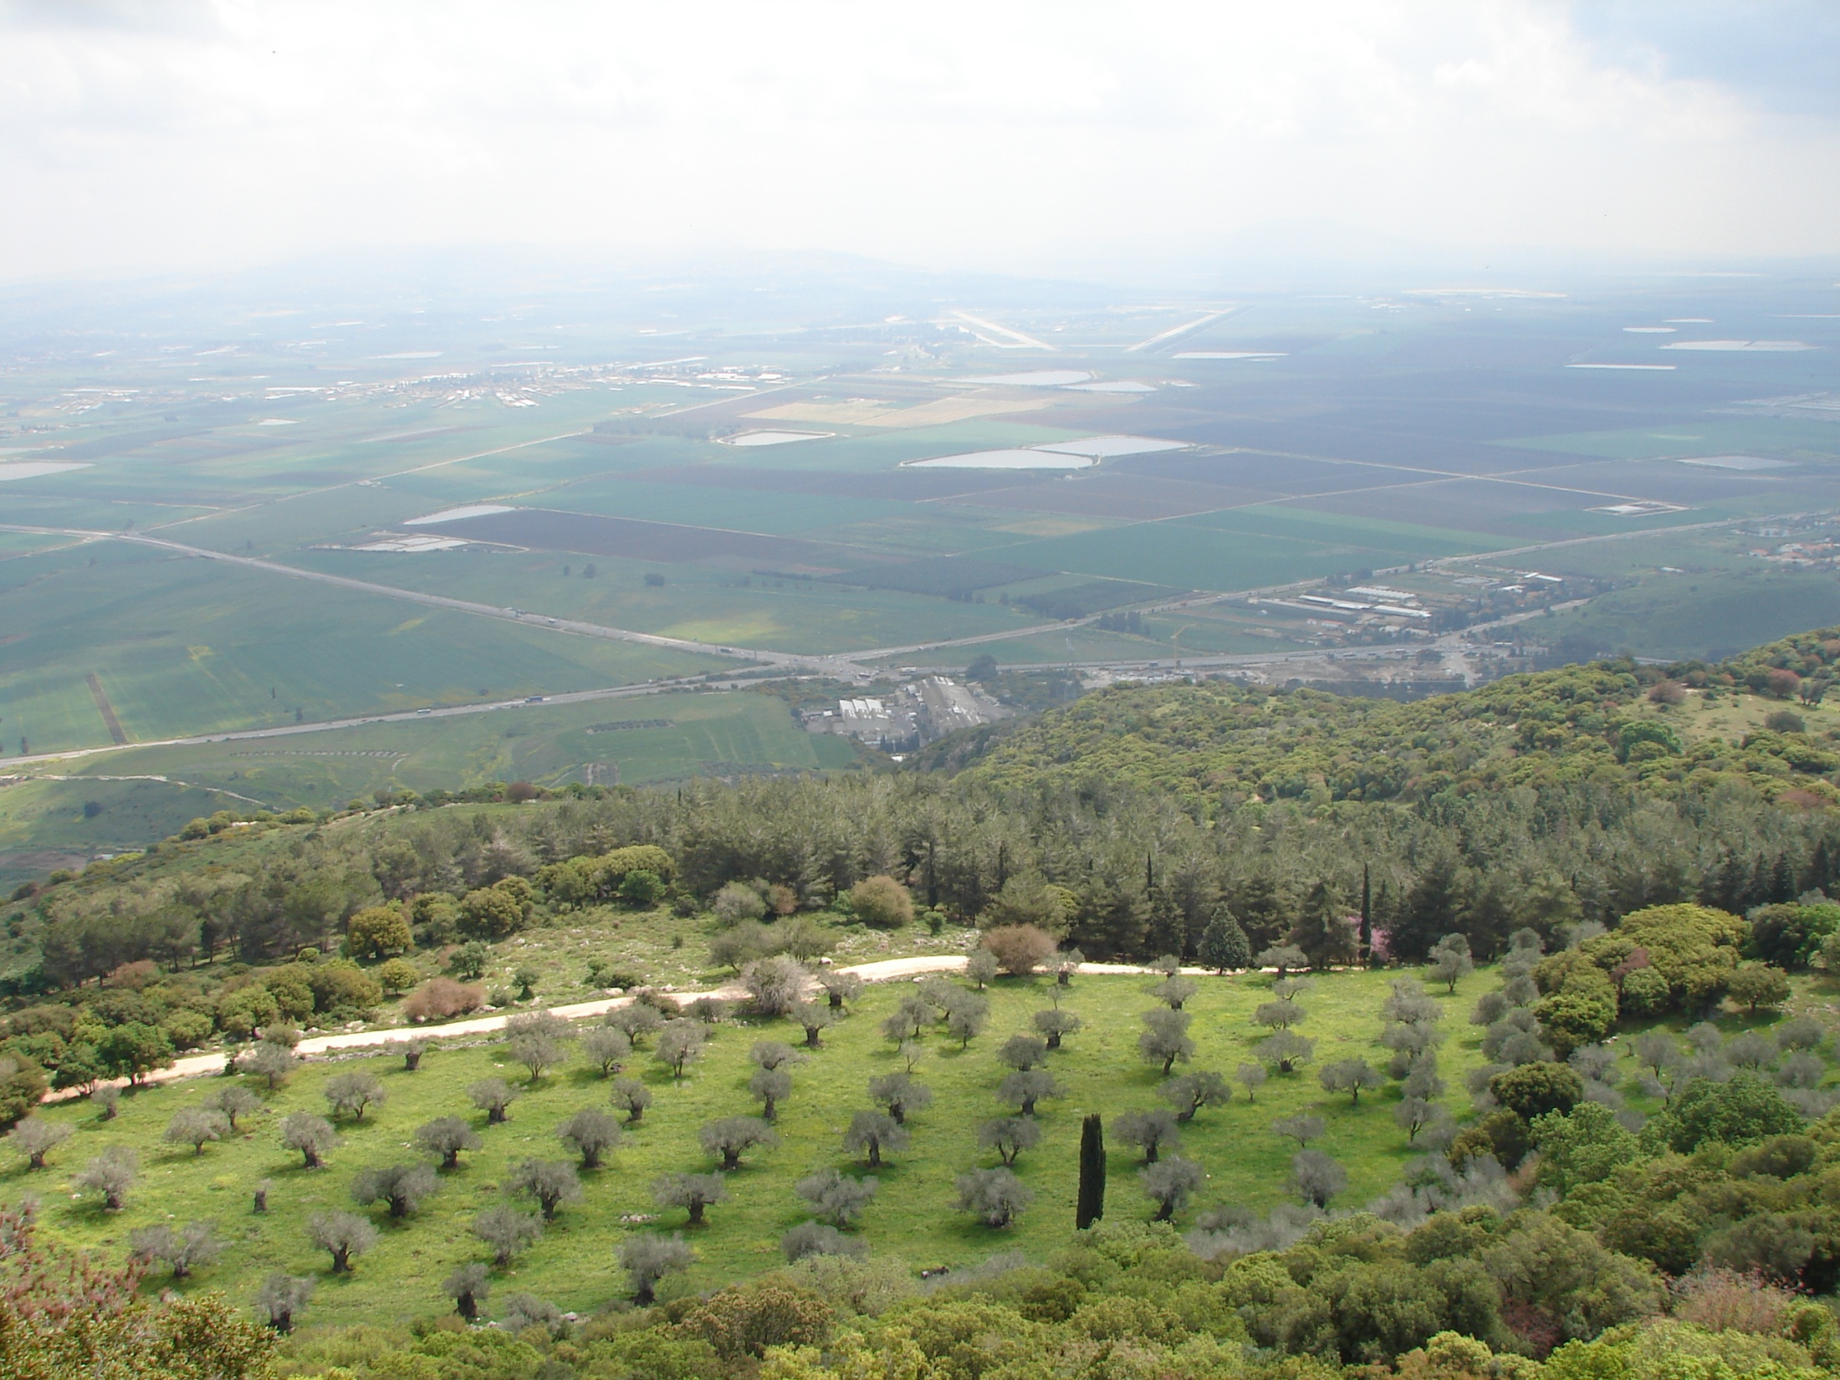
Numbers 13 (ESV) ²⁵At the end of forty days they returned from spying out the land.
²⁶And they came to Moses and Aaron and to all the congregation of the people of Israel in the wilderness of Paran, at Kadesh. They brought back word to them and to all the congregation, and showed them the fruit of the land. ²⁷And they told him,
“We came to the land to which you sent us. It flows with milk and honey, and this is its fruit.

Slide 9
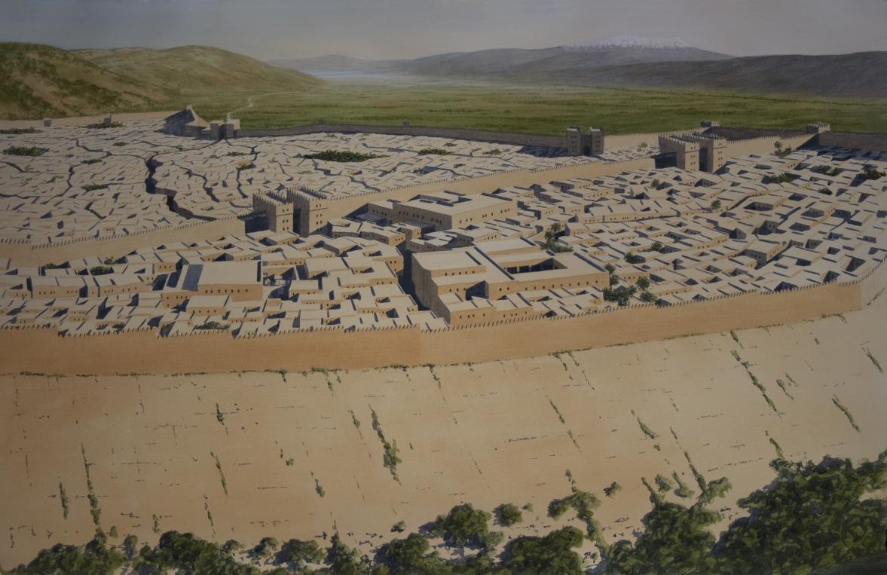
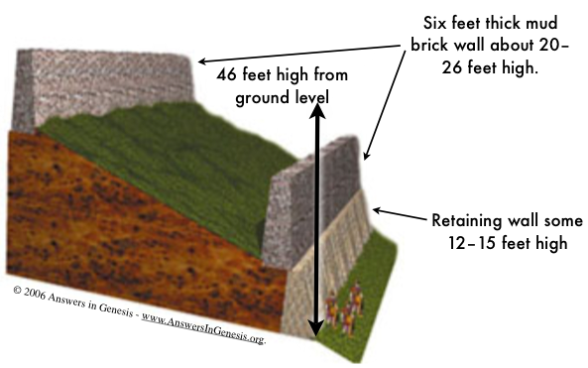
Numbers 13 (ESV)
²⁸However, the people who dwell in the land are strong, and the cities are fortified and very large.

Slide 10
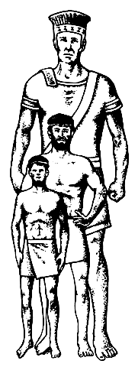
Giants in the Land
Numbers 13 (ESV)
28However, the people who dwell in the land are strong, and the cities are fortified and very large.
And besides, we saw the descendants of Anak there.

Slide 11
40 Years Later – A History Lesson
Deuteronomy 1
²⁵And they took in their hands some of the fruit of the land and brought it down to us, and brought us word again and said, ‘It is a good land that the Lord our God is giving us.’ ²⁶“Yet you would not go up, but rebelled against the command of the Lord your God. ²⁷And you murmured in your tents and said, ‘Because the Lord hated us he has brought us out of the land of Egypt, to give us into the hand of the Amorites, to destroy us. ²⁸Where are we going up?
Our brothers have made our hearts melt, saying, “The people are greater and taller than we. The cities are great and fortified up to heaven. And besides, we have seen the sons of the Anakim there.”’ ²⁹Then I said to you, ‘Do not be in dread or afraid of them. ³⁰The Lord your God who goes before you will himself fight for you, just as he did for you in Egypt before your eyes,

Slide 12
Moses Speaks to Israel
Deuteronomy 31
¹Then Moses went and spoke these words to all Israel.
²And he said to them: “I am one hundred and twenty years old today. I can no longer go out and come in.
Also the Lord has said to me, ‘You shall not cross over this Jordan.’ ³The Lord your God Himself crosses over before you; He will destroy these nations from before you, and you shall dispossess them.
Joshua himself crosses over before you, just as the Lord has said. .. ⁵The Lord will give them over to you, that you may do to them according to every commandment which I have commanded you.
⁶Be strong and of good courage, do not fear nor be afraid of them; for the Lord your God, He is the One who goes with you. He will not leave you nor forsake you.”

Slide 13
Moses Speaks to Joshua
Deuteronomy 31
⁷Then Moses called Joshua and said to him in the sight of all Israel,
“Be strong and of good courage, for you must go with this people to the land which the Lord has sworn to their fathers to give them, and you shall cause them to inherit it.
⁸And the Lord, He is the One who goes before you. He will be with you, He will not leave you nor forsake you; do not fear nor be dismayed.”

Slide 14
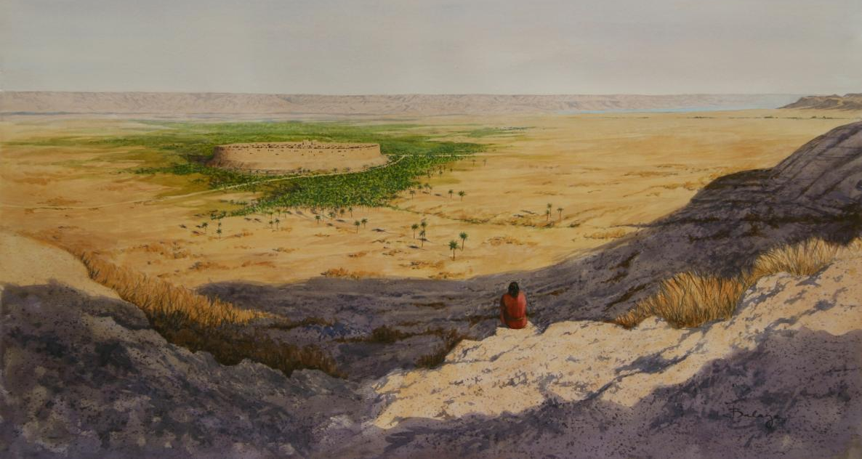
Joshua Faces a Fortified City

Slide 15
Lord Speaks to Joshua
Joshua 1
¹After the death of Moses the servant of the Lord, it came to pass that the Lord spoke to Joshua the son of Nun, Moses’ assistant, saying…
³Every place that the sole of your foot will tread upon I have given you, as I said to Moses. ⁴From the wilderness and this Lebanon as far as the great river, the River Euphrates, all the land of the Hittites, and to the Great Sea toward the going down of the sun, shall be your territory.
⁵No man shall be able to stand before you all the days of your life; as I was with Moses, so I will be with you. I will not leave you nor forsake you.
⁶Be strong and of good courage, for to this people you shall divide as an inheritance the land which I swore to their fathers to give them.

Slide 16
Lord Speaks to Joshua
Joshua 1
¹After the death of Moses the servant of the Lord, it came to pass that the Lord spoke to Joshua the son of Nun, Moses’ assistant, saying…
⁷Only be strong and very courageous,
that you may observe to do according to all the law which Moses My servant commanded you; do not turn from it to the right hand or to the left, that you may prosper wherever you go.
⁸This Book of the Law shall not depart from your mouth, but you shall meditate in it day and night, that you may observe to do according to all that is written in it. For then you will make your way prosperous, and then you will have good success.
⁹Have I not commanded you? Be strong and of good courage; do not be afraid, nor be dismayed, for the Lord your God is with you wherever you go.”

Slide 17
Tribes of Reuben & Gad Answer Joshua
Joshua 1
¹⁶So they answered Joshua, saying,
“All that you command us we will do, and wherever you send us we will go.
¹⁷Just as we heeded Moses in all things, so we will heed you. Only the Lord your God be with you, as He was with Moses.
¹⁸Whoever rebels against your command and does not heed your words, in all that you command him, shall be put to death. Only be strong and of good courage.”

Slide 18
Jericho Fears the Lord & Israel
Joshua 2
(Rahab) ⁹and said to the men:
“I know that the Lord has given you the land, that the terror of you has fallen on us, and that all the inhabitants of the land are fainthearted because of you.
¹⁰For we have heard how the Lord dried up the water of the Red Sea for you when you came out of Egypt,
and what you did to the two kings of the Amorites who were on the other side of the Jordan, Sihon and Og, whom you utterly destroyed.
¹¹And as soon as we heard these things, our hearts melted; neither did there remain any more courage in anyone because of you, for the Lord your God, He is God in heaven above and on earth beneath.

Slide 19
Joshua’s Farewell to the People
Joshua 23:2-6(NKJV) ²And Joshua called for all Israel… and said to them: “I am old, advanced in age. ³You have seen all that the Lord your God has done to all these nations because of you, for the Lord your God is He who has fought for you. ⁴See, I have divided to you by lot these nations that remain, to be an inheritance for your tribes, from the Jordan, with all the nations that I have cut off, as far as the Great Sea westward. ⁵And the Lord your God will expel them from before you and drive them out of your sight. So you shall possess their land, as the Lord your God promised you.
⁶Therefore be very courageous to keep and to do all that is written in the Book of the Law of Moses, lest you turn aside from it to the right hand or to the left,
(ESV –Strong)

Slide 20
David’s Instructions to Solomon
Instruction to Build the Temple 1 Chronicles 22:11-13(ESV) ¹¹“Now, my son, the Lord be with you, so that you may succeed in building the house of the Lord your God, as he has spoken concerning you.
¹²Only, may the Lord grant you discretion and understanding,
that when he gives you charge over Israel you may keep the law of the Lord your God. ¹³Then you will prosper if you are careful to observe the statutes and the rules that the Lord commanded Moses for Israel.
Be strong and courageous. Fear not; do not be dismayed.

Slide 21
David’s Charge to Leaders of Israel
Instruction to Build the Temple 1 Chronicles 28:6-8(ESV) ⁶He said to me, ‘It is Solomon your son who shall build my house and my courts, for I have chosen him to be my son, and I will be his father. ⁷I will establish his kingdom forever
if he continues strong in keeping
my commandments and my rules, as he is today.’
⁸Now therefore in the sight of all Israel, the assembly of the Lord, and in the hearing of our God, observe and seek out all the commandments of the Lord your God, that you may possess this good land and leave it for an inheritance to your children after you forever.

Slide 22
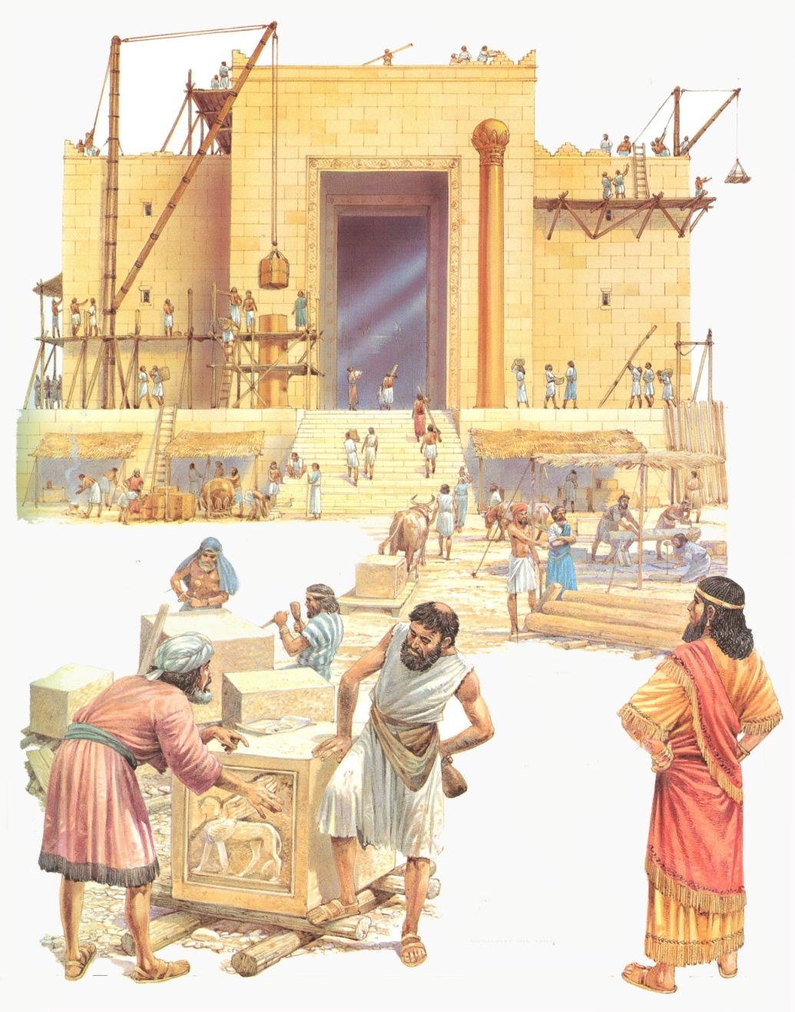
David’s Charge to Solomon
1 Chronicles 28:20(ESV) ²⁰Then David said to Solomon his son,
“Be strong and courageous and do it.
Do not be afraid and do not be dismayed, for the Lord God, even my God, is with you.
He will not leave you or forsake you, until all the work for the service of the house of the Lord is finished.

Slide 23
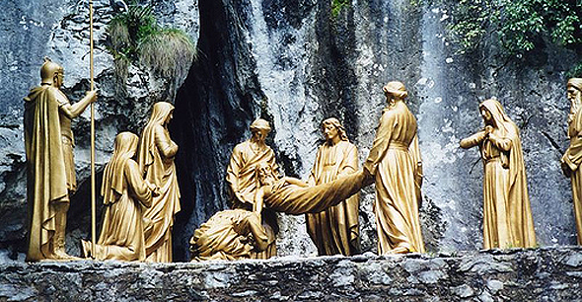
Courage of Joseph of Arimathea
Mark 15
⁴²Now when evening had come, because it was the Preparation Day, that is, the day before the Sabbath, ⁴³Joseph of Arimathea, a prominent council member, who was himself waiting for the kingdom of God, coming and taking courage, went in to Pilate and asked for the body of Jesus.

Slide 24
Paul in Corinth
Acts 18 (NKJV)
⁵When Silas and Timothy had come from Macedonia, Paul was compelled by the Spirit, and testified to the Jews that Jesus is the Christ. ⁶But when they opposed him and blasphemed, he shook his garments and said to them, “Your blood be upon your own heads; I am clean. From now on I will go to the Gentiles.” … ⁸Then Crispus, the ruler of the synagogue, believed on the Lord with all his household. And many of the Corinthians, hearing, believed and were baptized.
⁹Now the Lord spoke to Paul in the night by a vision,
“Do not be afraid, but speak, and do not keep silent;
¹⁰for I am with you, and no one will attack you to hurt you; for I have many people in this city.” ¹¹And he continued there a year and six months, teaching the word of God among them.
(Be Strong Be Courageous)

Slide 25
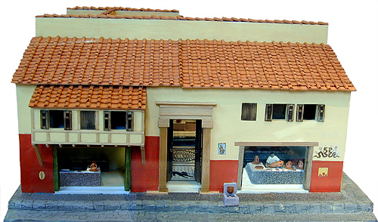
Paul & Christians in Rome
Acts 28
…And so we went toward Rome. ¹⁵And from there, when the brethren heard about us, they came to meet us as far as Appii Forum and Three Inns.
When Paul saw them, he thanked God and took courage.

Slide 26
How Can We Be Strong & Courageous?
Lord is with us, He is our might
Turn not to the left/right of His commandments
Lord is with us – no need to fear rulers, giants, hungers, big jobs
Paul afraid – Lord tells him there are many lost in Corinth
Lord is true to His promises/Trust Him (Joseph of Arimathea)
Teach/Instruct others in being Strong & Courageous
Moses taught people
Lord taught Israel in wilderness
Joshua instructed people
David taught Solomon
Remember the Unknown/New/Different is scary
Others may Fear us More (Rahab/Jericho)
Support of Others Gives Us Strength
Elders/Leaders to help Solomon
Silas & Timothy join Paul at Corinth
Saints meet Paul

