Slide 2
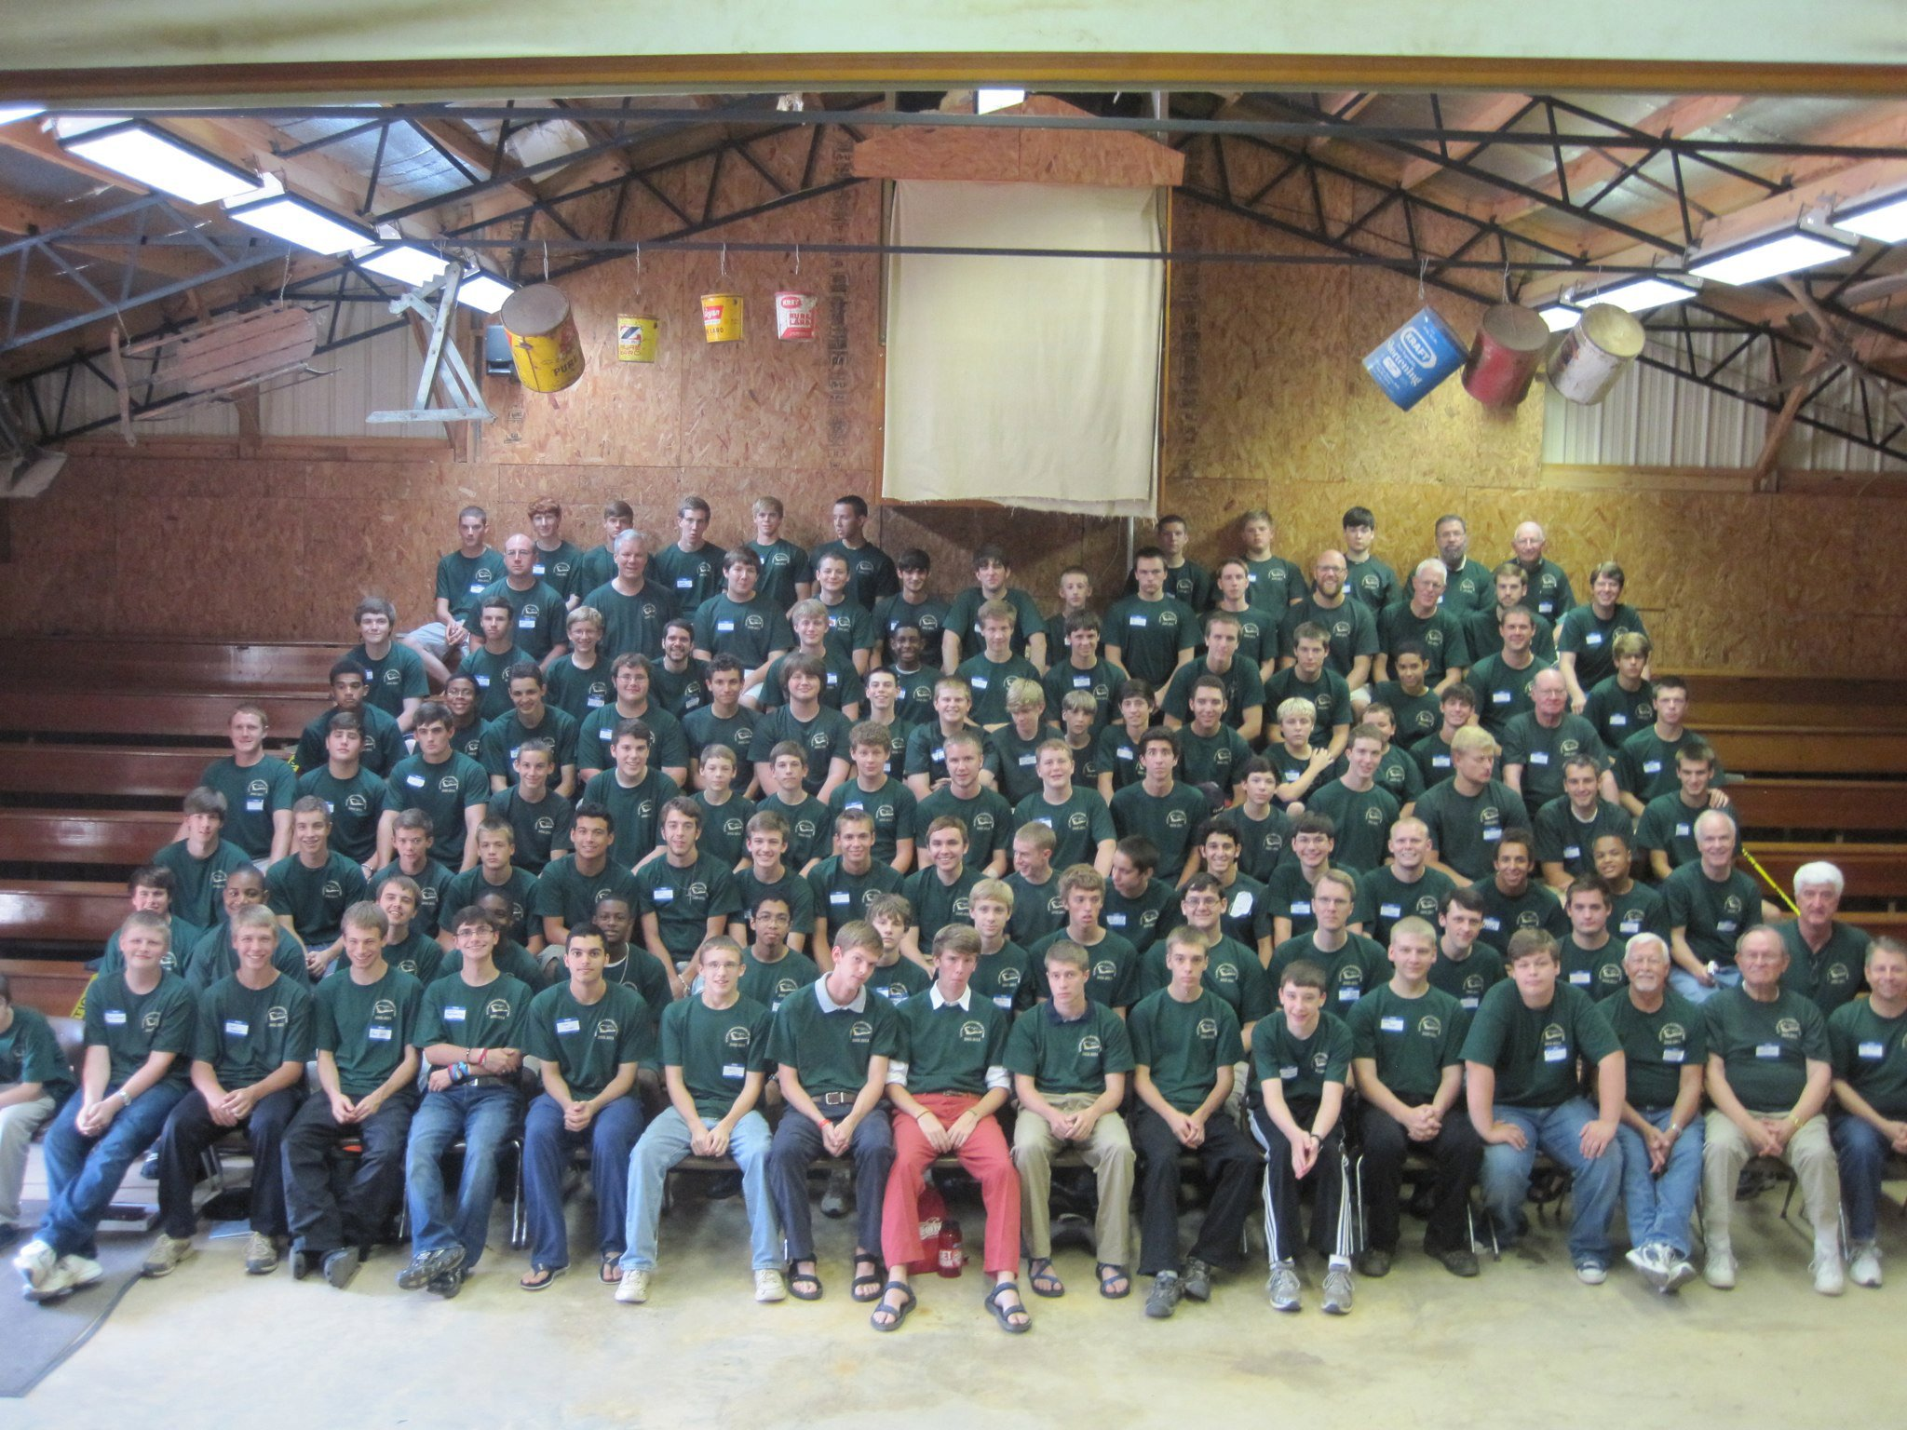

Slide 3
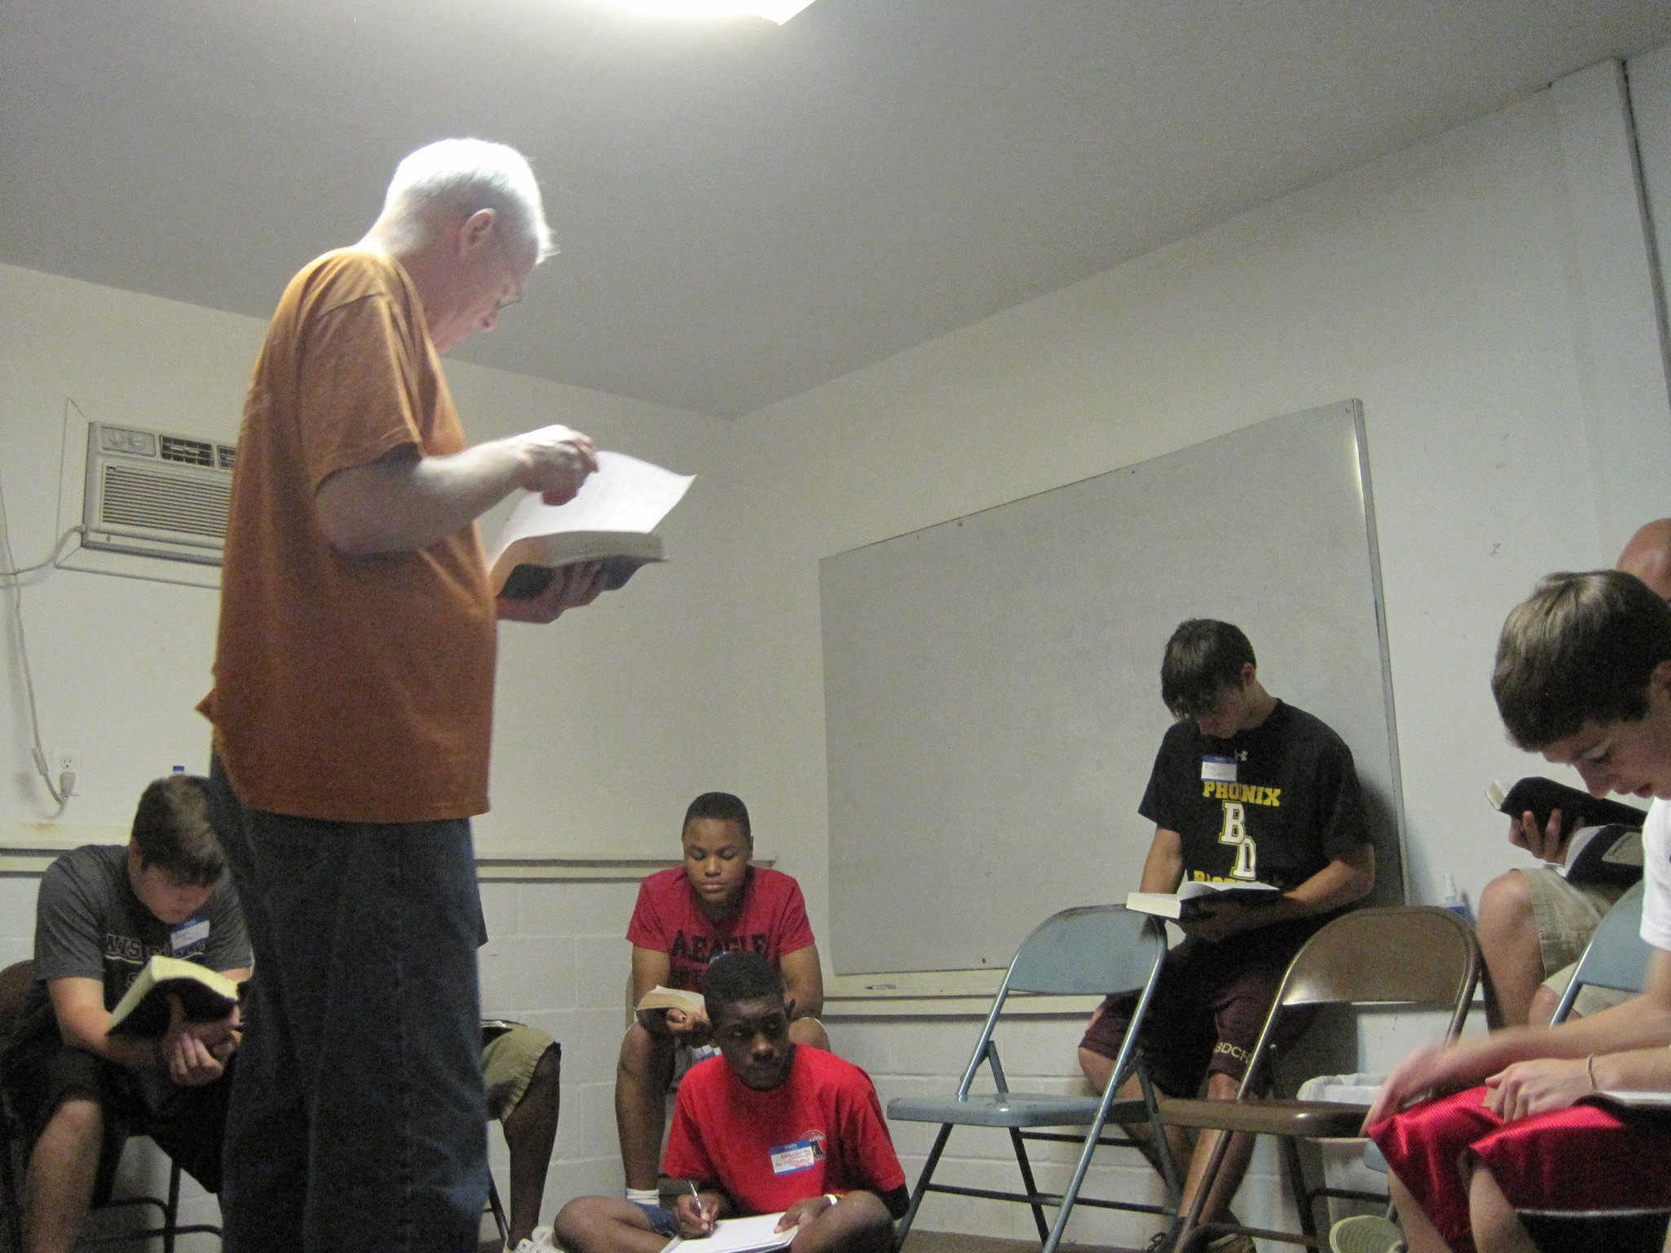

Slide 4
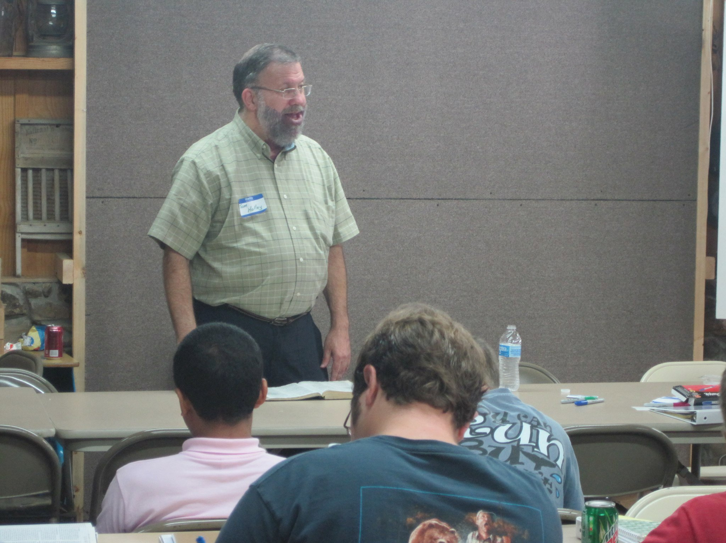

Slide 7
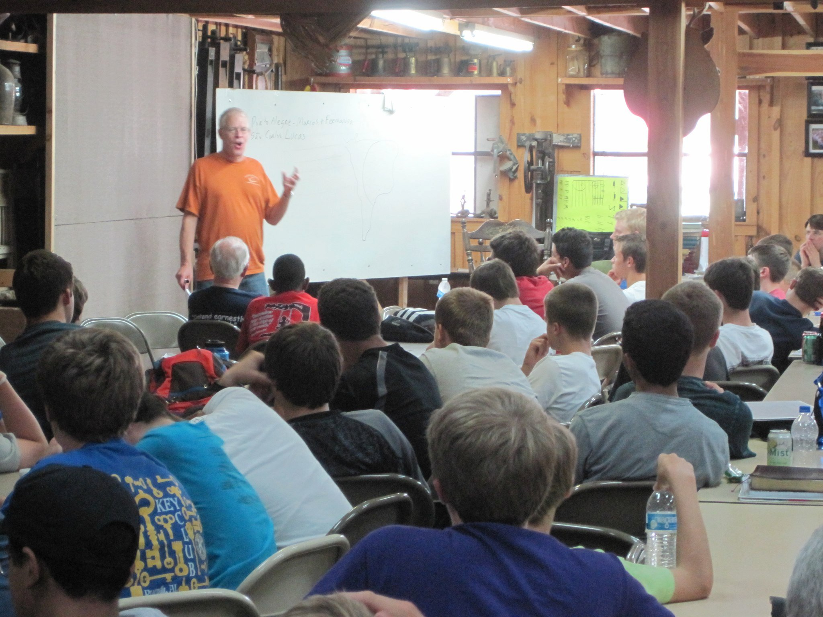

Slide 8
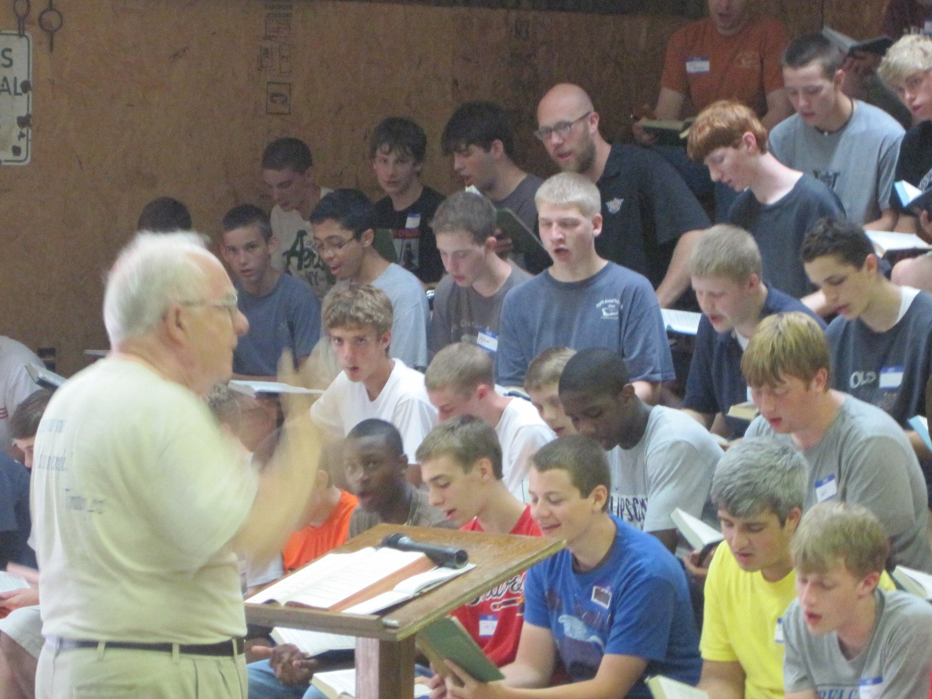

Slide 9
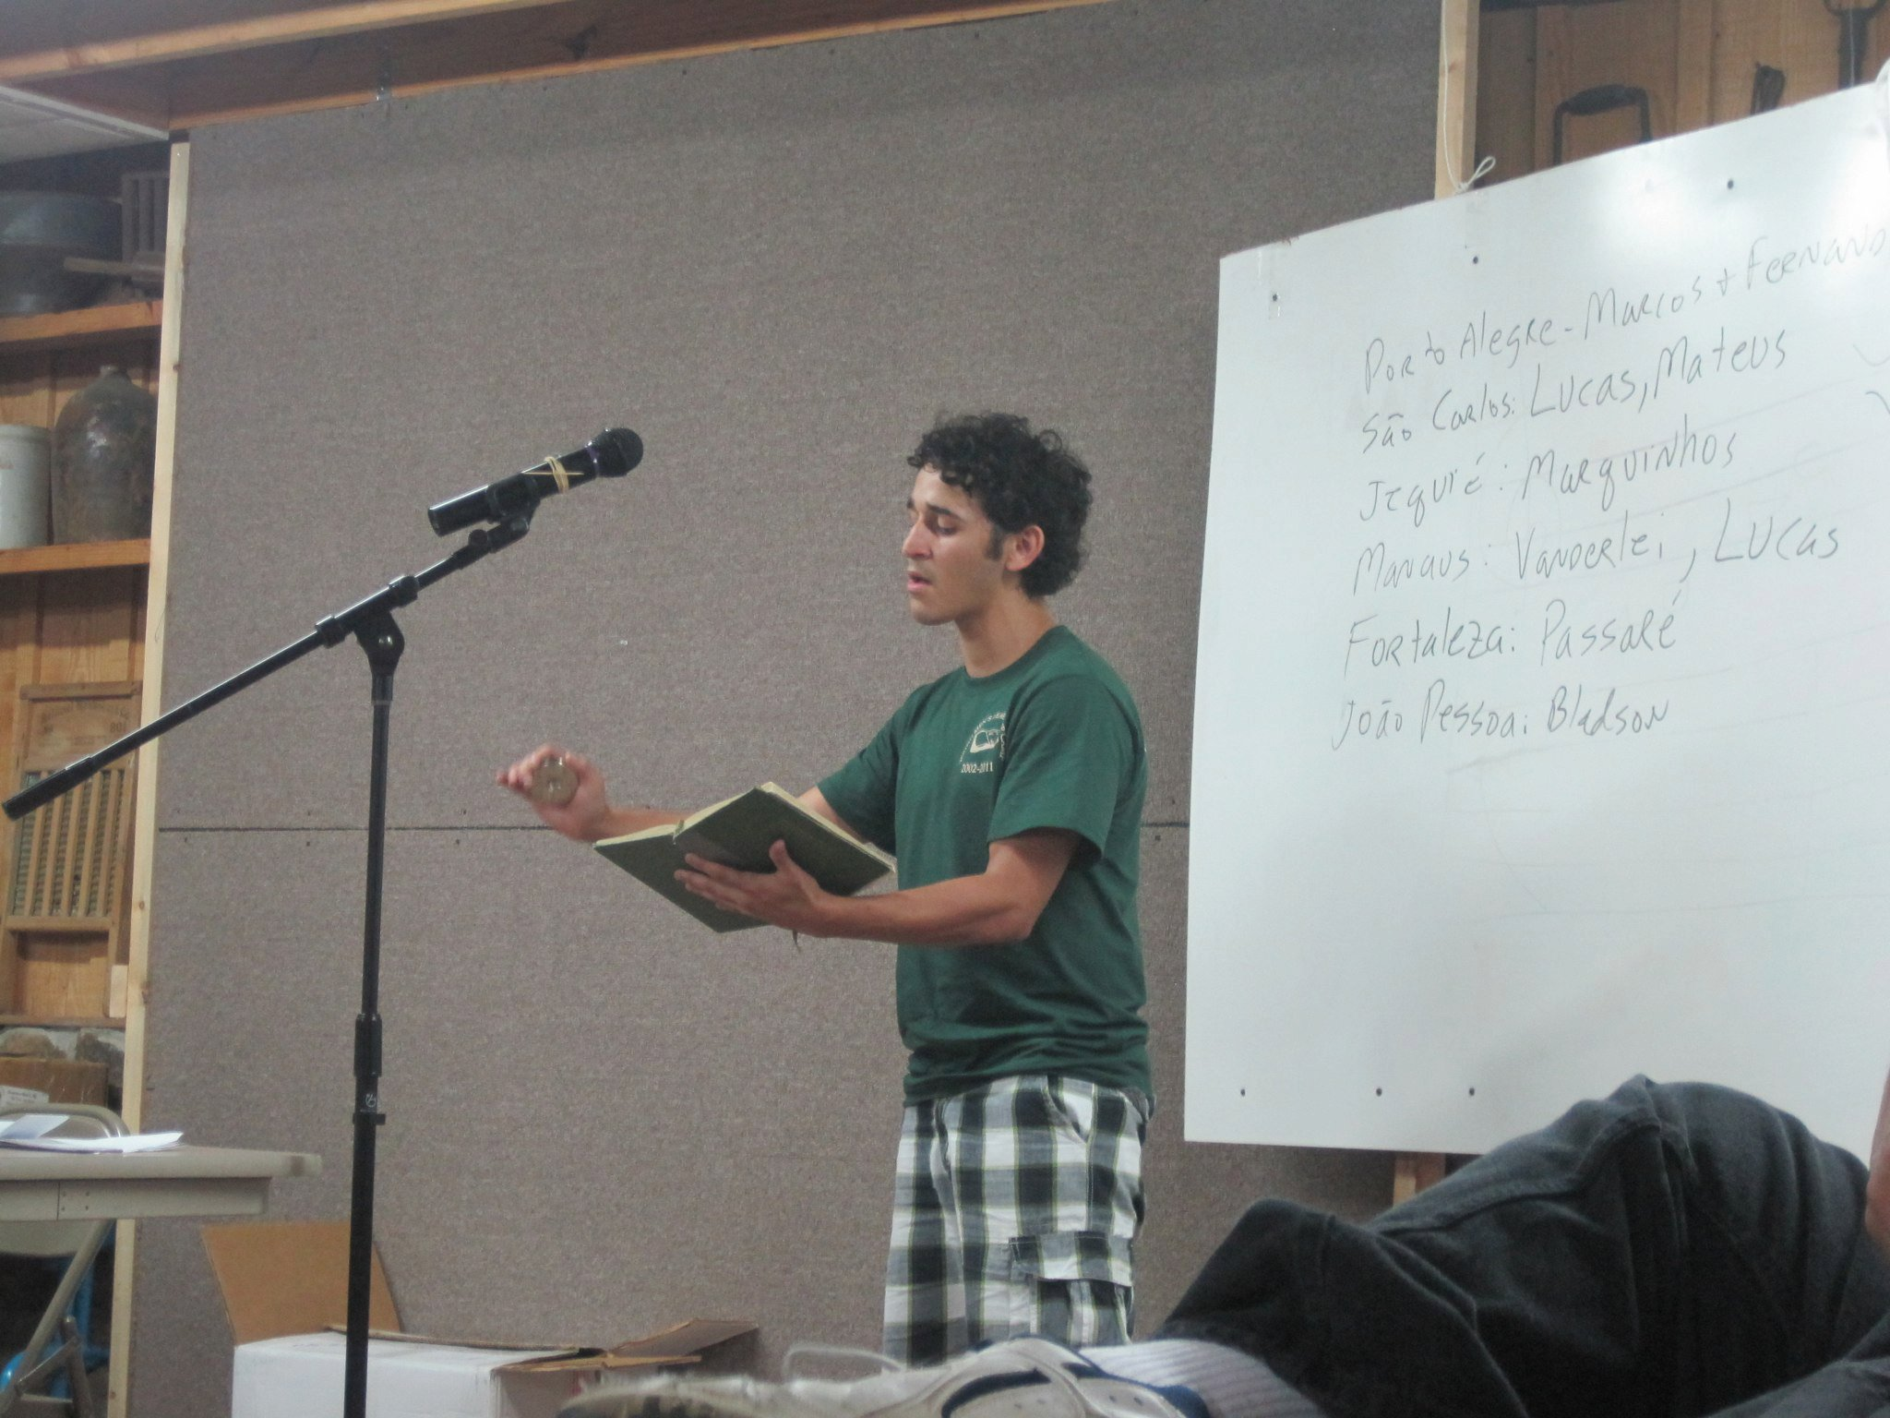

Slide 10
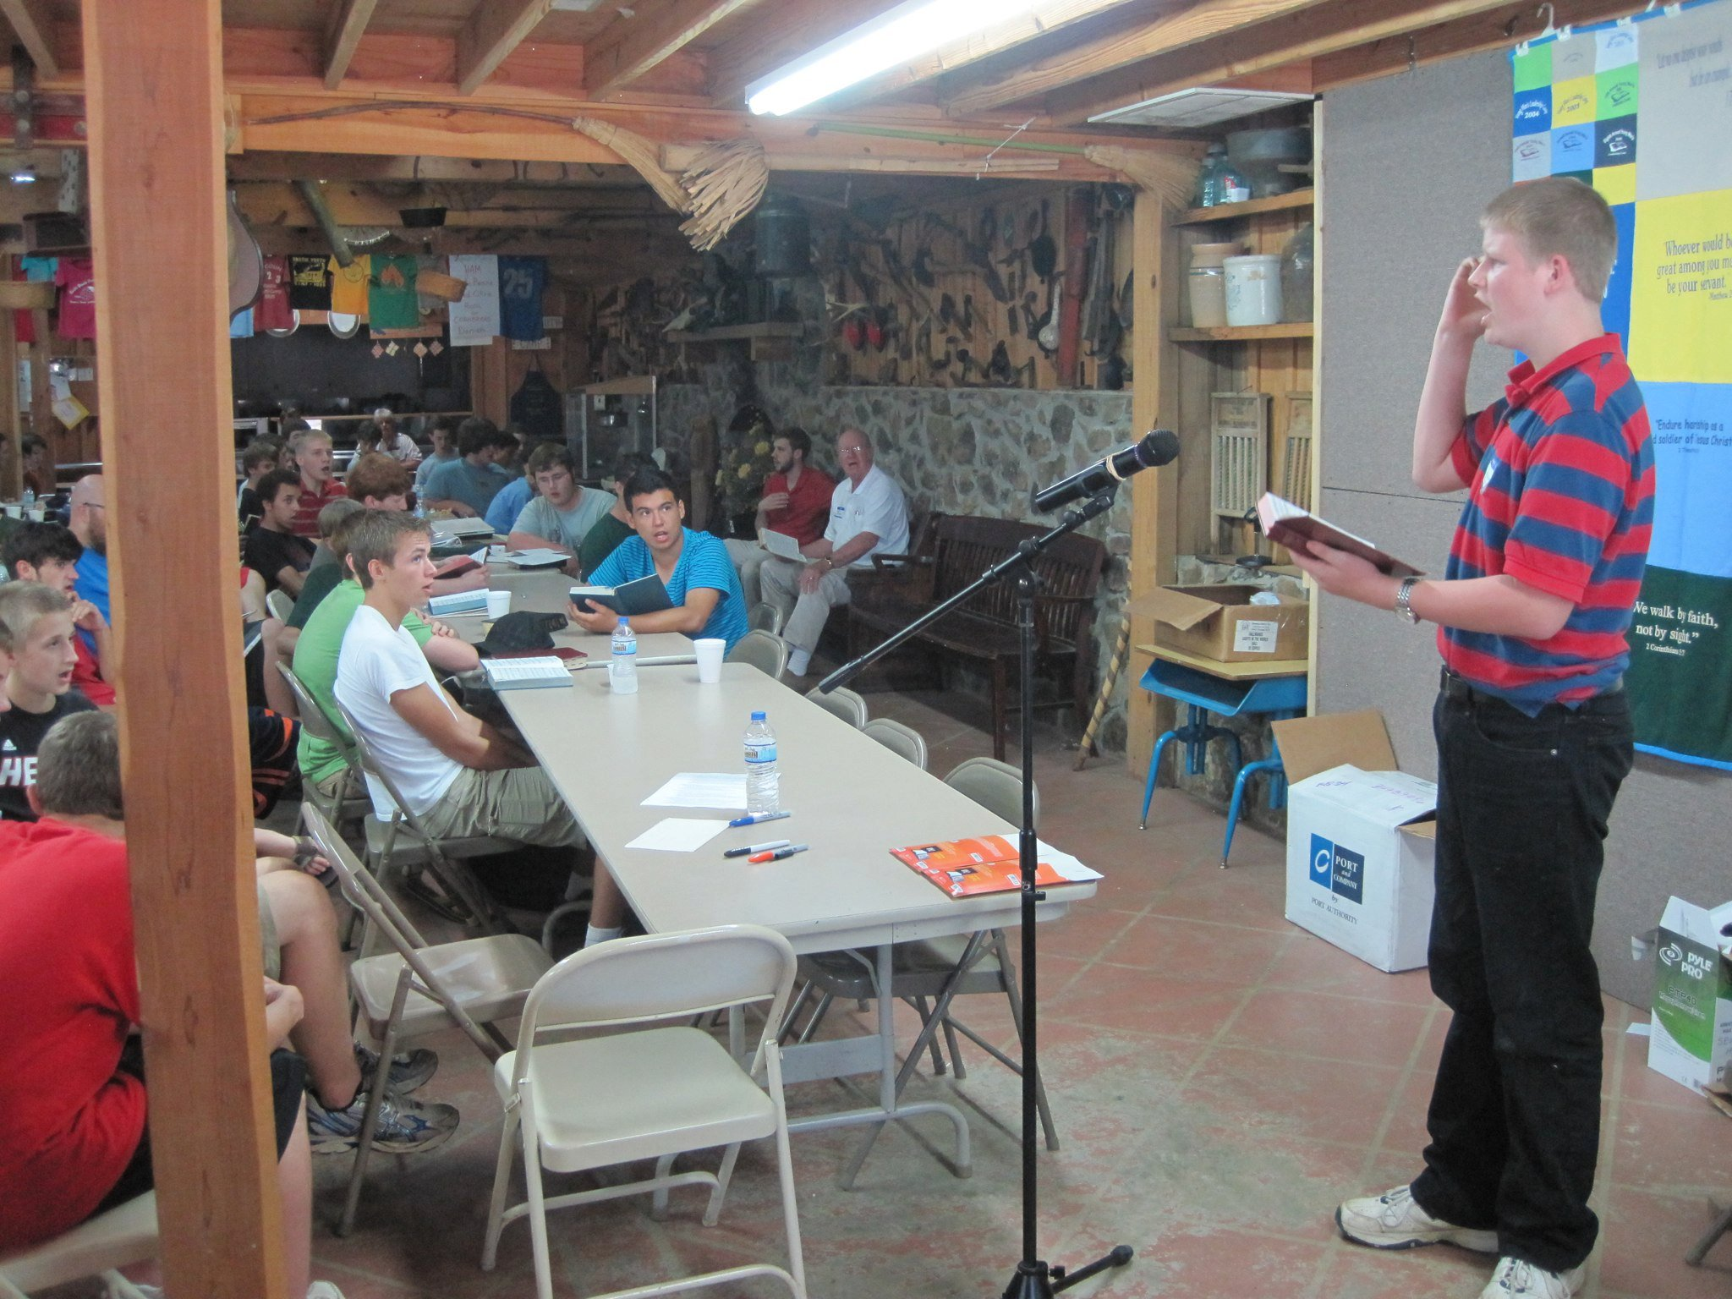

Slide 11
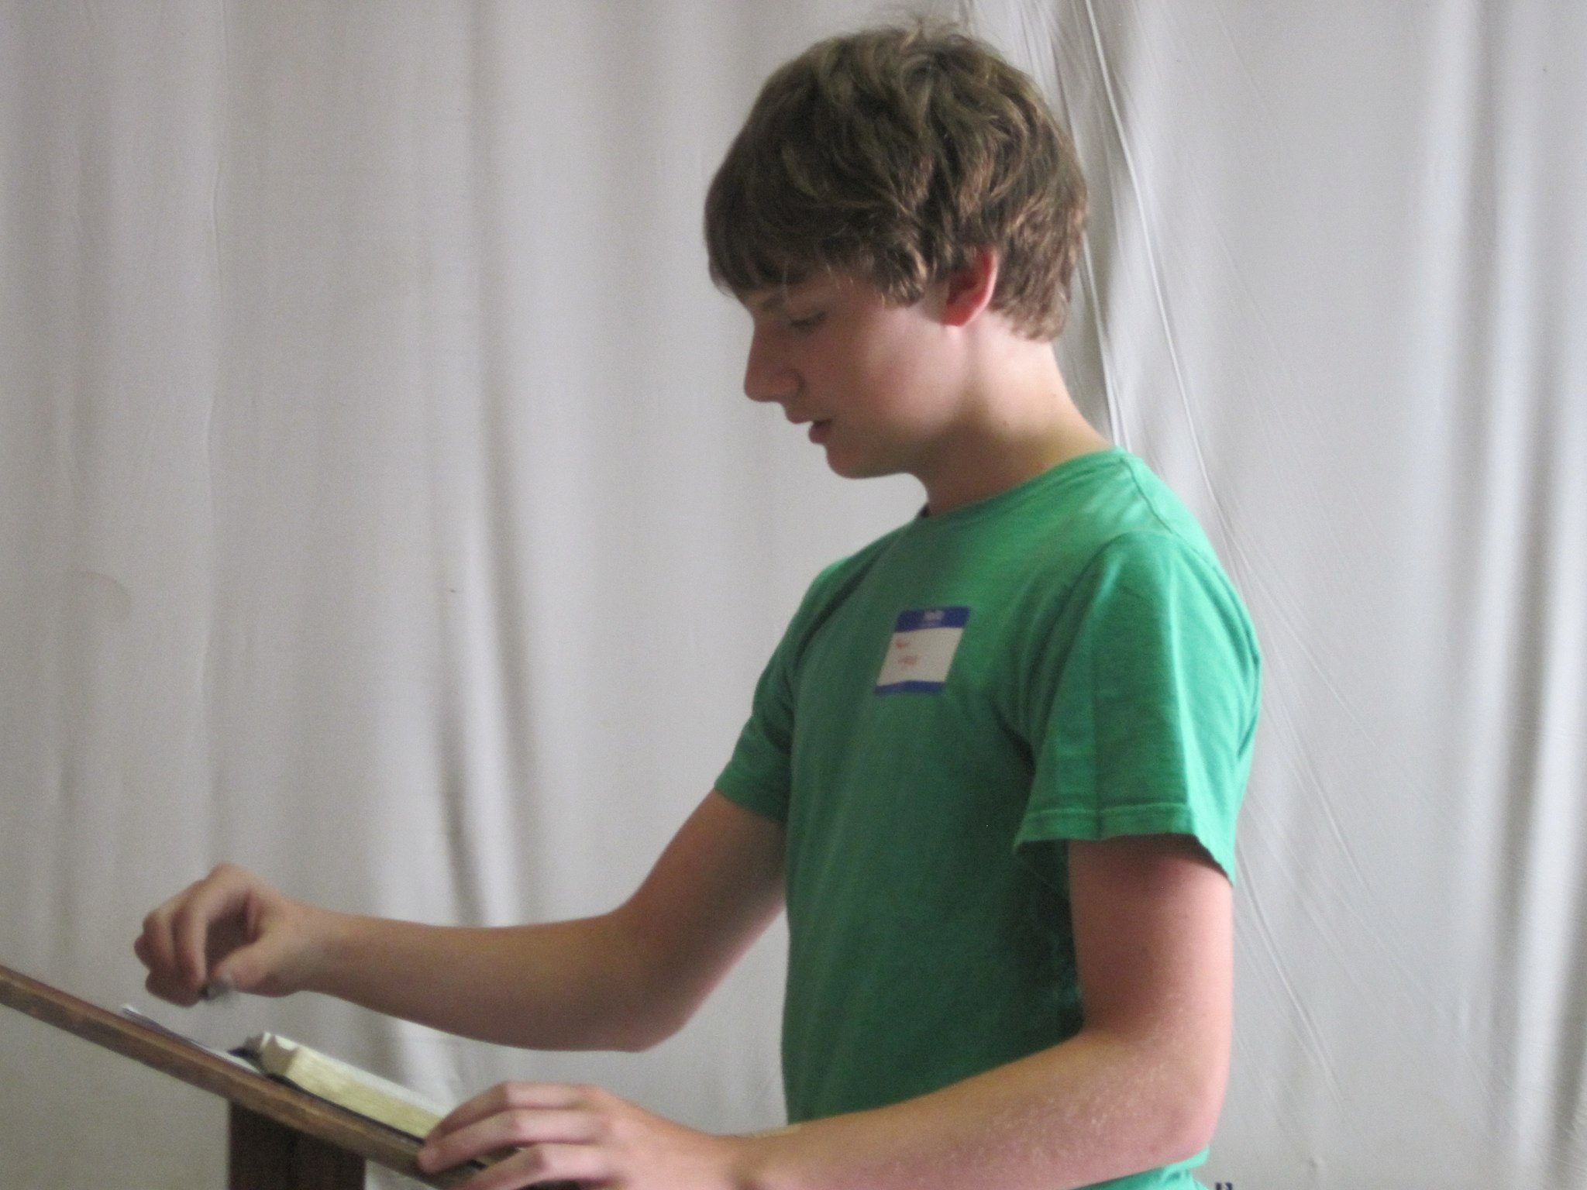

Slide 12
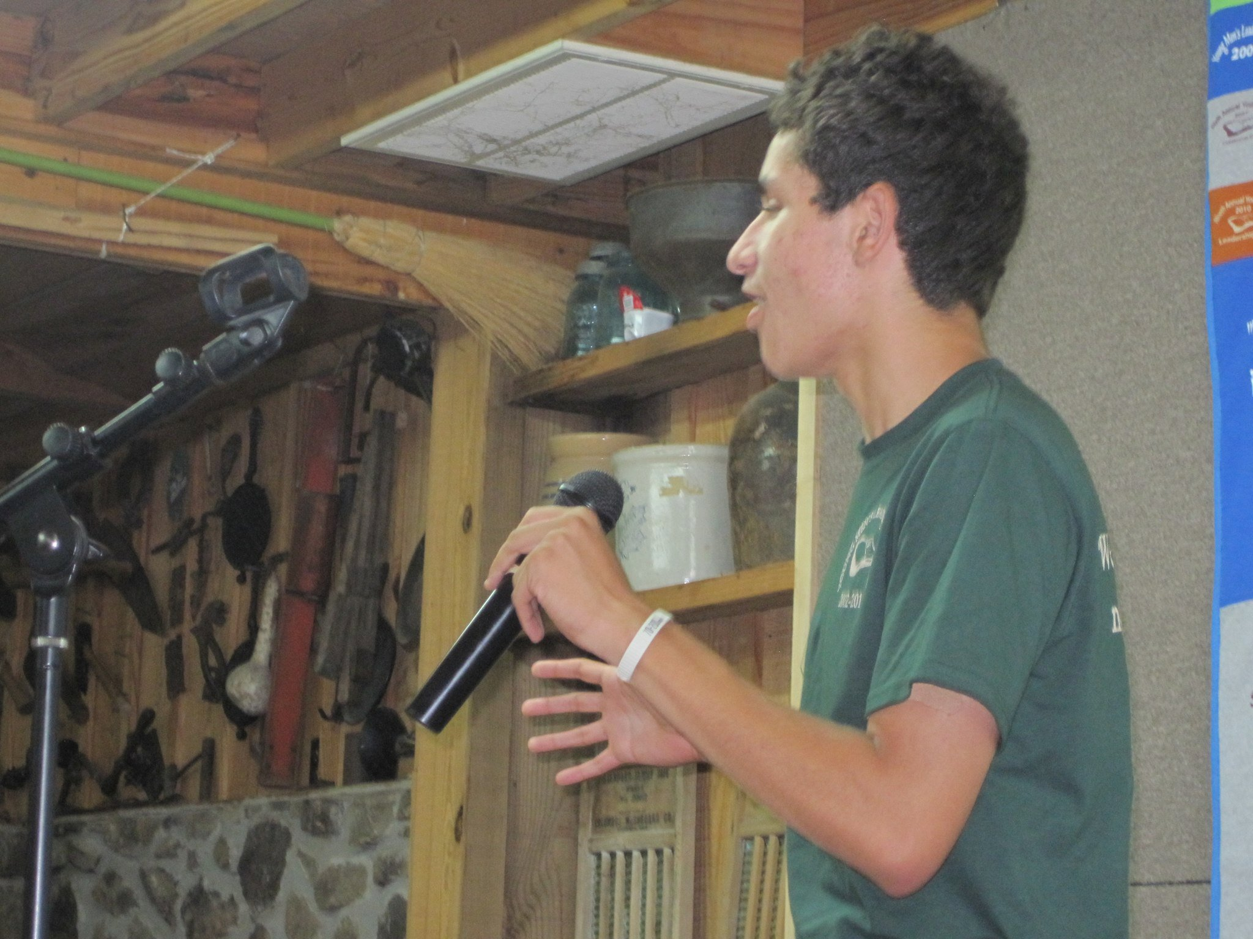

Slide 13
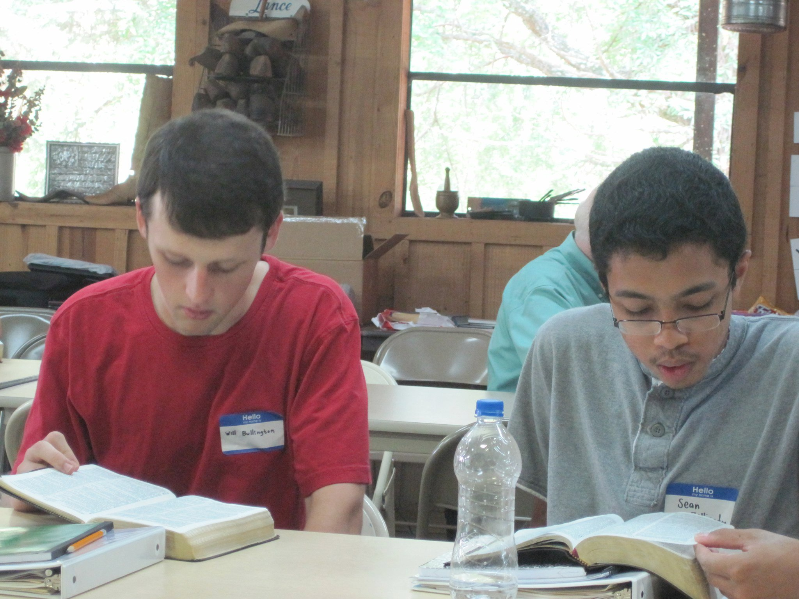

Slide 14
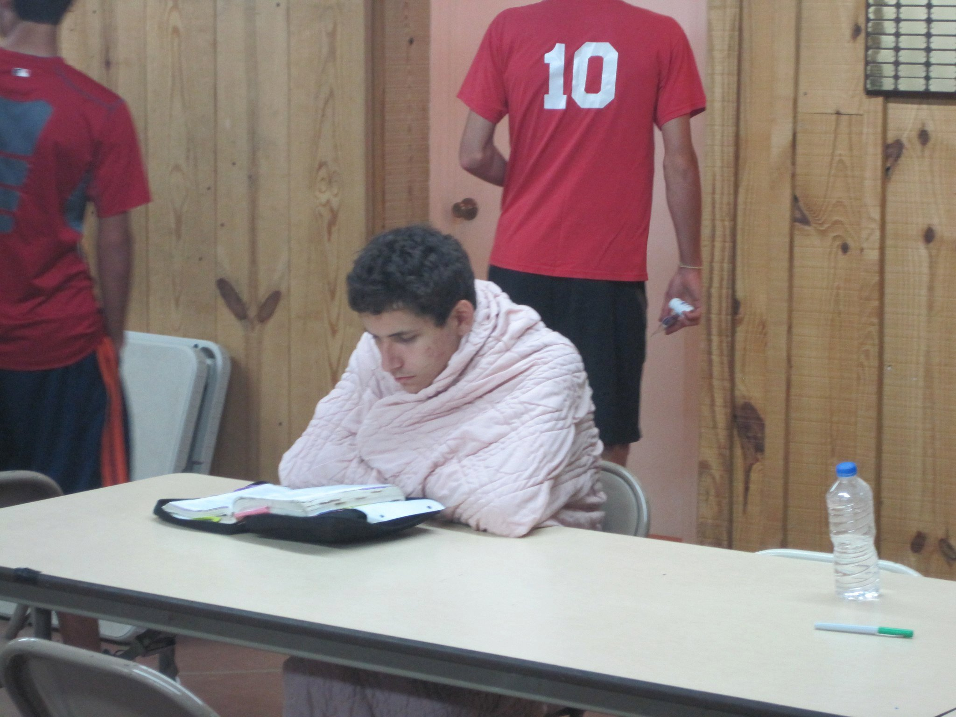

Slide 15
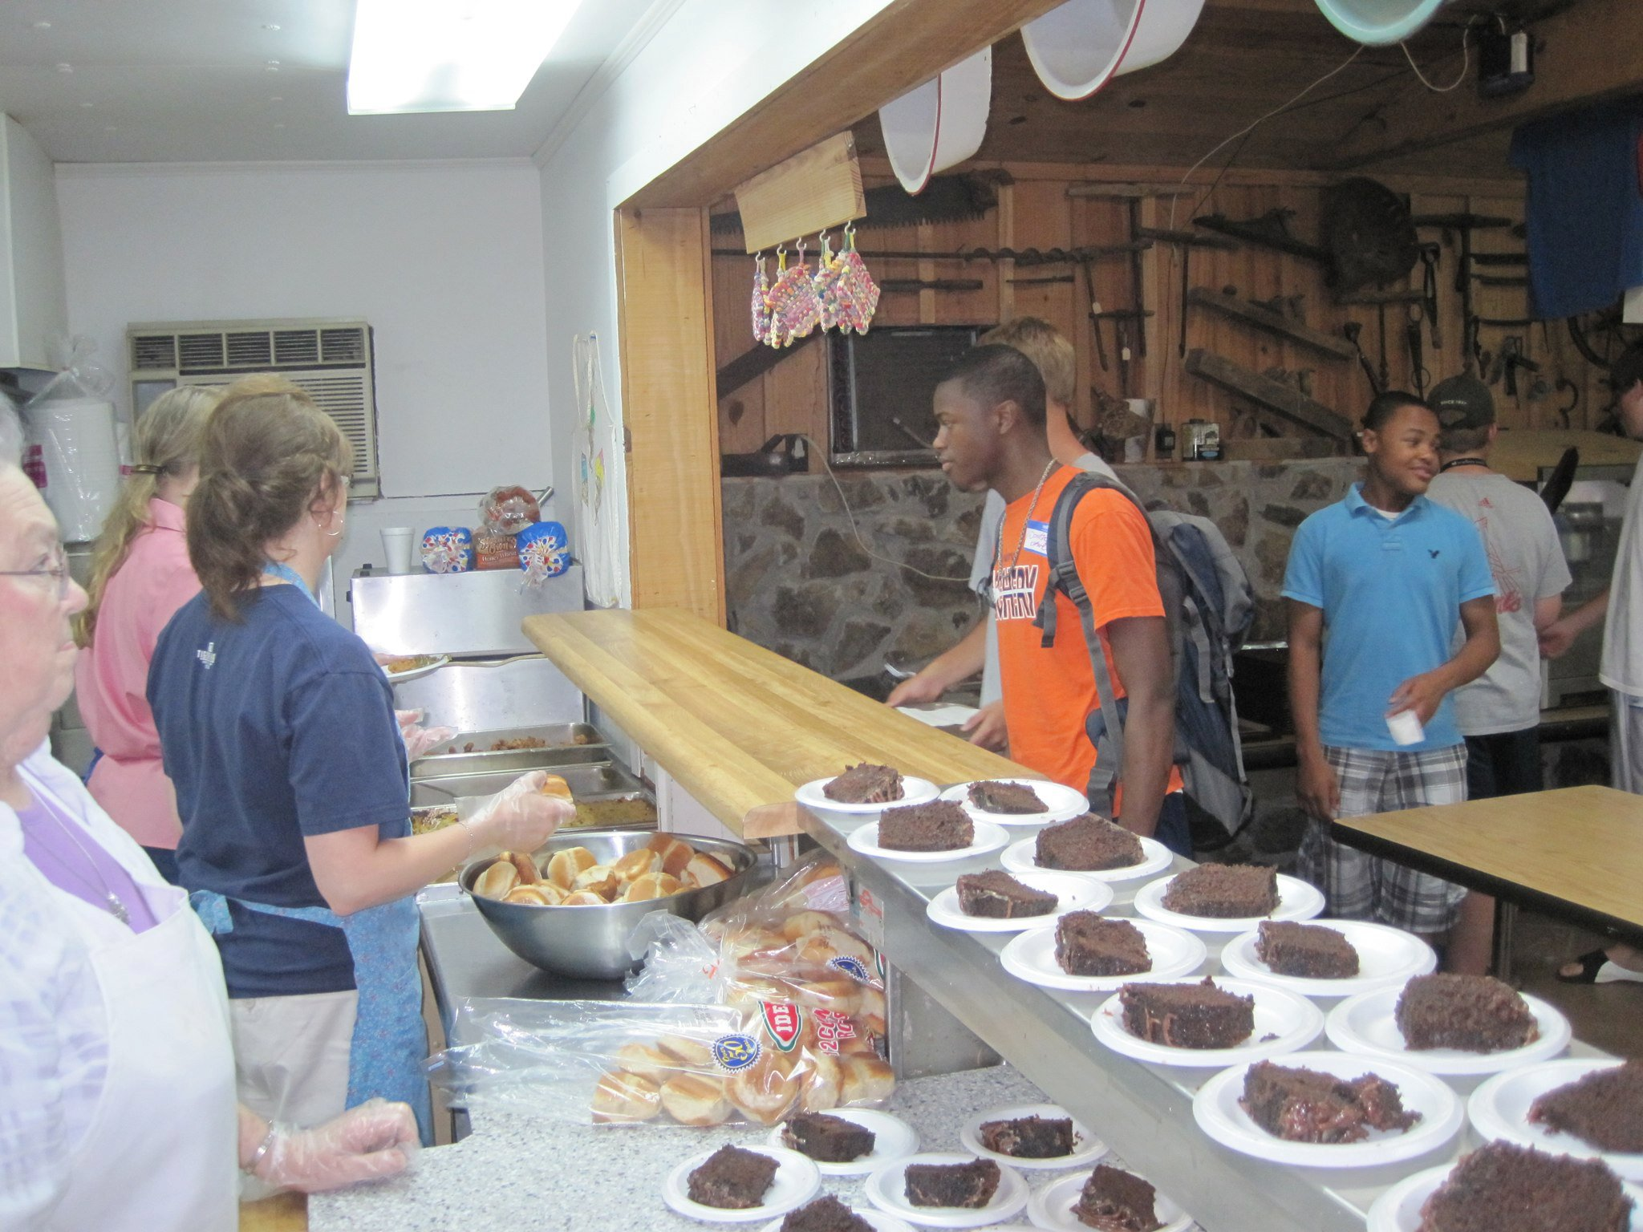

Slide 16
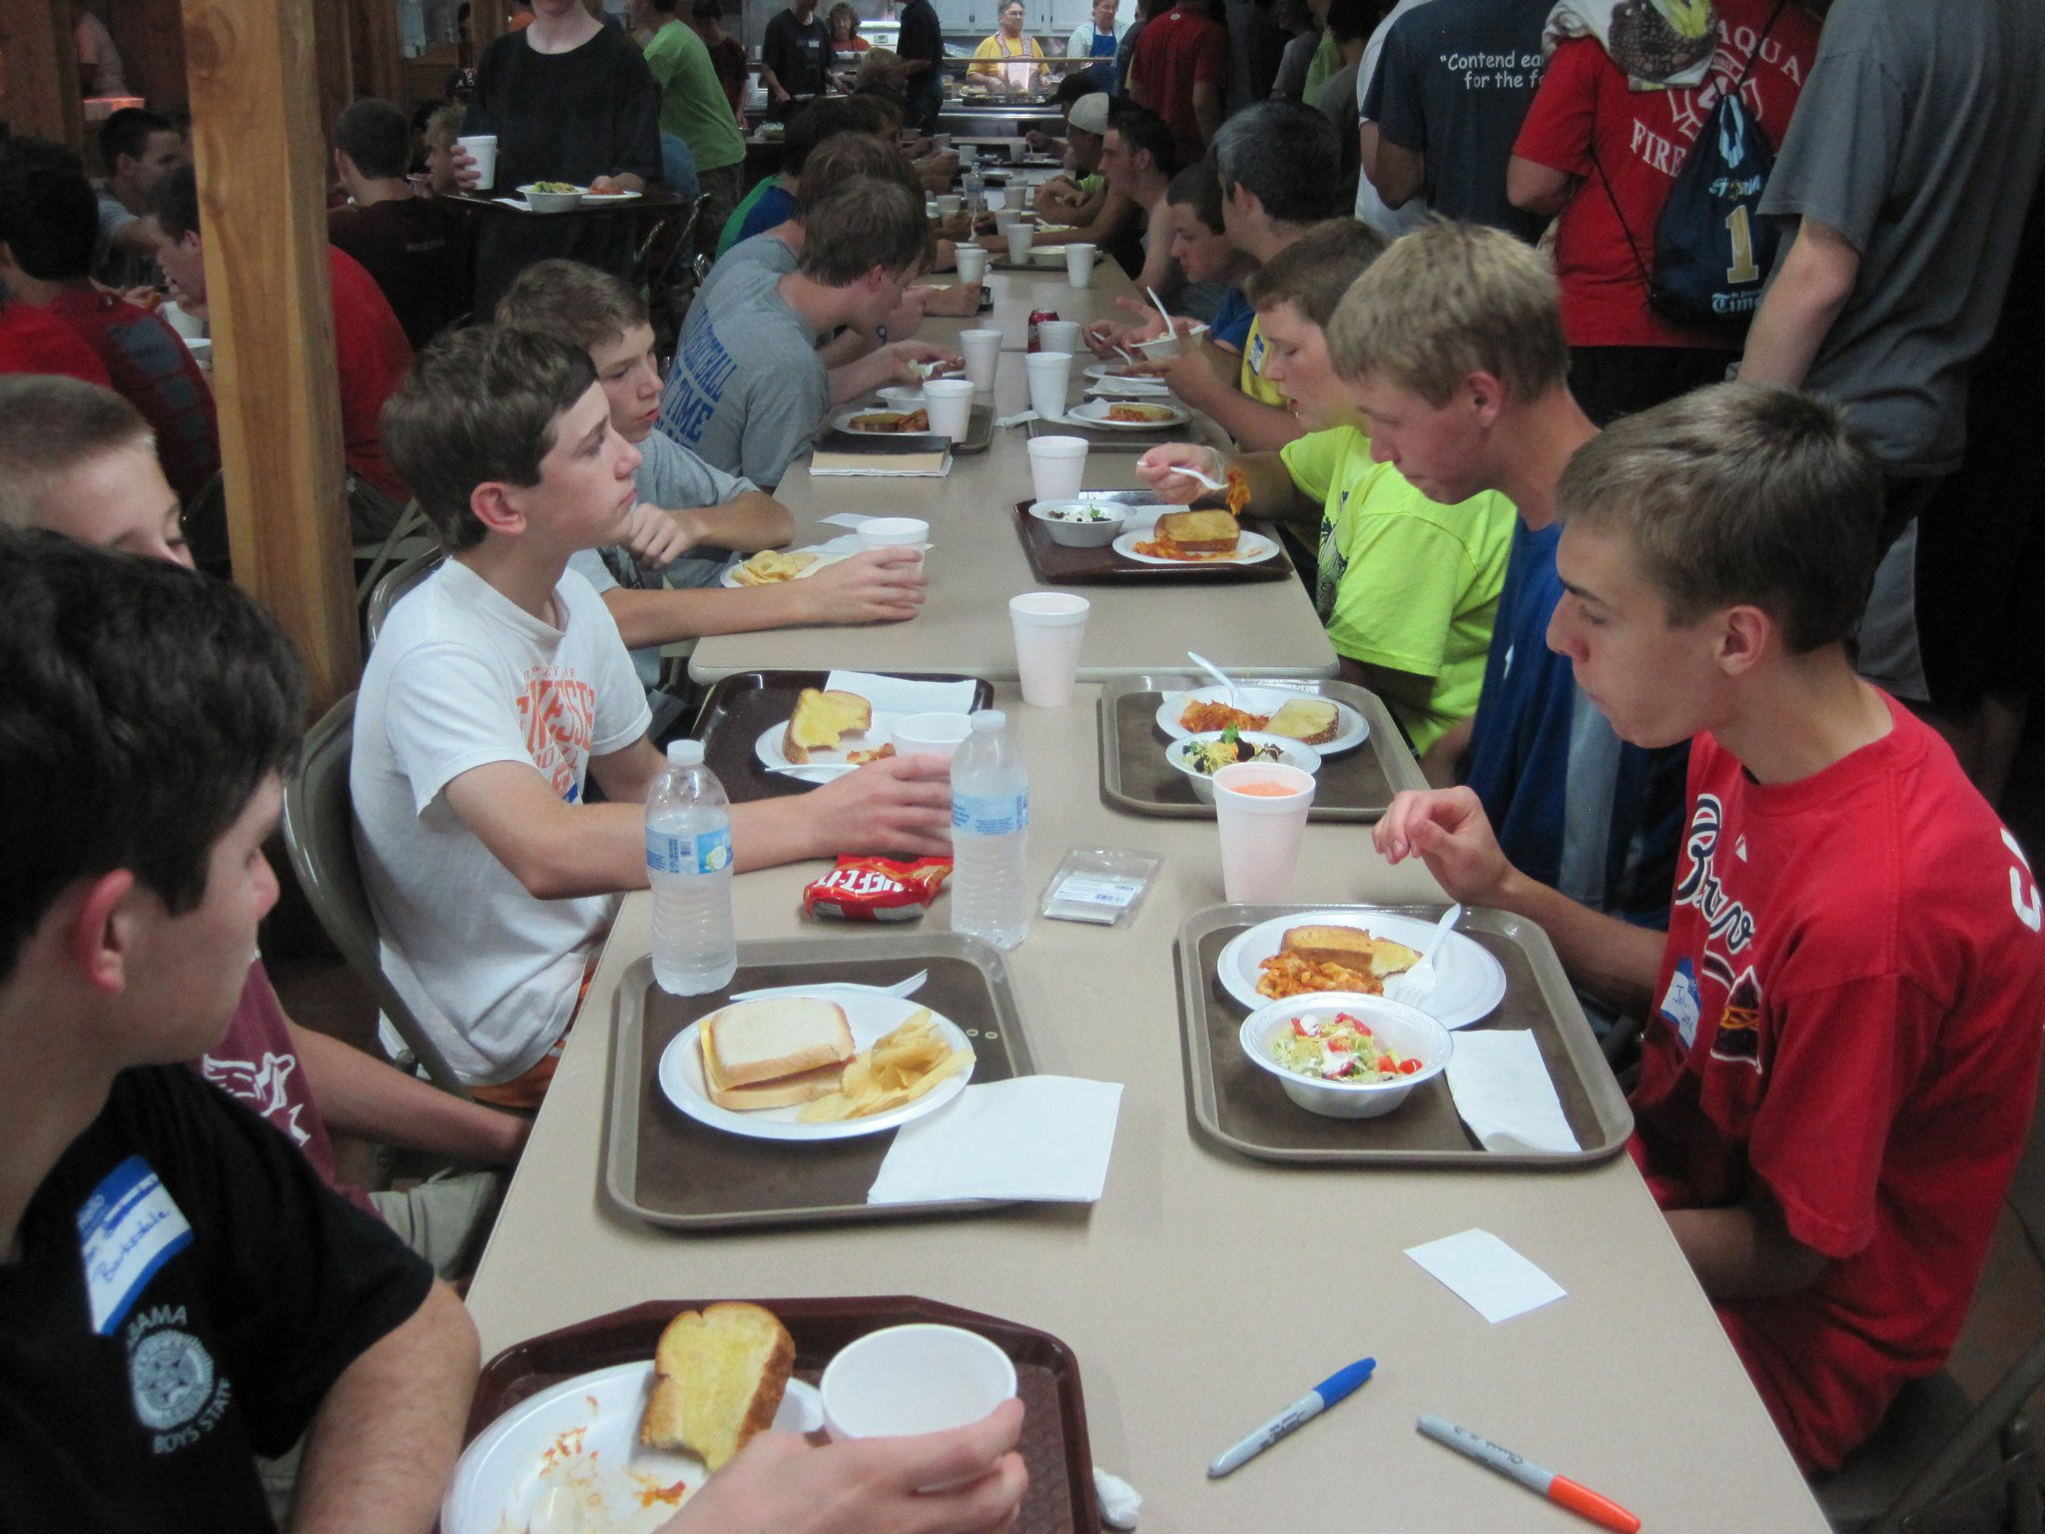

Slide 17
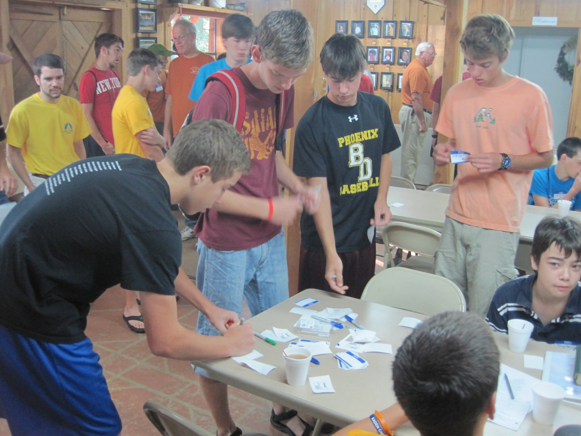

Slide 18
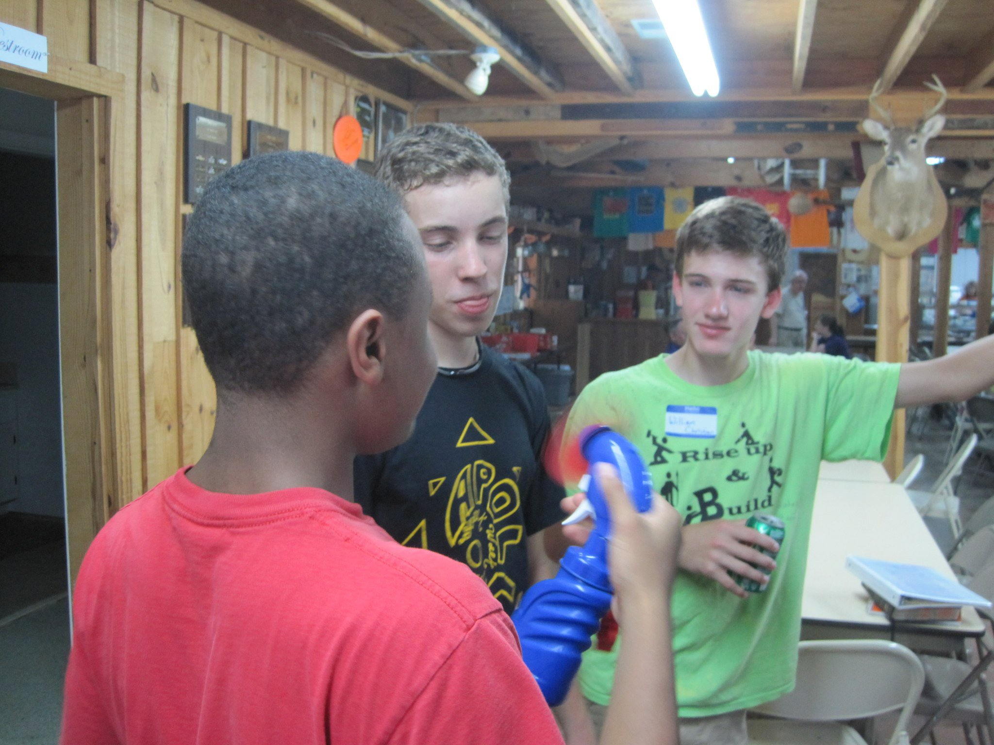

Slide 19
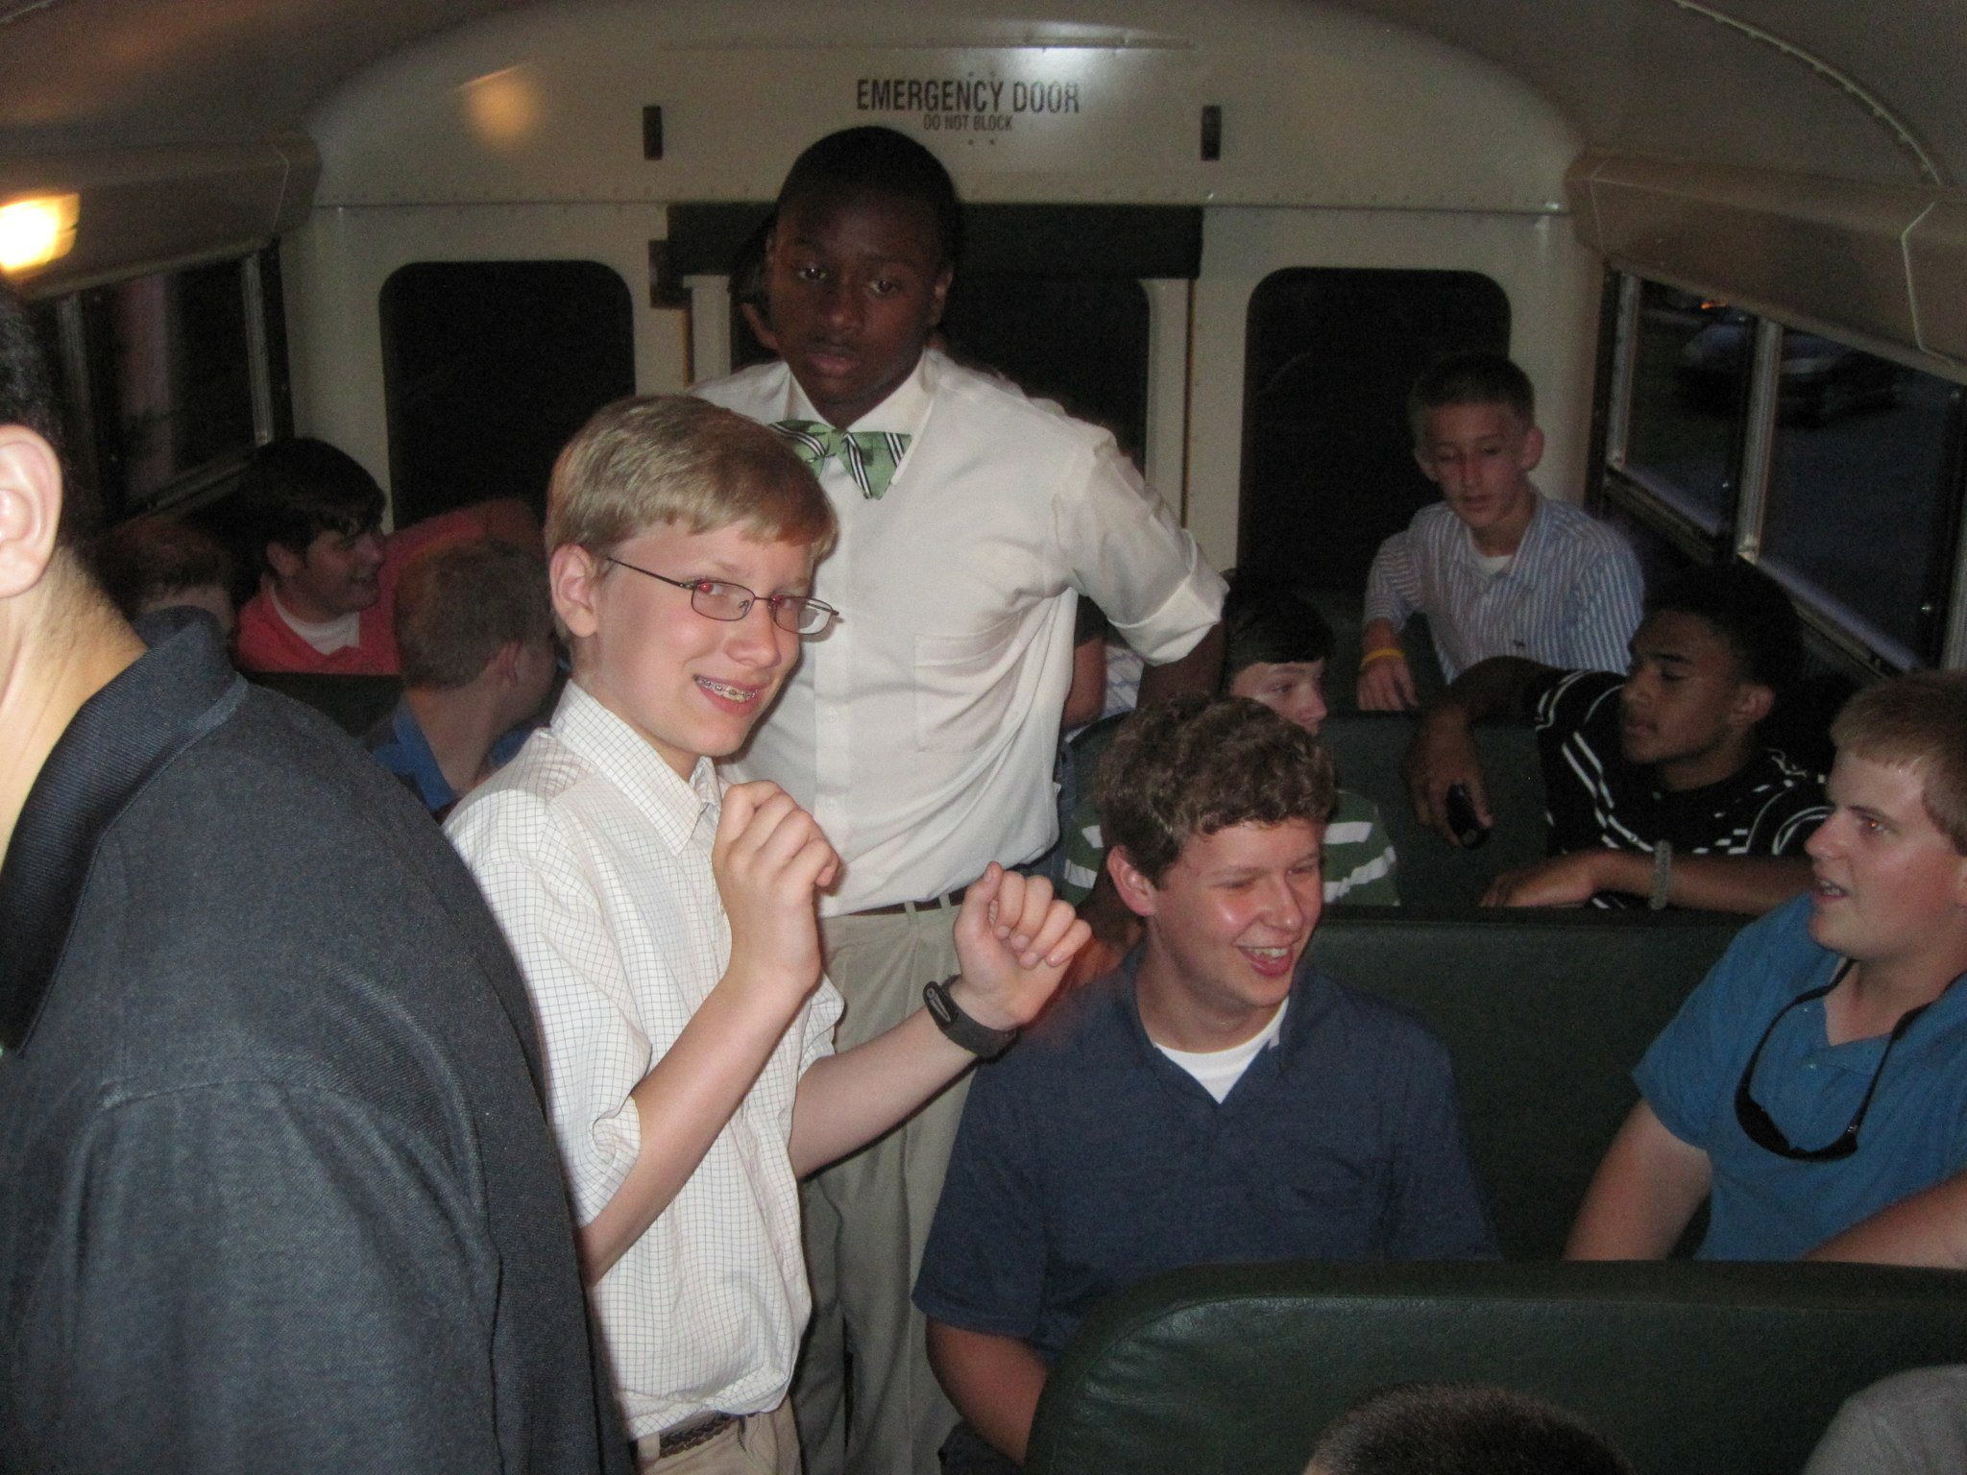

Slide 20
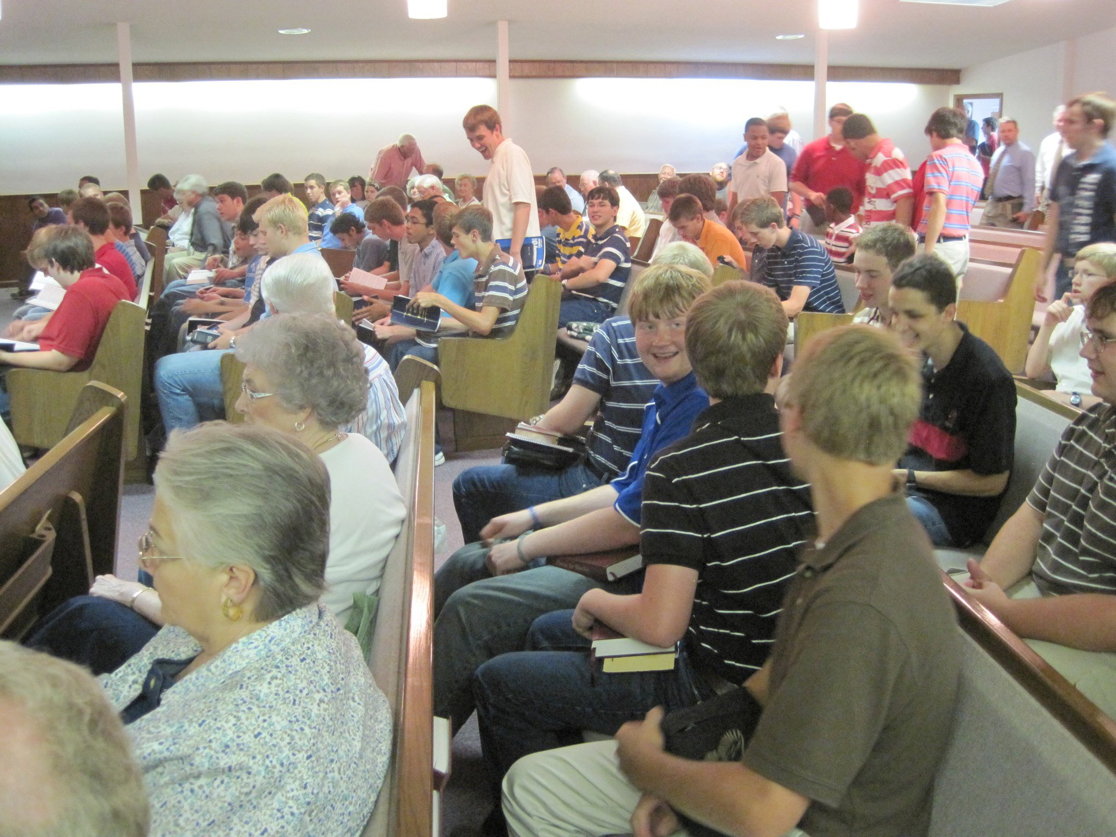

Slide 21
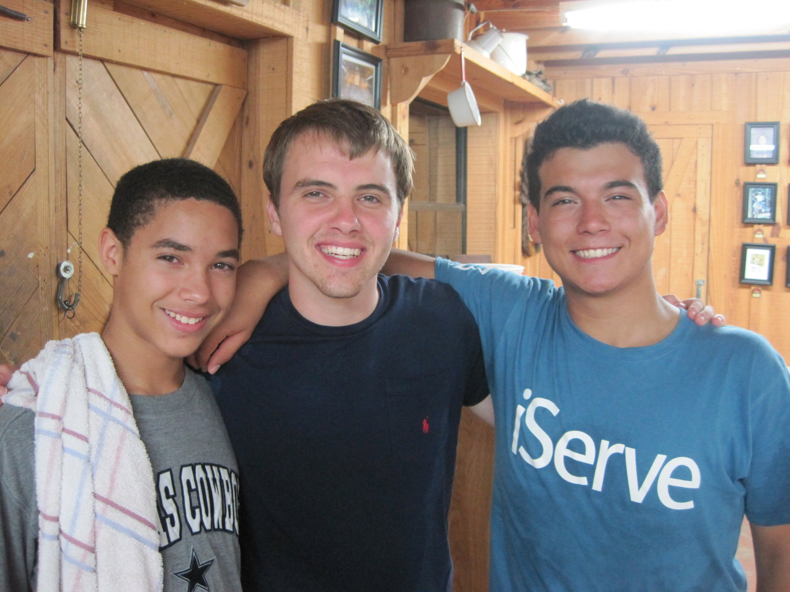

Slide 22
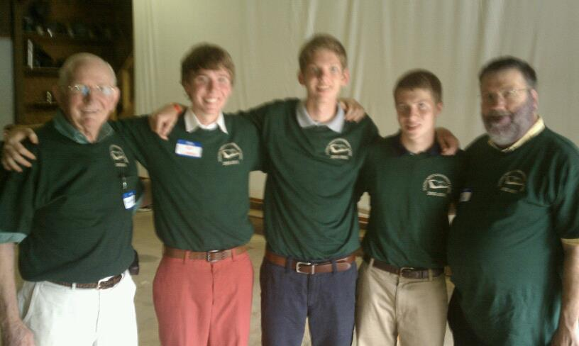

Slide 23
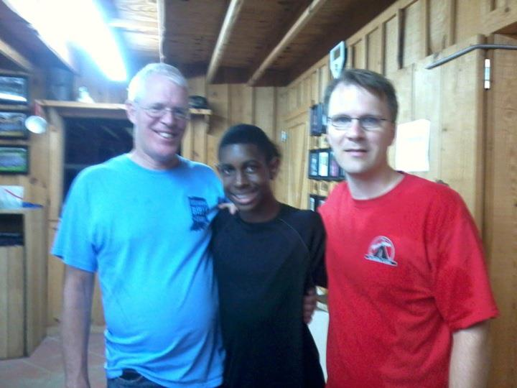

Slide 24
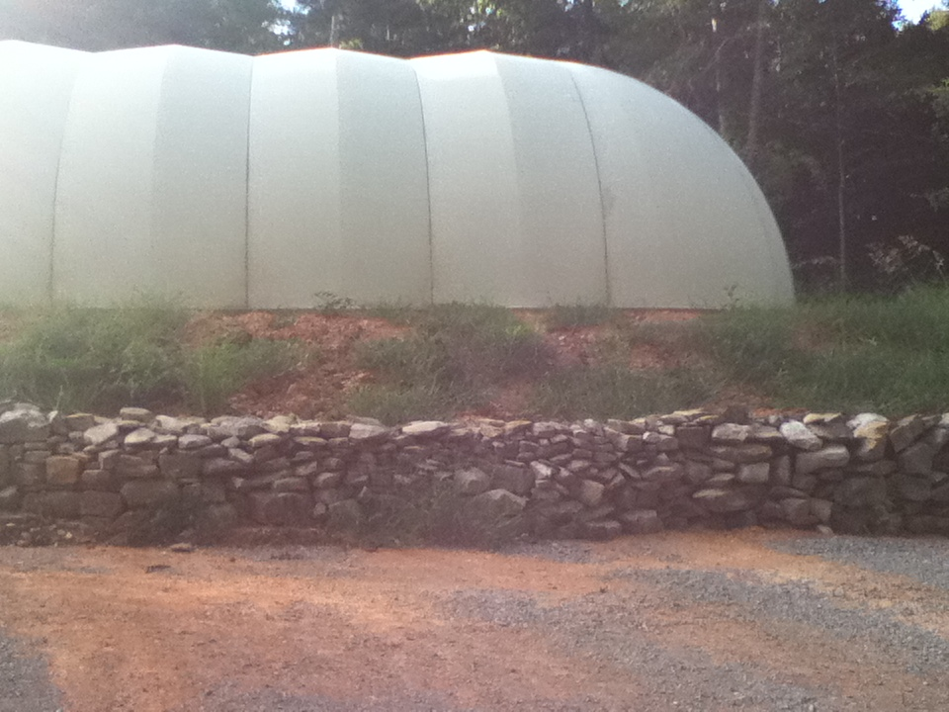

Slide 25
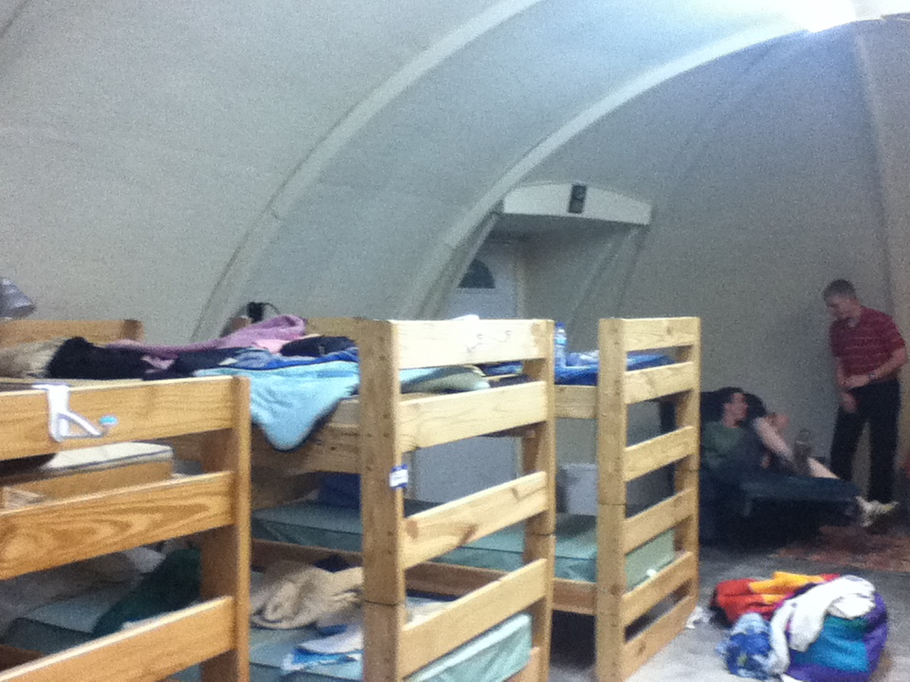

Slide 28
The Bubble
An important lesson I learned from leadership camp

Slide 29
So flee youthful passions and pursue righteousness, faith, love, and peace, along with those who call on the Lord from a pure heart.
2 Timothy 2:22

Slide 30
FLEE!
So flee youthful passions and pursue righteousness, faith, love, and peace, along with those who call on the Lord from a pure heart.
2 Timothy 2:22
youthful passions
righteousness
faith
love
peace
PURSUE!
PURSUE!
PURSUE!

Slide 31
youthful passions
FLEE!
faith
righteousness
love
peace
PURSUE!
PURSUE!
PURSUE!
along with those who call on the Lord from a pure heart.

Slide 32
So flee youthful passions…
Eliminate OPPORTUNITY
Eliminate
DESIRE
and pursue righteousness…
ISOLATION & INSULATION

Slide 33
So flee youthful passions…
Eliminate OPPORTUNITY
And it is my prayer that your love may abound more and more, with knowledge and all discernment, so that you may approve what is excellent, and so be pure and blameless for the day of Christ…
Philippians 1:9-10
Eliminate
DESIRE
and pursue righteousness…
ISOLATION & INSULATION

Slide 34
Eliminate
DESIRE
And it is my prayer that your love may abound more and more, with knowledge and all discernment, so that you may approve what is excellent, and so be pure and blameless for the day of Christ…
Philippians 1:9-10

Slide 35
Eliminate
DESIRE
And it is my prayer that your love may abound more and more, with knowledge and all discernment, so that you may approve what is excellent, and so be pure and blameless for the day of Christ…
Philippians 1:9-10
*KEY: Learning to love what God loves

Slide 36
Eliminate
DESIRE
And it is my prayer that your love may abound more and more, with knowledge and all discernment, so that you may approve what is excellent, and so be pure and blameless for the day of Christ…
Philippians 1:9-10
*KEY: Learning to love what God loves

Slide 37
And let us consider how to stir up one another to love and good works, not neglecting to meet together, as is the habit of some, but encouraging one another…
Hebrews 10:24-25
BUBBLE #1: Worship!

Slide 38
I have stored up your word in my heart, that I might not sin against you.
Psalm 119:11
BUBBLE #2: Bible study

Slide 39
“Abba, Father, all things are possible for you. Remove this cup from me. Yet not what I will, but what you will.”
Mark 14:36
BUBBLE #3: Prayer

Slide 40
Let the word of Christ dwell in you richly, teaching and admonishing one another in all wisdom, singing psalms and hymns and spiritual songs, with thankfulness in your hearts to God.
Colossians 3:16
BUBBLE #4: Singing

Slide 41
For I long to see you, that I may impart to you some spiritual gift to strengthen you—that is, that we may be mutually encouraged by each other’s faith, both yours and mine.
Romans 1:11-12
BUBBLE #5: Godly association

