Slide 3
In the Beginning
Was the Word
Steve Wolfgang
4 September 2011
Embry Hills, Atlanta

Slide 4
The Word
John 1:1
In the beginning was the Word, and the word was with God, and the word was God.

Slide 5
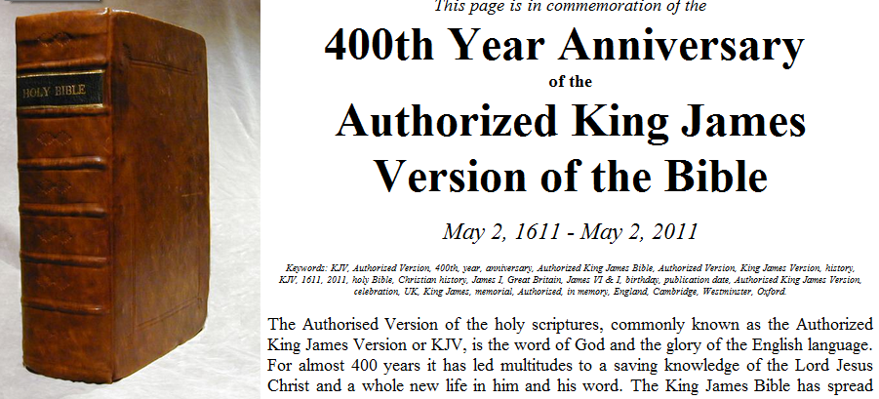
King James Version
400th Anniversary
1611 – 2011

Slide 6
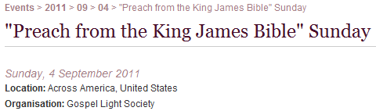

“Preach From the KJV”
Sunday 4 September 2011

Slide 7

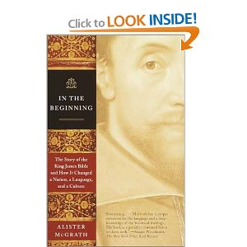

Of the Making of Many Books

Slide 8
Ancient Tablets to
Modern Translations:
How We Got the Bible
Steve Wolfgang

Slide 9
Reading the Bible
Can Be Dangerous
What if it gave you the wrong information?
  Misquotation – Matthew 4:4ff
  Omission – Psalm 119:160
Poor translation
False teaching in “Notes”

Slide 10
How to Destroy Any Culture
Change the language
  Genesis 11:1, 6-9
“Undone” in Acts 2:5ff
  See Galatians 4:4

Slide 11
Nehemiah 8:8
And they read from the book, from the law of God, translating to give the sense so that they understood the reading.
NASB

Slide 12
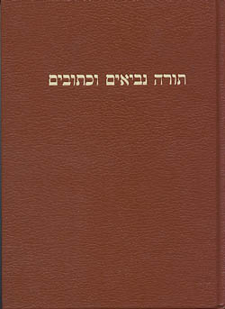

The Old Testament was written mainly in Hebrew, with some Aramaic.
A sample of
Aramaic letters.
The letter “aleph”
in Hebrew script.

Slide 13
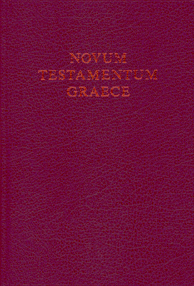
The New Testament
was written in Greek.
A sample of Greek letters.
The letter “alpha” in Koine Greek dialect.

Slide 14
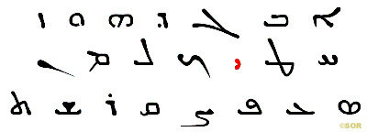
Matthew 5:18 (KJV) - “For verily I say unto you, Till heaven and earth pass, one jot or one tittle shall in no wise pass from the law, till all be fulfilled.”
Matthew 5:18
in the Aramaic language. The jot is highlighted in red.

Slide 15
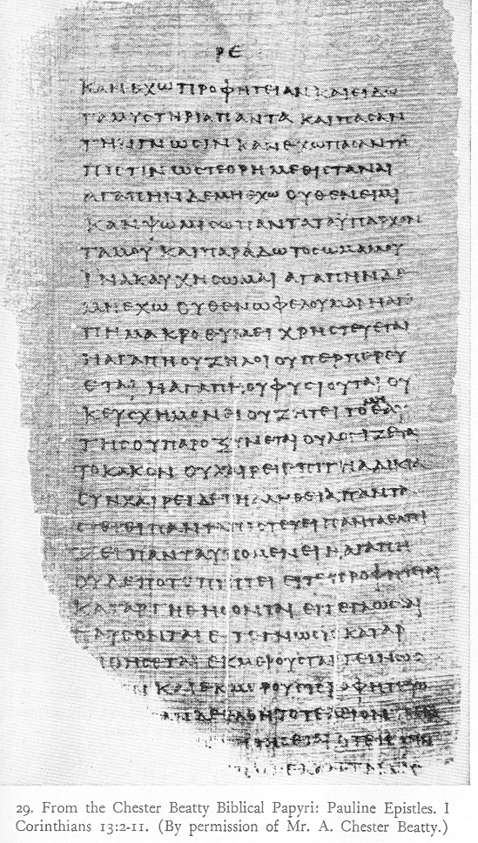
Chester
Beatty
Papyri

Slide 16
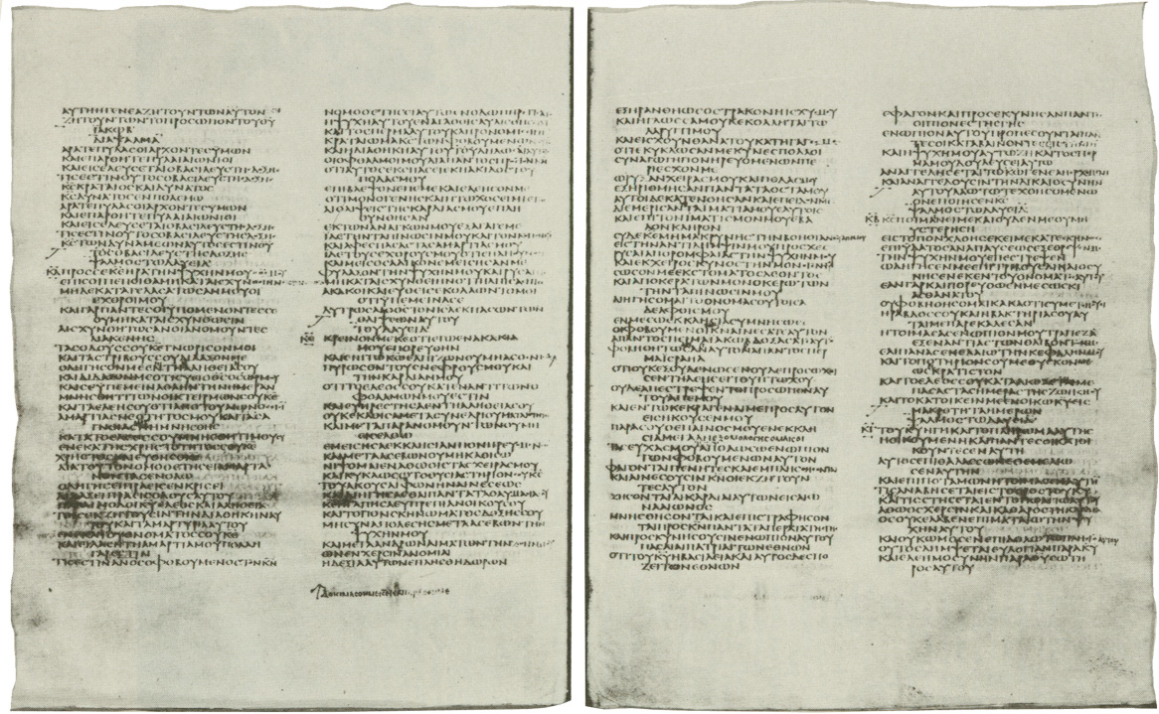
Codex Sinaiticus, c. AD 300

Slide 17
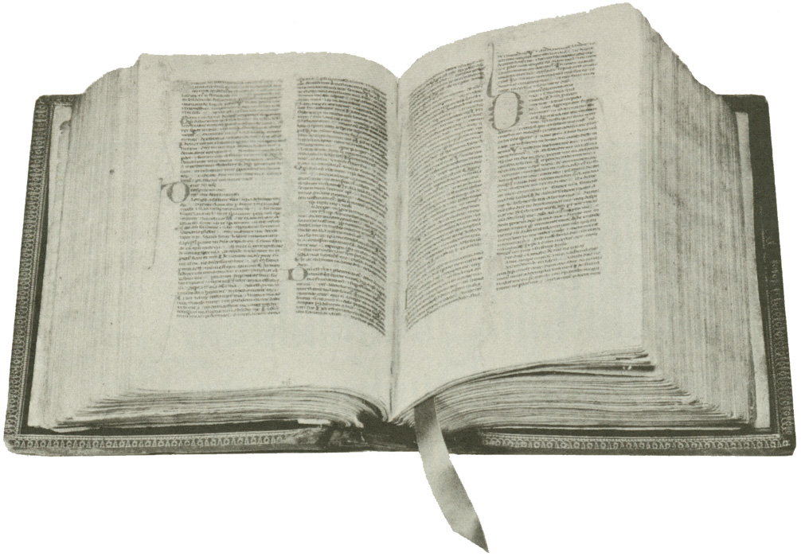
The Latin Vulgate

Slide 18
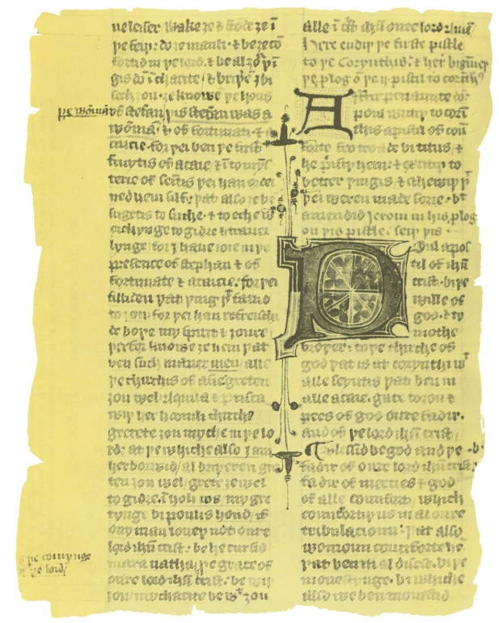
AD 1300
The Wycliffe Bible
The first English Bible is translated from Latin in AD 1382. It is called the Wycliffe Bible in honor of priest and Oxford scholar
John Wycliffe.
Page from Wycliffe Bible
1500 BC 500 BC AD 1 AD 500 AD 1000 AD 1500 AD 1900 AD 2000
1500 BC 500 BC AD1 AD 500 AD 1000 AD 1500 AD 1900 AD 2000

Slide 19
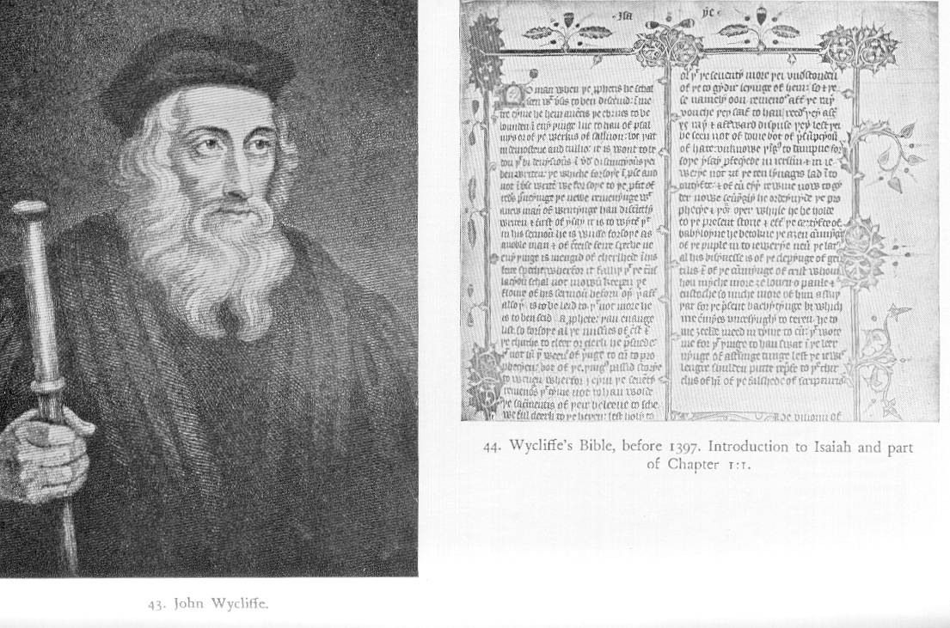
John Wycliffe (1320-1384)

Slide 20

AD 1428
The Wycliffe Bible
In AD 1415, the Wycliffe Bible is banned and burned. Forty years after Wycliffe’s death, in AD 1428, his bones are exhumed and burned for heresy.
1500 BC 500 BC AD 1 AD 500 AD 1000 AD 1500 AD 1900 AD 2000
1500 BC 500 BC AD1 AD 500 AD 1000 AD 1500 AD 1900 AD 2000
1500 BC 500 BC AD1 AD 500 AD 1000 AD 1500 AD 1900 AD 2000

Slide 21
By AD 2000, the Bible, or some of the Bible, was translated into 2,322 languages.
Source: Wycliffe Bible Translators.
1500 BC 500 BC AD 1 AD 500 AD 1000 AD 1500 AD 1900 AD 2000
1500 BC 500 BC AD1 AD 500 AD 1000 AD 1500 AD 1900 AD 2000

Slide 22
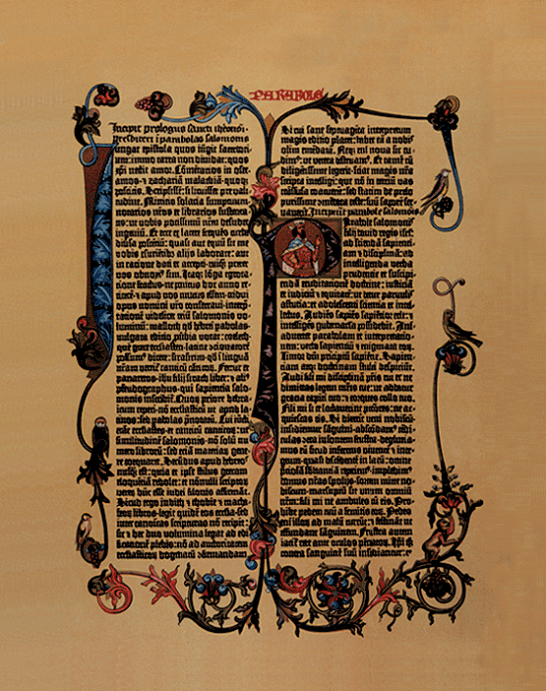
AD 1455
The Printing Press
The Gutenberg Bible is the first book ever printed with the printing press. This Latin Vulgate version is often illuminated by artists who hand paint letters and ornaments on each page.
Gutenberg
Bible Page
1500 BC 500 BC AD 1 AD 500 AD 1000 AD 1500 AD 1900 AD 2000
1500 BC 500 BC AD1 AD 500 AD 1000 AD 1500 AD 1900 AD 2000

Slide 23
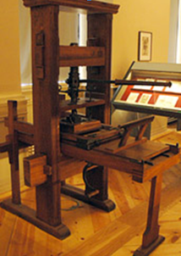
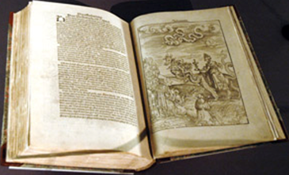
Luther Press and Bible – 1522
Luther Museum, Wittenberg

Slide 24
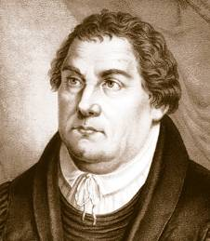
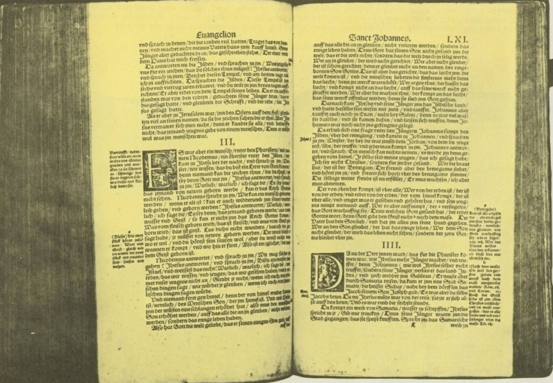
AD 1522
Martin Luther
Martin Luther translates the New Testament into German in AD 1522.
Martin Luther
1500 BC 500 BC AD 1 AD 500 AD 1000 AD 1500 AD 1900 AD 2000
1500 BC 500 BC AD1 AD 500 AD 1000 AD 1500 AD 1900 AD 2000

Slide 25
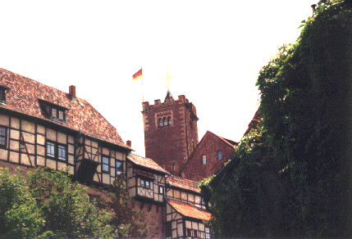
Wartburg Castle
Photo By Wolf

Slide 26
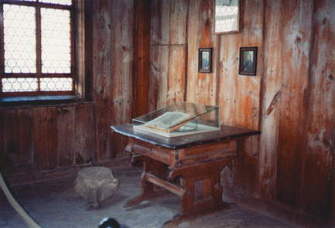
Luther Bibel – Wartburg

Slide 27
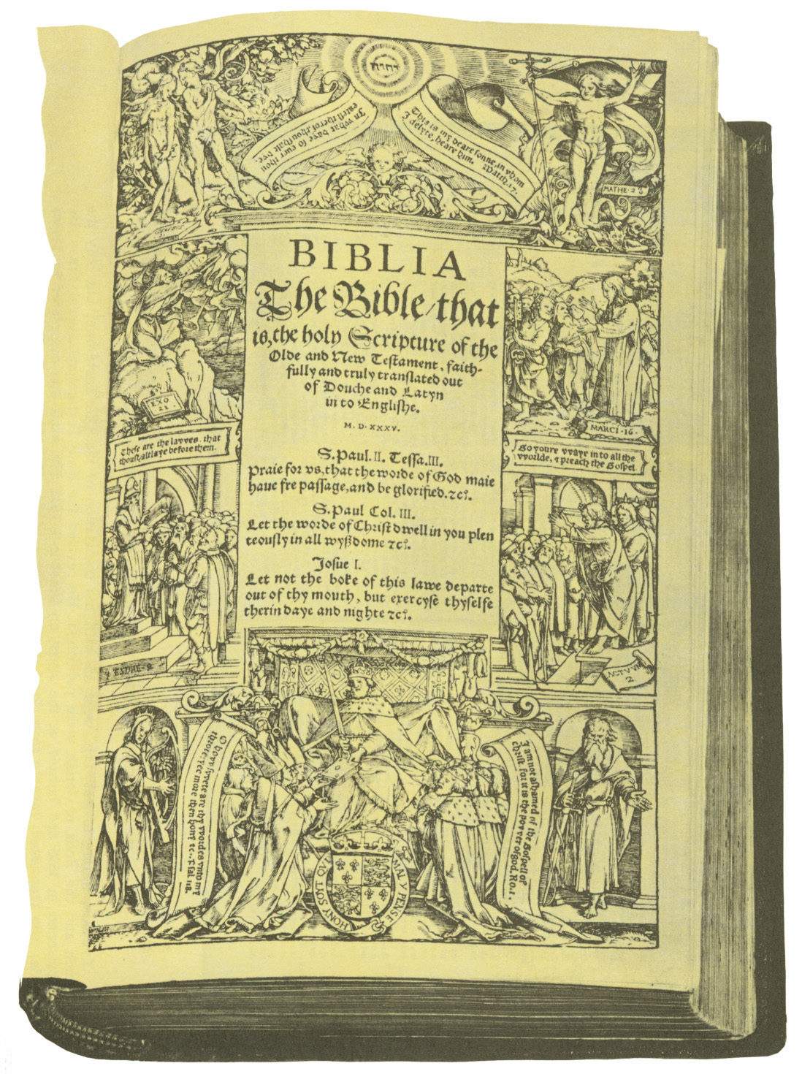
The First
Printed
English Bible
AD 1535
Coverdale Bible

Slide 28
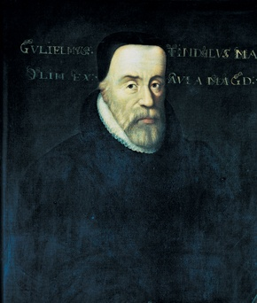
AD 1525
William Tyndale
William Tyndale, priest and Oxford scholar, translates the New Testament from Greek into English (AD 1525), but cannot get approval to publish it in England.
William Tyndale
1500 BC 500 BC AD 1 AD 500 AD 1000 AD 1500 AD 1900 AD 2000
1500 BC 500 BC AD1 AD 500 AD 1000 AD 1500 AD 1900 AD 2000

Slide 29
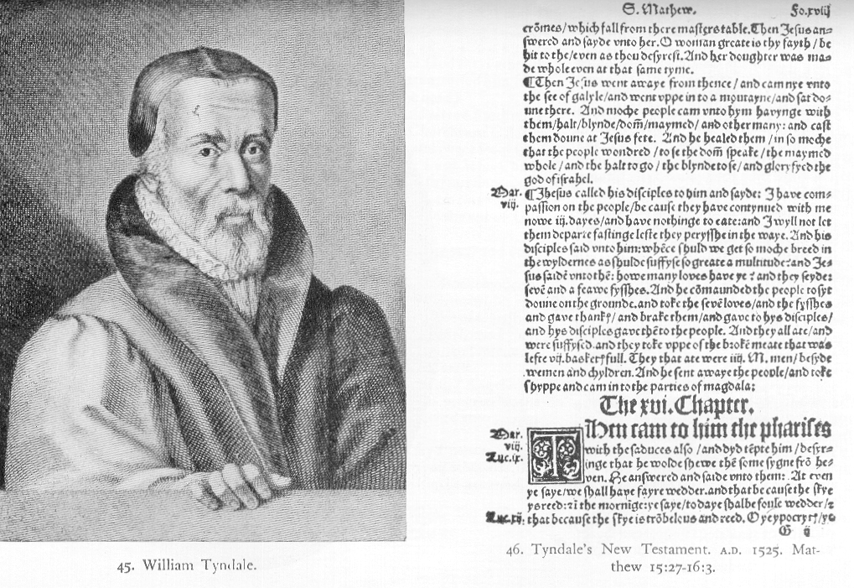
William Tyndale (1484-1536)

Slide 30
AD 1536
William Tyndale
In AD 1536, Tyndale is strangled and burned at the stake. His final words are: “Lord, open the King of England’s eyes.”
Tyndale is called the “Father of the English Bible” because his translation forms the basis of the King James Version. Much
of the style and vocabulary we know as “biblical English” is traceable to his work.
1500 BC 500 BC AD 1 AD 500 AD 1000 AD 1500 AD 1900 AD 2000
1500 BC 500 BC AD1 AD 500 AD 1000 AD 1500 AD 1900 AD 2000

Slide 31
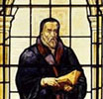
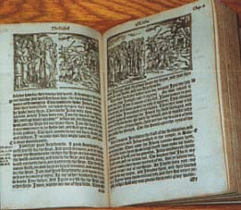
Tyndale New Testament

Slide 32
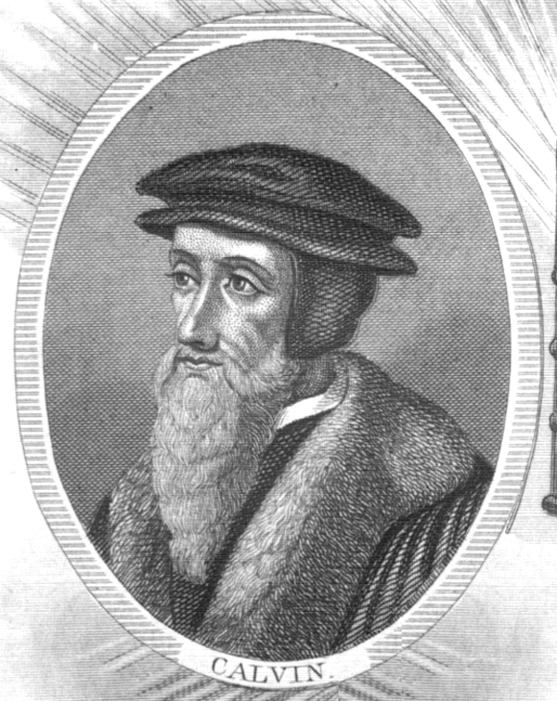
AD 1560
The Geneva Bible
The Geneva Bible contains theological notes from Protestant scholars
John Calvin, Beza, Knox,
and Whittingham. It is the first Bible to use Roman type.
John Calvin
1500 BC 500 BC AD 1 AD 500 AD 1000 AD 1500 AD 1900 AD 2000
1500 BC 500 BC AD1 AD 500 AD 1000 AD 1500 AD 1900 AD 2000

Slide 33
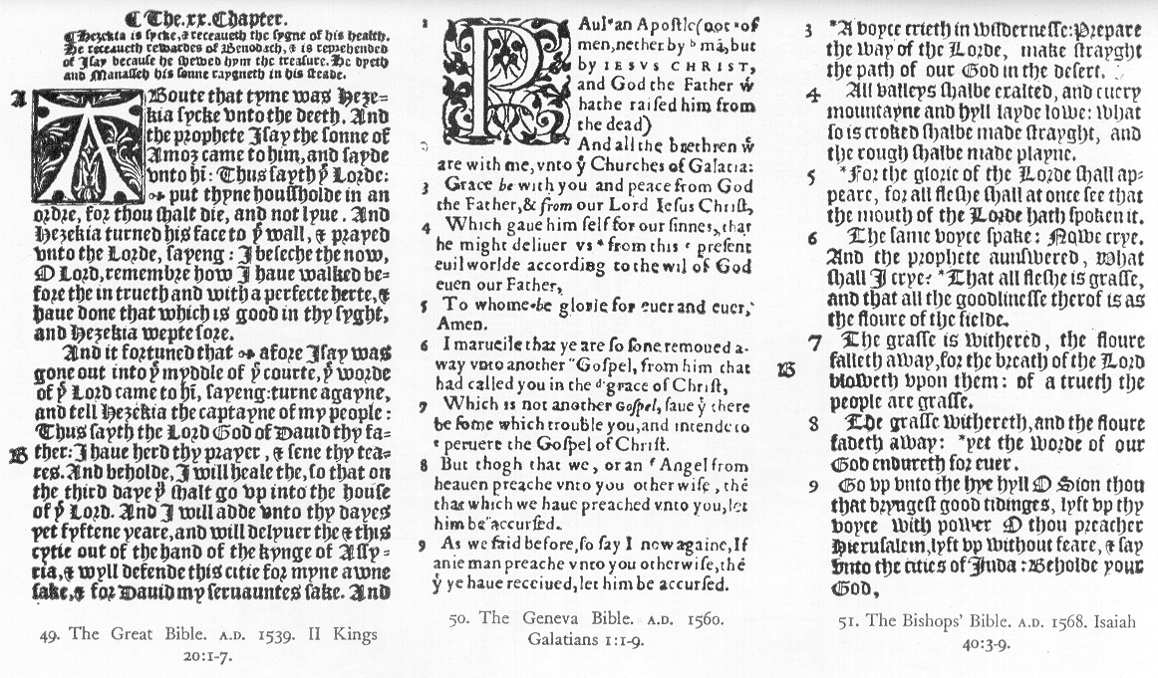
Great Geneva Bishops
Bible Bible Bible

Slide 34
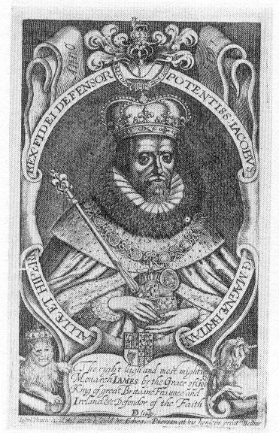
King
James I

Slide 35
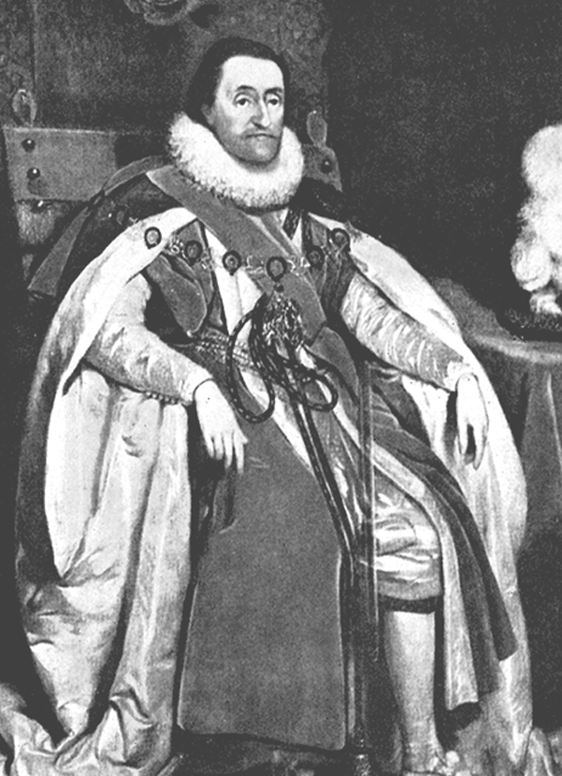
AD 1611
King James Version
King James I commissions 54 scholars to undertake a new Bible translation.
For six years, six teams of scholars using the Textus Receptus, Bishops Bible, and Tyndale’s Bible, complete the new version in AD 1611.
King James I of England
1500 BC 500 BC AD 1 AD 500 AD 1000 AD 1500 AD 1900 AD 2000
1500 BC 500 BC AD1 AD 500 AD 1000 AD 1500 AD 1900 AD 2000

Slide 36
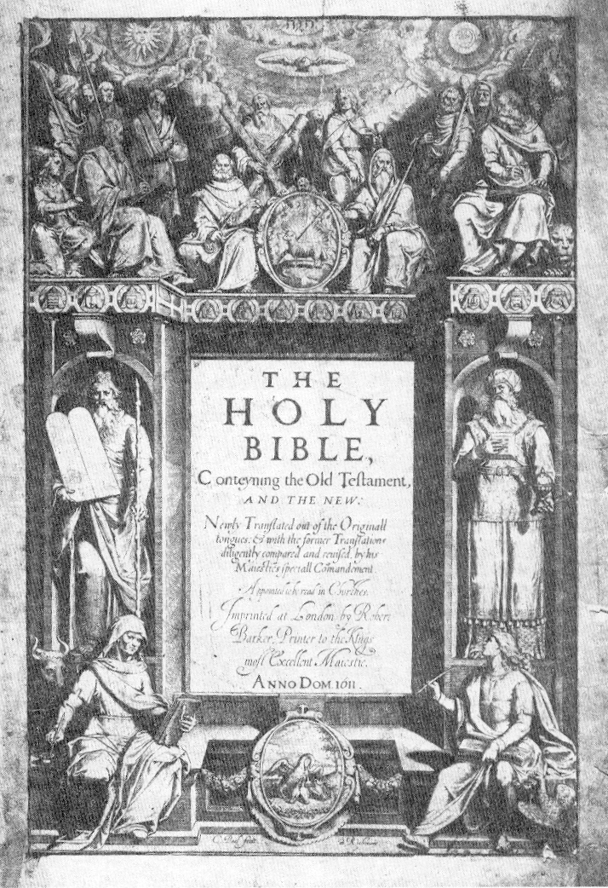
Original
King
James
Version
Title
Page

Slide 37
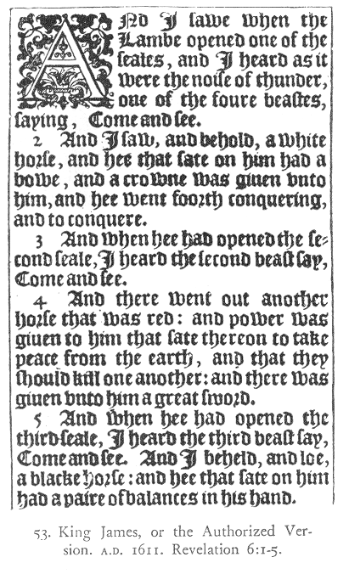
Original
King
James
Version
Revelation
6:1-5

Slide 38
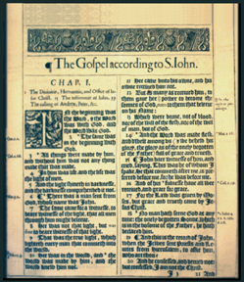
AD 1611
King James Version
The King James Version is also called the “Authorized Version,” even though King James never gave the finished version his royal approval.
It uses the best known manuscripts available at the time and it is revised several times.
King James Bible
Page from 1611 version
1500 BC 500 BC AD 1 AD 500 AD 1000 AD 1500 AD 1900 AD 2000
1500 BC 500 BC AD1 AD 500 AD 1000 AD 1500 AD 1900 AD 2000

Slide 39
“The Translators to the Reader”
“Truly (good Christian Reader) we never thought from the beginning, that we should need to make a new Translation, nor yet to make of a bad one a good one . . . but to make a good one better, or out of many good ones, one principal good one, not justly to be excepted against; that hath been our endeavor, that our mark.”

Slide 40
“The Translators to the Reader”
“But we desire that the Scripture may speak like itself, as in the language of Canaan, that it may be understood even of the very vulgar.”

Slide 41
KJV Phrases
A law unto themselves
A man after his own heart
A stumbling block
A thief in the night
A thorn in the flesh
All things to all men
Apple of my eye Be fruitful and multiply
Bottomless pit
By their fruits ye shall know them
Den of thieves

Slide 42
KJV Phrases
Eat, drink and be merry
Eye for an eye
Feet of clay Fell by the way side
Fell on stony ground
Fight the good fight
Give up the ghost
God forbid
Handwriting on the wall Holier than thou How are the mighty fallen

Slide 43
KJV Phrases
Pale horse Pearls before swine Physician, heal thyself
Prophet without honor Scapegoat
Seek and ye shall find
Set thine house in order
Sheep's clothing
Suffer fools gladly
The blind lead the blind

Slide 44
Old British Words
Almug, algum, chode, charashim, gat, habergeon, hosen, kab, ligure, nard, neesed, raca, ring-straked, stacte, sycamyne, wimples, ouches, tatches, bruit, crack-nels, wot, trow, sod, swaddling clothes, meteyard, collops, mallows, murrain

Slide 45
Odd Sounding
“Jacob sod pottage” – Genesis 25:29
“altogether on a smoke” – Exodus 19:18
“And all to brake his skull” – Judges 9:53
“To ear his ground” – 1 Samuel 8:12
“Woe to them...that stay on horses” – Isaiah 31:1
“sottish” – Jeremiah 4:22
“naughty figs” – Jeremiah 24:2
“I trow not” – Luke 17:9
“Fetching a compass” – Acts 28:13
“Ye are straitened in your own bowels” – 2 Corinthians 6:12
“Vain jangling” – 1 Timothy 1:6

Slide 46
Some Confusing Words
“Unknown”tongue – 1 Corinthians 14
Slave & servant – from doulos
Form & fashion – Philippians 2:6 (not “form” only)
Comfort – consolation
Teaching – doctrine
Soul – life
Blessed – happy
Serve – worship
Reckon – impute – account
Dispensation – stewardship

Slide 47
Confusing Constructions
“Give up the ghost” (Genesis 25:8, Jeremiah 15:9) = “expire”
“God save the king” (1 Kings 10:24, 2 Kings 11:12) = “let the king live”
“Slew and hanged on a tree” (Acts 5:30) = “slew by hanging”
“Abstain from all appearance” (1 Thessalonians 5:22) = “every form of evil”
“Charity” used 26 of 312 times to translate “agape”

Slide 48
Inconsistent Translation from Hebrew, Greek, and Latin
Elijah & Elias
Elisha & Eliseus
Hosea & Osee
Judas & Judah (+ Jude/Juda)
Phoencia & Phenice
Areopagus & Mars Hill

Slide 49
Acts 2:47
And the Lord added to the church daily such as should be saved. KJV
And the Lord was adding to their number day by day those who were being saved. NASB

Slide 50
Hebrews 6:4-6
For it is impossible for those who were once enlightened, and have tasted of the heavenly gift, and were made partakers of the Holy Ghost, 5 And have tasted the good word of God, and the powers of the world to come, 6 If they shall fall away KJV

Slide 51
Hebrews 6:4-6
For in the case of those who have once been enlightened and have tasted of the heavenly gift and have been made partakers of the Holy Spirit, 5 and have tasted the good word of God and the powers of the age to come, 6 and then have fallen away, it is impossible to renew them again to repentance NASB

Slide 52
Ephesians 1:13-14
And you also were included in Christ when you heard the word of truth, the gospel of your salvation. Having believed, you were marked in him with a seal, the promised Holy Spirit NIV

Slide 53
Ephesians 1:13-14
In whom ye also trusted, after that ye heard the word of truth, the gospel of your salvation: in whom also after that ye believed, ye were sealed with that holy Spirit of promise,
¹⁴ Which is the earnest of our inheritance until the redemption of the purchased possession, unto the praise of his glory. KJV

Slide 54
Acts 26:28
Almost thou persuadest me to be a Christian KJV
With but little persuasion thou wouldest fain make me a Christian ASV
In a short time you will persuade me to become a Christian NASB

Slide 55
Perennial Strengths
Psalm 23
1 Corinthians 13
Acts 2:38
Acts 26:28

Slide 56
The Word of God
Virtually indestructible
Roman Catholic Bibles can be used to convert Catholics
Jehovah’s witnesses can learn the truth even from the NWT
But should you recommend?
So which are best?

Slide 60
In 2003, there were 1,638 languages in which Bible translation is in progress.
Source: Wycliffe Bible Translators.
1500 BC 500 BC AD 1 AD 500 AD 1000 AD 1500 AD 1900 AD 2000
1500 BC 500 BC AD1 AD 500 AD 1000 AD 1500 AD 1900 AD 2000

Slide 62
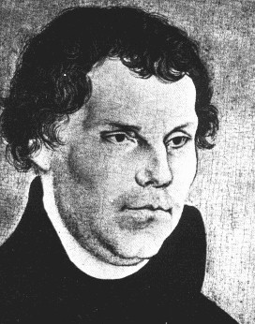
Martin
Luther
1483-1546

Slide 63
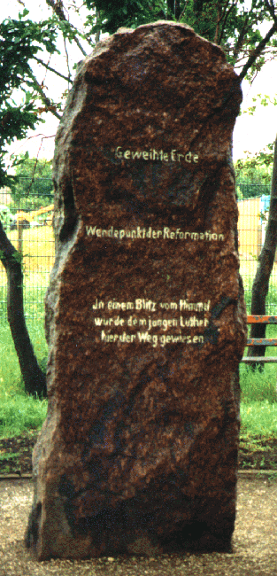
Luther
Monument
Stotternheim
Photo by Wolf

Slide 64
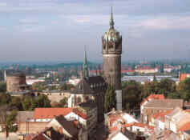
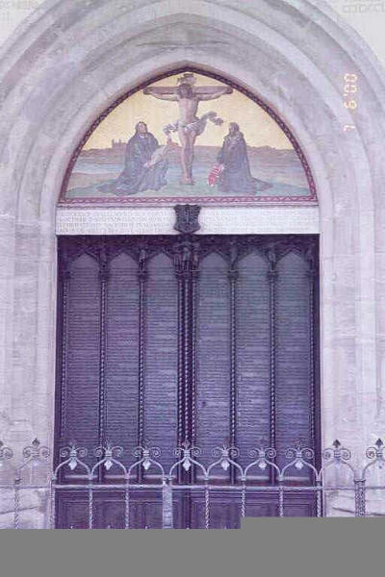
Wittenburg
Church Door – 95 Theses

Slide 65
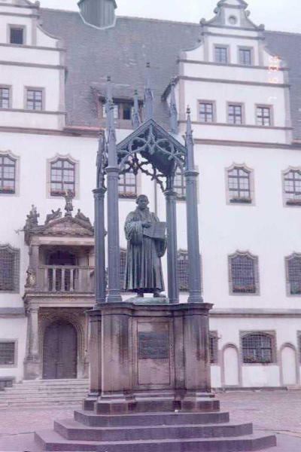
Luther
Statue
Wittenburg
Town
Square

Slide 66
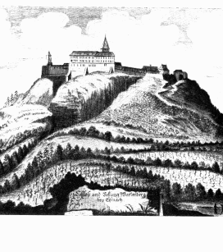
Wartburg Castle
Luther
Translates
German
Bible

Slide 67
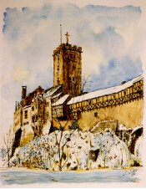
Wartburg
Castle
Luther
Translates
German
Bible

Slide 68
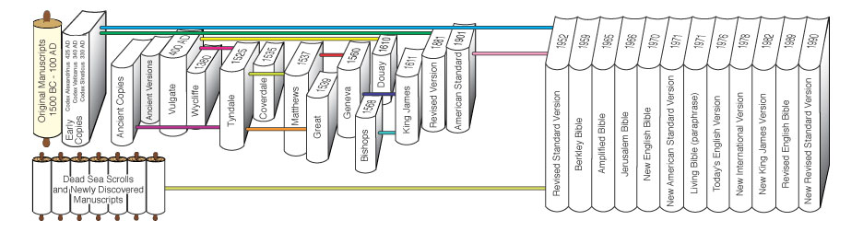
Sources Used: Ancient Greek and Hebrew Copies, the Geneva Bible, and the Bishops Bible,
King James
AD 1611
1500 BC 500 BC AD 1 AD 500 AD 1000 AD 1500 AD 1900 AD 2000
1500 BC 500 BC AD1 AD 500 AD 1000 AD 1500 AD 1900 AD 2000

Slide 69
KJV Phrases
In the twinkling of an eye
Led as a sheep to the slaughter
Left hand know what thy right hand doeth
Let my people go
Let there be light
Love thy neighbour as thyself
Milk and honey
My brother's keeper
No room for them in the inn
Out of the mouths of babes
honor

Slide 70
KJV Phrases
The last shall be first
The lost sheep
The powers that be
The skin of my teeth They know not what they do
Turn to him the other [cheek]
Turned the world upside down
Two-edged sword
Vengeance is mine
White as snow
Woe is me

Slide 71
“The Translators to the Reader”
“Lastly, we have on the one side avoided the scrupulosity of the Puritans, who leave the old Ecclesiastical words, as when they put WASHING for BAPTISM, and CONGREGATION instead of CHURCH: as also on the other side we have shunned the obscurity of the Papists . . .

Slide 72
Ephesians 1:13-14
In Him, you also, after listening to the message of truth, the gospel of your salvation-- having also believed, you were sealed in Him with the Holy Spirit of promise NASB

Slide 73
English Translation “Families”
Geneva Bible – 1560
KJV – 1611
ERV – 1881 ASV – 1901
RSV – 1952
NEB – 1970 NAS – 1970
NIV – 1977
NKJ – 1978
RNEB – 1990 NRS – 1999
ESV – 2000
CSV – 2001

Slide 74
English Translations
1560 – Geneva Bible – Shakespeare, Puritans/Pilgrims
1611 – King James (Authorized) Version
1833 – Noah Webster
1835 – Alexander Campbell
1880 – ERV – English Revised Version
1901 – ASV – American Standard Version
1952 – RSV – Revised Standard Version (Isaiah 7:14)
1970 – NASB – New American Standard Bible (literal)
1978 – NIV – New International Version (readable)
1982 – NKJV – New King James Version (Nelson)
1989 – NRSV – New Revised Standard Version (gender-inclusive)
1999 – CSB – Christian Standard Bible (Holman – Baptist – reaction to NIV)
2002 – ESV – English Standard Version

Slide 75
“Steve’s Picks”
(in descending order)
New American Standard Bible
New King James Bible
English Standard Version
Christian Standard Bible (Holman)
Revised Standard Version
New International Version
King James Version
Basic Rule: Read several!

Slide 76

All Scripture is God-breathed and is useful for teaching, rebuking, correcting and training in righteousness, so that the man of God may be thoroughly equipped for every good work.
2 Timothy 3:16-17
Above all, you must understand that no prophecy of Scripture came about by the prophet's own interpretation. For prophecy never had its origin in the will of man, but men spoke from God as they were carried along by the Holy Spirit.
2 Peter 1:20-21

Slide 77
“Reference” Bibles
X 1909 – Scofield Reference Bible (premillennial)
1946 – Thompson “Chain- Reference” Bible
1982 – Open Bible (some comments by members of Churches of Christ)

Slide 78
“Reference” Bibles
? Nelson Study Bible
? NIV Study Bible – Zondervan
Archaeology Study Bible
Holman Illustrated Study Bible

Slide 79
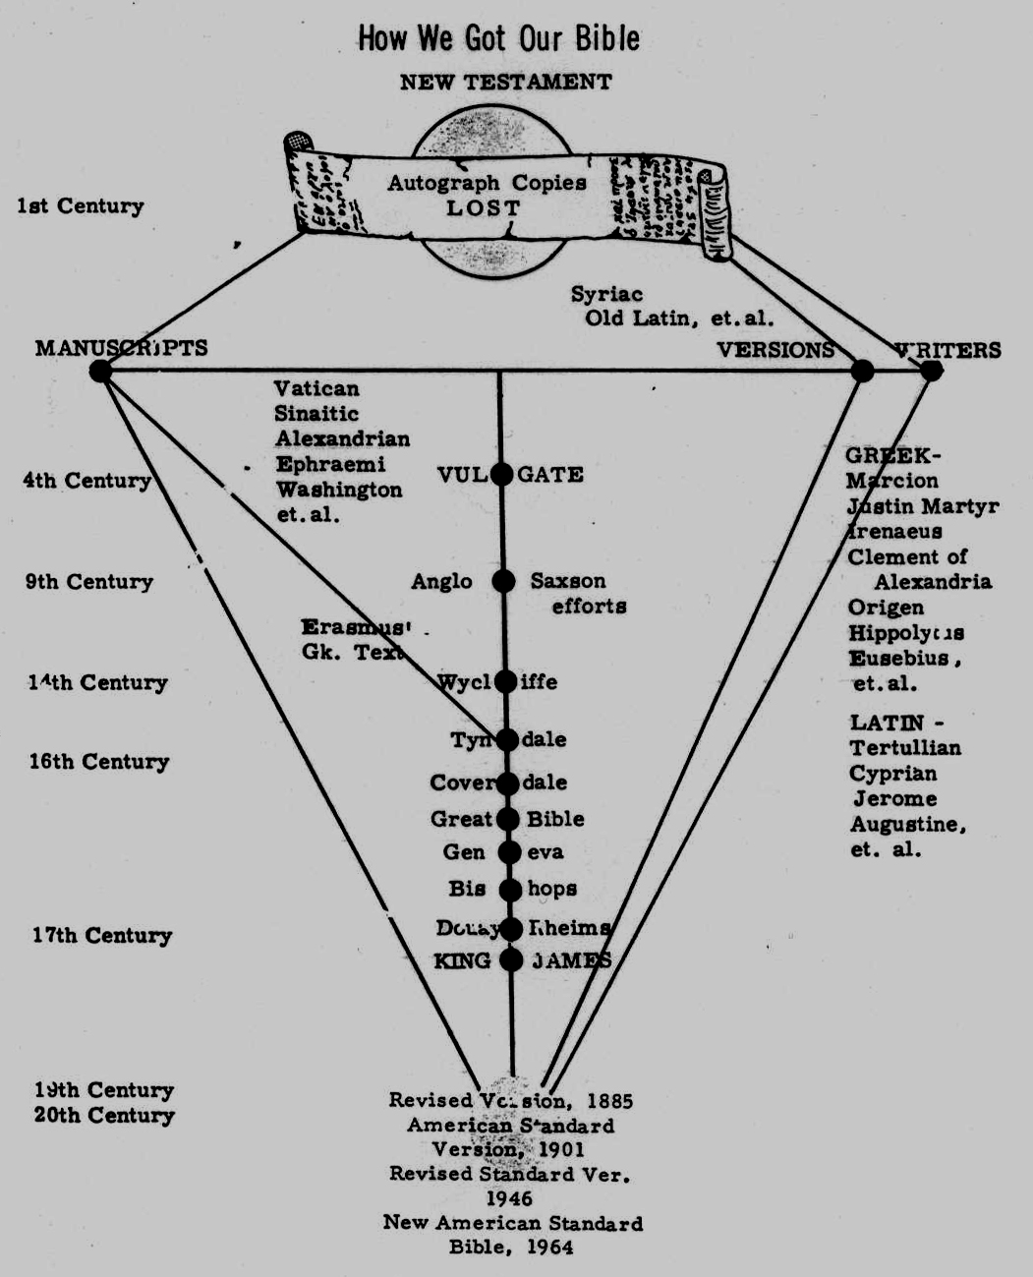

Slide 80
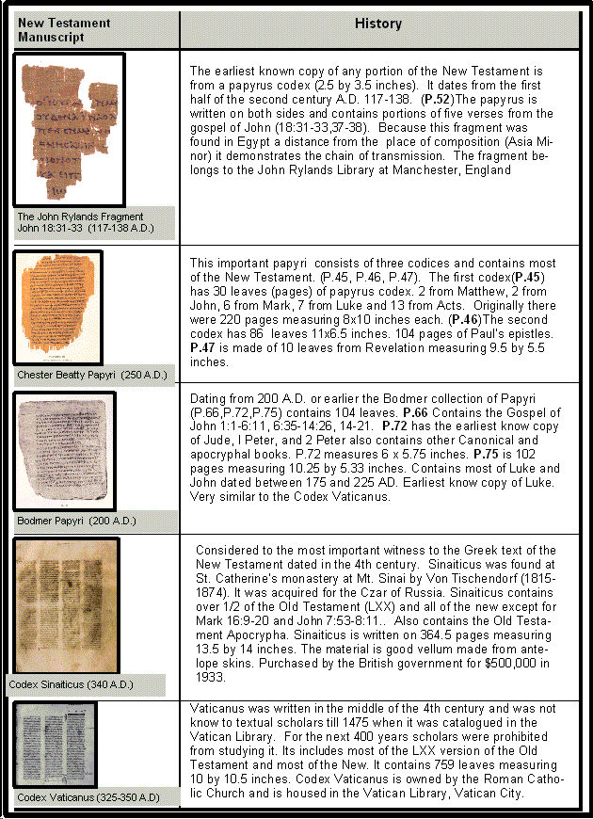

Slide 83
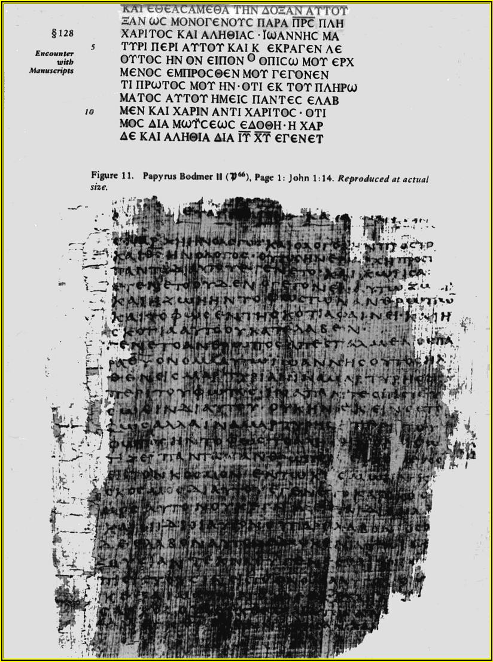
Papyrus
Bodmer p66
John 1:14

Slide 84
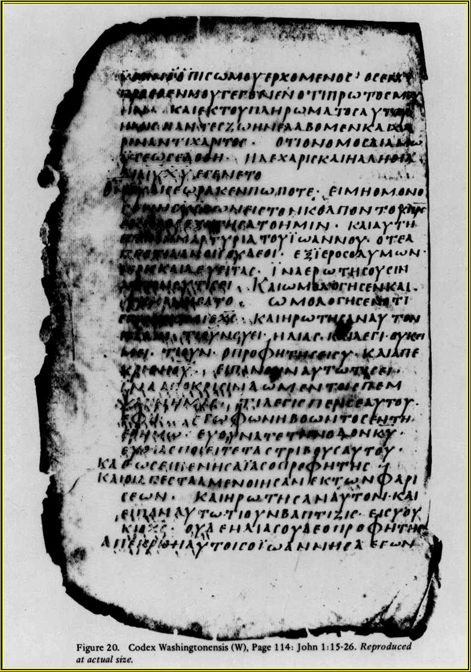
Codex W
Washingtonensis

Slide 85
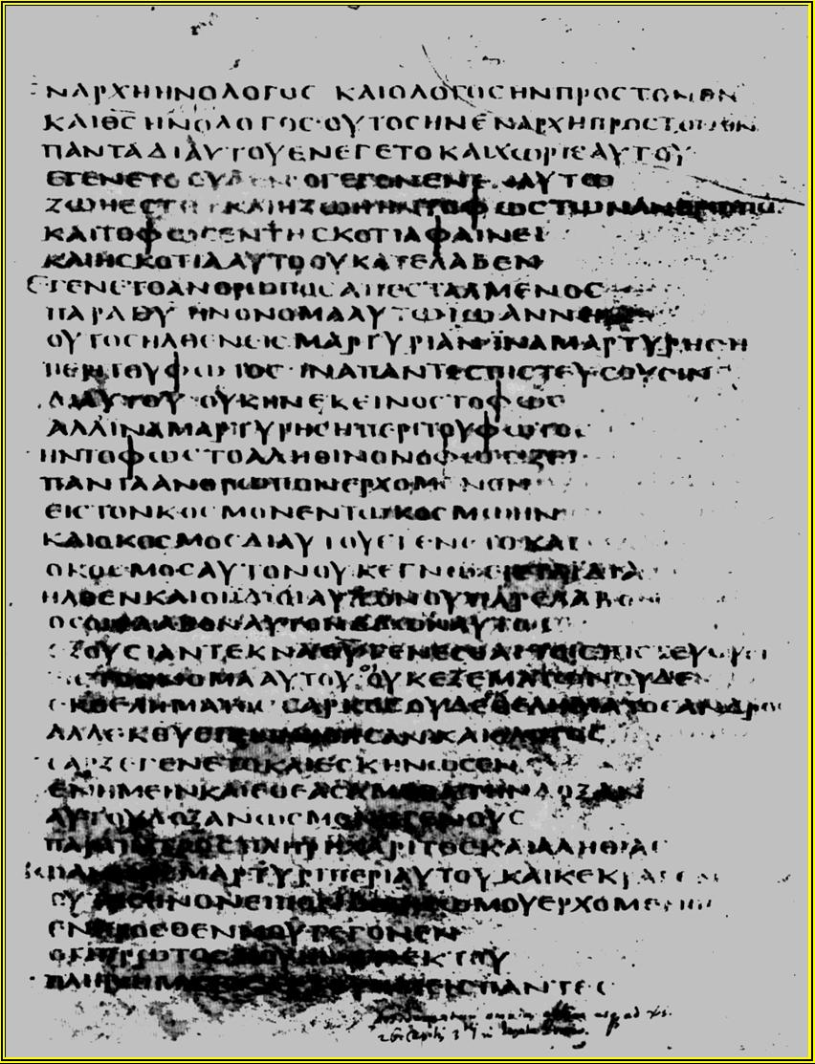
UNCIAL manscript
“CAPITAL” letters

Slide 86
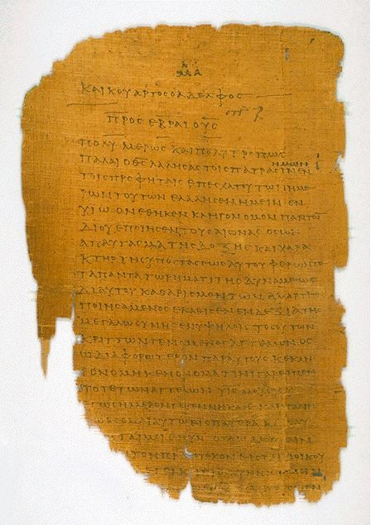

Slide 87
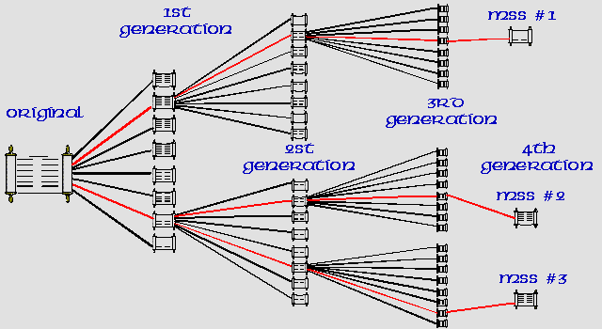
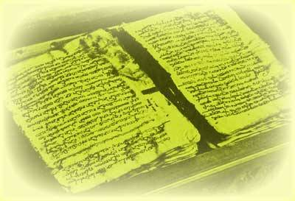
A.D.
0 100 200 300 400 500 600 700 800 900 1000 1100 1200

Slide 88
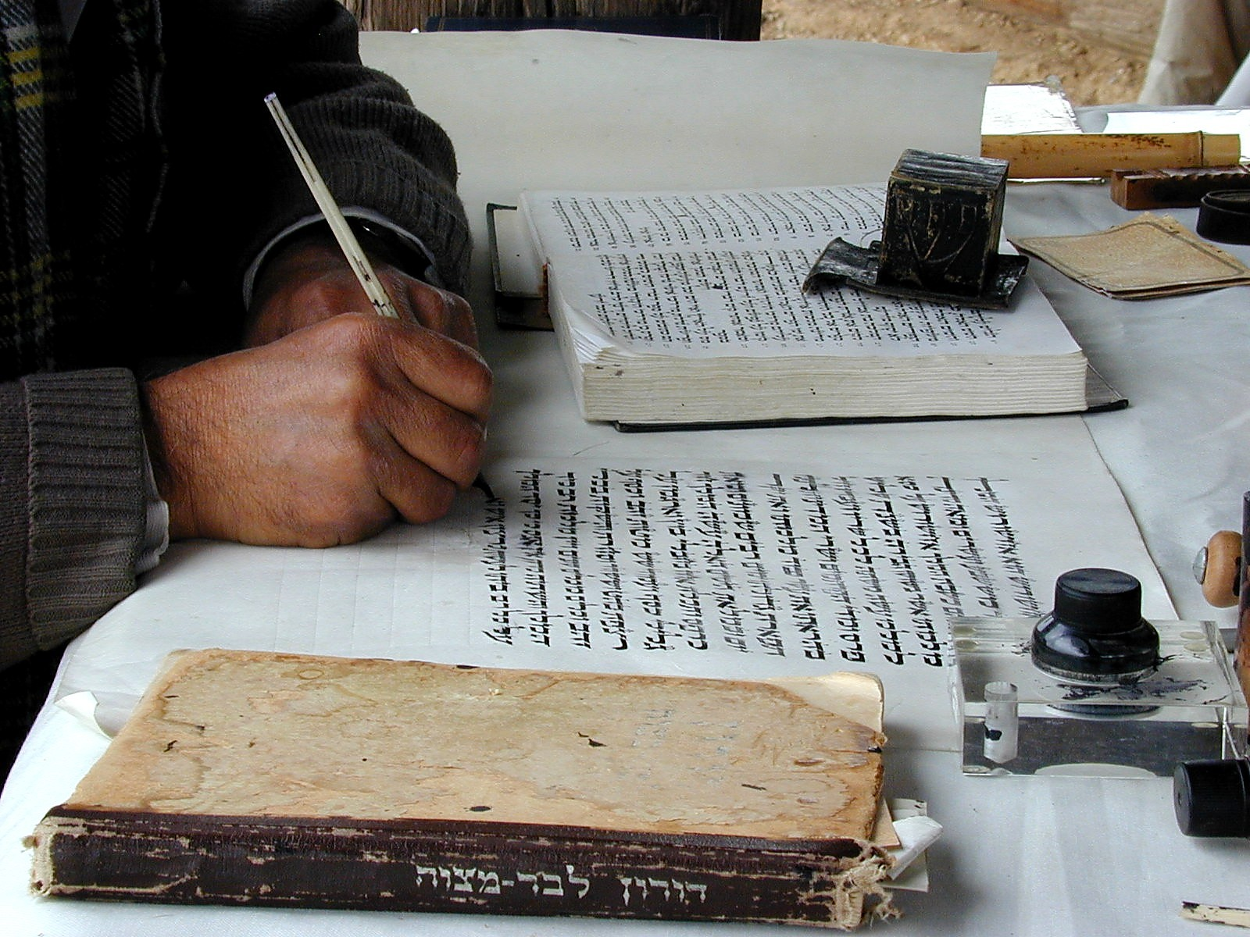
Scribal Copying

Slide 89
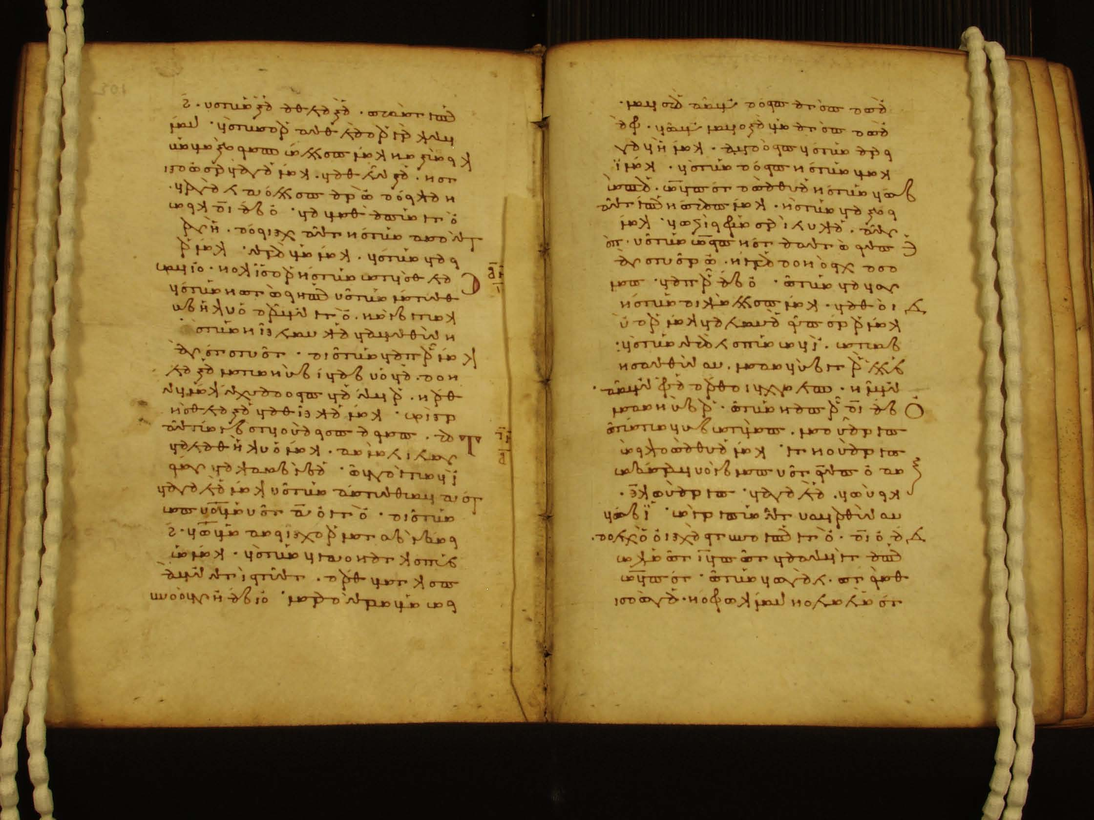
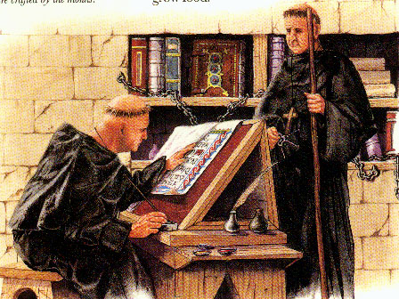

Slide 90
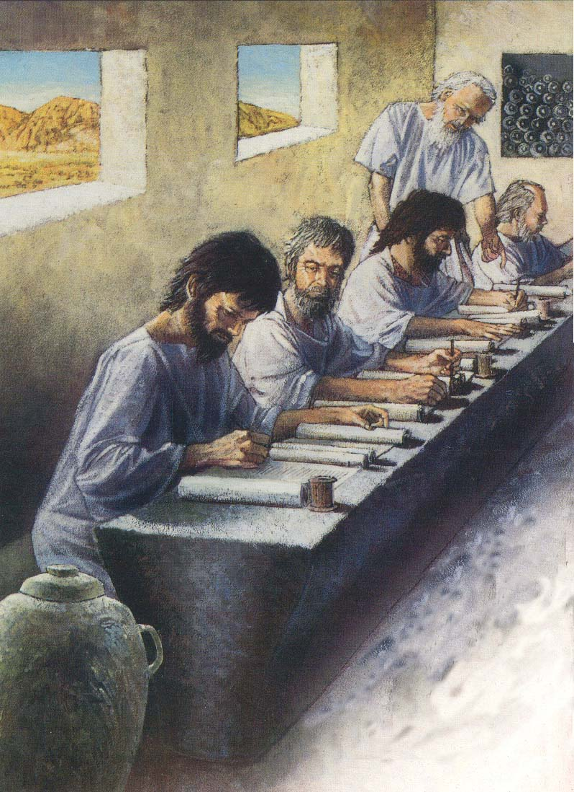

Slide 92
A.D.
0 100 200 300 400 500 600 700 800 900 1000 1100 1200
How many manuscripts are there for the New Testament?
Remember:
The Bible -
1. There are no Original Autographs
2. 1st Manuscript 50 years after the Original Autograph
3. There are 4-5 nearly complete manuscripts
4. There are 20 reliable manuscripts?

Slide 93

A.D.
0 100 200 300 400 500 600 700 800 900 1000 1100 1200
Caesar’s Gallic Wars
58–50 B.C.
1st Manuscript
No Original Autographs
*
Circa
900 A.D.
1.Only 9-10 useable manuscripts
2.No complete manuscripts!
3.Gap of nearly 1000 years!

Slide 94
A.D.
0 100 200 300 400 500 600 700 800 900 1000 1100 1200
How many manuscripts are there for the New Testament?
Remember:
Caesar’s Gallic Wars -
1. There are no Original Autographs
2. 1st Manuscript 1000 years after the Original Autograph
3. There are no complete manuscripts
4. There are only 9-10 reliable manuscripts

Slide 95
A.D.
0 100 200 300 400 500 600 700 800 900 1000 1100 1200
Caesar’s Gallic Wars
58–50 B.C.
1st Manuscript
No Original Autographs
*
Circa
900 A.D.
1.Only 9-10 useable manuscripts
2.No complete manuscripts!
3.Gap of nearly 1000 years!

Slide 96


Slide 97

New Testament Quotations
From Early Writers

Slide 98


Slide 99

Cross-checking all the different manuscripts –from many different scribes, in many different countries and many different centuries – allows to be assured that………

Slide 100
Cross-checking all the different manuscripts –from many different scribes, in many different countries and many different centuries – allows to be assured that………
the text of the Bible we have in our hands is what was actually delivered to the apostles and prophets

Slide 101
The Textus Receptus was largely based on Byzantine text-type manuscripts, mainly due to their availability at the time. Many modern translations use the Nestle or Nestle-Aland text (1st edition, 1898; 27th edition, 1993) and/or the various editions of The Greek New Testament published by the United Bible Societies (1st edition, 1966; 4th edition, 1993), which are largely based on Alexandrian text-type manuscripts rather than the Textus Receptus and the Byzantine text.

Slide 104

Lachish
Letter
See
Jeremiah
34:7

Slide 105

Clay Stamp
with text of
Jeremiah
48:11

Slide 106

Textual Criticism

Slide 107
Textual Comparison
Work When Earliest Time # of
Written Copy Span Copies
Homer 900 BC 400 BC 500yrs 643
(Iliad)
New 40-100 AD 125 AD 25yrs 24,000+
Testament

Slide 108

Nash
Papyrus
Exodus
20:2-7

Slide 109

Codex
Sinaiticus
(Aleph)

Slide 110
Codex
Sinaiticus
(Aleph)
Complete
Bible
In Greek

Slide 111

Jebel Musa Monastery

Slide 112

Monastery Location of
Codex Sinaiticus

Slide 113

Codex
Alexandrinus
(A)

Slide 114

Codex
Vaticanus
(B)
2 Cor
3:1--4:6

Slide 115

Codex Ephraem (C)

Slide 116

Codex Bezae (D)

Slide 117

Coptic
Version
Proverbs
19:21-25

Slide 118

Ethiopic
Text
Exodus
29:9-21

Slide 119

Old
Syriac
Gospel
Matthew
1:1-17

Slide 120
The Bible and
Ancient Documents
“The evidence for our New Testament writings is ever so much greater than the evidence for many writings of classical authors, the authenticity of which no one dreams of questioning… If the New Testament were a collection of secular writings, their authenticity would generally be regarded as beyond all doubt.”
-- F.F. Bruce, The New Testament Documents, p.15

Slide 121
Reliability of
Biblical Documents
“The interval between the dates of original composition (of the NT) and the earliest extant evidence becomes so small as to be in fact negligible, and the last foundation for any doubt that the Scriptures have come down to us substantially as they were written has now been removed. Both the authenticity and the general integrity of the books of the NT may be regarded as finally established.”
-- Sir Frederic Kenyon, The Bible and Archaeology, 288-89.

Slide 122
English Translations
Wycliffe and Tyndale
Great Bible, Geneva Bible,
Bishops’ Bible
King James Version
English Revised Version & ASV
New American Standard Version
Revised Standard Version & NRSV
New International Version

Slide 123

Rheims Version, 1582

Slide 124

RSV Revision Committee 1981

Slide 125

Samaritan
Pentateuch
With priest
Jacob ben Aaron
At Nablus (1909)

Slide 126

Samaritan Pentateuch
Text of Genesis 1

Slide 127

Isaiah Scroll (DSS)

Slide 128

Dead Sea Scroll Jars

Slide 129

Qumran Caves
Dead Sea Scrolls

Slide 130


Slide 131
Sources Used: Ancient Greek and Hebrew Copies and The Great Bible
Geneva
AD 1560
1500 BC 500 BC AD 1 AD 500 AD 1000 AD 1500 AD 1900 AD 2000
1500 BC 500 BC AD1 AD 500 AD 1000 AD 1500 AD 1900 AD 2000

Slide 132

AD 200-300
Early Translations
Earliest Translations:
Latin
Coptic (Egypt)
Syriac (Syria)
Early Coptic Translation
1500 BC 500 BC AD 1 AD 500 AD 1000 AD 1500 AD 1900 AD 2000
1500 BC 500 BC AD1 AD 500 AD 1000 AD 1500 AD 1900 AD 2000

Slide 133
AD 1859
Older Manuscripts
Codex Sinaiticus (earliest complete copy of the New Testament, copied in AD 350) is found in St. Catherine’s Monastery near
Mt. Sinai in AD 1859.
1500 BC 500 BC AD 1 AD 500 AD 1000 AD 1500 AD 1900 AD 2000
1500 BC 500 BC AD1 AD 500 AD 1000 AD 1500 AD 1900 AD 2000

Slide 134
250-100 BC
The Septuagint
The word “Septuagint” means seventy.
  Refers to the tradition that
  70 or 72 men translated it.
“Septuagint” is often abbreviated LXX,
the Roman numeral for seventy.
1500 BC 500 BC AD 1 AD 500 AD 1000 AD 1500 AD 1900 AD 2000
1500 BC 500 BC AD1 AD 500 AD 1000 AD 1500 AD 1900 AD 2000

Slide 135
250-100 BC
The Septuagint
The Septuagint is the first Greek
translation of the Hebrew Bible
(the Old Testament).
It was translated in 250-100 BC
by Jewish scholars in Alexandria,
Egypt.
1500 BC 500 BC AD 1 AD 500 AD 1000 AD 1500 AD 1900 AD 2000

Slide 136

27 books
Written approximately
AD 45-100
New Testament:
papyrus
The oldest New Testament fragment
(from John 18) that we have today was
copied in Greek on a papyrus codex
(folded book) around AD 110-130.

Slide 137

39 books
Written approximately
1500-400 BC
Clay
Old Testament:
Stone
Leather

Slide 138

The Bible is:
Made up of 66 different
books.
Written over a span of
1,600 years (approximately
1500 BC to AD 100).
Written by more than 40
kings, prophets, leaders,
and followers of Jesus.

Slide 139
Two Questions
Which translation(s) should I use?
How reliable are the “notes?”

Slide 140
Words
John 1:1
Acts 11:14
Acts 26:25
1 Corinthians 2:11-14

