Slide 2
Moses
The servant of the LORD

Slide 3
Summer Leadership Series
Great leaders in the Bible
David
Moses
Nehemiah
Jesus
Leadership qualities
How to handle opposition & criticism
The leader God wants in me

Slide 4
Moses kills an Egyptian
Exodus 2:11-15

Slide 5
Leadership Qualities
By faith Moses, when he was grown up, refused to be called the son of Pharaoh’s daughter, choosing rather to be mistreated with the people of God than to enjoy the fleeting pleasures of sin. Hebrews 11:24-25
Identification
Humility
Compassion
Initiative

Slide 6
Leadership Qualities
He considered the reproach of Christ greater wealth than the treasures of Egypt, for he was looking to the reward. By faith he left Egypt, not being afraid of the anger of the king, for he endured as seeing him who is invisible. Hebrews 11:26-27
Pilgrim mentality
Courage
Faith

Slide 7
The burning bush
Exodus 3:1-4:17

Slide 8
Leadership Qualities
But Moses said to God, “Who am I that I should go to Pharaoh and bring the children of Israel out of Egypt?” Exodus 3:11
Humility
Dependence on God

Slide 9
Leadership Qualities
Then Moses answered, “But behold, they will not believe me or listen to my voice, for they will say, ‘The LORD did not appear to you.’” The LORD said to him, “What is that in your hand?” Exodus 4:1-2
But Moses said to the LORD, “Oh, my Lord, I am not eloquent, either in the past or since you have spoken to your servant, but I am slow of speech and of tongue.” Then the LORD said to him, “Who has made man’s mouth?” Exodus 4:10-11
Faith in God, not faith in self
Willing heart, not impressive ability

Slide 10
The golden calf
Exodus 32:1-33:23

Slide 11
Leadership Qualities
“Up, make for us gods who shall go before us. As for this Moses, the man who brought us up out of the land of Egypt, we do not know what has become of him.” Exodus 32:1
Never equate leadership with success
According to worldly standards, Aaron was a greater leader than Moses!
A leader is a leader, even if no one follows him!

Slide 12
Grumbling in the Camp
Egypt
“you have made us stink in the sight of Pharaoh” Ex 5:21
The Red Sea
“Is it because there are no graves in Egypt that you have taken us away to die in the wilderness?” Ex 14:11
Marah
“What shall we drink?” Ex 15:24
Wilderness of Sin
“Would that we had died by the hand of the LORD in the land of Egypt…” Ex 16:3

Slide 13
Grumbling in the Camp
Rephidim
“Why did you bring us up… to kill us and our children and our livestock with thirst?” Ex 17:3
Taberah
And the people complained… Num 11:1
Paran
“Let us choose a leader and go back to Egypt.” Num 14:4
Rebellion of Korah
“Why then do you exalt yourselves above the assembly of the LORD?” Num 16:3

Slide 14
Moses’ Responses to Opposition
Child-like dependence
Then Moses turned to the LORD… Ex 5:22
Brutal honesty
“What shall I do with this people? They are almost ready to stone me.” Ex 17:4
Godly perspective
“Your grumbling is not against us but against the LORD.” Ex 16:8

Slide 15
Moses’ Responses to Opposition
Meekness
When Moses heard it, he fell on his face… Num 16:4-5
Unflinching courage
“Fear not, stand firm, and see the salvation of the LORD, which he will work for you today.” Ex 14:13
Uncompromising loyalty
“Who is on the LORD’s side? Come to me.” Ex 32:26
Undying love
“but if not, please blot me out of your book…” Ex 32:32

Slide 16
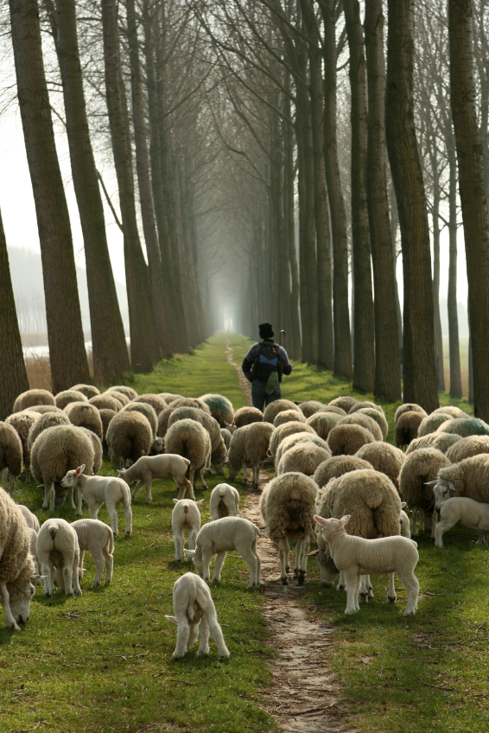
The Leader in Me
Accept whatever role God places before you.
Be faithful in the little tasks God puts in your path.

Slide 17
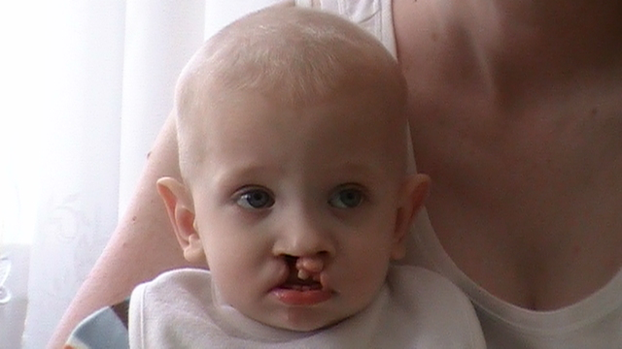
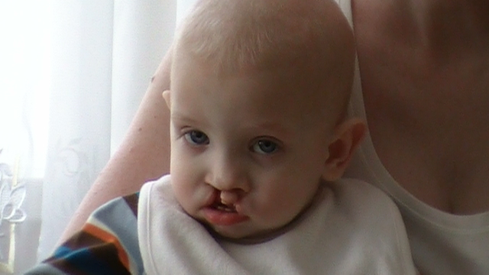
The Leader in Me
Accept whatever role God places before you.

Slide 18
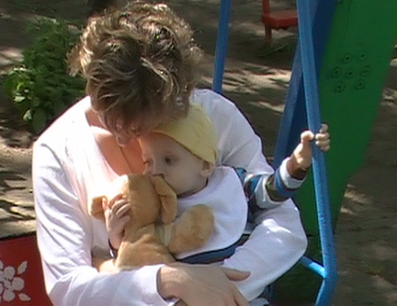
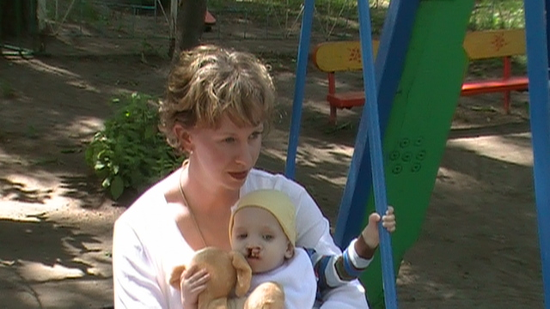
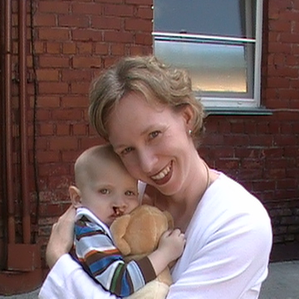
The Leader in Me
Accept whatever role God places before you.

Slide 19
The Leader in Me
Accept whatever role God places before you.

Slide 20
The Leader in Me
Accept whatever role God places before you.

Slide 21
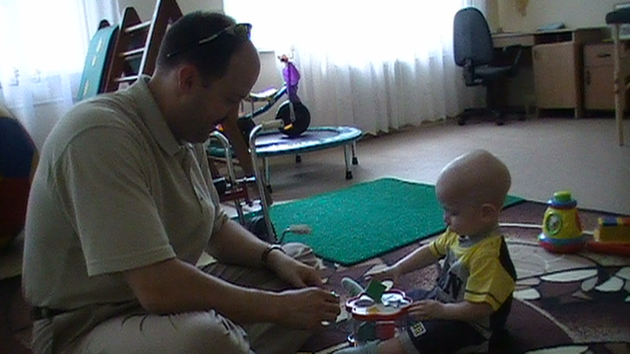
The Leader in Me
Accept whatever role God places before you.

Slide 22
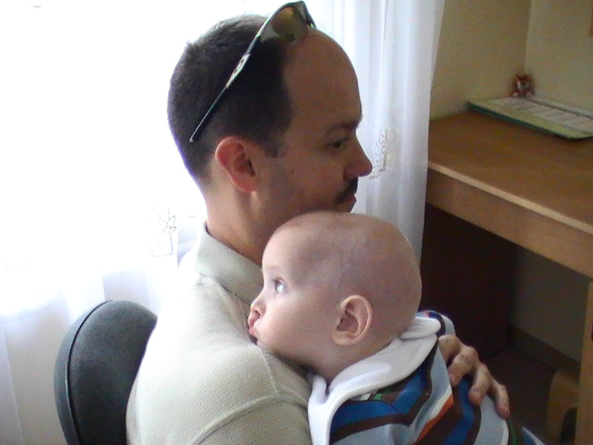
The Leader in Me
Accept whatever role God places before you.

Slide 23
The Leader in Me
Accept whatever role God places before you.

Slide 24
The Leader in Me
Accept whatever role God places before you.
Have courage to take on the big challenges.

Slide 25
The Leader in Me
Accept whatever role God places before you.
Let your life be about others, not about self.

Slide 26
The Leader in Me
Accept whatever role God places before you.
Be a leader to the glory of God!

