Slide 1
A more excellent way
And it is my prayer that your love may abound more and more, with knowledge and all discernment, so that you may approve what is excellent, and so be pure and blameless for the day of Christ, filled with the fruit of righteousness that comes through Jesus Christ, to the glory and praise of God.
Philippians 1:9-11

Slide 2
Series on Spirituality
Nov 6 – What Is Spirituality?
Nov 13 – Bible Study
Nov 20 – Prayer
Nov 27 – Evangelism

Slide 3
Spirituality
What is spirituality?

Slide 4
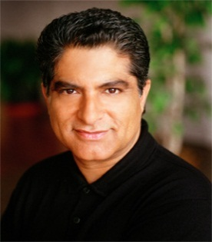
Failed attempts at spirituality
they exchanged the truth about God for a lie and worshiped and served the creature rather than the Creator…
Romans 1:25
God is our highest instinct to know ourselves.
How To Know God, Deepak Chopra
You don’t have to believe in God in order to experience God.
How To Know God, Deepak Chopra
God

Slide 5
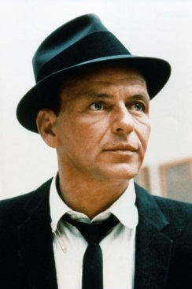
Failed attempts at spirituality
In those days there was no king in Israel. Everyone did what was right in his own eyes.
Judges 17:6
Rules
No Rules. Just Right.
I did it my way.
Frank Sinatra
Have it your way.

Slide 6
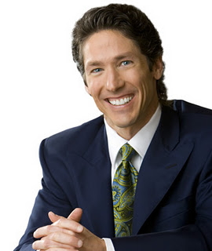
Failed attempts at spirituality
Their end is destruction, their god is their belly, and they glory in their shame, with minds set on earthly things.
Philippians 3:19
Do all you can to make your dreams come true.
Joel Osteen
God wants this to be the best time of your life.
Your Best Life Now, Joel Osteen
Obey

Slide 7
Libertines
Legalists
Self-worship
Romans 1
God
Self-worship
Matthew 6:1
iGod
Self-religion
Judges 17
Rules
Self-religion
Matthew 15:8-9
Self-gratification
Philippians 3:19
Obey
Self-gratification
Matthew 23:2-3

Slide 8
A more excellent way
And it is my prayer that your love may abound more and more, with knowledge and all discernment, so that you may approve what is excellent, and so be pure and blameless for the day of Christ, filled with the fruit of righteousness that comes through Jesus Christ, to the glory and praise of God.
Philippians 1:9-11
And it is my prayer that your love may abound more and more, with knowledge and all discernment, so that you may approve what is excellent, and so be pure and blameless for the day of Christ, filled with the fruit of righteousness that comes through Jesus Christ, to the glory and praise of God.
Philippians 1:9-11
And it is my prayer that your love may abound more and more, with knowledge and all discernment, so that you may approve what is excellent, and so be pure and blameless for the day of Christ, filled with the fruit of righteousness that comes through Jesus Christ, to the glory and praise of God.
Philippians 1:9-11
And it is my prayer that your love may abound more and more, with knowledge and all discernment, so that you may approve what is excellent, and so be pure and blameless for the day of Christ, filled with the fruit of righteousness that comes through Jesus Christ, to the glory and praise of God.
Philippians 1:9-11
God
Rules
Obey

Slide 9
What Is Spirituality?
A relationship with God,
rooted in knowledge,
evidenced by righteous fruit,
directed toward the day of Christ,
all to God’s glory.

Slide 10
What Is Spirituality?
Faith
Spiritual Vision
Hope
Spiritual Direction
Love
Spiritual Devotion

Slide 11
40 Day Challenge!
Do something new to ignite your spiritual life

Slide 12
Possible Goals
Read entire N.T.!
Focus on a few books
Listen to audio Bible
Listen to sermons
Join study group
Family devotionals
Attend Bible class
Come on Sun eve
Memorization
Meditation
Start a prayer list
Go through directory
Pray Phil 1:9-11 daily
Develop new routines
Find a partner
Evangelists overseas
Evangelists here
Top five prospects
Plan a fast
Wake up 30 min earlier

Slide 13
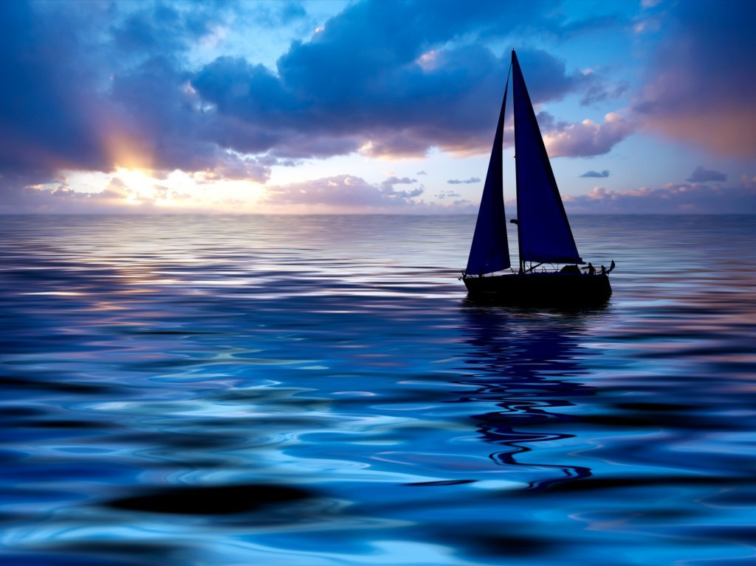
Disturb us, Lord, to dare more boldly,
To venture on wider seas
Where storms will show your mastery;
Where losing sight of land,
We shall find the stars.
We ask You to push back
The horizons of our hopes;
And to push into the future
In strength, courage, hope, and love.
--Sir Francis Drake (1540-1596)
Disturb us, Lord, when
With the abundance of things we possess
We have lost our thirst
For the waters of life;
Having fallen in love with life,
We have ceased to dream of eternity
And in our efforts to build a new earth,
We have allowed our vision
Of the new Heaven to dim.
Disturb us, Lord, when
We are too well pleased with ourselves,
When our dreams have come true
Because we have dreamed too little,
When we arrived safely
Because we sailed too close to the shore.

Slide 14
40 Day Challenge!
Do something new to ignite your spiritual life

