Slide 1
Spirituality

Slide 2
Libertines
Legalists
Self-worship
Romans 1
God
Self-worship
Matthew 6:1
iGod
Self-religion
Judges 17
Rules
Self-religion
Matthew 15:8-9
Self-gratification
Philippians 3:19
Obey
Self-gratification
Matthew 23:2-3

Slide 3
A more excellent way
And it is my prayer that your love may abound more and more, with knowledge and all discernment, so that you may approve what is excellent, and so be pure and blameless for the day of Christ, filled with the fruit of righteousness that comes through Jesus Christ, to the glory and praise of God.
Philippians 1:9-11
And it is my prayer that your love may abound more and more, with knowledge and all discernment, so that you may approve what is excellent, and so be pure and blameless for the day of Christ, filled with the fruit of righteousness that comes through Jesus Christ, to the glory and praise of God.
Philippians 1:9-11
And it is my prayer that your love may abound more and more, with knowledge and all discernment, so that you may approve what is excellent, and so be pure and blameless for the day of Christ, filled with the fruit of righteousness that comes through Jesus Christ, to the glory and praise of God.
Philippians 1:9-11
And it is my prayer that your love may abound more and more, with knowledge and all discernment, so that you may approve what is excellent, and so be pure and blameless for the day of Christ, filled with the fruit of righteousness that comes through Jesus Christ, to the glory and praise of God.
Philippians 1:9-11
God
Rules
Obey

Slide 4
What Is Spirituality?
A relationship with God,
rooted in knowledge,
evidenced by righteous fruit,
directed toward the day of Christ,
all to God’s glory.

Slide 5
What Is Spirituality?
Faith
Spiritual Vision
Hope
Spiritual Direction
Love
Spiritual Devotion

Slide 6
Spirituality
How Bible Study Promotes Spiritual Growth

Slide 9
All Scripture is breathed out by God and profitable for teaching, for reproof, for correction, and for training in righteousness, that the man of God may be competent, equipped for every good work.
2 Timothy 3:16-17

Slide 10
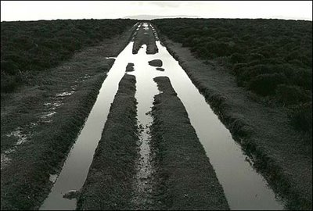
Do not be conformed to this world, but be transformed by the renewal of your mind, that by testing you may discern what is the will of God, what is good and acceptable and perfect.
Romans 12:2

Slide 11
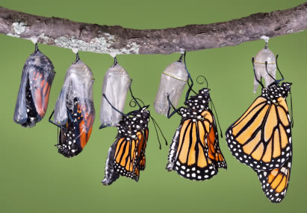
And we all, with unveiled face, beholding the glory of the Lord, are being transformed into the same image from one degree of glory to another.
2 Corinthians 3:18

Slide 12
Not that I have already obtained this or am already perfect, but I press on to make it my own, because Christ Jesus has made me his own.
Philippians 3:12

Slide 13
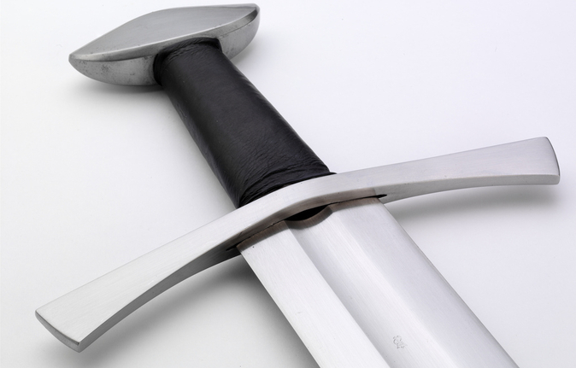
For the word of God is living and active, sharper than any two-edged sword, piercing to the division of joints and of marrow, and discerning the thoughts and intentions of the heart.
Hebrews 4:12

Slide 14
For God, who said, “Let light shine out of darkness,” has shone in our hearts to give the light of the knowledge of the glory of God in the face of Jesus Christ.
2 Corinthians 3:18

Slide 15
Where do I start?
Begin with Jesus
Matthew, Mark, Luke, John
Learn story of early church
Acts (read together with Luke)
Dive into the letters
Romans-3 John
Learn story of Israel
OT historical books (Gen, Ex, Num, Josh-Esther)

Slide 16
How can I succeed?
Read every day
Choose a time and a place
Attend Bible class
Share what you learn

