Slide 1
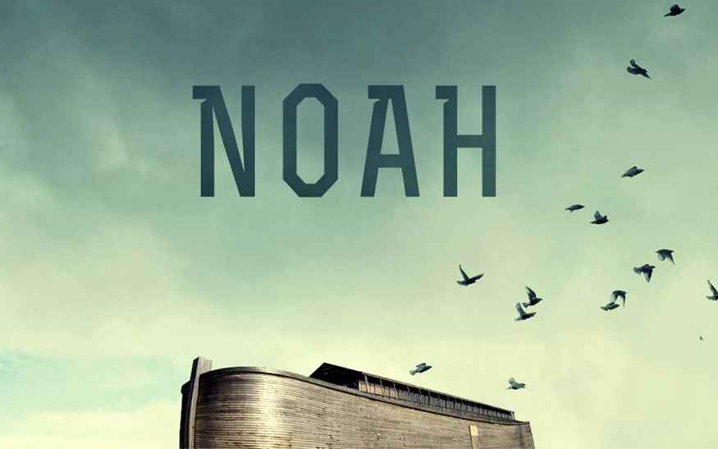
Noah
Notes:
THANK EVERYONE for the warm welcome & opportunity to work together. We’re excited about the work we can all engage in together.
Join me in Hebrews 11 to begin our study tonight…

Slide 2
Standing Out Like Noah
“By faith Noah, being warned by God about things not yet seen, in reverence prepared an ark for the salvation of his household, by which he condemned the world, and became an heir of the righteousness which is according to faith.” – Hebrews 11:7
Notes:
In Hebrews 11 – God highlights 4 qualities that made NOAH stand out from the violent and sinful world around Him. Certainly God wants us to imitate these, but there’s more to it than that. God calls our attention to the life of Noah, because Noah takes these 4 great virtues – and shows us what it looks like to EXCEL in each one.
So this morning, we are going to walk through Genesis beginning in chapter 6 and learn how we can stand out like Noah.

Slide 3
The Great Faith of Noah
“By faith Noah, being warned by God about things not yet seen…”
Noah Believed In God Before The Storm Came.
Noah Believed God Would Destroy The Wicked. (Romans 10:17)
Noah Believed & Preached Even When No One Was Converted. (2 Peter 2:5)
Noah Believed Even Though It Meant Separation From The World (2 Cor. 6:17, 1 John 2:15-17)
Notes:
6:1-18 > God reveals to Noah His plan…He is being warned of things not yet seen. So Noah chooses – with nothing more than the Word of God – to act with Faith.
OT Doesn’t tell us much about the construction of the Ark. Let’s think about that faith for a moment…
One thing that makes Noah’s faith special is that he Believed Before The Storm. Sometimes people wait until their life is in terrible shape before they call out to the Lord. But Noah doesn’t wait for the rain to begin falling – He chooses to TRUST God before the storm comes. Noah believes that this warning is a GRACIOUS message. – Noah’s faith was seen in his righteous living, despite being surrounded by evil. Noah didn’t let the “problem of evil” cause Him to doubt the GOODNESS of GOD.
DESTROY: Believe not just God’s grace to save, but in God’s holy justice to punish the wicked. To believe that FEW are going to be saved but that MANY are going to be lost. Do you really believe both the PROMISES of GOD and the PUNISHMENT”S OF GOD? We are never going to build like Noah, persevere like Noah, serve like Noah – unless you believe the punishment is as REAL as the REWARD. He knew that a day was coming when ALL of the wicked were going to face God’s judgment. We need to be motivated by this, too!
PREACHED: The NT calls Noah a “preacher” of righteousness. How would you feel if you were Noah – and the entire time you are building this ark – not one person repents. Are we like Noah so devoted to the message of God that even if no one else believes – OUR FAMILY will be saved?
SEPERATED: **I love the call to come out and be Separate. Be like Noah – go ahead and stand out. You may get left out, or not particiapte in eveything your peer are – but that’s ok! We don’t want the same FATE as those who are OF the world. We need a FAITH that is bigger.
Can I ask you to contrast the family of Noah with the family of LOT! Lot’s son-in-law’s laugh at him. Lot’s wife looks back with a heart turning back to the world. Does God look at our families and see spouses and children like Noah’s who are ready to leave this world behind?

Slide 4
The Great Reverence of Noah
“By faith Noah…in reverence …”
Noah’s Fear of God Was Not:
A Fear of Terror, Because Noah Knew God Would Show Grace.
A Fear of Recklessness, Because Noah Knew He Was Responsible To Serve God.
A Fear of Despair, Because Noah Knew As Long As He Lived, It Was Not Too Late.
Noah’s Fear Was Of Loyal Reverence.
Notes:
Noah doesn’t just respond with FAITH…and build the ark all wrong with his own dimensions or his own design. No. Noah responds to God with the HIGHEST respect.
Back to vs. 8 – Noah knows that he is not perfect. We read after the flood and see Noah in his sin – far from perfect. But He knows the grace is there.
RECKNLESS – Noah doesn’t look ahead and say – I’ll never be good enough, so I might as well live it up now. No – Noah will respond to Him as the LORD of LORDS
DESPAIR – Noah doesn’t look at the task ahead and quit because it’s too hard. He doesn’t say “there’s not enough” time. He looks at the opportunity to be saved and PRAISES God for the opportunity. Spurgeon says this about Noah: He sees… A Holy Awe of God who “would bring a solemn dread of the judgments which sin was drawing down upon the giddy world.” – Spurgeon.
Noah knows he is accountable. He is not swept away in distractions – and ultimately not in the flood. When we see God in this reverence – We will OBEY…

Slide 5
The Great Obedience of Noah
“By faith Noah…prepared an ark …”
Noah Obeyed All That God Commanded
Genesis 6:22, 7:5
Noah Obeyed at Great Personal Cost.
Noah Obeyed Over Great Lengths of Time.
Noah Obeyed In Spite of The Pressure Around Him. (2 Peter 3:3,6)
Noah Led His Family In Faithful Obedience.
Notes:
Careful Preparation, Not Rushed Activity. The bible goes out of its way to tell us twice that Noah didn’t do just “part” of what God requested – noah did it all.
** This is as good a place as any for us to remember that the LANGUAGE of Genesis 6,7, and 8 does NOT describe a “localized” flood. Noah is building and preparing for a WORLD-WIDE FLOOD. If this is only a regional flood in the Mediteranean area, then you don’t need to save all of the animals. Localized flooding doesn’t cause you to be in the Ark for months and months and months.
Noah has to prepare for a world-wide disaster and that was not an easy TASK! Day by day, board by board, covering the Ark with Pitch – this is a HUGE project to take on…And to not give up. But to keep working until the job is done, and done well.
Great Personal Cost – Noah’s is a living faith – active and obedient. Think of all the cost – in materials, in time, in energy and effort, there is SUCH huge investment in this tremendous project!
PRESSURE…vs. 3 begins as an initial warning to us…but notice in verse 5 and verse 6 that there is reference to the days of Noah…why? Because that was a time when people thought God would delay and the punishment Noah had preached about wouldn’t happen. We need to see that LITERALLY – everyone one else in the world by their choices and by their criticism – chip away at Noah’s faith…Yet He Holds ON to GOD.
FAMILY in FAITHFUL Obedience: **We need to believe that JESUS IS COMING BACK in a way the world has never seen – and that we MUST be prepared for. It calls for OBEDIENCE TODAY.

Slide 6
The Great Salvation of Noah
“…for the salvation of his household…”
Bringing Salvation To Our Household.
Hold On. Do Not Doubt. Your Family Can See Your Faith. Don’t Get Distracted! (Matt. 24:38)
Enter The Ark of Safety. (Genesis 7:1, 6-7)
Noah Is Saved…
By God’s Grace… Genesis 6:8
Through Faith… Hebrews 11:7
That Was Active & Obedient… Genesis 6:22
When God Saved With Water… 1 Peter 3:20-21
Notes:
FINAL point this morning…
I’ll be the first to acknowledge…Every family has some members who aren’t faithful…a son or a daughter…a mother or father….an aunt, uncle, cousin… I want to tell you today – DON’T GIVE UP. You don’t know yet, how your consistent example and dedication to the WORD OF GOD is going to impact them.
Matthew 24:38 – there were some who carried on in daily life – planning for their future when in reality they HAD NO Future.
But when GOD determines the right time: Noah’s family enters the ark.
Noah didn’t change the design of the ark to make it easier to build or more accomodating for his family. He helped raise His family up to the high calling of God.
Let them see that you are faithful in your worship habits.
Let them see that you study your bible beginning to end.
Let them see a family that abstains from every form of evil,
See a family that flees from lust, that rejects profanity.
Be a family that builds for the Lord!
Distracted – Calls for Perseverance. Keep on doing the right thing, day in and day out. It is NOT IN VAIN!

Slide 7
Noah
Notes:
BE SAVED!

