Slide 1
Why I Believe
Notes:
Natural vs. Super-Natural….
Because The Options Are So Extreme:: A little like listening to a Murder Trial with 2 suspects – does the evidence point toward suspect A or suspect B. There may be a lot of evidence to consider but if one of the suspects can be PROVEN to be in another country at the time of the murder, then the choice between the two gets a little more obvious.
Naturalist: Everything Is A Result of Chance
SuperNatural: Everything Is A Result of Creation.
OPTIONS ARE SO EXTREME: We Are Not Dealing With A CLOSE CALL! We Are Dealing With A Fundamental Belief – Is Everything Around Us An Accident – or is there a Supernatural Element!! Not Because I’ve Examined ALL of the Evidence (No One Has!) But I’ve examined enough to come to a very compelling conclusion. The two sides could not be further apart!!!
I admit there is more for me to learn, but the scale is dramatically tipped toward GOD!
…

Slide 2
1. God, The Designer of Everything
Hebrews 3:4
The Complexity & Diversity of Life (Job 9:10)
A human body is composed of over 30 different kinds of cells (red blood cells, white blood cells, nerve cells, etc.), totaling approximately 100 trillion cells in an average adult (Beck, 1971, p. 189).
“the information content of a simple cell has been estimated as around 1 trillion bits.”
The Balance of Life
Notes:
Job 9:5a (It is God) 10 “innumerable…”
The Cell
“It is God…who does great things, unfathomable, And wondrous works without number.” Job 9:5a,10
A human body is composed of over 30 different kinds of cells (red blood cells, white blood cells, nerve cells, etc.), totaling approximately 100 trillion cells in an average adult (Beck, 1971, p. 189).
In an article written for Encyclopedia Britannica, Carl Sagan observed that “the information content of a simple cell has been estimated as around 1 trillion bits. To emphasize to the reader the enormity of this figure, Dr. Sagan then noted that if one were to count every letter in every word of every book in the world’s largest library (over ten million volumes), the final tally would be approximately a trillion letters. Thus, a single cell contains the equivalent information content of every book in the world’s largest library of more than ten million volumes! Every rational person recognizes that not one of the books in such a library “just happened.” Rather, each and every one is the result of intelligence and painstaking design.
*** Context: It would take 7,812 iPhones to hold that much data (assuming a normal 16 Gig iPhone) even if you bumped to a 64 Gig iPhone you would still need almost 2,000 iphones just to store the data in ONE simple CELL!

Slide 3
2. The Evidence For The Bible
Fulfilled Prophecy
Isaiah 44:28, 45:1-7, Ezra 1:1-4 (150 Years before)
Psalm 22:16-18 (400 Yrs before Crucifixion Invented)
Manuscript Evidence
5,686 Greek Manuscripts
+ 19,284 In Other Languages!
Homer’s, The Illiad, Has Only 643
36,289 New Testament Quotations By ‘Church Fathers’
Notes:
Prophecy: There is a cohesive message – a theme about the redemption of man and glory of God that is communicated clearly and powerfully.
150 years before Cyrus was even BORN!
PROPHECY: From the location of his birth, to the means of his death, to the price of his betrayal for 30 pieces of silver…the life of Jesus is full of fullfilled prophecy.

Slide 4
2. The Evidence For The Bible
The John Rylands Fragment (117-138 A.D.)
John 18:31-33, 37-38
Notes:
Prophecy: There is a cohesive message – a theme about the redemption of man and glory of God that is communicated clearly and powerfully.
150 years before Cyrus was even BORN!
PROPHECY: From the location of his birth, to the means of his death, to the price of his betrayal for 30 pieces of silver…the life of Jesus is full of fullfilled prophecy.

Slide 5
2. The Evidence For The Bible
“In real terms, the New Testament is easily the best attested ancient writing in terms of the sheer number of documents, the time span between the events and the document, and the variety of documents available to sustain or contradict it. There is nothing in ancient manuscript evidence to match such textual availability and integrity.”
Ravi Zacharias
Notes:
Prophecy: There is a cohesive message – a theme about the redemption of man and glory of God that is communicated clearly and powerfully.

Slide 6
3. The Miracles of Jesus
His Undeniable Power
Matthew 9:32-35
His Resurrection
Absolutely Dead. (John 19:31-34)
Absolutely In The Tomb. (Matthew 27:62-66)
Absolutely Raised. (1 Corinthians 15:6)
Notes:
He Was Absolutely Dead. Verified by the Soldiers.
He Was Absolutely In The Tomb. Sealed & Guarded by his Enemies.
Some have suggested that Christ faked His death and later escaped from the tomb. This is patently absurd. According to the eyewitness testimony, Christ was beaten, tortured, lacerated, and stabbed. He suffered internal damage, massive blood loss, asphyxiation, and a spear through His heart. There is no good reason to believe that Jesus Christ (or any other man for that matter) could survive such an ordeal, fake His death, sit in a tomb for three days and nights without medical attention, food or water, remove the massive stone which sealed His tomb, escape undetected (without leaving behind a trail of blood), convince hundreds of eyewitnesses that He was resurrected from the death and in good health, and then disappear without a trace. Such a notion is ridiculous. Read more: http://www.gotquestions.org/why-believe-resurrection.html#ixzz3eeBEMAqo
He Was Absolutely Raised. There was No Body. He was seen by multiple witnesses at the same time (not a hallucination.)
Sincere Testimony - they would not deny what they had seen no matter the pain or threat.
Hostile Critics Accepted It - paul’s conversion.
Multiple Witnesses: 1 Cor 15:6 - 500 people all saw him at the same time!

Slide 7
4. Answers To The Problem of Evil
God Endures Short-Term Evil To Bring About Long-Term Good.
2 Peter 3:9
God Urges Us To Make The Free Will Choices That Would Prevent Much Of The World’s Suffering.
Matthew 22:39
God Explains The Attacks of Satan & Even Protects Us & Ultimately Saves Us.
Ephesians 6:11
Notes:
WE ADMIT – There are horrible atrocities in the world. Crimes, Pain, and Disease that are heartbreaking. “If someone things he can wrap everything up in a neat little package and put a fancy theological bow on it go somewhere else.”
I don’t want to minimize these – but as we try to process the horrible things that happen in the world – The Bible gives us reasonable answers to both understand and fight against the EVIL in the world.
1. TEST: The most horrible thing – the death of Jesus. No one saw how good could come from this tragedy at the time it happened. No one except God. The worst tragedy in history actually brought about the most glorious event in history.
If it happened with Jesus – if the ultimate evil can result in the ultimate good – then it can happen everywhere else, even in our own lives. With Jesus – God shows us the power up his sleeve, everywhere else he simply says “remember and trust me.”
JESUS came and endured this awful world and suffered some of the worst it had to offer – and in doing so – He promises to stand with us in the tears and hurt and love us and give us hope that no pain can take away.

Slide 8
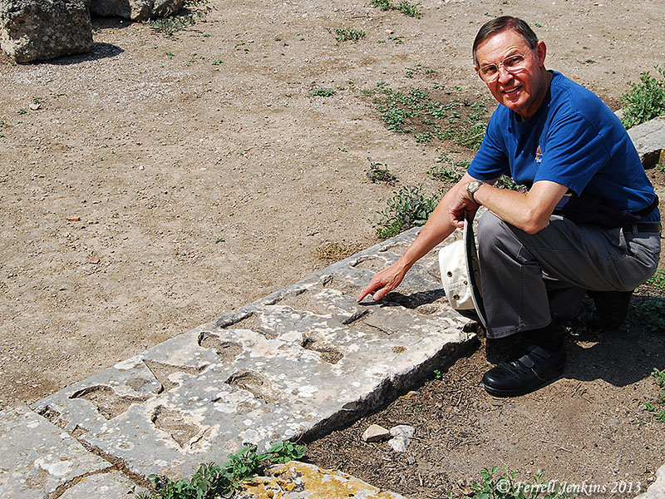
5. Archeological Discoveries
Excavations of Corinth, 1929 “Erastus, curator of public buildings, laid this pavement at his own expense” (Romans 16:23)
Notes:
I love the archeology! The Dead Sea Scrolls, the Pottery, the records of the Hittites, - all of the the physical, tangible items that reinforce the facts found in the Bible. Share just 3 with you…
The PRECISE detail….
The Locations and People….

Slide 9
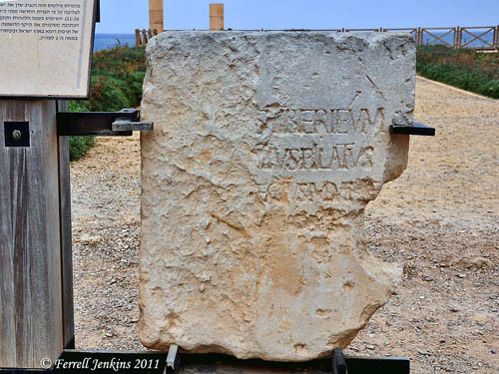
5. Archeological Discoveries
The Pilate Inscription, 1961
“Pontius Pilate, Prefect of Judea” (Mt. 27:2)
Notes:
Pilate Inscription… Not only is he named on this inscription, but he is mentioned by Josephus and other historical writers. This man lived and reliable records exists from his lifetime – just like they do for JESUS.

Slide 10
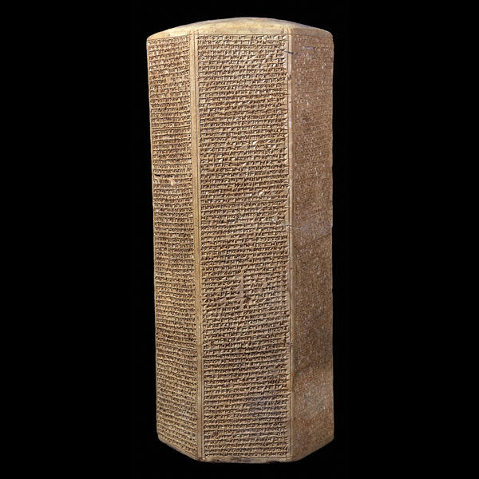
Prism of Sennacherib
"As to Hezekiah, the Jew, he did not submit to my yoke, I laid siege to 46 of his strong cities, walled forts and to the countless small villages in their vicinity, and conquered [them] by means of well stamped [earth-]ramps and battering-rams brought [thus] near [to the walls] [combined with] the attack by foot soldiers, [using] mines, breeches as well as sapper work.
Notes:
Even in Sennacherib’s boasting, he must admit that he was unable to fully conquer God’s people while Hezekiah was reigning. He mentions his invading of several cities, but returns to Assyria unable to fully complete his plan.

Slide 11
Prism of Sennacherib
“… I drove out [of them] 200,150 people, young and old, male and female, horses, mules, donkeys, camels, big and small cattle beyond counting, and considered [them] booty. Himself I made a prisoner in Jerusalem, his royal residence, like a bird in a cage."
Notes:
Even in Sennacherib’s boasting, he must admit that he was unable to fully conquer God’s people while Hezekiah was reigning. He mentions his invading of several cities, but returns to Assyria unable to fully complete his plan.

Slide 12
6. The Precise & Binding Study of Scripture
Jesus & His Apostles Used Scripture…
Focused On Even The Individual Words
Matthew 22:32-33
Fully Believing In The Source & Promises
Matthew 22:41-46
Giving Us An Example & Pattern To Follow
Philippians 3:17-20
Notes:
Why I believe…I don’t just believe the Bible is true – I believe the Bible is to be followed – with our GREATEST effort, Greatest Diligence, and even in Great Detail.
Why would I believe something that crazy?? Because Jesus and His apostles taught with authority.

Slide 13
7. The Torment of Hell Is Too Horrible To Dismiss.
“Then He will also say to those on His left, ‘Depart from Me, accursed ones, into the eternal fire which has been prepared for the devil and his angels” (Matthew 25:41)
“If your eye causes you to stumble, throw it out; it is better for you to enter the kingdom of God with one eye, than, having two eyes, to be cast into hell, where their worm does not die, and the fire is not quenched.” (Mark 9:47-48)
Notes:
If you believe in Jesus, you have to believe in Hell.

Slide 14
Why I Believe

