Slide 1
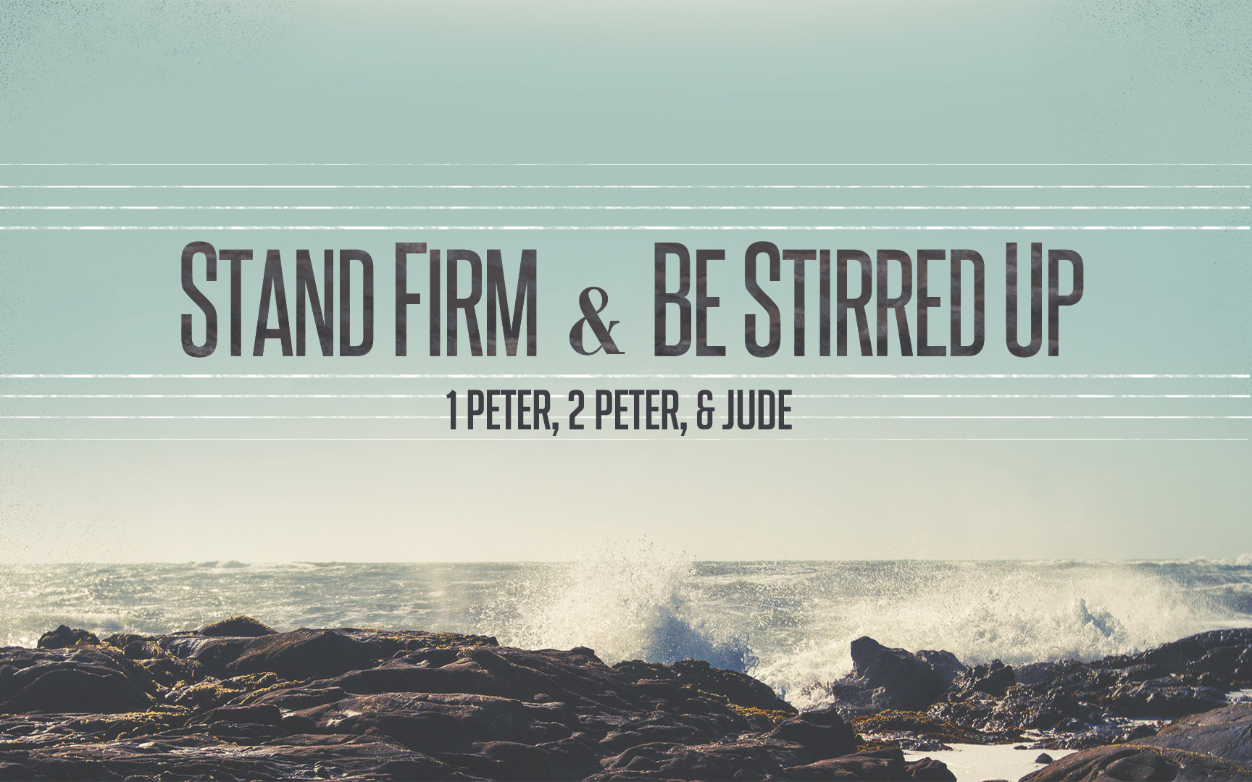
Stand Firm & Be Stirred Up
Notes:
Phillip: Be patient and get great comments out of the class. It is better NOT to finish than to rush through…

Slide 2
Warm Up Question
What events from the life of Peter the Apostle give you hope in your walk with Jesus?
Notes:
Peter knows something about Hope!
Hoping in Jesus when sinking in the sea of Galilee.
Hoping in Jesus when swimming to the land in John 21 – so excited and eager to see Jesus he can’t wait on the boat.
Hoping in Jesus that after all his mistakes (from rebuking Jesus, to cutting off Malchus ear, to denying Him, even to being called out by Paul) He was still LOVED and Accepted by the Lord.
And Peter knew something about HOLINESS TO! To see the Holy and Sinless Son of God – day in and day out. To hear the revolutionary teachings of the New Covenant given to the humble and ordinary.

Slide 3
1 Peter: Standing Firm
“Through Silvanus, our faithful brother (for so I regard him), I have written to you briefly, exhorting and testifying that this is the true grace of God. Stand firm in it!” 1 Peter 5:12 (NASB)
“…grace of God in which you stand.” (NKJV)
“…Stand fast in it.” (NET) Ft 28: “in which stand fast.” For emphasis, and due to constraints of contemporary English, this was made a separate sentence in the translation.
Notes:
This book is a message of God’s grace…as we study notice all the times our salvation and the sacrifice of Christ is continually mentioned… But also notice that in giving this message of grace the OBVIOUS response to that grace – is once you’ve received it – hold onto it. Don’t give up, Don’t give in no matter the difficulty doing what is right brings.

Slide 4
Stand Firm In Hope & Holiness
1:13 “fix your hope completely…”
1:15 “like the Holy One…be holy…FOR I AM…”
1:21 “so that your faith and hope are in God.”
2:1 “Therefore, putting aside all…grow in…”
2:5 “a spiritual house for a holy priesthood…”
2:9 “a royal priesthood, a holy nation…”
Notes:
Today’s Class – everyone will have their favorite verse or favorite sub-point. But the big idea we ALL need to come away with is that Peter wants Christians to STAND FIRM in their hope and in their HOLINESS.
Because of Jesus our mindset and our conduct CAN NEVER be the same again.

Slide 5
Stand Firm In Hope & Holiness
Our Hope Is In The Return of Jesus. (1:13)
Our Holiness Begins With Our Father. (1:14-18)
Our Holiness Respects The Price of Our Redemption. (1:19-21)
Our Holiness Is Seen In “Fervent Love.” (1:22)
Our Hope & Holiness Stands Firm In The Enduring Words of God. (1:23-25)
Notes:
RETURN OF JESUS: Question #2. Also, Application Question #1 – When is it the hardest to stand firm in Holiness? (When we lose focus!)
FATHER: Question #3.
PRICE: Jesus redeemed us – how could we go back into spiritual debt after the Price that has been paid to set us free!
FERVENT LOVE: Question #5: Saul is a great example. (1 Samuel 18:6-9)
Malice – ill-will, desire to injure.
Guile/Deceit: crafty deceit, two-faced
Hypocrisy: Insincere Answers, to act
Envy: desiring what belongs to another
Slander: making false, damaging statements about others.
Discussion Question #1

Slide 6
We Are A Holy People
A Holy People: Growing In Kindness. (2:1-3)
A Holy People: Like Living Stones. (2:4-8)
A Holy People: Given Mercy From Our King (1:12)
A Chosen Race (2:9, Isaiah 43:10,20, 44:1-2)
A Royal Priesthood (2:9, Isaiah 61:6)
A Holy Nation (2:9, Deuteronomy 28:9ff)
A People of God’s Own Possession (2:9, Isaiah 43:21)
The People of God (2:10, Hosea 1:10, 2:23)
You Have Received Mercy. (2:10)
Notes:
Vs 4-8: Application Question #3
Discussion Question #2.

Slide 7
Reaching Our Goals
Develop a reputation for good works among those who are most critical of our faith.
Promote greater “Harmony” in our home (and congregation) by learning our part well.
Build a deeper relationship with the shepherds.
Deepen our appreciation for the suffering of Christ and what it means to share in that suffering.
Invest in the things that last the longest.
Notes:
Yes, these are ambitious, but they certainly aren’t any more challenging than what Peter has asked of his original audience. In fact hopefully they are in alignment with exactly what Peter was asking of his audience.
#1. Our reputation for good works is going to grow when we are loving, when we don’t participate in office slander, when we aren’t in a church full of division or hypocrisy or slander. Our reputation is going to grow when we respond to the attacks of our critics with HOLINESS – and with a hope that is anchored outside of this life.
#2. Our Harmony as a church family is going to increase. We are living stones – all resting on CHRIST.
#3. Deeper relationship with Shepherds. Imagine how hard it would have been to be a shepherd and watch your sheep continually suffering and persecuted. A big part of that deeper relationship is in the humility and subjection we demonstrate.
#4. I’m really excited about studying this and discussing it together. We don’t take the suffering of Jesus to heart and not come away changed. And Peter puts a spotlight on the suffering of Christ as a powerful fact that encourages us when we need it the most.
#5. Chapter 1:24-25 are key verses for this concept. GOD’s WORD is timeless. It lasts. We can become masters of trivial information: daily news, personal hobbies…but what we really need to master is God’s ENDURING word. We will also see that big time in 2 Peter.

Slide 8
Stand Firm & Be Stirred Up

Slide 9
Class Lesson Schedule
Lesson | Title/Material | Teacher | Day | Date
1 | Introduction to I Peter | Russ | Sunday | May 29, 2016
2 | Stand Firm in Salvation (I Peter 1:1-12) | Russ | Wednesday | June 1, 2016
3 | Stand Firm in Hope & Holiness (I Peter 1:13-2:10) | Phillip | Sunday | June 5, 2016
 | VBS – Special Class |  | Wednesday | June 8, 2016
4 | Stand Firm in Community and Family (I Peter 2:11-3:12) | Phillip | Sunday | June 12, 2016
5 | Stand Firm in Zeal during Suffering (I Peter 3:13-4:19) | Phillip | Wednesday | June 15, 2016
6 | Stand Firm with the Chief Shepherd (I Peter 5:1-13) | Phillip | Sunday | June 19, 2016
7 | Introduction to II Peter | Russ | Wednesday | June 22, 2016
8 | Stirring Up our Spiritual Growth (II Peter 1:1-21) | Phillip | Sunday | June 26, 2016
9 | Stirring Up Pure Doctrine and Pure Living (II Peter 2:1-22) | Phillip | Wednesday | June 29, 2016
10 | Contending for the Faith (Jude) | Phillip | Sunday | July 3, 2016
11 | Stirring Up our Insight (II Peter 3:1-18) | Phillip | Wednesday | July 6, 2016
12 | Grounded & Growing in Difficult Times | Phillip | Sunday | July 10, 2016
13 | Review | Phillip | Wednesday | July 13, 2016

Slide 10
Stand Firm In Hope & Holiness
1:13 “fix your hope completely…”
1:15 “like the Holy One…be holy…FOR I AM…”
1:21 “so that your faith and hope are in God.”
2:1 “Therefore, putting aside all…grow in…”
2:5 “a spiritual house for a holy priesthood…”
2:9 “a royal priesthood, a holy nation…”
Notes:
Today’s Class – everyone will have their favorite verse or favorite sub-point. But the big idea we ALL need to come away with is that Peter wants Christians to STAND FIRM in their hope and in their HOLINESS.
Because of Jesus our mindset and our conduct CAN NEVER be the same again.

Slide 11
Stand Firm & Be Stirred Up

Slide 12
Major Points I Want To Cover
Vs. 13 “hope completely”
Vs. 16 OT reference
Vs. 18 “futile way”
Vs. 19 OUR LAMB! ☺
Vs. 22 “fervent love”
Vs. 23-25 **Class Goal: Things that last the longest.

Slide 13
Major Points I Want To Cover
2:2 Pure Milk (so many metaphors)
2:6 OT Reference
2:9-10 OT Reference

Slide 14
Dark Background Option
Dark Background Option

