Slide 1
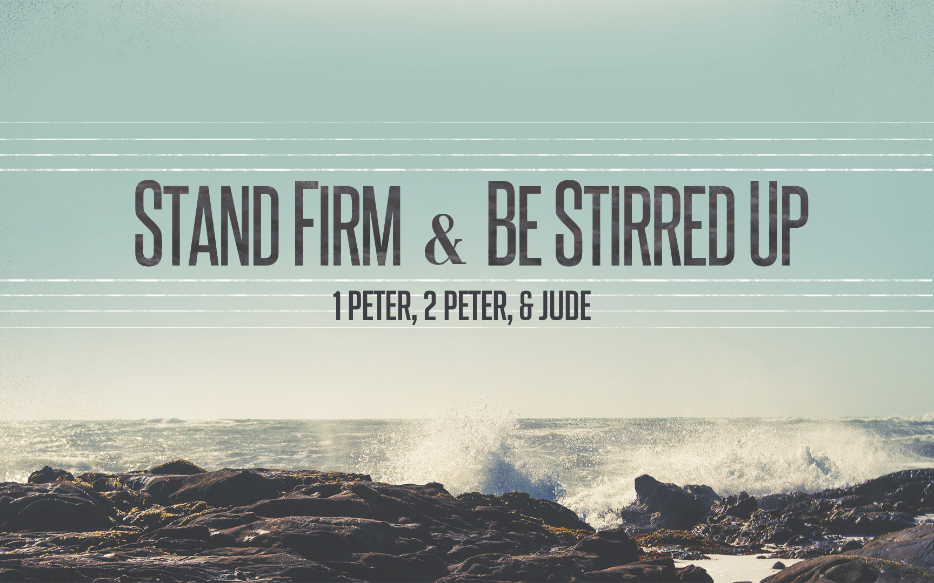
Stand Firm & Be Stirred Up
Notes:
Happy to be in class with you today… Warm up…
Phillip: Be patient and get great comments out of the class. It is better NOT to finish than to rush through…

Slide 2
Warm Up Question
What great qualities do you admire in a co-worker?
Notes:
Teamwork.
Dependable.
Helpful.
Patient.
Good Communication.
Hard Working.

Slide 3
Stand Firm In Hope & Holiness
1:13 “fix your hope completely…”
1:15 “like the Holy One…be holy…FOR I AM…”
1:21 “so that your faith and hope are in God.”
2:1 “Therefore, putting aside all…grow in…”
2:5 “a spiritual house for a holy priesthood…”
2:9 “a royal priesthood, a holy nation…”
Notes:
Today’s Class – everyone will have their favorite verse or favorite sub-point. But the big idea we ALL need to come away with is that Peter wants Christians to STAND FIRM in their hope and in their HOLINESS.
Because of Jesus our mindset and our conduct CAN NEVER be the same again.

Slide 4
Stand Firm In Community & Family
Review: Our Identity In Christ. (1:9-10)
As God’s People, We Are Now Under Attack In A Spiritual War with Fleshly Lusts. (11)
Christians Will Be Slandered
For Our Belief In The Return of Jesus
For Our Loyalty To God
Notes:
We Are Aliens & Strangers.
We Are In A War.
We Are Going To Battle Fleshly Lusts. (It’s part of being a Christian.)
>> Our War Also Has An External Component. Those who reject Christ and want to stop the spread of the gospel – will be looking for ways to criticize Christians. They are looking for our weaknesses to use them to turn public opinion against us.
DAY of Visitation: **Point: If reference to Jesus return such as… (Luke 19:44…1 Peter 1:13, 1 Peter 4:7)… They when the Lord returns they might glorify God that they were won over from enemy to disciple by what they observed in the lives of Christians.
WHEN? Destruction of Jerusalem? (Isaiah 10:3) But word also carries idea of examination (such as by an overseer). Thus, it might refer to the day you are put on trial. Dragged into courts. (Acts 4:21) May refer simply to the day of persecution. “You’re not going to escape their notice forever. Your day is going to come… When it does be ready”
What Good Works could they Mock and Later Honor? Christian Generosity. Christian Submission. Christian Work Ethic. *most likely – where Christians were accussed of being disruptive citizens, they could show how being a Christian actually made them an ideal citizen.
TRANSITION: …. They May Call Us Crazy, But Let Them See We Are A Crazy People Who…

Slide 5
Stand Firm In Community…
Let Them Observe Our Political Submission.
1 Peter 2:13-15
Let Them Observe Our Freedom To Serve All.
1 Peter 2:16-17
Let Them Observe Our Workplace Attitude.
1 Peter 2:18-20

Slide 6
When Suffering In Our Community
Christians Do Not Respond To Sin with Sin.
Christians Do Not Resort To Speaking with Deceit, Insults, or Threats. (Not Even Online.)
Christians Entrust Their Lives To The Father.
Christians Live For Righteousness.
Christians Follow The Chief Shepherd.
Notes:
Standing FIRM means taking some options OFF the table.
The world says: You hurt me – now I’ll hurt you. Jesus show us: You hurt me – I’ll turn the other cheek.
ACTS 5:40-41….
Guys this is so huge. We need to see the connection between our suffering and Christ suffering – Thankful that anyone could see even a glimpse of Jesus in us.
Think of the times you’ve been called a Bible thumper…or some such name. Think of the times others have criticized you for being honest or for doing things the right way. As Christians we have NO regret about those insults because we know the people hurling them at us: They just don’t get it.
Our Appreciation for Earthly Shepherds will never be higher than our appreication for our Heavenly Shepherd. Peter wants us to remember that He’s been here and done all of this. PRAISE GOD: I have a Heavenly Shepherd, loving me, guiding me, etc…

Slide 7
Stand Firm In Our Families
Wives Whose Behavior Speaks Volumes.
1 Peter 3:1-2 (Continuation of 2:12)
Wives Whose Beauty Is Inside Out.
1 Peter 3:3-4
Wives Who Think About Sarah.
1 Peter 3:5-6
Wives Whose Security Is In GOD.
Notes:
Those people believe some strange things…but wow, they have great families.
SARAH’s SECURITY WAS IN GOD. (Psalm 18:2)

Slide 8
Stand Firm In Our Families
Husbands Committed To What Is RIGHT.
Husbands “Live With” aka Show In Your Actions.
An Understanding Approach To Her Insights.
An Appreciation For Her As A Fine Vessel.
Husbands Honoring Their Wives.
An Everyday Treasure.
Notes:
**Understanding Approach: If you haven’t seen the viral video – it’s not about the nail – you really need to see it!
HONOR: To assign Value, Worth, or WEIGHT. Rather than treat as common or ordinary. Back to vs. 17. Honor in the Community. Honor at Home.
“Everywhere God wants me to show Honor – I will show it – because even when others are not worthy – GOD IS.”
An everyday Treasure….This summer people will go all over the world to see and to take pictures of things – that other people see every day.
>>You go to Paris to see the Effile tower – but other people see it everyday…so often they forget about it and ignore it.
>>You go to FL to see the beach or to see Mickey Mouse…but other people see it everyday – sometimes they even wish they could get away from the sand in their toes.
The more familiar something is, the more we tend to take it for granted, and even begin to let the negative qualities dominate our thinking. Husbands are reminded to SLOW DOWN and stop and realize how WILDLY LUCKY they are to have a Godly wife in their life. YOU HAVE A TREASURE. Having her everyday should make you more thankful – not less!

Slide 9
Family Harmony
Giving A Blessing To Others
1 Peter 2:8-12
Bringing Harmony To Our Relationships
Learn My Role Really Well.
Let Our Roles Compliment Instead of Compete.
Sympathy, Kindness, Humility, Peacemakers…

Slide 10
Moving Closer To Our Goals
Develop a reputation for good works among those who are most critical of our faith. (CITIZENS, WORKERS, FAMILY MEM)
Promote greater “Harmony” in our home and congregation by learning our part well. (ACTIONS IN OUR ROLES)
Build a deeper relationship with the shepherds. (JESUS 1st)
Deepen our appreciation for the suffering of Christ and what it means to share in that suffering. (IMITATING HIM)
Invest in the things that last the longest. (HEART OF SUBM.)
Notes:
Jesus First – We will never love them more than we love him. We need to FIRST appreciate HE IS OUR SHEPHERD!
More Like You…… Any way that we become more like Jesus is a cause for rejoicing. If people see HIS LOVE and HIS ACTIONS IN US, we can rejoice in that.
Suffering…..Don’t get upset and worked up over injustice in the political system or on the job. Get upset that there are people who are going to Hell and we need to help them!
Invest….. God is giving us plenty of ways to practice submission face to face – and that helps us develop the heart we ultimately need to be in submission to HIM who we can’t see. God is giving us practice to show HONOR to others – so that we are well exercised to show HONOR TO HIM.)

Slide 11
Stand Firm & Be Stirred Up

Slide 12
Class Lesson Schedule
Lesson | Title/Material | Teacher | Day | Date
1 | Introduction to I Peter | Russ | Sunday | May 29, 2016
2 | Stand Firm in Salvation (I Peter 1:1-12) | Russ | Wednesday | June 1, 2016
3 | Stand Firm in Hope & Holiness (I Peter 1:13-2:10) | Phillip | Sunday | June 5, 2016
 | VBS – Special Class |  | Wednesday | June 8, 2016
4 | Stand Firm in Community and Family (I Peter 2:11-3:12) | Phillip | Sunday | June 12, 2016
5 | Stand Firm in Zeal during Suffering (I Peter 3:13-4:19) | Phillip | Wednesday | June 15, 2016
6 | Stand Firm with the Chief Shepherd (I Peter 5:1-13) | Phillip | Sunday | June 19, 2016
7 | Introduction to II Peter | Russ | Wednesday | June 22, 2016
8 | Stirring Up our Spiritual Growth (II Peter 1:1-21) | Phillip | Sunday | June 26, 2016
9 | Stirring Up Pure Doctrine and Pure Living (II Peter 2:1-22) | Phillip | Wednesday | June 29, 2016
10 | Contending for the Faith (Jude) | Phillip | Sunday | July 3, 2016
11 | Stirring Up our Insight (II Peter 3:1-18) | Phillip | Wednesday | July 6, 2016
12 | Grounded & Growing in Difficult Times | Phillip | Sunday | July 10, 2016
13 | Review | Phillip | Wednesday | July 13, 2016

Slide 13
Stand Firm & Be Stirred Up

Slide 14
Major Points I Want To Cover
Vs. 13 “hope completely”
Vs. 16 OT reference
Vs. 18 “futile way”
Vs. 19 OUR LAMB! ☺
Vs. 22 “fervent love”
Vs. 23-25 **Class Goal: Things that last the longest.

Slide 15
Major Points I Want To Cover
2:2 Pure Milk (so many metaphors)
2:6 OT Reference
2:9-10 OT Reference

Slide 16
Dark Background Option
Dark Background Option

