Slide 1
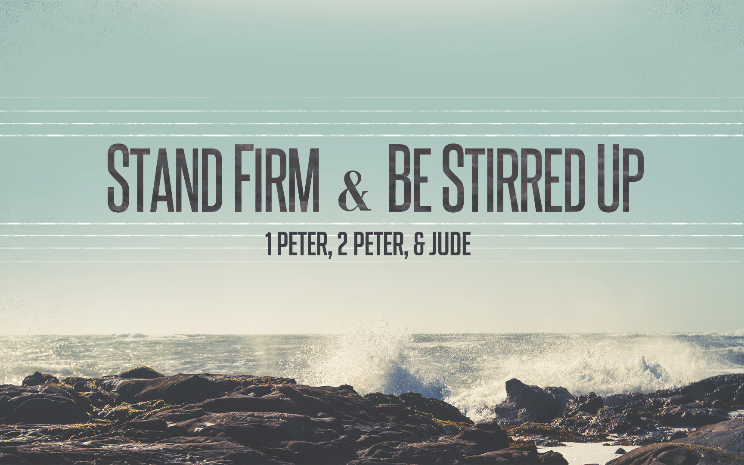
Stand Firm & Be Stirred Up
Notes:
Happy to be in class with you today… Warm up…
Phillip: Be patient and get great comments out of the class. It is better NOT to finish than to rush through…

Slide 2
Peter’s Approach & Purpose
“I consider it right, as long as I am in this earthly dwelling, to stir you up by way of reminder,” (2 Peter 1:13)
“This is now, beloved, the second letter I am writing to you in which I am stirring up your sincere mind by way of reminder.” (2 Peter 3:1)
“be on guard…but grow…” 2 Peter 3:17-18
Notes:
2 Peter 3:17-18

Slide 3
Warm Up Question
What things or people have helped to stir up your spiritual growth?
Notes:
Joining a New Church. Meeting new Friends.
Diligent Study.
Reading a deep book with careful insights.
Making prayer a Bigger Part of our lives..

Slide 4
False Teaching Is Obvious When We Are Stirred Up To Remember…
What We Have: “everything…true knowledge”
1 Peter 1:3a
What We Share: “partakers of the divine nature...”
1 Peter 1:4
How Far We’ve Come: “escaped the corruption that is in the world by lust.”
1 Peter 1:4b

Slide 5
Qualities of A Fruitful Life
Qualities We Give High Attention & Effort To Developing.
“applying all diligence” 2 Peter 1:5
Qualities That We Possess & That Are Growing.
“are yours and are increasing” 2 Peter 1:8
Qualities With A Logical Connection.
“and in your ___________, _____________”
Qualities That Lead To Good Fruit & Eternal Life.
2 Peter 1:8-11
Notes:
I believe.
I believe in a good God – I seek to be good like Him.
I believe in a good God – I seek to be good like Him, and to Understand His Will.
I believe in a good God – I seek to be good like Him, and to Understand His Will – The more I understand HIM, the more I deny myself.
I believe in a good God – I seek to be good like Him, and to Understand His Will – The more I understand HIM, the more I deny myself. The more I deny myself, the more I’m just not at home in this world so I press on and endure. The more I press on and endure the more I treasure and value godliness.
I believe in a good God – I seek to be good like Him. I seek to Understand His Will. I choose to deny myself. I place less value on comfort here. I place more value on being like God. I treat others with kindness. I don’t just treat them with kindness, I genuinely love God and others.

Slide 6
The High Cost of False Teaching
False Teaching Undermines True Character Development. (1:7)
False Teaching Renders Saints Useless & Unfruitful.(1:8)
False Teaching Encourages Short-Sighted Life Decisions That Corrupt & Pollute The Soul. (1:9)
False Teaching Introduces Stumbling Blocks. (1:10)
False Teaching Interferes With Entering God’s Kingdom. (1:11)

Slide 7
Peter & The False Prophets
Doctrines of the Day
Lies
Destablize
Accept Worldliness
Extinguish Zeal
Can Be Forgetten
Timeless Truth
Gives Knowledge
Establish Us In Truth
Rejects Worldliness
Rekindles Zeal
Must Be Remembered

Slide 8
Confidence In The Gospel Message
The Transfiguration: Matthew 17:1-13
Eyewitness Testimony
Heavenly Declaration
Fulfilled Prophecy
Notes:
Miracle Confirms That Jesus Is The Son of God
In Appearance & Association
In Divine Knowledge of The Future
In Declaration from God the Father
Miracle Confirms That The Law of Christ Is Greater Than The Law & Prophets.
Listen To & Worship Jesus, Not Moses & Elijah.
The Disciples Demonstrate Our Weaknesses & Response To God.
Sleeping, Speaking In Ignorance, Terrified
The Transfiguration Allows us to See Jesus as He Really IS: So That We Will Remember That The One ABOVE All Others, DIED For All Others.

Slide 9
The Holy Spirit & The Scriptures
Test Everything By The Scriptures
“pay attention…to the prophetic word…” (1:19)
Because The Scriptures Do Not Originate With Man.
2 Peter 1:20
Because The Scriptures Depend On The Holy Spirit, Sent From God.
2 Peter 1:21
Notes:
THEY are the key to our spiritual Growth….

Slide 10
Moving Closer To Our Goals
Develop a reputation for good works among those who are most critical of our faith.
Promote greater “Harmony” in our home and congregation by learning our part well.
Build a deeper relationship with the shepherds.
Deepen our appreciation for the suffering of Christ and what it means to share in that suffering.
Invest in the things that last the longest.
Notes:
Good Works: Let even false teachers see – that sound doctrine produces GOOD & LOVING people.
Harmony: Growing and Fruitful Christians will always enjoy greater harmony.
Shepherds: Willingness on our part to be stirred up by Timeless Truth allows the overseers to count on us.
SUFFERING: Self-Control & Perserverance….we just can’t be Christ like without them.
INVEST: Doctrines of the DAY come and go – but HOLY SCRIPTURE endures.

Slide 11
Stand Firm & Be Stirred Up
Notes:
Happy to be in class with you today… Warm up…
Phillip: Be patient and get great comments out of the class. It is better NOT to finish than to rush through…

Slide 12
Class Lesson Schedule
Lesson | Title/Material | Teacher | Day | Date
1 | Introduction to I Peter | Russ | Sunday | May 29, 2016
2 | Stand Firm in Salvation (I Peter 1:1-12) | Russ | Wednesday | June 1, 2016
3 | Stand Firm in Hope & Holiness (I Peter 1:13-2:10) | Phillip | Sunday | June 5, 2016
 | VBS – Special Class |  | Wednesday | June 8, 2016
4 | Stand Firm in Community and Family (I Peter 2:11-3:12) | Phillip | Sunday | June 12, 2016
5 | Stand Firm in Zeal during Suffering (I Peter 3:13-4:19) | Phillip | Wednesday | June 15, 2016
6 | Stand Firm with the Chief Shepherd (I Peter 5:1-13) | Phillip | Sunday | June 19, 2016
7 | Introduction to II Peter | Russ | Wednesday | June 22, 2016
8 | Stirring Up our Spiritual Growth (II Peter 1:1-21) | Phillip | Sunday | June 26, 2016
9 | Stirring Up Pure Doctrine and Pure Living (II Peter 2:1-22) | Phillip | Wednesday | June 29, 2016
10 | Contending for the Faith (Jude) | Phillip | Sunday | July 3, 2016
11 | Stirring Up our Insight (II Peter 3:1-18) | Phillip | Wednesday | July 6, 2016
12 | Grounded & Growing in Difficult Times | Phillip | Sunday | July 10, 2016
13 | Review | Phillip | Wednesday | July 13, 2016

Slide 13
Stand Firm & Be Stirred Up

