Slide 1
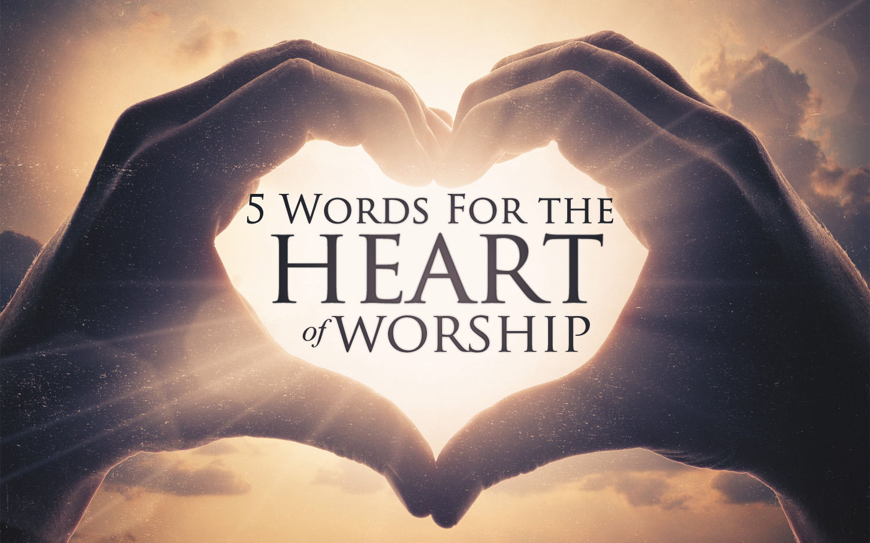
5 Words for the Heart of Worship
Notes:
Many of us have heard sermons on the 4 Greek words for love: agape, phileo, eros, storge….each carrying a different emphasis that is sometimes overlooked in the general word “love.”
In the same way, I want to teach you 5 Bible words for worship. Each carries a different emphasis – and being familiar with these specific concepts can help us be even more focused during our worship and can help us be even more thoughtful in our worship.

Slide 2
What Is Worship?
Worship Includes 4 Components:
An Object: God, An Idol, A Person
An Attitude: Reverence, Thanks, Joy, Etc…
A Posture (In Body or Heart): Stand, Etc…
A Form: Pray, Sing, Give, Etc…
Notes:
Body or Heart - meaning literal posture, and most importantly the figurative posture of your heart.

Slide 3
The 5 Words for Worship
To Kneel
To Bow (Literally: Kiss the earth)
To Offer Wages & Service
To Publicly Serve The Kingdom
To Confess Agreement
Notes:
We are going to study the importance of the forms and that is certainly helpful – but by way of introduction it is good for us to look at the attidue and posture behind worship as well.
There are 5 Key Words that have to be considered. Now these are not the only words – if you looked at every word for praise or song or prayer etc… the list could go on forever. But these 5 are the words usually translated as worship or other closely related thoughts. Each one is inseperable from understanding Worship properly and Biblically.

Slide 4
The 5 Words for Worship
1. To Kneel: (gónu)
“a gesture of worship which also symbolizes the inner attitude.”
Genuflection: Bending the knee or kneeling.
“It passed into the early church as an established practice in both individual and common prayer.”
Key Passages: Luke 22:41, Acts 21:5, Eph. 3:14, Phil. 2:10
Key Concept: Gesture to express humility, need, respect, submission, and adoration.
Notes:
Start with an easy one... To kneel.
Sounds just like it looks – “Gon – New”
Common in the old testament – before God, king, even false god like Baal.
KEY Passages: Normal posture and attitude of worship…
Just as we studied raising holy hands in prayer as a recommendable new testament posture – so is taking a knee or kneeling. I can remember very clearly a few times our preacher growing up, Shawn, would sit on the far aisle so he could kneel. Many of you have probably seen a song leader, kneel to the side when someone comes up to lead a prayer.

Slide 5
The 5 Words for Worship
2. To Bow: (proskuneín)
Literally: Kiss the earth
A visible act to a visible diety.
Declares: You have Total Claim to all that I am and all that I have.
Directed To Jesus: Matthew 14:33, 28:9, Highest Place, “…and worship at your feet.”
Refused To Men
By Mordecai, Esther 3:3
By Paul, Acts 10:25-26
Notes:
Phonetic: Pross – Q – nay – en
This word is a MAJOR worship word. There are times when people “take a bow” at the end of a great performance. An expression of appreciation or respect. THIS WORD IS MORE.
Kiss – not just kissing the ring of a king or kissing the hand of a beautiful woman. This is more out-streching your hands and feet so that your face is down to the ground.
To kiss is to express love and appreciation for the diety and what they have done.
Where kneeling shows humility – this word carries far more weight – it is what we most usually associate with the idea of “worship” in English. It is giving to God everything we are. This word deeply carries the idea of an inner reverence that motivates the outer posture.
** Song that really captures much of this meaning is “Highest Place” – We place you in the highest place, for you are the great High priest, we place you High above all else…and we come to you and worship at your feet.”
REFUSED: Famously, Shadrach, Meshach, and Abednego will not bow down to the king’s statue and are tossed into the fiery furnace.
**Interesting: Used in the gospels, early Acts, and Revelation. Almost excluded from the epistles – showing the early church did not “worship” just like the pagans of the day, and reserved this posture for being in God’s presence.

Slide 6
The 5 Words for Worship
2. To Bow: (proskuneín) Literally: Kiss the earth
Usage: Almost Exclusively in the Gospels & Revelation.
Such a powerful and meaningful response that Christians reserved it for being literally in the presence of God. (Revelation 15:4)
Key Passage:1 Cor. 14:24-25
The former pagan will respond as if God were literally among them.
Key Passage: John 4:20-24
Question of a given gesture at a given place.
Jesus shows the place is irrelevant, but does not reject the gesture.
Notes:
You might wonder: Why don’t we do this in our worship today? If this is the word that most expresses God is our everything – shouldn’t we be doing this? Actually, the NT shows this word and the accompanying posture are actually treated SO SPECIAL that this was not a regular occurance among NT Christians…
Respond as if God were literally among them. It is true, that Cornelius did just that – he fell down.
The only other time this is used in the NT is in reference to Old Testament worship practices twice in Acts and twice in Hebrews. The point here – it is not just oddly absent from epistles dealing with Christian worship. It is in fact NOTICABLE ABSENT – the point being. This is a powerful and meaningful response that Christians reserved for being literally in the presence of God. Culturally – it was far too confused with idol worship for Christian participation.
KEY CONCEPT: You have TOTAL CLAIM to all that I am and all that I have. The gesture is reserved for God’s literal presence – but the spirit and heart of this word is at the core of our worship. God is our Everything.

Slide 7
The 5 Words for Worship
3. To Offer Wages & Service (latreúō/latreía)
Service based on “an ultimate decision or committal of the heart.” (Deuteronomy 10:12)
Brings a new sphere of thought into our worship.
“The performance of acts associated with the cultus [the collective worship] seems to be the main connotation.” (See Hebrews 9:1)
Key Application:
In Prayer: Luke 2:37, Acts 26:7
In The Gospel: Romans 1:9
In Life: Acts 24:14, Romans 12:1
Notes:
4. “La’ – True – Oh”
This is service that is above and beyond mere slavery. It is not compelled, it is not even done in view of an immediate reward or payment. It is done as an offering to please the recipient. Often a reference to making the necessary preparations…
**Acts associated – guys running the computers – God is pleased with your Service. Guys doing the attendance – God is pleased with your service. What you are doing is not just a distraction from worship – it is a part of your service during and as worship.
(of divine service)
Prayer – that prayer was a sacrifice in itself – thus we use the term “we are having a special prayer service.” We don’t just say prayer assembly or even worship assembly – it is a prayer “service” or worship “service” because we are coming together to offer our prayers as wages we freely give to God.
Romans 1:9 – the idea here is the ministry (aka acts of service) performed for the spreading of the gospel. Not limited only to preaching – it is our furtherance of the gospel we do because of the WORTHINESS OF GOD.
Romans 12:1 – a living sacrifice is “our reasonable service” > This usage draws on the OT concept of sacrifice but greatly broadens our understanding. Paul wants us to see that Jehovah is worthy of weekly worship – but that they way we live for him every day – the way we freely offer every breath dedicated to Him – is the only fitting background for our organized worship assemblies. **Point: Worship does occur in a special fashion when we are together, but to think of only our assemblies as worship is an OVER-compartmentalization. Each day of our life is offered to Him.
REVIEW: 3 concepts so far: To kneel, To Bow, To offer Service. Two more…

Slide 8
The 5 Words for Worship
4. To Publicly Serve The Kingdom (Leitourgia)
“rendered primarily to God, liturgy was a national institution of benefit to the whole people.”
Noun: A person who renders service.
Christ: Hebrews 8:1-2
Epaphroditus: Philippians 2:25
Key Passages: Hebrews 9:21, 2 Cor. 9:12, Phil. 2:17
*Special Note: A description. Not an official term for apostles, teachers, elders or deacons. Not an office for ‘works of a priest.’ For example: It does not set song leaders or other worship facilitators over other saints.
Notes:
“Lie-Tor-Ge-Ah” *This is the word that was used when a government would request or would demand that a wealthy citizen perform some service for the good of the whole kingdom. This word describes the philanthropist carrying out the service.
In the New Testament, it is used in a similar fashion to refer to all those who take a leading role in facilitating the worship. The teacher is worshipping as much as the hearer. The song leader is worshipping as much as those following him. This word was used when an aspect of dignity was to be associated.
In the broadest sense, it reminds us that everything we do to build up God’s kingdom carries with it a reverence that He Alone is worthy of such dedication and devotion.
Hebrews 9:21 – every vessel used for service.
2 Corinthians 9:12 – offering given for the good of the whole.
Philippians 2:17 – Paul would give his life to allow them to continue to serve the kingdom.
Special Note: Does not set people over others. Does not turn an act into a sacrament. It simply shows that each act is publicly rendered as a blessing that benefits the whole group.
Just like James describes “living faith” as an active, doing faith. This can be thought of as “living worship” – activity directly engaged in the service of God’s kingdom. (The previous word reminds us that every day, every choice is INDIRECTLY an opportunity to honor God. Now this word looks at those things DIRECTLY associated with our service. Not like the previous word that everything is a living sacrifice…this is those things that are more directly connected with Kingdom Work.)

Slide 9
The 5 Words for Worship
5. To Confess Agreement (Homología)
“the acceptance of vows or more commonly the confession of sin.” “In the New Testament…solemn declaration.”
“Admission of sin becomes acknowledgement of the grace and power of God.”
Key Passages:
Psalm 118:15-24
2 Corinthians 9:13
Hebrews 11:13
Matthew 10:32
Key Concept: The faith of the heart leads to the confession of the lips. (Rom 10:9)
Notes:
“Hom – O – lo – Gay – a’
Homo – common/same Logo = word. The same word.
Homology is not a direct equivalent to worship. Nevertheless, it is in many ways the most comprehensive and significant of all the Greek words the Bible uses for veneration of God. This is because it is able, as no other term, to combine the most important features in genuine Christian worship.
Psalm 118 – Confession of God’s awesome works, as a personal expression of my faith in Him.
2 Corinthians 9:13 – broad term. Profession we embrace with hope.
Hebrews 11:13 – “were not merely confirming or admittin this they were making a declaration of faith.”
Matt 10 – WE MUST CONFESS Jesus!

Slide 10
The 5 Words for Worship
5. To Confess Agreement (Homología)
Its use builds in intensity from the confession of sin, to the confession of praise and prayer to God, to the central confession of Jesus and all the facts and doctrines relating to Him.
“As in the OT, homology is the praise of God which culminates in the heavenly anthems and in creation’s acknowledgement of Jesus Christ as Lord.”

Slide 11
The 5 Words for Worship
To Kneel: Teaches Humility
To Bow:
Teaches His Presence & His Total Claim
To Offer Wages & Service:
Teaches You Freely Give To The God You Love
To Publicly Serve The Kingdom:
Teaches You Are His Vessel
To Confess Agreement:
Teaches You Declare Your Sin, Savior, & God’s Ultimate Worthiness
Notes:
So to re-cap.
When I come to worship God – I come with HUMILITY. My heart is in submission and show God greatest respect.
When I come to worship God – I am placing HIM in the HIGHEST PLACE possible. A place which no other person or thing holds. GOD has total claim to all that I am and all that I have.
When I come to worship God – I do so out of love – everything I offer to him from prayers to songs to helping others – I give him Freely because He is worthy.
When I come to worship God – I’m not alone. I’m part of a spiritual kingdom – and I may be called upon to perform a vareity of tasks for the good of the whole group – these tasks themselves are performed with total dedication to the Lord.
When I come to worship God – I’m declaring that HE is holy and I have sinned. I’m declaring that JESUS is my Savior and ultimately worthy of everything.

Slide 12
We worship

