Slide 1
Complete in Christ: Colossians

Slide 2
What does Paul mean, when he describes Christians as “knit together in love?” Colossians 2:2
Notes:
Carries Ideas of LOYALTY, FRIENDSHIP, DEVOTION, SACRIFICE, ENCOURAGEMENT, COMRADDERIE,
UNITY (Judges 20:11)
David & Jonathan (1 Sam 18)
Colossians 2:19 – our togetherness as a BODY.
The family bond we share is special and it begins with our COMMON FAITH.
When false teaching is introduced, it threatens our souls, it threatens the church, and it threatens this loving bond…
What actions can we take that help our hearts become EVEN MORE “knit together.”

Slide 3
Book Overview
The Preeminence of Christ Declared
Chapter 1
The Preeminence of Christ Defended
Chapter 2
The Preeminence of Christ Demonstrated
Chapter 3 and 4

Slide 4
Our Class Goals
To understand and appreciate the preeminence of Christ.
To guard against worldly arguments which undermine Christ.
To elevate our thinking towards heavenly blessings in Christ.
To transform daily decisions in the light of the leadership of Christ.

Slide 5
Ch. 2: Defending Christ’s Preeminence
Two Main Purposes Of This Chapter
A Warning Against Worldly Thinking
“I say this so that no one will delude you with persuasive argument.” Colossians 2:4
A Call To Faithfulness: Walk In Christ
Firmly Rooted, Being Built Up, Established, Instructed, Grateful. Colossians 2:6-7
Notes:
Ch. 2:1-7 is Paul’s introduction to his purposes in this section….
This is a very neat chapter not only in content – but in communication style. Paul uses a TON of metaphors…. This is a chapter that calls to mind:
treasure boxes and warm woven fabric and strong, healthy trees, and full (overflowing) baskets…
Good Chance To Use Some Images: Identify The Metaphors Paul Uses
Jesus Knits our Hearts Together In Love
Jesus Is A Rich Treasure/Wealth
Treasures of Wisdom
I Am With You In Spirit
Stability of Faith
Walk In Him
Firmly Rooted
Built Up
Overflowing with Gratitude

Slide 6
Warning Against Worldly Thinking
“But I am afraid that, as the serpent deceived Eve by his craftiness, your minds will be led astray from the simplicity and purity of devotion to Christ. For if one comes and preaches another Jesus whom we have not preached, or you receive a different spirit which you have not received, or a different gospel which you have not accepted, you bear this beautifully.”
2 Corinthians 11:3-4
Notes:
Satan wants to introduce false doctrines and perversions of the gospel – to draw us away from the TRUTH.

Slide 7
Warning Against Worldly Thinking
“You are of your father the devil, and you want to do the desires of your father. He was a murder from the beginning, and does not stand in the truth because there is no truth in him. Whenever he speaks a lie, he speaks from his own nature, for he is a liar and the father of lies.”
John 8:44
Notes:
Satan uses lies about WHO God really is. Lies about WHAT GOD has really said. LIES to blind us…so we NEED THE TRUTH!

Slide 8
Christ Provides Truth & Freedom
“So Jesus was saying to those Jews who had believed Him, “If you continue in My word, then you are truly disciples of Mine; and you will know the truth, and the truth will make you free.” John 8:31-32
We are FREE, When We Are Walking In The Narrow Way…
Notes:
World says true freedom is no limits, but God shows us how this leads to being slaves to our own lusts and foolishness.
Greatest Freedom is freedom combined with great stability and wisdom and love.
TRUTH gives the GREATEST Freedom and Jesus is the source of all TRUTH.

Slide 9
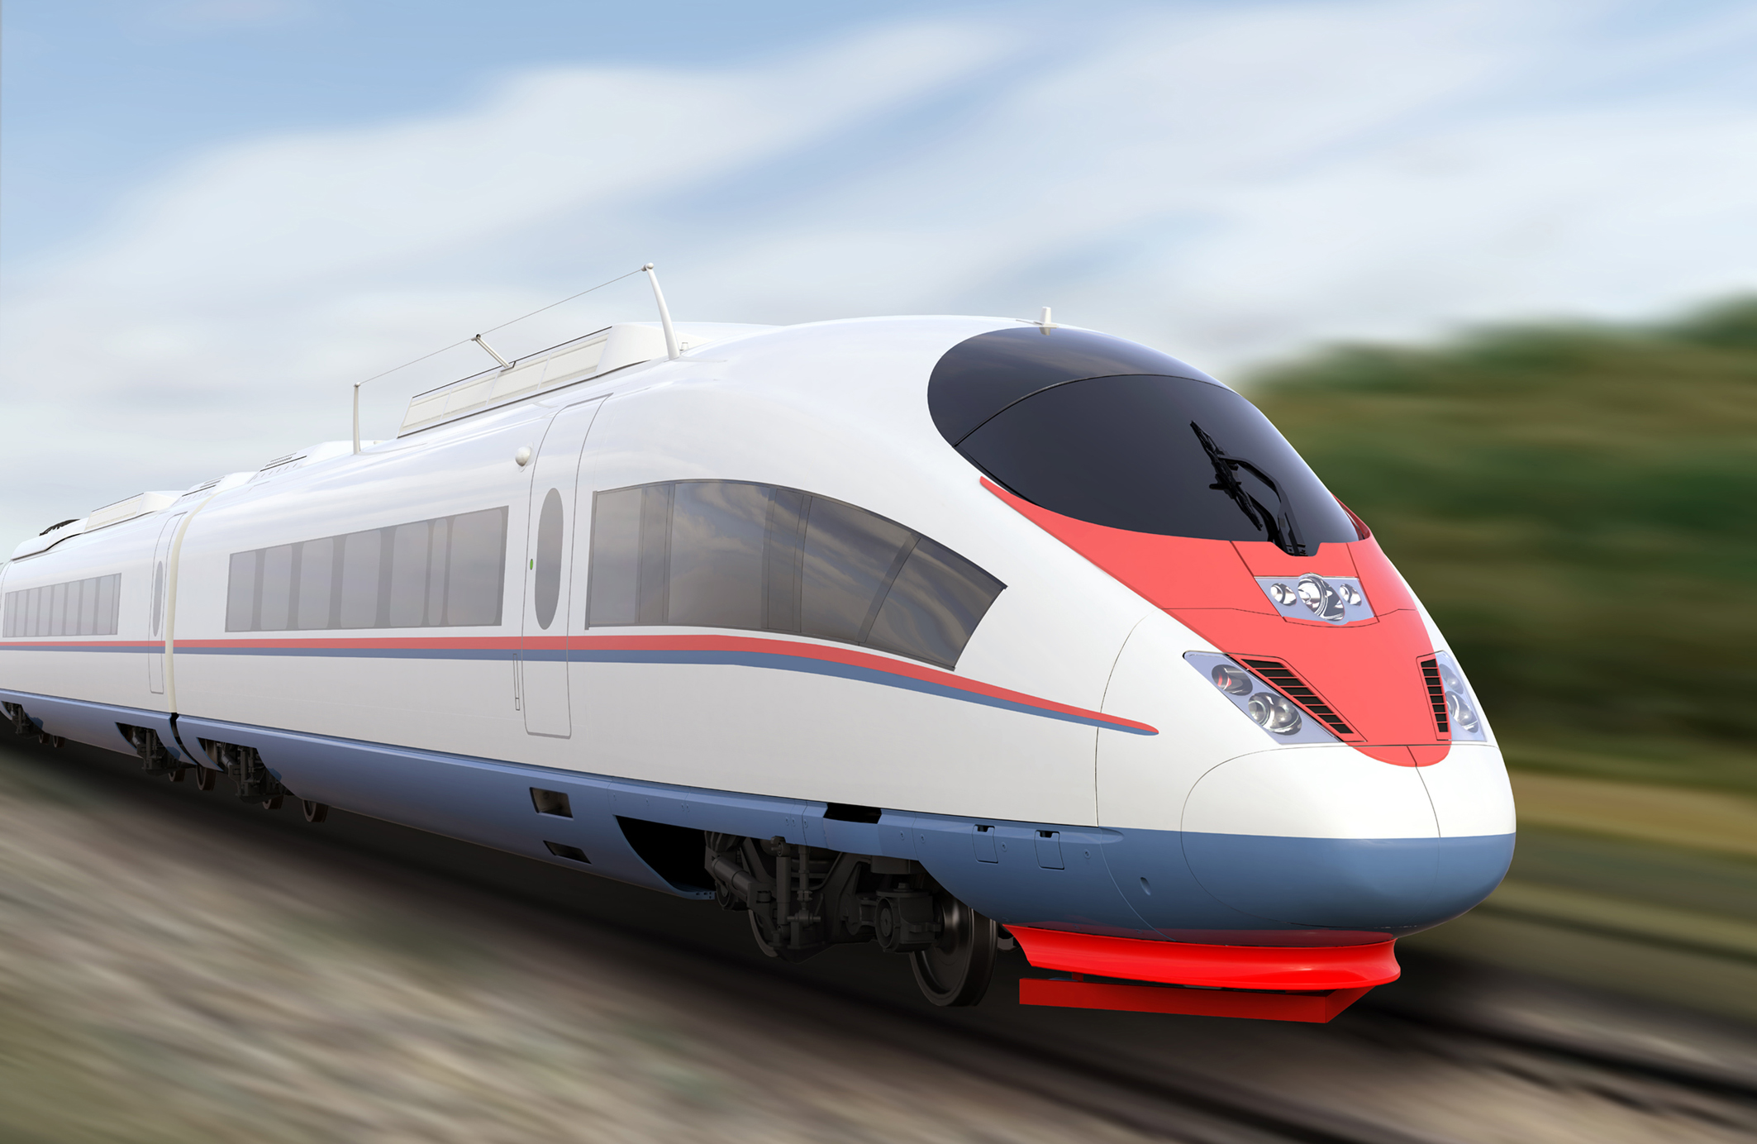
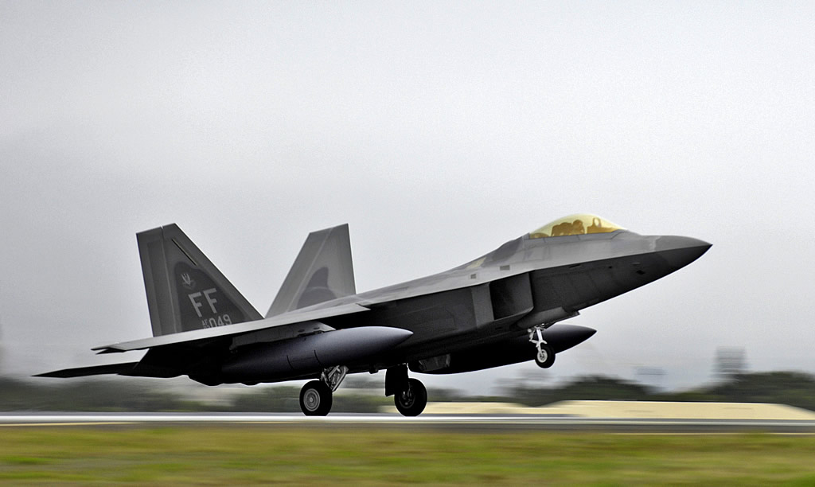
The Blessings of The Narrow Way
Notes:
>>> Freedom In Christ Means Walking On The Narrow Way
When we think of the “Narrow” way we automatically think about “limitations, restrictions…” and can assume that these restrictions are a bad thing. They are keeping us from doing what we would like to do or what appears to be fun, or what other teens are doing.
Yes – they are restrictions – but you need to think about the POWER that comes from Beneficial Restrictions!
TRAIIN: Go further & faster…
RUNWAY: Further, Fathers & Smoother. **There is value here! #noDrama #PEACE

Slide 10
Maintaining Freedom In Christ When Under Attack By Satan
Remember The Teachers Who Diligently Labored For You. (Vs. 1)
Seek Encouragement From Strong Christians Who Love You. (Vs. 2)
Turn To The Unchanging Words of Christ For Knowledge, Understanding, & Wisdom. (Vs. 3)
Be On Guard Against Persuasive Arguments. (Vs. 4)
Notes:
QUESTIONS 1, 2 and 3
Why Does He Want Them To Be Aware of His Great Struggle On Their Behalf?
Like Parents Want Children To See How Hard They Are Working To Bless Them – To Raise Them Right…
And For Those In Laodicea…
Connection Of These Towns. (SHOW a MAP)
Not Seen Face… 2 Options
They are part of those who haven’t seen him.
He additionally cares for others…
Hearts Knit Together in Love
Common Love for God
Common Love for Good
Common Love for Being Transformed
Full Assurance of Understanding
Studying Together & Filling In Each Other’s Gaps
Avoid Being Deluded With Persuasive Arguments.
LOVE FOR DISTANT SAINTS… Present In Spirit (Family Connection, Memory of One Another’s Influence & Words, Love Stronger Than Geography)
Rejoicing In Good Discipline.
Rejoicing In Stability of Faith in Christ Jesus

Slide 11
Verse 5, Question 5
“Good Discipline”
Daily Prayer
Every Good Work
Sound Thinking
Acceptable Worship
“Stability of Your Faith”
Unshaken In Conviction
Built On The Right Foundation.
Doubts Addressed With Truth.
Notes:
& Question 5 “a” why do we rejoice in the faihtfulness of others?

Slide 12
“Walk In Him”
Notes:
There are a MILLION devices and plans designed to help us “count our steps” to be sure we are walking for our physical health…we need to be paying attention to our spiritual WALK.
How can we “Measure” a healthy walk….
Our Path: Am I imitating Jesus attitude, choices, priorities?
Our Direction: Are we moving closer to God?
Our Speed: Are we walking to go the distance? Are we urgent and eager to make corrections when we go astray?
Our Strength: Are we building up the body?

Slide 13
“Walk In Him”
AM I…Renewing My Mind in the Apostles Teaching?
“as you have received Christ Jesus the Lord…”
AM I… Going Deeper into the Truth?
“been firmly rooted”
AM I…Building On the Foundation I’ve Been Given?
“built up in Him”
AM I…IMMOVABLE in Simple Devotion to Jesus?
“established in your faith” (1:7 and 2:7)
AM I… “Overflowing with Gratitude”?
Notes:
Parallel To Our Annual Theme “Walk As Children of Light” Eph 5:8
>> Apostles Teaching…Go back and study doctrinal issues.
>> Deeper…looking for common themes in multiple books of the Bible. Using the Scriptures as our PRIMARY source of spiritual food. Studying for personal application, not just academic knowledge. Learning stories and details beyond the Most Popular characters. ** Eleazar and Phinehas. King Manassah and King Asa. Abishag and Elizabeth** There is a lifetime of study in this one book. We need to be the people who know it inside out.
>> DEVOTION…Is it Jesus, no matter what.
>> Gratitude…our souls have been saved. We’ve been transferred to the Kingdom of the Beloved Son.
Walk In The Gospel You’ve Received
Have Firm Roots
Be Built Up
Be Established In Your Faith As Instructed
Bookend concept of staying true to what the apostles originally taught and modeled.
Overflow with Gratitude
If our gratitude is missing, then our comprehension is fading. Bc Anyone who Comprehends what JESUS has truly done will immediately be grateful.

Slide 14
Complete in Christ: Colossians

