Slide 1
Complete in Christ: Colossians

Slide 2
Our Theme: Complete In Christ
“We proclaim Him, admonishing every man and teaching every man with all wisdom, so that we may present every man complete in Christ.”
Colossians 1:28
“For in Him all the fullness of Deity dwells in bodily form, and in Him you have been made complete, and He is the head over all rule and authority;”
Colossians 2:9-10
Notes:
“in Christ” – How many times is the word “Christ” used in verse 1-4? 4 times.
What does Christ mean? OUR THEME: Complete in Christ.
There is a sense in which we are daily “becoming” complete in Christ. An on-going process of learning and growing.
There is also a sense in which we are already MADE complete in Christ. We have been made the children of God. Made holy. Made justified.

Slide 3
Our Class Goals
To understand and appreciate the preeminence of Christ.
To guard against worldly arguments which undermine Christ.
To elevate our thinking towards heavenly blessings in Christ.
To transform daily decisions in the light of the leadership of Christ.

Slide 4
Threats Faced By The Colossians
The Danger of Relapse Into Paganism
1:21-23 - 2:6 - 3:5ff
The Danger of Accepting ‘The Colossian Heresy.’ A Mixture of 4 Teachings…
Philosophies denying the completeness of Jesus. (2:8)
Jewish ceremonial traditions (2:16-17)
Angel worship (2:18)
Asceticism (2:20-23)
Notes:
In what sense are these dangers that ALL CHRISTIANS face?
Question # 7… They need to be STEADFAST.

Slide 5
4 Major Threats
“See to it that no one takes you captive through philosophy and empty deception, according to the tradition of men, according to the elementary principles of the world, rather than according to Christ.”
Colossians 2:8

Slide 6
4. Elementary Principles of the World
Helpful Cross Reference: Galatians 4:8-11
Elementary Principles At Their Best…
Point Us Towards God’s Greatness
Elementary Principles At Their Worst…
When Holidays Become A Greater Joy Than JESUS!
Looking To Religious Holidays To Connect Us To God, Instead of Jesus! (2:16-17)
Notes:
What Paul primarily has in mind is religious feasts and practices based on the calendar. The World & TIME It Exist Within.
Heb. 5:12 – first principles.
Idea: You are treating those things as more important than JESUS! You are

Slide 7
4. Elementary Principles of the World
Christians Must Not Idolize The Natural World. (Romans 1:21-25, 2 Peter 3:10)
The Life of Christ Reveals His Power Over Nature. John 9:26
Our Hope Is In Christ Who Is Over All Creation & Over All Time.
Colossians 1:15-17
Notes:
Tangible resources , our ability to manipulate them, understand them, rmake them.

Slide 8
Complete in Christ: Colossians

Slide 9
Freedom From Spiritual Death Chapter 2:9-15
“See to it that no one takes you captive through philosophy and empty deception, according to the tradition of men, according to the elementary principles of the world, rather than according to Christ.”
Colossians 2:8

Slide 10
The Colossians & All Christians Remain True To Christ Because…
In Him all the fullness of Deity dwells in bodily form... (vs. 9)
In Him you have been made complete… (vs. 10)
In Him you were also circumcised with a circumcision made without hands… (vs. 11)
Notes:
1.) First lesson: Jesus is fully God. This is a VERY direct statement. Paul affirms exactly what Peter confessed (Matt 16:16)
And he affirms it with nothing lacking.
We’ve already been given two evidences of Jesus Divinity.
In ch 1, we learned that he was OVER all things…
In ch 1, we learned he was the full image of God… we can SEE the NATURE of God in his behavior.
In ch 2, we learn he was God in bodily form…HE lived on earth as GOD in a human body.
2.) Second Lesson: Jesus who perfectly existed as God in the flesh – is helping us – in the flesh to become more like God. He is the one who perfects and completes us. And this verse is past tense. So it’s not a reference to our ongoing spiritual growth. It is a description of our status. WE ARE COMPLETE. We are not lacking anything pertaining to our spiritual life. Need a Savior? You’ve got Him. Need an Example? You’ve got Him. Need a Teacher? You’ve got Him. Need an Advocate? You’ve got Him.
I know we keep going to the puzzel analogy, but it just fits so well. We have been given every component. You have the complete set.
Third Lesson: What HE has done is FAR superior to circumcision under the law of Moses. Don’t take pride in a 2,000 year old ritual. Take pride in the CHRIST who has done what Circumscision alone never could.

Slide 11
You Have Been Made Complete
We were lacking a Head to follow…He became King.
We were lacking a way to remove our sin…He removed it.
We were lacking a resurrection from spiritual death…He allows us to share in His resurrection.
We were lacking a solution to our transgressions…He became our Savior.
We were lacking life, a spiritual connection to God…He bridged the separation.
We were lacking a way to pay our debt…He provides Himself.
We were lacking an escape from the system of Law…He nailed it to the cross.
We were lacking power over authorities…He overpowered and disarmed them.
Notes:
False teachers are claiming you lack sometihng…come listen to them and they will give you the final component. NO! Jesus has provided all we need!
We were lacking a way to remove our sin…He removed It.
We were lacking a king to follow…He became King.
We were lacking a resurrection from spiritual death…He allows us to share in His resurrection.
We were lacking a solution to our transgressions…He became our Savior.
We were lacking life, a spiritual connection to God…He bridged the separation.
We were lacking a way to pay our debt…He provides Himself.
We were lacking an escape from the system of Law…He nailed it to the cross.
We were lacking power over authorities…He overpowered and disarmed them.

Slide 12
Discussion: What Lies Does Satan Attack Us With, Claiming That Christians Are “Lacking” or “Missing Out” On Something Today?
Notes:
You Christians are “lacking” a sophisticated modern view of the world.
>> We have the wisdom of God at our fingertips directing us to live very full rich lives. We aren’t missing anything!
You Christians are “lacking” the approval of the world. Thousands of fans cheering your name.
>>> We have the approval of God. ONE loving, righteous, all-powerful, most important Father, who cares more than a billion fans.
You Christians are “lacking” a wide range of sensational experiences…you are missing out on the thrill… of a drug high, of a sexual encounter, etc…
>>>We are PROTECTED from the horrible aftershocks of those choices. Yes, we are lacking those experiences, like we are lacking a terrible disease – no thank you!
You Christians are “lacking” the financial success that comes from putting yourself first.
>>> We have a treasurer greater, and longer lasting than any earthly treasure.
MARK 10:28-31

Slide 13
The Colossians & All Christians Remain True To Christ Because…
Don’t Leave GOD HIMSELF
In Him all the fullness of Deity dwells in bodily form (vs. 9)
Don’t Leave The One Who Makes Us COMPLETE
In Him you have been made complete (vs. 10)
Don’t Leave The One Who Saves Us From DEATH
In Him you were also circumscised with a circumsision made without hands (vs. 11)
2 Cor. 11:3b “…the simplicity and purity of devotion to Christ…”
Notes:
Because we have GOD HIMSELF on our side, as our rescuer….
We need to see this – whenever we choose to follow some twisted doctrine or some man-made doctrine – or some tradition…….WE ARE REJECTING CHRIST.
We are rejecting GOD HIMSELF!
We are rejecting the ONE WHO MAKES US COMPLETE
We are rejecting the ONE WHO SAVES US FROM SPIRITUAL DEATH
>>> When we put it in those terms – it becomes a lot more obvious why the false teachings at Colossae and false teachings today matter so much.

Slide 14
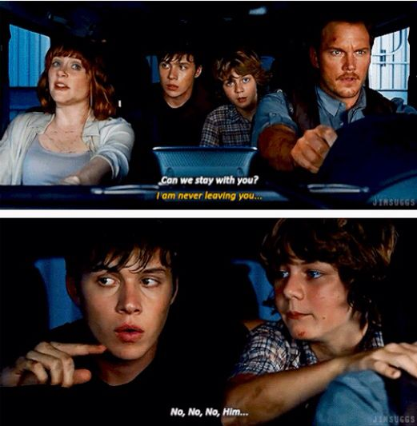
Can we stay with you? I am never leaving you… No, No, No HIM!
Notes:
This scene could be pulled from a THOUSAND movies to make the same point…. YOU STAY WITH THE HERO.
In Jurrasic World…Those kids did not want to leave the ONE PERSON they could count on!
As Christians we are staying with JESUS. But Paul doesn’t just identify him as our HERO…this section goes into detail as to why SALVATION in Christ is Superior to Circumscision in the Law of Moses.

Slide 15
Salvation In Christ Is Superior To Circumcision In The Law of Moses
BEFORE • AFTER
Notes:
Use WHITE BOARD….

Slide 16
What Points Can We Make From Colossians 2:9-15 About How To Be Saved?
Need To Be “In Him”
Need Removal of Flesh
Transgression = Sin
Not Under Old Law
Baptism Is A Burial
Faith Is Essential
Confidence Is In God’s Work, Not Our Own
Life & Forgiveness Are Granted To Us When Baptized Into Christ.

Slide 17
Complete in Christ: Colossians

