Slide 1
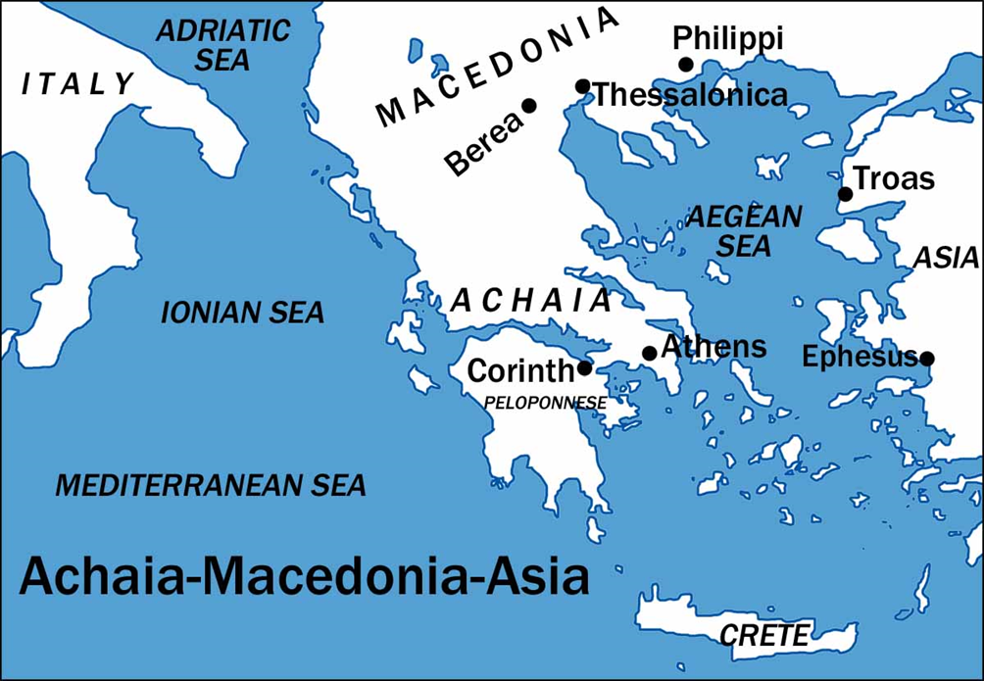
I Corinthians
Auditorium
Class 3
I Corinthians 3

Slide 2
 | Title | Day | Date
1 | Introduction | Sunday | Feb 25, 2017
2 | The Wisdom of God | Wednesday | March 1, 2017
3 | Spiritual vs. Carnal | Sunday | March 5, 2017
4 | Puffed Up | Wednesday | March 8, 2017
5 | Lawsuits and Former Lives | Sunday | March 12, 2017
6 | Questions of Marriage | Wednesday | March 15, 2017
7 | Regard for Others | Sunday | March 19, 2017
 | Meeting | Wednesday | March 22, 2017

Slide 3
Approach for today’s study:
Chp. 1 and 2 Ideas Continued
Men of Flesh (3:1-8)
Building God’s Building (9-15)
Wisdom and Foolishness (16-23)

Slide 4
Continuing On…
Don’t fall for the “Chapter Trap”
Quarrels, Jealousy, and Strife 1:11 3:3
-“I am of…..” 1:12-13 3:4-5
Wisdom & Foolishness 1:18-31 3:18-19
- Reasons for boasting 1:31 3:21
Spiritual Immaturity 2:1-16 3:1-3

Slide 5
1 Corinthians 3:1 And I , brethren, could not speak to you as to spiritual men, but as to men of flesh, as to infants in Christ. 2 I gave you milk to drink, not solid food; for you were not yet able to receive it. Indeed, even now you are not yet able, 3 for you are still fleshly. For since there is jealousy and strife among you, are you not fleshly, and are you not walking like mere men? 4 For when one says, “I am of Paul,” and another, “I am of Apollos,” are you not mere men?

Slide 6
1 Corinthians 3:1 And I , brethren, could not speak to you as to spiritual men, but as to men of flesh, as to infants in Christ. 2 I gave you milk to drink, not solid food; for you were not yet able to receive it. Indeed, even now you are not yet able, 3 for you are still fleshly. For since there is jealousy and strife among you, are you not fleshly, and are you not walking like mere men? 4 For when one says, “I am of Paul,” and another, “I am of Apollos,” are you not mere men?
2:14 “natural man” ψυχικὸς (psychikos) = animal man or infidel
3:1 “men of flesh’ σαρκίνοις (sarkinois) = fleshly, weak
- Paul uses the same word describing himself in Romans 7:14

Slide 7
1 Corinthians 3:1 And I , brethren, could not speak to you as to spiritual men, but as to men of flesh, as to infants in Christ. 2 I gave you milk to drink, not solid food; for you were not yet able to receive it. Indeed, even now you are not yet able, 3 for you are still fleshly. For since there is jealousy and strife among you, are you not fleshly, and are you not walking like mere men? 4 For when one says, “I am of Paul,” and another, “I am of Apollos,” are you not mere men?
What were the Corinthians like? (Hebrews 5:12-14)
- Not accustomed to the word of righteousness
- Did not have senses trained to discern good and evil
What, physically speaking, determines our ability to handle solid food?

Slide 8
1 Corinthians 3:1 And I , brethren, could not speak to you as to spiritual men, but as to men of flesh, as to infants in Christ. 2 I gave you milk to drink, not solid food; for you were not yet able to receive it. Indeed, even now you are not yet able, 3 for you are still fleshly. For since there is jealousy and strife among you, are you not fleshly, and are you not walking like mere men? 4 For when one says, “I am of Paul,” and another, “I am of Apollos,” are you not mere men?

Slide 9
1 Corinthians 3:1 And I , brethren, could not speak to you as to spiritual men, but as to men of flesh, as to infants in Christ. 2 I gave you milk to drink, not solid food; for you were not yet able to receive it. Indeed, even now you are not yet able, 3 for you are still fleshly. For since there is jealousy and strife among you, are you not fleshly, and are you not walking like mere men? 4 For when one says, “I am of Paul,” and another, “I am of Apollos,” are you not mere men?

Slide 10
1 Corinthians 3:4 What then is Apollos? And what is Paul? Servants through whom you believed, even as the Lord gave opportunity to each one. 6 I planted, Apollos watered, but God was causing the growth.
7 So then neither the one who plants nor the one who waters is anything, but God who causes the growth.
8 Now he who plants and he who waters are one; but each will receive his own reward according to his own labor.

Slide 11
1 Corinthians 3:4 What then is Apollos? And what is Paul? Servants through whom you believed, even as the Lord gave opportunity to each one. 6 I planted, Apollos watered, but God was causing the growth.
7 So then neither the one who plants nor the one who waters is anything, but God who causes the growth.
8 Now he who plants and he who waters are one; but each will receive his own reward according to his own labor.

Slide 12
1 Corinthians 3:4 What then is Apollos? And what is Paul? Servants through whom you believed, even as the Lord gave opportunity to each one. 6 I planted, Apollos watered, but God was causing the growth.
7 So then neither the one who plants nor the one who waters is anything, but God who causes the growth.
8 Now he who plants and he who waters are one; but each will receive his own reward according to his own labor.

Slide 13
1 Corinthians 3:9 For we are God’s fellow workers; you are God’s field, God’s building. 10 According to the grace of God which was given to me, like a wise master builder I laid a foundation, and another is building on it. But each man must be careful how he builds on it. 11 For no man can lay a foundation other than the one which is laid, which is Jesus Christ. 12 Now if any man builds on the foundation with gold, silver, precious stones, wood, hay, straw, 13 each man’s work will become evident; for the day will show it because it is to be revealed with fire, and the fire itself will test the quality of each man’s work. 14 If any man’s work which he has built on it remains, he will receive a reward. 15 If any man’s work is burned up, he will suffer loss; but he himself will be saved, yet so as through fire.

Slide 14
1 Corinthians 3:9 For we are God’s fellow workers; you are God’s field, God’s building. 10 According to the grace of God which was given to me, like a wise master builder I laid a foundation, and another is building on it. But each man must be careful how he builds on it. 11 For no man can lay a foundation other than the one which is laid, which is Jesus Christ. 12 Now if any man builds on the foundation with gold, silver, precious stones, wood, hay, straw, 13 each man’s work will become evident; for the day will show it because it is to be revealed with fire, and the fire itself will test the quality of each man’s work. 14 If any man’s work which he has built on it remains, he will receive a reward. 15 If any man’s work is burned up, he will suffer loss; but he himself will be saved, yet so as through fire.

Slide 15
1 Corinthians 3:9 For we are God’s fellow workers; you are God’s field, God’s building. 10 According to the grace of God which was given to me, like a wise master builder I laid a foundation, and another is building on it. But each man must be careful how he builds on it. 11 For no man can lay a foundation other than the one which is laid, which is Jesus Christ. 12 Now if any man builds on the foundation with gold, silver, precious stones, wood, hay, straw, 13 each man’s work will become evident; for the day will show it because it is to be revealed with fire, and the fire itself will test the quality of each man’s work. 14 If any man’s work which he has built on it remains, he will receive a reward. 15 If any man’s work is burned up, he will suffer loss; but he himself will be saved, yet so as through fire.

Slide 16
1 Corinthians 3:16 Do you not know that you are a temple of God and that the Spirit of God dwells in you? 17 If any man destroys the temple of God, God will destroy him, for the temple of God is holy, and that is what you are.
18 Let no man deceive himself. If any man among you thinks that he is wise in this age, he must become foolish, so that he may become wise. 19 For the wisdom of this world is foolishness before God. For it is written, “he is THE ONE WHO CATCHES THE WISE IN THEIR CRAFTINESS”; 20 and again, “THE LORD KNOWS THE REASONINGS of the wise, THAT THEY ARE USELESS”

Slide 17
1 Corinthians 3:16 Do you not know that you are a temple of God and that the Spirit of God dwells in you? 17 If any man destroys the temple of God, God will destroy him, for the temple of God is holy, and that is what you are.
18 Let no man deceive himself. If any man among you thinks that he is wise in this age, he must become foolish, so that he may become wise. 19 For the wisdom of this world is foolishness before God. For it is written, “he is THE ONE WHO CATCHES THE WISE IN THEIR CRAFTINESS”; 20 and again, “THE LORD KNOWS THE REASONINGS of the wise, THAT THEY ARE USELESS”

Slide 18
1 Corinthians 3:16 Do you not know that you are a temple of God and that the Spirit of God dwells in you? 17 If any man destroys the temple of God, God will destroy him, for the temple of God is holy, and that is what you are.
18 Let no man deceive himself. If any man among you thinks that he is wise in this age, he must become foolish, so that he may become wise. 19 For the wisdom of this world is foolishness before God. For it is written, “he is THE ONE WHO CATCHES THE WISE IN THEIR CRAFTINESS”; 20 and again, “THE LORD KNOWS THE REASONINGS of the wise, THAT THEY ARE USELESS”

Slide 19
1 Corinthians 3:21 So then let no one boast in men. For all things belong to you, 22 whether Paul or Apollos or Cephas or the world of life or death or things present or things to come; all things belong to you, 23 and you belong to Christ; and Christ belongs to God.

Slide 20
1 Corinthians 3:21 So then let no one boast in men. For all things belong to you, 22 whether Paul or Apollos or Cephas or the world of life or death or things present or things to come; all things belong to you, 23 and you belong to Christ; and Christ belongs to God.

