Slide 1
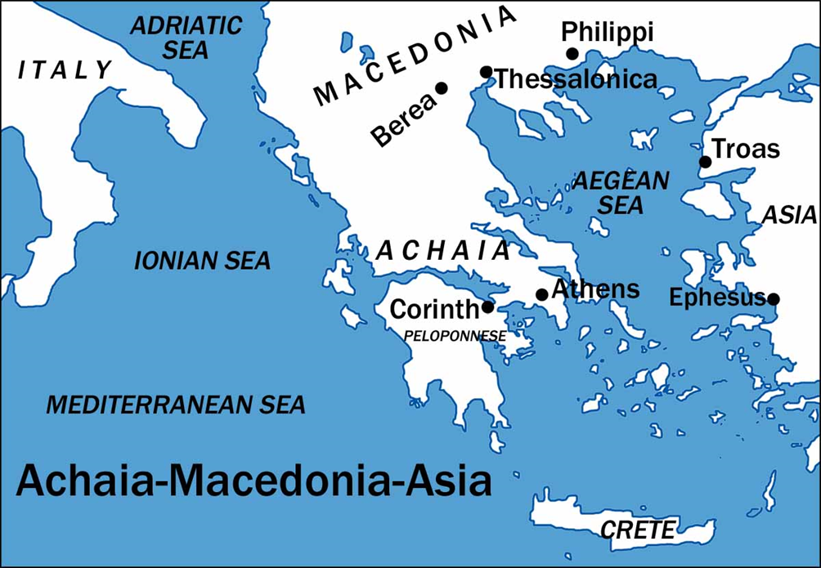
I Corinthians
Auditorium
Class 6
I Corinthians 7:1-40

Slide 2
 | Title | Day | Date
1 | Introduction | Sunday | Feb 25, 2017
2 | The Wisdom of God | Wednesday | March 1, 2017
3 | Spiritual vs. Carnal | Sunday | March 5, 2017
4 | Puffed Up | Wednesday | March 8, 2017
5 | Lawsuits and Former Lives | Sunday | March 12, 2017
6 | Questions of Marriage | Wednesday | March 15, 2017
7 | Regard for Others | Sunday | March 19, 2017
 | Meeting | Wednesday | March 22, 2017

Slide 3
Approach for today’s study:
Finish chapter 6
Paul Answers Questions on Marriage
Walk in the Manner You Were Called
4. Questions on Marriage Continued

Slide 4
I Corinthians
Auditorium
Class 5
I Corinthians 6:1 - 20

Slide 5
1 Corinthians 6:12 All things are lawful for me, but all things are not helpful. All things are lawful for me, but I will not be brought under the power of any. 13 Food is for the stomach and the stomach for foods, but God will destroy both it and them. Now the body is not for sexual immorality but for the Lord, and the Lord for the body. 14 And God both raised up the Lord and will also raise us up by His power.
15 Do you not know that your bodies are members of Christ? Shall I then take the members of Christ and make them members of a harlot? Certainly not! 16 Or do you not know that he who is joined to a harlot is one body with her? For “the two,” He says, “shall become one flesh.” 17 But he who is joined to the Lord is one spirit with Him.
“…but all things are not expedient:”
Helpful
Profitable
Worthwhile
Advisable

Slide 6
1 Corinthians 6:12 All things are lawful for me, but all things are not helpful. All things are lawful for me, but I will not be brought under the power of any. 13 Foods for the stomach and the stomach for foods, but God will destroy both it and them. Now the body is not for sexual immorality but for the Lord, and the Lord for the body. 14 And God both raised up the Lord and will also raise us up by His power.
15 Do you not know that your bodies are members of Christ? Shall I then take the members of Christ and make them members of a harlot? Certainly not! 16 Or do you not know that he who is joined to a harlot is one body with her? For “the two,” He says, “shall become one flesh.” 17 But he who is joined to the Lord is one spirit with Him.
I will not become a Slave to any of it…
Romans 6:12 Therefore do not let sin reign in your mortal body, that you should obey it in its lusts. 13 And do not present your members as instruments of unrighteousness to sin, but present yourselves to God as being alive from the dead, and your members as instruments of righteousness to God. 14 For sin shall not have dominion over you, for you are not under law but under grace.

Slide 7
Our bodies do have a natural desire for food and sex… so shouldn’t following those desires be ok?

Slide 8
1 Corinthians 6:15 Do you not know that your bodies are members of Christ? Shall I then take the members of Christ and make them members of a harlot? Certainly not! 16 Or do you not know that he who is joined to a harlot is one body with her? For “the two,” He says, “shall become one flesh.” 17 But he who is joined to the Lord is one spirit with Him.
11 And such were some of you. But you were washed, but you were sanctified, but you were justified in the name of the Lord Jesus
In Christ
Sin

Slide 9
1 Corinthians 6:15 Do you not know that your bodies are members of Christ? Shall I then take the members of Christ and make them members of a harlot? Certainly not! 16 Or do you not know that he who is joined to a harlot is one body with her? For “the two,” He says, “shall become one flesh.” 17 But he who is joined to the Lord is one spirit with Him.
1 Corinthians 6:18 Flee Immorality. Every other sin that a man commits is outside the body, but the immoral man sins against his own body. 19 Or do you not know that your body is a temple of the Holy Spirit who is in you, whom you have from God, and that you are not your own? 20 For you have been bought with a price: Therefore glorify God in your body.
Galatians 2:20 I have been crucified with Christ; it is no longer I who live, but Christ lives in me; and the life which I now live in the flesh I live by faith in the Son of God, who loved me and gave Himself for me

Slide 10
1 Corinthians 6:15 Do you not know that your bodies are members of Christ? Shall I then take the members of Christ and make them members of a harlot? Certainly not! 16 Or do you not know that he who is joined to a harlot is one body with her? For “the two,” He says, “shall become one flesh.” 17 But he who is joined to the Lord is one spirit with Him.
2 Peter 1:1 Simon Peter, a bondservant and apostle of Jesus Christ, To those who have obtained like precious faith with us by the righteousness of our God and Savior Jesus Christ:
2 Grace and peace be multiplied to you in the knowledge of God and of Jesus our Lord, 3 as His divine power has given to us all things that pertain to life and godliness, through the knowledge of Him who called us by glory and virtue, 4 by which have been given to us exceedingly great and precious promises, that through these you may be partakers of the divine nature, having escaped the corruption that is in the world through lust.

Slide 11
1 Corinthians 6:18 Flee Immorality. Every other sin that a man commits is outside the body, but the immoral man sins against his own body. 19 Or do you not know that your body is a temple of the Holy Spirit who is in you, whom you have from God, and that you are not your own? 20 For you have been bought with a price: Therefore glorify God in your body.

Slide 12
1 Corinthians 6:18 Flee Immorality. Every other sin that a man commits is outside the body, but the immoral man sins against his own body. 19 Or do you not know that your body is a temple of the Holy Spirit who is in you, whom you have from God, and that you are not your own? 20 For you have been bought with a price: Therefore glorify God in your body.

Slide 13
I Corinthians
Auditorium
Class 6
I Corinthians 7:1-40

Slide 14
1 Corinthians 7:1 Now concerning the things about which you wrote, it is good for a man not to touch a woman. 2 But because of immoralities, each man is to have his own wife, and each woman is to have her own husband. 3 The husband must fulfill his duty to his wife, and likewise also the wife to her husband. 4 The wife does not have authority over her own body, but the husband does; and likewise also the husband does not have authority over his own body, but the wife does. 5 Stop depriving one another, except by agreement for a time, so that you may devote yourselves to prayer, and come together again so that Satan will not tempt you because of your lack of self-control. 6 But this I say by way of concession, not of command. 7 Yet I wish that all men were even as I myself am. However, each man has his own gift from God, one in this manner, and another in that.

Slide 15
Possible Questions:
Is it ok for Christians to remain unmarried?
Should Christians seek to leave marriages, particularly where one spouse does not believe?
How should Christians’ lives change in social matters after being called to Christ?
Christian propriety toward marriage and a man’s virgin?
If a spouse dies, is the remaining spouse free to marry again?

Slide 16
1 Corinthians 7:1 Now concerning the things about which you wrote, it is good for a man not to touch a woman. 2 But because of immoralities, each man is to have his own wife, and each woman is to have her own husband. 3 The husband must fulfill his duty to his wife, and likewise also the wife to her husband. 4 The wife does not have authority over her own body, but the husband does; and likewise also the husband does not have authority over his own body, but the wife does. 5 Stop depriving one another, except by agreement for a time, so that you may devote yourselves to prayer, and come together again so that Satan will not tempt you because of your lack of self-control. 6 But this I say by way of concession, not of command. 7 Yet I wish that all men were even as I myself am. However, each man has his own gift from God, one in this manner, and another in that.

Slide 17
1 Corinthians 7:1 Now concerning the things about which you wrote, it is good for a man not to touch a woman. 2 But because of immoralities, each man is to have his own wife, and each woman is to have her own husband. 3 The husband must fulfill his duty to his wife, and likewise also the wife to her husband. 4 The wife does not have authority over her own body, but the husband does; and likewise also the husband does not have authority over his own body, but the wife does. 5 Stop depriving one another, except by agreement for a time, so that you may devote yourselves to prayer, and come together again so that Satan will not tempt you because of your lack of self-control. 6 But this I say by way of concession, not of command. 7 Yet I wish that all men were even as I myself am. However, each man has his own gift from God, one in this manner, and another in that.

Slide 18
1 Corinthians 7:1 Now concerning the things about which you wrote, it is good for a man not to touch a woman. 2 But because of immoralities, each man is to have his own wife, and each woman is to have her own husband. 3 The husband must fulfill his duty to his wife, and likewise also the wife to her husband. 4 The wife does not have authority over her own body, but the husband does; and likewise also the husband does not have authority over his own body, but the wife does. 5 Stop depriving one another, except by agreement for a time, so that you may devote yourselves to prayer, and come together again so that Satan will not tempt you because of your lack of self-control. 6 But this I say by way of concession, not of command. 7 Yet I wish that all men were even as I myself am. However, each man has his own gift from God, one in this manner, and another in that.

Slide 19
1 Corinthians 7:8 But I say to the unmarried and to widows that it is good for them if they remain even as I. 9 But if they do not have self-control, let them marry; for it is better to marry than to burn with passion. 10 But to the married I give instructions, not I, but the Lord, that the wife should not leave her husband 11 (but if she does leave, she must remain unmarried, or else be reconciled to her husband), and that the husband should not divorce his wife. 12 But to the rest I say, not the Lord , that if any brother has a wife who is an unbeliever, and she consents to live with him, he must not divorce her. 13 And a woman who has an unbelieving husband, and he consents to live with her, she must not send her husband away. 14 For the unbelieving husband is sanctified through his wife, and the unbelieving wife is sanctified through her believing husband; for otherwise your children are unclean, but now they are holy. 15 Yet if the unbelieving one leaves let him leave; the brother or the sister is not under bondage in such cases, but God has called us to peace. 16 For how do you know, O wife, whether you will save your husband? Or how do you know, O husband, whether you will save your wife?

Slide 20
1 Corinthians 7:8 But I say to the unmarried and to widows that it is good for them if they remain even as I. 9 But if they do not have self-control, let them marry; for it is better to marry than to burn with passion. 10 But to the married I give instructions, not I, but the Lord, that the wife should not leave her husband 11 (but if she does leave, she must remain unmarried, or else be reconciled to her husband), and that the husband should not divorce his wife. 12 But to the rest I say, not the Lord , that if any brother has a wife who is an unbeliever, and she consents to live with him, he must not divorce her. 13 And a woman who has an unbelieving husband, and he consents to live with her, she must not send her husband away. 14 For the unbelieving husband is sanctified through his wife, and the unbelieving wife is sanctified through her believing husband; for otherwise your children are unclean, but now they are holy. 15 Yet if the unbelieving one leaves let him leave; the brother or the sister is not under bondage in such cases, but God has called us to peace. 16 For how do you know, O wife, whether you will save your husband? Or how do you know, O husband, whether you will save your wife?
I Peter 3:1-2
In the same way, you wives, be submissive to your own husbands so that even if any of them are disobedient to the word, they may be won without a word by the behavior of their wives, as they observe your chaste and respectful behavior.
For how do you know, O wife,
whether you will save your husband? Or how do you know, O husband, whether you will save your wife?

Slide 21
1 Corinthians 7:17 Only, as the Lord has assigned to each one, as God has called each, in this manner let him walk. And so I direct in all the churches. 18 Was any man called when he was already circumcised? He is not to become uncircumcised. Has anyone been called in uncircumcision? He is not to be circumcised. 19 Circumcision is nothing, and uncircumcision is nothing, but what matters is the keeping of the commandments of God. 20 Each man must remain in the condition in which he was called. 21 Were you called while a slave? Do not worry about it; but if you are able also to become free, rather do that. 22 For he who was called in the Lord while a slave, is the Lord’s freedman; likewise he who was called while free, is Christ’s slave. 23 You were bought with a price; do not become slaves of men. 24 Brethren, each one is to remain with God in that condition in which he was called.

Slide 22
1 Corinthians 7:25 Now concerning virgins I have no command of the Lord, but I give an opinion as one who by the mercy of the Lord is trustworthy. 26 I think then that this is good in view of the present distress, that it is good for a man to remain as he is. 27 Are you bound to a wife? Do not seek to be released. Are you released from a wife? Do not seek a wife? 28 But if you marry, you have not sinned; and if a virgin marries, she has not sinned. Yet such will have trouble in this life, and I am trying to spare you. 29 But this I say, brethren, the time has been shortened, so that from now on those who have wives should be as though they had none; 30 and those who weep, as though they did not weep; and those who rejoice, as though they did not rejoice; and those who buy, as though they did not possess; 31 and those who use the world, as thought they did not make full use of it; for the form of this world is passing away.
I Pet 4:7 The end of all things is near; therefore be of sound judgment and sober spirit for the purpose of prayer.

Slide 23
1 Corinthians 7:32 But I want you to be free from concern. One who is unmarried is concerned about the things of the Lord, how he may please the Lord; 33 but one who is married is concerned about the things of the world, how he may please his wife, 34 and his interests are divided. The woman who is unmarried, and the virgin, is concerned about things of the Lord, that she may be holy both in body and spirit; but one who is married is concerned about the things of the world, how she may please her husband. 35 This I say for your own benefit; not to put a restraint upon you, but to promote what is appropriate and to secure undistracted devotion to the Lord.

Slide 24
1 Corinthians 7:36 But if any man thinks he is acting unbecomingly toward his virgin daughter, if she is past her youth, and if it must be so, let him do what he whishes, he does not sin; let her marry. 37 But he who stands firm in his heart, being under no constraint, but has authority over his own will, and has decided this in his own heart, to keep his own virgin daughter, he will do well. 38 So then both he who gives his own virgin daughter in marriage does well, and he who does not give her in marriage will do better.
1 Corinthians 7:39 A wife is bound as long as her husband lives; but if her husband is dead, she is free to be married to whom she wishes, only in the Lord. 40 But in my opinion she is happier if she remains as she is; and I think that I also have the Spirit of God.
Alternate Translations of “Father, Daughter” man, betrothed (ESV); man, virgin (NKJV);
virgin he is engaged to (NIV)
Does indicate a Christian only. Similar to the language in II Cor 12:2

