Slide 1
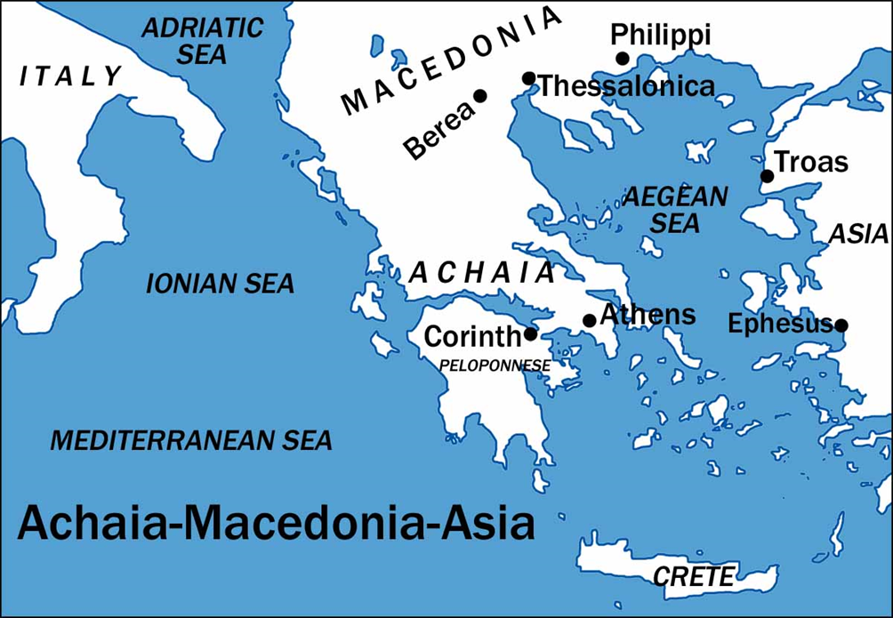
I Corinthians
Auditorium
Class 7
I Corinthians 8 & 9

Slide 2
 | Title | Day | Date
1 2 | Introduction The Wisdom of God | Sunday Wednesday | February 26 March 1
3 4 | Spiritual vs. Carnal Puffed Up | Sunday Wednesday | March 5 March 8
5 6 | Lawsuits and Former Lives Questions of Marriage | Sunday Wednesday | March 8 March 15
7 | Regard for Others NO CLASS (Gospel Meeting) | Sunday Wednesday | March 19 March 22
8 9 | Lessons from History Men and Women, Lord’s Supper | Sunday Wednesday | March 26 March 29
10 11 | Spiritual Gifts Spiritual Gifts in Worship | Sunday Wednesday | April 2 April 5
12 13 | Resurrection Conclusion and Review | Sunday Wednesday | April 9 April 12

Slide 3
Approach for today’s study:
Finish chapter 7
Take Care of Your Liberty
Paul Refuses His Liberty
Paul Becomes “All Things” to Win Souls
5. Running to Win? Control from Within!

Slide 4
1 Corinthians 7:36 But if any man thinks he is acting unbecomingly toward his virgin daughter, if she is past her youth, and if it must be so, let him do what he whishes, he does not sin; let her marry. 37 But he who stands firm in his heart, being under no constraint, but has authority over his own will, and has decided this in his own heart, to keep his own virgin daughter, he will do well. 38 So then both he who gives his own virgin daughter in marriage does well, and he who does not give her in marriage will do better.
1 Corinthians 7:39 A wife is bound as long as her husband lives; but if her husband is dead, she is free to be married to whom she wishes, only in the Lord. 40 But in my opinion she is happier if she remains as she is; and I think that I also have the Spirit of God.
Alternate Translations of “Father, Daughter” man, betrothed (ESV); man, virgin (NKJV);
virgin he is engaged to (NIV)
Does indicate a Christian only. Similar to the language in II Cor 12:2

Slide 5
I Corinthians
Auditorium
Class 7
I Corinthians 8 & 9

Slide 6
1 Corinthians 8:1 Now concerning things sacrificed to idols, we know that we all have knowledge. Knowledge makes arrogant, but love edifies. 2 If anyone supposes that he knows anything, he has not yet known as he ought to know; 3 but if anyone loves God, he is known by Him. 4 Therefore concerning the eating of things sacrificed to idols, we know that there is no such thing as an idol in the world, and that there is no God but one. 5 For even if there are so-called gods whether in heaven or on earth, as indeed there are many gods and many lords, 6 yet for us there is but one God, the Father, from whom are all things and we exist for Him; and one Lord, Jesus Christ, by whom are all things, and we exist through him.
Now concerning…
7:1,25 things about which you wrote, virgins
8:1,4 things sacrificed to idols, eating of things sacrificed
12:1 spiritual gifts
16:1 the collection for the saints

Slide 7
1 Corinthians 8:1 Now concerning things sacrificed to idols, we know that we all have knowledge. Knowledge makes arrogant, but love edifies. 2 If anyone supposes that he knows anything, he has not yet known as he ought to know; 3 but if anyone loves God, he is known by Him. 4 Therefore concerning the eating of things sacrificed to idols, we know that there is no such thing as an idol in the world, and that there is no God but one. 5 For even if there are so-called gods whether in heaven or on earth, as indeed there are many gods and many lords, 6 yet for us there is but one God, the Father, from whom are all things and we exist for Him; and one Lord, Jesus Christ, by whom are all things, and we exist through him.

Slide 8
1 Corinthians 8:1 Now concerning things sacrificed to idols, we know that we all have knowledge. Knowledge makes arrogant, but love edifies. 2 If anyone supposes that he knows anything, he has not yet known as he ought to know; 3 but if anyone loves God, he is known by Him. 4 Therefore concerning the eating of things sacrificed to idols, we know that there is no such thing as an idol in the world, and that there is no God but one. 5 For even if there are so-called gods whether in heaven or on earth, as indeed there are many gods and many lords, 6 yet for us there is but one God, the Father, from whom are all things and we exist for Him; and one Lord, Jesus Christ, by whom are all things, and we exist through him.

Slide 9
1 Corinthians 8:1 Now concerning things sacrificed to idols, we know that we all have knowledge. Knowledge makes arrogant, but love edifies. 2 If anyone supposes that he knows anything, he has not yet known as he ought to know; 3 but if anyone loves God, he is known by Him. 4 Therefore concerning the eating of things sacrificed to idols, we know that there is no such thing as an idol in the world, and that there is no God but one. 5 For even if there are so-called gods whether in heaven or on earth, as indeed there are many gods and many lords, 6 yet for us there is but one God, the Father, from whom are all things and we exist for Him; and one Lord, Jesus Christ, by whom are all things, and we exist through him.
“If I have the gift of prophecy, and know all mysteries and all knowledge; and if I have all faith, so as to remove mountains, but do not have love, I am nothing.”
-I Corinthians 13:2

Slide 10
1 Corinthians 8:4 Therefore concerning the eating of things sacrificed to idols, we know that there is no such thing as an idol in the world, and that there is no God but one. 5 For even if there are so-called gods whether in heaven or on earth, as indeed there are many gods and many lords, 6 yet for us there is but one God, the Father, from whom are all things and we exist for Him; and one Lord, Jesus Christ, by whom are all things, and we exist through him.
I Corinthians 10:14-22
Sounds good!
“However…”

Slide 11
1 Corinthians 8:7 However not all men have this knowledge; but some, being accustomed to the idol until now, eat food as if it were sacrificed to an idol; and their conscience being weak is defiled. 8 But food will not commend us to God; we are neither the worse if we do not eat, nor the better if we do eat. 9 But take care that this liberty of yours does not somehow become a stumbling block to the weak. 10 For if someone sees you, who have knowledge, dining in an idol’s temple, will not his conscience, if he is weak be strengthened to eat things sacrificed to idols? 11 For through your knowledge he who is weak is ruined, the brother for whose sake Christ died. 12 And so, by sinning against the brethren and wounding their conscience when it is weak, you sin against Christ. 13 Therefore, if food causes my brother to stumble, I will never eat meat again, so that I will not cause my brother to stumble.

Slide 12
1 Corinthians 8:7 However not all men have this knowledge; but some, being accustomed to the idol until now, eat food as if it were sacrificed to an idol; and their conscience being weak is defiled. 8 But food will not commend us to God; we are neither the worse if we do not eat, nor the better if we do eat. 9 But take care that this liberty of yours does not somehow become a stumbling block to the weak. 10 For if someone sees you, who have knowledge, dining in an idol’s temple, will not his conscience, if he is weak be strengthened to eat things sacrificed to idols? 11 For through your knowledge he who is weak is ruined, the brother for whose sake Christ died. 12 And so, by sinning against the brethren and wounding their conscience when it is weak, you sin against Christ. 13 Therefore, if food causes my brother to stumble, I will never eat meat again, so that I will not cause my brother to stumble.

Slide 13
So, to what does this apply for us?
Therefore, if ________ causes my brother to stumble, I will never _______ again, so that I will not cause my brother to stumble.

Slide 14
1 Corinthians 9:1 Am I not free? Am I not an apostle? Have I not seen Jesus our Lord? Are you not my work in the Lord? 2 If to others I am not an apostle, at least I am to you; for you are the seal of my apostleship in the Lord. 3 My defense to those who examine me is this: 4 Do we not have a right to eat and drink? 5 Do we not have a right to eat and drink? 5 Do we not have a right to take along a believing wife, even as the rest of the apostles and the brothers of the Lord and Cephas? 6 Or do only Barnabas and I not have a right to refrain from working? 7 Who at any time serves as a soldier at his own expense? Who plants a vineyard and does not eat the fruit of it? Or who tends a flock and does not use the milk of the flock?

Slide 15
1 Corinthians 9:1 Am I not free? Am I not an apostle? Have I not seen Jesus our Lord? Are you not my work in the Lord? 2 If to others I am not an apostle, at least I am to you; for you are the seal of my apostleship in the Lord. 3 My defense to those who examine me is this: 4 Do we not have a right to eat and drink? 5 Do we not have a right to eat and drink? 5 Do we not have a right to take along a believing wife, even as the rest of the apostles and the brothers of the Lord and Cephas? 6 Or do only Barnabas and I not have a right to refrain from working? 7 Who at any time serves as a soldier at his own expense? Who plants a vineyard and does not eat the fruit of it? Or who tends a flock and does not use the milk of the flock?

Slide 16
1 Corinthians 9:8 I am not speaking these things according to human judgment, am I? Or does not the Law also say these things? 9 For it is written in the Law of Moses, “You shall not muzzle the ox while he is threshing.” God is not concerned about the oxen is He? 10 Or is He speaking altogether for our sake? Yes, for our sake it was written, because the plowman ought to plow in hope, and the thresher to thresh in hope of sharing the crops. 11 If we sowed spiritual things in you, is it too much if we reap material things from you? 12 If others share the right over you do we not more? Nevertheless, we did not use this right, but we endure all things so that we will cause no hindrance to the gospel of Christ. 13 Do you not know that those who perform sacred services eat the food of the temple and those who attend regularly to the altar have their share from the altar? 14 So also the Lord directed those who proclaim the gospel to get their living from the gospel.

Slide 17
1 Corinthians 9:8 I am not speaking these things according to human judgment, am I? Or does not the Law also say these things? 9 For it is written in the Law of Moses, “You shall not muzzle the ox while he is threshing.” God is not concerned about the oxen is He? 10 Or is He speaking altogether for our sake? Yes, for our sake it was written, because the plowman ought to plow in hope, and the thresher to thresh in hope of sharing the crops. 11 If we sowed spiritual things in you, is it too much if we reap material things from you? 12 If others share the right over you do we not more? Nevertheless, we did not use this right, but we endure all things so that we will cause no hindrance to the gospel of Christ. 13 Do you not know that those who perform sacred services eat the food of the temple and those who attend regularly to the altar have their share from the altar? 14 So also the Lord directed those who proclaim the gospel to get their living from the gospel.
“Whatever city you enter and they receive you, eat what is set before you;” - Luke 10:8

Slide 18
1 Corinthians 9:15 But I have used none of these things. And I am not writing these things so that it will be done so in my case; for it would be better for me to die than have any man make my boast an empty one. 16 For if I preach the gospel, I have nothing to boast of, for I am under compulsion; for woe is me if I do not preach the gospel. 17 For if I do this voluntarily, I have a reward; but if against my will, I have a stewardship entrusted to me. 18 What then is my reward? That, when I preach the gospel, I may offer the gospel without charge, so as not to make full use of my right in the gospel.

Slide 19
1 Corinthians 9:19 For though I am free from all men, I have made myself a slave to all, so that I may win more. 20 To the Jews I became as a Jew, so that I might win Jews; to those who are under the Law, as under the Law, as under the Law though not being myself under the Law, so that I might win those who are under the Law; 21 to those who are without the law, as without the law, though not being without the law of God but under the law of Christ, so that I might win those who are without the law. 22 To the weak I became weak, that I might win the weak; I have become all things to all men, so that I may by all means save some. 23 I do all things for the sake of the gospel, so that I may become a fellow partaker of it.

Slide 20
1 Corinthians 9:19 For though I am free from all men, I have made myself a slave to all, so that I may win more. 20 To the Jews I became as a Jew, so that I might win Jews; to those who are under the Law, as under the Law, as under the Law though not being myself under the Law, so that I might win those who are under the Law; 21 to those who are without the law, as without the law, though not being without the law of God but under the law of Christ, so that I might win those who are without the law. 22 To the weak I became weak, that I might win the weak; I have become all things to all men, so that I may by all means save some. 23 I do all things for the sake of the gospel, so that I may become a fellow partaker of it.

Slide 21
1 Corinthians 9:24 Do you not know that those who run in a race all run, but only one receives the prize? Run in such a way that you may win. 25 Everyone who competes in the games exercises self-control in all things. They then do it to receive a perishable wreath, but we an imperishable. 26 Therefore I run in such a way, as not without aim; I box in such a way, as not beating the air; 27 but I discipline my body and make it my slave, so that, after I have preached to others, I myself will not be disqualified.

Slide 22
1 Corinthians 9:24 Do you not know that those who run in a race all run, but only one receives the prize? Run in such a way that you may win. 25 Everyone who competes in the games exercises self-control in all things. They then do it to receive a perishable wreath, but we an imperishable. 26 Therefore I run in such a way, as not without aim; I box in such a way, as not beating the air; 27 but I discipline my body and make it my slave, so that, after I have preached to others, I myself will not be disqualified.
Self-control: (enkrateuetai) literally means “exercising dominion, from within”
“Therefore since we have so great a cloud of witnesses surrounding us, let us lay aside every encumbrance and the sin which so easily entangles us, and let us run with endurance the race that is set before us, fixing our eyes on Jesus…” -Hebrews 12:1-2a

Slide 23
1 Corinthians 9:24 Do you not know that those who run in a race all run, but only one receives the prize? Run in such a way that you may win. 25 Everyone who competes in the games exercises self-control in all things. They then do it to receive a perishable wreath, but we an imperishable. 26 Therefore I run in such a way, as not without aim; I box in such a way, as not beating the air; 27 but I discipline my body and make it my slave, so that, after I have preached to others, I myself will not be disqualified.
“…the time of my departure has come. I have fought the good fight, I have finished the course, I have kept the faith; in the future there is laid up for me the crown of righteousness, which the Lord, the righteous Judge, will award to me on that day; and not only to me, but also to all who have loved His appearing.” -II Timothy 4:6b-8

