Slide 1
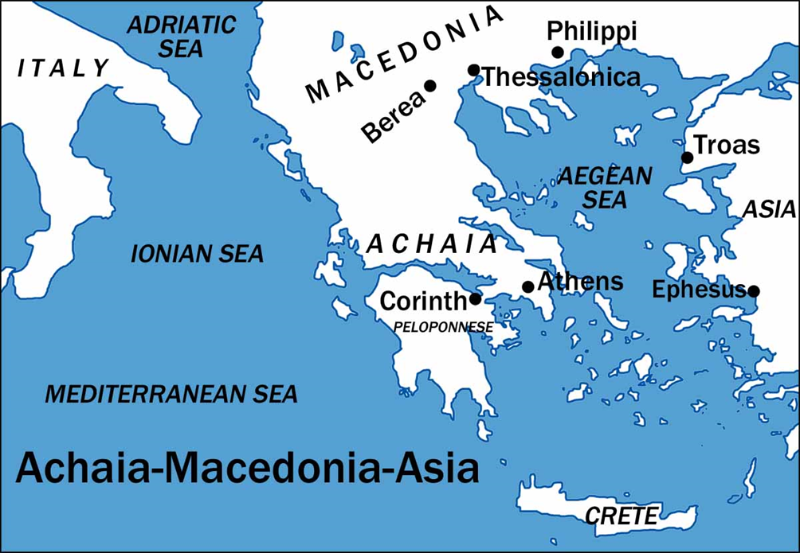
I Corinthians
Auditorium
Class 2
I Cor 1:17-2:16

Slide 2
Approach for today’s study:
Review Class 1 & 1 Cor 1:1-17
Man vs. the Wisdom of God
Lessons for us
Source of Spiritual Wisdom

Slide 3
 | Title | Day | Date
1 | Introduction | Sunday | Feb 25, 2017
2 | The Wisdom of God | Wednesday | March 1, 2017
3 | Spiritual vs. Carnal | Sunday | March 5, 2017
4 | Puffed Up | Wednesday | March 8, 2017
5 | Lawsuits and Former Lives | Sunday | March 12, 2017
6 | Questions of Marriage | Wednesday | March 15, 2017
7 | Regard for Others | Sunday | March 19, 2017
 | Meeting | Wednesday | March 22, 2017

Slide 4
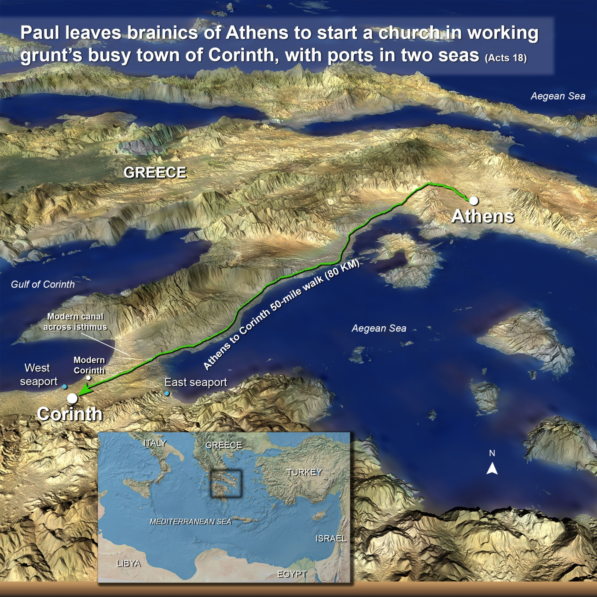

Slide 5
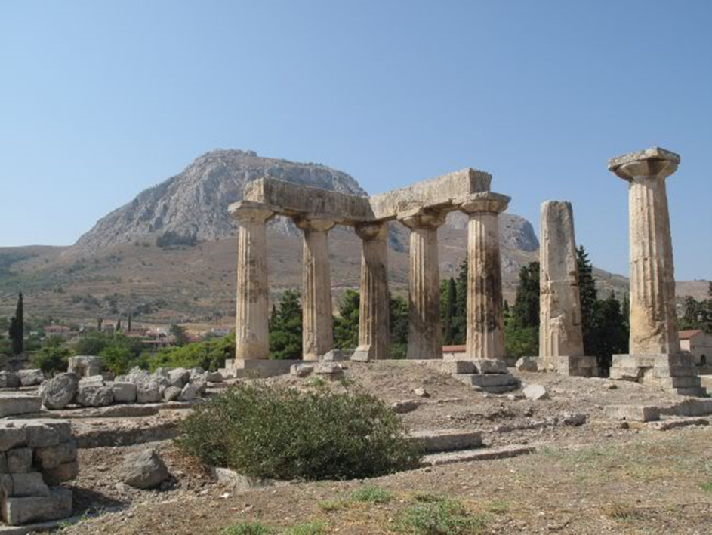
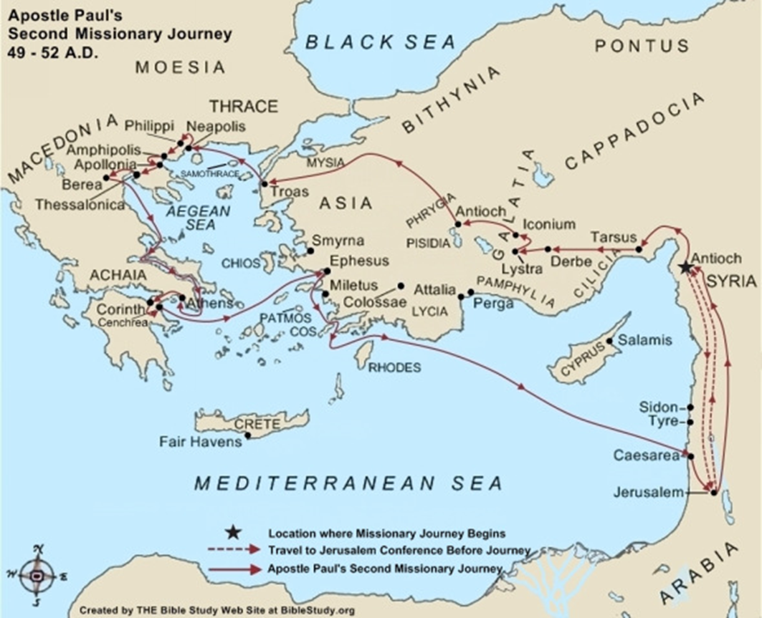
Notes:
The old Corinth was burned in 146 B.C. by the Roman proconsul, L. Mummius. Because it was a city devoted to the gods. In 46 B.C., Julius Caesar rebuilt the city, populated it with a colony of veterans and freedmen, and
named it Julia Corinthus. It soon became a very important commercial center. About 50 miles to the east was the city of Athens. The city's close proximity to the city of Athens probably added the problem of intellectualism.

Slide 6
1 Corinthians 1: 11 For it has been declared to me concerning you, my brethren, by those of Chloe’s household, that there are contentions among you.

Slide 7
1 Corinthians 1: 11 For it has been declared to me concerning you, my brethren, by those of Chloe’s household, that there are contentions among you.
12 Now I say this, that each of you says, “I am of Paul,” or “I am of Apollos,” or “I am of Cephas,” or “I am of Christ.” 13 Is Christ divided? Was Paul crucified for you? Or were you baptized in the name of Paul?14 I thank God that I baptized none of you except Crispus and Gaius, 15 lest anyone should say that I had baptized in my own name. 16 Yes, I also baptized the household of Stephanas. Besides, I do not know whether I baptized any other. 17 For Christ did not send me to baptize, but to preach the gospel, not with wisdom of words, lest the cross of Christ should be made of no effect.
“My Preacher Says______”
“Brother So’Andso teaches that__________”
“Most Preacher in the church of Christ would agree that ________”
“My church has always taught that___________”

Slide 8
1 Corinthians 1: 18 For the message of the cross is foolishness to those who are perishing, but to us who are being saved it is the power of God. 19 For it is written:
“I will destroy the wisdom of the wise,
And bring to nothing the understanding of the prudent.”
20 Where is the wise? Where is the scribe? Where is the disputer of this age? Has not God made foolish the wisdom of this world? 21 For since, in the wisdom of God, the world through wisdom did not know God, it pleased God through the foolishness of the message preached to save those who believe. 22 For Jews request a sign, and Greeks seek after wisdom; 23 but we preach Christ crucified, to the Jews a stumbling block and to the Greeks foolishness, 24 but to those who are called, both Jews and Greeks, Christ the power of God and the wisdom of God. 25 Because the foolishness of God is wiser than men, and the weakness of God is stronger than men.

Slide 9
1 Corinthians 1: 18 For the message of the cross is foolishness to those who are perishing, but to us who are being saved it is the power of God. 19 For it is written:
“I will destroy the wisdom of the wise,
And bring to nothing the understanding of the prudent.”
20 Where is the wise? Where is the scribe? Where is the disputer of this age? Has not God made foolish the wisdom of this world? 21 For since, in the wisdom of God, the world through wisdom did not know God, it pleased God through the foolishness of the message preached to save those who believe. 22 For Jews request a sign, and Greeks seek after wisdom; 23 but we preach Christ crucified, to the Jews a stumbling block and to the Greeks foolishness, 24 but to those who are called, both Jews and Greeks, Christ the power of God and the wisdom of God. 25 Because the foolishness of God is wiser than men, and the weakness of God is stronger than men.

Slide 10




?
Right / Wrong
Spiritual Things

Slide 11
1 Corinthians 1: 18 For the message of the cross is foolishness to those who are perishing, but to us who are being saved it is the power of God. 19 For it is written:
“I will destroy the wisdom of the wise,
And bring to nothing the understanding of the prudent.”
20 Where is the wise? Where is the scribe? Where is the disputer of this age? Has not God made foolish the wisdom of this world? 21 For since, in the wisdom of God, the world through wisdom did not know God, it pleased God through the foolishness of the message preached to save those who believe. 22 For Jews request a sign, and Greeks seek after wisdom; 23 but we preach Christ crucified, to the Jews a stumbling block and to the Greeks foolishness, 24 but to those who are called, both Jews and Greeks, Christ the power of God and the wisdom of God. 25 Because the foolishness of God is wiser than men, and the weakness of God is stronger than men.
What kind(s) of foolishness is Paul talking about?

Slide 12

Teaching back
by Miracles
Divine Revelation
Death on a Cross
Then Resurrection
Right / Wrong
Spiritual Things
Notes:
Do people Still think these things are foolish today?

Slide 13
Are these principles on how we understand right/ wrong and God’s plan for man still viewed as foolish today?
Why did God choose what the world viewed as foolish to save the world?

Slide 14
1 Corinthians 1: 26 For you see your calling, brethren, that not many wise according to the flesh, not many mighty, not many noble, are called. 27 But
God has chosen the foolish things of the world to put to shame the wise, and
God has chosen the weak things of the world to put to shame the things which are mighty;
28 and the base things of the world and the things which are despised God has chosen,
and the things which are not, to bring to nothing the things that are,
29 that no flesh should glory in His presence.
30 But of Him you are in Christ Jesus, who became for us wisdom from God—and righteousness and sanctification and redemption— 31 that, as it is written, “He who glories, let him glory in the Lord

Slide 15
Lessons for us:
Be mindful of pride in wisdom / knowledge
Don’t think yourself mighty
God finds good in things most men reject
Things held in high regard by men are negated by what God wants

Slide 16
So what are we to cling to ?
30 But of Him you are in Christ Jesus, who became for us wisdom from God—and righteousness and sanctification and redemption— 31 that, as it is written, “He who glories, let him glory in the Lord

Slide 17
1 Corinthians 2:1 And I, brethren, when I came to you, did not come with excellence of speech or of wisdom declaring to you the testimony of God. 2 For I determined not to know anything among you except Jesus Christ and Him crucified. 3 I was with you in weakness, in fear, and in much trembling. 4 And my speech and my preaching were not with persuasive words of human wisdom, but in demonstration of the Spirit and of power, 5 that your faith should not be in the wisdom of men but in the power of God.

Slide 18
1 Corinthians 2:1 And I, brethren, when I came to you, did not come with excellence of speech or of wisdom declaring to you the testimony of God. 2 For I determined not to know anything among you except Jesus Christ and Him crucified. 3 I was with you in weakness, in fear, and in much trembling. 4 And my speech and my preaching were not with persuasive words of human wisdom, but in demonstration of the Spirit and of power, 5 that your faith should not be in the wisdom of men but in the power of God.
Contrast Paul to the leading teachers of the day.

Slide 19
Paul’s Manner Of Preaching
  Paul Proclaimed Only Christ and Him Crucified (1-3)
  In Weakness, Fear, and Trembling (3)
  Demonstrated Of The Spirit And Of Power (4-5)
  Faith Should Rest In Power Of God Not In Men (5)

Slide 20
1 Corinthians 2:6 However, we speak wisdom among those who are mature, yet not the wisdom of this age, nor of the rulers of this age, who are coming to nothing. 7 But we speak the wisdom of God in a mystery, the hidden wisdom which God ordained before the ages for our glory, 8 which none of the rulers of this age knew; for had they known, they would not have crucified the Lord of glory.

Slide 21
1 Corinthians 2:6 However, we speak wisdom among those who are mature, yet not the wisdom of this age, nor of the rulers of this age, who are coming to nothing. 7 But we speak the wisdom of God in a mystery, the hidden wisdom which God ordained before the ages for our glory, 8 which none of the rulers of this age knew; for had they known, they would not have crucified the Lord of glory.
1 Corinthians 2:10 But God has revealed them to us through His Spirit. For the Spirit searches all things, yes, the deep things of God. 11 For what man knows the things of a man except the spirit of the man which is in him? Even so no one knows the things of God except the Spirit of God. 12 Now we have received, not the spirit of the world, but the Spirit who is from God, that we might know the things that have been freely given to us by God.

Slide 22
1 Corinthians 2:12 Now we have received, not the spirit of the world, but the Spirit who is from God, that we might know the things that have been freely given to us by God.
?
Right / Wrong
Spiritual Things

Slide 23
Lessons for us:
Look for spiritual understanding in things delivered by the Spirit to us
Be filled with the wisdom of God as guided by the Spirit
Know God by his words/ wisdom not your perceptions

Slide 24
1 Corinthians 2: 13 These things we also speak, not in words which man’s wisdom teaches but which the Holy Spirit teaches, comparing spiritual things with spiritual. 14 But the natural man does not receive the things of the Spirit of God, for they are foolishness to him; nor can he know them, because they are spiritually discerned. 15 But he who is spiritual judges all things, yet he himself is rightly judged by no one. 16 For “who has known the mind of the Lord that he may instruct Him?” But we have the mind of Christ.

Slide 25
1 Corinthians 2: 13 These things we also speak, not in words which man’s wisdom teaches but which the Holy Spirit teaches, comparing spiritual things with spiritual. 14 But the natural man does not receive the things of the Spirit of God, for they are foolishness to him; nor can he know them, because they are spiritually discerned. 15 But he who is spiritual judges all things, yet he himself is rightly judged by no one. 16 For “who has known the mind of the Lord that he may instruct Him?” But we have the mind of Christ.
Why do those Wise in the world tend to reject Christ?

