Slide 1
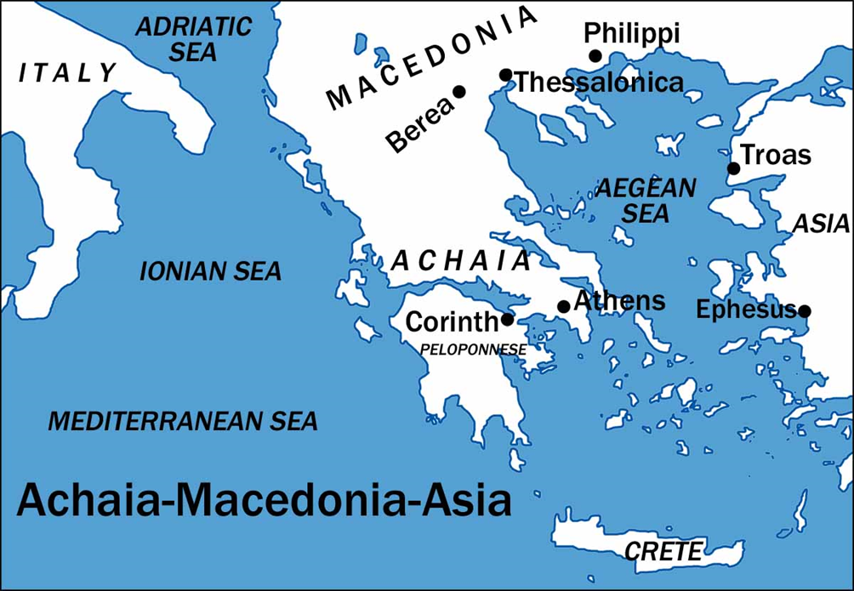
I Corinthians
Auditorium
Class 13
I Corinthians 16 & Review

Slide 2
Approach for today’s study:
Chapter 16
Review
Comments and Discussion

Slide 3
1 Corinthians 16
Prefaced by 15:58
The collection
On the first day of every week
Each one to put aside and save – store up, deposit
As he may prosper – as one is able
So no collections be made when I come
Other things
Paul is coming after he goes through Macedonia
If Timothy comes be a blessing to him (10-11)
Call to strength and love (13-14)
“My love be with you all in Christ Jesus. Amen (24)

Slide 4
1. City of Corinth
Notes:
The old Corinth was burned in 146 B.C. by the Roman proconsul, L. Mummius. Because it was a city devoted to the gods. In 46 B.C., Julius Caesar rebuilt the city, populated it with a colony of veterans and freedmen, and
named it Julia Corinthus. It soon became a very important commercial center. About 50 miles to the east was the city of Athens. The city's close proximity to the city of Athens probably added the problem of intellectualism.

Slide 5
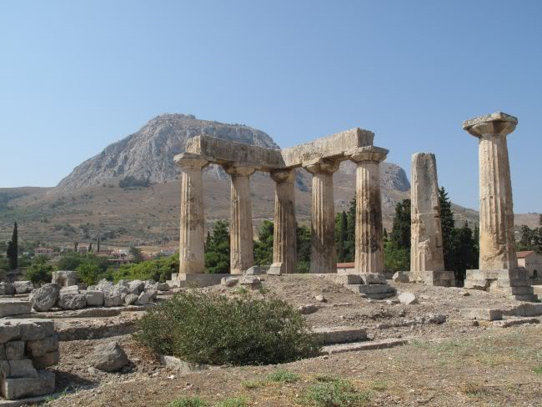
Temple of Aphrodite
Notes:
it was a place for all sorts of vice. An example of its immorality was found in the temple of Venus (Aphrodite),which hosted 1000 priestesses dedicated to prostitution in the name of religion.

Slide 6
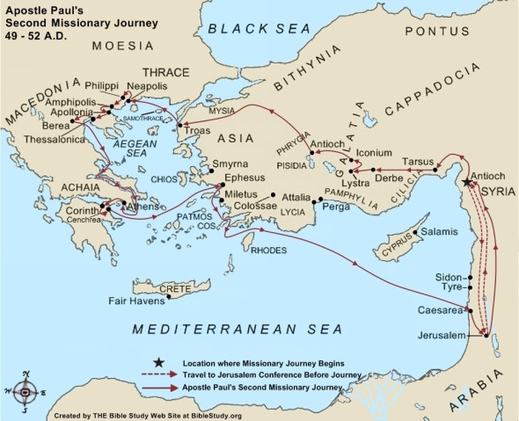
2. Paul’s Relationship with them
Acts 18:1 After these things Paul departed from Athens and went to Corinth. 2 And he found a certain Jew named Aquila, born in Pontus, who had recently come from Italy with his wife Priscilla (because Claudius had commanded all the Jews to depart from Rome); and he came to them

Slide 7
2. Paul’s Relationship with them
Acts 18:1-18
Abiding with Aquila and Priscilla, fellow tentmakers; reasoning in the synagogue every Sabbath (Ac 18:1-6).
9Now the Lord spoke to Paul in the night by a vision, “Do not be afraid, but speak, and do not keep silent; 10 for I am with you, and no one will attack you to hurt you; for I have many people in this city.”
2) In the house of Justus, abiding there and teaching for a year and six months (Ac 18:7-11)
3) An incident before Gallio, proconsul of Achaia (Ac 18:12-18)
12 When Gallio was proconsul of Achaia, the Jews with one accord rose up against Paul and brought him to the judgment seat, 13 saying, “This fellow persuades men to worship God contrary to the law.”
Notes:
8Then Crispus, the ruler of the synagogue, believed on the Lord with all his household. And many of the Corinthians, hearing, believed and were baptized.

Slide 8
2. Paul’s Relationship with them
Took with him Aquila and Priscilla when he sailed for Syria Acts 18:18
Paul looked at them as his children 1Cor 4:14-15
14 I do not write these things to shame you, but as my beloved children I warn you. 15 For though you might have ten thousand instructors in Christ, yet you do not have many fathers; for in Christ Jesus I have begotten you through the gospel.
Notes:
8Then Crispus, the ruler of the synagogue, believed on the Lord with all his household. And many of the Corinthians, hearing, believed and were baptized.

Slide 9
Reasons for writing
The bad news concerning the problems at Corinth had reached Paul in Ephesus…
Two sources:
1) the household of Chloe (1:11)
2) a letter sent to him (7:1), (possibly by the hands of Stephanas, Fortunatus, and Achaicus 16:17)

Slide 10
Content Overview
I. PROBLEMS REPORTED BY THE HOUSE OF CHLOE (1:10-6:20)
A. FACTIONS IN THE CHURCH (1:1-4:21)
B. SEXUAL IMMORALITY (5:1-13)
C. LAWSUITS AMONG BRETHREN (6:1-11)
D. MORAL DEFILEMENTS (6:12-20)

Slide 11
Content Overview
II. PROBLEMS MENTIONED IN THE LETTER FROM CORINTH (7:1-16:9)
A. MARRIAGE & CELIBACY (7:1-40)
B. EATING MEATS SACRIFICED TO IDOLS (8:1-11:1)
C. WOMEN PRAYING AND PROPHESYING (11:2-16)
D. THE LORD'S SUPPER (11:17-34)
E. SPIRITUAL GIFTS (12:1-14:40)
F. RESURRECTION FROM THE DEAD (15:1-58)
G. COLLECTION FOR THE SAINTS (16:1-4)

Slide 12
Applicable for us today?
Questions about inspiration
Problems of addictive behavior (sexual, drugs, alcohol, tobacco ) chap 6
Living with an unbelieving spouse (chap 7)
Need to make sacrifices to encourage others (Chap 10)
Lack of heartfelt worship (Chap 14)
Need for self-control (Chap 9)
A woman’s spiritual role (Chap 11, and 14)
Faith in resurrection

Slide 13
Ch 1: No Reason for Divisions
KEY TEXT
Vs. 10 “Now I exhort you… that there be no divisions among you…”
WHAT WERE THEY DOING?
Vs. 12-13 “I am of Paul, Apollos, Cephas, Christ”
LESSONS
Vs 10 All agree, be made complete in the same mind and in the same judgment
Vs 30-31 by His doing you are in Christ Jesus…Let him who boasts, boast in the Lord

Slide 14
Ch 2: Paul’s Message: The Wisdom of God
KEY TEXT
Vs. 4f “[Paul’s] message/preaching were not in persuasive words of wisdom…so that your faith wouldn’t rest on the wisdom of men, but on the power of God.
WHAT WERE THEY DOING?
3:1f They were immature and not ready for this wisdom
LESSONS
Vs 7f God’s wisdom is not of this age, predestined before the ages to our glory, none of the rulers of this age has understood, revealed through the Spirit who searches even the depths of God

Slide 15
Ch 3: Corinthians’ Carnal Minds
KEY TEXT
Vs. 1 I gave you milk to drink, not solid food; for you were note yet able to receive it.
WHAT WERE THEY DOING?
Showing their immaturity by their fleshly nature, walking like mere men
LESSONS
Vs 16 Do you not know that the Spirit of God dwells in you?
Vs 19 For the wisdom of this world is foolishness before God.

Slide 16
Ch 4: Servant Evangelists
KEY TEXT
Vs. 1 Let a man regard us…as servants of Christ and stewards of the mysteries of God.
WHAT WERE THEY DOING?
Vs 3 Examining Paul (and the other apostles) when the Lord is the One to Whom they must answer.
LESSONS
Vs 14f Paul is admonishing as a father to beloved children.
Vs 19 Imitate the righteous.
Vs 21 Paul would do what was necessary for their good in the Gospel, whether with a rod or love and gentleness

Slide 17
Ch 5: Sin in the Church
KEY TEXT
Vs. 2 You have become arrogant and have not mourned instead, so that the one who had done this deed would be removed from your midst.
WHAT WERE THEY DOING?
Vs 1 One among them had his father’s wife and they were tolerant of the sin.
Vs 2,6 They were arrogant and boasting
LESSONS
Vs 5 Deliver such a one to Satan for the destruction of his flesh, so that his spirit may be saved in the day of the Lord Jesus.
Vs 12-13 But those who are outside, God judges. Remove the wicked man from yourselves

Slide 18
Ch 6: Lawsuits and Liberties (or Immorality)
KEY TEXTS
Vs. 7 It is already a defeat for you, that you have lawsuits with one another.
Vs. 11 You were sinners but you were washed, sanctified, justified in Christ and in the Spirit of God.
WHAT WERE THEY DOING?
Vs 1-6 Taking each other to court before judges who are of no account in the church
LESSONS
Vs 2 Saints will judge the world and are able to judge among brethren in earthly matters.
Vs. 13 The body is not for immorality but for the Lord.

Slide 19
Ch 7: Liberties: Marriage
KEY TEXT
Vs. 1 Because of immoralities, each man is to have his own wife and each woman is to have her own husband.
WHAT WERE THEY DOING?
Vs 1 Questioning marriage as it relates to walking with Christ
LESSONS
Vs 9 Two options: Marry or have self-control
Vs 12f If a Christian has an unbelieving spouse who consents to live with them, they should stay.
Vs 19 what matters is keeping the commandments of God.
Vs 17 Remain in the condition in which you were called.

Slide 20
Ch 8: Liberties: Meat Offered to Idols
KEY TEXT
Vs. 9 But take care that this liberty of yours does not somehow become a stumbling block to the weak.
WHAT WERE THEY DOING?
Vs 1 Some were comfortable partaking of meat sacrificed to idols while others were not. Brethren were wounding weaker brethren’s consciences.
LESSONS
Vs 8 Food will not commend us to God, nor refraining.
Vs 12-13 Sin against a brother and wounding their conscience is sin against Christ. If food causes my brother to stumble, I will never ear meat again, so that I will not cause my brother to stumble.

Slide 21
Ch 9: Paul’s Liberties
KEY TEXT
Vs. 18 What then is my reward? That, when I preach the gospel, I may offer the gospel without charge, so as not to make full use of my right in the gospel.
WHAT WERE THEY DOING?
Not adequately considering the conscience of others
LESSONS
Paul was foregoing liberties to which he was entitled to as an apostle and minister of the gospel.
Vs 19-27 Paul’s effort to “by all means save some”

Slide 22
Ch 10: Israel’s “Liberties” Lesson
KEY TEXT
Vs. 6 Now these things happened as examples for us, so that we would not crave evil things as they also craved.
WHAT WERE THEY DOING?
Falling into the same traps as the Israelites.
LESSONS
Vs 6-10 Do not be idolaters, nor act immorally, nor try the Lord, nor grumble.
Vs 12-13 Don’t overestimate your status; God provides a way of escape so that you will be able to endure.

Slide 23
Ch 11: Ch 11: Head Covering & Lord’s Supper
KEY TEXT
Vs. 18 …when you come together as a church, I hear that divisions exist among you; and in part I believe it.\
WHAT WERE THEY DOING?
Vs. 17 Come together not for the better but for the worse.
Vs. 20 When you meet together, it is not to eat the Lord’s Supper
LESSONS
Vs 3 God – Christ – every man - woman
Vs 26f Lord’s Supper: proclaiming the Lord’s death, one must examine himself so that he does not eat unworthily, wait for one another.
Vs 31 If we judged ourselves rightly, we would not be judged.

Slide 24
Ch 12: Spiritual Gifts: Members of One Body
KEY TEXT
Vs. 12 For even as the body is one and yet has many members, and all the members of the body, though they are many, are one body, so also is Christ.
WHAT WERE THEY DOING?
Having trouble understanding the variety of gifts and seemingly showing partiality based on gifts.
LESSONS
Vs 7 manifestations of the Spirit were for the common good
Vs 18 God has placed the members, each one of them, in the body, just as he desired.

Slide 25
Ch 13: Spiritual Gifts: Love is Better
KEY TEXT
Vs. 1-3 without love: we are useless noise, we are nothing, actions profit us nothing
WHAT WERE THEY DOING?
They focused on the actions, or gifts, rather than the motivation for using them.
LESSONS
Vs 4f Love is patient, kind, not jealous, doesn’t brag, is not arrogant, does not act unbecomingly, does not seek its own, is not provoked, doesn’t take into account a wrong suffered, doesn’t rejoice in unrighteousness, rejoices with the truth, bears, believes, hopes, and endures all things. LOVE NEVER FAILS.

Slide 26
Ch 14: Spiritual Gifts: Strive for Edification
KEY TEXT
Vs 26 Let all things be done for edification
WHAT WERE THEY DOING?
Placing the display of gifts above the edification of the church
LESSONS
Vs 33 God is not a God of confusion but of peace, as in all the churches of the saints.
Vs 40 But all things must be done properly and in an orderly manner.

Slide 27
Ch 15: Summary of the Gospel
KEY TEXT
Vs 14f if Christ has not been raised, then our preaching vain, your faith also is vain…but now Christ has been raised…
WHAT WERE THEY DOING?
Vs 12 Some were saying there is no resurrection from the dead
LESSONS
Vs 40 The last enemy that will be abolished is death.
Vs 49 Just as we have borne the image of the earthly, we will also bear the image of the heavenly.
Vs 58 Therefore be steadfast, immovable always abounding in the work of the Lord

Slide 28
Ch 16: Collection for the Saints
KEY TEXT
Vs. 12-13 Be on the alert, stand firm in the faith, act like men, be strong. Let all that you do be done in love.

Slide 30
Applicable for us today?
Questions about inspiration
Problems of addictive behavior (sexual, drugs, alcohol, tobacco ) chap 6
Living with an unbelieving spouse (chap 7)
Need to make sacrifices to encourage others (Chap 10)
Lack of heartfelt worship (Chap 14)
Need for self-control (Chap 9)
A woman’s spiritual role (Chap 11, and 14)
Faith in resurrection

