Slide 1
What are some of the problems in Corinth that Paul has addressed so far in this letter?

Slide 2
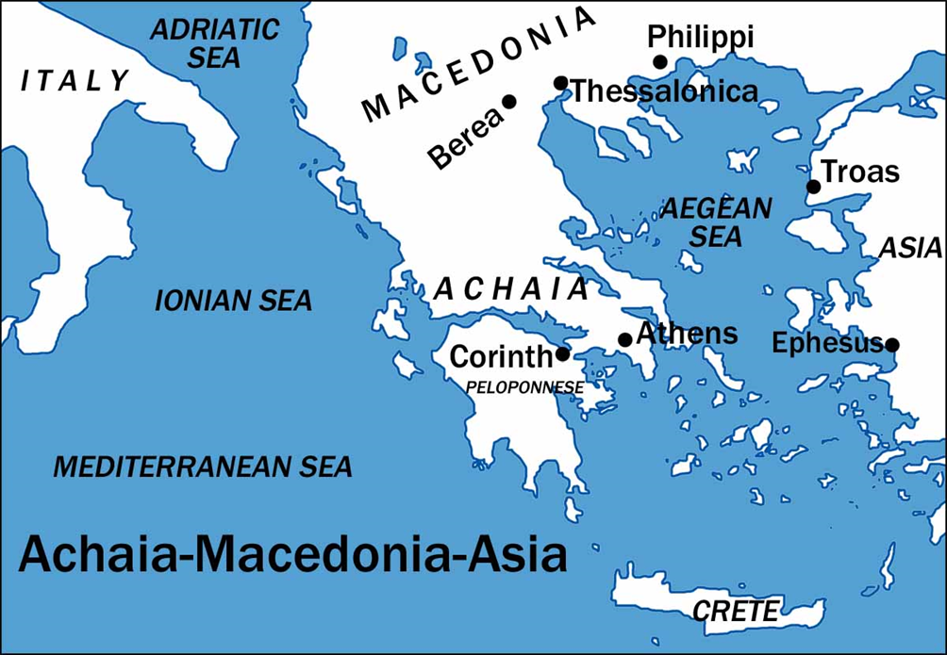
I Corinthians
Auditorium
Class 11
I Corinthians 14:1 - 40

Slide 3
 | Title | Day | Date
8 | Lessons from History | Sunday | March 26, 2017
9 | Men and Women, Lord's Supper | Wednesday | March 29, 2017
10 | Spiritual Gifts | Sunday | April 2, 2017
11 | Spiritual Gifts in Worship | Wednesday | April 5, 2017
12 | Resurrection | Sunday | April 9, 2017
13 | Conclusion and Review | Wednesday | April 12, 2017

Slide 4
Approach for Today’s Study:
Overview: Purpose of Assemblies
General Practices in Assemblies
Restrictions for Assemblies

Slide 5
What does 1 Corinthians 14 teach to be the primary purpose of church assemblies?

Slide 6
Assemblies are for Edification
But one who prophesies speaks to men for edification and exhortation and consolation. (3)
One who speaks in a tongue edifies himself; but one who prophesies edifies the church. (4)
Now I wish … that you would prophesy … so that the church may receive edifying. (6)
… seek to abound for the edification of the church. (12)
For you are giving thanks well enough, but the other person is not edified. (17)
When you assemble … Let all things be done for edification. (26)
For you can all prophesy one by one, so that all may learn and all may be exhorted (31)

Slide 7
Principles for Edification
Edification is the purpose of the body. (14:3, 4, 5, 12, 17, 26, 31)
Notes:
What other purposes might people see in the church?
How does 14:31 answer some views of the operation of spiritual gifts?
_______________________
_______________________ How does the concept of communication in the assemblies being understandable relate to our assemblies today? [insider, ‘churchy’ language in prayers and teaching; ‘We all know…’; unnecessarily difficult songs
What are some ways we could conduct our assemblies in ways that detract from God and the conviction people should experience?
________________________
________________________

Slide 8
14 Pursue love, yet desire earnestly spiritual gifts, but especially that you may prophesy. ² For one who speaks in a tongue does not speak to men but to God; for no one understands, but in his spirit he speaks mysteries.³ But one who prophesies speaks to men for edification and exhortation and consolation. ⁴ One who speaks in a tongue edifies himself; but one who prophesies edifies the church. ⁵ Now I wish that you all spoke in tongues, but even more that you would prophesy; and greater is one who prophesies than one who speaks in tongues, unless he interprets, so that the church may receive edifying.
Notes:
“Pursuing Love” = Seeking Edification, Exhortation, Consolation for the good of others.
Love + Knowledge → Edification, Exhortation, Consolation for Others
“Edification” mentioned 7 times in this chapter. This is why we do what we do!
Tongues < Prophecy in seeking edification for others … Why? [Advance to next section]

Slide 9
Principles for Edification
Edification is the purpose of the body. (14:3, 4, 5, 12, 17, 26, 31)
Edifying love for one another is an intentional pursuit. (14:1)
Notes:
What other purposes might people see in the church?
How does 14:31 answer some views of the operation of spiritual gifts?
_______________________
_______________________ How does the concept of communication in the assemblies being understandable relate to our assemblies today? [insider, ‘churchy’ language in prayers and teaching; ‘We all know…’; unnecessarily difficult songs
What are some ways we could conduct our assemblies in ways that detract from God and the conviction people should experience?
________________________
________________________

Slide 10
⁶ But now, brethren, if I come to you speaking in tongues, what will I profit you unless I speak to you either by way of revelation or of knowledge or of prophecy or of teaching? ⁷ Yet even lifeless things, either flute or harp, in producing a sound, if they do not produce a distinction in the tones, how will it be known what is played on the flute or on the harp? ⁸ For if the bugle produces an indistinct sound, who will prepare himself for battle?⁹ So also you, unless you utter by the tongue speech that is clear, how will it be known what is spoken? For you will be speaking into the air. ¹⁰ There are, perhaps, a great many kinds of languages in the world, and no kind is without meaning. ¹¹ If then I do not know the meaning of the language, I will be to the one who speaks a barbarian, and the one who speaks will be a barbarian to me. ¹² So also you, since you are zealous of spiritual gifts, seek to abound for the edification of the church.
Notes:
6 – How could a tongue benefit someone unless it comes with discernable information?
7-12 – Without clarity / understanding there can be no edification.
“Pursue … Seek” used in 14:1 and 14:12 forming an inclusio to show what our gifts are to be used for in our assemblies.
Love paired with knowledge (meaning, understanding, etc.) are both necessary for edification.

Slide 11
⁶ But now, brethren, if I come to you speaking in tongues, what will I profit you unless I speak to you either by way of revelation or of knowledge or of prophecy or of teaching? ⁷ Yet even lifeless things, either flute or harp, in producing a sound, if they do not produce a distinction in the tones, how will it be known what is played on the flute or on the harp? ⁸ For if the bugle produces an indistinct sound, who will prepare himself for battle?⁹ So also you, unless you utter by the tongue speech that is clear, how will it be known what is spoken? For you will be speaking into the air. ¹⁰ There are, perhaps, a great many kinds of languages in the world, and no kind is without meaning. ¹¹ If then I do not know the meaning of the language, I will be to the one who speaks a barbarian, and the one who speaks will be a barbarian to me. ¹² So also you, since you are zealous of spiritual gifts, seek to abound for the edification of the church.
Notes:
6 – How could a tongue benefit someone unless it comes with discernable information?
7-12 – Without clarity / understanding there can be no edification.
“Pursue … Seek” used in 14:1 and 14:12 forming an inclusio to show what our gifts are to be used for in our assemblies.
Love paired with knowledge (meaning, understanding, etc.) are both necessary for edification.

Slide 12
⁶ But now, brethren, if I come to you speaking in tongues, what will I profit you unless I speak to you either by way of revelation or of knowledge or of prophecy or of teaching? ⁷ Yet even lifeless things, either flute or harp, in producing a sound, if they do not produce a distinction in the tones, how will it be known what is played on the flute or on the harp? ⁸ For if the bugle produces an indistinct sound, who will prepare himself for battle?⁹ So also you, unless you utter by the tongue speech that is clear, how will it be known what is spoken? For you will be speaking into the air. ¹⁰ There are, perhaps, a great many kinds of languages in the world, and no kind is without meaning. ¹¹ If then I do not know the meaning of the language, I will be to the one who speaks a barbarian, and the one who speaks will be a barbarian to me. ¹² So also you, since you are zealous of spiritual gifts, seek to abound for the edification of the church.
Notes:
6 – How could a tongue benefit someone unless it comes with discernable information?
7-12 – Without clarity / understanding there can be no edification.
“Pursue … Seek” used in 14:1 and 14:12 forming an inclusio to show what our gifts are to be used for in our assemblies.
Love paired with knowledge (meaning, understanding, etc.) are both necessary for edification.

Slide 13
⁶ But now, brethren, if I come to you speaking in tongues, what will I profit you unless I speak to you either by way of revelation or of knowledge or of prophecy or of teaching? ⁷ Yet even lifeless things, either flute or harp, in producing a sound, if they do not produce a distinction in the tones, how will it be known what is played on the flute or on the harp? ⁸ For if the bugle produces an indistinct sound, who will prepare himself for battle?⁹ So also you, unless you utter by the tongue speech that is clear, how will it be known what is spoken? For you will be speaking into the air. ¹⁰ There are, perhaps, a great many kinds of languages in the world, and no kind is without meaning. ¹¹ If then I do not know the meaning of the language, I will be to the one who speaks a barbarian, and the one who speaks will be a barbarian to me. ¹² So also you, since you are zealous of spiritual gifts, seek to abound for the edification of the church.
¹³ Therefore let one who speaks in a tongue pray that he may interpret.¹⁴ For if I pray in a tongue, my spirit prays, but my mind is unfruitful.¹⁵ What is the outcome then? I will pray with the spirit and I will pray with the mind also; I will sing with the spirit and I will sing with the mind also.¹⁶ Otherwise if you bless in the spirit only, how will the one who fills the place of the ungifted say the “Amen” at your giving of thanks, since he does not know what you are saying? ¹⁷ For you are giving thanks well enough, but the other person is not edified. ¹⁸ I thank God, I speak in tongues more than you all; ¹⁹ however, in the church I desire to speak five words with my mind so that I may instruct others also, rather than ten thousand words in a tongue.
Notes:
6 – How could a tongue benefit someone unless it comes with discernable information?
7-12 – Without clarity / understanding there can be no edification.
“Pursue … Seek” used in 14:1 and 14:12 forming an inclusio to show what our gifts are to be used for in our assemblies.
Love paired with knowledge (meaning, understanding, etc.) are both necessary for edification.

Slide 14
Principles for Edification
Edification is the purpose of the body. (14:3, 4, 5, 12, 17, 26, 31)
Edifying love for one another is an intentional pursuit. (14:1)
There can be no edification without understandable communication. (14:16-19)
Notes:
What other purposes might people see in the church?
How does 14:31 answer some views of the operation of spiritual gifts?
_______________________
_______________________ How does the concept of communication in the assemblies being understandable relate to our assemblies today? [insider, ‘churchy’ language in prayers and teaching; ‘We all know…’; unnecessarily difficult songs
What are some ways we could conduct our assemblies in ways that detract from God and the conviction people should experience?
________________________
________________________

Slide 16
²⁰ Brethren, do not be children in your thinking; yet in evil be infants, but in your thinking be mature. ²¹ In the Law it is written, “By men of strange tongues and by the lips of strangers I will speak to this people, and even so they will not listen to Me,” says the Lord. ²² So then tongues are for a sign, not to those who believe but to unbelievers; but prophecy is for a sign, not to unbelievers but to those who believe. ²³ Therefore if the whole church assembles together and all speak in tongues, and ungifted men or unbelievers enter, will they not say that you are mad? ²⁴ But if all prophesy, and an unbeliever or an ungifted man enters, he is convicted by all, he is called to account by all; ²⁵ the secrets of his heart are disclosed; and so he will fall on his face and worship God, declaring that God is certainly among you.
Notes:
14:21 referenced from Isaiah 28:11
20-22 – Tongues intended to be used to convict unbelievers
23 – But if used improperly (competitively, disorderly), then their purpose would be ruined.
24-25 – Goal of the manner of worship is to convict and move unbelievers toward God which will even more effectively be done through prophecy (instruction, see 6-19)

Slide 17
Principles for Edification
Edification is the purpose of the body. (14:3, 4, 5, 12, 17, 26, 31)
Edifying love for one another is an intentional pursuit. (14:1)
There can be no edification without understandable communication. (14:16-19)
Church assemblies should consider the conviction of unbelievers as we work for edification of believers. (14:20-26)
Notes:
What other purposes might people see in the church?
How does 14:31 answer some views of the operation of spiritual gifts?
_______________________
_______________________ How does the concept of communication in the assemblies being understandable relate to our assemblies today? [insider, ‘churchy’ language in prayers and teaching; ‘We all know…’; unnecessarily difficult songs
What are some ways we could conduct our assemblies in ways that detract from God and the conviction people should experience?
________________________
________________________

Slide 19
Commands for Church Assemblies
²⁷ If anyone speaks in a tongue, it should be by two or at the most three, and each in turn, and one must interpret; ²⁸ but if there is no interpreter, he must keep silent in the church; and let him speak to himself and to God. ²⁹ Let two or three prophets speak, and let the others pass judgment. ³⁰ But if a revelation is made to another who is seated, the first one must keep silent. ³¹ For you can all prophesy one by one, so that all may learn and all may be exhorted; ³² and the spirits of prophets are subject to prophets; ³³ for God is not a God of confusion but of peace, as in all the churches of the saints.
³⁴ The women are to keep silent in the churches; for they are not permitted to speak, but are to subject themselves, just as the Law also says. ³⁵ If they desire to learn anything, let them ask their own husbands at home; for it is improper for a woman to speak in church.
Take turns in an orderly manner in addressing the church.
Many must keep silent [3x]
Tongues: No interpreter, then silence
Prophets: Wait for others to finish
Women: Subject themselves, no speaking
Assemblies have these restrictions in order to reflect the character of God. (14:33)

Slide 20
³⁶ Was it from you that the word of God first went forth? Or has it come to you only? ³⁷ If anyone thinks he is a prophet or spiritual, let him recognize that the things which I write to you are the Lord’s commandment. ³⁸ But if anyone does not recognize this, he is not recognized.
³⁹ Therefore, my brethren, desire earnestly to prophesy, and do not forbid to speak in tongues. ⁴⁰ But all things must be done properly and in an orderly manner.

Slide 21
Principles for Edification
Edification is the purpose of the body. (14:3, 4, 5, 12, 17, 26, 31)
Edifying love for one another is an intentional pursuit. (14:1)
There can be no edification without understandable communication. (14:16-19)
Church assemblies should consider the conviction of unbelievers as we work for edification of believers. (14:20-25)
God has given directions and restrictions for the conducting of edifying and convicting assemblies. (14:26-34)
Gifts in the body are under the control of the gifted who are to exercise these gifts for the good of others. (14:31-32)
All things must be done properly and in an orderly manner (14:40)
Notes:
What other purposes might people see in the church?
How does 14:31 answer some views of the operation of spiritual gifts?
_______________________
_______________________ How does the concept of communication in the assemblies being understandable relate to our assemblies today? [insider, ‘churchy’ language in prayers and teaching; ‘We all know…’; unnecessarily difficult songs
What are some ways we could conduct our assemblies in ways that detract from God and the conviction people should experience?
________________________
________________________

